Slide 1

Fundamentals of Computer Science and Programming
Unit 2 – Logic

Slide 2
Outline
Propositions
Logical operators
Implication and biconditional
Operator precedence and truth tables
Logical equivalence
Exercise
More on logical equivalence
Exercise

Slide 3
Propositions

Slide 4
Introduction to logic
The rules of logic give precise meaning to mathematical statements
These rules allow to distinguish between valid and invalid arguments
Logic has numerous applications in computer science:
Design of computer circuits
Construction of computer programs
Verification of program correctness

Slide 5
Propositions
Definition 1: A proposition is a statement that is either true or false, but not both.
Example 1: All the following statements are propositions.
Vienna is the capital of Austria.
Munich is the capital of Germany.
2 + 2 = 4.
2 + 3 = 6.
Propositions 1 and 3 are true, whereas propositions 2 and 4 are false.

Slide 6
Propositions
Example 2: Not all sentences are propositions.
What day is today?
Read this text carefully.
x + 2 = 4.
x + y = 6.
Sentences 1 and 2 are not propositions because they are not statements.
Sentences 3 and 4 are not propositions because they are neither true nor false since the variables in these sentences (x and y) have not been assigned values.

Slide 7
A bit of notation
We use letters to denote propositions: p, q, r, s, …
The truth value of a true proposition is true, denoted by T
The truth value of a false proposition is false, denoted by F
Example 3: Truth values of the following propositions are:
Name | Proposition | Truth value
p | Vienna is the capital of Austria. | T
q | Munich is the capital of Germany. | F
r | 2 + 2 = 4 | T
s | 2 + 3 = 6 | F

Slide 8
Logical operators

Slide 9
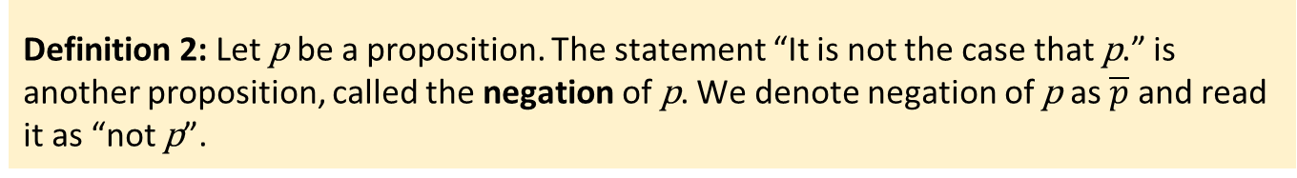
Compound propositions
We can construct new propositions by combining those that we already have
These new propositions are called compound propositions
Definition 2: Let p be a proposition. The statement “It is not the case that p.” is another proposition, called the negation of p. We denote negation of p as $\overline{p}$ and read it as “not p”.
Example 4: Find the negation of these propositions.
Proposition | Negation of proposition
Today is Friday. | Today is not Friday.
Munich is the capital of Germany. | Munich is not the capital of Germany.
It is raining today. | It is not raining today.
George Boole first introduced compound propositions (The Laws of Thought)

Slide 10
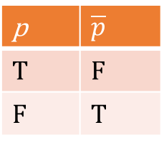
Truth tables and unary logical operators
Truth table displays the truth values of propositions
Especially valuable for determining the truth values of compound propositions
The truth table for the negation of a proposition.
p | $\overline{p}$
T | F
F | T
Remark 1: We can consider the negation of a proposition as a result of the negation operator on a proposition. The negation operator constructs a new proposition from a single existing proposition, i.e., this operator is a unary operator.

Slide 11
Binary logical operators (connectives): Conjunction
Definition 3: Let p and q be propositions. The statement “p and q,” denoted by p ∧ q, is the proposition that is true when both p and q are true and is false otherwise. The proposition p ∧ q is called the conjunction of p and q or logical and of p and q .
The truth table for the conjunction of two propositions.
p | q | p ∧ q
T | T | T
T | F | F
F | T | F
F | F | F
Remark 2: Conjunction of two propositions is a binary logical operator.

Slide 12
Conjunction
Example 5: Find the conjunction of the propositions p „Today is Friday“ and q „It is raining today“. When is this conjunction true and when it is false?
p ∧ q : „Today is Friday and it is raining today.“
p ∧ q : True on rainy Fridays
False on any other day than Friday and on Fridays without rain
p : Today is Friday | q : It is raining today | p ∧ q : Today is Friday and it is raning today
T | T | T
T | F | F
F | T | F
F | F | F

Slide 13
Disjunction
Definition 4: Let p and q be propositions. The statement “p or q,” denoted by p ∨ q, is the proposition that is false when both p and q are false and is true otherwise. The proposition p ∨ q is called the disjunction of p and q or logical or of p and q .
The truth table for the disjunction of two propositions.
p | q | p ∨ q
T | T | T
T | F | T
F | T | T
F | F | F
Remark 3: Disjunction of two propositions is also a binary logical operator.

Slide 14
Disjunction
Example 6: Find the disjunction of the propositions p „Today is Friday“ and q „It is raining today“. When is this disjunction true and when it is false?
p ∨ q : „Today is Friday or it is raining today.“
p ∨ q : True on any Friday or any rainy day (including rainy Fridays)
False on days other than Friday when it also does not rain
p : Today is Friday | q : It is raining today | p ∨ q : Today is Friday or it is raning today
T | T | T
T | F | T
F | T | T
F | F | F
Remark 4: The use of or in disjunction corresponds to an inclusive way, i.e., a disjunction is true when either of the two propositions is true or when both are true.

Slide 15
Exclusive OR
Use of „or“ in a disjunction was in an inclusive way
We also have exclusive „or“ in English, i.e., „p or q (but not both)“
Definition 5: Let p and q be propositions. The exclusive or of p and q, denoted by p ⊕ q, is the proposition that is true when exactly one of p and q is true and is false otherwise.
The truth table for the exclusive or of two propositions.
p | q | p ⊕ q
T | T | F
T | F | T
F | T | T
F | F | F

Slide 16
Exclusive OR
Example 7: Find the exclusive or of the propositions p „Mary is a singer“ and q „Mary is a writer“. When is this exclusive or true and when it is false?
p ⊕ q : „Mary is a singer or a writer.“
p ⊕ q : True if Mary is a singer or if she is a writer (but not both)
False if Mary is neither a singer nor a writer or if she is both a singer and a writer
p : Mary is a singer | q : Mary is a writer | p ⊕ q : Mary is a singer or a writer
T | T | F
T | F | T
F | T | T
F | F | F

Slide 17
Implication and biconditional

Slide 18
Implication
Definition 6: Let p and q be propositions. The implication p → q, is the proposition that is false when p is true and q is false and true otherwise. In this implication p is called the hypothesis (or antecedent or premise) and q is called conclusion (or consequence).
The truth table for the implication of two propositions.
p | q | p → q
T | T | T
T | F | F
F | T | T
F | F | T

Slide 19
Implication
Implications arise in many places in mathematical reasoning
A wide variety of terminology is used to express p → q :
if p, then q
p implies q
if p, q
p only if q
p is sufficient for q
q if p
q whenever p
q is necessary for p
p | q | p → q
T | T | T
T | F | F
F | T | T
F | F | T
Remark 5: p → q is false only if p is true and q is false. Hence, it is true when both p and q are true, and when p is false (no matter the truth value of q).

Slide 20
Implication
Implication is true when its hypothesis is false
We can think of it as a contract or an obligation
If the condition specified by a contract is false, no obligation is in force.
Example 8: The obligation „If you make more than 25,000€, then you must file a tax return“ does not specify anything for someone making less than 25,000€. You violate the obligation only if you make more than 25,000€ and do not file a return.

Slide 21
Implication
Remark 6: We have defined implications more generally than their meaning in the English language. In English there is a relationship between the hypothesis and the conclusion. In the logical implication this relationship does not need to exist.
Example 9: Consider „If it is sunny today, then we will go to the beach“. There is a clear (causal) relationship between being sunny and going to beach. This implication is valid unless it is sunny but we do not go to the beach.
Now consider the implication: „If today is Friday, then 2 + 2 = 4“.
Clearly, there is no direct (cause-and-effect) relationship
between the hypothesis and the consequence. Indeed the
consequence is true regardless of what day is it today. Morover,
the whole (logical) implication is true (from the definition of the
implication) since the consequence is true and the truth value of hypothesis does not matter then.
p | q | p → q
T | T | T
T | F | F
F | T | T
F | F | T

Slide 22
Implication
Example 10: Determine whether each of the following implications is true or false.
If 1 + 1 = 2, then 2 + 2 = 5. False
If 1 + 1 = 3, then 2 + 2 = 4. True
If 1 + 1 = 3, then 2 + 2 = 5. True
If pigs can fly, then 1 + 1 = 3. True
If 1 + 1 = 3, then pigs can fly. True
If 1 + 1 = 2, then pigs can fly. False
If 2 + 2 = 4, then 1 + 2 =3. True
p | q | p → q
T | T | T
T | F | F
F | T | T
F | F | T

Slide 23
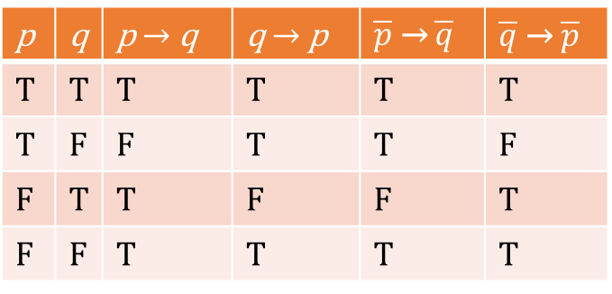
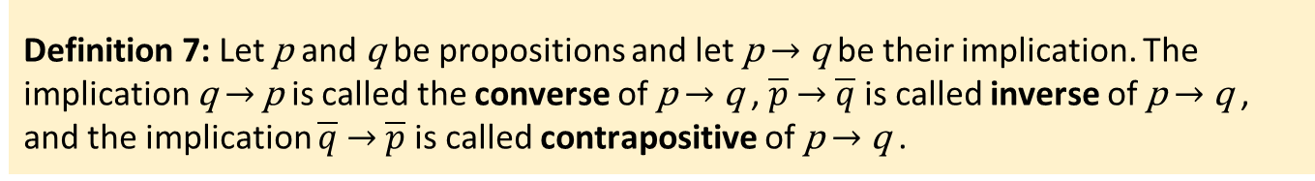
Converse, inverse, and contrapositive
Definition 7: Let p and q be propositions and let p → q be their implication. The implication q → p is called the converse of p → q , $\overline{p}$ → $\overline{q}$is called inverse of p → q , and the implication $\overline{q}$→ $\overline{p}$is called contrapositive of p → q .
The truth table for the converse, inverse, and contrapositive of the implication p → q .
p | q | p → q | q → p | $\overline{p}$ → $\overline{q}$ | $\overline{q}$→ $\overline{p}$
T | T | T | T | T | T
T | F | F | T | T | F
F | T | T | F | F | T
F | F | T | T | T | T

Slide 24
Biconditional
Definition 8: Let p and q be propositions. The biconditional p ↔ q, is the proposition that is true when p and q have the same truth values and is false otherwise.
The truth table for the biconditional of two propositions.
p | q | p ↔ q
T | T | T
T | F | F
F | T | F
F | F | T

Slide 25
Biconditional
Biconditional is true when both implications p → q and q → p are true
Terminology used to express p ↔ q :
p if and only if q
p iff q
p is necessary and sufficient for q
if p then q, and conversely
p | q | p ↔ q
T | T | T
T | F | F
F | T | F
F | F | T

Slide 26
Biconditional
Example 11: Find the biconditional of the propositions p „It is below freezing“ and q „It is snowing“. When is this biconditional true and when it is false?
p ↔ q : „It is below freezing if and only if it is snowing.“
p ↔ q : True if it is both below freezing and snowing or if it is neither below freezing nor snowing
False otherwise
p : It is below freezing | q : It is snowing | p ↔ q : It is below freezing iff it is snowing
T | T | T
T | F | F
F | T | F
F | F | T

Slide 27
Operator precedence and truth tables

Slide 28
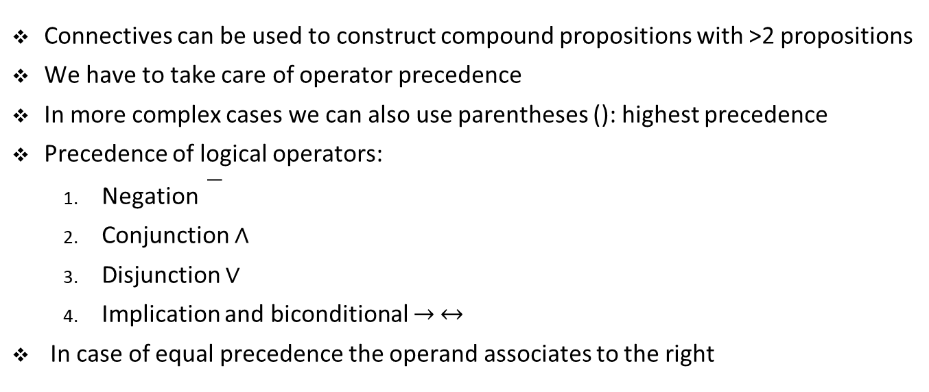
Compound propositions with >2 propositions
Connectives can be used to construct compound propositions with >2 propositions
We have to take care of operator precedence
In more complex cases we can also use parentheses (): highest precedence
Precedence of logical operators:
Negation
Conjunction ∧
Disjunction ∨
Implication and biconditional → ↔
In case of equal precedence the operand associates to the right

Slide 29
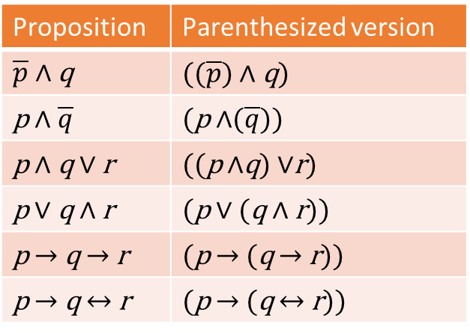
Operator precedence
Example 12: Operator precedence:
Proposition | Parenthesized version
$\overline{p}$ ∧ q | $((\overline{p})$ ∧ q)
p ∧ $\overline{q}$ | (p ∧$(\overline{q}))$
p ∧ q ∨ r | ((p ∧q) ∨r)
p ∨ q ∧ r | (p ∨ (q ∧ r))
p → q → r | (p → (q → r))
p → q ↔ r | (p → (q ↔ r))

Slide 30
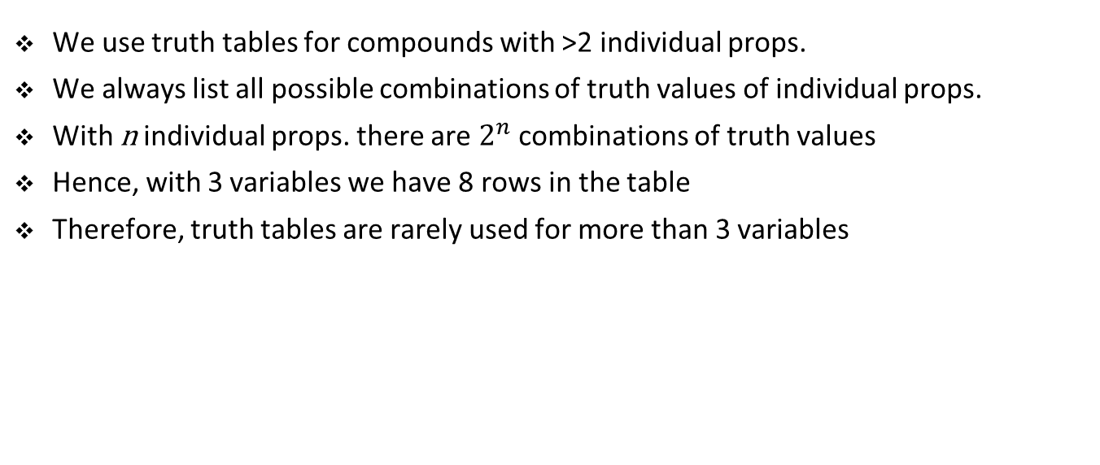
Truth tables
We use truth tables for compounds with >2 individual props.
We always list all possible combinations of truth values of individual props.
With n individual props. there are $2^{n}$ combinations of truth values
Hence, with 3 variables we have 8 rows in the table
Therefore, truth tables are rarely used for more than 3 variables

Slide 31
Truth tables
Example 13: Construct a truth table for the proposition p → q → r .
Using our precendence rules the parenthesized version is: p → (q → r).
p | q | r | q → r | p → (q → r)
T | T | T | T | T
T | T | F | F | F
T | F | T | T | T
T | F | F | T | T
F | T | T | T | T
F | T | F | F | T
F | F | T | T | T
F | F | F | T | T

Slide 32
Logical equivalence

Slide 33
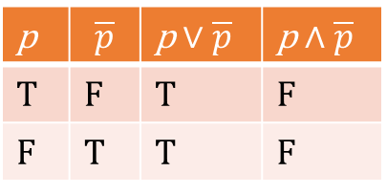
Tautology and contradiction
Definition 9: A compound proposition that is always true, no matter what the truth values of the individual propositions that occur in it, is called a tautology. A compound proposition that is always false is called a contradiction. Finally, a proposition that is neither a tautology nor a contradiction is called a contingency.
The truth table for examples of a tautology and a contradiction.
p | $$\overline{p}$$ | p ∨ $\overline{p}$ | p ∧$\overline{p}$
T | F | T | F
F | T | T | F

Slide 34
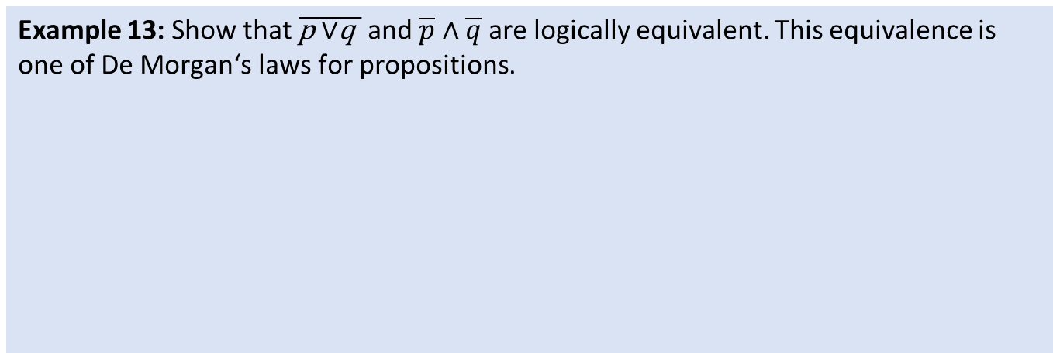
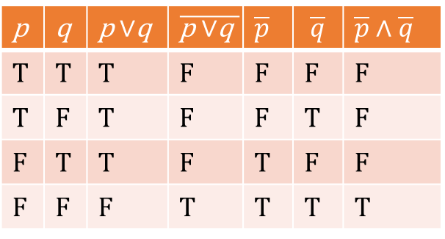
Logical equivalence
Definition 10: The propositions p and q are called logically equivalent if p ↔ q is a tautology. The notation p ⇔q denotes that p and q are logically equivalent.
One way to determine the equivalence is with truth tables
p and q are equivalent if and only if the columns of their truth values agree
Example 13: Show that $\overline{\text{p} \text{∨}\text{q} }$ and $\overline{p}$ ∧ $\overline{q}$are logically equivalent. This equivalence is one of De Morgan‘s laws for propositions.
p | q | p ∨q | $$\overline{\text{p} \text{∨}\text{q} }$$ | $\overline{p}$ | $$\overline{q}$$ | $\overline{p}$ ∧ $\overline{q}$
T | T | T | F | F | F | F
T | F | T | F | F | T | F
F | T | T | F | T | F | F
F | F | F | T | T | T | T

Slide 35
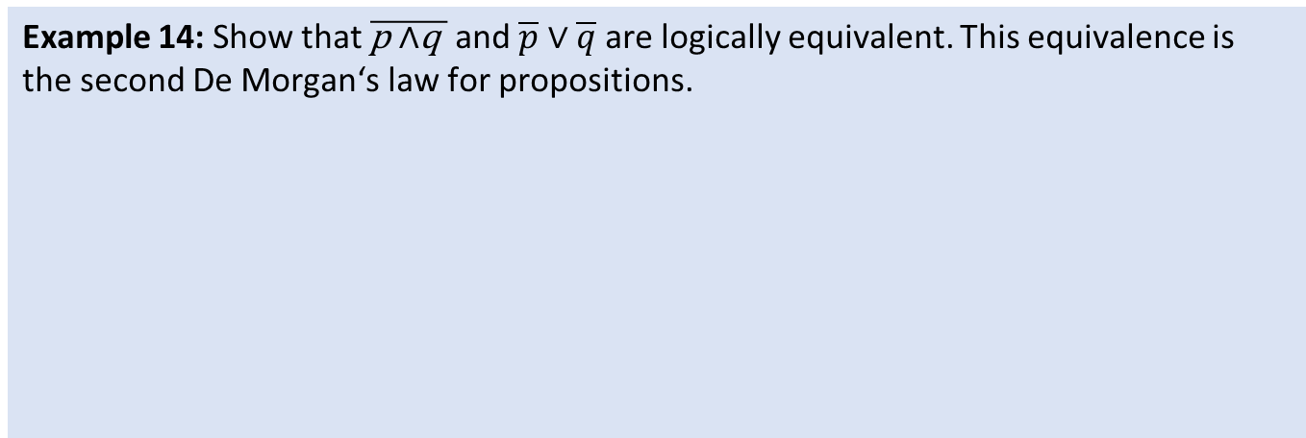
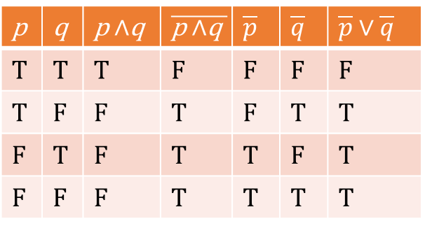
Logical equivalence
Example 14: Show that $\overline{\text{p} \text{∧}\text{q} }$ and $\overline{p}$ ∨ $\overline{q}$are logically equivalent. This equivalence is the second De Morgan‘s law for propositions.
p | q | p ∧q | $$\overline{\text{p} \text{∧}\text{q} }$$ | $\overline{p}$ | $\overline{q}$ | $\overline{p}$ ∨$\overline{q}$
T | T | T | F | F | F | F
T | F | F | T | F | T | T
F | T | F | T | T | F | T
F | F | F | T | T | T | T

Slide 36
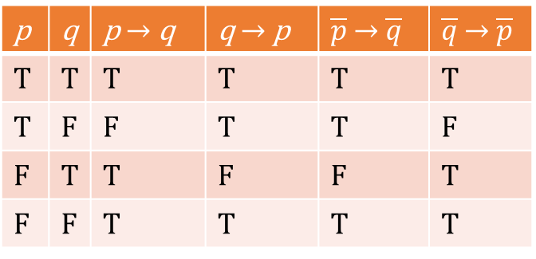
Equivalences of converse, inverse, and contrapositive
Remark 7: Recollect the converse, inverse and contrapositive of the implication p → q. Converse and inverse are logically equivalent and so is the implication and ist contrapositive.
The truth table for the converse, inverse, and contrapositive of the implication p → q .
p | q | p → q | q → p | $\overline{p}$ → $\overline{q}$ | $\overline{q}$ → $\overline{p}$
T | T | T | T | T | T
T | F | F | T | T | F
F | T | T | F | F | T
F | F | T | T | T | T

Slide 37
Exercise

Slide 38
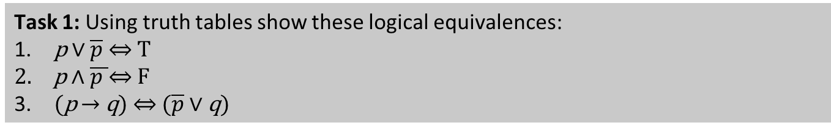
Student task
Task 1: Using truth tables show these logical equivalences:
p ∨ $\overline{p}$ ⇔ T
p ∧ $\overline{p }\text{⇔} \text{F}$
(p → q) ⇔ ($\overline{p}$ ∨ q)

Slide 39
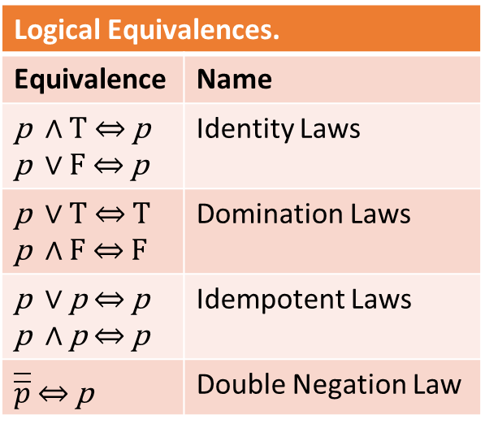
Student task
Task 2: Using truth tables show these important logical equivalences.
Logical Equivalences.
Equivalence | Name
p ∧ T ⇔ p p ∨ F ⇔ p | Identity Laws
p ∨ T ⇔ T p ∧ F ⇔ F | Domination Laws
p ∨ p ⇔ p p ∧ p ⇔ p | Idempotent Laws
$\overline{\overline{p}}$ ⇔ p | Double Negation Law

Slide 40
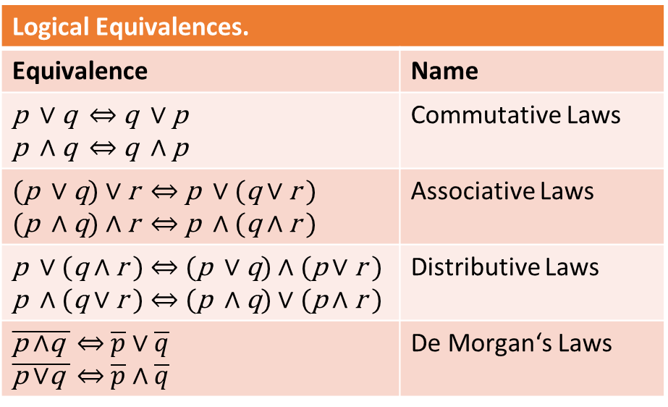
Student task
Task 3: Using truth tables show these important logical equivalences. You do not need to show logical equivalences of De Morgan‘s Laws as we already did that.
Logical Equivalences.
Equivalence | Name
p ∨ q ⇔ q ∨ p p ∧ q ⇔ q ∧ p | Commutative Laws
(p ∨ q) ∨ r ⇔ p ∨ (q ∨ r ) (p ∧ q) ∧ r ⇔ p ∧ (q ∧ r ) | Associative Laws
p ∨ (q ∧ r ) ⇔ (p ∨ q) ∧ (p ∨ r ) p ∧ (q ∨ r ) ⇔ (p ∧ q) ∨ (p ∧ r ) | Distributive Laws
$\overline{\text{p} \text{∧}\text{q} }$ ⇔$\overline{p}$ ∨ $\overline{q}$ $\overline{\text{p} \text{∨}\text{q} }$ ⇔$\overline{p}$ ∧$\overline{q}$ | De Morgan‘s Laws

Slide 41
More on logical equivalence

Slide 42
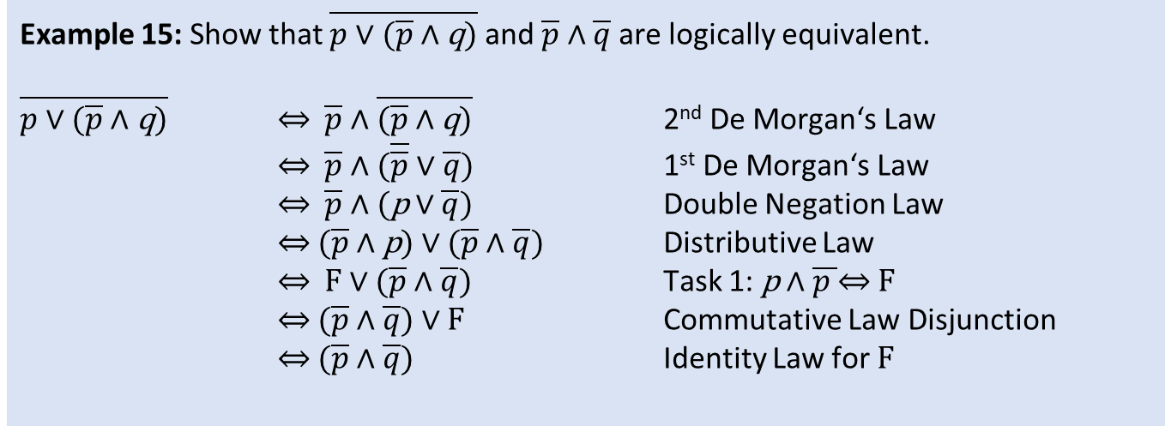
Working with logical equivalences
Remark 8: Using the basic logical equivalences that we have already proved we can prove further logical equivalences without using truth tables.
Example 15: Show that $\overline{p \text{∨}\text{ (}\overline{p} \text{∧} \text{q}\text{)}}$ and $\overline{p}$ ∧ $\overline{q}$are logically equivalent.
$\overline{p \text{∨}\text{ (}\overline{p} \text{∧} \text{q}\text{)}}$ ⇔ $\overline{p} \text{∧} \overline{(\overline{p} \text{∧} \text{q}\text{)}}$ 2nd De Morgan‘s Law
⇔ $\overline{p} \text{∧}$ ($\overline{\overline{p}} \text{∨} \overline{q}$) 1st De Morgan‘s Law
⇔ $\overline{p} \text{∧}$ (p $\text{∨} \overline{q}$) Double Negation Law
⇔ ($\overline{p} \text{∧}$ p) $\text{∨} (\overline{p} \text{∧} \overline{q}$) Distributive Law
⇔ F $\text{∨} (\overline{p} \text{∧} \overline{q}$) Task 1: p ∧ $\overline{p }\text{⇔} \text{F}$
⇔ $(\overline{p} \text{∧} \overline{q}$) $\text{∨}$ F Commutative Law Disjunction
⇔ $(\overline{p} \text{∧} \overline{q}$) Identity Law for F

Slide 43
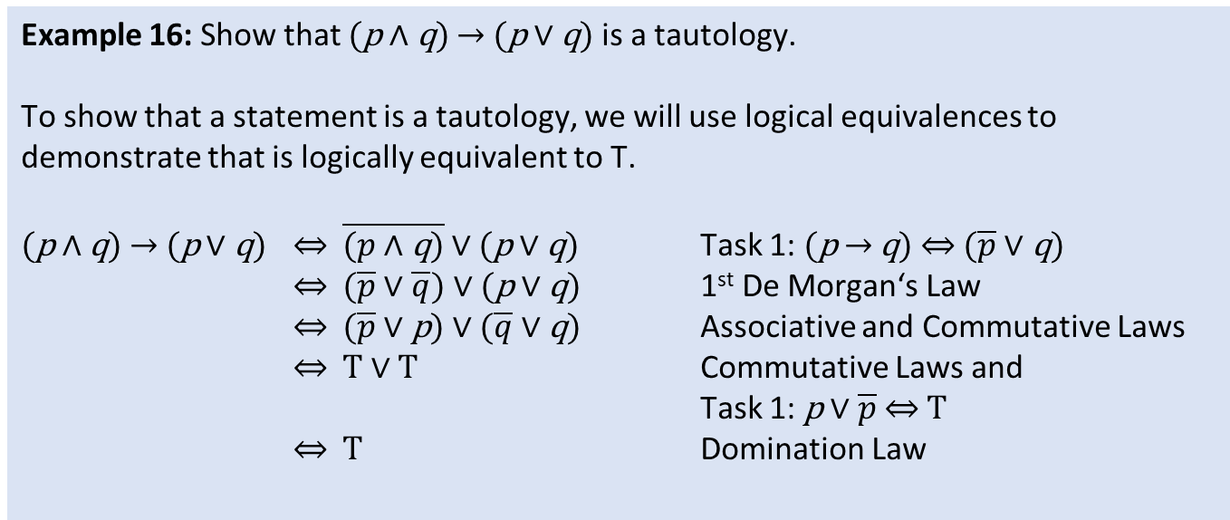
Working with logical equivalences
Example 16: Show that (p ∧ q) → (p ∨ q) is a tautology.
To show that a statement is a tautology, we will use logical equivalences to demonstrate that is logically equivalent to T.
(p ∧ q) → (p ∨ q) ⇔ $\overline{(p \text{∧} \text{q}\text{)}}$ $\text{∨}$(p ∨ q) Task 1: (p → q) ⇔ ($\overline{p}$ ∨ q)
⇔ ($\overline{p} \text{∨} \overline{q}$) $\text{∨}$(p ∨ q) 1st De Morgan‘s Law
⇔ ($\overline{p} \text{∨}$ p) $\text{∨}$($\overline{q}$∨ q) Associative and Commutative Laws
⇔ T$\text{∨} T$ Commutative Laws and
Task 1: p ∨ $\overline{p}$ ⇔ T
⇔ T Domination Law

Slide 44
Exercise

Slide 45
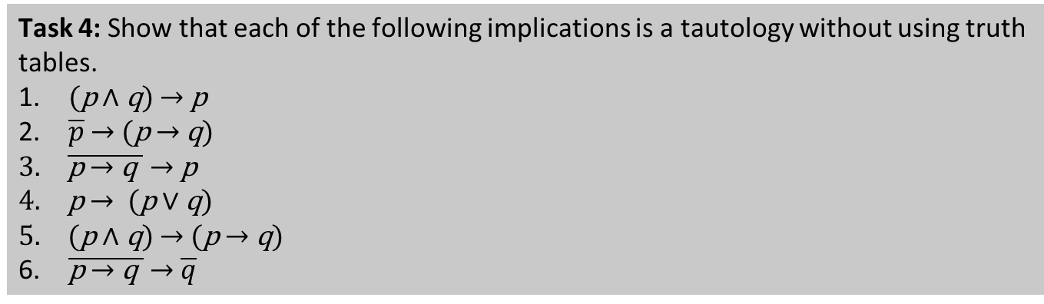
Student task
Task 4: Show that each of the following implications is a tautology without using truth tables.
(p ∧ q) → p
$\overline{p}$ → (p → q)
$\overline{\text{p} \text{→ }\text{q} }$ → p
p → (p $\text{∨}$ q)
(p ∧ q) → (p → q)
$\overline{\text{p} \text{→ }\text{q} }$ → $\overline{q}$

