Slide 1

Fundamentals of Computer Science and Programming
Unit 7 – Programming Part IV

Slide 2
Outline
Sets
Dictionaries
Recursions
Examples
Exercise

Slide 3
Sets

Slide 4
Basics of sets
Unordered collection of unique elements
Equivalent to mathematical sets
No duplicates
Definition with {} or set()
Empty set: empty = set()
When to use sets?
Quick checks for element membership
Removing of duplicates
Mathematical set operations
...
No direct access to elements via indexing (sets are unordered)
Number of elements: len()
colors = {'blue', 'red'}
characters = set('Hello, World')

Slide 5
Basics of sets
Adding elements to sets
Individual elements: colors.add('red')
Multiple elements: colors.update(['orange', 'black'])
Deleting elements
With membership check
colors.remove('blue')
Without membership check
colors.discard('blue')
Deleting all elements
colors.clear()

Slide 6
Set operations
Intersection (AND)
x.intersection(y) or x & y
Union (OR)
x.union(y) or x | y
Membership
'b' in y
Difference
x – y
Further operations: Python-Doc
=> {'b'}
=> {'a', 'b', 'd'}
=> True
=> {'a'}
x = {'a', 'b'}
y = {'b', 'd'}

Slide 7
Dictionaries

Slide 8
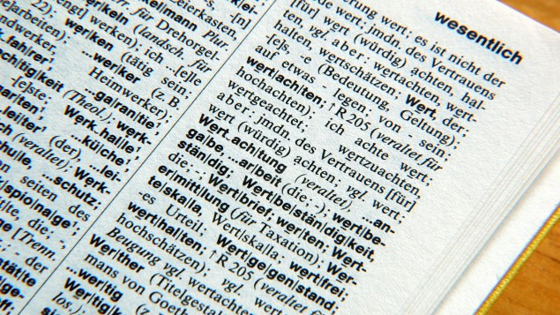

Real world dictionaries
https://www.deutschlandfunkkultur.de/zentrum-fuer-digitale-lexikographie-die-gesamte-deutsche.1008.de.html?dram:article_id=439553
https://pxhere.com/en/photo/529235

Slide 9
Basics of dictionaries
Collection of unordered key-value pairs
Very important concept in python!
Access via unique keys
Arbitrary immutable data type: integer, string, etc.
For each key a single value:
integer, string, list, set, dictionary, etc.
Mutable and immutable
KeyError if key not present in dictionary
Access per [] and key
Membership check with in and not in
references
key
value

Slide 10
Manipulating dictionaries
Definition
students = {123: 'Maria', 131: 'Tim', 42: 'Max'}
Access
students[123]
students.get(123)
Inserting and updating
students[20] = 'Lisa'
students[123] = 'Moritz'
Deleting with key
del students[123]

Slide 11
Example with dictionaries
students = {123: 'Maria', 131: 'Tim', 42: 'Max'}
students[668] = 'Martina'
del students[123]
students[131] = 'Anna'
del students[9999]
print(f'e: {students[42]}')

Slide 12
Retrieving and iterating over dictionary elements
Retrieving
Keys
students.keys()
Values
students.values()
Key-Value tuples
students.items()
Iterating over all keys and values (unordered):
See unit7.ipynb
students = {123: 'Maria',
131: 'Tim',
42: 'Max'}
for key, value in students.items():
print(f'{key}: {value}')

Slide 13
Recursions

Slide 14
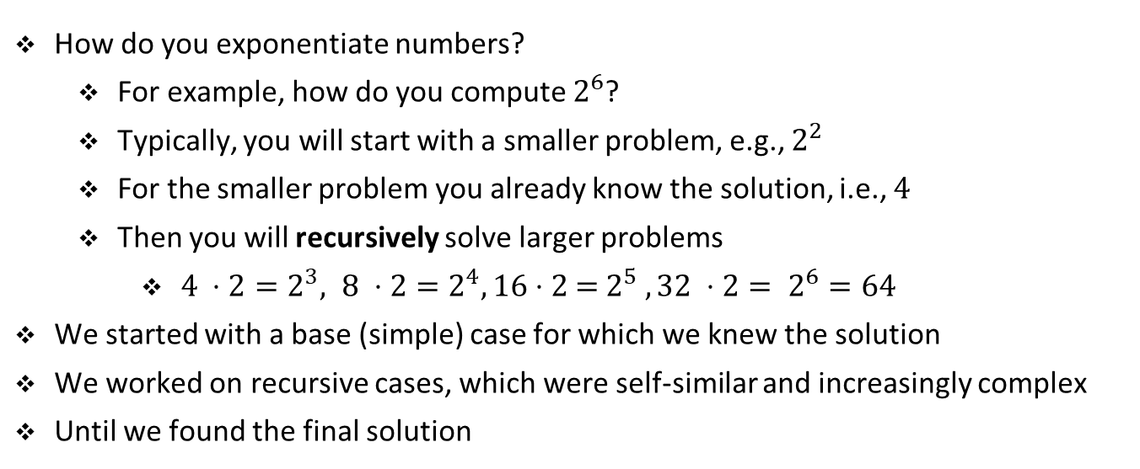
Intuition
How do you exponentiate numbers?
For example, how do you compute $2^{6}$?
Typically, you will start with a smaller problem, e.g., $2^{2}$
For the smaller problem you already know the solution, i.e., $4$
Then you will recursively solve larger problems
$4 ⋅2=2^{3}, 8 ⋅2=2^{4}, 16$ ⋅ 2 = $2^{5} , 32 ⋅2= 2^{6}=64$
We started with a base (simple) case for which we knew the solution
We worked on recursive cases, which were self-similar and increasingly complex
Until we found the final solution

Slide 15
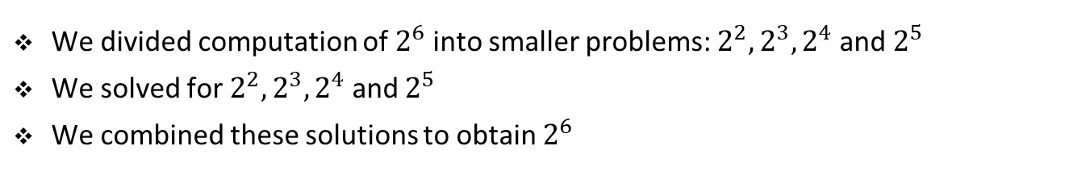
Recursive algorithms
Definition 1: An algorithm is called recursive if it solves a problem by reducing it to an instance of the same problem with smaller input.
Remark 1: We call this algorithmic technique divide-and-conquer. We break the problem into several subproblems that are similar to the original problem but smaller in size, solve the subproblems recursively, and then combine these solutions to create a solution to the original problem.
We divided computation of $2^{6}$ into smaller problems: ${2^{2},2^{3}, 2}^{4}$ and $2^{5}$
We solved for ${2^{2},2^{3}, 2}^{4}$ and $2^{5}$
We combined these solutions to obtain $2^{6}$

Slide 16
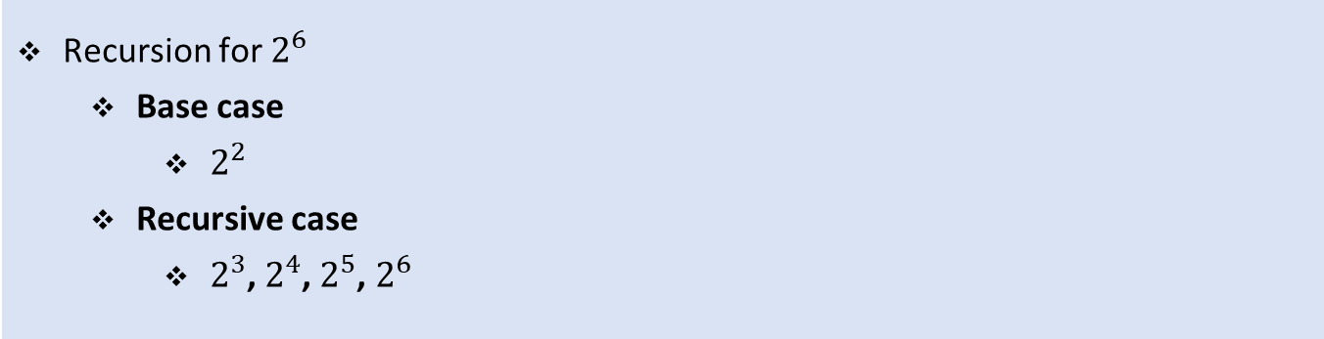
Recursive algorithms
Recursion has two main parts
Base case
Simplest form of the problem that has a direct answer
Recursive case
Where we break the problem into smaller self-similar subproblems
Recursion for $2^{6}$
Base case
$2^{2}$
Recursive case
$2^{3}$, $2^{4}$, $2^{5}$, $2^{6}$

Slide 17
Recursive function calls in Python
def print_result_simple(res):
print(f'The result is:', res)
def div2(num):
result = num / 2
print_result_simple(result)
div2(10)
The result is: 5

Slide 18
Recursive function calls in Python
def print_result(res):
print(f'The result is:', res)
div_res = res / 2
print_result(div_res)
print_result(10)
The result is: 5
The result is: 2.5
The result is: 1.25
The result is: 0.625
The result is: 0.3125
The result is: 0.1563
...
RecursionError

Slide 19
Implementing recursions
Recursive implementation = „Functions call themselves“
With each new call a smaller subproblem is solved
We need a base case in the implementation!
Otherwise an infinite loop!
=> RecursionError: maximum recursion depth exceeded [...]
Recursive implementation is typically also possible as a loop
Recursions have typically less code
But sometimes not intuitive
More memory (storing function frames when calling recursively)

Slide 20

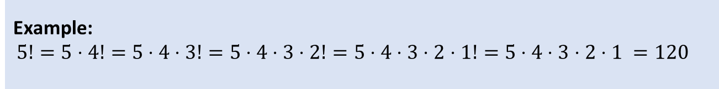
Factorial
$$n!= \prod_{i=1}^{n}{i}$$
Base cases: $0!=1$, $1!=1$
Recursive case: $n!=n ⋅ \left(n−1\right)!$
$\left(n −1\right)!=\left(n −1\right)⋅\left(n−2\right)!$
$\left(n −2\right)!=\left(n −2\right)⋅\left(n−3\right)!$
…
$2!=2 ⋅1!$
$1!=1$
Example:
$$5!=5⋅4!=5⋅4⋅3!=5⋅4⋅3⋅2!=5⋅4⋅3⋅2⋅1!=5⋅4⋅3⋅2⋅1 =120$$

Slide 21

Implementation of factorial
Base case: $0!=1$
Recursive case: $n!=n ⋅ \left(n−1\right)!$
def fac(n):
if n <= 1:
return 1
return n * fac(n-1)

Slide 22
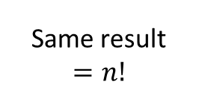
Implementation of factorial
Iteration with for loop
Iteration with while loop
Recursion
def fac_for(n):
f = 1
for i in range(2, n+1):
f *= i
return f
def fac_while(n):
f = n
while n > 1:
n -= 1
f *= n
return f
Same result
$$=n!$$
def fac(n):
if n <= 1:
return 1
return n * fac(n-1)

Slide 23

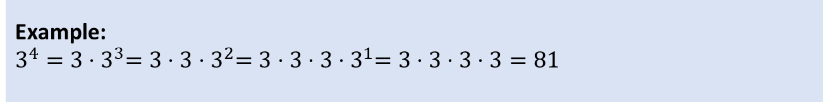
Recursive powers
$$x^{n}= \prod_{i=1}^{n}{x}$$
Base cases: $x^{0}=1$,${ x}^{1}=x$
Recursive case:${ x}^{n}=x ⋅x^{n−1}$
$x^{n−1}=x ⋅x^{n−2}$
$x^{n−2}=x ⋅x^{n−3}$
…
$x^{2}=x ⋅x^{1}$
$x^{1}=x$
Example:
$$3^{4}=3{⋅3}^{3}=3⋅3{⋅3}^{2}=3⋅3⋅3{⋅3}^{1}=3⋅3⋅3⋅3=81$$

Slide 24

Implementation of powers
Base case: $x^{0}=1$
Recursive case:${ x}^{n}=x ⋅x^{n−1}$
def exp_rec(x, n):
if n == 0:
return 1
return x * exp_rec(x, n-1)

Slide 25
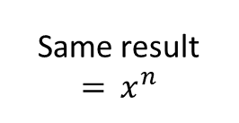
Implementation of powers
Iteration with for loop
Iteration with while loop
Recursion
def exp_for(x, n):
result = 1
for i in range(n):
result *= x
return result
def exp_while(x, n):
result = 1
while n > 0:
result *= x
n -= 1
return result
Same result
$$={ x}^{n}$$
def exp_rec(x, n):
if n == 0:
return 1
return x * exp_rec(x, n-1)

Slide 26
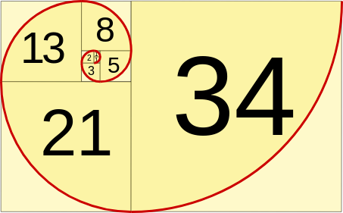
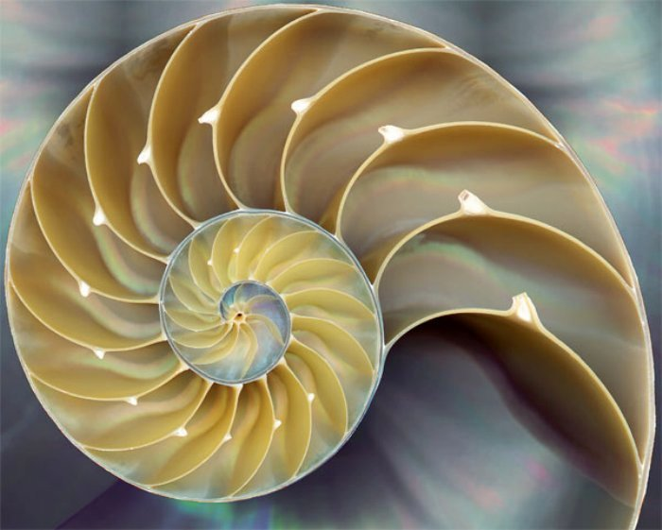
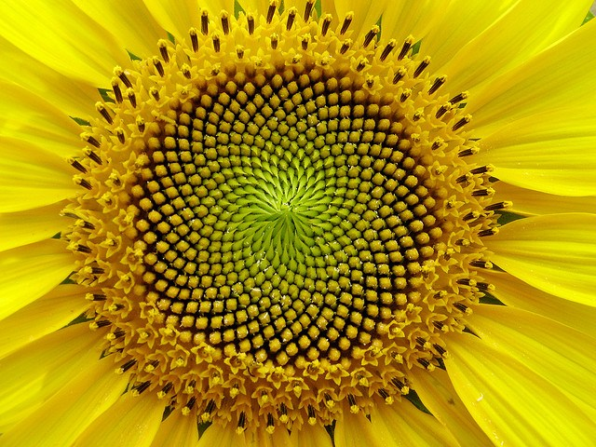
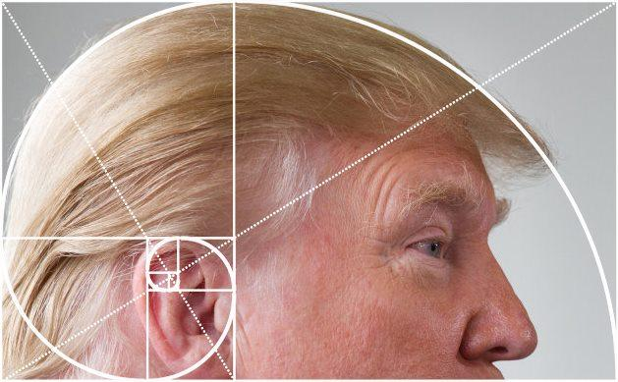
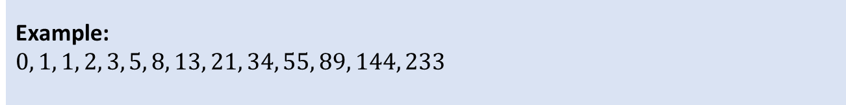
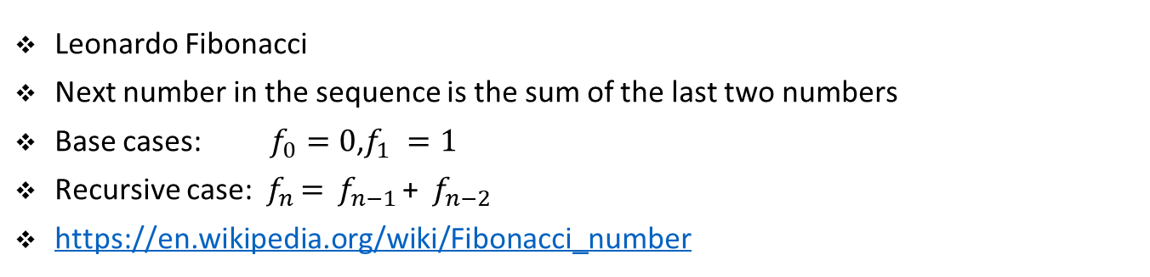
Fibonacci numbers (Golden ratio)
Leonardo Fibonacci
Next number in the sequence is the sum of the last two numbers
Base cases: $f_{0}=0$,$f_{1} =1$
Recursive case: ${ f}_{n }= { f}_{n−1 }$+ ${ f}_{n−2 }$
https://en.wikipedia.org/wiki/Fibonacci_number
Example:
$$0, 1, 1, 2, 3, 5, 8, 13, 21, 34, 55, 89, 144, 233$$
https://www.mathsisfun.com/numbers/fibonacci-sequence.html
https://insteading.com/blog/fibonacci-sequence-in-nature/
http://thesmarthappyproject.com/fibonacci-in-a-sunflower/
https://knowyourmeme.com/photos/1054836-donald-trump

Slide 27
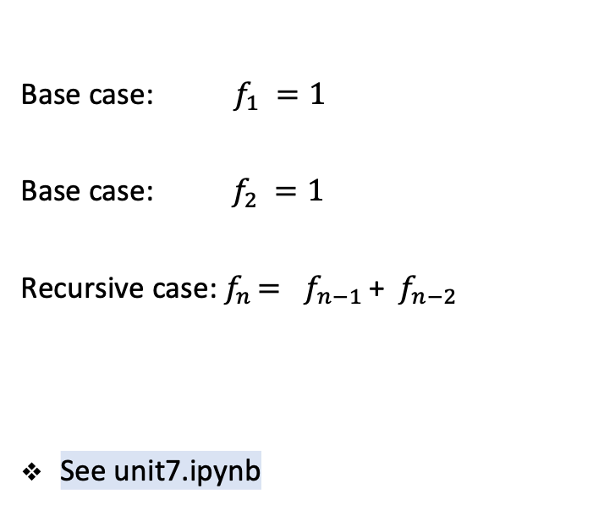
Implementation of Fibonacci
Base case: $f_{1} =1$
Base case:$f_{2} =1$
Recursive case:${ f}_{n }= { f}_{n−1 }\text{+ }{ f}_{n−2 }$
See unit7.ipynb
def fib(n):
if n == 1:
return 1
if n == 2:
return 1
return fib(n-2) + fib(n-1)
# Iterative with for
def fib_for(n):
num_1 = 0
num_2 = 1
for i in range(0, n-1):
num_1_old = num_1
num_1 = num_2
num_2 = num_1_old + num_2
return num_1

Slide 28
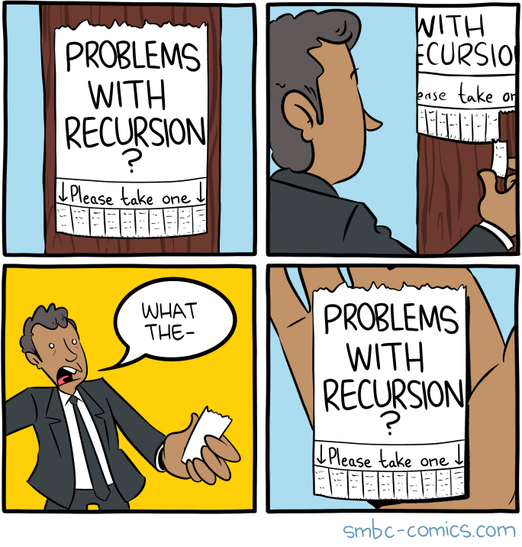
Problems with recursion
Quelle: https://www.smbc-comics.com/comic/recursion

Slide 29
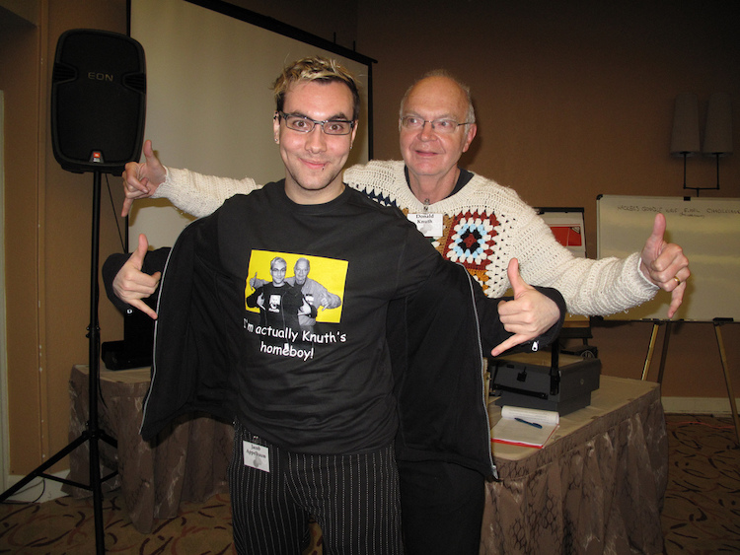
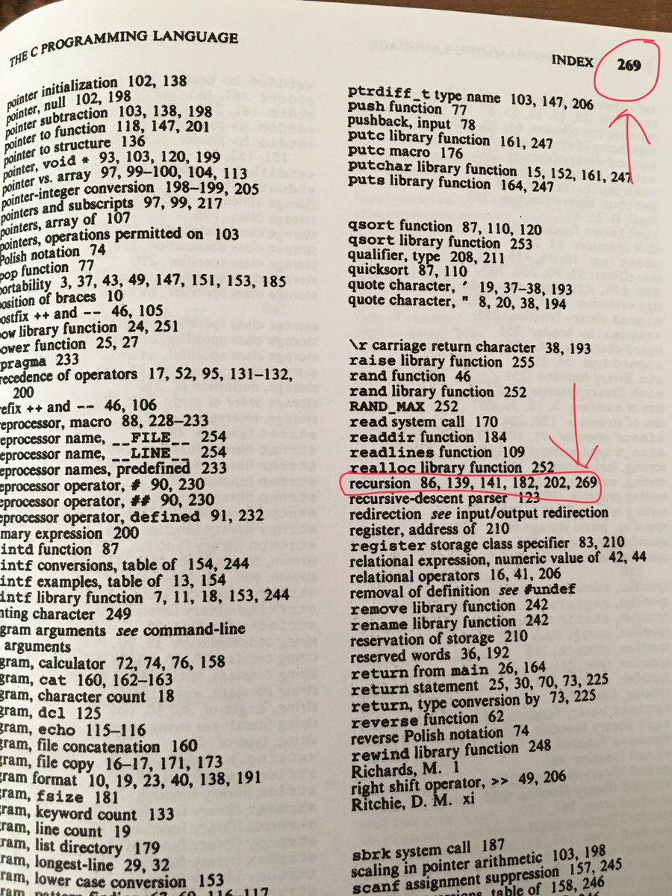
Recursion, recursion, recursion, …
“The C Programming Language" by Brian W. Kernighan and Dennis M. Ritchie
https://laughingsquid.com/jacob-appelbaum-donald-knuth-recursive-homeboys-principle/

Slide 30
Examples

Slide 31

Recursion examples
Example 1. Binary representation. Compose a recursive program that takes
a positive integer n (in decimal) from the command line and writes its binary
representation. Recall the following method: repeatedly divide n by 2 and
read the remainders backwards.
Example 2. Permutations. Compose a program that takes a command-line
argument n and writes all n! permutations of the n letters starting at a
(assume that n is no greater than 26). A permutation of n elements is one
of the n! possible orderings of the elements.
Example 3. Recursive squares (fractals). Compose a program to produce the
following recursive pattern.
See unit7.ipynb

Slide 32
Exercise

Slide 33

Student task
Task 1: Create a list of student dictionaries defined below. Write a function, which nicely prints all the students including all of their data. The functions takes the student list as a parameter. Do not forget to test your code.
student1 = {'first': 'Max', 'last': 'Mustermann', 'matnr': 131211, 'grade': 2}
student2 = {'first': 'Maria', 'last': 'Musterfrau', 'matnr': 12119, 'grade': 2}
student3 = {'first': 'Lukas', 'last': 'Student', 'matnr': 13299, 'grade': 3}
student4 = {'first': 'Lisa', 'last': 'Studentin', 'matnr': 131211, 'grade': 4}
See See unit7_exercise.ipynb
Task 2: Write a function, which computes the average student grade from the list of students. The list contains student dictionaries as in the previous exercise.
Task 3: Compute the sum of first n natural numbers with a recursion.
Task 4. Use the drawing code from previous examples and produce the following pattern:

