Slide 1

Fundamentals of Computer Science and Programming
Unit 4 – Programming Part I

Slide 2
Outline
Programming tools
Requirements
Variables
Integers and Floats
Strings
Casting, Printing, Commenting, None-Keyword
Boolean variables and operators
Conditions (if-Statements)
Exercise

Slide 3
Programming tools

Slide 4
How does “text” become an executable program?
When translating source code (“text”)
The computer translates your written code into machine language.
There are two different ways of translation:
Compiler
One-time translation into a binary file (executable)
Interpreter
Interpretation of the source code at each execution

Slide 5
Compiler
Translates source code into machine code
The resulting executable (file) only contains computer instructions
The executable is no more human readable
Saved as binary file (executable)
Translation takes place only once!
This process is also called compilation
The computer directly executes the program (executable)
print(”Hi”)
…
000100111101101100110111010
compile
Source code
Executable file (.exe)

Slide 6
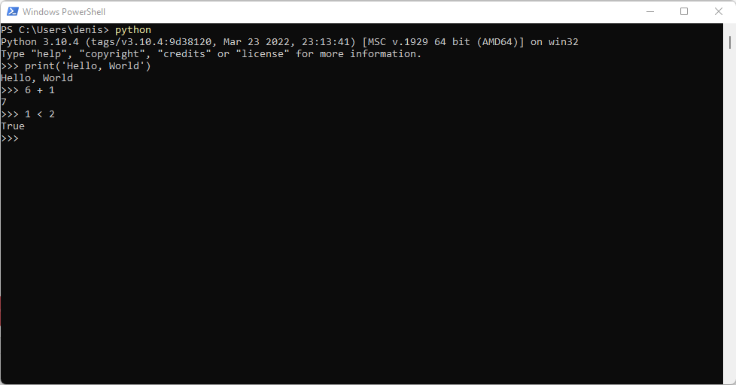
Interpreter
Similar to the compiler
The program gets executed using computer instructions, but:
Each command (e.g. print(“Hi”)) gets translated on its execution
No additional binary file (executable) is created
Source code gets translated on each execution
This process is called “interpretation”
Compilers can lead to drastic performance advantages

Slide 7
Basic terms in programming languages
Programming language
Formal language with fixed rules
Syntax
Fix rules on how to write in a programming language
Fix rules for all language elements
Semantics
Meaning of the language elements
What is exectued?
Program logic, program flow, program structure
Execution sequence and interplay between different program parts

Slide 8
Requirements

Slide 9
Requirements
Computer (Mac OSX, Linux, Windows)
No tablet
No smartphone
Python3 interpreter
Integrated Development Environment (IDE)
Jupyter Notebook / Jupyter Lab
Installation instruction: https://github.com/dhelic/focsp/blob/main/installation.md
Windows: https://www.youtube.com/watch?v=Kn1HF3oD19c
Macbook: https://www.youtube.com/watch?v=nhv82tvFfkM&t=163s (p.s.The steps shown for Python 3.12 also apply to Python 3.10.)
Questions about installing Python or Jupyter? Email: libo.ren@modul.ac.at

Slide 10
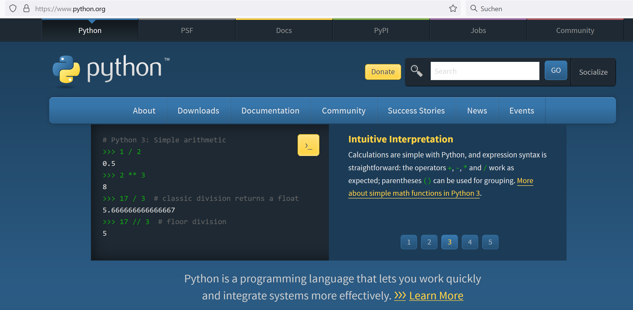
Python (www.python.org)

Slide 11
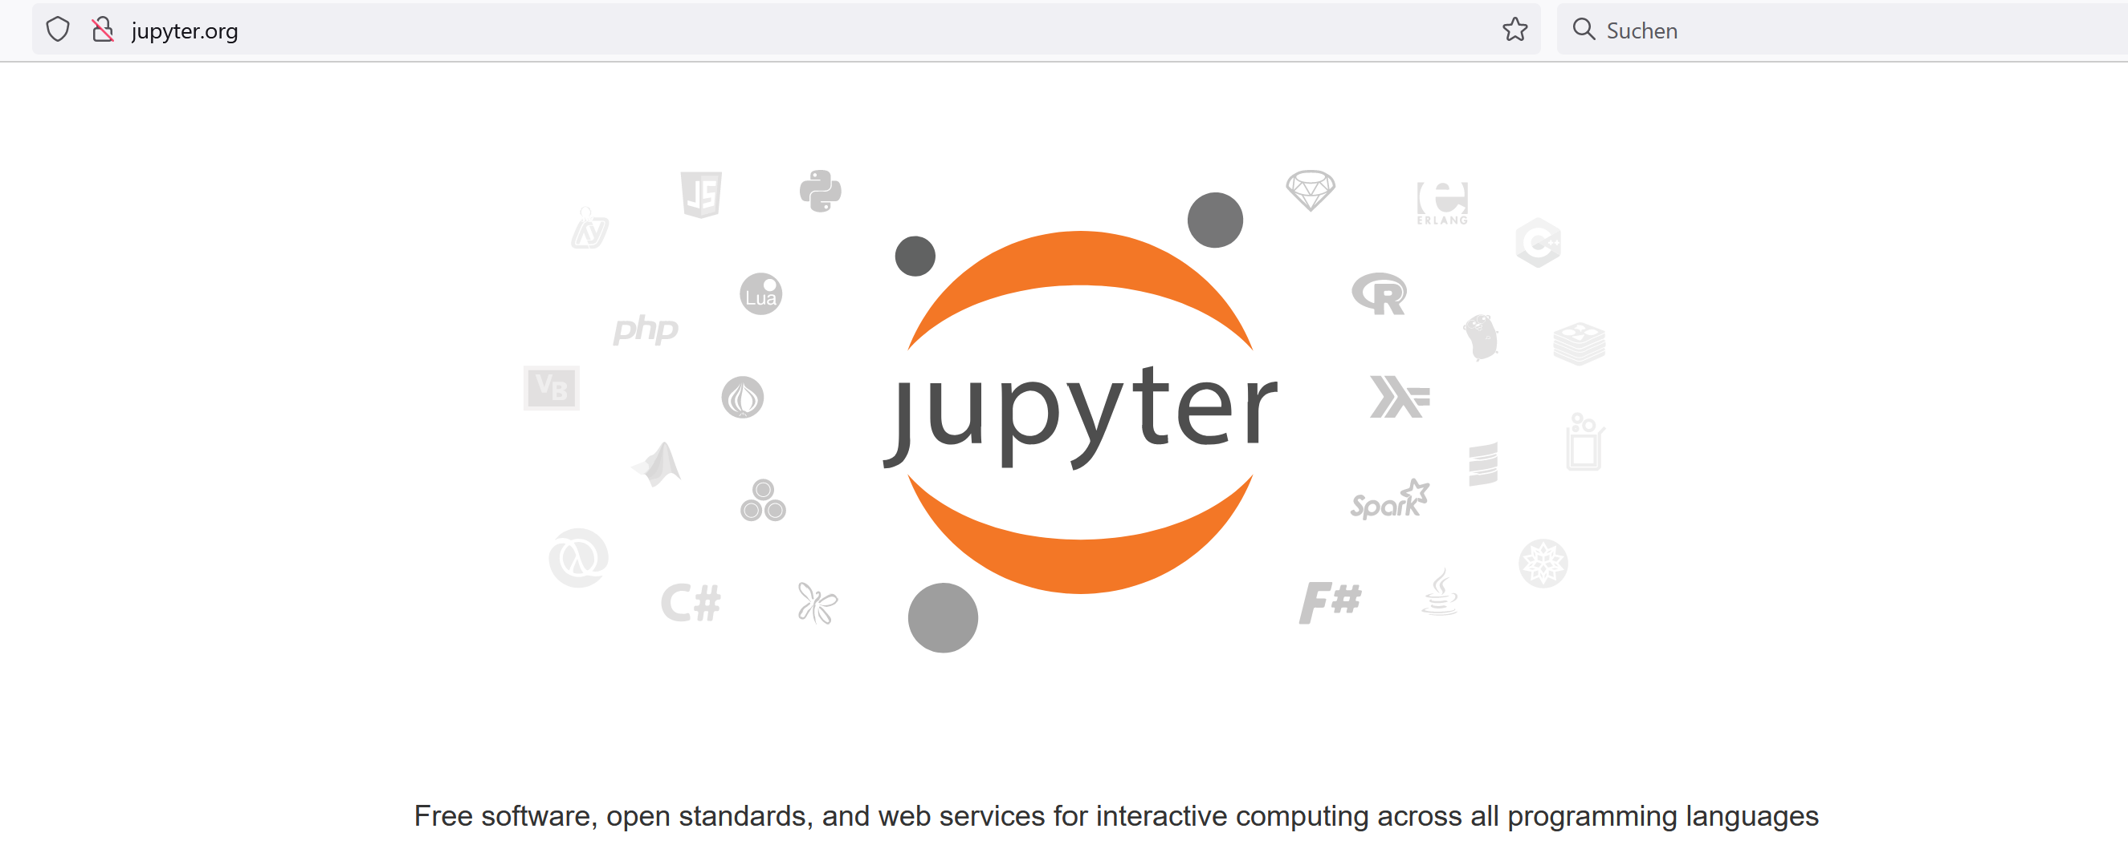
Jupyter (www.jupyter.org)

Slide 12
Python3
Python 3.10 is recommended for the exercise
Good readability, clear structure
Interpreted
Runs on all common OS

Slide 13
Requirements
How to Install Jupyter Notebook (Windows)
1. Create an Environment Folder on Any Disk
Create a new folder where the Python virtual environment will be stored.For example, you can create a folder named `python_env` at: ‘E:\python_env’
2. Create a Virtual Environment
Open CMD or PowerShell and enter the following command:
python -m venv E:\python_env
3. Activate the Virtual Environment
Activate the environment by running: E:\python_env\Scripts\activate
If activation is successful, you will see `(python_env)` appear at the beginning of the command line, for example: (python_env) C:\Users\HP>

Slide 14
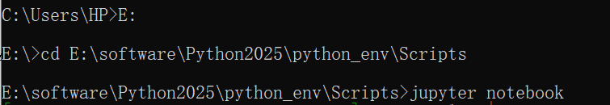
Requirements
How to Install Jupyter Notebook (Windows)
4. Install Jupyter Inside the Virtual Environment
Once the environment is activated, install Jupyter Notebook by typing:
pip install notebook
5. Launch Jupyter Notebook
Navigate to the `Scripts` folder of your environment and start Jupyter.
For this example, you should do:

Slide 15
Requirements
How to Install Jupyter Notebook (Mac)
1. Create a Virtual Environment
Open Terminal and enter the following command:
python -m venv myenv
2. Activate the Virtual Environment
Activate the environment by running: source myenv/bin/activate
If activation is successful, you will see `myenv` appear at the beginning of the command line, for example: (myenv) lili@lili-MacBook-Pro ~%
3. Install Jupyter Inside the Virtual Environment
Once the environment is activated, install Jupyter Notebook by typing:
pip install notebook

Slide 16
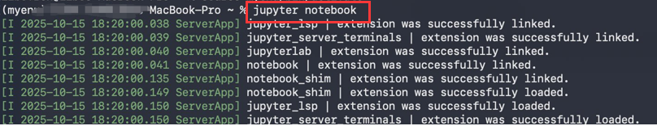
Requirements
How to Install Jupyter Notebook (Mac)
4. Launch Jupyter Notebook
When you want to open your notebook, just activate the virtual environment (Step 2) and type ’jupyter notebook’

Slide 17
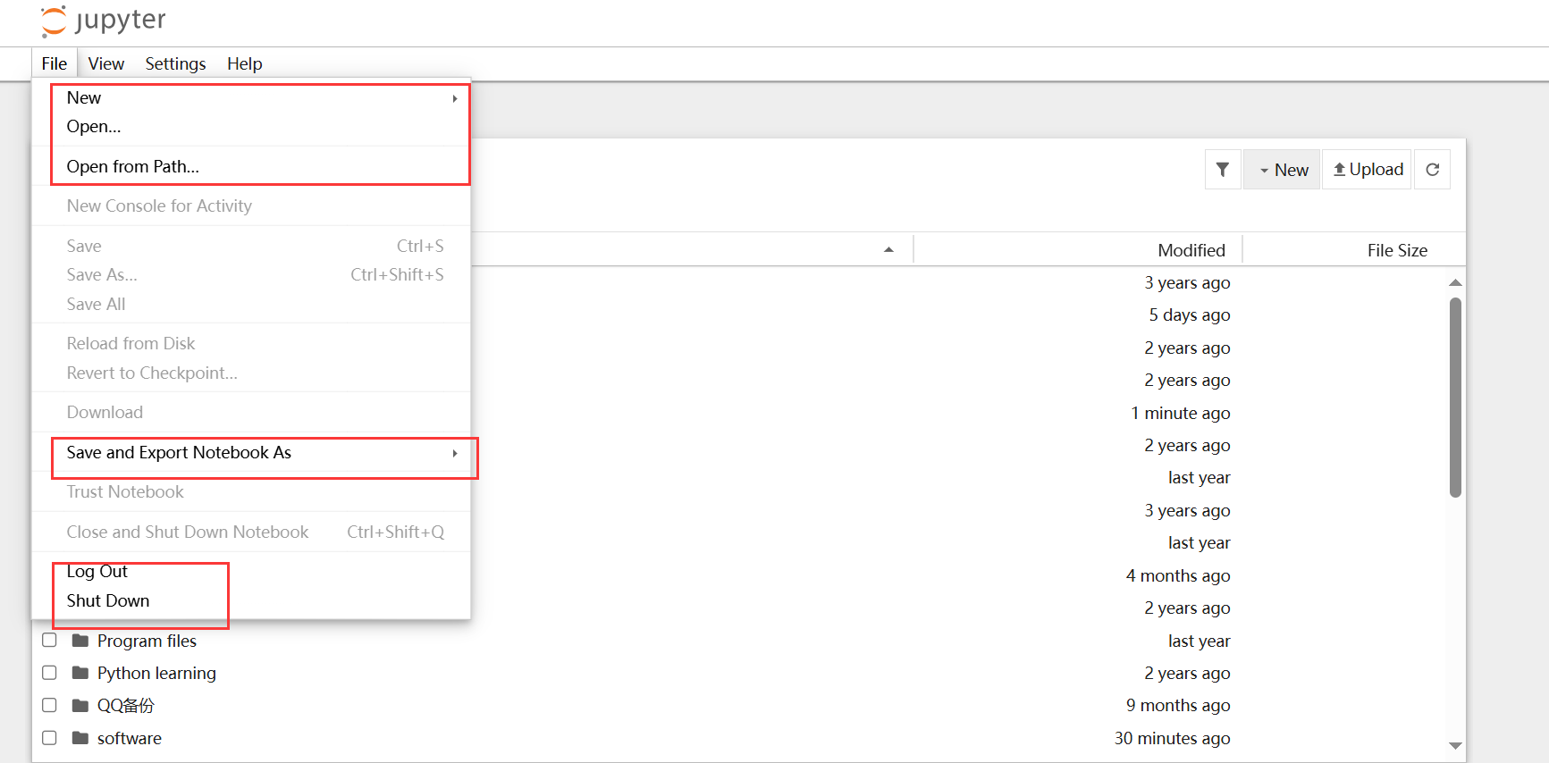
Jupyter (www.jupyter.org)

Slide 18
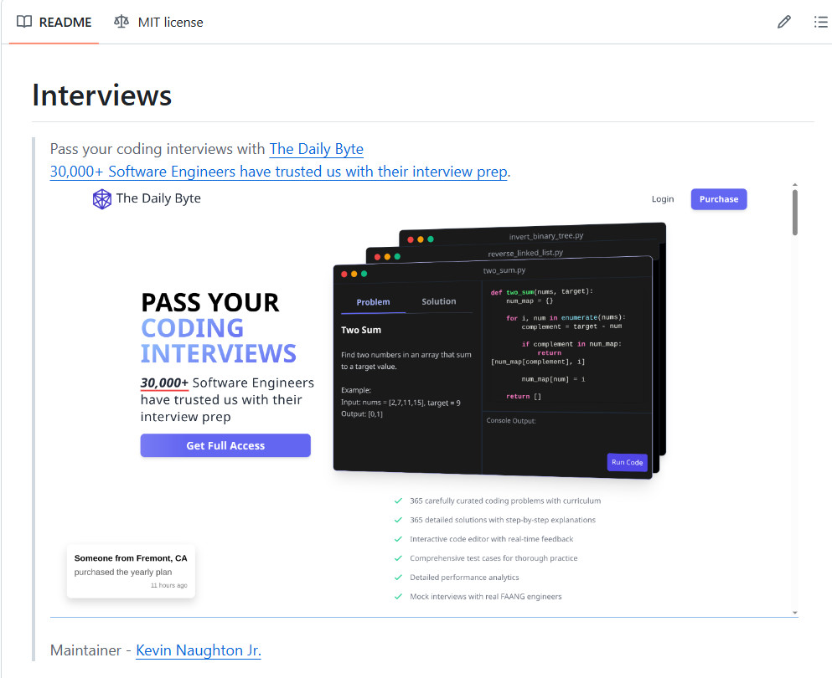
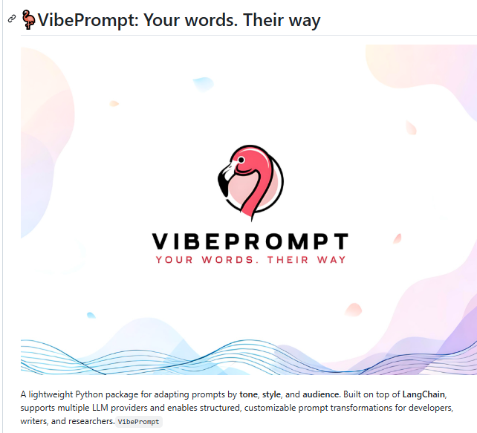
GitHub
Not Only for Programming – A free and Shared Resource Hub for Creativity and Productivity
Code Sharing
Dataset Sharing
Resource Sharing
Personal Knowledge Base & Version Control
Can store, organize, and manage your projects, notes, and knowledge — with every change tracked over time.

Slide 19
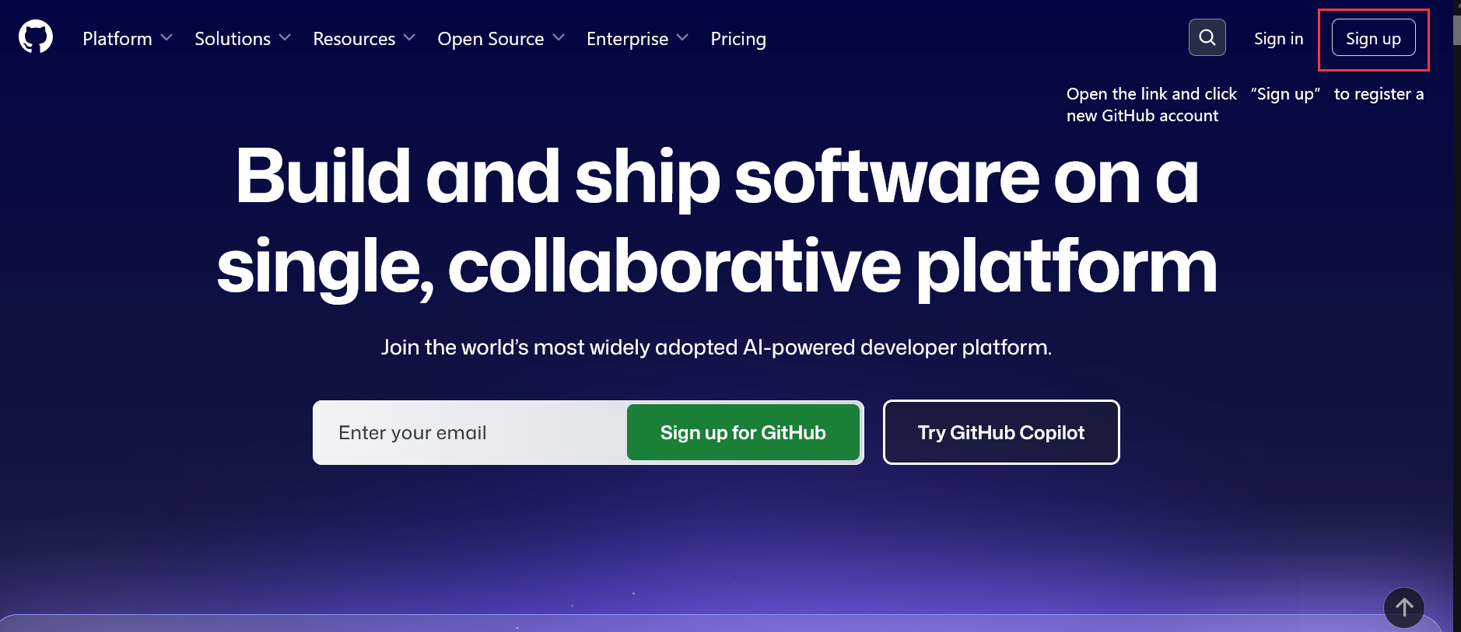
Sign in
Step 1: https://github.com open the link and sign up your own account based on the instruction.

Slide 20
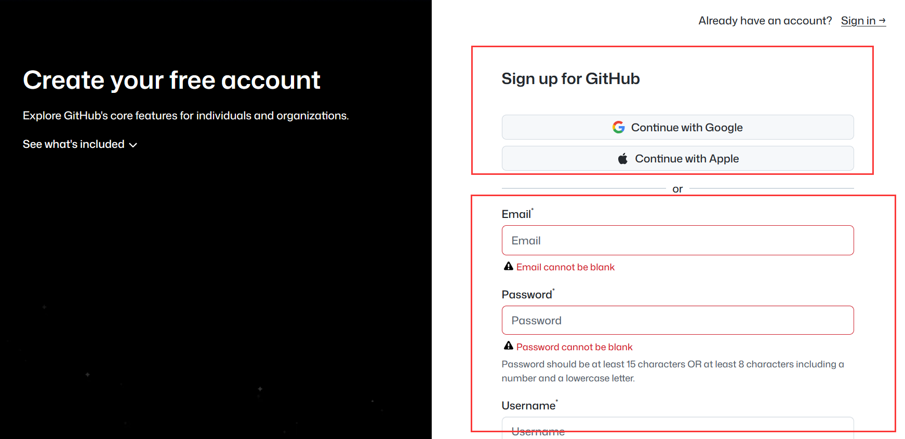
Sign in
Step 1: Sign up using your Google or Apple ID, or create a new account with your email address.

Slide 21

Sign in
Step 2: Sign in with the account you just created.

Slide 22
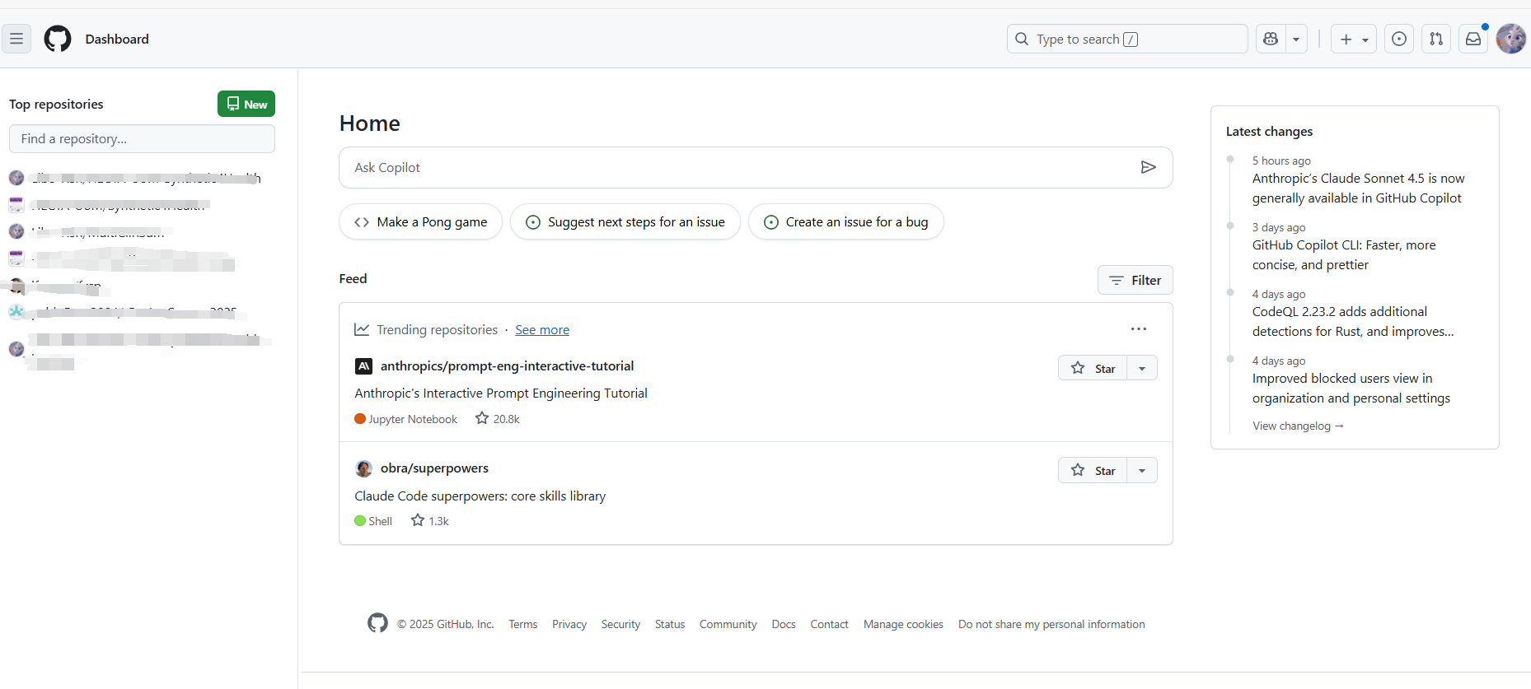
Homepage

Slide 23
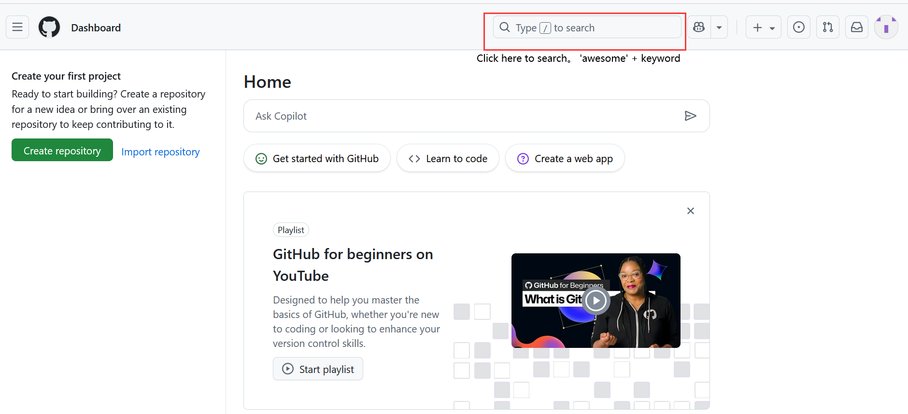
Resource Hub
Try searching “awesome + keyword” (awesome list)

Slide 24
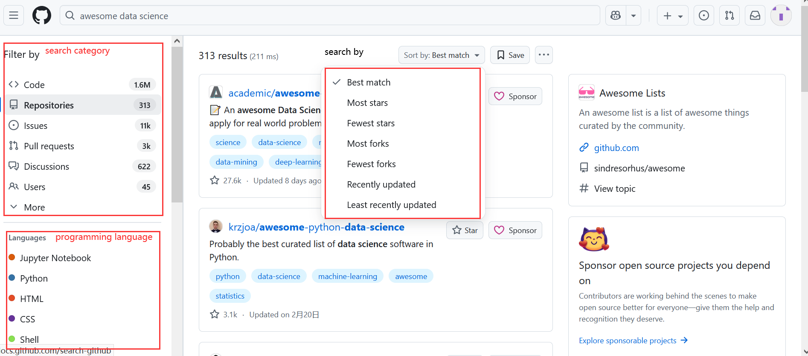
Resource Hub
Try searching “awesome + keyword” (awesome list) [e.g. ‘awesome data science’]

Slide 25
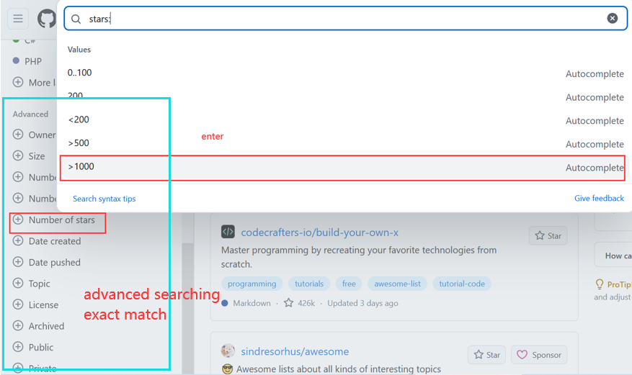
Resource Hub
Try searching “awesome + keyword” (awesome list) [e.g. ‘awesome data science’]

Slide 26
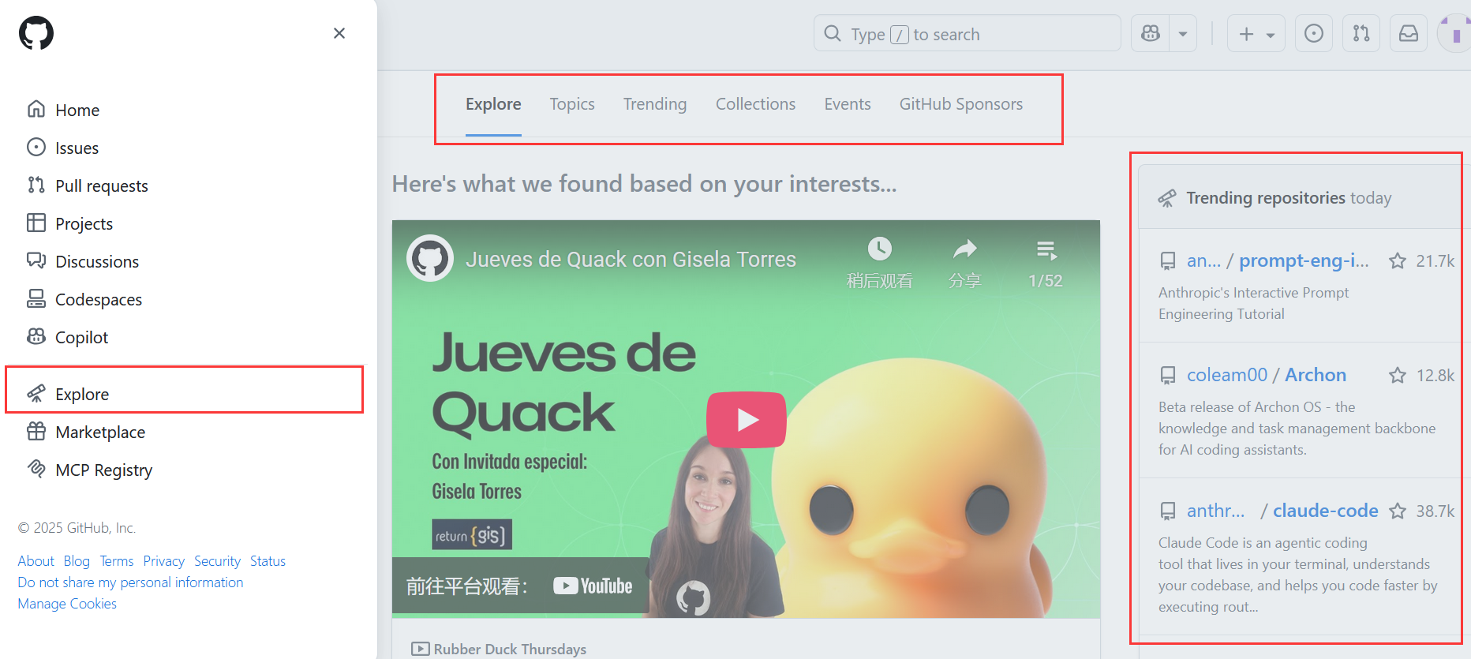
Resource Hub
If you don’t have a specific search goal, just click “Explore.” Use it like a social media platform (similar to Instagram or Twitter.)

Slide 27
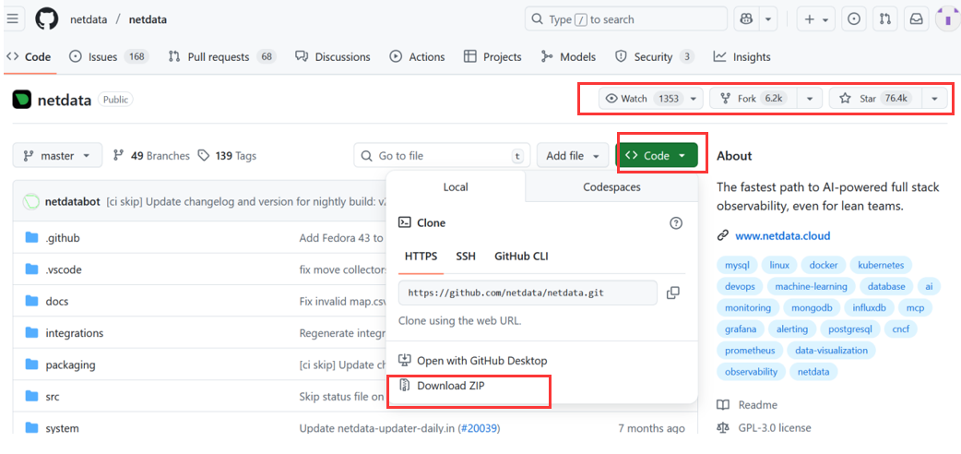
Resource Hub
View and download the project
watch: receive notifications about changes
fork: create your own copy of this repo
star: bookmark or like the project
copy the repo to your local machine
three ways to clone the repo
Always use “Download ZIP” to get the project.

Slide 28
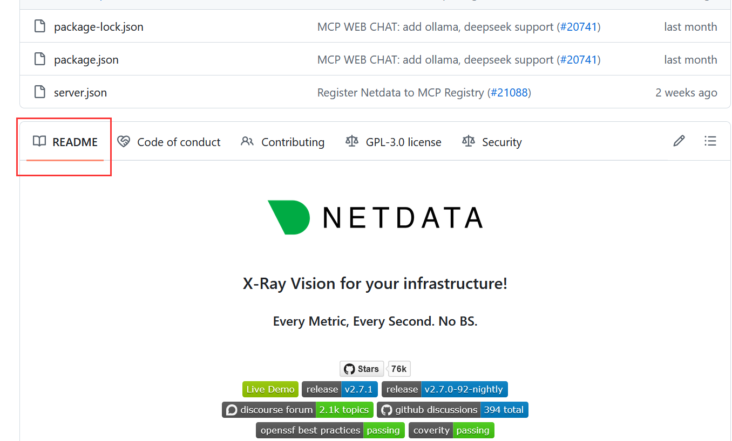
Resource Hub
README is very important because it usually includes an introduction, installation guide, and instructions on how to use the resources you downloaded.

Slide 29
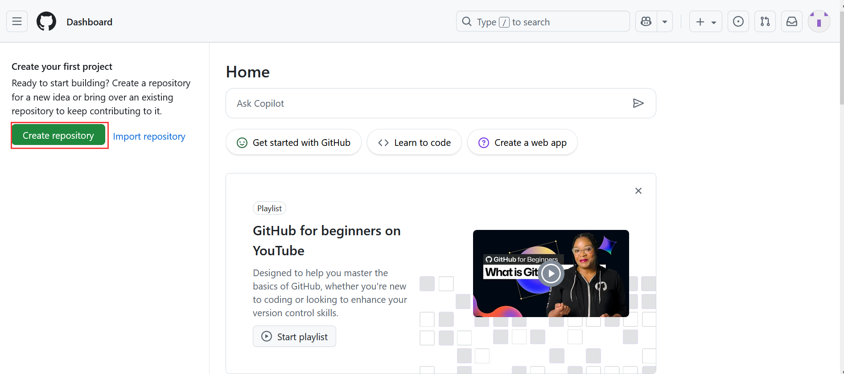
Personal Knowledge Base
Create and share your own project (called “repositories” on GitHub).

Slide 30
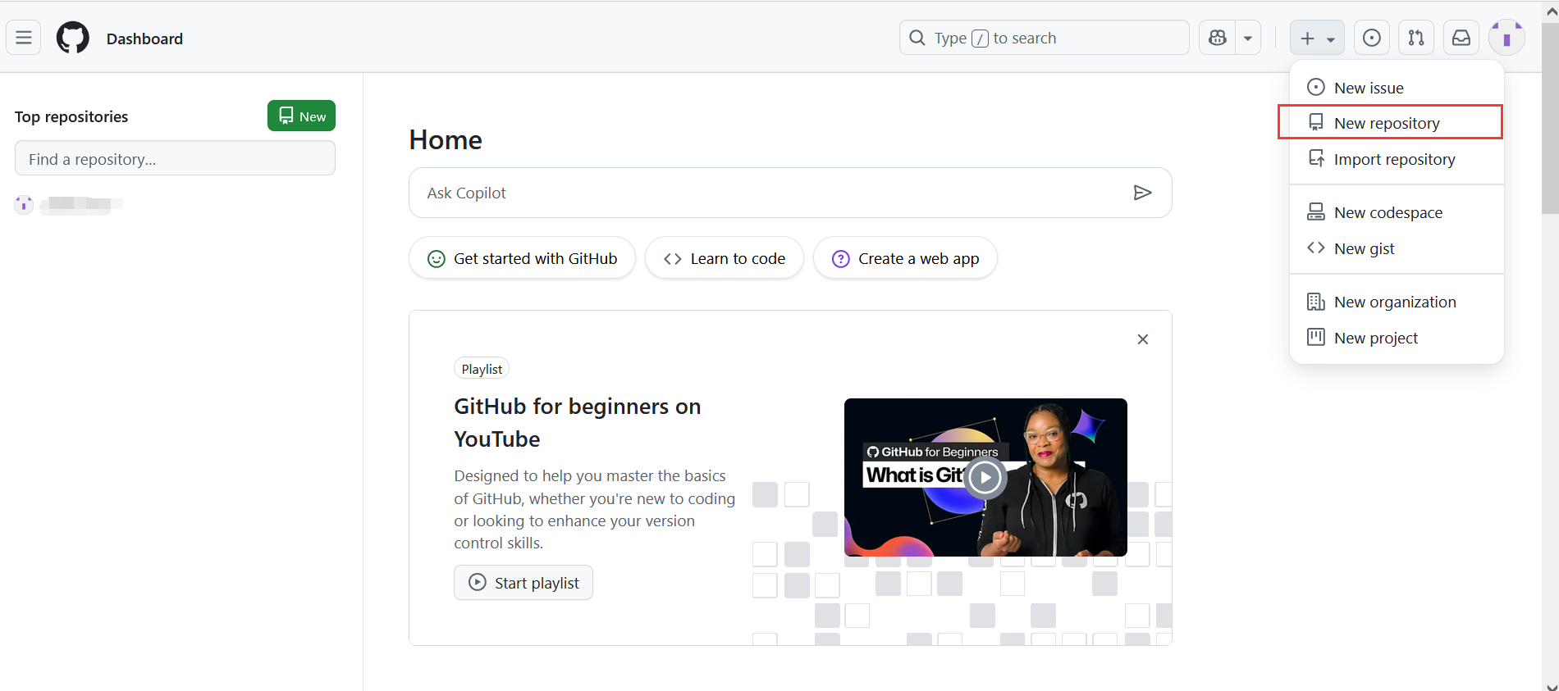
Personal Knowledge Base
Create and share your own project (called “repositories” on GitHub).

Slide 31
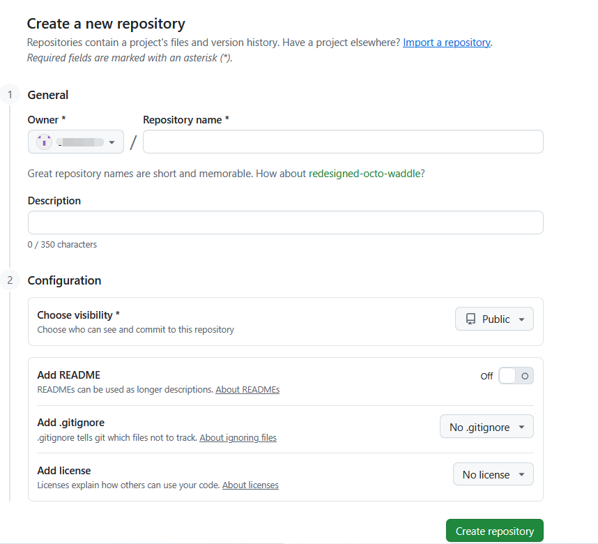
Personal Knowledge Base
Create and share your own project (called “repositories” on GitHub).
default
name of your project
click here to add README
No .gitignore means no files will be ignored — every file will be tracked.

Slide 32
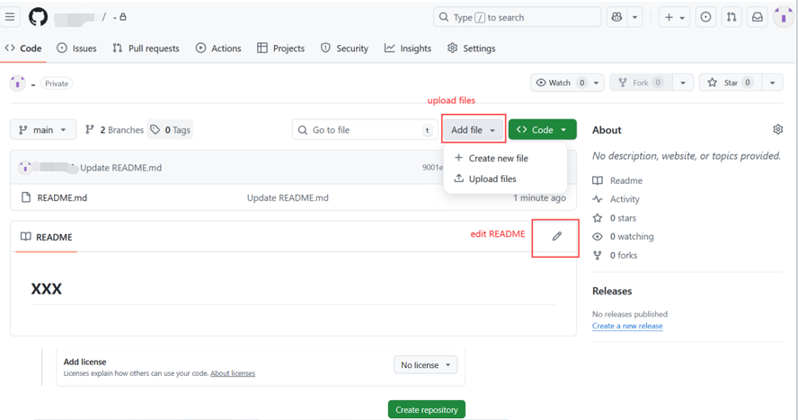
Personal Knowledge Base
Create and share your own project (called “repositories” on GitHub).

Slide 33
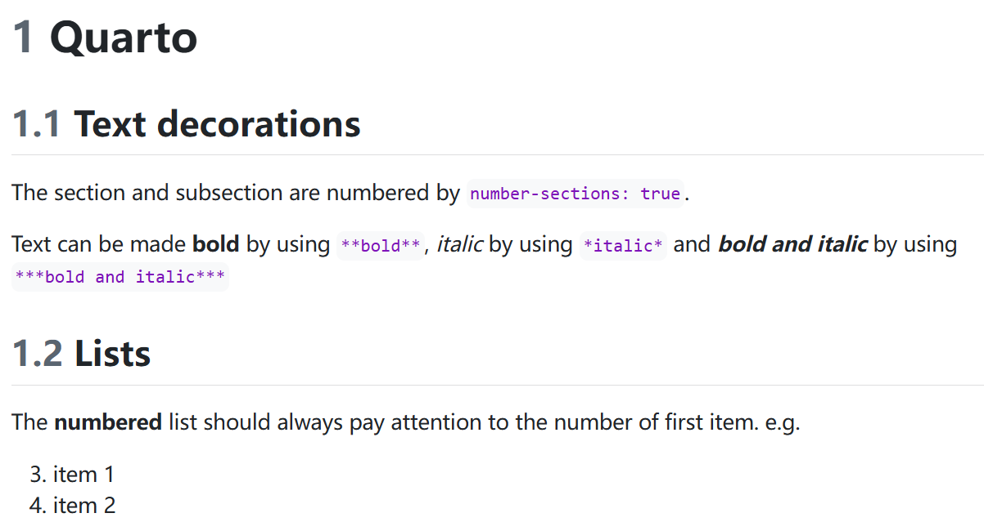
Personal Knowledge Base
README: Follow the syntax of Markdown.
e.g.
# title ## subtitle **bold** *italic*
See the link below for more detailed syntax. https://www.markdownguide.org/basic-syntax/

Slide 34
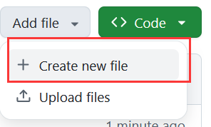
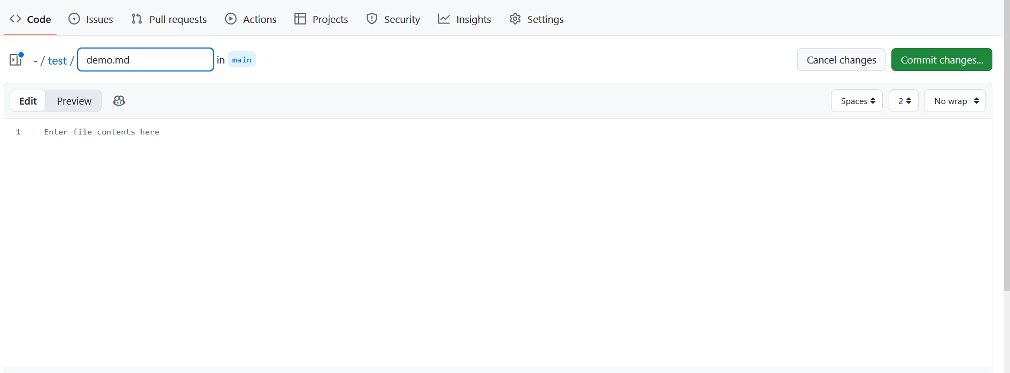
Personal Knowledge Base
Create folder: create file -> folder name/ -> file name

Slide 35
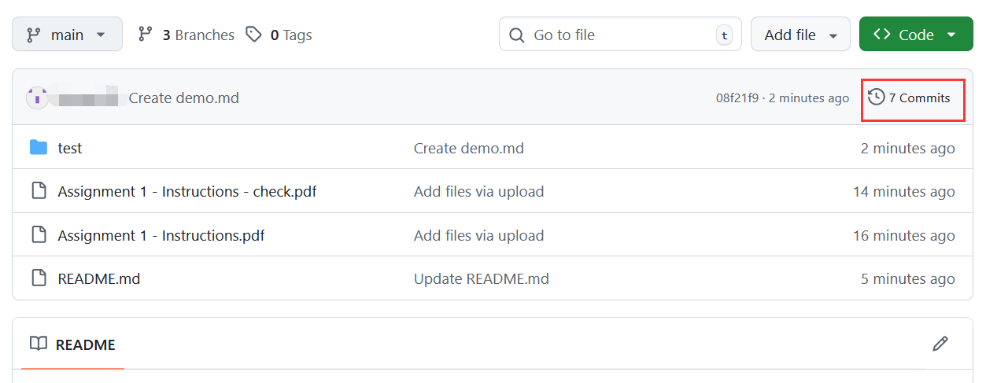
Personal Knowledge Base
View previous version
View commit history

Slide 36
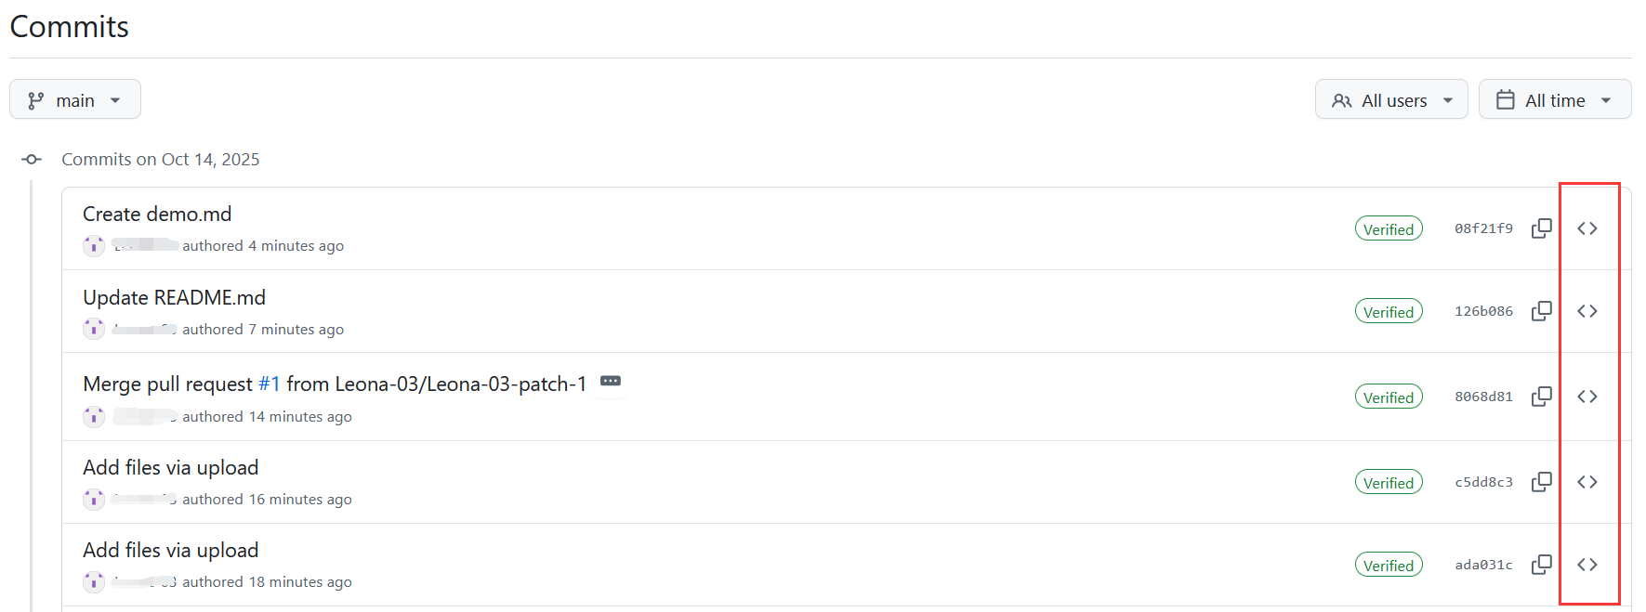
Personal Knowledge Base
Create folder: create file -> folder name/ -> file name
View commit history
View the unmodified version

Slide 37
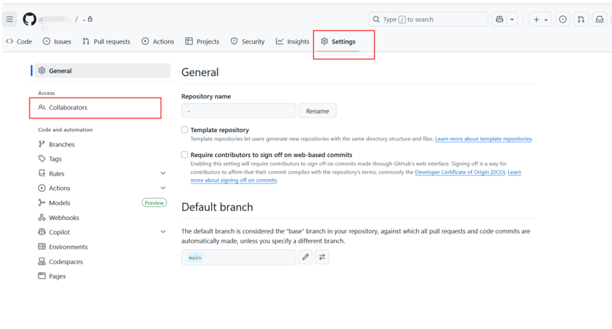
Personal Knowledge Base
Change the repository settings and add collaborators.

Slide 38
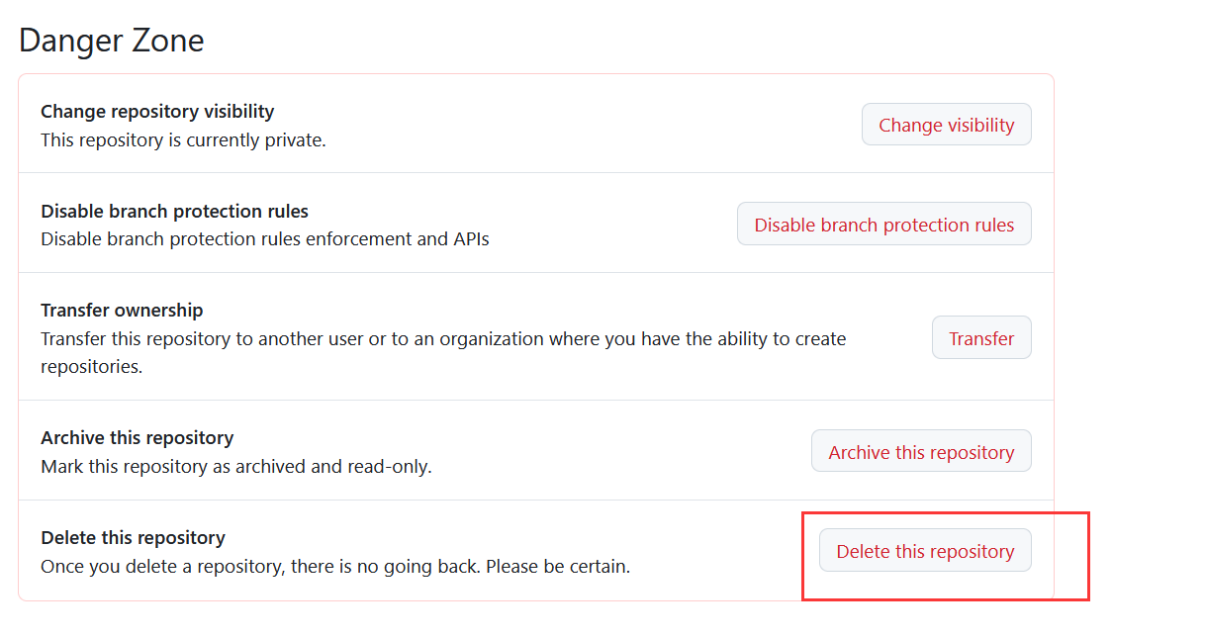
Personal Knowledge Base
Delete the repository: Settings -> Danger Zone

Slide 39
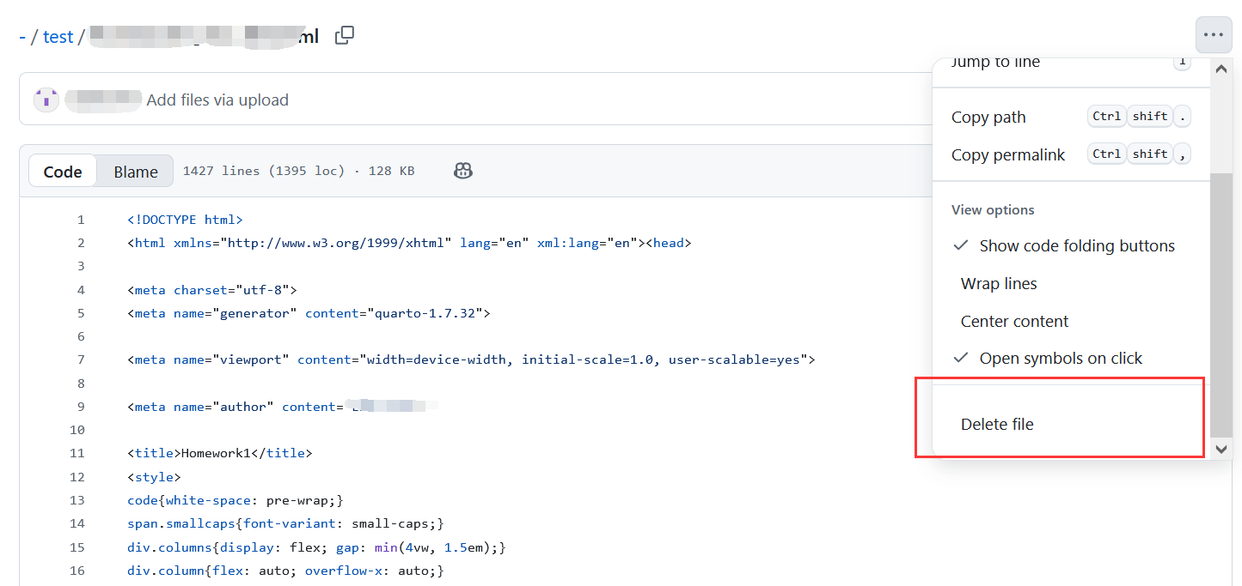
Personal Knowledge Base
Delete the file

Slide 40
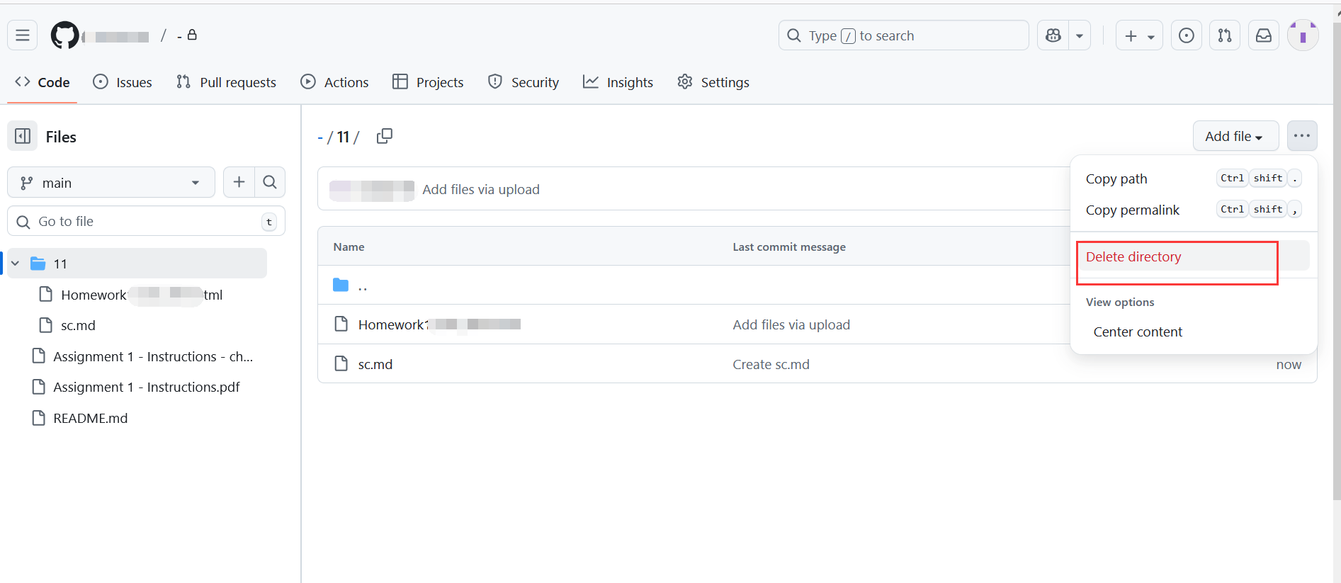
Personal Knowledge Base
Delete the folder

Slide 41
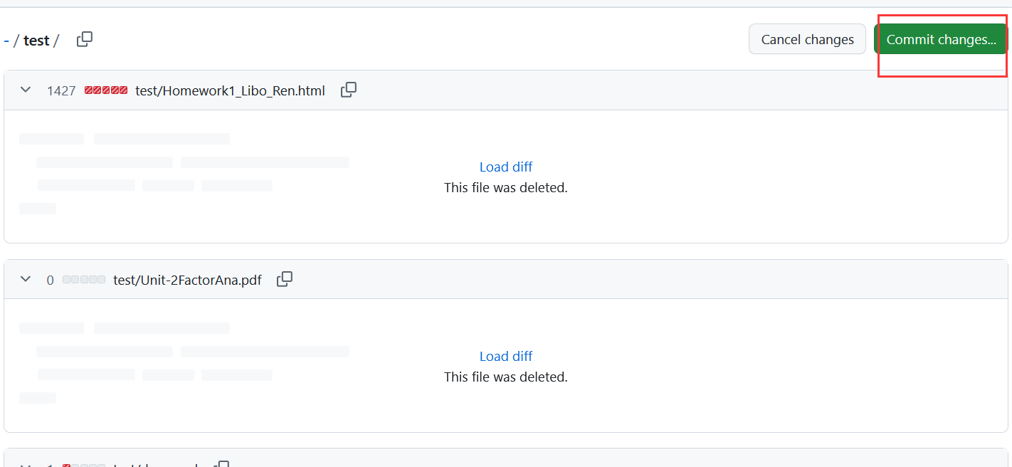
Personal Knowledge Base
Delete the folder

Slide 42
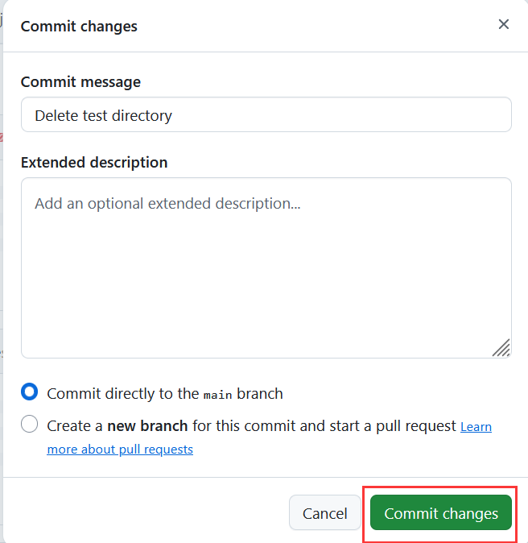
Personal Knowledge Base
Delete the folder

Slide 43
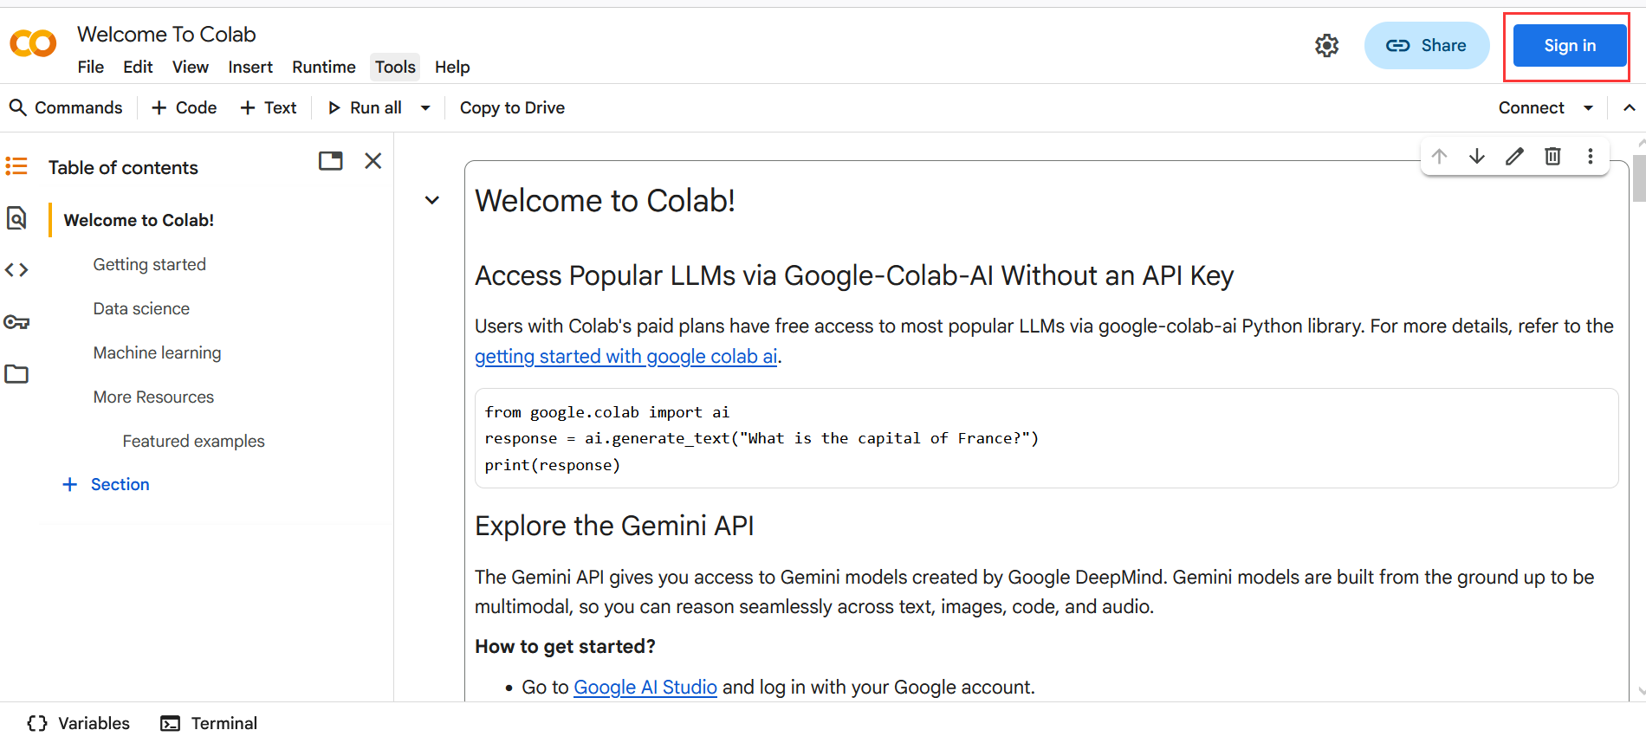
Google Colab
Open the link: https://colab.research.google.com/?hl=en and sign in with your Google account

Slide 44
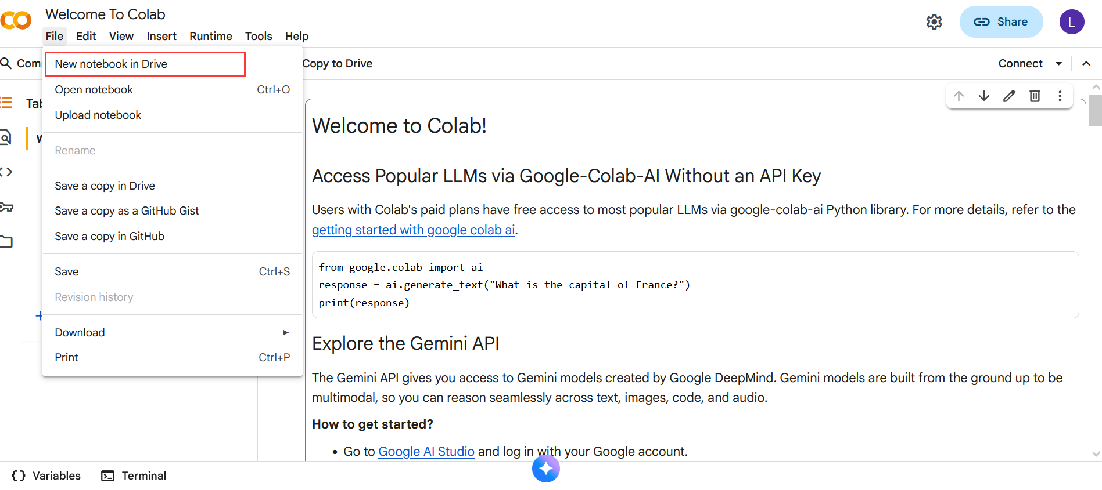
Google Colab
Create a new notebook. It will be automatically saved in Google Drive.

Slide 45
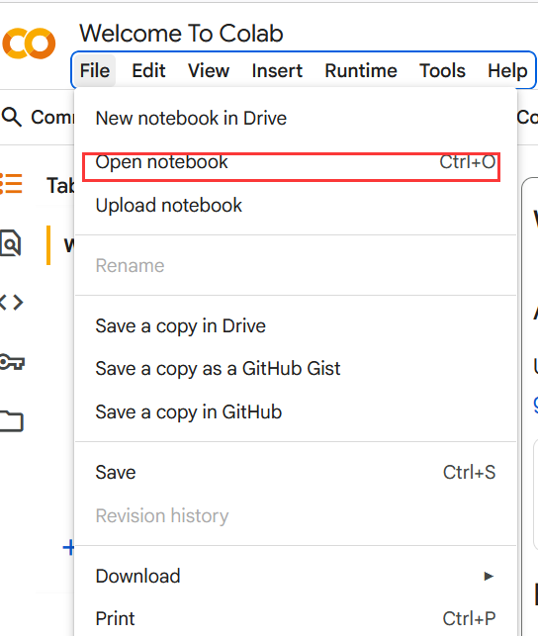
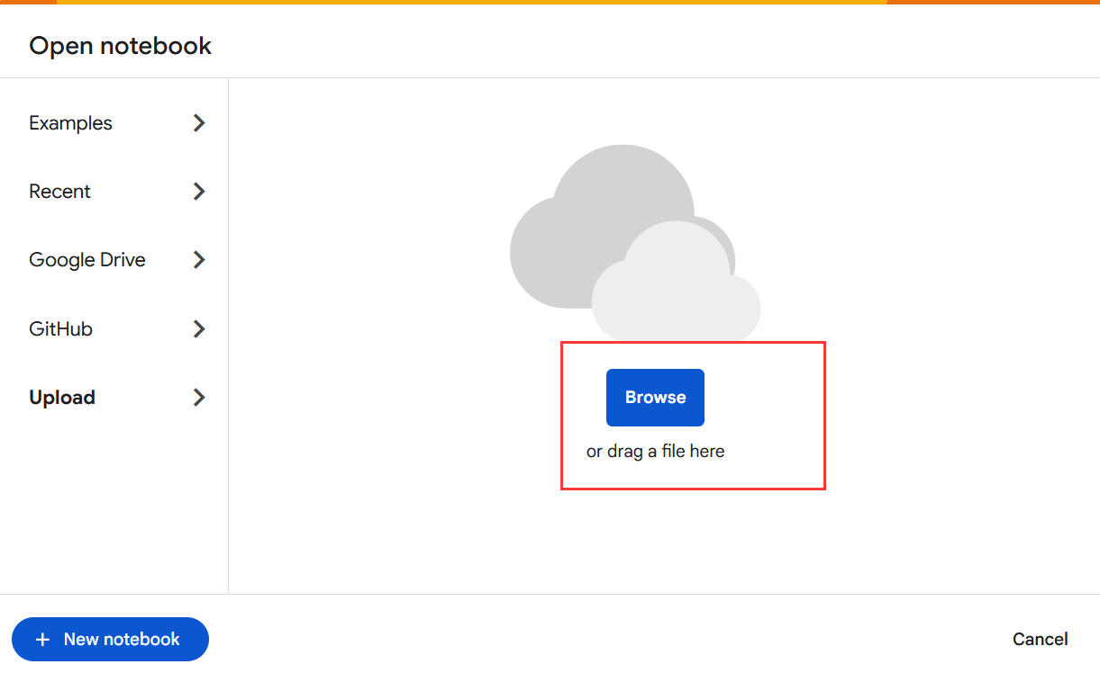
Google Colab
Open the given notebook
Choice 1: upload from local machine

Slide 46
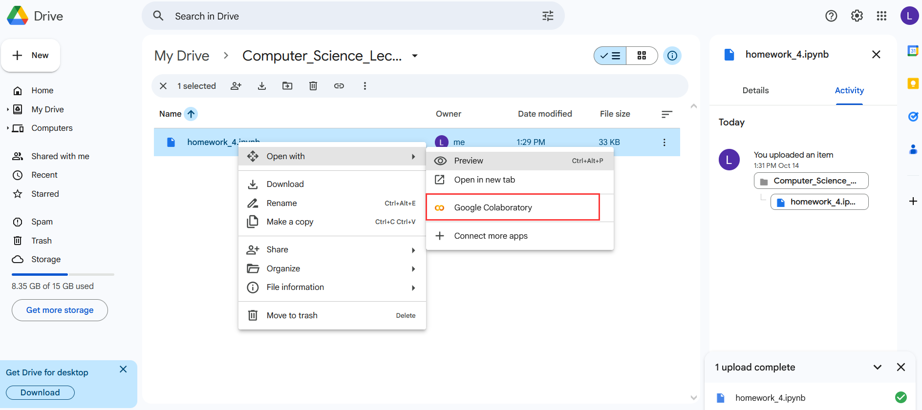
Google Colab
Open the given notebook
Choice 2: Upload from Google Drive — open the folder that contains the notebook, then open it with Colab.

Slide 47
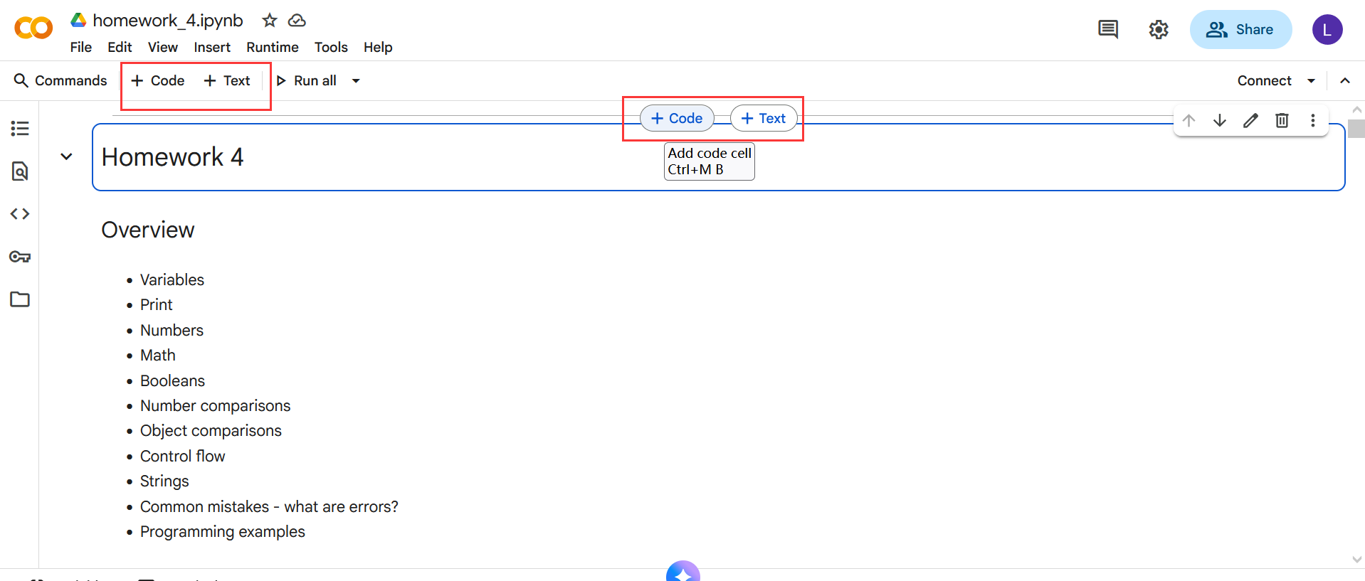
Google Colab
A notebook is organized into several code cells and text cells.
For text cells, we need to follow Markdown syntax.
For code cells, we can write code in Python or R.

Slide 48
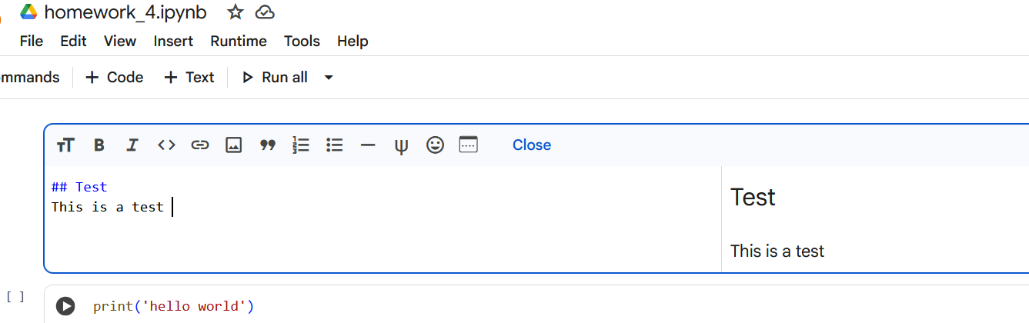
Google Colab
A notebook is organized into several code cells and text cells.
For text cells, we need to follow Markdown syntax.
Markdown Guide: https://colab.research.google.com/notebooks/markdown_guide.ipynb
For code cells, we can write code in Python or R.

Slide 49
Google Colab
A notebook is organized into several code cells and text cells.
For text cells, we need to follow Markdown syntax.
For code cells, we can write code in Python or R.

Slide 50
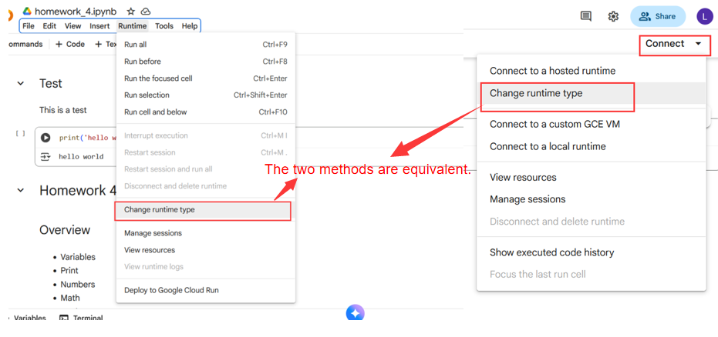
Google Colab
Change runtime settings (e.g., choose CPU or GPU, select the interpreter such as Python or R, etc.).The two methods are equivalent.

Slide 51
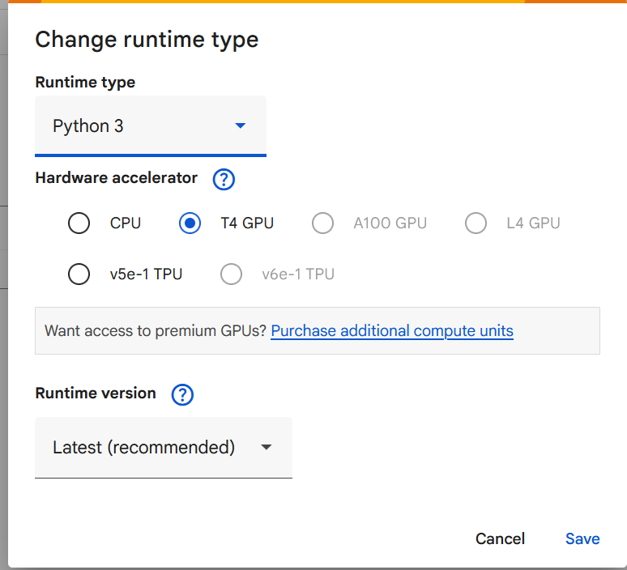
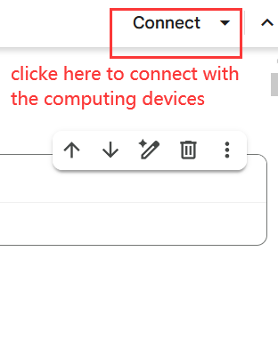
Google Colab
Change runtime settings (e.g., choose CPU or GPU, select the interpreter such as Python or R, etc.).

Slide 52
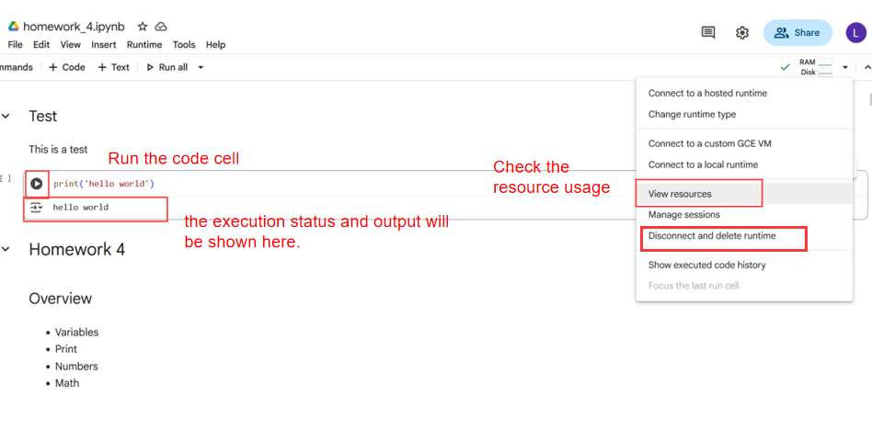
Google Colab
Change runtime settings (e.g., choose CPU or GPU, select the interpreter such as Python or R, etc.).

Slide 53
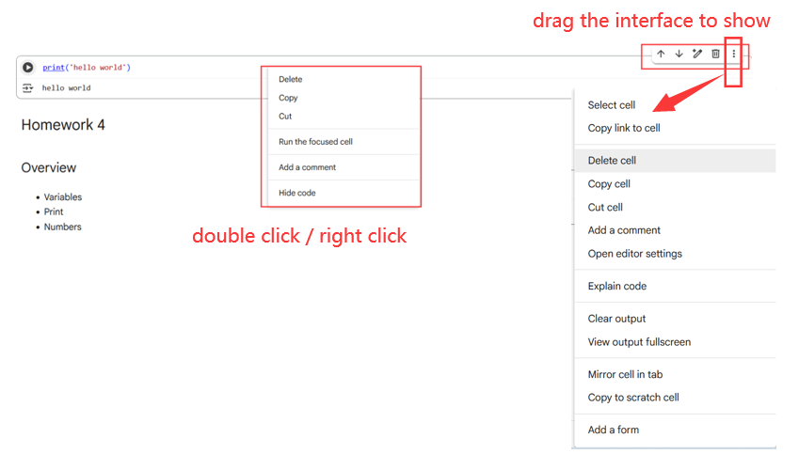
Google Colab
Edit or delete the cell: 3 methods: double-click / right-click / drag the interface to show it

Slide 54
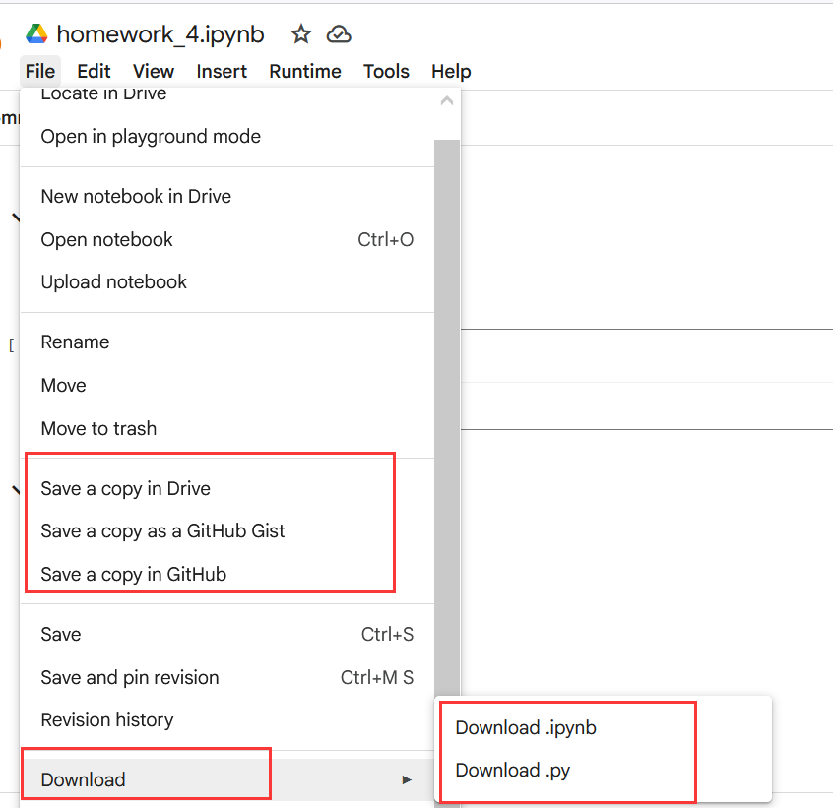
Google Colab
Save and export the notebook
The original version is automatically saved.
You can also save a copy to Google Drive or GitHub.
It can be downloaded to your local machine in two formats: .ipynb or .py.

Slide 55
Variables

Slide 56
Variables
Labels (names) for values and computations
Variables reference values
Placeholders
Assignment of values with =
<Variable name> = <Assigned value>
Transient (temporary) storage of values
Lifetime ends with the end of the program execution
Start value is needed, after that we can change to arbitrary values
Mutable
number = 123 message = 'Hello World!'
number2 = number

Slide 57
Variables
Naming conventions for variable names
Fixed rules (if not followed results in errors)
Only letters, numbers and underscore _
No numbers at the beginning
No whitespaces
Style guidelines
Lower case, short and descriptive
Words separated with underscore _
https://github.com/dhelic/focsp/blob/main/style.md
See Unit 4 Python Notebook

Slide 58
Variables and data types
Data type | Function | Examples
int | Natural numbers | x = 3
float | Floating point numbers | x = 3.0
bool | Booleans | x = True x = False
str | Strings | x = 'Test' x = "Test"
tuple | Tuples | x = (1, 2, 3)
list | Lists | x = [1, 2, 3]
dict | Dictionaries | x = {1: 'blue', 2: 'red'}
io.TextIOWrapper | Files | x = open('readme.txt')
... | ... | ...

Slide 59
Integers and Floats

Slide 60
Integers and floating point numbers
Integers:
1, -13, 15, -42, 12345, ...
Floats:
1.3, 3.14159, -42.123, …
Arithemtic operations:
Adding (+), Subtracting (-), Multiplying (*), Dividing (/)
Exponantiating (**)
Modulo Operator (%)
number = 5 + 13
number_2 = number + 5

Slide 61
Extended operators
Arithmetic operations with direct assignment:
Adding (+=), Subtracting (-=), Multiplying (*=), Dividing (/=)
number = 42
number += 8 # => 50
number -= 10 # => 40
number /= 4 # => 10
number *= 2 # => 20
number = 42
number = number + 8
number = number - 10
number = number / 4
number = number * 2

Slide 62
Some special cases
Operations with integers and Float == Float
4/2 = 2.0, 2 * 3.0 = 6.0, 3.0 ** 2 = 9.0
Floating point error
0.2 + 0.1 ≠ 0.3
See unit4.ipynb on Moodle

Slide 63
Strings

Slide 64
Strings
Text = sequence of characters
Begin and end marked with quotation marks " or '
string = 'This is a string'
string = "This is also a string"
string = '"Python" was named after "Monty Python".'
string = '''This is a multiline
string'''
string = """This is another multiline
string"""

Slide 65
Strings
Accessing
Individual characters: [] and an index (0-based!)
First character = index 0
Last character = length of the string – 1
Multiple characters with slicing: [], : and indices
Length: len(string)

Slide 66
String slicing
Slicing
Retrieve the i-th character:
string[i-1]
Retrieve a substring with characters from start (inclusive) until end (exclusive):
string[start:end]
Retrieve a substring with characters from start (inclusive) until end (exclusive) in steps of the given size:
string[start:end:stepsize]

Slide 67
String slicing
Advanced slicing
Retrieve the i-th last character:
string[-i]
Retrieve everything from the i-th last character (inclusive):
string[-i:]
Retrieve everything until the i-th last character (exclusive):
string[:-i]
Reversed string:
string[::-1]

Slide 68
String slicing: example
text = 'Vienna'
Command with text | Result
text[0] | 'V'
text[:2] text[0:2] | 'Vi'
text[6] | IndexError
text[5] text[-1] | 'a'
text[2:] text[2:6] | 'enna'
text[::2] | 'Ven'
text[::-1] | 'anneiV'

Slide 69
String methods
Strings are flexible with a huge standard functionality
Methods take actions on the variable values
Examples:
See Unit 4 Python Notebook
Call | Result
name + ' , hi!' | 'John Doe, hi!'
text * 2 | ' Python! Python! '
name.title() | 'John Doe'
name.upper() | 'JOHN DOE'
text.lower() | ' python! '
text.rstrip() | ' Python!'
text.lstrip() | 'Python! '
text.strip() | 'Python!'
name.split(' ') | ['John', 'Doe']
text = ' Python! '
name = 'John Doe'

Slide 70
Casting, Printing, Commenting, None-Keyword

Slide 71
Conversion between data types
num1 = 123
num2 = '15'
num3 = num1 + num2
Casting: converting between data types
int(), str(), float(), bool()…
Examples:
int('5') => 5
float('5.23') => 5.23
str(5) => '5'
int(True) => 1
bool(0) => False
Output:
TypeError
1 num1 = 123
2 num2 = '15'
--> 3 num3 = num1 + num2
TypeError: unsupported operand type(s) for +: 'int' and 'str'
Solution:
num1 = 123
num2 = '15'
num3 = num1 + int(num2)

Slide 72
Formatting output
print() function
Prints also a new line at the end
Parameters separated with ,
Space character as a whitespace
We can also print and format variables
f before the string to print
Variables in brackets {}
name = 'Max' age = 20 print(f'My name is {name} and I am {age} years old')
Output: My name is Max and I am 20 years old

Slide 73
Formatting output
Whitespaces and special characters
Sequence | Result
\n | New line
\t | Tabulator
\' | ' character in strings
\" | " character in strings
\\ | \ character (backslash)

Slide 74
Comments
Syntax
# single-line comment
""" multi line
comment """
''' multi line
documentation '''
Explanations to program flow and structure
Supports understanding of the program
Useful for group projects, longer lasting projects, etc.

Slide 75
None-Keyword
None
No value, Null value
Placeholder when the variable value is still not assigned
x = None is different than:
0
False
''
See Unit 4 Python Notebook

Slide 76
Boolean variables and operators

Slide 77
Boolean variables
Boolean variables (boolean, bool) store true/false values
True
False
Boolean variables are results of comparisons of other variables
value = ((2 + 2) < 4)
print('This is', value)

Slide 78
Comparison operators
Operator | Description | Example
== | is equal | x == y
!= | is not equal | x != y
> | greater than | x > y
< | smaller than | x < y
>= | greater or equal | x >= y
<= | smaller or equals | x <= y
is | objects are identical | x is y
is not | objects are different | x is not y
Result of comparisons: Boolean value (True oder False)

Slide 79
Logical operators
Operator | Description | Example
and | True iff both statements are true | x == y and y < 5
or | False iff both statement are false | x > 2 or y > 3
not | Negation of the statement | not x == y not z
^ | True iff one of the statements is true (XOR) | x == 2 ^ y < 4
Note that ^ is so-called bitwise operator
Works on bits
Result of each comparison is a boolean value
Hence, this should work as expected

Slide 80
Operator precedence
Operator precedence (from low to high)
or
and
not
in, not in, is, is not, <, <=, >, >=, !=, ==
|
^
&
<<, >>
+, -
*, @, /, //, %
+x, -x, ~x
**
If not sure: ()
See Unit 4 Python Notebook

Slide 81
Conditions (if-Statements)

Slide 82
Branching: if statements
Checking whether conditions are satisfied
Conditional execution of code
Control flow
If condition satisfied then do something
Syntax:
if condition:
print('Do something')
if x > 2: print('In if')
print('Not in if')
Indented 4 spaces

Slide 83
Branching: if-else statements
If statement with a fallback
In case the condition is not fullfilled
If condition satisfied then do something else do something else
Syntax:
if condition:
print('Do something')
else:
print('Do something else')
if x > 2: print('In if')
else:
print('In else')

Slide 84
Branching: if-elif-else statements
Multiple branching for more complex case
If first condition satisfied then do something
else if second condition then do something else
else if third condition then do somenthing else than before
…
else do something completly different

Slide 85
Branching: if-elif-else statements
Syntax:
if condition:
print('Do something')
elif condition2:
print('Do something else')
elif condition3:
print('Do something different')
# there could be more elifs below this
else: # optional
print('Do something completely different')

Slide 86
Branching: if-elif-else statements
Examples:
if x < 5: print('Small')
elif x < 15: print('Medium')
elif x < 20: print('Big')
else: print('Huge')
if x < 5: print('Small')
if x < 15: print('Medium')
if x < 20: print('Big')
else: print('Huge')
≠

Slide 87
Indentation rules
Standard PEP8 (https://peps.python.org/pep-0008/)
4 spaces, no tabulators (configure editors to replaces tabs with 4 spaces)
Block indentation
Everything that is indented after : belongs to the current block
This is language syntax!
Not following the syntax results in an error
Implicitly: supports formatting and readability of code
Changes the relation to the rest of the code
if, for, while, def, …

Slide 88
Nested indentation
Code blocks can be arbitrarly nested at multiple levels
age_max = 35
age_peter = 42
age_berta = 37
if age_max < age_peter:
print('Max is younger than Peter')
if age_berta < age_max:
print('Berta is the youngest!')
else:
print('Max is the youngest!')
else:
if age_berta < age_peter:
print('Berta is the youngest!')
else:
print('Peter is the youngest!')
See Unit 4 Python Notebook

Slide 89
Exercise

Slide 90
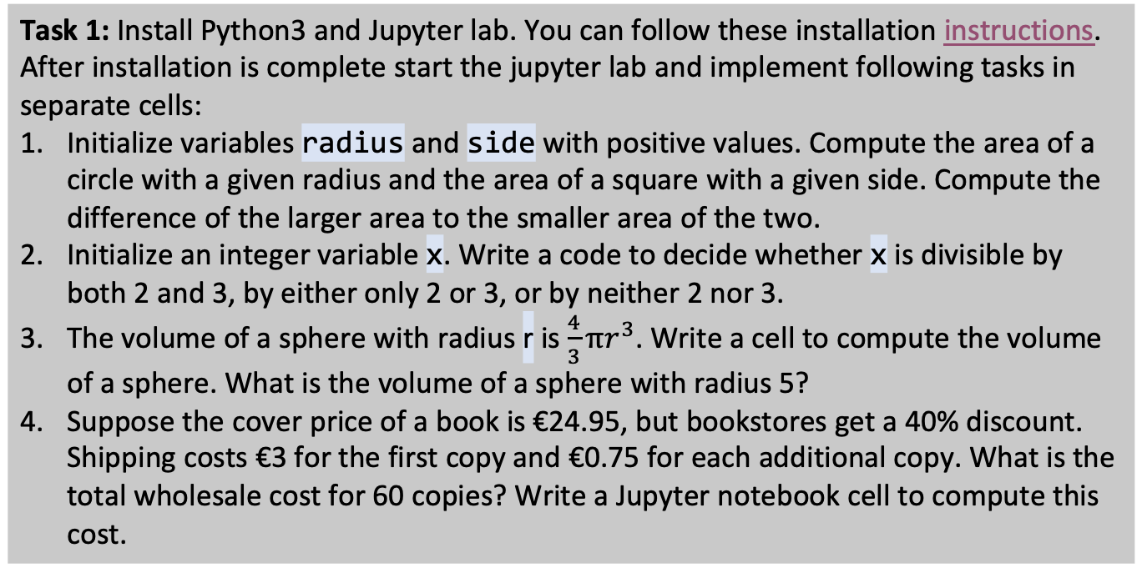
Student task
Task 1: Install Python3 and Jupyter lab. You can follow these installation instructions. After installation is complete start the jupyter lab and implement following tasks in separate cells:
Initialize variables radius and side with positive values. Compute the area of a circle with a given radius and the area of a square with a given side. Compute the difference of the larger area to the smaller area of the two.
Initialize an integer variable x. Write a code to decide whether x is divisible by both 2 and 3, by either only 2 or 3, or by neither 2 nor 3.
The volume of a sphere with radius r is $\frac{4}{3}πr^{3}$. Write a cell to compute the volume of a sphere. What is the volume of a sphere with radius 5?
Suppose the cover price of a book is €24.95, but bookstores get a 40% discount. Shipping costs €3 for the first copy and €0.75 for each additional copy. What is the total wholesale cost for 60 copies? Write a Jupyter notebook cell to compute this cost.

