Slide 1

Fundamentals of Computer Science and Programming
Unit 10 – Algorithms and Complexity, Part II

Slide 2
Outline
Growth of functions
Exercise
Big-O for polynomials
Exercise
Growth of function combinations
Exercise
Tractable vs. intractable complexity
Exercise
Complexity table
Exercise

Slide 3
Growth of functions

Slide 4
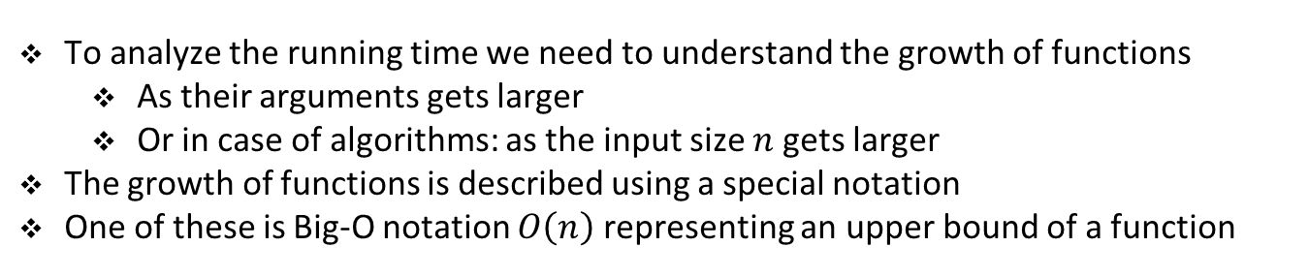
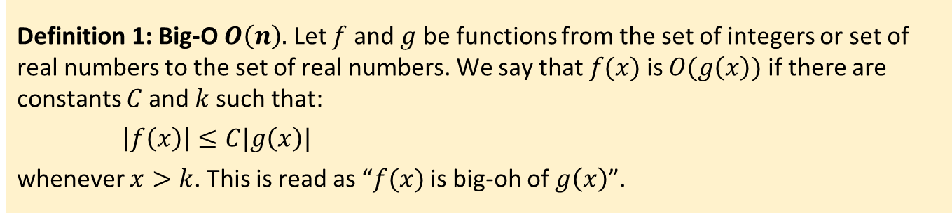
Big-O notation
To analyze the running time we need to understand the growth of functions
As their arguments gets larger
Or in case of algorithms: as the input size $n$ gets larger
The growth of functions is described using a special notation
One of these is Big-O notation $O\left(n\right)$ representing an upper bound of a function
Definition 1: Big-O $O\left(n\right).$ Let $f$ and $g$ be functions from the set of integers or set of real numbers to the set of real numbers. We say that $f(x)$is $O(g\left(x\right))$ if there are constants $C$and $k$such that:
$\left|f\left(x\right)\right|≤C|g\left(x\right)|$
whenever $x>k$. This is read as “$f(x)$ is big-oh of $g\left(x\right)$”.

Slide 5
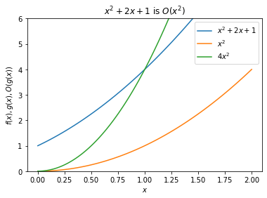
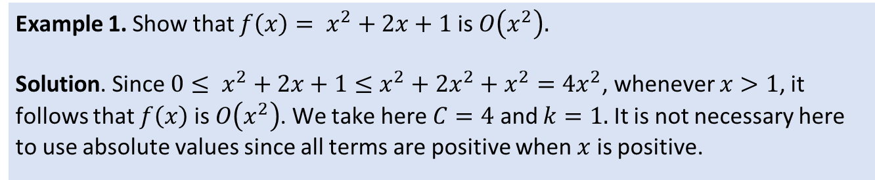
Big-O notation
Example 1. Show that $f\left(x\right)= x^{2}+2x+1$ is $O\left(x^{2}\right).$
Solution. Since ${0≤ x}^{2}+2x+1≤x^{2}+2x^{2}+x^{2}=4x^{2}$, whenever $x>1$, it follows that $f\left(x\right)$ is $O\left(x^{2}\right)$. We take here $C=4$ and $k=1.$ It is not necessary here to use absolute values since all terms are positive when $x$ is positive.

Slide 6
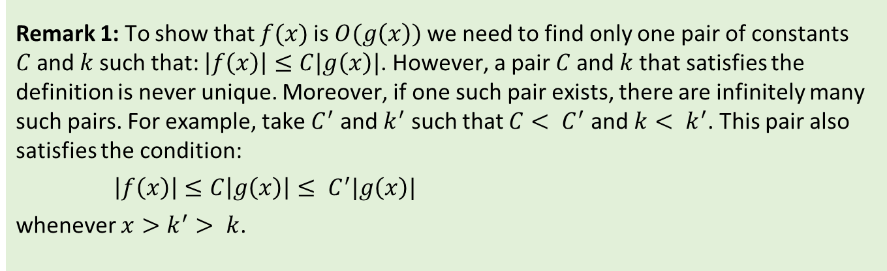
Big-O notation
Remark 1: To show that $f(x)$is $O(g\left(x\right))$ we need to find only one pair of constants $C$and $k$such that: $\left|f\left(x\right)\right|≤C|g\left(x\right)|$. However, a pair $C$and $k$that satisfies the definition is never unique. Moreover, if one such pair exists, there are infinitely many such pairs. For example, take $C^{′}$ and $k^{′}$ such that $C< C^{′}$ and $k< k^{′}$. This pair also satisfies the condition:
$\left|f\left(x\right)\right|≤C\left|g\left(x\right)\right|≤ C^{′}|g\left(x\right)|$
whenever $x>k^{′}> k$.

Slide 7
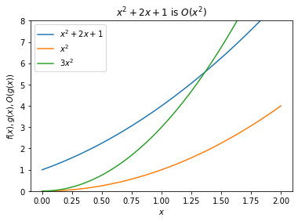
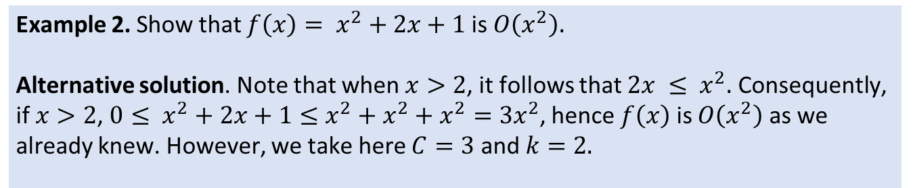
Big-O notation
Example 2. Show that $f\left(x\right)= x^{2}+2x+1$ is $O\left(x^{2}\right).$
Alternative solution. Note that when $x>2$, it follows that ${2x ≤ x}^{2}.$ Consequently, if $x>2$, ${0≤ x}^{2}+2x+1≤x^{2}+x^{2}+x^{2}=3x^{2}$, hence $f\left(x\right)$ is $O\left(x^{2}\right)$ as we already knew. However, we take here $C=3$ and $k=2.$

Slide 8
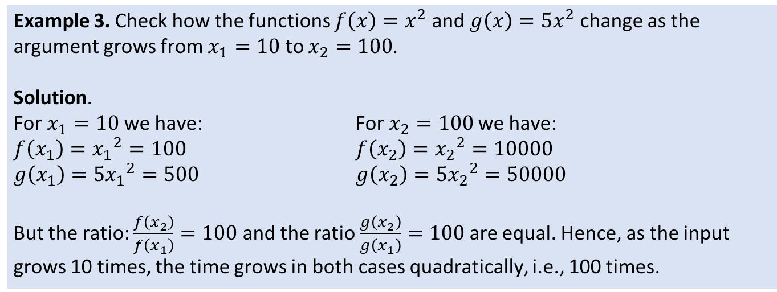
Big-O notation
Remark 2: Big-O estimate of the time complexity of an algorithm expresses how the time required to solve the problem changes as the input grows in size. Big-O estimates can not be directly translated into the actual amount of computer time used. For example, in the definition of the Big-O multiplicative constants are “ignored” as they subsume all the implementation and hardware details. Such details can not be ignored in practice in most cases.
Example 3. Check how the functions $f\left(x\right)=x^{2}$ and $g\left(x\right)=5x^{2}$ change as the argument grows from $x_{1}=10$ to $x_{2}=100$.
Solution.
For $x_{1}=10$ we have: For $x_{2}=100$ we have:
$f\left(x_{1}\right)={x_{1}}^{2}=100$ $f\left(x_{2}\right)={x_{2}}^{2}=10000$
$g\left(x_{1}\right)=5{x_{1}}^{2}=500$ $g\left(x_{2}\right)=5{x_{2}}^{2}=50000$
But the ratio: $\frac{f\left(x_{2}\right)}{f\left(x_{1}\right)}=100$ and the ratio $\frac{g\left(x_{2}\right)}{g\left(x_{1}\right)}=100$ are equal. Hence, as the input grows 10 times, the time grows in both cases quadratically, i.e., 100 times.

Slide 9
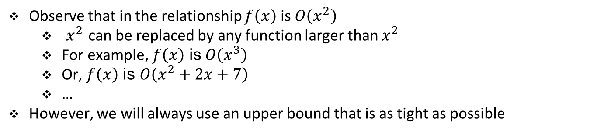
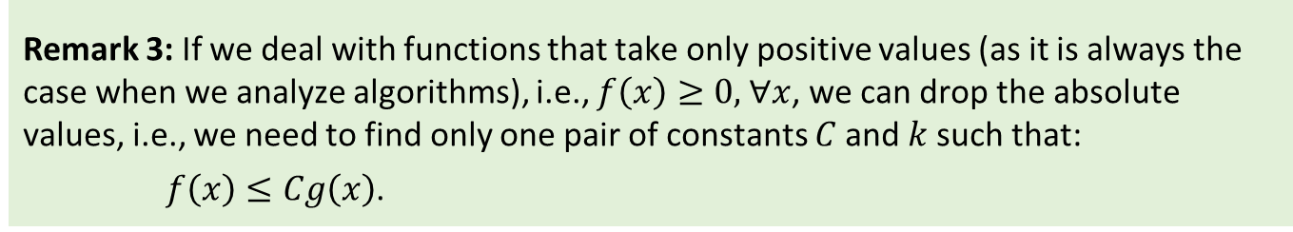
Big-O notation
Observe that in the relationship $f\left(x\right)$ is $O\left(x^{2}\right)$
$x^{2}$ can be replaced by any function larger than $x^{2}$
For example, $f\left(x\right)$ is $O\left(x^{3}\right)$
Or, $f\left(x\right)$ is $O\left(x^{2}+2x+7\right)$
…
However, we will always use an upper bound that is as tight as possible
Remark 3: If we deal with functions that take only positive values (as it is always the case when we analyze algorithms), i.e., $f\left(x\right)≥0,$∀$x$, we can drop the absolute values, i.e., we need to find only one pair of constants $C$and $k$such that:
$f\left(x\right)≤Cg\left(x\right)$.

Slide 10
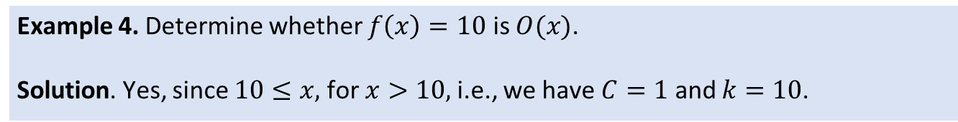
Big-O notation
Example 4. Determine whether $f\left(x\right)=10$ is $O(x)$.
Solution. Yes, since $10≤x,$ for $x>10,$i.e., we have $C=1$ and $k=10$.

Slide 11
Exercise

Slide 12

Student task
Task 1: Show that ${7x}^{2}$ is $O\left(x^{3}\right).$
Task 2: Is it also true that $x^{3}$ is $O\left({7x}^{2}\right)$?

Slide 13
Big-O for polynomials

Slide 14
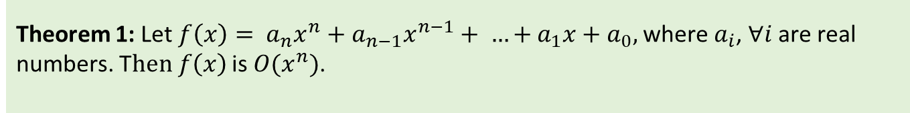
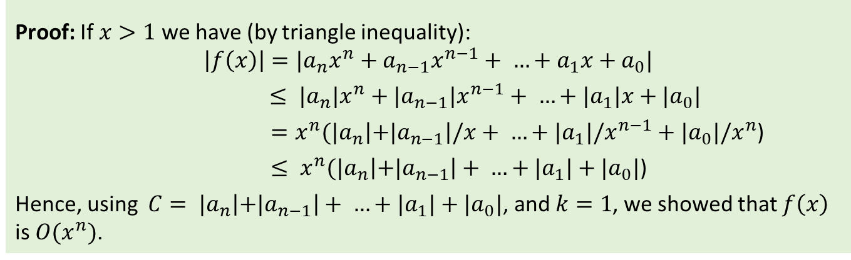
Big-O of polynomials
Polynomials can be often used to represent the growth of functions
Instead of analyzing the growth every time a polynomial occurs
We would like a general results on Big-O for polynomials
Theorem 1: Let $f\left(x\right)= a_{n}x^{n}+a_{n−1}x^{n−1}+ …+a_{1}x+a_{0},$where $a_{i}$, ∀$i$ are real numbers. T$hen f\left(x\right)$ is $O(x^{n})$.
Proof: If $x>1$ we have (by triangle inequality):
$$\left|f\left(x\right)\right|=|a_{n}x^{n}+a_{n−1}x^{n−1}+ …+a_{1}x+a_{0}|$$
$≤ {|a}_{n}|x^{n}+{|a}_{n−1}|x^{n−1}+ …+{|a}_{1}|x+{|a}_{0}|$
${ =x^{n}(|a}_{n}\left|+{|a}_{n−1}\right|/x+ …+{|a}_{1}|/x^{n−1}+{|a}_{0}|/x^{n}$)
${ ≤ x^{n}(|a}_{n}\left|+{|a}_{n−1}\right|+ …+{|a}_{1}|+{|a}_{0}|$)
Hence, using ${ C= |a}_{n}\left|+{|a}_{n−1}\right|+ …+{|a}_{1}|+{|a}_{0}|$, and $k=1$, we showed that $f\left(x\right)$ is $O(x^{n})$.

Slide 15
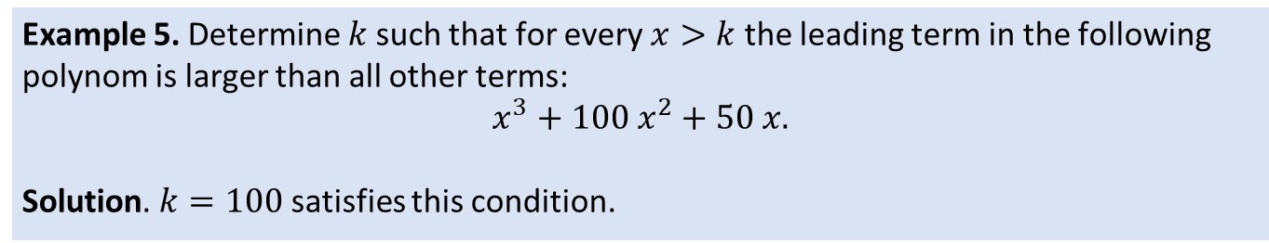
Big-O of polynomials
Remark 4: The previous theorem shows that the leading term of a polynom dominates its growth regardless of polynom coefficients. Intuitiavely, we can always make the argument as large as we want so that the leading coefficient will start to dominate eventually.
Example 5. Determine $k$such that for every $x>k$ the leading term in the following polynom is larger than all other terms:
$$x^{3}+100 x^{2}+50 x.$$
Solution. $k=100$ satisfies this condition.

Slide 16
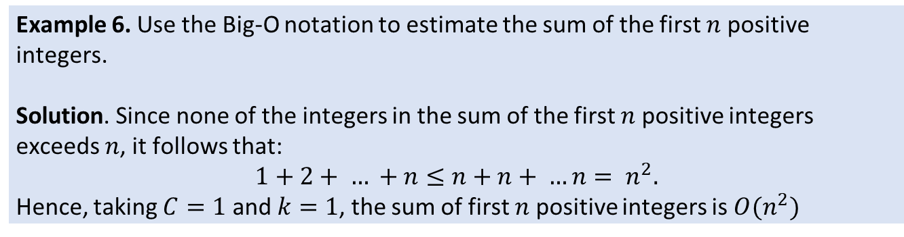
Big-O notation
Example 6. Use the Big-O notation to estimate the sum of the first $n$ positive integers.
Solution. Since none of the integers in the sum of the first $n$positive integers exceeds $n$, it follows that:
$$1+2+ … +n≤n+n+ …n= n^{2}.$$
Hence, taking $C=1$ and $k=1$, the sum of first $n$ positive integers is $O(n^{2})$

Slide 17
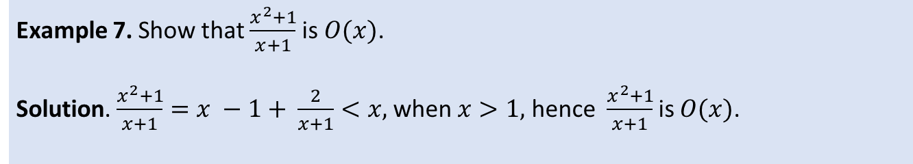
Big-O notation
Example 7. Show that $\frac{x^{2}+1}{x+1}$ is $O(x)$.
Solution. $\frac{x^{2}+1}{x+1}=x −1+ \frac{2}{x+1}<x,$when $x>1,$ hence $\frac{x^{2}+1}{x+1}$ is $O(x)$.

Slide 18
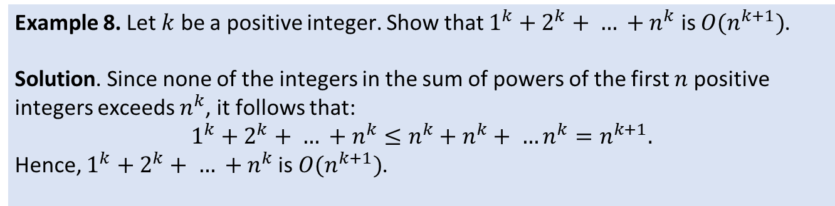
Big-O notation
Example 8. Let $k$ be a positive integer. Show that $1^{k}+2^{k}+ … +n^{k}$ is $O(n^{k+1})$.
Solution. Since none of the integers in the sum of powers of the first $n$positive integers exceeds $n^{k}$, it follows that:
$$1^{k}+2^{k}+ … +n^{k}≤n^{k}+n^{k}+ …n^{k}=n^{k+1}.$$
Hence, $1^{k}+2^{k}+ … +n^{k}$is $O(n^{k+1})$.

Slide 19
Exercise

Slide 20
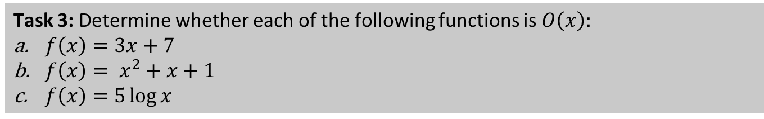
Student task
Task 3: Determine whether each of the following functions is $O\left(x\right):$
$f\left(x\right)=3x+7$
$f\left(x\right)= x^{2}+x+1$
$f\left(x\right)=5\log{x}$

Slide 21
Growth of function combinations

Slide 22
Big-O for function combinations
Many algorithms are made up of two or more subprocedures
The total number of steps is then the sum of the number of steps of all subprocedures
To calculate the Big-O estimate we first calculate individual Big-O estimates
Then we need to combine these estimates to get the total estimate
This often involves estimating growth of sums and products of two functions

Slide 23
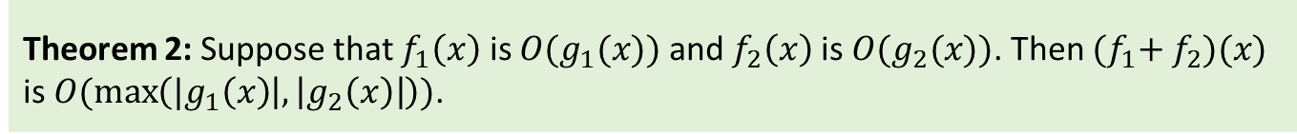
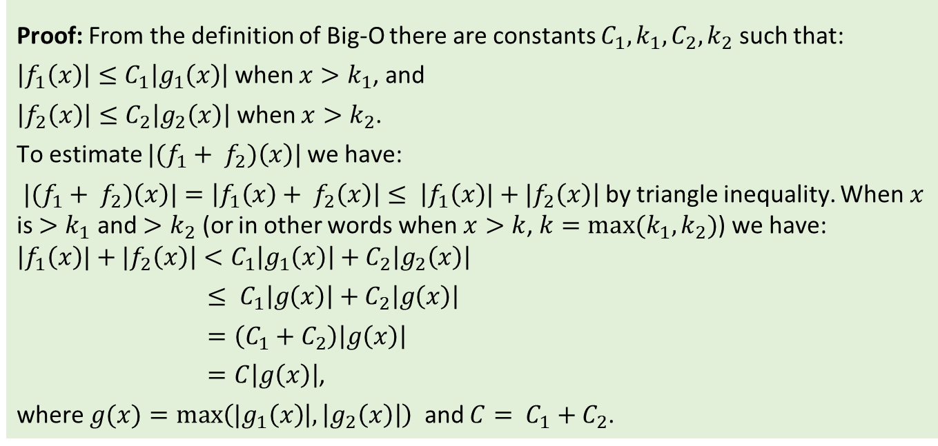
Big-O of the sum of two functions
Theorem 2: Suppose that $f_{1}\left(x\right)$ is $O(g_{1}(x))$ and $f_{2}\left(x\right)$ is $O(g_{2}(x))$. Then ${(f}_{1}+ f_{2})(x)$ is $O(\max\left({|g}_{1}\left(x\right) | , \left|g_{2}\left(x\right)\right|\right))$.
Proof: From the definition of Big-O there are constants $C_{1}, k_{1}, C_{2}, k_{2}$ such that:
$\left|f_{1}\left(x\right)\right|≤C_{1}\left|g_{1}\left(x\right)\right|$ when $x>k_{1}$, and
$\left|f_{2}\left(x\right)\right|≤C_{2}\left|g_{2}\left(x\right)\right|$ when $x>k_{2}$.
To estimate ${|(f}_{1}+ f_{2})\left(x\right)|$we have:
${|(f}_{1}+ f_{2})\left(x\right)|=\left|f_{1}\left(x\right)+ f_{2}\left(x\right)\right|≤ \left|f_{1}\left(x\right)|+|f_{2}\left(x\right)\right|$ by triangle inequality. When $x$ is ${>k}_{1}$ and $>k_{2}$ (or in other words when $x>k$, $k=max⁡(k_{1},k_{2})$) we have:
$$\left|f_{1}\left(x\right)|+|f_{2}\left(x\right)\right|<C_{1}\left|g_{1}\left(x\right)\right|+C_{2}\left|g_{2}\left(x\right)\right|$$
$≤ C_{1}\left|g\left(x\right)\right|+C_{2}\left|g\left(x\right)\right|$
$=\left(C_{1}+C_{2}\right)\left|g\left(x\right)\right|$
$=C\left|g\left(x\right)\right|$,
where $g(x)=max\left({|g}_{1}\left(x\right) | , \left|g_{2}\left(x\right)\right|\right)⁡$ and $C= C_{1}+C_{2}$.

Slide 24
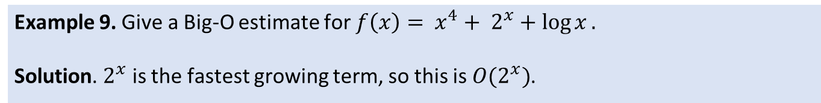
Big-O of the sum of two functions
Remark 5: Faster growing function dominates the sum of two functions.
Remark 6: If your main program calls another function as a subprocedure the time complexity is dominated by that part of the program, which is more complex.
Example 9. Give a Big-O estimate for ${f\left(x\right)= x}^{4}+ 2^{x}+\log{x}.$
Solution. $2^{x}$ is the fastest growing term, so this is $O(2^{x})$.

Slide 25
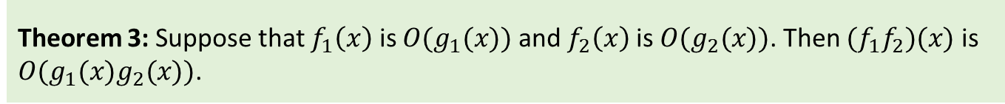
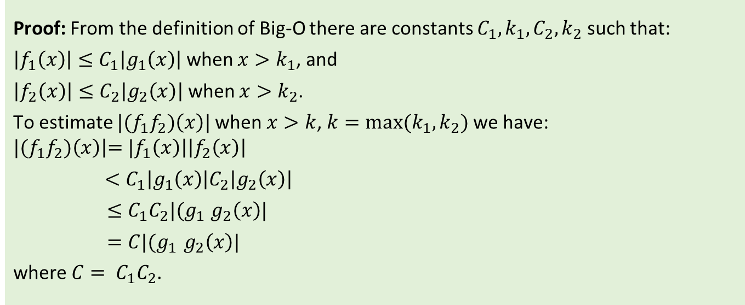
Big-O of the product of two functions
Theorem 3: Suppose that $f_{1}\left(x\right)$ is $O(g_{1}(x))$ and $f_{2}\left(x\right)$ is $O(g_{2}(x))$. Then ${(f}_{1}f_{2})(x)$ is $O(g_{1}(x)g_{2}(x))$.
Proof: From the definition of Big-O there are constants $C_{1}, k_{1}, C_{2}, k_{2}$ such that:
$\left|f_{1}\left(x\right)\right|≤C_{1}\left|g_{1}\left(x\right)\right|$ when $x>k_{1}$, and
$\left|f_{2}\left(x\right)\right|≤C_{2}\left|g_{2}\left(x\right)\right|$ when $x>k_{2}$.
To estimate ${|(f}_{1}f_{2})\left(x\right)|$when $x>k$, $k=max⁡(k_{1},k_{2})$we have:
$${|(f}_{1}f_{2})\left(x\right)\left|={|f}_{1}\left(x\right)\right|\left|f_{2}\left(x\right)\right|$$
$<C_{1}\left|g_{1}\left(x\right)\right|C_{2}\left|g_{2}\left(x\right)\right|$
$≤C_{1}C_{2}|(g_{1}$ $g_{2}\left(x\right)|$
$=C|(g_{1} g_{2}\left(x\right)|$
where $C= C_{1}C_{2}$.

Slide 26
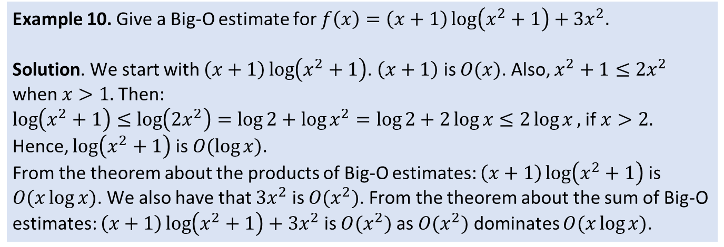
Big-O of the sum of two functions
Remark 7: Growth of product of two functions is the product of growth of individual functions.
Remark 8: If your main program calls another function, e.g., from a loop the time complexity will be complexity of the main program (i.e., the loop) times the complexity of the subprocedure.
Example 10. Give a Big-O estimate for $f\left(x\right)=\left(x+1\right)\log\left(x^{2}+1\right)+3x^{2}.$
Solution. We start with $\left(x+1\right)\log\left(x^{2}+1\right)$. $\left(x+1\right)$ is $O(x)$. Also, $x^{2}+1≤2x^{2}$ when $x>1.$Then:
$\log\left(x^{2}+1\right)≤\log\left(2x^{2}\right)=\log{2}+\log{x^{2}}=\log{2+2\log{x≤2\log{x}}},$if $x>2.$
Hence, $\log\left(x^{2}+1\right)$ is $O(\log{x})$.
From the theorem about the products of Big-O estimates: $\left(x+1\right)\log\left(x^{2}+1\right)$ is $O(x\log{x})$. We also have that $3x^{2}$ is $O(x^{2})$. From the theorem about the sum of Big-O estimates: $\left(x+1\right)\log\left(x^{2}+1\right)+3x^{2}$ is $O(x^{2})$ as $O(x^{2})$ dominates $O(x\log{x})$.

Slide 27
Exercise

Slide 28
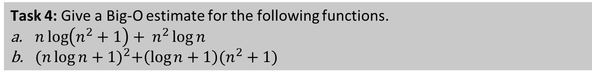
Student task
Task 4: Give a Big-O estimate for the following functions.
$n\log\left(n^{2}+1\right)+ n^{2}\log{n}$
${(n\log{n+1)}}^{2}+\left(\log{n}+1\right)(n^{2}+1)$

Slide 29
Tractable vs. intractable complexity

Slide 30
Tractable vs. intractable complexity
A problem solvable with a polynomial worst-case is a tractable problem
Searching, sorting, etc.
However, there are problems which require more time
Exponential complexity
Factorial complexity
These problems are called intractable
These are not solvable in practice for large input size
They are solvable for smaller input sizes in practice
There are even harder problems, which are not solvable at all
Neither in practice nor in theory
We will not discuss them any further in this course

Slide 31
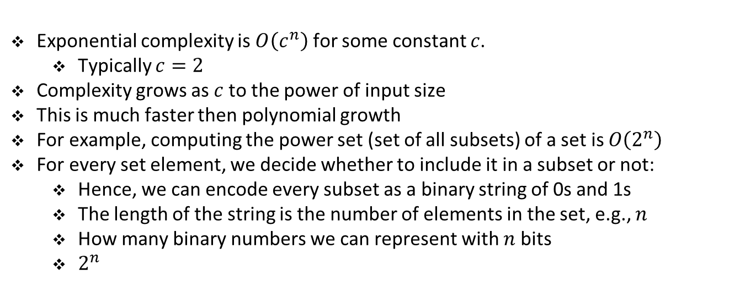
Exponential complexity
Exponential complexity is $O\left(c^{n}\right)$ for some constant $c$.
Typically $c=2$
Complexity grows as $c$ to the power of input size
This is much faster then polynomial growth
For example, computing the power set (set of all subsets) of a set is $O\left(2^{n}\right)$
For every set element, we decide whether to include it in a subset or not:
Hence, we can encode every subset as a binary string of 0s and 1s
The length of the string is the number of elements in the set, e.g., $n$
How many binary numbers we can represent with $n$ bits
$2^{n}$

Slide 32
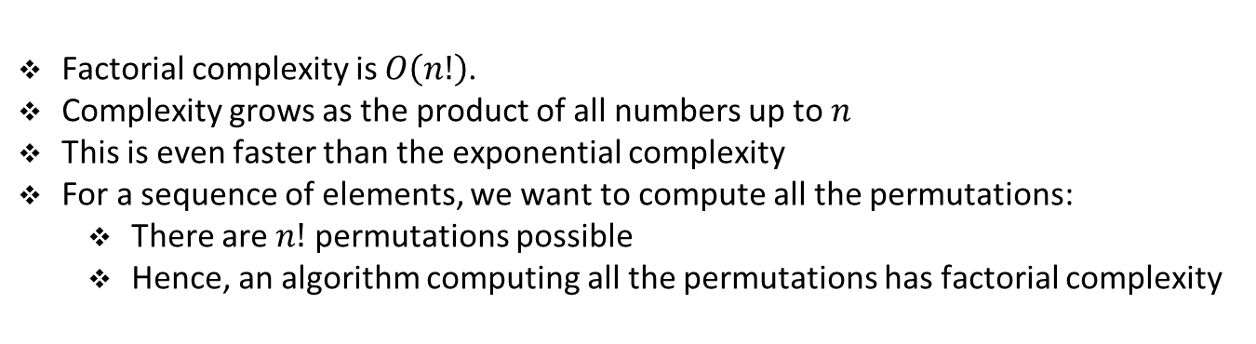
Factorial complexity
Factorial complexity is $O\left(n!\right)$.
Complexity grows as the product of all numbers up to $n$
This is even faster than the exponential complexity
For a sequence of elements, we want to compute all the permutations:
There are $n!$ permutations possible
Hence, an algorithm computing all the permutations has factorial complexity

Slide 33
Exercise

Slide 34
Student task
Task 5. Give Big-O estimates for the factorial function $f\left(n\right)=n!$ and the logarithm of the factorial function.

Slide 35
Complexity table

Slide 36
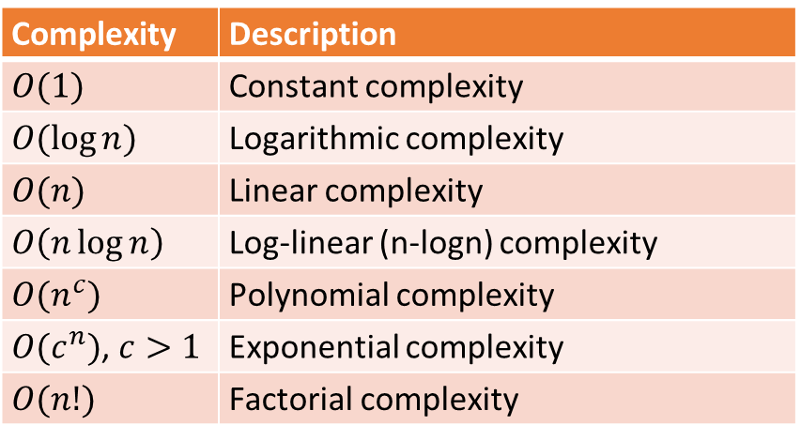
Complexity table
Complexity | Description
$$O(1)$$ | Constant complexity
$$O(\log{n})$$ | Logarithmic complexity
$$O(n)$$ | Linear complexity
$$O\left(n\log{n}\right)$$ | Log-linear (n-logn) complexity
$${O(n}^{c})$$ | Polynomial complexity
${O(c}^{n})$, $c>1$ | Exponential complexity
$$O(n!)$$ | Factorial complexity
Complexity grows from top to bottom

Slide 37
Exercise

Slide 38
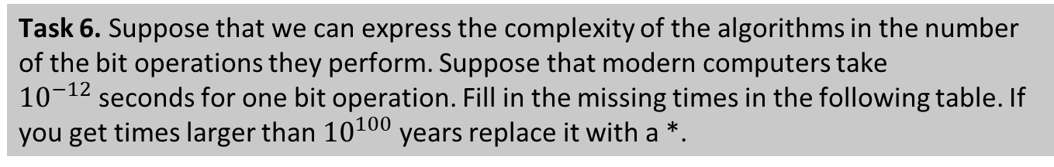
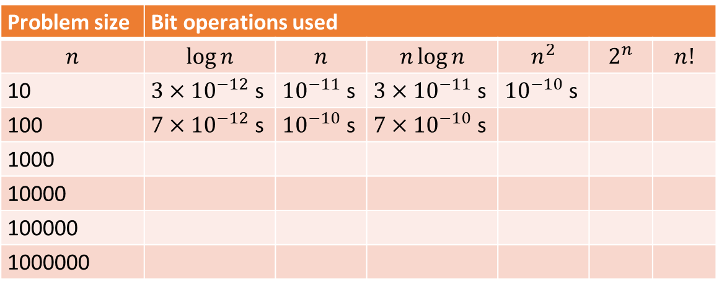
Student task
Task 6. Suppose that we can express the complexity of the algorithms in the number of the bit operations they perform. Suppose that modern computers take ${10}^{−12}$seconds for one bit operation. Fill in the missing times in the following table. If you get times larger than ${10}^{100}$ years replace it with a *.
Problem size | Bit operations used
$$n$$ | $$\log{n}$$ | $$n$$ | $$n\log{n}$$ | $$n^{2}$$ | $$2^{n}$$ | $$n!$$
10 | $3×{10}^{−12}$ s | ${10}^{−11}$ s | $3×{10}^{−11}$ s | ${10}^{−10}$ s
100 | $7×{10}^{−12}$ s | ${10}^{−10}$ s | $7×{10}^{−10}$ s
1000
10000
100000
1000000

