Slide 1

Fundamentals of Computer Science and Programming
Unit 11 – Searching and sorting

Slide 2
Outline
Searching – recap
Sorting – recap
Bogosort
Bubble sort
Exercise
Selection sort
Exercise
Merge sort
Slides are based on Chapter 10 of
Introduction to Computation and Programming using Python
and the corresponding MIT course
by John Guttag

Slide 3
Searching - recap

Slide 4
Search algorithms
Search algorithms are methods for finding an item (or group of items) with specific properties in a collection of items
Collection may be implicit
E.g., find a square root of a number
Exhaustive enumeration
Bisection algorithm
Netwon‘s method
Collection may be explicit
Find a student in a database (list) of students

Slide 5
Search algorithms
Linear search
Brute force search
List does not have to be sorted
Binary search
List has to be sorted
Iterative and recursive implemenations

Slide 6
Linear search
def search(l, o):
for e in l:
if e == o:
return True
return False
Complexity is $O(n)$

Slide 7
Binary search
def binary_search(l, o):
low = 0
high = len(l) - 1
while low <= high:
mid = low + (high - low)//2
if l[mid] == o:
return True
elif l[mid] < o:
low = mid + 1
else:
high = mid - 1
return False
Complexity is $O(\log{n})$

Slide 8
Sorting - recap

Slide 9
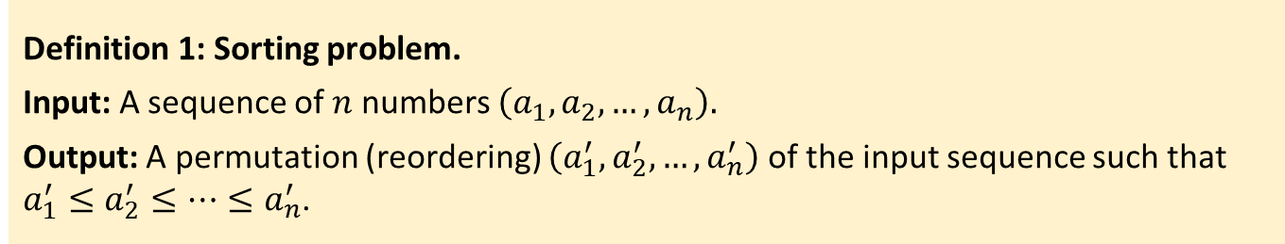
Sorting
Definition 1: Sorting problem.
Input: A sequence of $n$ numbers $\left(a_{1}, a_{2}, …,a_{n}\right).$
Output: A permutation (reordering) $\left(a_{1}^{′},a_{2}^{′}, …,a_{n}^{′}\right)$ of the input sequence such that $a_{1}^{′}≤a_{2}^{′}≤…≤a_{n}^{′}$.
Example 1: Given an input sequence (31, 41, 59, 26, 41, 58), a sorting algorithm returns as output the sequence (26, 31, 41, 41, 58, 59).
Sorting is a fundamental operation in computer science
Many programs use it as an intermediate step
There are many good and efficient sorting algorithms

Slide 10
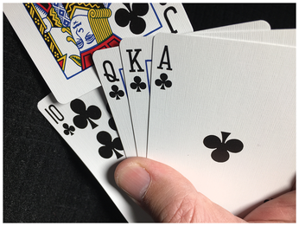
Insertion sort
Insertion sort works the way many people sort a hand of cards
You start with an empty left hand and a deck of cards on the table
You pick one card at a time from the table
You compare the new card with the cards in the left hand
You make the space for the new card
You insert the new card in the correct position
Source: https://www.linux-magazine.com/Issues/2020/233/Sorted/%28offset%29/3

Slide 11
Insertion sort
def insertion_sort(l):
if len(l) < 2:
return
for i in range(1, len(l)):
current_value = l[i]
j = i - 1
while j >= 0 and current_value < l[j]:
l[j + 1] = l[j]
j -= 1
l[j + 1] = current_value
Complexity is $O(n^{2})$

Slide 12
Bogosort

Slide 13
Bogosort
Also known as monkey sort, stupid sort, permutation sort ☺
To sort a deck of cards
Throw them in the air
Pick them up
Check whether they are sorted
Repeat if not sorted

Slide 14
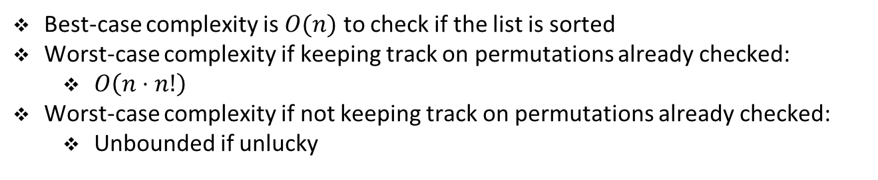
Bogosort
def bogo_sort(l):
while not is_sorted(l):
random.shuffle(l)
Best-case complexity is $O(n)$ to check if the list is sorted
Worst-case complexity if keeping track on permutations already checked:
$O\left(n⋅n!\right)$
Worst-case complexity if not keeping track on permutations already checked:
Unbounded if unlucky

Slide 15
Bubble sort

Slide 16
Bubble sort
Compare consecutive pairs of elements
Swap elements in pairs such that smaller is first
One such pass through the list will place the largest element at the end of the list
When the end of the list is reached
Start over again
Stop when there are no more swaps
0 | 1 | 2 | 3 | 4 | 5
5 | 2 | 4 | 6 | 1 | 3

Slide 17
Bubble sort
First pass
0 | 1 | 2 | 3 | 4 | 5
5 | 2 | 4 | 6 | 1 | 3

Slide 18
Bubble sort
First pass
0 | 1 | 2 | 3 | 4 | 5
2 | 5 | 4 | 6 | 1 | 3

Slide 19
Bubble sort
First pass
0 | 1 | 2 | 3 | 4 | 5
2 | 5 | 4 | 6 | 1 | 3

Slide 20
Bubble sort
First pass
0 | 1 | 2 | 3 | 4 | 5
2 | 4 | 5 | 6 | 1 | 3

Slide 21
Bubble sort
First pass
0 | 1 | 2 | 3 | 4 | 5
2 | 4 | 5 | 6 | 1 | 3

Slide 22
Bubble sort
First pass
0 | 1 | 2 | 3 | 4 | 5
2 | 4 | 5 | 6 | 1 | 3

Slide 23
Bubble sort
First pass
0 | 1 | 2 | 3 | 4 | 5
2 | 4 | 5 | 1 | 6 | 3

Slide 24
Bubble sort
First pass
0 | 1 | 2 | 3 | 4 | 5
2 | 4 | 5 | 1 | 6 | 3

Slide 25
Bubble sort
First pass
0 | 1 | 2 | 3 | 4 | 5
2 | 4 | 5 | 1 | 3 | 6

Slide 26
Bubble sort
Second pass
0 | 1 | 2 | 3 | 4 | 5
2 | 4 | 5 | 1 | 3 | 6

Slide 27
Bubble sort
Second pass
0 | 1 | 2 | 3 | 4 | 5
2 | 4 | 5 | 1 | 3 | 6

Slide 28
Bubble sort
Second pass
0 | 1 | 2 | 3 | 4 | 5
2 | 4 | 5 | 1 | 3 | 6

Slide 29
Bubble sort
Second pass
0 | 1 | 2 | 3 | 4 | 5
2 | 4 | 5 | 1 | 3 | 6

Slide 30
Bubble sort
Second pass
0 | 1 | 2 | 3 | 4 | 5
2 | 4 | 1 | 5 | 3 | 6

Slide 31
Bubble sort
Second pass
0 | 1 | 2 | 3 | 4 | 5
2 | 4 | 1 | 5 | 3 | 6

Slide 32
Bubble sort
Second pass
0 | 1 | 2 | 3 | 4 | 5
2 | 4 | 1 | 3 | 5 | 6

Slide 33
Bubble sort
Second pass
0 | 1 | 2 | 3 | 4 | 5
2 | 4 | 1 | 3 | 5 | 6

Slide 34
Bubble sort
Third pass
0 | 1 | 2 | 3 | 4 | 5
2 | 4 | 1 | 3 | 5 | 6

Slide 35
Bubble sort
Third pass
0 | 1 | 2 | 3 | 4 | 5
2 | 4 | 1 | 3 | 5 | 6

Slide 36
Bubble sort
Third pass
0 | 1 | 2 | 3 | 4 | 5
2 | 4 | 1 | 3 | 5 | 6

Slide 37
Bubble sort
Third pass
0 | 1 | 2 | 3 | 4 | 5
2 | 1 | 4 | 3 | 5 | 6

Slide 38
Bubble sort
Third pass
0 | 1 | 2 | 3 | 4 | 5
2 | 1 | 4 | 3 | 5 | 6

Slide 39
Bubble sort
Third pass
0 | 1 | 2 | 3 | 4 | 5
2 | 1 | 3 | 4 | 5 | 6

Slide 40
Bubble sort
Third pass
0 | 1 | 2 | 3 | 4 | 5
2 | 1 | 3 | 4 | 5 | 6

Slide 41
Bubble sort
Third pass
0 | 1 | 2 | 3 | 4 | 5
2 | 1 | 3 | 4 | 5 | 6

Slide 42
Bubble sort
Fourth pass
0 | 1 | 2 | 3 | 4 | 5
2 | 1 | 3 | 4 | 5 | 6

Slide 43
Bubble sort
Fourth pass
0 | 1 | 2 | 3 | 4 | 5
2 | 1 | 3 | 4 | 5 | 6

Slide 44
Bubble sort
Fourth pass
0 | 1 | 2 | 3 | 4 | 5
1 | 2 | 3 | 4 | 5 | 6

Slide 45
Bubble sort
Fourth pass
0 | 1 | 2 | 3 | 4 | 5
1 | 2 | 3 | 4 | 5 | 6

Slide 46
Bubble sort
Fourth pass
0 | 1 | 2 | 3 | 4 | 5
1 | 2 | 3 | 4 | 5 | 6

Slide 47
Bubble sort
Fourth pass
0 | 1 | 2 | 3 | 4 | 5
1 | 2 | 3 | 4 | 5 | 6

Slide 48
Bubble sort
Fourth pass
0 | 1 | 2 | 3 | 4 | 5
1 | 2 | 3 | 4 | 5 | 6

Slide 49
Bubble sort
Fifth pass
0 | 1 | 2 | 3 | 4 | 5
1 | 2 | 3 | 4 | 5 | 6

Slide 50
Bubble sort
Fifth pass
0 | 1 | 2 | 3 | 4 | 5
1 | 2 | 3 | 4 | 5 | 6

Slide 51
Bubble sort
Fifth pass
0 | 1 | 2 | 3 | 4 | 5
1 | 2 | 3 | 4 | 5 | 6

Slide 52
Bubble sort
Fifth pass
0 | 1 | 2 | 3 | 4 | 5
1 | 2 | 3 | 4 | 5 | 6

Slide 53
Bubble sort
Fifth pass
0 | 1 | 2 | 3 | 4 | 5
1 | 2 | 3 | 4 | 5 | 6

Slide 54
Bubble sort
Fifth pass
0 | 1 | 2 | 3 | 4 | 5
1 | 2 | 3 | 4 | 5 | 6

Slide 55
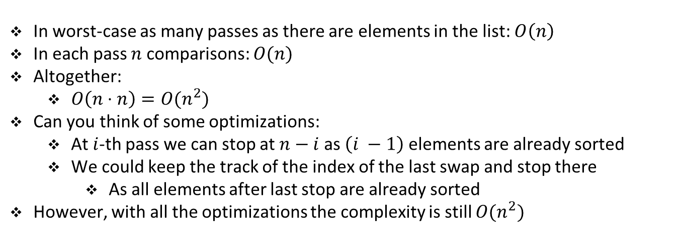
Bubble sort
In worst-case as many passes as there are elements in the list: $O\left(n\right)$
In each pass $n$ comparisons: $O(n)$
Altogether:
$O\left(n⋅n\right)=O(n^{2})$
Can you think of some optimizations:
At $i$-th pass we can stop at $n−i$ as $\left(i −1\right)$ elements are already sorted
We could keep the track of the index of the last swap and stop there
As all elements after last stop are already sorted
However, with all the optimizations the complexity is still $O(n^{2})$

Slide 56
Exercise

Slide 57
Student task
Task 1: Implement the bubble sort.

Slide 58
Selection sort

Slide 59
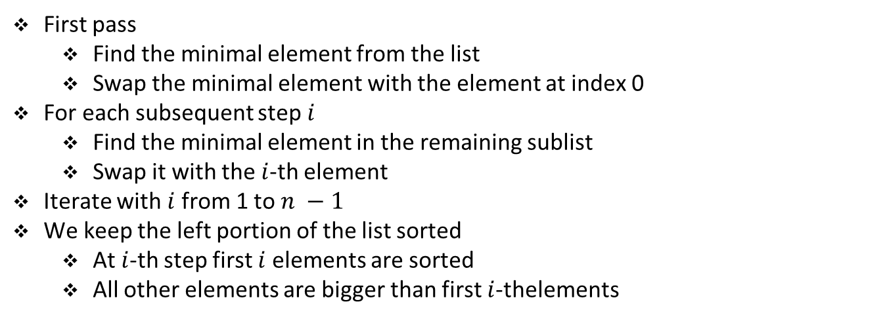
Selection sort
First pass
Find the minimal element from the list
Swap the minimal element with the element at index 0
For each subsequent step $i$
Find the minimal element in the remaining sublist
Swap it with the $i$-th element
Iterate with $i$from 1 to $n −1$
We keep the left portion of the list sorted
At $i$-th step first $i$ elements are sorted
All other elements are bigger than first $i$-thelements
0 | 1 | 2 | 3 | 4 | 5
5 | 2 | 4 | 6 | 1 | 3

Slide 60
Selection sort
First pass
0 | 1 | 2 | 3 | 4 | 5
5 | 2 | 4 | 6 | 1 | 3

Slide 61
Selection sort
First pass
0 | 1 | 2 | 3 | 4 | 5
5 | 2 | 4 | 6 | 1 | 3

Slide 62
Selection sort
First pass
0 | 1 | 2 | 3 | 4 | 5
5 | 2 | 4 | 6 | 1 | 3

Slide 63
Selection sort
First pass
0 | 1 | 2 | 3 | 4 | 5
5 | 2 | 4 | 6 | 1 | 3

Slide 64
Selection sort
First pass
0 | 1 | 2 | 3 | 4 | 5
5 | 2 | 4 | 6 | 1 | 3

Slide 65
Selection sort
First pass
0 | 1 | 2 | 3 | 4 | 5
5 | 2 | 4 | 6 | 1 | 3

Slide 66
Selection sort
First pass
0 | 1 | 2 | 3 | 4 | 5
5 | 2 | 4 | 6 | 1 | 3

Slide 67
Selection sort
First pass
0 | 1 | 2 | 3 | 4 | 5
1 | 2 | 4 | 6 | 5 | 3

Slide 68
Selection sort
Second pass
0 | 1 | 2 | 3 | 4 | 5
1 | 2 | 4 | 6 | 5 | 3

Slide 69
Selection sort
Second pass
0 | 1 | 2 | 3 | 4 | 5
1 | 2 | 4 | 6 | 5 | 3

Slide 70
Selection sort
Second pass
0 | 1 | 2 | 3 | 4 | 5
1 | 2 | 4 | 6 | 5 | 3

Slide 71
Selection sort
Second pass
0 | 1 | 2 | 3 | 4 | 5
1 | 2 | 4 | 6 | 5 | 3

Slide 72
Selection sort
Second pass
0 | 1 | 2 | 3 | 4 | 5
1 | 2 | 4 | 6 | 5 | 3

Slide 73
Selection sort
Second pass
0 | 1 | 2 | 3 | 4 | 5
1 | 2 | 4 | 6 | 5 | 3

Slide 74
Selection sort
Third pass
0 | 1 | 2 | 3 | 4 | 5
1 | 2 | 4 | 6 | 5 | 3

Slide 75
Selection sort
Third pass
0 | 1 | 2 | 3 | 4 | 5
1 | 2 | 4 | 6 | 5 | 3

Slide 76
Selection sort
Third pass
0 | 1 | 2 | 3 | 4 | 5
1 | 2 | 4 | 6 | 5 | 3

Slide 77
Selection sort
Third pass
0 | 1 | 2 | 3 | 4 | 5
1 | 2 | 4 | 6 | 5 | 3

Slide 78
Selection sort
Third pass
0 | 1 | 2 | 3 | 4 | 5
1 | 2 | 4 | 6 | 5 | 3

Slide 79
Selection sort
Third pass
0 | 1 | 2 | 3 | 4 | 5
1 | 2 | 4 | 6 | 5 | 3

Slide 80
Selection sort
Third pass
0 | 1 | 2 | 3 | 4 | 5
1 | 2 | 4 | 6 | 5 | 3

Slide 81
Selection sort
Third pass
0 | 1 | 2 | 3 | 4 | 5
1 | 2 | 3 | 6 | 5 | 4

Slide 82
Selection sort
Fourth pass
0 | 1 | 2 | 3 | 4 | 5
1 | 2 | 3 | 6 | 5 | 4

Slide 83
Selection sort
Fourth pass
0 | 1 | 2 | 3 | 4 | 5
1 | 2 | 3 | 6 | 5 | 4

Slide 84
Selection sort
Fourth pass
0 | 1 | 2 | 3 | 4 | 5
1 | 2 | 3 | 6 | 5 | 4

Slide 85
Selection sort
Fourth pass
0 | 1 | 2 | 3 | 4 | 5
1 | 2 | 3 | 6 | 5 | 4

Slide 86
Selection sort
Fourth pass
0 | 1 | 2 | 3 | 4 | 5
1 | 2 | 3 | 6 | 5 | 4

Slide 87
Selection sort
Fourth pass
0 | 1 | 2 | 3 | 4 | 5
1 | 2 | 3 | 4 | 5 | 6

Slide 88
Selection sort
Fifth pass
0 | 1 | 2 | 3 | 4 | 5
1 | 2 | 3 | 4 | 5 | 6

Slide 89
Selection sort
Fifth pass
0 | 1 | 2 | 3 | 4 | 5
1 | 2 | 3 | 4 | 5 | 6

Slide 90
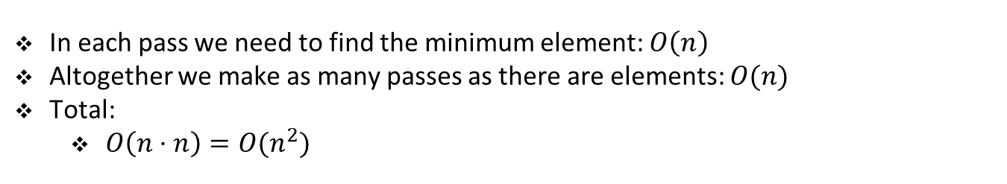
Selection sort
In each pass we need to find the minimum element: $O\left(n\right)$
Altogether we make as many passes as there are elements: $O(n)$
Total:
$O\left(n⋅n\right)=O(n^{2})$

Slide 91
Exercise

Slide 92
Student task
Task 2: Implement the selection sort.

Slide 93
Merge sort

Slide 94
Merge sort
We will use divide-and-conquer approach
We will break the problem into several smaller subproblems (divide)
We will solve subproblems easier than the original problem (conquer)
Finally, we will combine the solution to subproblems
Obtaining the solution for the original problem
As previously, we will solve the subproblems recursively

Slide 95
Merge sort
Divide-and-conquer for sorting:
If list is of length 0 or 1, already sorted (Base case)
If list has more than one element (Recursive case)
Split into two lists
Sort each sublist
Merge sorted sublists
Look at first element of each sublist
Move smaller to the end of the result list
When one list is empty, just copy the rest of the other list

Slide 96
Merge sort
Divide-and-conquer (split list in half until sublists have only 1 element):
Unsorted
Divide
Unsorted
Unsorted
Divide
Unsorted
Unsorted
Unsorted
Unsorted
Divide
Unsorted
Unsorted
Unsorted
Unsorted
Unsorted
Unsorted
Unsorted
Unsorted
Divide
Conquer
Divide
Merge
Merge
Merge
Merge
Merge
Merge
Merge
Merge

Slide 97
Merge sort
Divide-and-conquer:
Unsorted
Unsorted
Unsorted
Unsorted
Unsorted
Unsorted
Unsorted
Sorted
Sorted
Sorted
Sorted
Sorted
Sorted
Sorted
Sorted
Merge
Merge
Merge
Merge

Slide 98
Merge sort
Divide-and-conquer:
Unsorted
Unsorted
Unsorted
Sorted
Sorted
Sorted
Sorted
Merge
Merge

Slide 99
Merge sort
Divide-and-conquer:
Unsorted
Sorted
Sorted
Merge

Slide 100
Merge sort
Divide-and-conquer:
Sorted

Slide 101
Merge sort
5 | 2 | 4 | 6 | 1 | 3
5 | 2 | 4
6 | 1 | 3
5
2 | 4
6
1 | 3
2
4
1
3

Slide 102
Merge sort
5
6
2
4
1
3

Slide 103
Merge sort
5
2 | 4
6
1
3

Slide 104
Merge sort
5
2 | 4
6
1 | 3

Slide 105
Merge sort
2 | 4 | 5
6
1 | 3

Slide 106
Merge sort
2 | 4 | 5
1 | 3 | 6

Slide 107
Merge sort
1 | 2 | 3 | 4 | 5 | 6

Slide 108
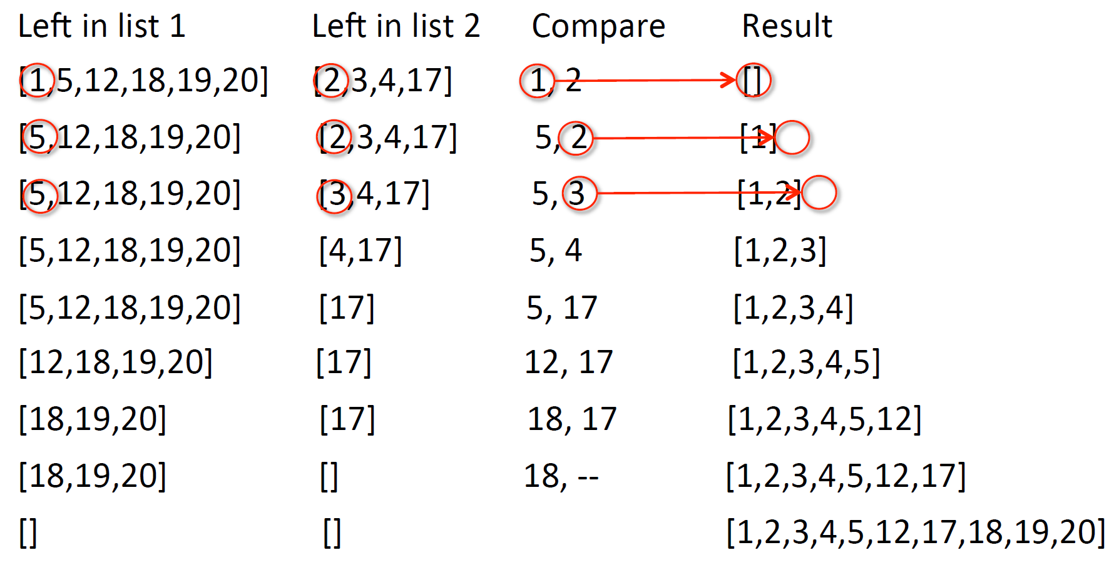
Example of merging
Source: Introduction to Computation and Programming using Python, MIT Open Courseware

Slide 109
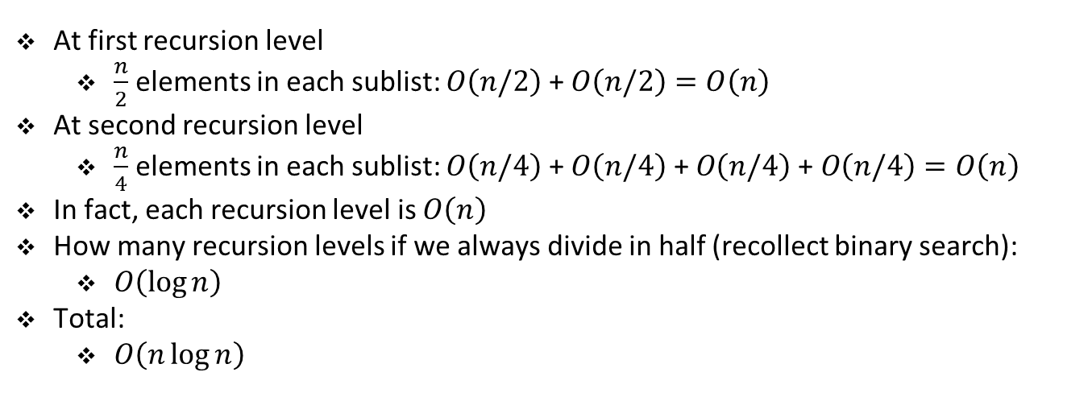
Merge sort
At first recursion level
$\frac{n}{2}$ elements in each sublist: $O\left(n/2\right)$ + $O\left(n/2\right)=O\left(n\right)$
At second recursion level
$\frac{n}{4}$ elements in each sublist: $O\left(n/4\right)$ + $O\left(n/4\right) \text{+ }O\left(n/4\right) \text{+ }O\left(n/4\right)=O\left(n\right)$
In fact, each recursion level is $O\left(n\right)$
How many recursion levels if we always divide in half (recollect binary search):
$O\left(\log{n}\right)$
Total:
$O\left(n\log{n}\right)$

