Slide 1

Fundamentals of Computer Science and Programming
Unit 12 – Object-oriented Programming

Slide 2
Outline
Object-oriented Programming
Classes and objects
Inheritance & Composition
Error Handling
Exercise

Slide 3
Object-oriented Programming

Slide 4
Procedural programming
Typical structure of a computer program
Definition of data structures for manipulation of the data
Division of the functionality into functions
Combination of common functionality into modules
Communication via global variables and functions‘ parameters/return values
Notes:
10:35

Slide 5
Procedural programming
Problems of procedural programming
Mismatch between real world objects and data structures
Loose coupling between functions and data structures
Unprotected access to global data
Complex maintanance
Changing a data structure may cause functions to stop working
Notes:
10:35

Slide 6
Object-oriented programming
Real-world objects are reproduced by objects in programs
Data and functions are combined together in corresponding objects
Objects are composed of
Behavior (what an object can do?)
Implemented as functions: in OOP they are called methods
State (what do we know about an object?)
Implemented as variables: in OOP they are called attributes
Notes:
10:35

Slide 7
Object-oriented programming
Objects are created from classes
Classes are formal definitions of the structure of objects
They define methods and attributes
Hence, a class is a self-defined complex data type
Notes:
10:35

Slide 8
Important concepts in OOP
Data abstraction
Development of self-defined complex data types
Representation of real-world objects
Data encapsulation
Data is enclosed into objects and combined with the methods
Tight coupling of data and methods for manipulation of that data
Information hiding
Hiding of implementation details
Reading and changing the object‘s state only via dedicated methods
Notes:
10:35

Slide 9
Important concepts in OOP
Code reuse
Inheritance: subclasses inherit from the the base class
Both methods and attributes
Subclasses can extend both
Is-a relation
Composition:
Classes can consist of one or more other classes
Has-a relation
Notes:
10:35

Slide 10
Classes and objects

Slide 11
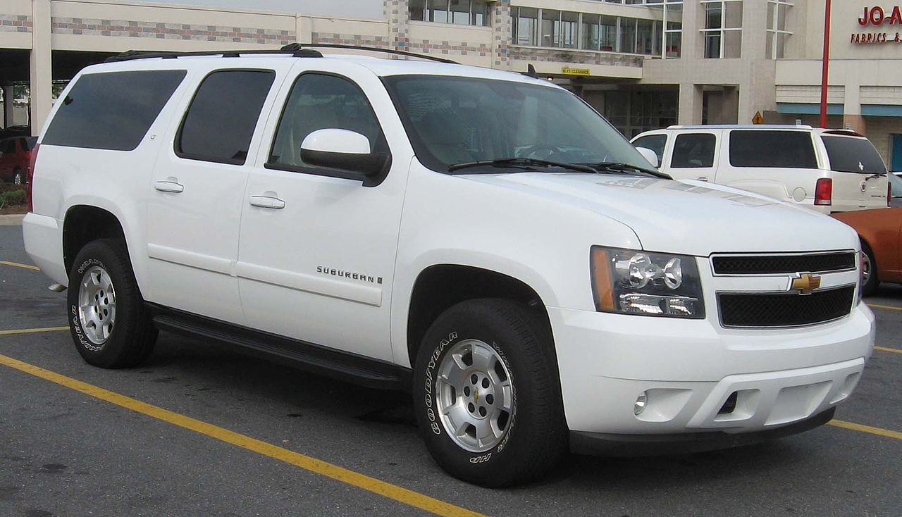
Classes vs. objects
Blueprint (Class)
Actual implementation (Object)
Blueprint of a car:
Attributes:
number_of_seats
horse_power
Methods:
turn_engine_on()
blow_horn()
Source: Wikipedia.org
Notes:
10:35

Slide 12
Class definition
class Car:
def __init__(self, number_seats, HP):
self.horse_power = HP # instance variable
self.n_seats = number_seats # instance variable
def turn_engine_on(self): # method / function
print(f"Motor sound of {self.horse_power} HP.")
def blow_horn(self): # method / function
print("🎺")
Notes:
10:35

Slide 13
Class instantiation, aka constructing objects
my_car = Car(number_seats = 5, HP = 400)
Class_Name(arguments_for_init_method)
sports_car = Car(number_seats = 2, HP = 600)
You do not need to specify the parameter self!
Python does that for you.
Notes:
pandas-Funktionalität in dieser Vorlesung:
Daten laden/anlegen ➡ Daten abrufen und filtern ➡ Spalten neu anlegen ➡ Fehlende Daten ausfüllen ➡ Daten verarbeiten und Ergebnisse berechnen ➡ Neu berechnete Daten speichern
-------

Slide 14
Inheritance & Composition

Slide 15
Inheritance
Improves the reusability, extensibility and maintainability of code
Base class passes on attributes and functionality
Derived class inherits attributes and functionality of base class
Bicycle
tires
color
ride()
Base class
Mountain bike
suspension
City bike
basket
E-bike
battery
charge()
Derived class
Derived class
Derived class
Notes:
pandas-Funktionalität in dieser Vorlesung:
Daten laden/anlegen ➡ Daten abrufen und filtern ➡ Spalten neu anlegen ➡ Fehlende Daten ausfüllen ➡ Daten verarbeiten und Ergebnisse berechnen ➡ Neu berechnete Daten speichern
-------

Slide 16
Composition
Also improves the reusability, extensibility and maintainability of code
Classes are modeled as compositions of other classes
Composed class has access to the functionality of included classes
Base class
Breaks
type
Bicycle
tires
color
ride()
Tires
profile
Mountain bike
suspension
City bike
basket
E-bike
battery
charge()
Derived class
Derived class
Derived class
Notebook examples
Notes:
pandas-Funktionalität in dieser Vorlesung:
Daten laden/anlegen ➡ Daten abrufen und filtern ➡ Spalten neu anlegen ➡ Fehlende Daten ausfüllen ➡ Daten verarbeiten und Ergebnisse berechnen ➡ Neu berechnete Daten speichern
-------

Slide 17
Error Handling

Slide 18
Exception handling
Simplifies error handling via a special mechanism
Return values are used for a normal program control flow
Errors are handled in a structured and parallel flow
Errors „throw“ exception objects „upwards“
Terminate the execution of the current function
Higher-level functions can
Catch the exception and continue
Catch, „throw“ it „upwards“ and terminate the function
Terminate the function without catching
Notes:
10:35

Slide 19
Exception object
Contains attributes and methods to classify the error
e = Exception("My custom error")
print(e.args) # prints: ('My custom error',)
e = Exception("My custom error", 1, 2)
print(e.args) # prints: ('My custom error', 1, 2)
Notes:
10:35

Slide 20
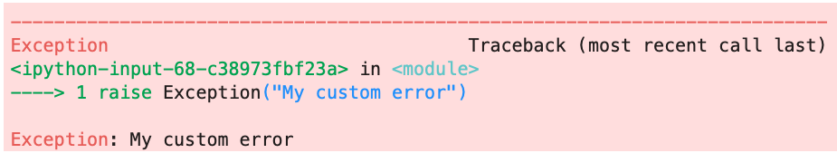
Throwing (raising) an exception
raise Exception("My custom error")
Notes:
10:35

Slide 21
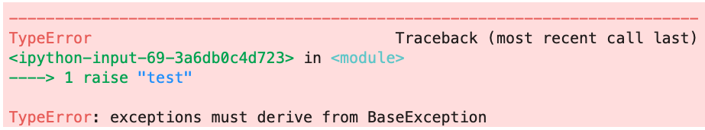
Throwing (raising) an exception
We can only throw BaseException objects and…
Objects derived from BaseException (inheritance)
raise "test"
Notes:
10:35

Slide 22
Built-in exceptions
BaseException
Exception (Base class for user)
SyntaxError
NameError
TypeError
ImportError
… (see docs.python.org)
Notes:
10:35

Slide 23
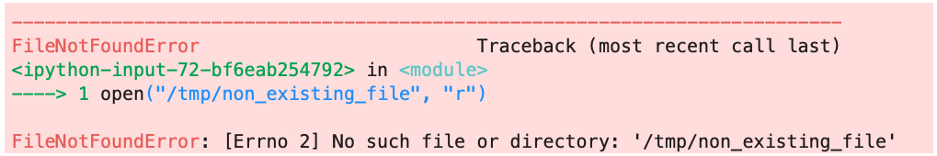
Exception handling
try keyword opens a try-block
Exceptions within that try-block are caught within the except-block
except defines which exceptions should be handled
open("/tmp/non_existing_file", "r")
Notes:
10:35

Slide 24
Exception handling
try:
open("/tmp/non_existing_file", "r")
except FileNotFoundError as e:
print(f"Caught: {e}")
# prints:
# Caught: [Errno 2] No such file or directory: '/tmp/non_existing_file'
Notes:
10:35

Slide 25
Try-Except-Else
try:
print("all good")
except NameError:
# catch and continue
print("Undefined variables found.")
except:
print("Don't know this error.")
raise # throw the exception "upwards"
else:
print("Everything is fine!")
Notes:
10:35

Slide 26
Finally
finally block is always executed at the end (“cleanup” handler)
try:
print(a)
except FileNotFoundError:
print("File does not exist")
except:
print("Don't know this error")
raise
finally:
print("cleaning up")
Notes:
10:35

Slide 27
Type checks
Check variable type with isinstance()
def my_function(number):
if isinstance(number, int):
print(f"My number: {number}")
else:
raise TypeError("Only integers are allowed as input.")
Notes:
10:35

Slide 28
Exercise

Slide 29
Student task
Task 1: Think about a problem that you would like to solve using OOP. Your problem should require at least three classes, one inheritance (is-a relation) and one composition (has-a relation). Sketch a class diagram for your solution and identify the attributes and methods for your classes.
Some ideas:
Plotting data histograms
Fitting curves to data
Performing statistical tests
Database of students
Web application to search for students
Searching for words in text documents
Manipulating images
…
Select a topic that is of interest to you. The goal is that every student works on her/his own topic.

