Slide 1

Fundamentals of Computer Science and Programming
Unit 4 – Programming Part I

Slide 2
Outline
Programming tools
Requirements
Variables
Integers and Floats
Strings
Casting, Printing, Commenting, None-Keyword
Boolean variables and operators
Conditions (if-Statements)
Exercise

Slide 3
Programming tools

Slide 4
How does “text” become an executable program?
When translating source code (“text”)
The computer translates your written code into machine language.
There are two different ways of translation:
Compiler
One-time translation into a binary file (executable)
Interpreter
Interpretation of the source code at each execution

Slide 5
Compiler
Translates source code into machine code
The resulting executable (file) only contains computer instructions
The executable is no more human readable
Saved as binary file (executable)
Translation takes place only once!
This process is also called compilation
The computer directly executes the program (executable)
print(”Hi”)
…
000100111101101100110111010
compile
Source code
Executable file (.exe)

Slide 6
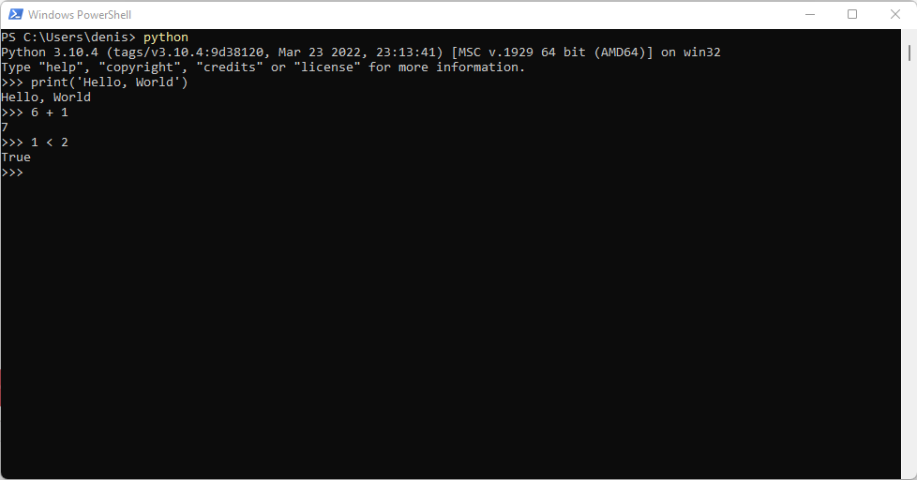
Interpreter
Similar to the compiler
The program gets executed using computer instructions, but:
Each command (e.g. print(“Hi”)) gets translated on its execution
No additional binary file (executable) is created
Source code gets translated on each execution
This process is called “interpretation”
Compilers can lead to drastic performance advantages

Slide 7
Basic terms in programming languages
Programming language
Formal language with fixed rules
Syntax
Fix rules on how to write in a programming language
Fix rules for all language elements
Semantics
Meaning of the language elements
What is exectued?
Program logic, program flow, program structure
Execution sequence and interplay between different program parts

Slide 8
Requirements

Slide 9
Requirements
Computer (Mac OSX, Linux, Windows)
No tablet
No smartphone
Python3 interpreter
Integrated Development Environment (IDE)
Jupyter Notebook / Jupyter Lab
Installation instruction: https://github.com/dhelic/focsp/blob/main/installation.md

Slide 10
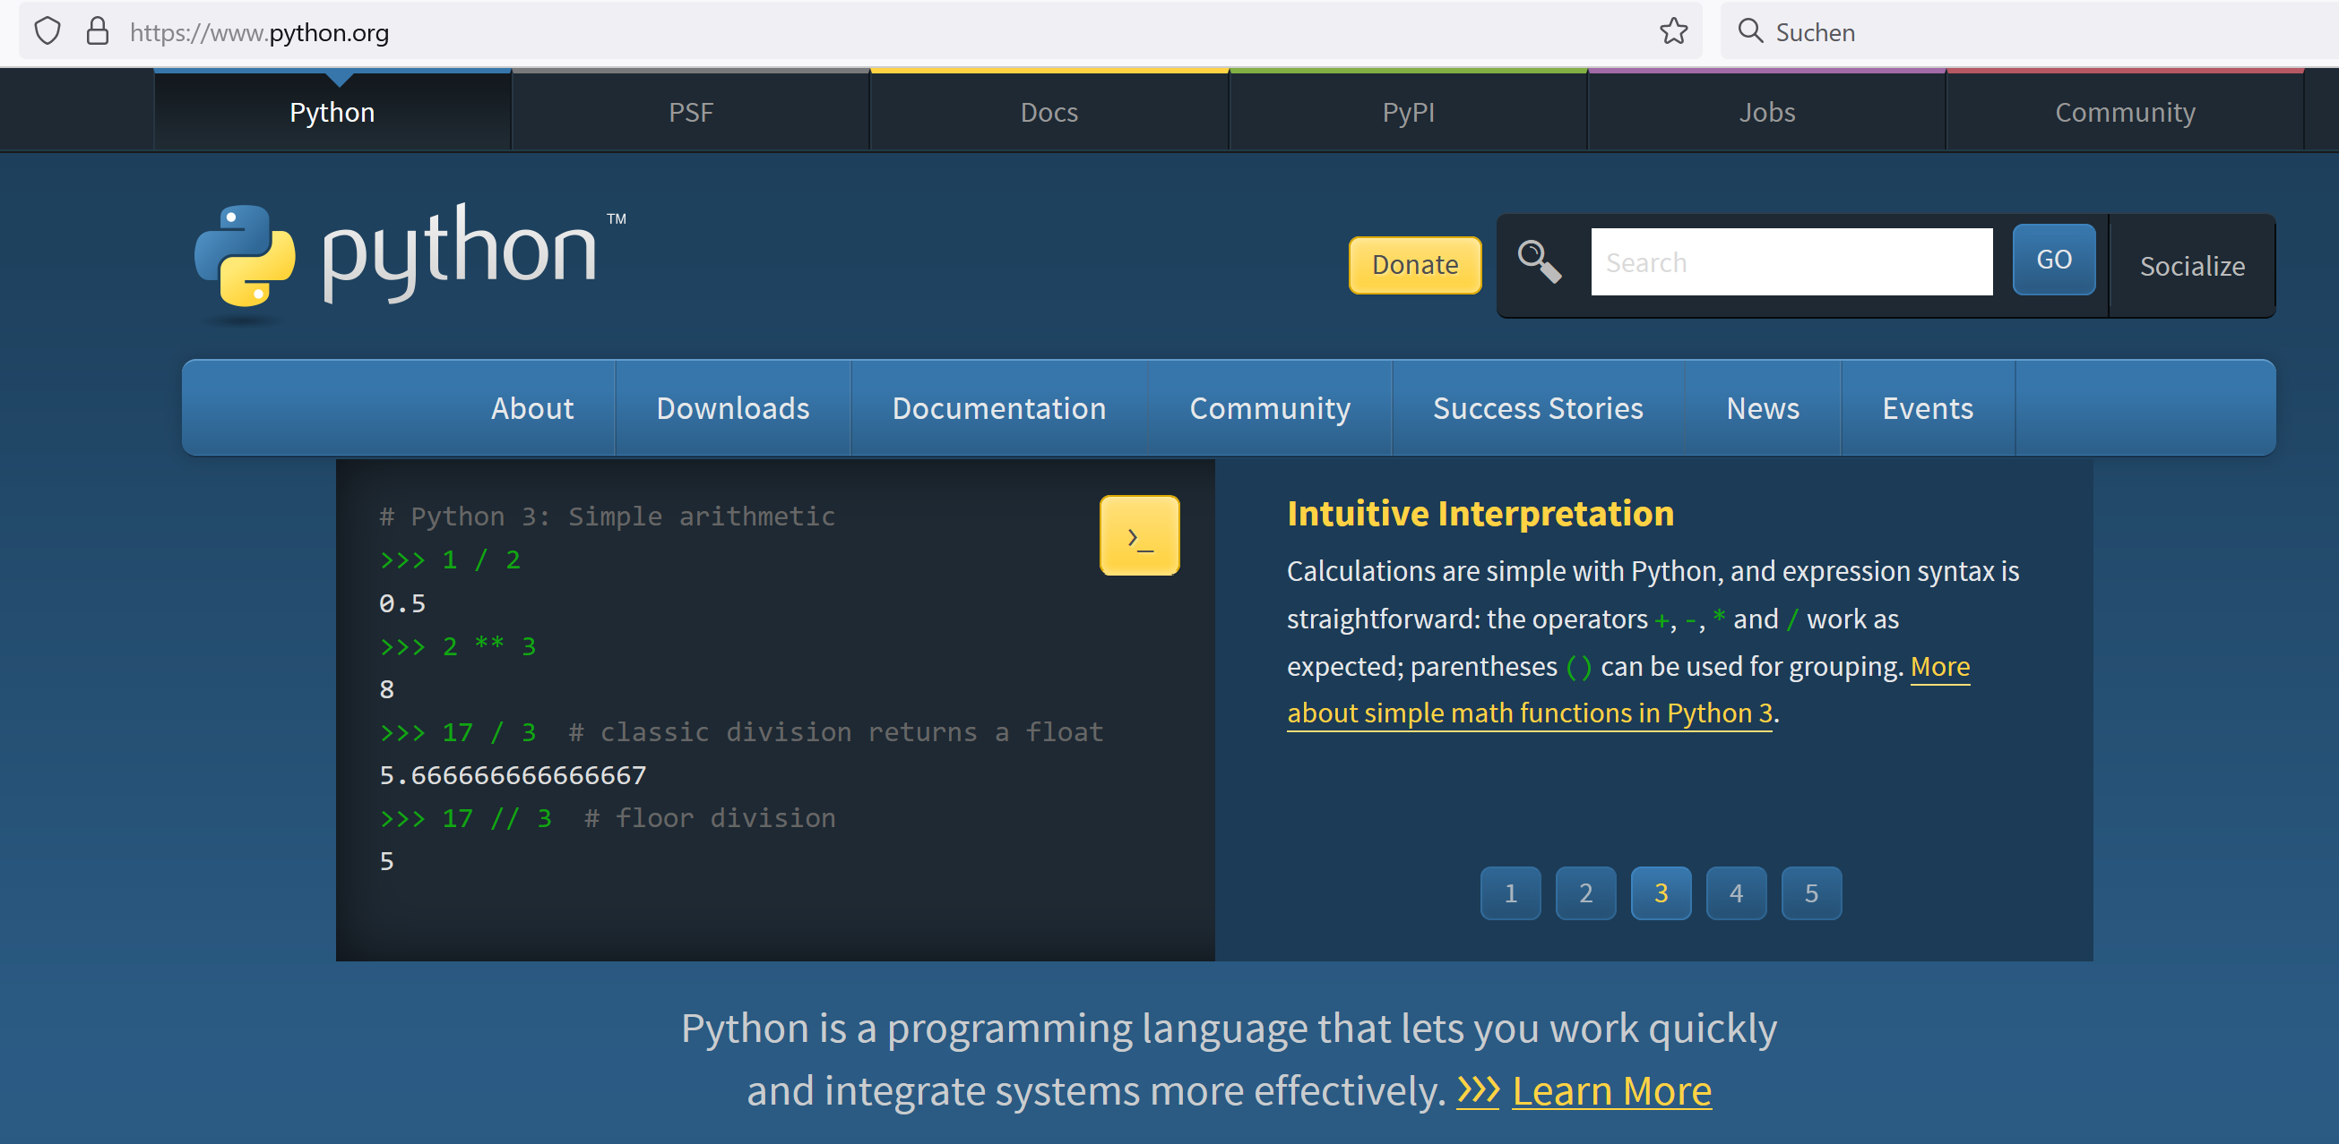
Python (www.python.org)

Slide 11
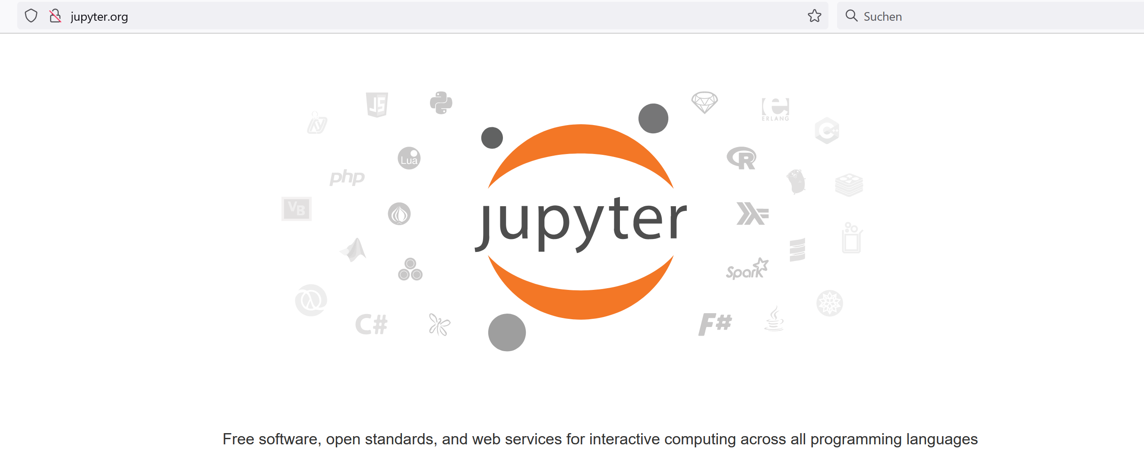
Jupyter (www.jupyter.org)

Slide 12
Python3
Python 3.10 is recommended for the exercise
Good readability, clear structure
Interpreted
Runs on all common OS

Slide 13
Variables

Slide 14
Variables
Labels (names) for values and computations
Variables reference values
Placeholders
Assignment of values with =
<Variable name> = <Assigned value>
Transient (temporary) storage of values
Lifetime ends with the end of the program execution
Start value is needed, after that we can change to arbitrary values
Mutable
number = 123 message = 'Hello World!'
number2 = number

Slide 15
Variables
Naming conventions for variable names
Fixed rules (if not followed results in errors)
Only letters, numbers and underscore _
No numbers at the beginning
No whitespaces
Style guidelines
Lower case, short and descriptive
Words separated with underscore _
https://github.com/dhelic/focsp/blob/main/style.md
Notebook examples

Slide 16
Variables and data types
Data type | Function | Examples
int | Natural numbers | x = 3
float | Floating point numbers | x = 3.0
bool | Booleans | x = True x = False
str | Strings | x = 'Test' x = "Test"
tuple | Tuples | x = (1, 2, 3)
list | Lists | x = [1, 2, 3]
dict | Dictionaries | x = {1: 'blue', 2: 'red'}
io.TextIOWrapper | Files | x = open('readme.txt')
... | ... | ...

Slide 17
Integers and Floats

Slide 18
Integers and floating point numbers
Integers:
1, -13, 15, -42, 12345, ...
Floats:
1.3, 3.14159, -42.123, …
Arithemtic operations:
Adding (+), Subtracting (-), Multiplying (*), Dividing (/)
Exponantiating (**)
Modulo Operator (%)
number = 5 + 13
number_2 = number + 5

Slide 19
Extended operators
Arithemtic operations with direct assignement:
Adding (+=), Subtracting (-=), Multiplying (*=), Dividing (/=)
number = 42
number += 8 # => 50
number -= 10 # => 40
number /= 4 # => 10
number *= 2 # => 20
number = 42
number = number + 8
number = number - 10
number = number / 4
number = number * 2

Slide 20
Some special cases
Operations with integers and Float == Float
4/2 = 2.0, 2 * 3.0 = 6.0, 3.0 ** 2 = 9.0
Floating point error
0.2 + 0.1 ≠ 0.3
Notebook examples

Slide 21
Strings

Slide 22
Strings
Text = sequence of characters
Begin and end marked with quotation marks " or '
string = 'This is a string'
string = "This is also a string"
string = '"Python" was named after "Monty Python".'
string = '''This is a multiline
string'''
string = """This is another multiline
string"""

Slide 23
Strings
Accessing
Individual characters: [] and an index (0-based!)
First character = index 0
Last character = length of the string – 1
Multiple characters with slicing: [], : and indices
Length: len(string)

Slide 24
String slicing
Slicing
Retreive the i-th character:
string[i]
Retrieve a substring with characters from start (inxlusive) until end (exclusive):
string[start:end]
Retrieve a substring with characters from start (inxlusive) until end (exclusive) in steps of the given size:
string[start:end:stepsize]

Slide 25
String slicing
Advanced slicing
Retreive the i-th last character:
string[-i]
Retrieve everything from the i-th last character (inclusive):
string[-i:]
Retrieve everything until the i-th last character (exclusive):
string[:-i]
Reversed string:
string[::-1]

Slide 26
String slicing: example
text = 'Vienna'
Command with text | Result
text[0] | 'V'
text[:2] text[0:2] | 'Vi'
text[6] | IndexError
text[5] text[-1] | 'a'
text[2:] text[2:6] | 'enna'
text[::2] | 'Ven'
text[::-1] | 'anneiV'

Slide 27
String methods
Strings are flexible with a huge standard functionality
Methods take actions on the variable values
Examples:
Notebook examples
Call | Result
name + ' , hi!' | 'John Doe, hi!'
text * 2 | ' Python! Python! '
name.title() | 'John Doe'
name.upper() | 'JOHN DOE'
text.lower() | ' python! '
text.rstrip() | ' Python!'
text.lstrip() | 'Python! '
text.strip() | 'Python!'
name.split(' ') | ['John', 'Doe']
text = ' Python! '
name = 'John Doe'

Slide 28
Casting, Printing, Commenting, None-Keyword

Slide 29
Conversion between data types
num1 = 123
num2 = '15'
num3 = num1 + num2
Casting: converting between data types
int(), str(), float(), bool()…
Examples:
int('5') => 5
float('5.23') => 5.23
str(5) => '5'
int(True) => 1
bool(0) => False
Output:
TypeError
1 num1 = 123
2 num2 = '15'
--> 3 num3 = num1 + num2
TypeError: unsupported operand type(s) for +: 'int' and 'str'
Solution:
num1 = 123
num2 = '15'
num3 = num1 + int(num2)

Slide 30
Formatting output
print() function
Prints also a new line at the end
Parameters separated with ,
Space character as a whitespace
We can also print and format variables
f before the string to print
Variables in brackets {}
name = 'Max' age = 20 print(f'My name is {name} and I am {age} years old')
Output: My name is Max and I am 20 years old

Slide 31
Formatting output
Whitespaces and special characters
Sequence | Result
\n | New line
\t | Tabulator
\' | ' character in strings
\" | " character in strings
\\ | \ character (backslash)

Slide 32
Comments
Syntax
# single-line comment
""" multi line
comment """
''' multi line
documentation '''
Explanations to program flow and structure
Supports understanding of the program
Useful for group projects, longer lasting projects, etc.

Slide 33
None-Keyword
None
No value, Null value
Placeholder when the variable value is still not assigned
x = None is different than:
0
False
''
Notebook examples

Slide 34
Boolean variables and operators

Slide 35
Boolean variables
Boolean variables (boolean, bool) store true/false values
True
False
Boolean variables are results of comparisons of other variables
value = ((2 + 2) < 4)
print('This is', value)

Slide 36
Comparison operators
Operator | Description | Example
== | is equal | x == y
!= | is not equal | x != y
> | greater than | x > y
< | smaller than | x < y
>= | greater or equal | x >= y
<= | smaller or equals | x <= y
is | objects are identical | x is y
is not | objects are different | x is not y
Result of comparisons: Boolean value (True oder False)

Slide 37
Logical operators
Operator | Description | Example
and | True iff both statements are true | x == y and y < 5
or | False iff both statement are false | x > 2 or y > 3
not | Negation of the statement | not x == y not z
^ | True iff one of the statements is true (XOR) | x == 2 ^ y < 4
Note that ^ is so-called bitwise operator
Works on bits
Result of each comparison is a boolean value
Hence, this should work as expected

Slide 38
Operator precedence
Operator precedence (from low to high)
or
and
not
in, not in, is, is not, <, <=, >, >=, !=, ==
|
^
&
<<, >>
+, -
*, @, /, //, %
+x, -x, ~x
**
If not sure: ()
Notebook examples

Slide 39
Conditions (if-Statements)

Slide 40
Branching: if statements
Checking whether conditions are satisfied
Conditional execution of code
Control flow
If condition satisfied then do something
Syntax:
if condition:
print('Do something')
if x > 2: print('In if')
print('Not in if')
Indented 4 spaces

Slide 41
Branching: if-else statements
If statement with a fallback
In case the condition is not fullfilled
If condition satisfied then do something else do something else
Syntax:
if condition:
print('Do something')
else:
print('Do something else')
if x > 2: print('In if')
else:
print('In else')

Slide 42
Branching: if-elif-else statements
Multiple branching for more complex case
If first condition satisfied then do something
else if second condition then do something else
else if third condition then do somenthing else than before
…
else do something completly different

Slide 43
Branching: if-elif-else statements
Syntax:
if condition:
print('Do something')
elif condition2:
print('Do something else')
elif condition3:
print('Do something different')
# there could be more elifs below this
else: # optional
print('Do something completely different')

Slide 44
Branching: if-elif-else statements
Examples:
if x < 5: print('Small')
elif x < 15: print('Medium')
elif x < 20: print('Big')
else: print('Huge')
if x < 5: print('Small')
if x < 15: print('Medium')
if x < 20: print('Big')
else: print('Huge')
≠

Slide 45
Indentation rules
Standard PEP8 (https://peps.python.org/pep-0008/)
4 spaces, no tabulators (configure editors to replaces tabs with 4 spaces)
Block indentation
Everything that is indented after : belongs to the current block
This is language syntax!
Not following the syntax results in an error
Implicitly: supports formatting and readability of code
Changes the relation to the rest of the code
if, for, while, def, …

Slide 46
Nested indentation
Code blocks can be arbitrarly nested at multiple levels
age_max = 35
age_peter = 42
age_berta = 37
if age_max < age_peter:
print('Max is younger than Peter')
if age_berta < age_max:
print('Berta is the youngest!')
else:
print('Max is the youngest!')
else:
if age_berta < age_peter:
print('Berta is the youngest!')
else:
print('Peter is the youngest!')
Notebook examples

Slide 47
Exercise

Slide 48
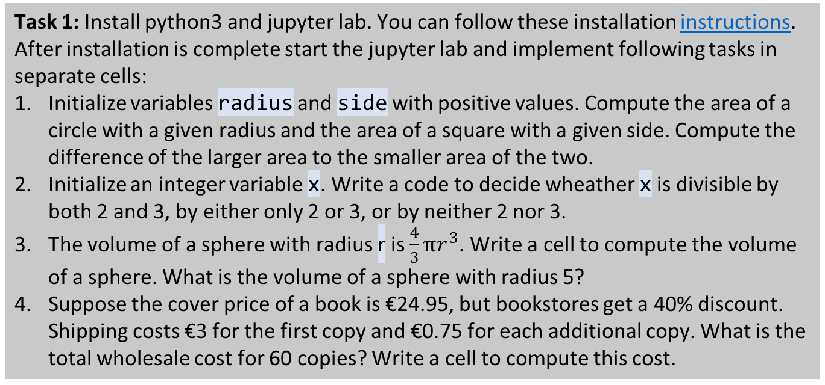
Student task
Task 1: Install python3 and jupyter lab. You can follow these installation instructions. After installation is complete start the jupyter lab and implement following tasks in separate cells:
Initialize variables radius and side with positive values. Compute the area of a circle with a given radius and the area of a square with a given side. Compute the difference of the larger area to the smaller area of the two.
Initialize an integer variable x. Write a code to decide wheather x is divisible by both 2 and 3, by either only 2 or 3, or by neither 2 nor 3.
The volume of a sphere with radius r is $\frac{4}{3}πr^{3}$. Write a cell to compute the volume of a sphere. What is the volume of a sphere with radius 5?
Suppose the cover price of a book is €24.95, but bookstores get a 40% discount. Shipping costs €3 for the first copy and €0.75 for each additional copy. What is the total wholesale cost for 60 copies? Write a cell to compute this cost.

