Slide 1

Fundamentals of Computer Science and Programming
Unit 5 – Programming Part II

Slide 2
Outline
Lists
Tuples
for loops
Some common mistakes
Input
while loops
Putting it all together
Exercise

Slide 3
Lists

Slide 4
Lists
Array (sequence) of elements
Ordered and mutable
Arbitrary data types for elemements
[] creates a list, elements are separated with commas
colors = ['blue', 'red', 'green']
empty_list = []
Element access with [] and index – 0 based !
colors[1] => 'red’
Reverse indexing: negative index (-1 is the index of the last element)

Slide 5
Lists
Replacing elements
Accesing an element and assinging a new value:
colors[0] = 'grey'
Inserting new elements
At the end of the list: append()
colors.append('orange‘)
At an arbitrary position: insert()
colors.insert(1, 'yellow')

Slide 6
Lists
Deleting elements
Basic operation: del with an index
del colors[2]
Deleting and retrieving: pop()
With or without (last element) the index
removed_color = colors.pop()
removed_color = colors.pop(1)
Deleting an element with a value: remove()
colors.remove('grey')
Length of the list: function len()

Slide 7
Indexing of lists
Python sequences including lists start with 0 ! (recollect also strings)
numbers = [1, 13, 42]
print(numbers[3])
Indexing with [-1] returns always the last element (recollect string slicing!)
IndexError also if the list is empty
General hint: be alwas careful with indexing!
=> „IndexError: list index out of range“

Slide 8
List slicing
Recollect string slicing: list slicing uses same syntax
Strings can be also seen as lists of characters!
Selected slicing operations (check the slides from the previous unit!):
items[i]
i-th element
items[start:ende]
Elements from start (inclusive) till end (exclusive)
etc.

Slide 9
Membership operators
Operator | Description | Example
in | True, if element (or subsequence) belongs to the object | 1 in number_list [1, 2] in number_list 'HELP' in string
not in | True, if element (or subsequence) does not belong to the object | 1 not in number_list ['A','B'] not in letter_list 'HELP' not in 'Hello World'

Slide 10
Sorting of lists
Sorting
Permanent (in-place) sorting: methode sort()
colors.sort()
Temporary (returns sorted list): function sorted()
sorted_colors = sorted(colors)
Strings: be careful with capital/small letters
Capital letters come before small letters alphabetically
Reversing: method reverse() und function reversed()
colors.reverse()
reversed_colors = list(reversed(colors))
Equivalent: colors[::-1]

Slide 11
Numerical lists
Generating number sequences (these are not lists!): range()
Parameters (similar to slicing):
Start (optional, default value 0), end, step size (optional)
Start is inclusive, end is exclusive
Examples:
range(4)
range(1,4)
range(1, 10, 3)
Generating a list from the range object: list(range())
=> 0, 1, 2, 3
=> 1, 2, 3
=> 1, 4, 7

Slide 12
Basic statistics with lists
num_list = list(range(3))
=> [0, 1, 2]
=> 0
=> 2
=> 3
=> 1
Minimum: min(num_list)
Maximum: max(num_list)
Sum: sum(num_list)
Avarage: sum(num_list)/len(num_list)

Slide 13
Tuples

Slide 14
Tuples
Ordered and immutable
Definition with (), elements separated with commas
Elements accessed with index
colors[1]
Small internal overhead
Usage examples:
Associated values
Fixed sequences
len()
Notebook examples
base_colors = ('red', 'blue', 'green')

Slide 15
for loops

Slide 16
Basics of for loops
Iterating (traversing) sequences (e. g., lists)
FOR each element IN a sequence:
Execute instructions
Python syntax for FOR loops:
for item in list_of_items:
print('This will be repeated.')
Loop (iterating) variables can have arbitrary names
Repeated code block with arbitrary number of instructions

Slide 17
Example of a for loop
lectures = ['Maths', 'English', 'Computer Science']
for lecture in lectures:
print(f'I love {lecture}')
lectures = ['Maths', 'English', 'Computer Science']
for lecture in lectures:
print(f'I love {lecture}')
Legend
Iterated sequence (e. g., a list)
Definition of the sequence
for loop definition (syntax)
Repeated code block
Running (loop) variable

Slide 18
for loops: counting with range()
print('Count from one to ten!')
for number in range(1, 11):
print(number)

Slide 19
for loops: elements and indices with enumerate()
lectures = ['Maths', 'English', 'Computer Science']
for index, lecture in enumerate(lectures):
print(f'Lecture {index}: {lecture}')

Slide 20
for loops: iterating over strings (spelling)
string = 'Fundamentals of CS and programming'
for char in string:
print(char)

Slide 21
Keywords for flow control in loops
pass
Empty instruction doing nothing
break
Break the loop and jump to the line after the current loop
Immediate termination of the current loop
continue
Jump to the next iteration step
Immediate termination of the current iteration step
Notebook examples

Slide 22
Some common mistakes

Slide 23
Syntax of for loops (also if and while)
item_list = [1, 13, 42]
for item in item_list
print(item)
File "<stdin>", line 1
for item in item_list
^
SyntaxError: invalid syntax

Slide 24
Wrong indentation with loops
item_list = [1, 13, 42]
for item in item_list:
print(item)
File "<stdin>", line 2
print(item)
^
IndentationError: expected an indented block

Slide 25
Indentation errors again
item_list = [1, 13, 42]
print(f'Here is index 0: {item_list[0]}')
File "<stdin>", line 1
print(f'Here is index 0: {item_list[0]}')
^
IndentationError: unexpected indent

Slide 26
Logical indentation errors
item_list = [13, 42]
for item in item_list:
print(f'Here comes the next item… {item}')
print('These were all items!')
Here comes the next item… 13
These were all items!
Here comes the next item… 42
These were all items!

Slide 27
Wrong use of the loop variable
item_list = [1, 13, 42]
for item in item_list:
print('Here comes the next item…')
print(f'Here it is: {item}'}
Here comes the next item…
Here comes the next item…
Here comes the next item…
Here it is: 42

Slide 28
Input

Slide 29
User input
So far, no interaction with the user
Basic interaction in python
Rading the user keyboard input
input() function
name = input('Tell me your name!')
print(f'Oh, hi {name}!')

Slide 30
Correcting user input
input() function reads and returns a string
Frequently, this string needs to be processed and corrected
Trimming of whitespaces (e. g., with strip())
Casting to an appropriate data type
Upper and lower cases (e.g., lower(), upper(), title())
etc.
Notebook examples
name = input('Tell me your name! ') corrected_name = name.strip()
corrected_name = corrected_name.title()

Slide 31
while loops

Slide 32
Basics of while loops
Executing instruction while condition is satisfied
Or in other words: as long as condition is satisfied
AS LONG AS condition satisfied:
Execute instructions
Python syntax for WHILE loops:
while condition:
print('Running')
No explicit loop (iterating) variable
Repeated code block with arbitrary number of instructions
x = 0
while x < 3:
print(x)
x = x + 1
print(x)

Slide 33
Combination of while loops with user input
Ask user for input as long as the user enters a specific input
Controlling through flags, which are typically booleans
user_input = ''
while user_input != 'quit':
user_input = input('What are you saying?')
print(user_input)

Slide 34
Infinite loops
Program runs forever
while True:
To quit the loop use a termination condition and break
Notebook examples
while True:
user_input = input('What are you saying?')
print(user_input)
if user_input == 'quit':
break

Slide 35
Putting it all together

Slide 36
Example: fitting a line to data
Suppose we collect some experimental data
Measurements of temperature, air pressure
Sales data of e.g., video games, music, movies
Prices of houses, apartments
etc.
In many such cases we have associations between variables
Temperature is associated with the air pressure
Music sales are associated with the movie sales
House price is associated with the area of the house
etc.

Slide 37
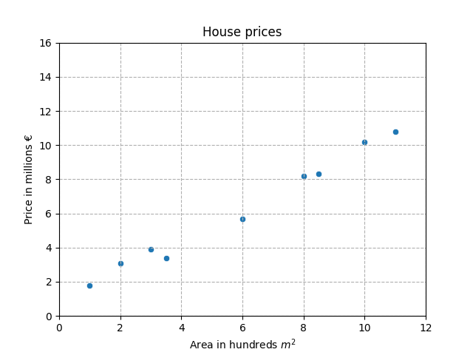
Example: fitting a line to data
Typically we will plot the data first to explore the associations

Slide 38
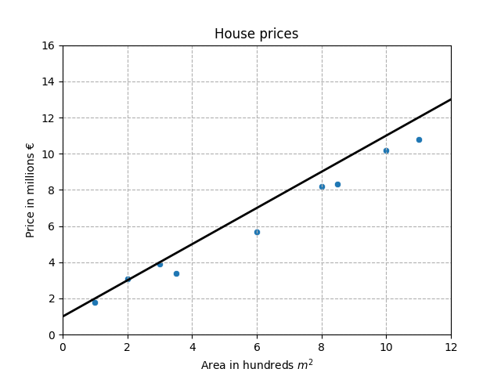
Example: fitting a line to data
Next, we can fit a curve to data to represent the association, e.g., we can fit a line

Slide 39
Example: fitting a line to data
But, what is the “best” line to fit?

Slide 40
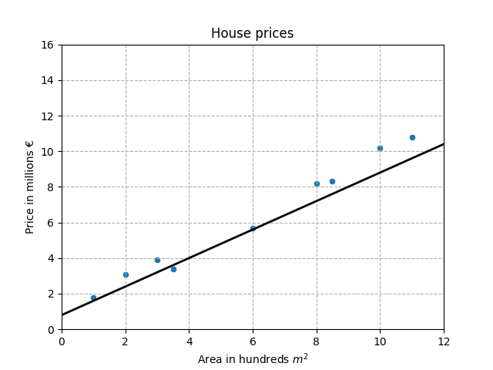
Example: fitting a line to data
But, what is the “best” line to fit?

Slide 41
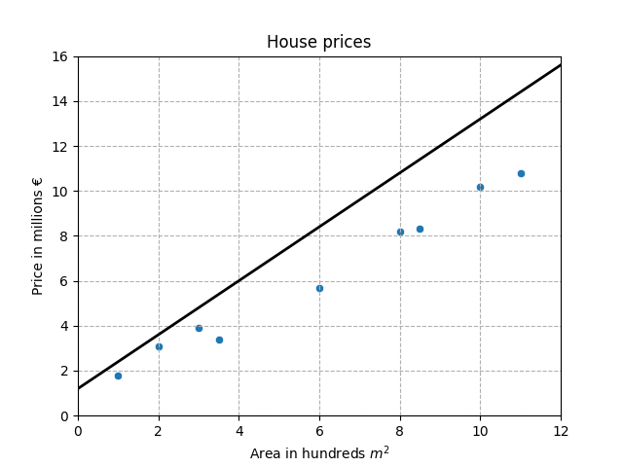
Example: fitting a line to data
But, what is the “best” line to fit?

Slide 42
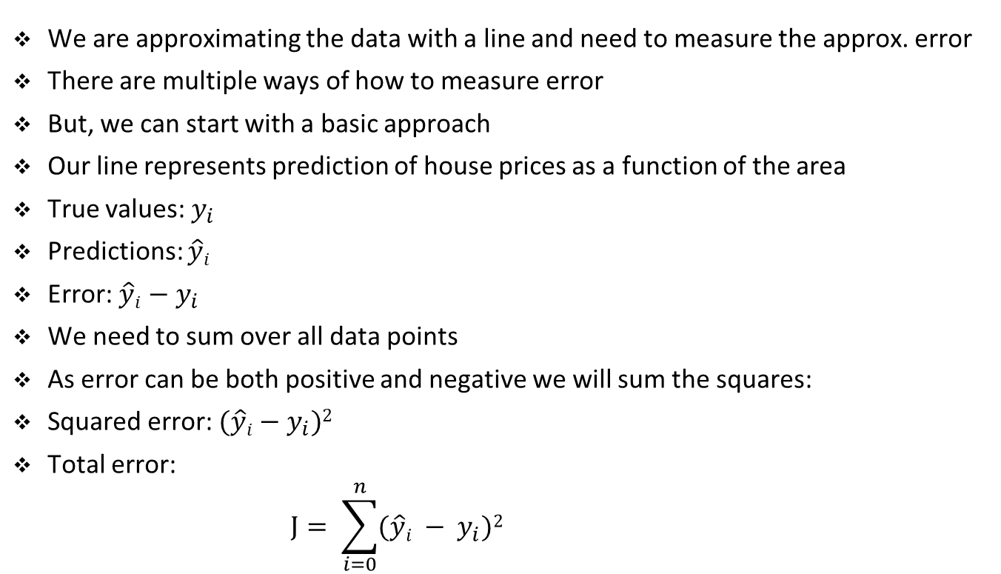
Example: fitting a line to data
We are approximating the data with a line and need to measure the approx. error
There are multiple ways of how to measure error
But, we can start with a basic approach
Our line represents prediction of house prices as a function of the area
True values: $y_{i}$
Predictions: $\hat{y}i$
Error: $\hat{y}i$ $− y_{i}$
We need to sum over all data points
As error can be both positive and negative we will sum the squares:
Squared error: $(\hat{y}i$ $− y_{i})2$
Total error:
$$J= \sum_{i=0}^{n}{(\hat{y}i − y_{i})2 }$$

Slide 43
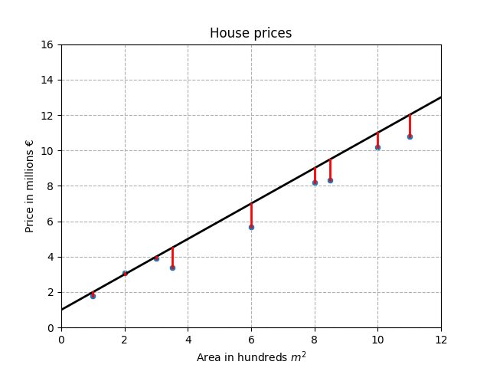
Example: fitting a line to data
Sum of squared errors

Slide 44
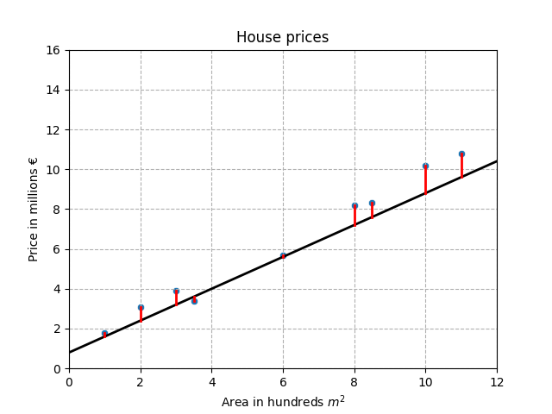
Example: fitting a line to data
Sum of squared errors

Slide 45
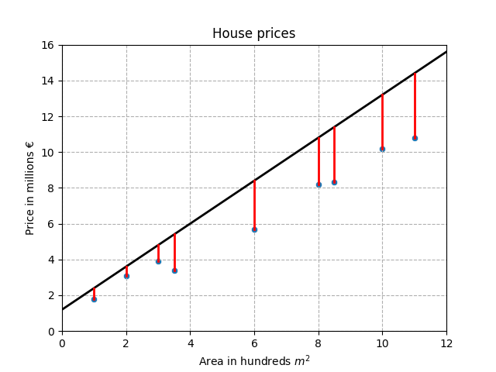
Example: fitting a line to data
Sum of squared errors

Slide 46
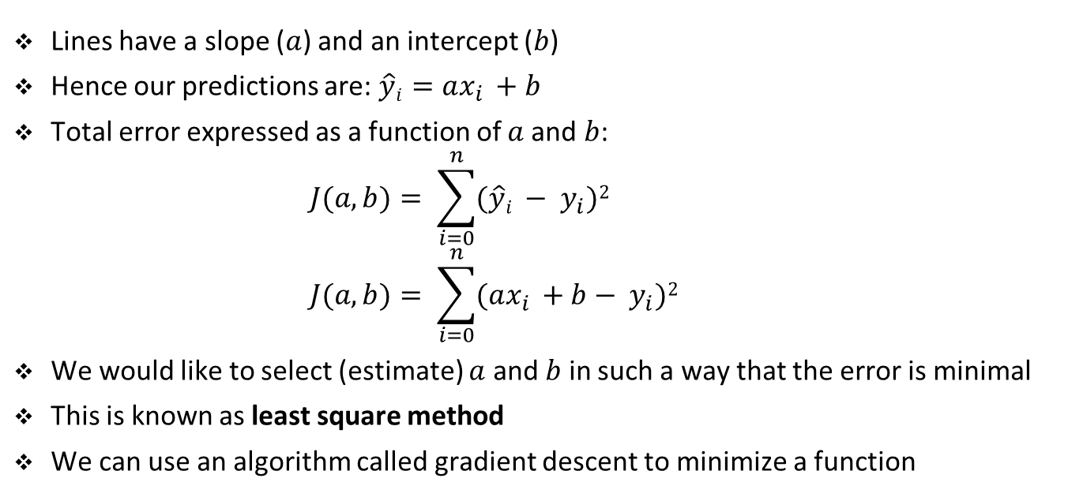
Example: fitting a line to data
Lines have a slope ($a$) and an intercept ($b$)
Hence our predictions are: $\hat{y}i=ax_{i }+b$
Total error expressed as a function of $a$and $b$:
$$J(a, b)= \sum_{i=0}^{n}{(\hat{y}i − y_{i})2 }$$
$$J(a, b)= \sum_{i=0}^{n}{(ax_{i }+b− y_{i})2 }$$
We would like to select (estimate) $a$ and $b$ in such a way that the error is minimal
This is known as least square method
We can use an algorithm called gradient descent to minimize a function

Slide 47
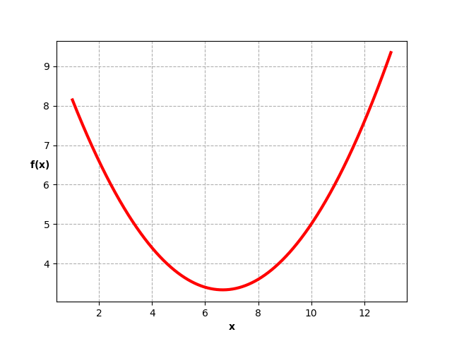


Gradient descent
gradient
new gradient
guess
new gradient
next guess
next guess
stop
$${f(x}_{min})$$
$$x_{min}$$

Slide 48
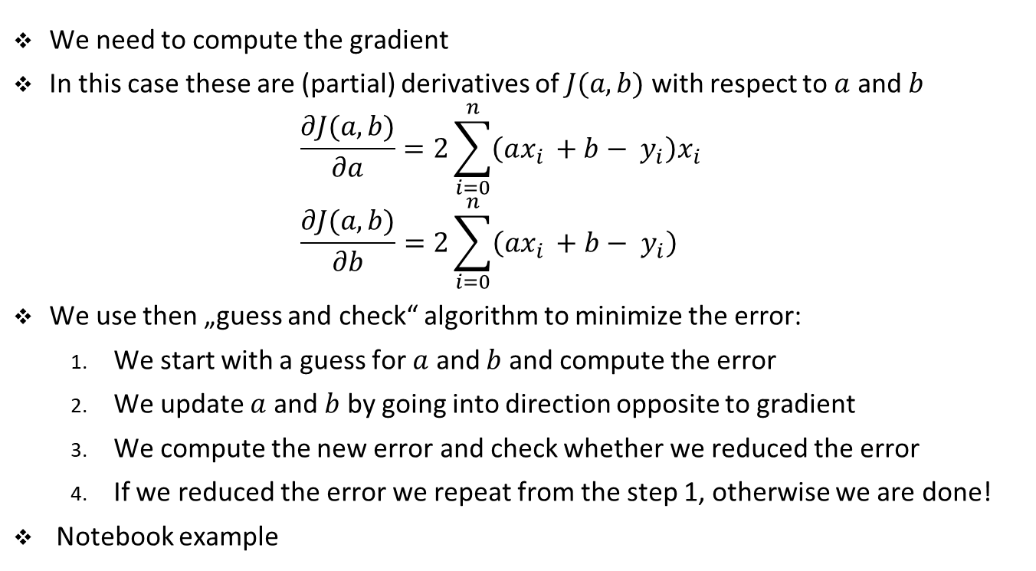
Gradient descent
We need to compute the gradient
In this case these are (partial) derivatives of $J(a, b)$ with respect to $a$ and $b$
$$\frac{∂J(a, b)}{∂a}=2\sum_{i=0}^{n}{\left(ax_{i }+b− y_{i}\right)x_{i} }$$
$$\frac{∂J(a, b)}{∂b}=2\sum_{i=0}^{n}{\left(ax_{i }+b− y_{i}\right) }$$
We use then „guess and check“ algorithm to minimize the error:
We start with a guess for $a$ and $b$ and compute the error
We update $a$ and $b$ by going into direction opposite to gradient
We compute the new error and check whether we reduced the error
If we reduced the error we repeat from the step 1, otherwise we are done!
Notebook example

Slide 49
Exercise

Slide 50
Student task
Task 1: Calculate the sum of a list or a tuple and print the resulting sum. Solve this problem:
without using sum() for lists or tuples,
with using sum().
Ad 2) There are for a lot of simple tasks already built in functions in python: https://docs.python.org/3.9/library/functions.html
Example:
[1,2,3] -> 6
(6, 90, 10, 15, 114, 25, 18, 91, 51) -> 420
[63, 100, 48, 79, 4, 85, 26, 84, 16, 73, 58, 78, 87, 198, 321, 17] -> 1337

Slide 51
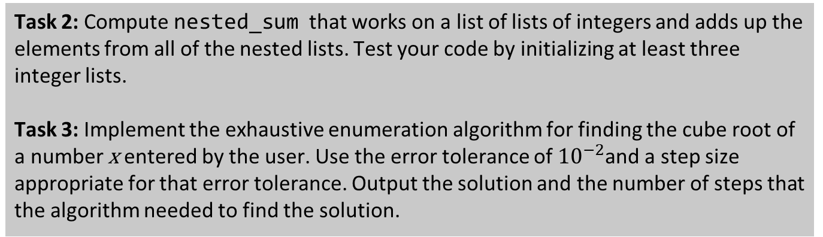
Student task
Task 2: Compute nested_sum that works on a list of lists of integers and adds up the elements from all of the nested lists. Test your code by initializing at least three integer lists.
Task 3: Implement the exhaustive enumeration algorithm for finding the cube root of a number x entered by the user. Use the error tolerance of ${10}^{−2}$and a step size appropriate for that error tolerance. Output the solution and the number of steps that the algorithm needed to find the solution.

