Slide 1

Fundamentals of Computer Science and Programming
Unit 6 – Programming Part III

Slide 2
Outline
List comprehensions
Nested loops
Functions
Variable scope
Tips for learning programming
Example
Exercise

Slide 3
List comprehensions

Slide 4
List comprehensions
Typically, we can rewrite loops that create lists into list comprehensions
Syntax:
resulting_list = [iterator for iterator in sequence]
We can combine comprehensions also with conditions
resulting_list = [iterator for iterator in sequence if condition]
squared_numbers = [1, 4, 9]
numbers = []
for x in squared_numbers:
numbers.append(x ** (1 / 2))
numbers = [x ** (1 / 2) for x in squared_numbers]
squared_numbers = [1, 4, 9, -1]
numbers = [x ** (1 / 2) for x in squared_numbers if x > 0]

Slide 5
Nested loops

Slide 6
Nested loops
Nested loop is a loop inside of another loop
Nested loop is also called inner loop, the enclosing loop is outer loop
Inner loop will be executed as many items as there are iterations in the outer loop
Total number of iterations
#iterations_inner_loop * #iteration_outer_loop
for x in range(1, 11):
for y in range(1, 11):
print(x * y, end=' ')
print()

Slide 7
Nested loops
We can combine different kinds of loops with each other
Recollect our line fitting example
…
while abs(error_old - error) > tol:
a_grad = 0
b_grad = 0
for point in data:
a_grad += (a * point[0] + b - point[1]) * point[0]
b_grad += a * point[0] + b - point[1]
a -= learning_rate * a_grad
b -= learning_rate * b_grad
…

Slide 8
Nested loops
We can use break and continue within nested loops as well
They are always associated with the loop where we use them
for i, row in enumerate(list):
for j, e in enumerate(row):
if e >= 0:
print(f'list[{i}][{j}]: {e}')
else:
break
for i, row in enumerate(list):
for j, e in enumerate(row):
if e >= 0:
print(f'list[{i}][{j}]: {e}')
else:
continue

Slide 9
Nested loops
We can also combine nested loops and list comprehensions
products = []
for x in first:
for y in second:
products.append(x * y)
products = [x * y for x in first for y in second]

Slide 10
Nested loops
Nested loops are often used with multi-dimensional data structures
Notebook examples
products = [['tv', 'computer'], ['plate', 'glass']]
for category in products:
for product in category:
print(product)

Slide 11
Functions

Slide 12
Functions
„Named“ block of code for solving a specific task
Reusable, readable, easier to maintain
Examples of Python functions: len(), print(), input(), …
Defined with the keyword def, function name, list of parametrs
Code block in functions: indented 4 spaces!
Executed via function call
After function execution the main program continues with its execution
Functions may return values to the main program
def test_function(param):
print(f'You passed "{param}" to this function')
test_function(13)

Slide 13
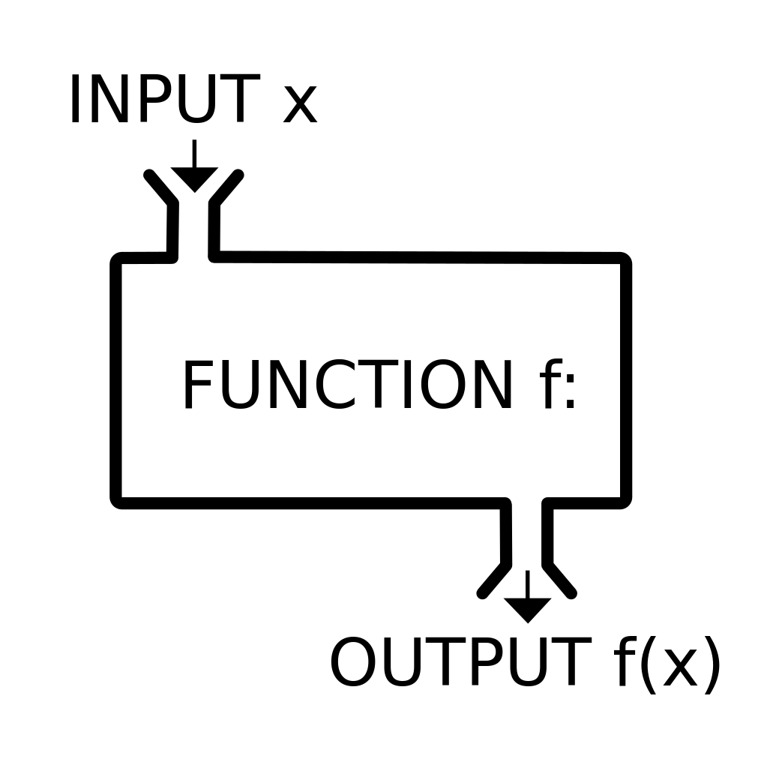
Functions: basic concepts
Input parameters (arguments)
Function logic (code)
Return value, console output,
parameter updates, ...
https://commons.wikimedia.org/wiki/File:Function_machine2.svg

Slide 14
Example for basic concepts
Example:
print('This', 'is', 'a', 'test')
Parameters:
'This', 'is', 'a', 'test'
Console output:
This is a test

Slide 15
Example for basic concepts
Example:
len([4, 8,'This', 'test'])
Parameters:
[4, 8,'This', 'test']
Return value:
4

Slide 16
Example for basic concepts
Example:
random.randomint(1, 100)
Parameters:
1, 100
Return value:
13

Slide 17
Definition and call of functions
def test_simple():
print(f'Hi everyone!')
def test_param(param):
print(f'You passed "{param}" to this function')
test_simple()
test_param('Hello!')
Notebook examples

Slide 18
Function parameters
Types of parameters for value passing
Positional parameters
Identified through position
Keyword parameters
Identified with a name
Default values are possible
def say_name(first, last, country='Austria'):
print(f'Firstname is {first}, surname is {last}.')
print(f'I live in {country}.')
say_name('Jane', last='Doe')

Slide 19
Function parameters: valid calls
def say_name(first, last, country='Austria'):
print(f'Firstname is {first}, surname is {last}.')
print(f'I live in {country}.')
# Positional parameters
say_name('John', 'Doe')
say_name('Jane', 'Doe', 'Germany')
# Keyword parameters
say_name(first='John', last='Doe')
say_name(country='Germany', first='Jane', last='Doe')
# Mix of both
say_name('Jane', country='Germany', last='Doe')

Slide 20
Function parameters: common mistakes
Confusing the order of parameters
Typo when assigning keyword parameters
Wrong number of parameters (TypeError)
Positional parameter after keyword parameter
Wrong data types for parameters
...

Slide 21
Function parameters: common mistakes
def say_name(first, last, country='Austria'):
print(f'Firstname is {first}, surname is {last}.')
print(f'I live in {country}.')
say_name('Max')
# TypeError: say_name() missing 1 required positional argument: 'last_name'
say_name('Austria', 'Muster', 'Max')
# No execution error but a logical mistake
say_name(fs='Max', last='Muster')
# TypeError: say_name() got an unexpected keyword argument 'fs'
say_name(first='Max', 'Muster')
# SyntaxError: positional argument follows keyword argument
# There are many more possibilities for errors :-)

Slide 22
Return values
Often we compute some values in functions
We return newly computed values from functions to the main program
Returnig values
Keyword: return
Immediate return to the main program
Also possible without return value
def format_name(first, last):
full_name = f'{first} {last}'
full_name = full_name.title()
return full_name
name = format_name('aRnOlD', 'sChWaRzEnEgGeR')
'aRnOlD', ' sChWaRzEnEgGeR')
'aRnOlD sChWaRzEnEgGeR'
'Arnold Schwarzenegger'
'Arnold Schwarzenegger'
'Arnold Schwarzenegger'
'aRnOlD', ' sChWaRzEnEgGeR')

Slide 23
Return values
Complex return values are possible
Lists, tuples, etc.
Returning more than one value is also possible
return x, y, z
def build_person(forename, surname):
person = [forename, surname]
return person
arnie = build_person('Arnold', 'Schwarzenegger')

Slide 24
Function vs. methods
Functions
Independent functionality
print(), len(), range(), ...
Methods
Belong to an object or a variable
Called for that object („method call“)
Has access to the object's data
string.upper(), item_list.append(), dictionary.keys(), ...
We will learn more on methods when we discuss object-orientation
Notebook examples

Slide 25
Variable scope

Slide 26
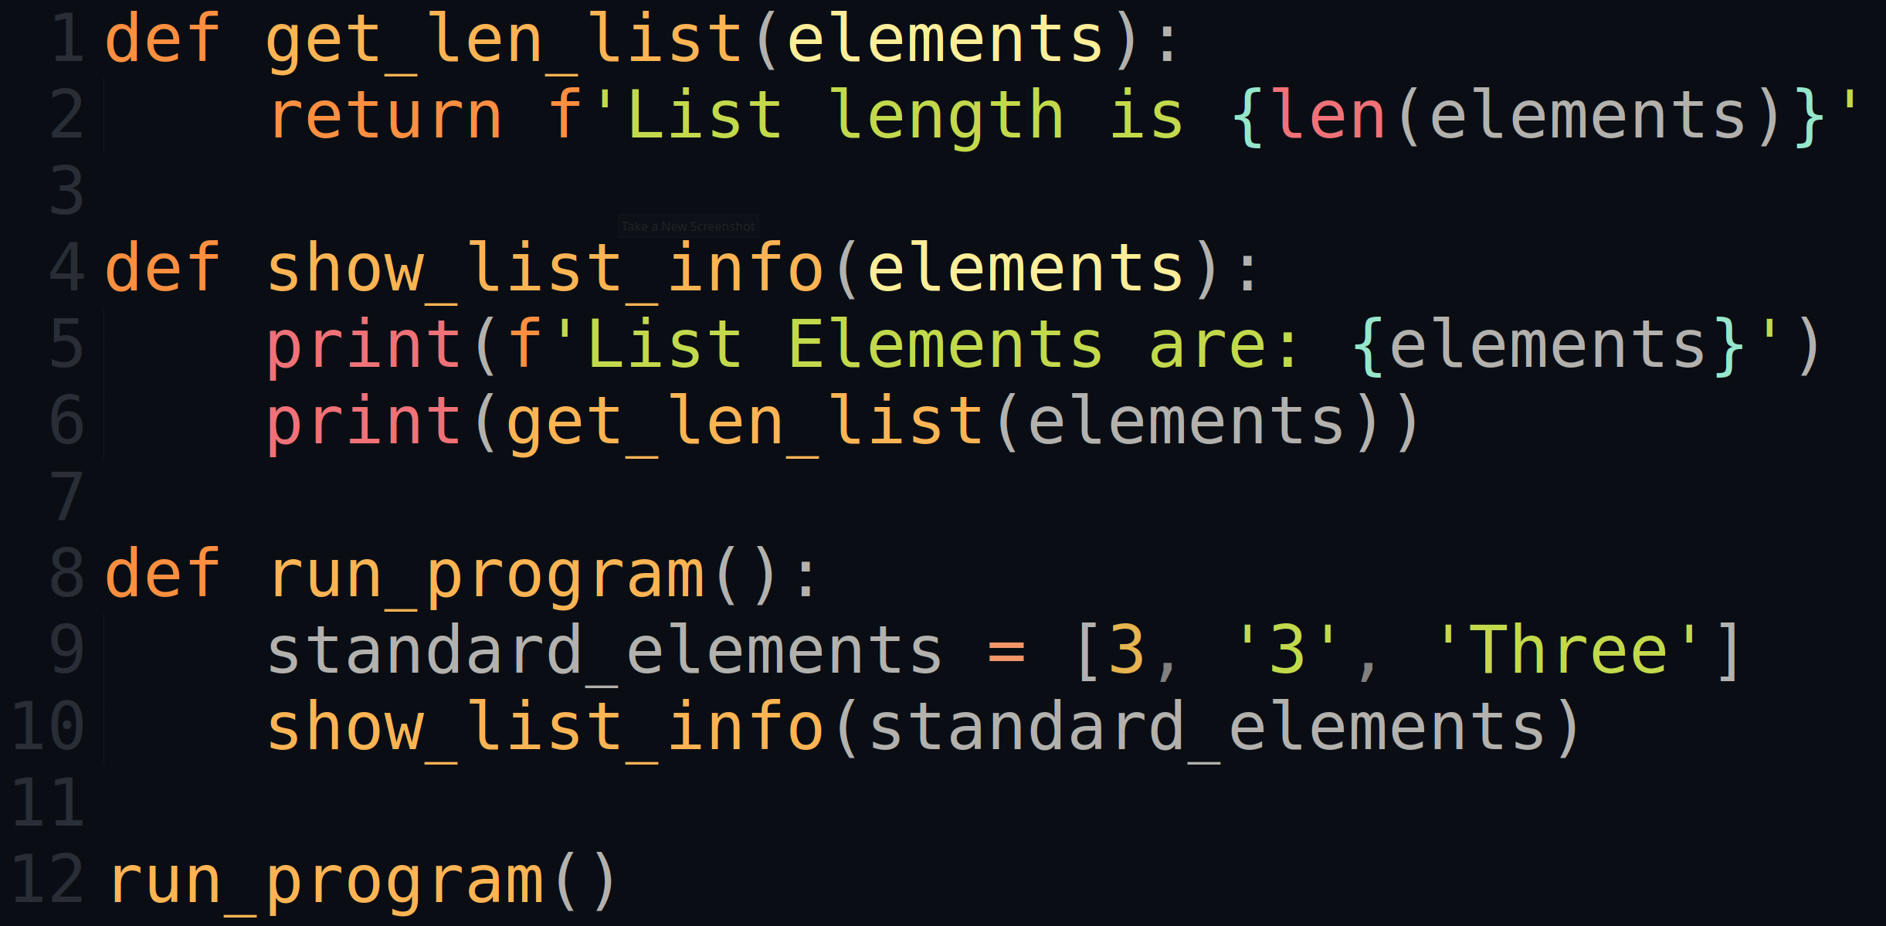
More on function parameters
elements = elements
elements = standard_elements
List Elements are: [3, '3', 'Three']
List length is 3
List Elements are: [3, '3', 'Three']

Slide 27
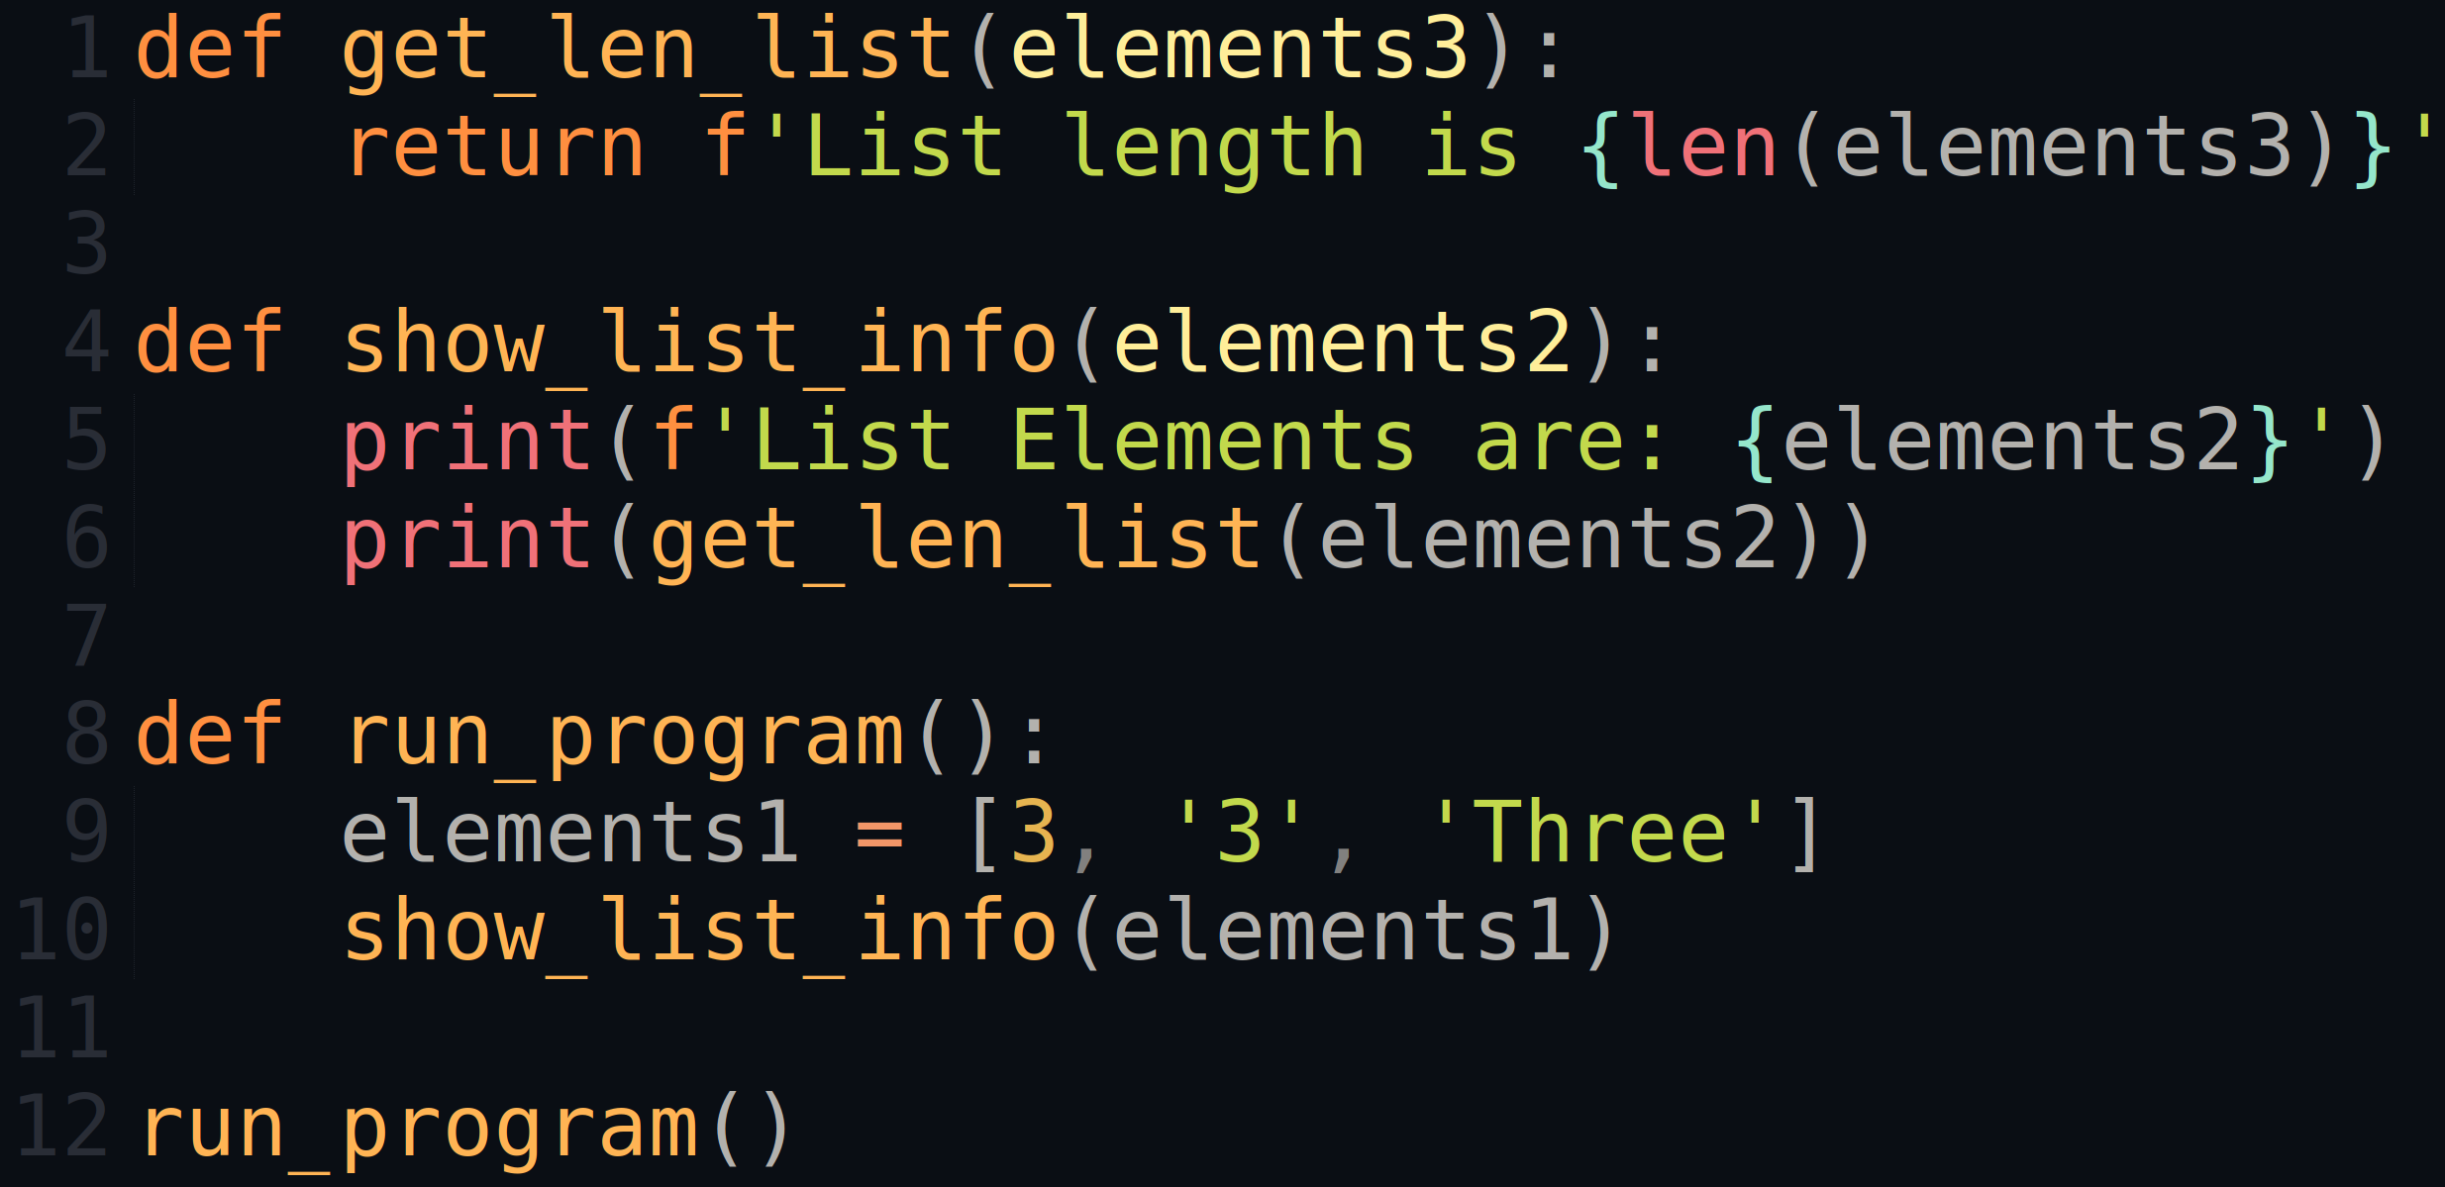
More on function parameters
List Elements are: [3, '3', 'Three']
List length is 3

Slide 28
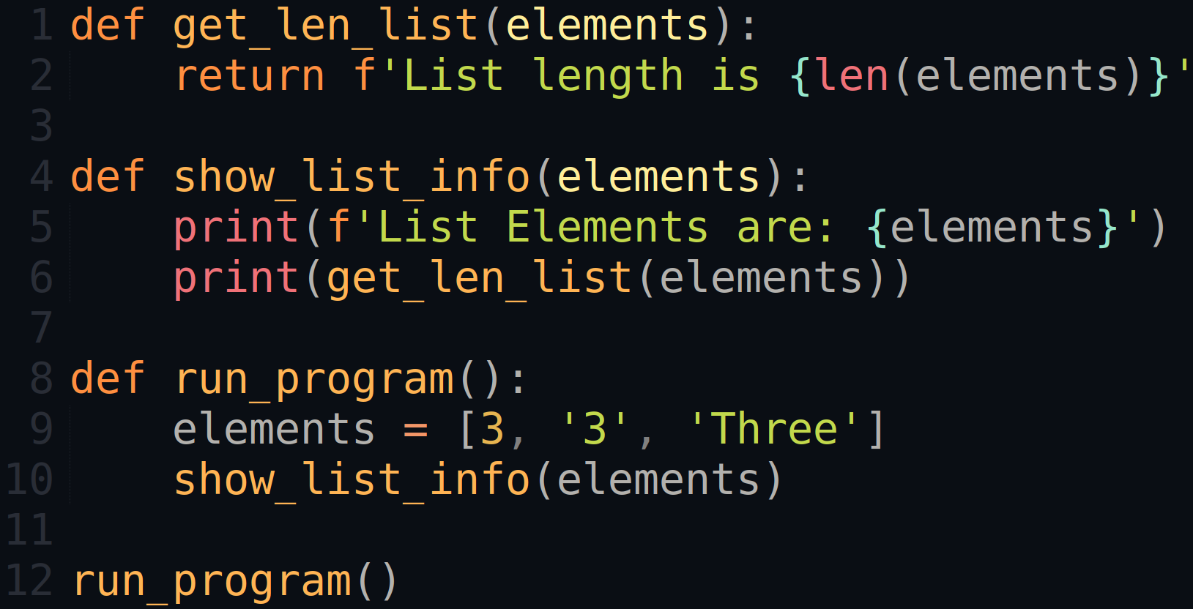
More on function parameters
List Elements are: [3, '3', 'Three']
List length is 3

Slide 29
Global and local variable scope
ERROR!
(UnboundLocalError)
ERROR!
(NameError)
Global variables: defined outside of functions
Readable inside of functions
Immutable inside of functions
Usage typically not meaningful
Try to avoid them!
Local variables: defined insides of functions
Not readable outside of functions
Same global and local names are possible
Try to avoid using same names!
Reduces the problems/errors
Visability of variables is called scope
Visible everywhere vs. visible inside of a function
Notebook examples, Python Tutor Example 1, Python Tutor Example 2
def test_scope():
print('in1',z)
z = 5
print('in2',z)
y = 4
z = 3
print('out1', z)
test_scope()
print('out2', z)
def test_scope1():
y = x + 5
print('in1',y)
def test_scope2():
print('in2',x)
print('in2',y)
x = 3
test_scope1()
test_scope2()
def test_scope():
print('in1',y)
z = 5
print('in2',z)
y = 4
z = 3
print('out1', z)
test_scope()
print('out2', z)

Slide 30
Value vs. reference Assignment of mutable vs. immutable data types
Two ways of assigning values to variables
By value
Immutable data types: int, float, bool, string, tuple…
Initially: left variable points to the value of the variable on the right
After the variable on the right has changed:
Left variable copies the value of the variable on the right
Left variable points to the old value
By reference
Mutable data types: list, dictionary, set, …
Left variable references the variable on the right
val1 = 5
val2 = val1
list1 = [5]
list2 = list1

Slide 31
Assignment by value vs. by reference
Assignment by value
Assignment by reference
val1 = 5
val2 = val1
print('V1A', val1)
print('V2A', val2)
val1 += 8
print('V1B', val1)
print('V2B', val2)
list1 = [5]
list2 = list1
print('L1A', list1)
print('L2A', list2)
list1.append(8)
print('L1B', list1)
print('L2B', list2)
V1A 5
V2A 5
V1B 13
V2B 5
L1A [5]
L2A [5]
L1B [5,8]
L2B [5,8]

Slide 32
Call by value vs. call by reference
Two ways of passing values to functions
By value
Immutable data types: int, float, bool, string, tuple…
Parameters point to the values and copy after a change
By reference
Mutable data types: list, dictionary, set, …
Parameters reference the variables being passed to functions

Slide 33
Call by value vs. call by reference
Call by value
Call by reference
def do_stuff1(x):
x += 5
print('B', x)
val = 8
print('A', val)
do_stuff1(val)
print('C', val)
def do_stuff2(x):
x.append(5)
print('B', x)
list1 = [8]
print('A', list1)
do_stuff2(list1)
print('C', list1)
Value
Reference
A 8
B 13
C 8
A [8]
B [8, 5]
C [8, 5]
Value copied
Reference passed

Slide 34
Call by value vs. call by reference New assignments in functions
Call by value
Call by reference
def do_stuff3(z):
print('B', z)
z = 13
print('C', z)
z = 8
print('A', z)
do_stuff3(z)
print('D', z)
def do_stuff4(z):
print('B', z)
z = [8, 5]
print('C', z)
z = [13]
print('A', z)
do_stuff4(z)
print('D', z)
A 8
B 8
C 13
D 8
A [13]
B [13]
C [8, 5]
D [13]
Notebook examples, Python Tutor Examples: 3, 4, 5, 6

Slide 35
Tips for learning programming

Slide 36
How do I learn to program?
Start with smaller examples
Code snippets from the lectures
Homework explanations!
Homeworks
Online resources, ...
Experiment, experiment, experiment, …
Debug:
Visualize intermediate results and program flow with print()
Text books

Slide 37
How to deal with problems?
Start with these three questions to yourself
What am I trying to do/achieve?
What did I try out so far?
What were my results so far?
If necessary: start once more from the beginning
Take a break
Larger examples
Make a sketch on paper before you start
Pseudocode, diagram, …

Slide 38
How to deal with problems?
Debug and test
Using print()
Write a test example on a paper
Where you know the input and the result
Test your implementation with those small tests
More tests is always better
Online search, e.g., error messages, problem descriptions
StackOverflow ( https://stackoverflow.com/ )
Python Docs ( https://docs.python.org/3/ )
…

Slide 39
Example

Slide 40
Tic-tac-toe
In the game of tic-tac-toe a player (X or O) wins if there are three same
characters in a row, column, or any of the two diagonals. The game is played
on a 3x3 board.
We will represent the board in tic-tac-toe as a list of strings. For example:
['OOX', 'OXX', 'OOO']
We want to write a function check_win(board),which returns the winner
of the provided game, and the way how the game was one, i.e.,
horizontal, vertical, or diagonal.
Hence, if player X won, the function should return the string X, and if player
O won, the function should return the string O. In addition, the function
returns H, V, D for horizontal, vertical, and diagonal win respectively.
If there is a draw, then the function should return None.
Notebook examples

Slide 41
Exercise

Slide 42
Student task
Task 1: Text statistics.
Write a function count_letter(text, letter). It counts and returns how often some letter occurs in a text (both are str). Let the function be case-insensitive and don't use any builtin-functionality for counting! Using your function, count the occurences of letters from the ABC string below in a text defined below. Output each letter and its count on a separate line.
Notebook example.

Slide 43
Student task
Task 2: Subset of a list.
Write a function, which checks whether a list is a subset of another list. The function returns True if that is the case and False otherwise.

