Slide 1

Fundamentals of Computer Science and Programming
Unit 8 – Programming Part V

Slide 2
Outline
File I/O
CSV files and module imports
Pandas
Examples
Exercise

Slide 3
File I/O

Slide 4
Reading and writing files: File I/O
Text files (.txt) and text file in a table format
Function to open files: open(filepath, mode='rt')
filepath: Path (or name) of file as a string
mode: Opening mode + file type
Default: Access 'r', file type 't'
Combinations: 'w', 'wt', 'ab', 'b', 'rb', ...
Symbol | Description
'r' | Read (Default)
'w' | Write, current file dropped
'a' | Write, append at the end of the current file
Symbol | Description
't' | Text file (Default)
'b' | Binary file
+
Notes:
10:35

Slide 5
Paths
Two types of file paths:
Absolute Paths: Full path over the whole file system
unix_path = '/home/ruptho/code/test.txt'
windows_path = 'C:\\Documents\\code\\test.txt'
Relative Paths: Path relative to the executable file
f_path = 'text.txt'
Subfolder files: path = 'files/text.txt'
Notes:
10:35

Slide 6
Reading and writing files: File I/O
with: control structure
Combined with open controls:
File opening
Accessing the file content
Automatic closing of the file
with open('test.txt') as file_obj:
# open() = return object representing file in Python
# file_obj = variable where file object is stored
print('Access file and content now using file_obj')
Notes:
10:35

Slide 7
Reading text files
Lines in text files are separated with the newline character ('\n')
Example: Reading a text file ('test.txt')
Default mode is 'r' and 't'
Reading the whole content: read()
with open('test.txt') as file_obj:
# open() = return object representing file in Python
# file_obj = variable where file object is stored
file_content = file_obj.read() # read from file object
print(file_content)
Notes:
10:35

Slide 8
Reading text files line by line
Example: Reading a text file ('test.txt')
Default mode is 'r' and 't'
Reading one line at a time: for loop
with open('test.txt') as file_obj:
# Iterating over object = Iterating over lines
for line in file_obj:
print(line)
Notes:
10:35

Slide 9
Reading all lines at once
Example: Reading a text file ('test.txt')
Default mode is 'r' and 't'
Reading all lines at once: readlines()
with open('test.txt') as file_obj:
# store lines from text in list:
lines = file_obj.readlines()
print(f'The list of lines is {lines}')
Notes:
10:35

Slide 10
Writing text files
Example: Writing a text file ('test.txt')
Setting the writing mode as 'w', default file type is 't'
Append content instead of overwriting: 'a'
Writing characters: write()
filename = 'test_write.txt'
with open(filename, 'w') as file_obj:
# Note the newline char (\n)
file_obj.write('I love Programming.\n')
file_obj.write('I do not like Maths.\n')
Notes:
10:35

Slide 11
CSV files and module imports

Slide 12
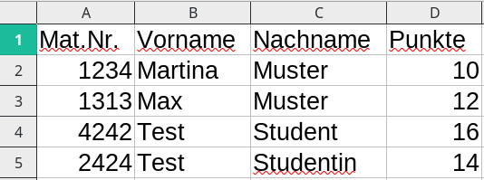
CSV files
CSV files = Files in a table format, i.e., Excel format
CSV = Comma Separated Value
Cells separated with a delimiter (e.g., , ; \t)
Default separator depends on the operating system and the language
Can be imported in table processing software
Reading/writing of csv files: external modules (e.g., csv, pandas)
Mat.Nr.,Vorname,Nachname,Punkte
1234,Martina,Muster,10
1313,Max,Muster,12
4242,Test,Student,16
2424,Test,Studentin,14
Notes:
10:35

Slide 13
Importing modules
import keyword
Importing functionality from other python scripts and modules
Python modules: external code libraries
Functionality can be used in own programs
Module from Python Standard Library are available per default
External modules (e.g., pandas): installation via pip
Notes:
11:30

Slide 14
Importing modules
import syntax
import <ModuleName>
Or: import <ModuleName> as <alias>
Examples:
import random
import pandas as pd
Calling funcitons: <alias>.<function_name>()
# random-module: https://docs.python.org/3/library/random.html
import random as rd
# for example, get random number between 1 and (inclusive) 13
random_number = rd.randint(1, 13)
Notes:
10:35

Slide 15
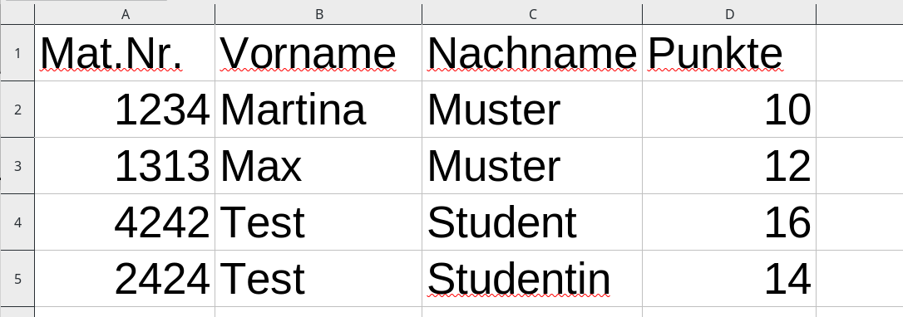
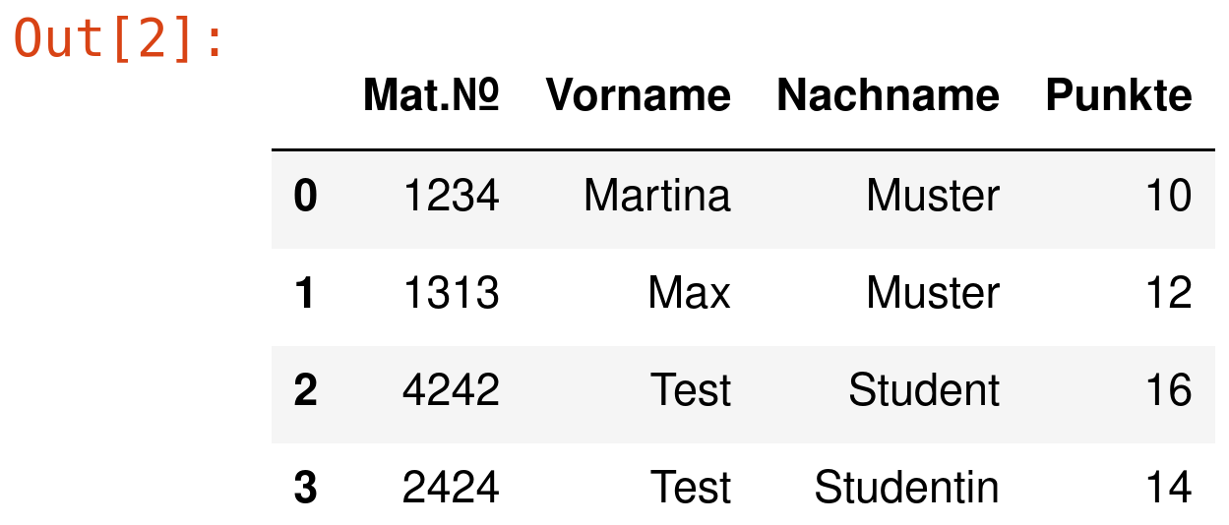
Example: pd.read_csv
Mat.Nr.,Vorname,Nachname,Punkte
1234,Martina,Muster,10
1313,Max,Muster,12
4242,Test,Student,16
2424,Test,Studentin,14
students.csv
In a text editor
In Excel
# imports are usually at the beginning of files
# But for the sake of this example, let's imagine this is a Jupyter-Cell!
import pandas as pd
dataframe = pd.read_csv('students.csv', sep=',')
dataframe
Code
Output
Notebook examples
Notes:
10:35

Slide 16
Pandas

Slide 17
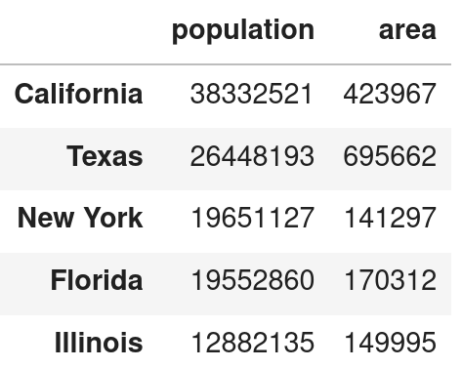
Pandas
Python module for processing of tabular data (e.g., xls/csv tables)
import pandas as pd
Main data structure in pandas: DataFrame
Multidimensional array/list
Fixed names/descriptors for rows and columns
Access to rows/columns is similar to dictionaries
Individual rows/columns: similar to lists
Notes:
Generelle Data Science Pipeline
Daten anlegen/laden ➡ Preprocessing ➡ Daten explorieren ➡ Daten verarbeiten ➡ Ergebnisse ausgeben
-----
Python macht man das ganz oft mit pandas
----
der name pandas kommt (angeblich) von einer abkürzung für “Panel Data”, und das beschreibt oft “tabulare Daten” .Was versteht man unter tabularen Daten? (Tabellendateien)
pandas (Panel data), numpy (=Numeric Python)
Man stelle sich eine CSV oder excel Datei vor, dann lad ma die Daten einfach
Zeilen anzeigen
Man kann sich das als spezialisiertes Dictionary vorstellen
Die einzelnen spalten: Series, im hintergrund numpy array (ist jetzt für uns nicht wichtig)

Slide 18
Pandas
pandas and DataFrame
Efficient data manipulation
Convinient and powerful functionality:
Loading and storing
Accessing and filtering
Missing and data with errors easy to replace/delete
Easy computations with data
Adding data
Data visualization (ploting)
…
Notes:
pandas-Funktionalität in dieser Vorlesung:
Daten laden/anlegen ➡ Daten abrufen und filtern ➡ Spalten neu anlegen ➡ Fehlende Daten ausfüllen ➡ Daten verarbeiten und Ergebnisse berechnen ➡ Neu berechnete Daten speichern
-------

Slide 19
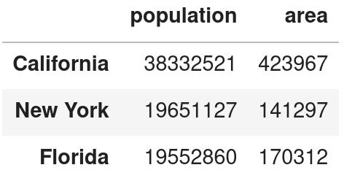
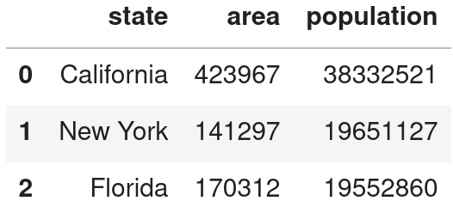
Creating DataFrames manually
Creating DataFrame from a dictionary
Creating DataDrame from a list
In practice: loading data from a (e.g., CSV file)
import pandas as pd
data = {'population': {'California': 38332521,
'New York': 19651127,
'Florida': 19552860},
'area': {'California': 423967,
'New York': 141297,
'Florida': 170312}}
df = pd.DataFrame(data)
import pandas as pd
data = [['California', 423967, 38332521],
['New York', 141297, 19651127],
['Florida', 170312, 19552860]]
df = pd.DataFrame(data, columns=['state','area','population'])
Notes:
Ganz oft kürzt man das eben einfach mit df (kurz für DataFrame ab), und obwohl das jetzt vielleicht nicht unbedingt unserem CodingStyle entspricht, kann man das hier scho so machen weil das einfach ein namen ist der si eingebürgert hat.

Slide 20
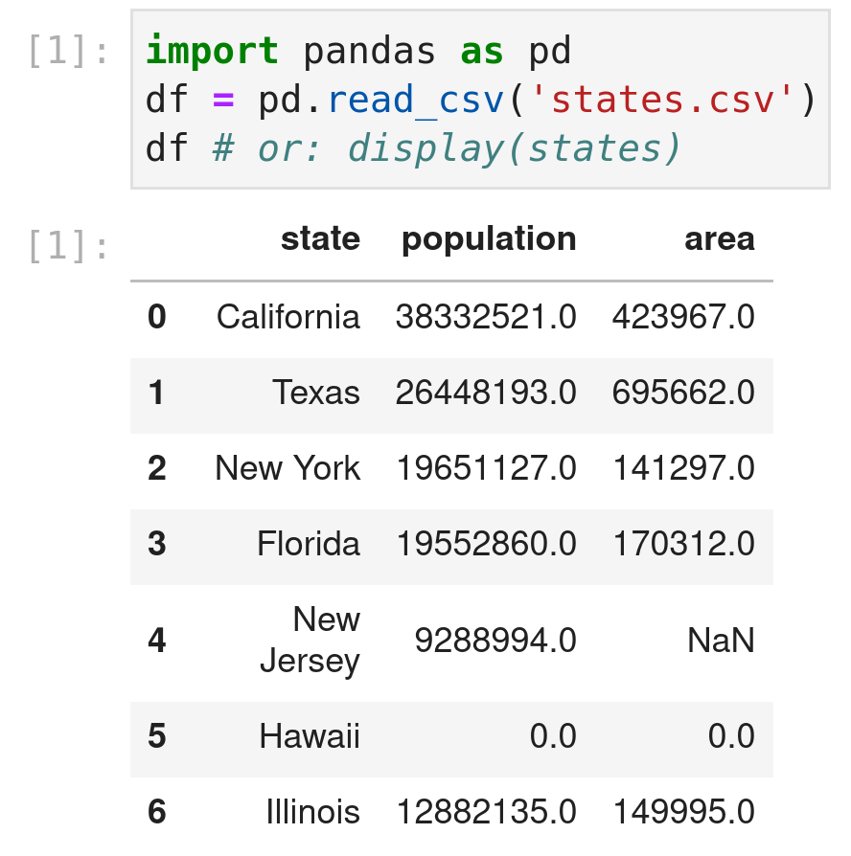
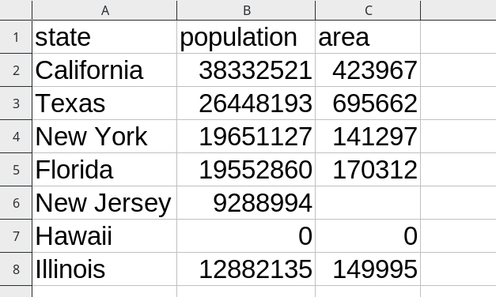
Loading DataFrames from a CSV file
state,population,area
California,38332521.0,423967.0
Texas,26448193.0,695662.0
New York,19651127.0,141297.0
Florida,19552860.0,170312.0
New Jersey,9288994.0,
Hawaii,0.0,0.0
Illinois,12882135.0,149995.0
DataFrame load
In a text editor
states.csv
Code (Jupyter-Notebook)
DataFrame display
In Excel
Notes:
10:35

Slide 21
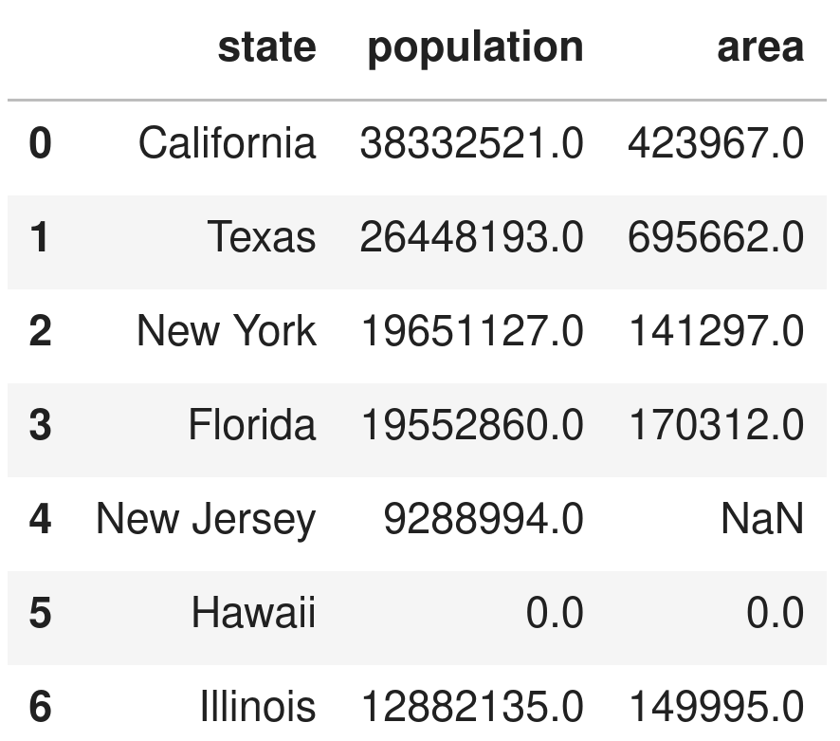
Accessing rows and columns in DataFrames
df = pd.read_csv('states.csv')
Access to rows via index with loc
df.loc[3]
Access to columns (e.g., area)
df['area']
df.area
df.loc[:, 'area']
Notes:
Loc: man sieht es kann auch zwei parameter übernehmen, erstes ist immer welche Zeilen man nehmen soll, zweites ist dann die jeweilige Spalte

Slide 22
Filtering columns in DataFrames
Filtering with operators
Comparison operators as previously: >, <, >=, <=, ==, !=
Logical operators similar to set operators:
Applying an operator to a DataFrame column results in a boolean mask
Accessing a DataFrame column with a boolean mask results in a selection
Logical operator | pandas
and | &
or | |
not | ~
Notes:
Welche logischen Operatoren haben wir in der ganz ersten lv gemacht?

Slide 23
Filtering columns in DataFrames
What rows contain states with more than 25 million people?
df[df.population > 25000000]
df[df['population'] > 25000000]
df.loc[df.population > 25000000]
Why does this syntax work? Boolean masking!
(df.population > 25000000) =>
[True, True, False, False, False, False]
df = pd.read_csv('states.csv')
Notes:
10:35

Slide 24
Filtering columns in DataFrames
What rows contain states with less than 15 millions people and less than 200 thousend km² area?
df[(df.population < 15000000) & (df.area < 200000)]
df.loc[(df.population < 15000000) & (df.area < 200000)]
What are the names of these states?
df[(df.population < 15000000) & (df.area < 200000)]['state']
df.loc[(df.population < 15000000) & (df.area < 200000), 'state']
df = pd.read_csv('states.csv')
Notes:
10:35

Slide 25
Aggregating columns and DataFrames
Applying operations over a complete column or a DataFrame
Pandas methods are similar to list functions
Lists:
Functions: sum(), max(), min(), len(), …
Example with list called elements: len(elements)
pandas:
Methods: sum(), max(), min(), count(), median(), mean(), value_counts(), ...
Example for a DataFrame column: df['area'].sum()
Notes:
Tafel vielleicht

Slide 26
String operations and filtering via strings
String operations in pandas: callable for each str atttribute
Similar to known string functions:
str.lower(), str.upper(), str.contains(), str.startswith(), str.endswith(), str.split(), ...
All functions: see pandas documentation
Example: Select all states with New in name
df[df['state'].str.contains('New')]
df[df.state.str.contains('New')]
DataFrame df
Notes:
10:35

Slide 27
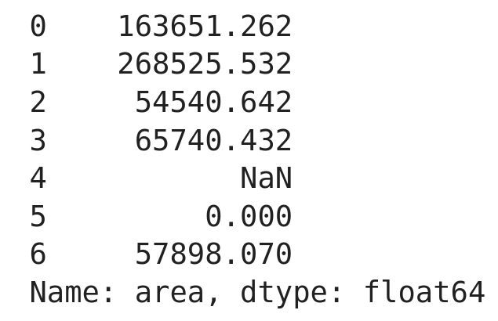
Arithmetic operations over columns
DataFrame df
Arithmetic operations can be applied on columns
Similar to standard python: *, /, +, -, ...
Result is another column (Series object)
Example: Compute area in squared miles (ratio 0,386 km²).
df['area'] * 0.386
df.area * 0.386
Can be directly combined with aggregation (e.g., sum)
(df['area'] * 0.386).sum()
Result: 610355.938
Output in Notebook
Notes:
10:35

Slide 28
Missing data and data with errors
Missing data in datasets: cells with NaN
NaN = pandas representation of python’s None
Automatic replacement of NaNs with a value:
In complete DataFrame (df)
df = df.fillna(value)
Only in a specific column
df['column'] = df['column'].fillna(value)
df = df.fillna({'column': value})
Notes:
10:35

Slide 29
Missing data and data with errors
Replace all missing values in the column area with a default value of 25000 km².
df['area'] = df['area'].fillna(25000)
df.loc[:, 'area'] = df['area'].fillna(25000)
df = df.fillna({'area': 25000})
df = pd.read_csv('states.csv')
Notes:
10:35

Slide 30
Missing data and data with errors
Replace all missing values in the column area with a default value of 25000 km².
df['area'] = df['area'].fillna(25000)
df.loc[:, 'area'] = df['area'].fillna(25000)
df = df.fillna({'area': 25000})
Remove all cells with errors (= 0) in population or area
= select all cells with area and population > 0
df = df[(df.area > 0) & (df.population > 0)]
df = pd.read_csv('states.csv')
25000.0
Notes:
10:35

Slide 31
Adding new columns
New column = similar to adding a key-value pair to a dictionary
Same value for all rows
df['new_column'] = value
df.loc[:, 'new_column'] = value
From operations on an existing column
df['pop_in_mil'] = df['population'] / 1000000
df.loc[:, 'pop_in_mil'] = df['population'] / 1000000
From operations with several existing columns
df['pop_density'] = df['population'] / df['area']
df.loc[:, 'pop_density'] = df['population'] / df['area']
Notes:
10:35

Slide 32
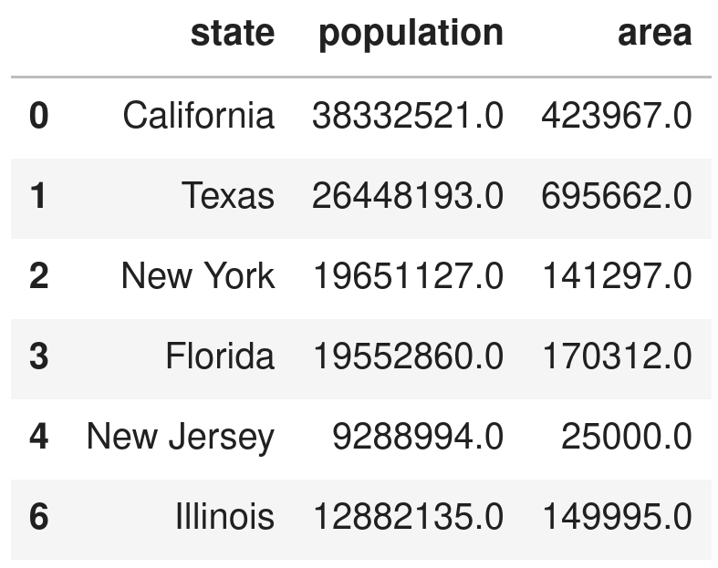
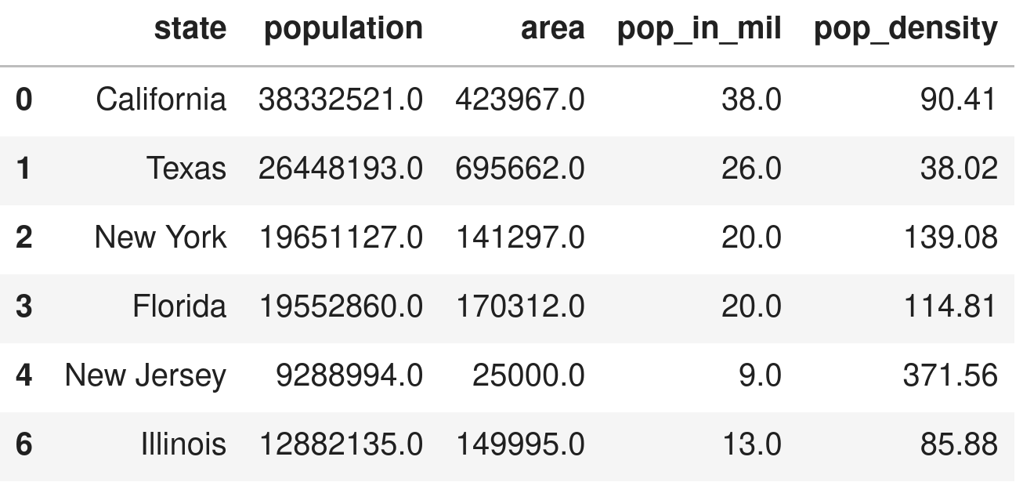
Adding new columns
df.loc[:, 'pop_in_mil'] = df['population'] / 1000000
# Can also use Python math operations like round(), abs(),...
df.loc[:, 'pop_in_mil'] = round(df['pop_in_mil'])
df.loc[:, 'pop_density'] = round(df['population'] / df['area'], 2)
Notes:
10:35

Slide 33
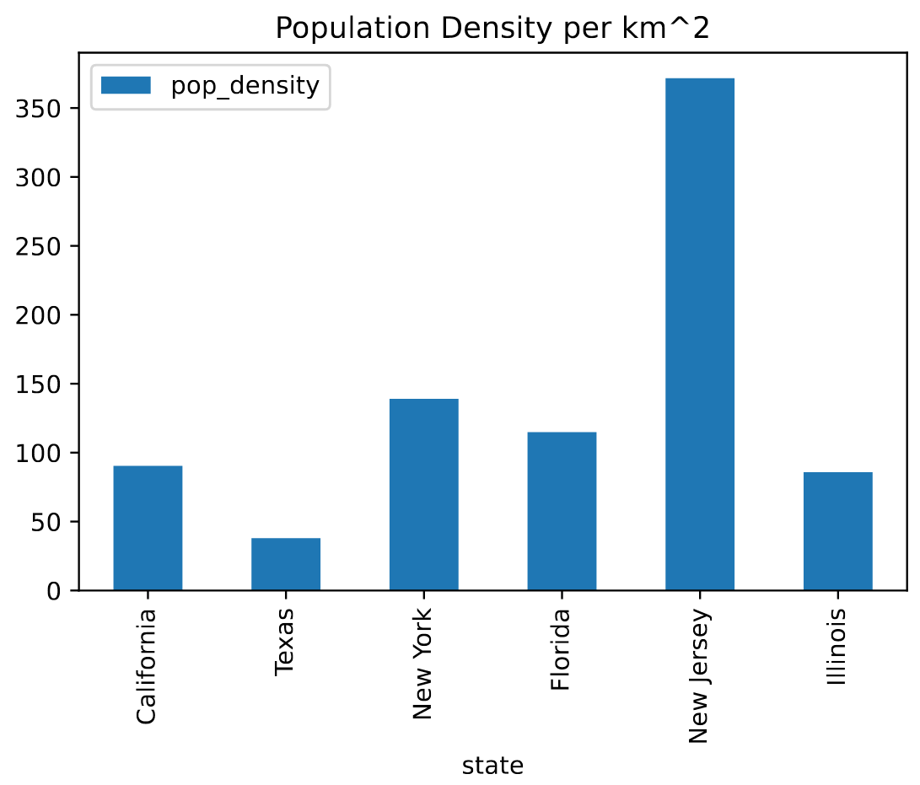
Plotting data
Simple plotting interface with df.plot()
Check Pandas reference
Example: Population density bar chart
DataFrame df
df.plot(x='state', y='pop_density',
title='Population Density per km^2', kind='bar')
Notes:
10:35

Slide 34
Storing DataFrames as CVS files
Storing via a DataFrame method to_csv(path)
path = File path or file name
Optional parameter index (Boolean) whether to store the index
df.to_csv('states_processed.csv', index=False):
state,population,area,pop_in_mil,pop_density
California,38332521.0,423967.0,38.0,90.41
Texas,26448193.0,695662.0,26.0,38.02
New York,19651127.0,141297.0,20.0,139.08
Florida,19552860.0,170312.0,20.0,114.81
New Jersey,9288994.0,25000.0,9.0,371.56
Illinois,12882135.0,149995.0,13.0,85.88
DataFrame df
states_new.csv (in a text editor)
Notes:
10:35

Slide 35
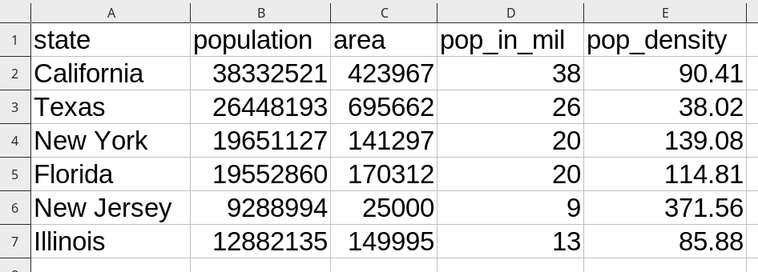
Storing DataFrames as CVS files
Storing via a DataFrame method to_csv(path)
path = File path or file name
Optional parameter index (Boolean) whether to store the index
df.to_csv('states_processed.csv', index=False):
DataFrame df
states_new.csv (in Excel)
Notes:
10:35

Slide 36
Examples

Slide 37
Example with pandas and CSV files
Example 1. Load, preprocess, and explore the data set containing information
on all USA states.
Notebook examples

Slide 38
Exercise

Slide 39
Student task
Task 1: Work on states dataset and perform some additional computations.
Notebook example.

