Slide 1

Fundamentals of Computer Science and Programming
Unit 9 – Algorithms and Complexity, Part I

Slide 2
Outline
Algorithms
Insertion sort
Exercise
Analyzing algorithms
Exercise

Slide 3
Algorithms

Slide 4
Algorithm
Description of the method:
Sequence of simple steps
Flow of control that specifies when each step is executed
Such a description is called an algorithm
Definition 1: An algorithm is a finite list of instructions that describe a computation that when executed on a provided set of inputs will proceed through a set of well-defined states and eventually produce an output.

Slide 5
Square root algorithm
Finite list of instructions describing a computation
State
Input
Example 1: Let us identify the basic algorithm components in a simple recipe for computing the square root of a number x.
Start by a guess g being equal to 0.
If g ⋅ g is close to x, stop and say that g is the answer.
Otherwise create a new guess by adding step s equal to 0.1 to g, i.e., g + 0.1.
Using this new guess g, repeat the process until g ⋅ g is close enough to x.
Instruction
Output
State
State
Instruction
State
Instruction
Instruction
Definition 1: An algorithm is a finite list of instructions that describe a computation that when executed on a provided set of inputs will proceed through a set of well-defined states and eventually produce an output.
Remark 2: This algorithmic technique is called guess and check. In fact, it is a special variant of guess and check called exhaustive enumeration. We enumerate all possibilities until we get the right answer or exhaust the space of possibilities.

Slide 6
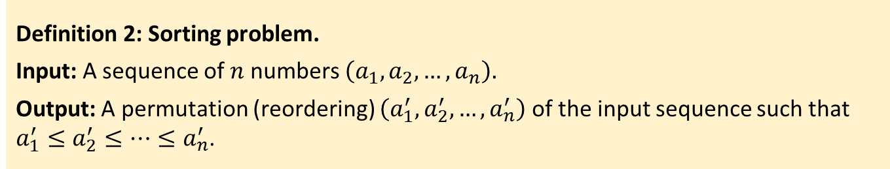
Studying algorithms
Example 2: Sorting problem. Sorting a sequence of numbers into an ascending order.
Definition 2: Sorting problem.
Input: A sequence of $n$ numbers $\left(a_{1}, a_{2}, …,a_{n}\right).$
Output: A permutation (reordering) $\left(a_{1}^{′},a_{2}^{′}, …,a_{n}^{′}\right)$ of the input sequence such that $a_{1}^{′}≤a_{2}^{′}≤…≤a_{n}^{′}$.
Example 3: Given an input sequence (31, 41, 59, 26, 41, 58), a sorting algorithm returns as output the sequence (26, 31, 41, 41, 58, 59).
Sorting is a fundamental operation in computer science
Many programs use it as an intermediate step
There are many good and efficient sorting algorithms

Slide 7
Studying algorithms
Example 3: Given an input sequence (31, 41, 59, 26, 41, 58), a sorting algorithm returns as output the sequence (26, 31, 41, 41, 58, 59).
The sequence from the example is called an instance of the sorting problem
An instance of a problem consists of all inputs needed to compute a solution
An algoritm is correct if, for every input instance, it halts with a correct output
A correct algorithm solves the given computational problem
An incorrect algorithm:
May never halt
Halts with an incorrect solution

Slide 8
Insertion sort

Slide 9
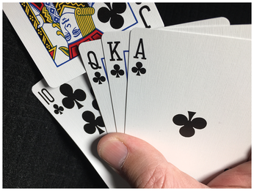
Insertion sort
We will start with insertion sort
Efficient algorithm for sorting small number of elements
Insertion sort works the way many people sort a hand of cards
You start with an empty left hand and a deck of cards on the table
You pick one card at a time from the table
You compare the new card with the cards in the left hand
You make the space for the new card
You insert the new card in the correct position
Source: https://www.linux-magazine.com/Issues/2020/233/Sorted/%28offset%29/3

Slide 10
Insertion sort
def insertion_sort(l):
if len(l) < 2:
return
for i in range(1, len(l)):
current_value = l[i]
j = i - 1
while j >= 0 and current_value < l[j]:
l[j + 1] = l[j]
j -= 1
l[j + 1] = current_value
0 | 1 | 2 | 3 | 4 | 5
5 | 2 | 4 | 6 | 1 | 3

Slide 11
Insertion sort
def insertion_sort(l):
if len(l) < 2:
return
for i in range(1, len(l)):
current_value = l[i]
j = i - 1
while j >= 0 and current_value < l[j]:
l[j + 1] = l[j]
j -= 1
l[j + 1] = current_value
0 | 1 | 2 | 3 | 4 | 5
5 | 2 | 4 | 6 | 1 | 3

Slide 12
Insertion sort
def insertion_sort(l):
if len(l) < 2:
return
for i in range(1, len(l)):
current_value = l[i]
j = i - 1
while j >= 0 and current_value < l[j]:
l[j + 1] = l[j]
j -= 1
l[j + 1] = current_value
0 | 1 | 2 | 3 | 4 | 5
2 | 5 | 4 | 6 | 1 | 3

Slide 13
Insertion sort
def insertion_sort(l):
if len(l) < 2:
return
for i in range(1, len(l)):
current_value = l[i]
j = i - 1
while j >= 0 and current_value < l[j]:
l[j + 1] = l[j]
j -= 1
l[j + 1] = current_value
0 | 1 | 2 | 3 | 4 | 5
2 | 4 | 5 | 6 | 1 | 3

Slide 14
Insertion sort
def insertion_sort(l):
if len(l) < 2:
return
for i in range(1, len(l)):
current_value = l[i]
j = i - 1
while j >= 0 and current_value < l[j]:
l[j + 1] = l[j]
j -= 1
l[j + 1] = current_value
0 | 1 | 2 | 3 | 4 | 5
2 | 4 | 5 | 6 | 1 | 3

Slide 15
Insertion sort
def insertion_sort(l):
if len(l) < 2:
return
for i in range(1, len(l)):
current_value = l[i]
j = i - 1
while j >= 0 and current_value < l[j]:
l[j + 1] = l[j]
j -= 1
l[j + 1] = current_value
0 | 1 | 2 | 3 | 4 | 5
1 | 2 | 4 | 5 | 6 | 3

Slide 16
Insertion sort
def insertion_sort(l):
if len(l) < 2:
return
for i in range(1, len(l)):
current_value = l[i]
j = i - 1
while j >= 0 and current_value < l[j]:
l[j + 1] = l[j]
j -= 1
l[j + 1] = current_value
0 | 1 | 2 | 3 | 4 | 5
1 | 2 | 3 | 4 | 5 | 6

Slide 17
Exercise

Slide 18
Student task
Task 1: Using the table from the previous example as a model, illustrate the operation of the insertion sort on the sequence (31, 41, 59, 26, 41, 58).
Task 2: Rewrite the insertion sort procedure to sort into descending (nonincreasing) order instead of ascending (nondecreasing) order.

Slide 19
Analyzing algorithms

Slide 20
Analyzing algorithms
When analyzing an algorithm we want to predict resources it needs
Time
Memory
We are interested in efficient algorithms that do not require a lot of resources
Before we can analyze an algorithm we need a computation model
Random-access machine (RAM)
Instructions are executed one after another
Analyzing algorithms requires sophisticated mathematical tools:
Combinatorics
Probability theory
Algebra
Asymptotic theory

Slide 21
Analyzing insertion sort
The time taken by the insertion sort depends on the input
Sorting a thousand numbers takes longer than sorting three numbers
Even two input sequences of the same size may take different times
Depending on how nearly sorted they already are
A nearly sorted sequence will take less time
Hence, we need to define terms running time and input size

Slide 22
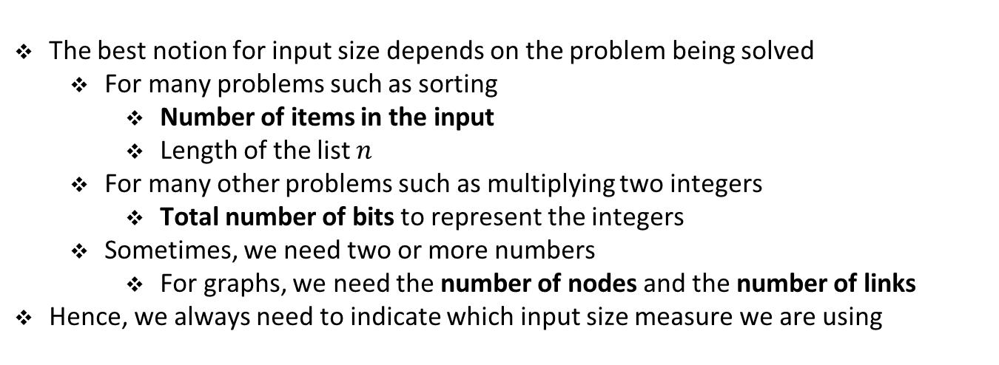
Defining input size
The best notion for input size depends on the problem being solved
For many problems such as sorting
Number of items in the input
Length of the list $n$
For many other problems such as multiplying two integers
Total number of bits to represent the integers
Sometimes, we need two or more numbers
For graphs, we need the number of nodes and the number of links
Hence, we always need to indicate which input size measure we are using

Slide 23
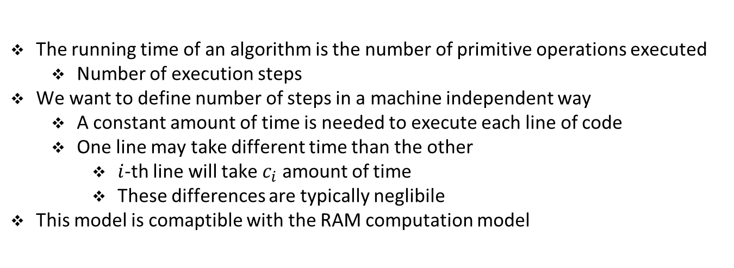
Defining running time
The running time of an algorithm is the number of primitive operations executed
Number of execution steps
We want to define number of steps in a machine independent way
A constant amount of time is needed to execute each line of code
One line may take different time than the other
$i$-th line will take $c_{i}$ amount of time
These differences are typically neglibile
This model is comaptible with the RAM computation model

Slide 24
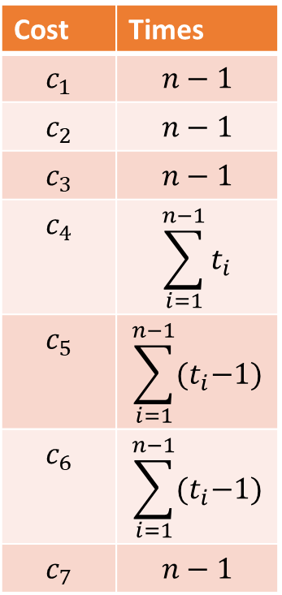
Running time of insertion sort
Cost | Times
$$c_{1}$$ | $$n−1$$
$$c_{2}$$ | $$n−1$$
$$c_{3}$$ | $$n−1$$
$$c_{4}$$ | $$\sum_{i=1}^{n−1}{t_{i}}$$
$$c_{5}$$ | $$\sum_{i=1}^{n−1}{{(t}_{i}−1)}$$
$$c_{6}$$ | $$\sum_{i=1}^{n−1}{{(t}_{i}−1)}$$
$$c_{7}$$ | $$n−1$$
for i in range(1, len(l)):
current_value = l[i]
j = i – 1
while j >= 0 and current_value < l[j]:
l[j + 1] = l[j]
j -= 1
l[j + 1] = current_value

Slide 25
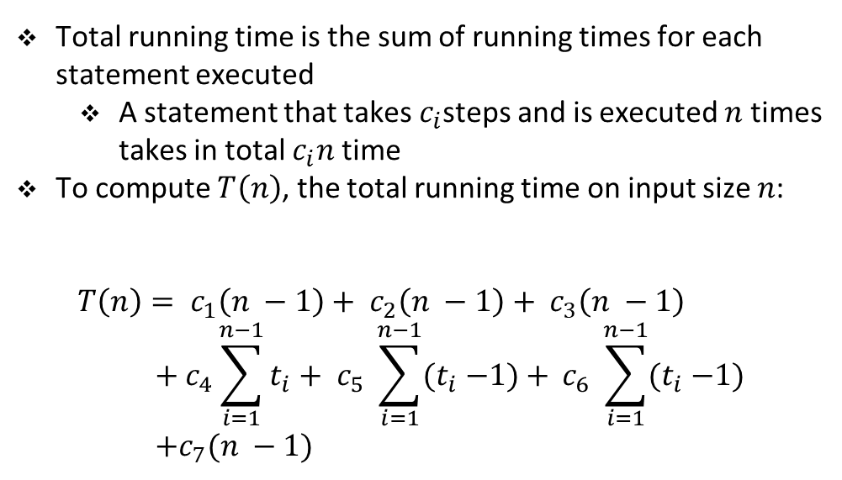
Running time of insertion sort
Cost | Times
$$c_{1}$$ | $$n−1$$
$$c_{2}$$ | $$n−1$$
$$c_{3}$$ | $$n−1$$
$$c_{4}$$ | $$\sum_{i=1}^{n−1}{t_{i}}$$
$$c_{5}$$ | $$\sum_{i=1}^{n−1}{{(t}_{i}−1)}$$
$$c_{6}$$ | $$\sum_{i=1}^{n−1}{{(t}_{i}−1)}$$
$$c_{7}$$ | $$n−1$$
Total running time is the sum of running times for each statement executed
A statement that takes $c_{i}$steps and is executed $n$ times takes in total $c_{i}n$time
To compute $T\left(n\right)$, the total running time on input size $n$:
$$T\left(n\right)= c_{1}\left(n −1\right)+ c_{2}\left(n −1\right)+ c_{3}\left(n −1\right) \\ + c_{4}\sum_{i=1}^{n−1}{t_{i}+ c_{5} \sum_{i=1}^{n−1}{{(t}_{i} −1)+ }c_{6} }\sum_{i=1}^{n−1}{{(t}_{i} −1)} \\ +c_{7}(n −1)$$

Slide 26

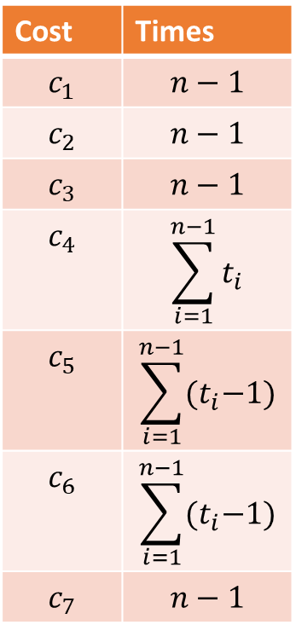
Best case
Cost | Times
$$c_{1}$$ | $$n−1$$
$$c_{2}$$ | $$n−1$$
$$c_{3}$$ | $$n−1$$
$$c_{4}$$ | $$\sum_{i=1}^{n−1}{t_{i}}$$
$$c_{5}$$ | $$\sum_{i=1}^{n−1}{{(t}_{i}−1)}$$
$$c_{6}$$ | $$\sum_{i=1}^{n−1}{{(t}_{i}−1)}$$
$$c_{7}$$ | $$n−1$$
$$T\left(n\right)= c_{1}\left(n −1\right)+ c_{2}\left(n −1\right)+ c_{3}\left(n −1\right) \\ + c_{4}\sum_{i=1}^{n−1}{t_{i}+ c_{5} \sum_{i=1}^{n−1}{{(t}_{i} −1)+ }c_{6} }\sum_{i=1}^{n−1}{{(t}_{i} −1)} \\ +c_{7}(n −1)$$
Best case is when the list is already sorted
while condition is executed only once in each iteration of for
Statements in the while loop are never executed
for i in range(1, len(l)):
current_value = l[i]
j = i - 1
while j >= 0 and current_value < l[j]:
l[j + 1] = l[j]
j -= 1
l[j + 1] = current_value

Slide 27
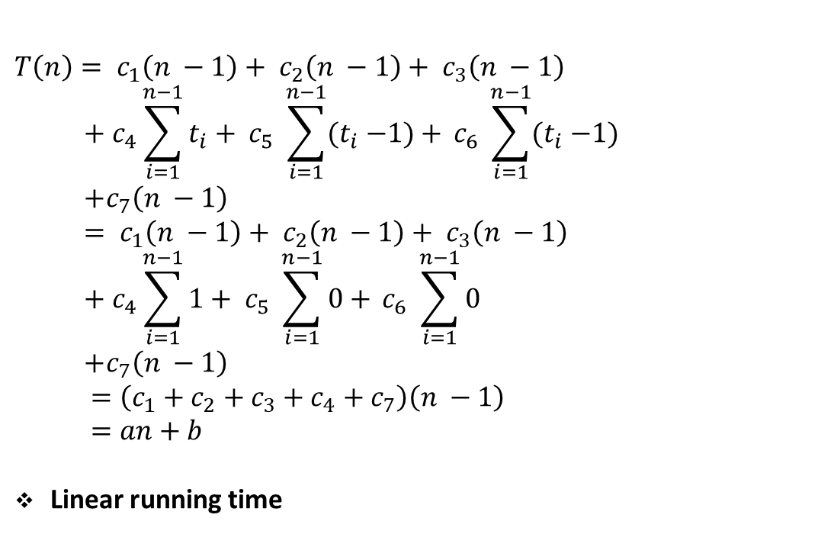
Best case
Cost | Times
$$c_{1}$$ | $$n−1$$
$$c_{2}$$ | $$n−1$$
$$c_{3}$$ | $$n−1$$
$$c_{4}$$ | $$\sum_{i=1}^{n−1}{t_{i}}$$
$$c_{5}$$ | $$\sum_{i=1}^{n−1}{{(t}_{i}−1)}$$
$$c_{6}$$ | $$\sum_{i=1}^{n−1}{{(t}_{i}−1)}$$
$$c_{7}$$ | $$n−1$$
$$T\left(n\right)= c_{1}\left(n −1\right)+ c_{2}\left(n −1\right)+ c_{3}\left(n −1\right) \\ + c_{4}\sum_{i=1}^{n−1}{t_{i}+ c_{5} \sum_{i=1}^{n−1}{{(t}_{i} −1)+ }c_{6} }\sum_{i=1}^{n−1}{{(t}_{i} −1)} \\ +c_{7}\left(n −1\right) \\ = c_{1}\left(n −1\right)+ c_{2}\left(n −1\right)+ c_{3}\left(n −1\right) \\ + c_{4}\sum_{i=1}^{n−1}{1+ c_{5} \sum_{i=1}^{n−1}{0+ }c_{6} }\sum_{i=1}^{n−1}{0} \\ +c_{7}\left(n −1\right)$$ $=\left(c_{1}+c_{2}+c_{3}+c_{4}+c_{7}\right)\left(n −1\right)$ $$=an+b$$
Linear running time

Slide 28
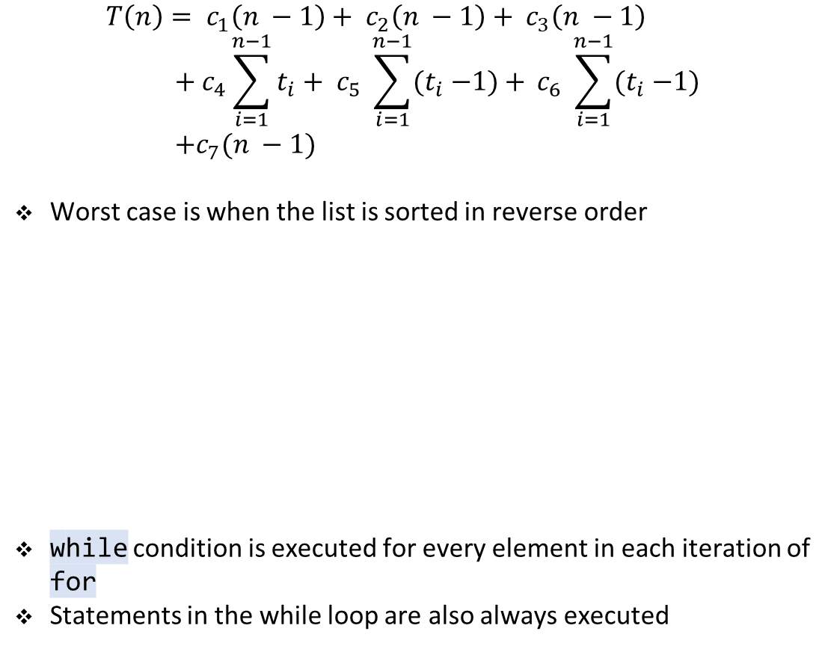
Worst case
Cost | Times
$$c_{1}$$ | $$n−1$$
$$c_{2}$$ | $$n−1$$
$$c_{3}$$ | $$n−1$$
$$c_{4}$$ | $$\sum_{i=1}^{n−1}{t_{i}}$$
$$c_{5}$$ | $$\sum_{i=1}^{n−1}{{(t}_{i}−1)}$$
$$c_{6}$$ | $$\sum_{i=1}^{n−1}{{(t}_{i}−1)}$$
$$c_{7}$$ | $$n−1$$
$$T\left(n\right)= c_{1}\left(n −1\right)+ c_{2}\left(n −1\right)+ c_{3}\left(n −1\right) \\ + c_{4}\sum_{i=1}^{n−1}{t_{i}+ c_{5} \sum_{i=1}^{n−1}{{(t}_{i} −1)+ }c_{6} }\sum_{i=1}^{n−1}{{(t}_{i} −1)} \\ +c_{7}(n −1)$$
Worst case is when the list is sorted in reverse order
while condition is executed for every element in each iteration of for
Statements in the while loop are also always executed
for i in range(1, len(l)):
current_value = l[i]
j = i - 1
while j >= 0 and current_value < l[j]:
l[j + 1] = l[j]
j -= 1
l[j + 1] = current_value

Slide 29
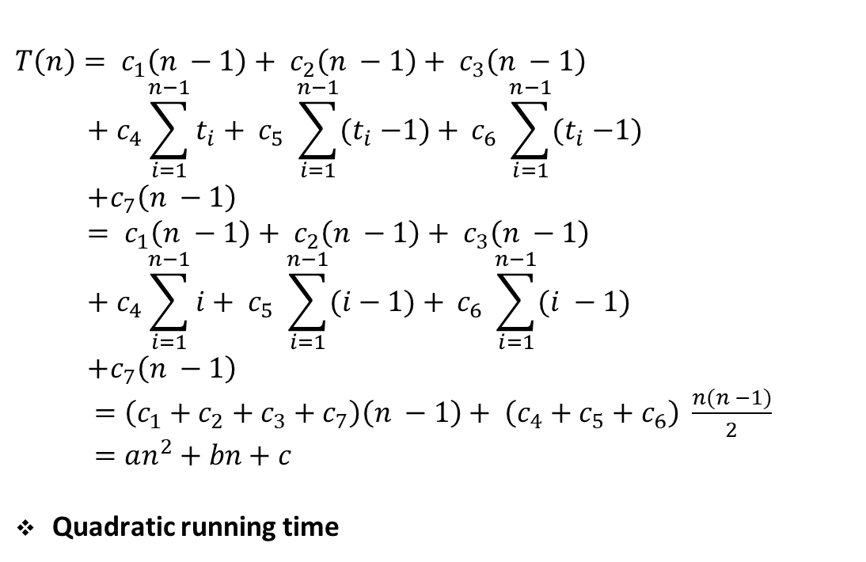
Worst case
Cost | Times
$$c_{1}$$ | $$n−1$$
$$c_{2}$$ | $$n−1$$
$$c_{3}$$ | $$n−1$$
$$c_{4}$$ | $$\sum_{i=1}^{n−1}{t_{i}}$$
$$c_{5}$$ | $$\sum_{i=1}^{n−1}{{(t}_{i}−1)}$$
$$c_{6}$$ | $$\sum_{i=1}^{n−1}{{(t}_{i}−1)}$$
$$c_{7}$$ | $$n−1$$
$$T\left(n\right)= c_{1}\left(n −1\right)+ c_{2}\left(n −1\right)+ c_{3}\left(n −1\right) \\ + c_{4}\sum_{i=1}^{n−1}{t_{i}+ c_{5} \sum_{i=1}^{n−1}{{(t}_{i} −1)+ }c_{6} }\sum_{i=1}^{n−1}{{(t}_{i} −1)} \\ +c_{7}\left(n −1\right) \\ = c_{1}\left(n −1\right)+ c_{2}\left(n −1\right)+ c_{3}\left(n −1\right) \\ + c_{4}\sum_{i=1}^{n−1}{i+ c_{5} \sum_{i=1}^{n−1}{(i−1)+ }c_{6} }\sum_{i=1}^{n−1}{(i −1)} \\ +c_{7}\left(n −1\right)$$ $=\left(c_{1}+c_{2}+c_{3}+c_{7}\right)\left(n −1\right)+ \left(c_{4}+c_{5}+c_{6}\right) \frac{n(n −1)}{2}$ $$=an^{2}+bn+c$$
Quadratic running time

Slide 30
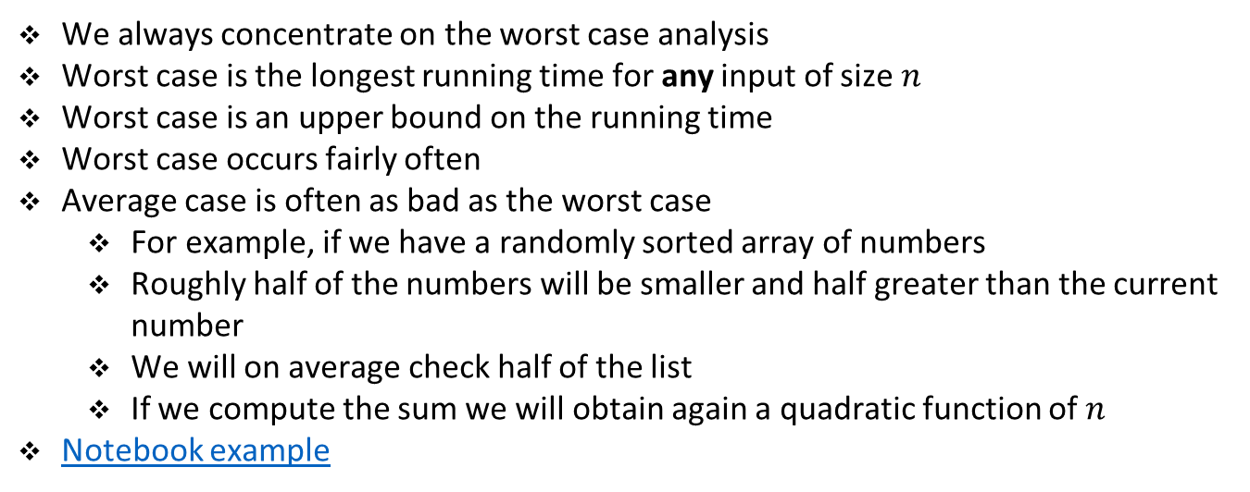
Best vs. worst case running time
We always concentrate on the worst case analysis
Worst case is the longest running time for any input of size $n$
Worst case is an upper bound on the running time
Worst case occurs fairly often
Average case is often as bad as the worst case
For example, if we have a randomly sorted array of numbers
Roughly half of the numbers will be smaller and half greater than the current number
We will on average check half of the list
If we compute the sum we will obtain again a quadratic function of $n$
Notebook example

Slide 31
Exercise

Slide 32
Student task
Task 3: Using the method from before analyze the running time of a simple search.
def search(l, o):
for e in l:
if e == o:
return True
return False

Slide 33
Student task
Task 4: Analyze the running time of an algorithm for finding the maximal number in a list.
def max(l):
m = l[0]
for e in l:
if m < e:
m = e
return m

Slide 34
Student task
Task 5: Analyze the running time of the binary search algorithm for sorted lists.
def binary_search(l, o):
low = 0
high = len(l) - 1
while low <= high:
mid = low + (high - low)//2
if l[mid] == o:
return True
elif l[mid] < o:
low = mid + 1
else:
high = mid - 1
return False

