Slide 1

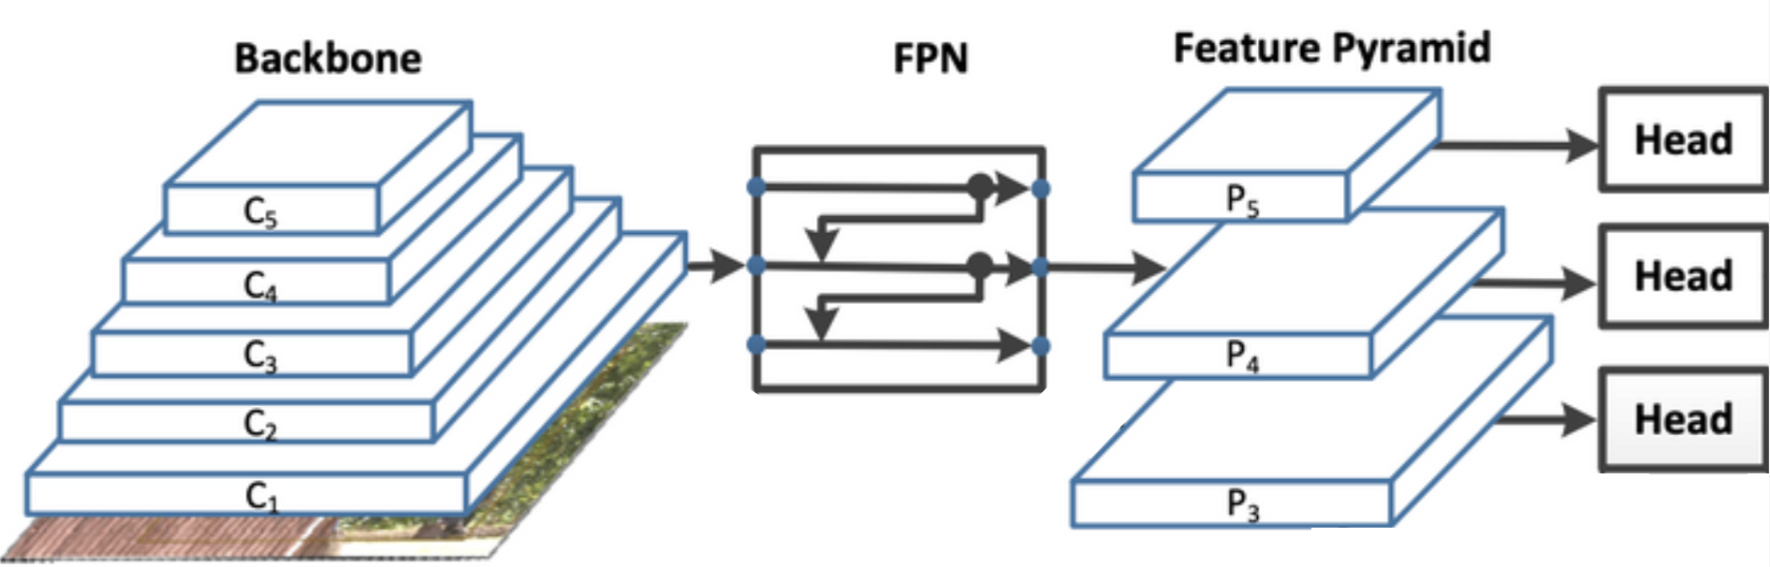
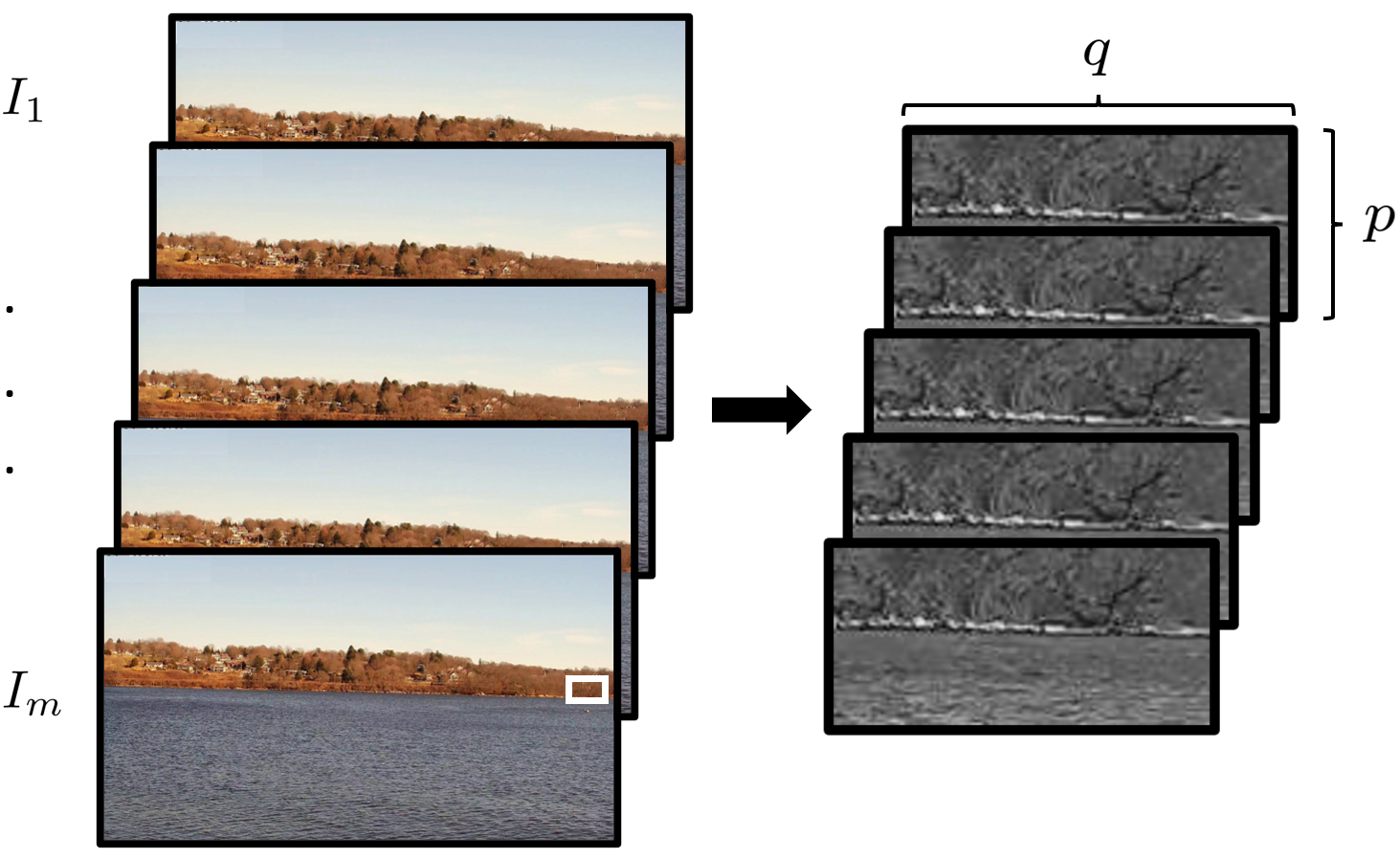
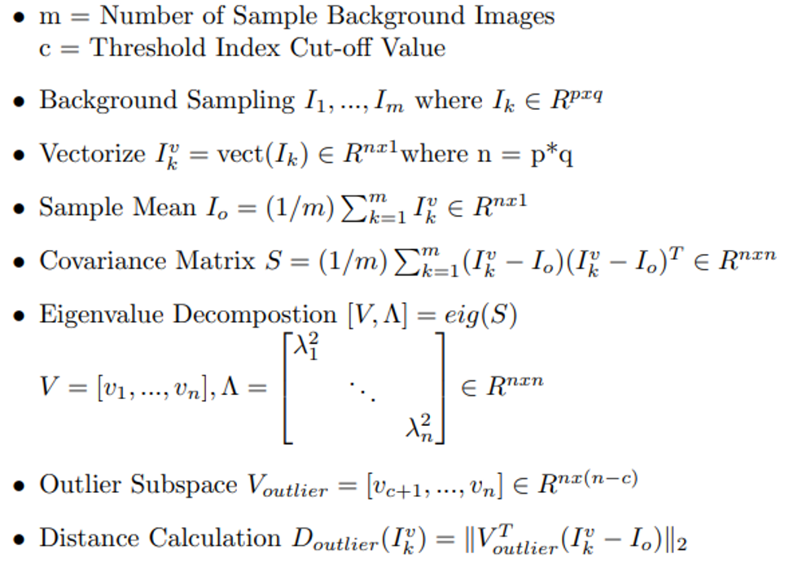
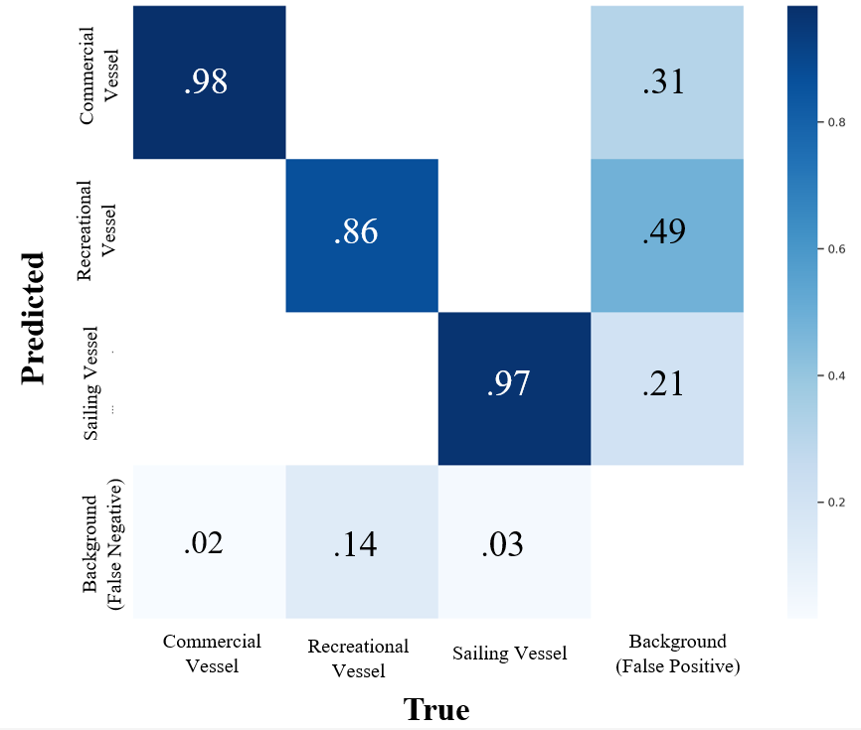
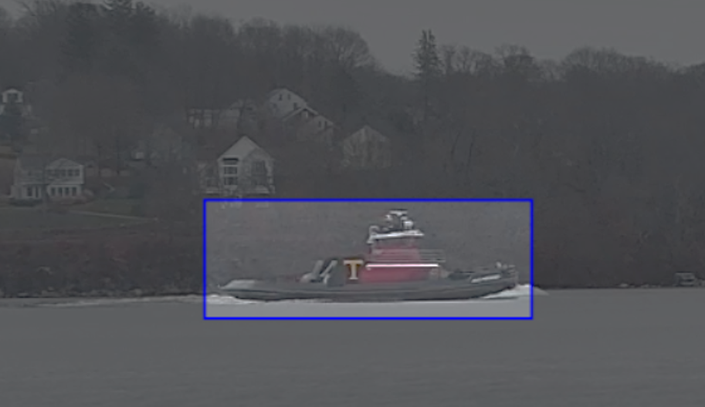
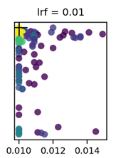
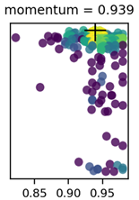
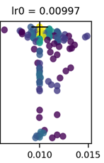
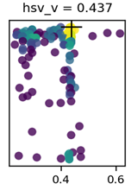
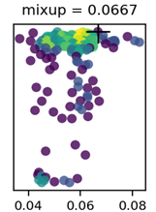
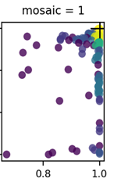
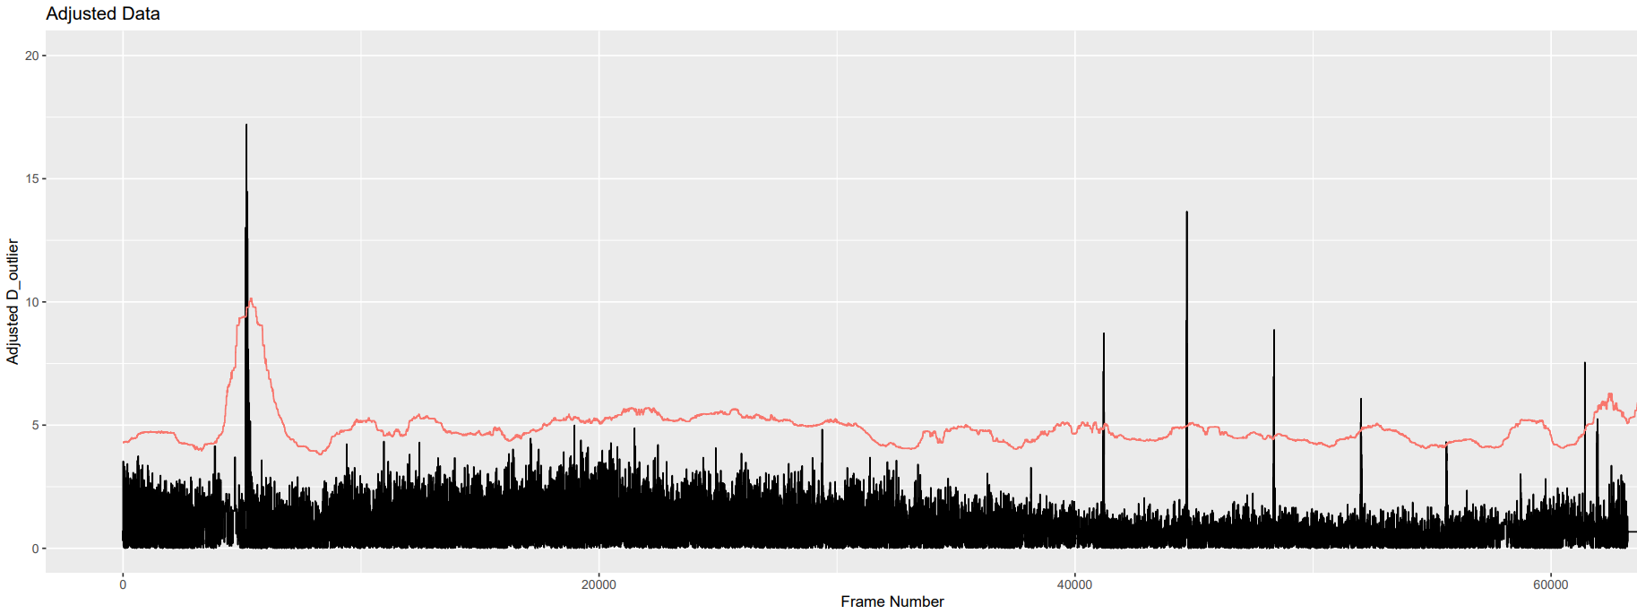
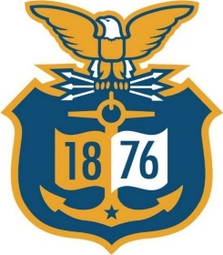

Vessel Detection and Classification through Computer Vision to Aid Maritime Domain Awareness
Department of Mathematics - Spring 2023
Problem Statement:
Using the network and camera infrastructure established by the Fall 2022 Cyber Systems Major Advanced Research Project (ARP), this study seeks to establish a streamlined method of data collection, model tuning, feature extraction, and model training which allows the implementation of a locally processed computer vision model at the Academy Waterfront and on the training vessel SHUMAN.
Methodology:
Object Detection Algorithm:
Classifies and locates objects in image and video data
Uses a one-stage detector, made up of convolutional layers, to produce real-time inference
Architecture of the network allows it to have a trade-off between accuracy and speed
Dynamic Event Detection:
Detects high levels of variance from average background scene
Offers secondary detection model for a higher level of domain awareness
Addresses object detection inefficiency in small and untrained objects
YOLO v7 Algorithm:
One-stage detector
Backbone: convolutional layers
Neck: assemble feature pyramids
Head: detection
Full and tiny models
Principal Component Analysis (PCA) Method:
Used for anomaly detection
Finds subspace corresponding to natural levels of variance to distinguish when outlying event occurs
Sample mean calculated with sliding window on video stream
Data Collection & Final Dataset
Model Training
YOLO v7 Tiny Results:
PCA Results:
Images collected through the Cyber ARP's network
Final dataset consisted of 7,187 instances with the classes: recreational vessel, commercial vessel, and sailing vessel
80% train, 10% test, 10% validation
Hyperparameter and augmentation tuning with YOLO v7 evolve method
Evolved hyperparameters based off error analysis
Model trained on 80 epochs
Detection ran over 36-minute time span at 30 frames per second
Vessels detected by threshold of moving median curve
Model performance by class is indicated in the confusion matrix and table below
A sweep through hyperparameter values led to improved performance (as measured by mAP)
Results
Detections | 7
Misses | 1
Augmentations
Hyperparameters
Class | mAP 0.5 : 0.95
All | 0.603 (+1.5%)
Commercial Vessel | 0.729 (+1.8%)
Recreational Vessel | 0.444 (+1.9%)
Sailing Vessel | 0.637 (+1.0%)
Known Vessels
CLASS​ | TRAIN​ | TEST​ | VALIDATION​ | TOTAL​ | TOTAL ​ (PERCENT)​
COMMERCIAL​ VESSEL​ | 2346​ | 303​ | 303​ | 2952​ | 41.1%​
RECREATIONAL​ VESSEL​ | 1979​ | 249​ | 245​ | 2473​ | 34.4%​
SAILING VESSEL​ | 1427​ | 146​ | 189​ | 1762​ | 24.5%​
Group Members:
1/c Elise Birkhaeuser,
1/c Meghan Bolin, 1/c Clay Forfinski
Advisors:
Dr. Ian Frommer, Dr. Arundhati Bagchi Misra
Sponsors:
Coast Guard Research and Development Center
Notes:
Bit path, paste special (unformatted bit map)
Shrink array down, have 2 bigger ones one evolved and one disabled
Results: put most important things that you can fit (conf mat)
Redo pic of boat with box
Last panel:
What we want to do in the Coast Guard – what are we focusing on
Text mining
Text classification
Global math – data entered incorrectly
Suggestions:
- Don’t use beveled text, it prints pixelated
- Verify pictures if grainy will print pixelated and unreadable
- If doing a picture background verify if distorted. Suggestion is to make use format/ color/ recolor/washout on picture. Warning: If printing a dark heavy color large picture the colors may start to run, and smear.
- Verify presentation is set under Design/ Slide Size/ Custom Slide Size/ width 27 & height 41 & portrait.
- Save as pdf to print ensuring no movement of graphs/ pictures/ textboxes within poster.
- Poster is printed at ratio of 381% if it looks grainy on the screen it will probably print pixelated.

Slide 2
Questions
Should we have a Theme or should it be a white background – this is your choice
Lowercase vs uppercase

