Slide 1
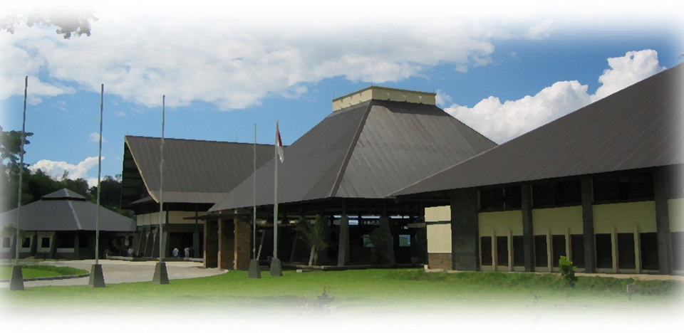
Parallel Processing using GPU
Johannes Sianipar
29 April 2021
Notes:
Komunitas
Membiarkan pelanggaran sama dengan melakukan

Slide 2
Parallel Processing
how you can organize code so that some portions run in parallel, potentially on multiple CPUs or GPUs

Slide 3
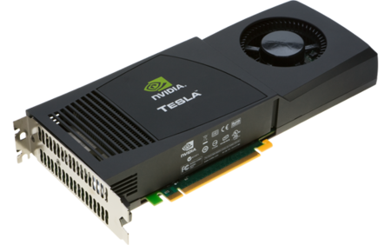
History of GPU
Originally designed as a graphics processor
Originally developed for gaming
Typical workloads requires arithmetic operations on large amounts of data (pixels, objects, etc) for rendering and shading
Designed to be good at matrix operations
Nvidia's GeForce 256 (1999) – first GPU

Slide 4
GPU Usage
Embedded systems
Personal Computers
Game consoles
Mobile Phones
Workstations

Slide 5
When is a GPU a good idea?
Linear algebra
Signal and image processing (FFTs)
Neural networks and deep learning
Other machine learning algorithms, including generalized linear models, gradient boosting, etc.
Monte Carlo simulation and particle transport
Fluid simulation
In-memory databases
Etc.

Slide 6
What types of operations should I send to the GPU?
In general, if the step of the process can be described such as “do this mathematical operation thousands of times”, then send it to the GPU.
matrix multiplication and computing the inverse of a matrix.
There is also a cost to changing devices and using GPUs.
GPUs don’t have direct access to the rest of your computer (except, of course for the display).
Due to this, if you are running a command on a GPU, you need to copy all of the data to the GPU first, then do the operation, then copy the result back to your computer’s main memory.
TensorFlow handles this under the hood, so the code is simple.

Slide 7
GPU & CPU Specifications
Cores
CPUs consist of a few cores optimized for serial processing
GPUs consist of hundreds or thousands of smaller, efficient cores designed for parallel performance
GPU provides much higher instruction throughput and memory bandwidth than the CPU within a similar price and power envelope.
Many applications leverage these higher capabilities to run faster on the GPU than on the CPU

Slide 8
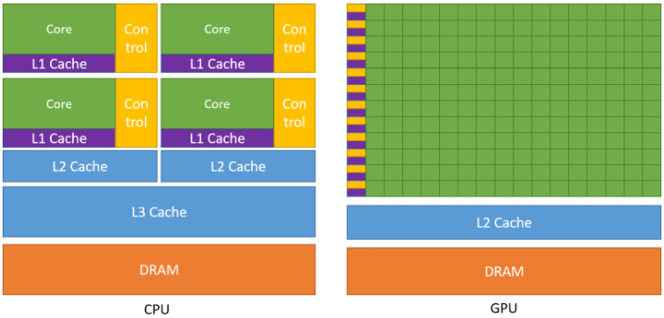
GPU & CPU Architecture
CPU is designed to excel at executing a sequence of operations, called a thread, as fast as possible and can execute a few tens of these threads in parallel
GPU is designed to excel at executing thousands of them in parallel (amortizing the slower single-thread performance to achieve greater throughput)
https://docs.nvidia.com/cuda/cuda-c-programming-guide/index.html

Slide 9
CUDA - Compute Unified Device Architecture
Parallel computing platform and application programming interface (API) model created by Nvidia
Allows software developers and software engineers to use a CUDA-enabled graphics processing unit for general purpose processing
CUDA Toolkit
https://developer.nvidia.com/cuda-toolkit
provides a development environment for creating high performance GPU-accelerated applications

Slide 10
CUDA (Cont.)
Two keywords widely used in CUDA programming model:
host and device.
The host is the CPU available in the system. The system memory associated with the CPU is called host memory.
The GPU is called a device and GPU memory likewise called device memory.
To execute any CUDA program, there are three main steps:
Copy the input data from host memory to device memory, also known as host-to-device transfer.
Load the GPU program and execute, caching data on-chip for performance.
Copy the results from device memory to host memory, also called device-to-host transfer.

Slide 11
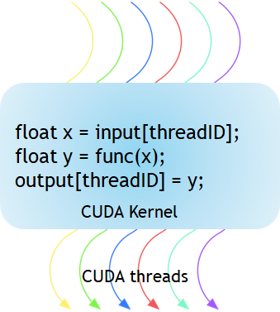
CUDA Kernel
The kernel is a function executed on the GPU.
The parallel portion of your applications is executed K times in parallel by K different CUDA threads, as opposed to only one time like regular C/C++ functions
Every CUDA kernel starts with a __global__ declaration specifier.
https://developer.nvidia.com/blog/cuda-refresher-cuda-programming-model/

Slide 12
CUDA Kernel (Cont.)
// Kernel definition
__global__ void VecAdd(float* A, float* B, float* C)
{
int i = threadIdx.x;
C[i] = A[i] + B[i];
}
int main()
{
...
// Kernel invocation with N threads
VecAdd<<<1, N>>>(A, B, C);
...
}

Slide 13
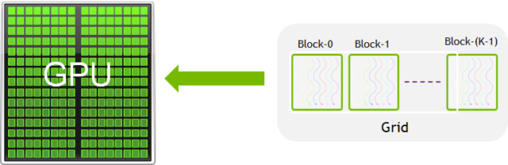
CUDA Block
A group of threads is called a CUDA block. CUDA blocks are grouped into a grid. A kernel is executed as a grid of blocks of threads
Each CUDA block is executed by one streaming multiprocessor (SM) and cannot be migrated to other SMs in GPU (except during preemption, debugging, or CUDA dynamic parallelism).
https://developer.nvidia.com/blog/cuda-refresher-cuda-programming-model/

Slide 14
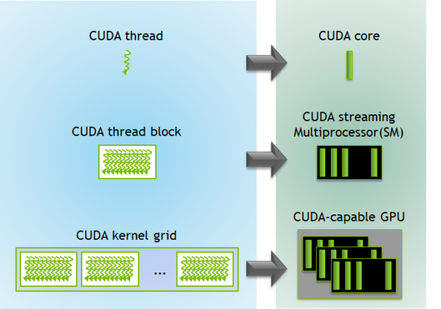
Cuda - Hardware
One SM can run several concurrent CUDA blocks depending on the resources needed by CUDA blocks.
Each kernel is executed on one device and CUDA supports running multiple kernels on a device at one time
https://developer.nvidia.com/blog/cuda-refresher-cuda-programming-model/

Slide 15
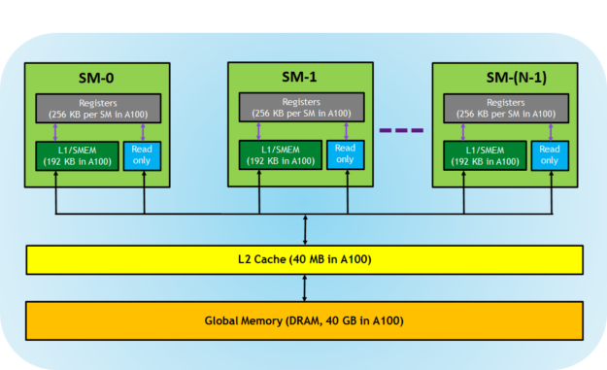
Memory Hierarchy in GPU

Slide 16
Memory Hierarchy in GPU
Registers—These are private to each thread, which means that registers assigned to a thread are not visible to other threads. The compiler makes decisions about register utilization.
L1/Shared memory (SMEM)—Every SM has a fast, on-chip scratchpad memory that can be used as L1 cache and shared memory. All threads in a CUDA block can share shared memory, and all CUDA blocks running on a given SM can share the physical memory resource provided by the SM.
Read-only memory—Each SM has an instruction cache, constant memory, texture memory and RO cache, which is read-only to kernel code.
L2 cache—The L2 cache is shared across all SMs, so every thread in every CUDA block can access this memory. The NVIDIA A100 GPU has increased the L2 cache size to 40 MB as compared to 6 MB in V100 GPUs.
Global memory—This is the framebuffer size of the GPU and DRAM sitting in the GPU.

Slide 17
Libraries (GPU)
pyCuda
Python programming environment for CUDA
Numba
an open source JIT compiler that translates a subset of Python and NumPy code into fast machine code.
pyTorch
an open source machine learning library based on the Torch library, used for applications such as computer vision and natural language processing, primarily developed by Facebook's AI Research lab (FAIR)
TensorFlow
a free and open-source software library for machine learning. It can be used across a range of tasks but has a particular focus on training and inference of deep neural networks.
Keras
an open-source software library that provides a Python interface for artificial neural networks. Keras acts as an interface for the TensorFlow library

Slide 18
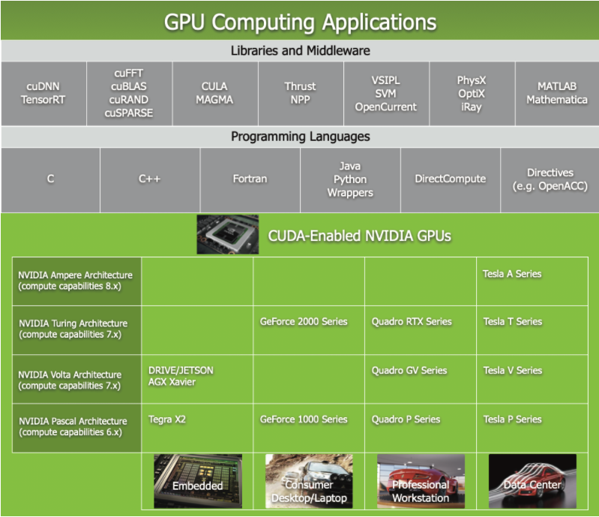
Libraries (GPU)

Slide 19
PyCuda
PyCUDA lets you access Nvidia’s CUDA parallel computation API from Python
import pycuda.autoinit
import pycuda.driver as drv
import numpy
from pycuda.compiler import SourceModule
mod = SourceModule("""
__global__ void multiply_them(float *dest, float *a, float *b)
{
const int i = threadIdx.x;
dest[i] = a[i] * b[i];
}
""")
multiply_them = mod.get_function("multiply_them")
a = numpy.random.randn(400).astype(numpy.float32)
b = numpy.random.randn(400).astype(numpy.float32)
dest = numpy.zeros_like(a)
multiply_them(
drv.Out(dest), drv.In(a), drv.In(b),
block=(400,1,1), grid=(1,1))
print(dest-a*b)

Slide 20
Numba
a Python compiler from Anaconda that can compile Python code for execution on CUDA®-capable GPUs.
With CUDA Python and Numba, you get the best of both worlds:
rapid iterative development with Python combined with the speed of a compiled language targeting both CPUs and NVIDIA GPUs.
import numpy as np
from timeit import default_timer as timer
from numba import vectorize
@vectorize(["float32(float32,float32)"],target = 'cuda')
def VectorAdd(a,b):
return a + b
def main():
N = 32000000
A = np.ones(N,dtype=np.float32)
B = np.ones(N,dtype=np.float32)
C = np.zeros(N,dtype=np.float32)
start = timer()
C = VectorAdd(A,B)
vectoradd_time = timer() - start
print("C[:5] = " + str(C[:5]))
print("C[-5:]= " + str(C[-5:]))
print("VectorAdd took %f seconds" % vectoradd_time)
if __name__ == '__main__':
main()

Slide 21
PyTorch
an optimized tensor library for deep learning using GPUs and CPUs.
import torch
import math
dtype = torch.float
device = torch.device("cpu")
# device = torch.device("cuda:0") # Uncomment this to run on GPU
# Create random input and output data
x = torch.linspace(-math.pi, math.pi, 2000, device=device, dtype=dtype)
y = torch.sin(x)
# Randomly initialize weights
a = torch.randn((), device=device, dtype=dtype)
b = torch.randn((), device=device, dtype=dtype)
c = torch.randn((), device=device, dtype=dtype)
d = torch.randn((), device=device, dtype=dtype)
learning_rate = 1e-6
for t in range(2000):
# Forward pass: compute predicted y
y_pred = a + b * x + c * x ** 2 + d * x ** 3
# Compute and print loss
loss = (y_pred - y).pow(2).sum().item()
if t % 100 == 99:
print(t, loss)
# Backprop to compute gradients of a, b, c, d with respect to loss
grad_y_pred = 2.0 * (y_pred - y)
grad_a = grad_y_pred.sum()
grad_b = (grad_y_pred * x).sum()
grad_c = (grad_y_pred * x ** 2).sum()
grad_d = (grad_y_pred * x ** 3).sum()
# Update weights using gradient descent
a -= learning_rate * grad_a
b -= learning_rate * grad_b
c -= learning_rate * grad_c
d -= learning_rate * grad_d
print(f'Result: y = {a.item()} + {b.item()} x + {c.item()} x^2 + {d.item()} x^3')

Slide 22
Tensorflow
TensorFlow is an end-to-end open source platform for machine learning
import tensorflow as tf
print("Num GPUs Available: ", len(tf.config.list_physical_devices('GPU')))
import tensorflow as tf
mnist = tf.keras.datasets.mnist
(x_train, y_train),(x_test, y_test) = mnist.load_data()
x_train, x_test = x_train / 255.0, x_test / 255.0
model = tf.keras.models.Sequential([
tf.keras.layers.Flatten(input_shape=(28, 28)),
tf.keras.layers.Dense(128, activation='relu'),
tf.keras.layers.Dropout(0.2),
tf.keras.layers.Dense(10, activation='softmax')
])
model.compile(optimizer='adam',
loss='sparse_categorical_crossentropy',
metrics=['accuracy'])
model.fit(x_train, y_train, epochs=5)
model.evaluate(x_test, y_test)

Slide 23
Reference
Distributed Computing with Python by Francesco Pierfederici
https://developer.nvidia.com/blog/cuda-refresher-cuda-programming-model/#:~:text=CUDA%20kernels%20are%20subdivided%20into,are%20grouped%20into%20a%20grid.&text=Each%20kernel%20is%20executed%20on,hardware%20resources%20available%20in%20GPU.
https://docs.nvidia.com/cuda/cuda-c-programming-guide/index.html
https://developer.nvidia.com/how-to-cuda-python

Slide 24
Thank you for your attention!
Johannes Sianipar

