Slide 1

Ifsan Imran: | 221089
Mishkat Fatima: | 221336
Muhammad Moiz: | 221073
NoiseSentinel: Portable IoT Stick for Detecting Modified Bike Silencers
FYP Semester: | I
FYP-ID:
NoiseSentinal
Date: | 02-06-2025
Supervisor: | Dr Abdul Hameed

Slide 2
Table of Contents
NoiseSentinal
Introduction
Problem Statement
Related System Analysis/Literature Review
Problem Solution
Objectives
Architecture Diagram
Mockups

Slide 3
Introduction
Noise pollution from illegal bike silencers is a growing problem.
Traditional detection methods are unreliable.
Courts demand digital, verifiable proof.
Need for an automated, field-usable solution

Slide 4
Problem Statement
No accurate system to detect modified silencers.
Police rely on judgment, which is often challenged.
Courts reject cases due to lack of sound proof.
Legal process becomes ineffective against violators.

Slide 5
Problem Solution
A handheld IoT stick to detect modified silencers.
Device captures exhaust audio and sends to mobile app.
App generates challan with tamper-proof evidence.
Data uploaded to a web portal for legal access.

Slide 6
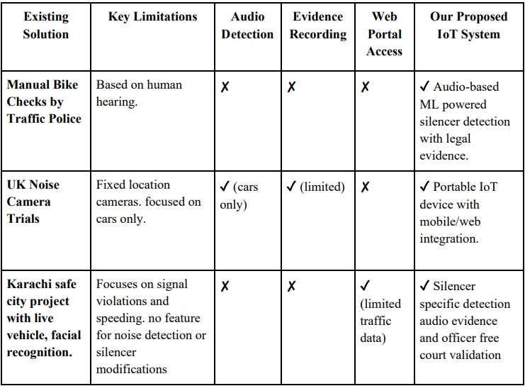
Related System Analysis / Literature Review

Slide 7
Modules
IoT Stick
Web Portal
Mobile App
App Connectivity
Noise/Sound Classification
Pollution Classification
Data Forwarding
Login / Signup
Officer/Court Registration
Device Registration
Report Generation
Record Search
Challan Updates
Notification & Dashboard
Challan Generation
Record Search

Slide 8
Objectives
Detect silencer tampering using sound analysis.
Provide digital evidence (audio, location, officer ID).
Auto-generate challans with mobile app.
Allow court access to reduce in-person testimonies.
Improve legal reliability and reduce urban noise.

Slide 9
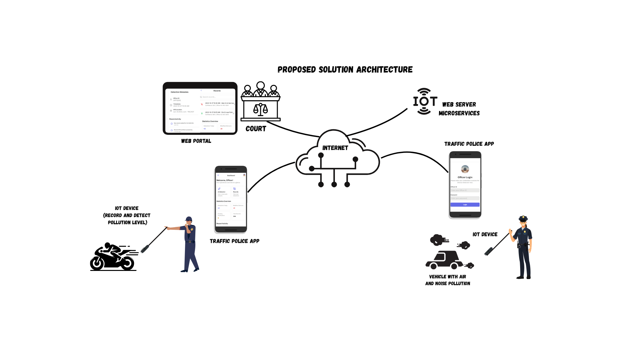
Architecture Diagram

Slide 10
Motivation
Eliminate the need for costly laboratory inspection of vehicles
No need for the officer’s testimony(shahadat) or bike in court.
Allow courts and authorities to view evidence remotely.
Make easy relevant departments to monitor the progress of each case.

Slide 11
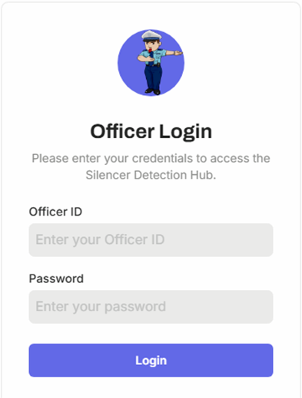
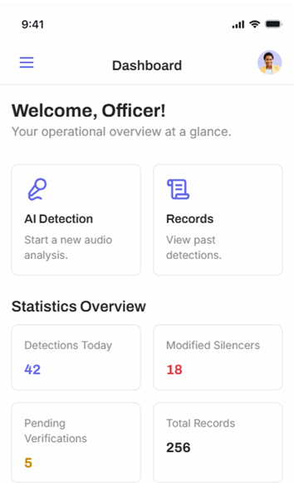
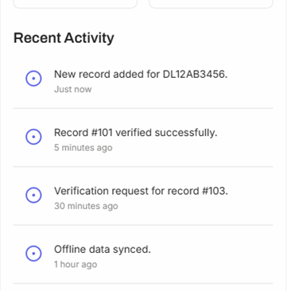
Mockups
Login Screen
Dashboard

Slide 12
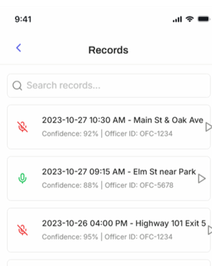
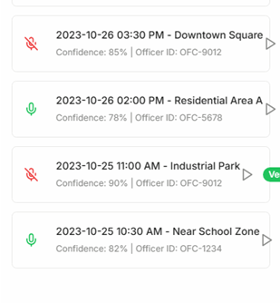
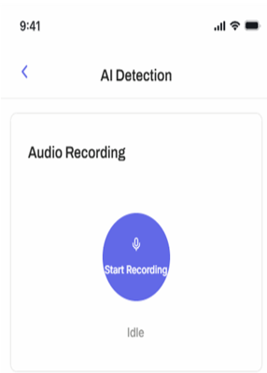
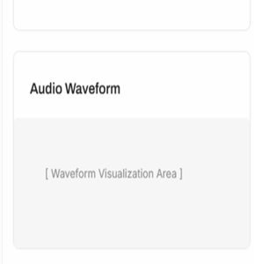
Mockups
Records
AI Detection

Slide 13
Thank You

