Slide 1
Git1x1

Slide 2
Git
Free and Open Source Version control system
“Source Control Management” (SCM)
Managing your files, keep track of changes
Which file(s) have changed?
Who made the change(s)
Review/Discuss changes
When has it changed?
Mostly for software development
Websites
Commercial and Non-commercial Software
Writing Books / Scripts / Scores
Perfect for collaboration
If necessary, revert changes to stable/correct version

Slide 3
Git…
is transparent
requires an active revision to make changes
requires a lot of space on the (remote) hard drive
requires many transmissions of data between local/remote (host/client)
is mostly used via command line
is also available in many softwares with GUIs, like Github Desktop

Slide 4
Git & Github Tutorial Texts
https://web.archive.org/web/20170602211147/http://gitref.org/
https://blog.gitguardian.com/github-actions-security-cheat-sheet/
Włodzimierz Gajda: Git Recipes. A Problem-Solution Approach, Apress 2013, https://link.springer.com/book/10.1007/978-1-4302-6104-9

Slide 5
Git & Github Tutorial Videos
https://www.youtube.com/playlist?list=PLRqwX-V7Uu6ZF9C0YMKuns9sLDzK6zoiV
https://www.youtube.com/playlist?list=PL4cUxeGkcC9goXbgTDQ0n_4TBzOO0ocPR
https://www.udemy.com/course/git-and-github-crash-course-creating-a-repository-from-scratch/
https://www.youtube.com/playlist?list=PLhW3qG5bs-L8OlICbNX9u4MZ3rAt5c5GG
https://www.youtube.com/playlist?list=PLWKjhJtqVAbkFiqHnNaxpOPhh9tSWMXIF

Slide 6
Git-Terminology

Slide 7
Repository
One repository is typically one software that is worked on
Examples:
One game
One website
One Book
One Android App
…
Sometimes, it is not much more than a folder structure with single files

Slide 8
Project
A repository is practically the same as a project
Project and Repository used to be synonyms
By now, projects contain a project management tool (mostly using a visual board) and can contain one or more repositories

Slide 9
2 Lines
Local and remote
Local:
Only you are working on it
Local is often on your PC (HDD)
Local can also mean on a cloud / server accessible (read/write access) by your PC
Remote:
Remote code is available for you and others
Nobody is working on it, except for push / merge

Slide 10
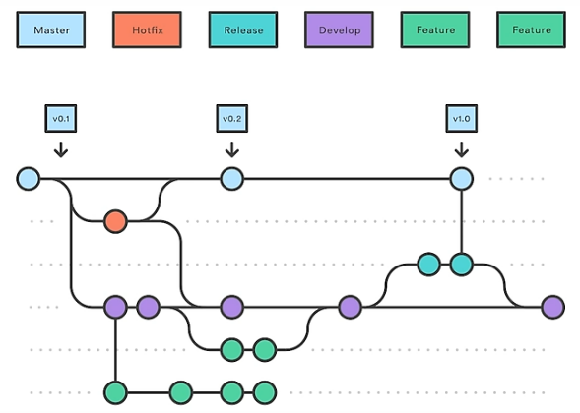
Branches and Commits

Slide 11
Main
The “main” branch (used to be called “master”) is the software as it is supposed to be
Ideally, the main branch contains no unused features, no unfinished code and no known bugs

Slide 12
Other branches
“Hotfix” for urgent bug fixes
Developer branch for adding/restructuring/modifying code
Feature1 branch for adding feature 1
Feature2 branch for adding feature 2
TomFeature1 and JerryFeature1 branches if multiple people work individually on the same feature (e.g., if you have different solution approaches in mind)
QAbranch (quality assurance, alpha testing, performance tests, …)
Production Branch (for compiling and releasing software)
…

Slide 13
Branches…
are copies of the main branch or other branches at one point in time (commit)
Every branch has its own history of commits

Slide 14
Commit
A commit means you safe and describe the current state of your (local) branch (all files)
Every commit gets a title and a short description:
What has changed and
why
Best practice: Make many small commits

Slide 15
Why commits?
Git can recover every single commit
if your code is broken
if you or your customer changed their minds and want to neglect the latest changes
You have a brief documentation on what you have done when and why

Slide 16
Dangers
Branches having their own line of commits can cause conflicts:
What if one person changes a variable name that is also used by others?
What if you delete a function that others are using?
What if two people created different files with the exact same file name?
Don’t worry, Git has many functions to solve / prevent conflicts

Slide 17
Fetch
A fetch downloads the latest commit of your desired branch from remote to local
A fetch is all you need when you have not worked on the code locally, so you simply update your local branch to the latest version
But what if several different local and remote commits exist?
This can mean that you have two versions of a branch:
One with your local commits
One with the remote commits
These may be conflicting

Slide 18
Push
To copy your commit from local to remote, you have to push it
You usually do not push every single commit
Instead, you push as soon as you’ve created a commit that shall be shared with others (e.g., when you completed a function)

Slide 19
Merge
Merge means you apply changes, e.g., from your local developer branch to your local main branch
If they are conflicting, you have to resolve issues:
Whose new lines of code are accepted?
In what order?
Do I accept deletions of code lines from on of the branches, or not?
What if two graphic files have the same file name but different content?
Do I stick to one of them?
Do I need to rename one file?
Does this means I have to change a file path in the source code?
…
Every merge is a new commit

Slide 20
Pull
Pull is just a combination of fetch and merge:
Fetches the latest version from remote
Then merges your latest local version with the latest remote version

Slide 21
Clones…
… are meaningful when you have push access (as a collaborator of a repository)
… are not meaningful if you are no collaborator. In this case, you fork a project.

Slide 22
Clone
A forked repository is on the host
To create a local copy, you need to clone it (download)
From this point on, you can fetch and merge from the upstream project
You can push, fetch, merge, pull, within your fork
You can fetch/merge from the upstream project but not push to it
You can request changes/modifications to the upstream project:
This is called a “pull request”
Maintainers of the upstream project can review your request and approve / decline your pull request

Slide 23
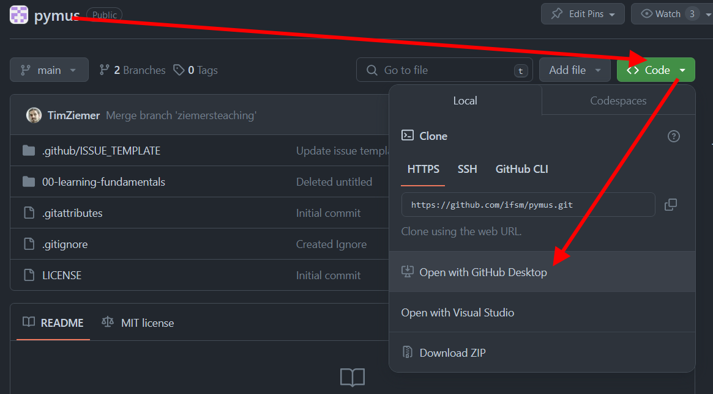
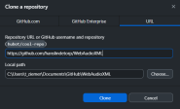
Clone
A clone is a copy of a remote repo to your local repo
You just choose the source and a local folder to copy it to

Slide 24
Fork
When you are a member of a project team, you can contribute to it directly (using a local clone)
When you’re not a member, you can fork public projects
A forked project is a copy of the “upstream”-repository, including all settings:
You are the owner of the copy
The source of the project remains known (projects stay linked)
You can send pull requests to the upstream project
You can leave the traces of the upstream and continue to develop your own project in another direction

Slide 25
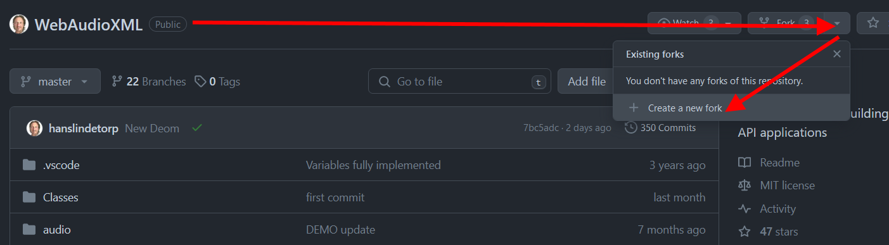
Fork
A fork copies the project to your remote github account
To work on that locally, you clone the fork

Slide 26
Pull Request
Request to add your code to the main branch
Give your new code/changes a title
Describe what is new
Your request should be reviewed
Your pull request can be rejected (hopefully with good arguments)
Your pull request can be approved, meaning that your changes are merged into the master branch

Slide 27
Issues
Place to discuss:
Bug report
Feature request
Custom templates, e.g., to suggest changes (more efficient code, different order of operations, …)

Slide 28
Bug report
**Describe the bug**
A clear and concise description of what the bug is.
**To Reproduce**
Steps to reproduce the behavior:
1. Go to '...'
2. Click on '....'
3. Scroll down to '....'
4. See error
**Expected behavior**
A clear and concise description of what you expected to happen.
**Screenshots**
If applicable, add screenshots to help explain your problem.
**Desktop (please complete the following information):**
- OS: [e.g. iOS]
- Browser [e.g. chrome, safari]
- Version [e.g. 22]
**Smartphone (please complete the following information):**
- Device: [e.g. iPhone6]
- OS: [e.g. iOS8.1]
- Browser [e.g. stock browser, safari]
- Version [e.g. 22]
**Additional context**
Add any other context about the problem here.

Slide 29
Famous Github Projects

Slide 30
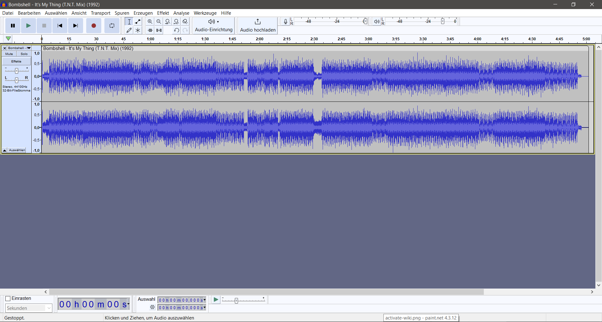
Audacity
https://github.com/audacity/audacity

Slide 31
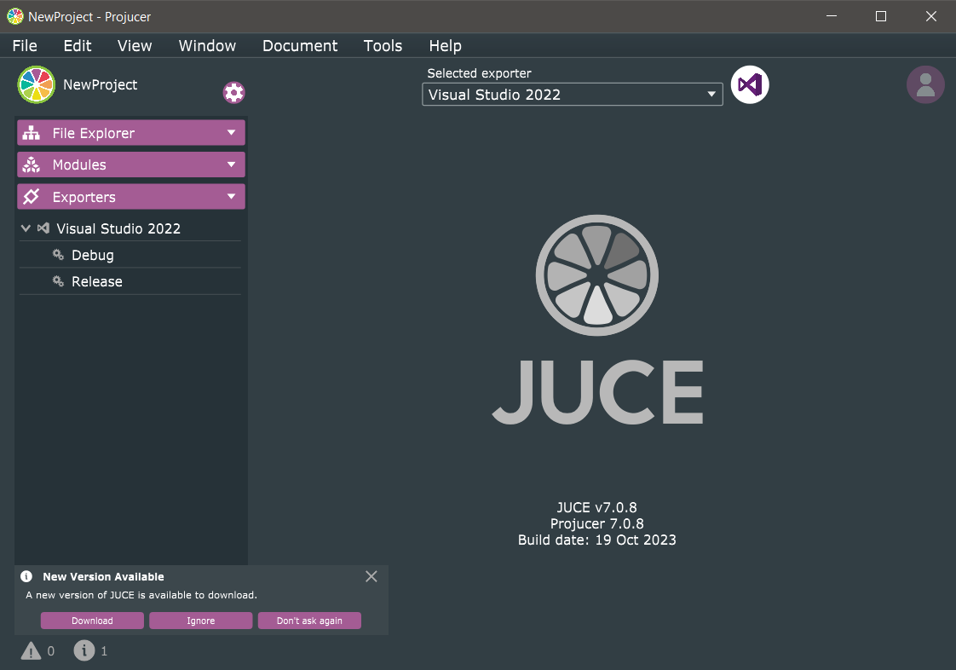
JUCE
https://github.com/juce-framework/JUCE

Slide 32

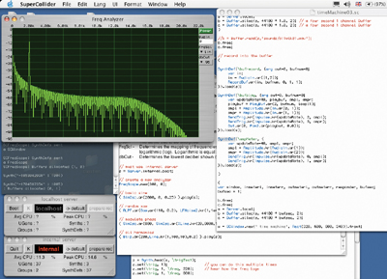
Super Collider
https://github.com/supercollider/supercollider?tab=readme-ov-file

Slide 33
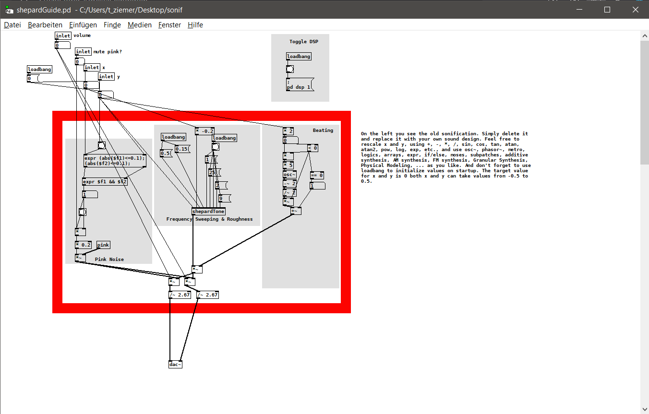
Pure Data
https://github.com/pure-data/pure-data

Slide 34
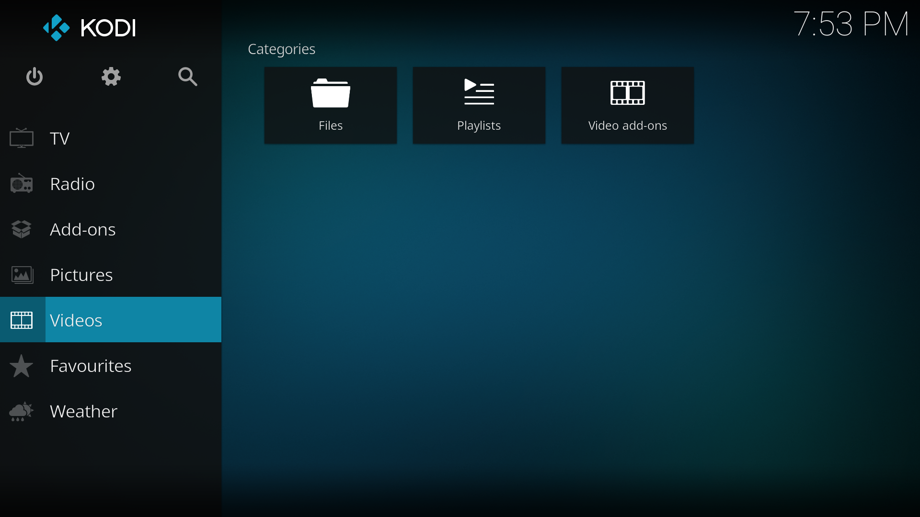
Kodi – Media Center (ex-Microsoft)
https://github.com/xbmc/xbmc

Slide 35

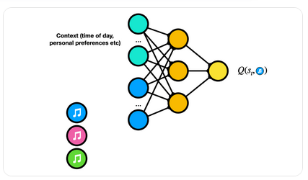
TensorFlow – Google ML
https://github.com/tensorflow/tensorflow

Slide 36
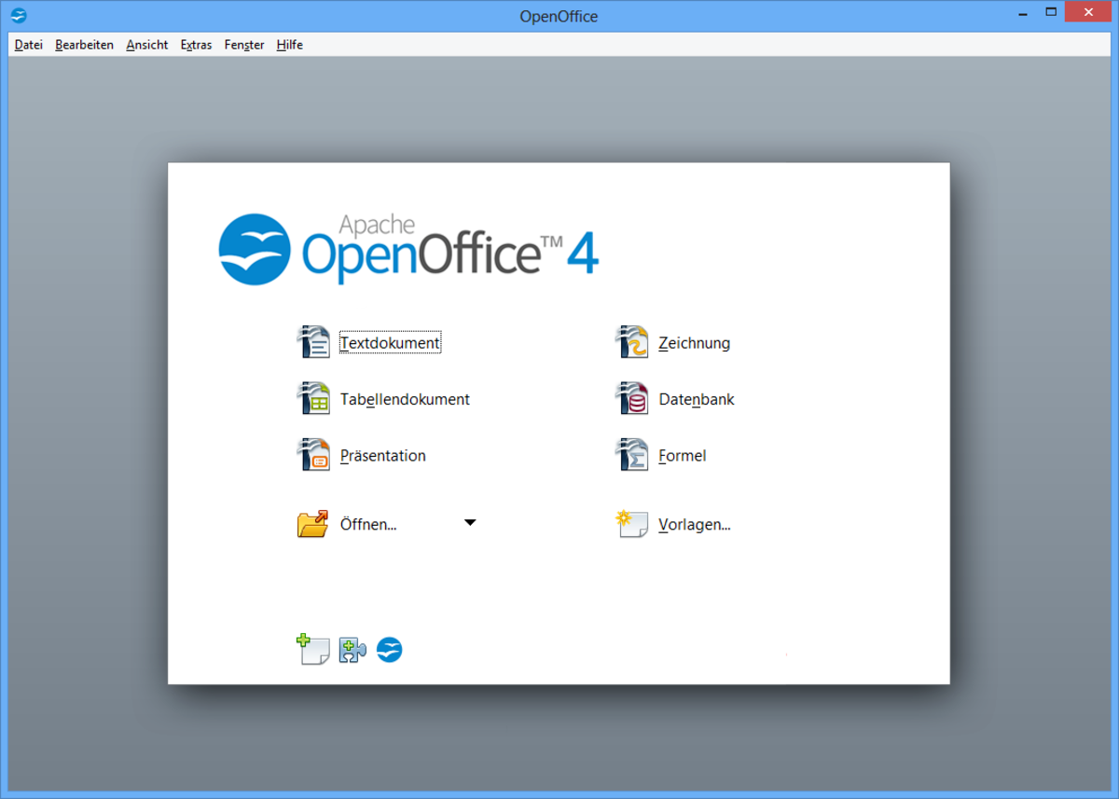
Open Office
https://github.com/apache/openoffice

Slide 37
GPTs
https://github.com/imartinez/privateGPT
https://github.com/Pythagora-io/gpt-pilot
https://github.com/Significant-Gravitas/AutoGPT
https://github.com/geekan/MetaGPT
https://github.com/AIGC-Audio/AudioGPT

Slide 38
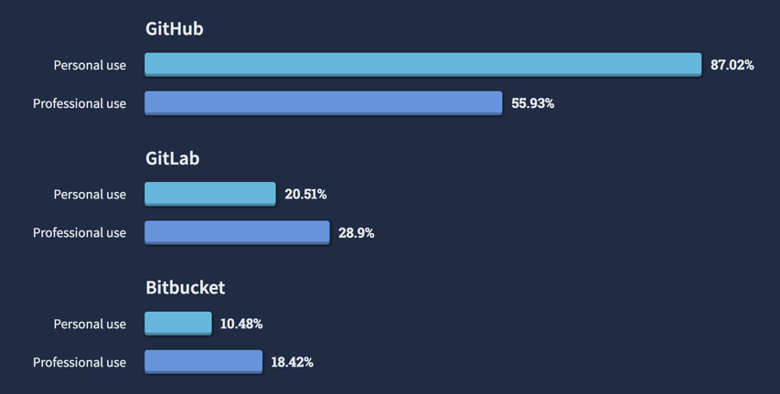
GitHub-Alternatives
https://survey.stackoverflow.co/2022/#section-version-control-version-control-platforms0

Slide 39
Gitlab
Open Source
You can use your own server
Gitlab projects can easily be ported to GitHub

Slide 40
BitBucket
Centered around Jira, a software for workflow management
Not only dedicated to doftware development, but to production and processes in general

Slide 41
Git-Clients
GitKraken
GitHub Desktop
gitk
…

Slide 42
Issues in GitHub

Slide 43
Issues
Githib knows several types of issue
You can also define new types

Slide 44
Homework:
Request your feature (Github will help you with that)

Slide 45
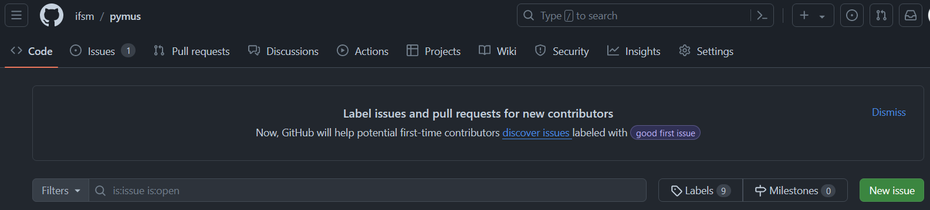

Slide 46
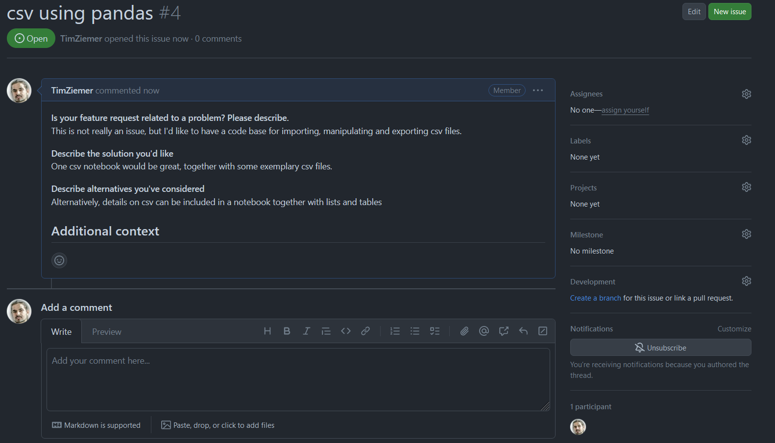

Slide 47
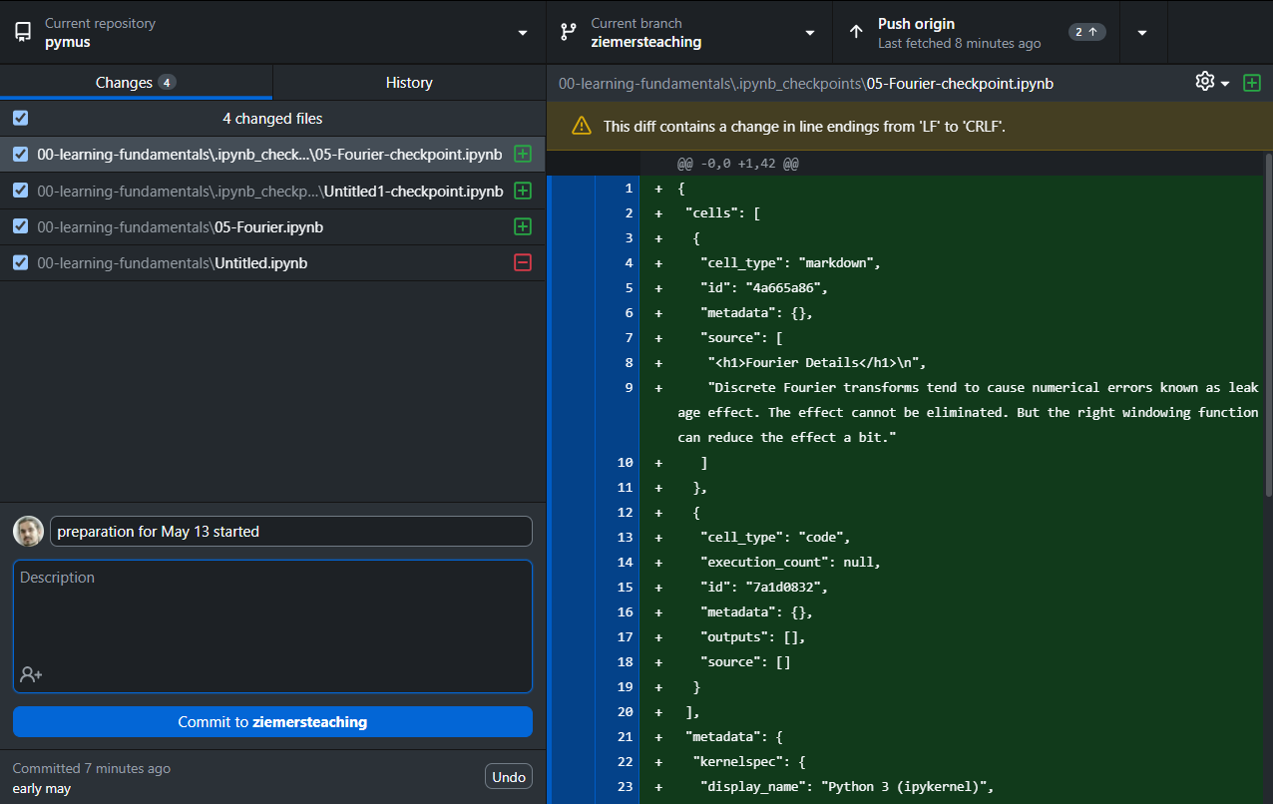

Slide 48
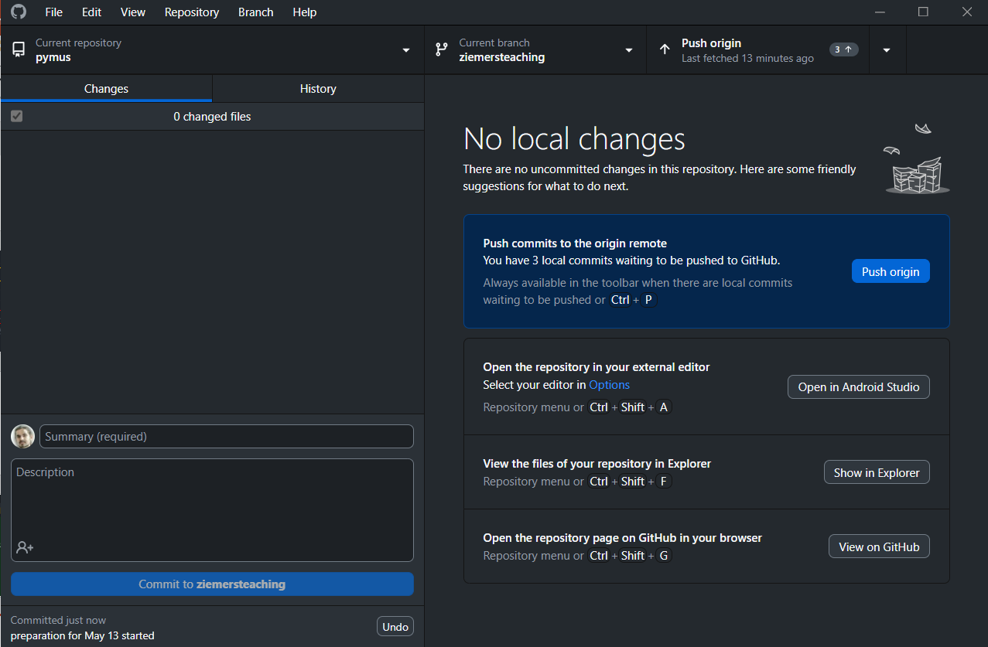

Slide 49
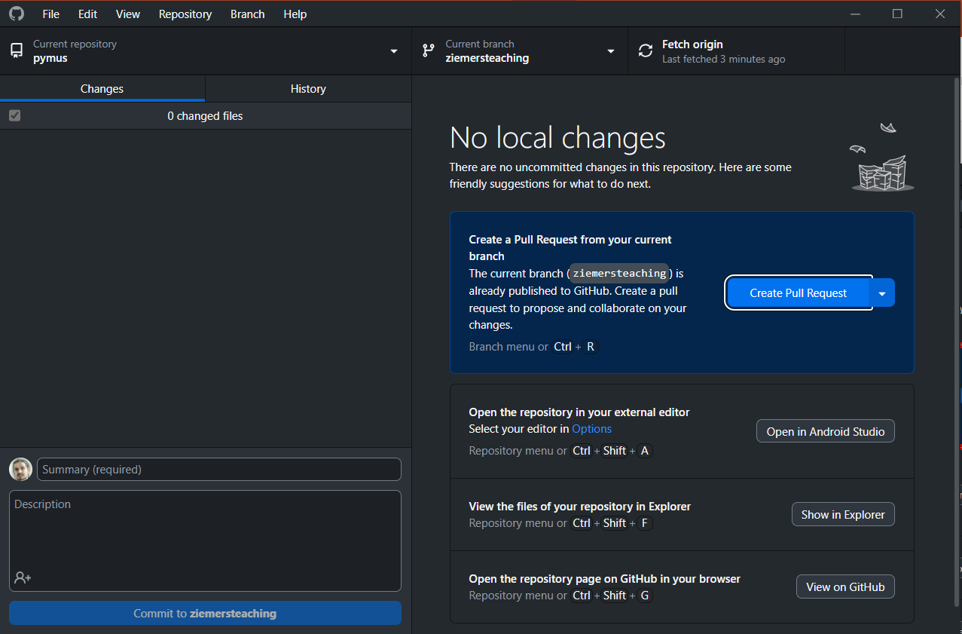

Slide 50
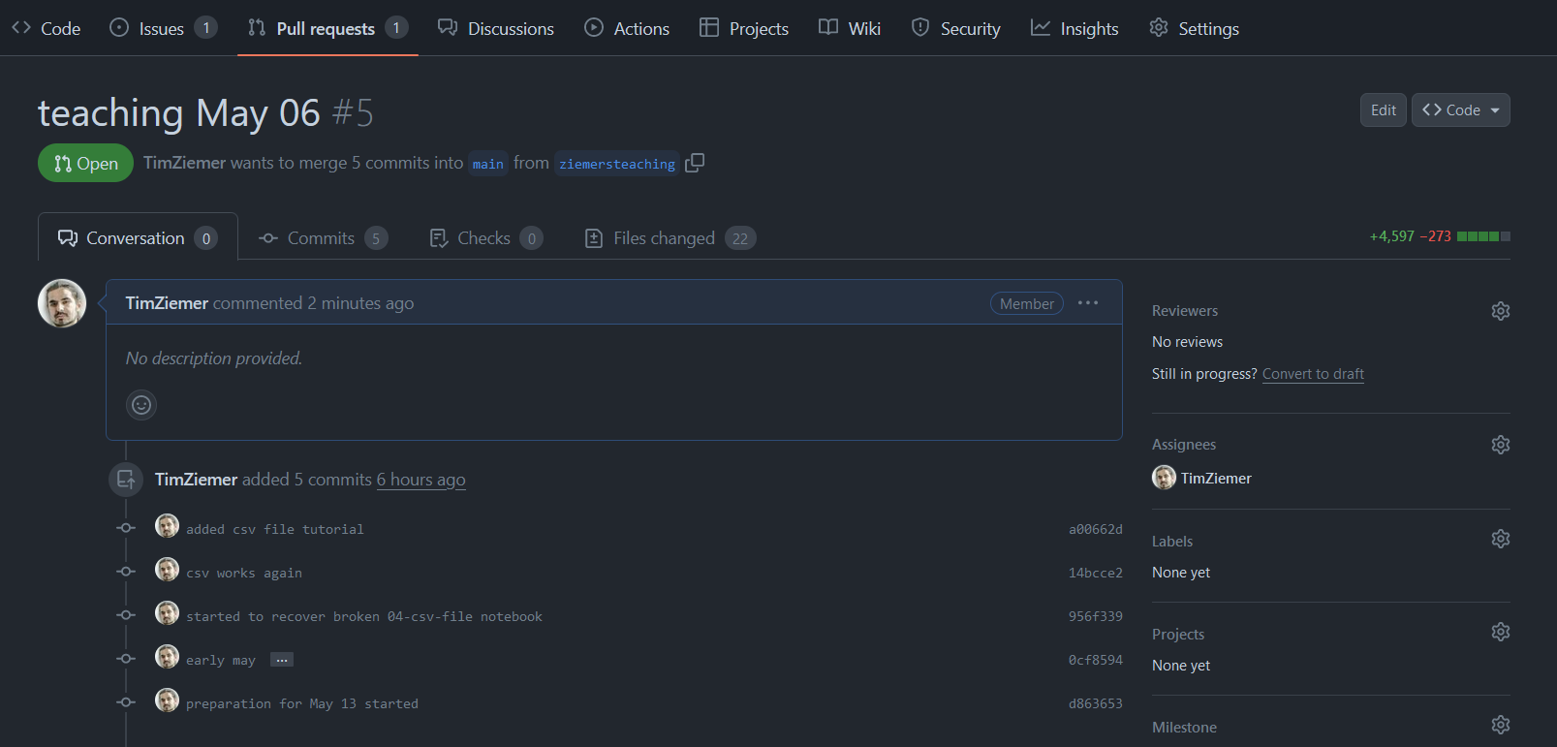

Slide 51
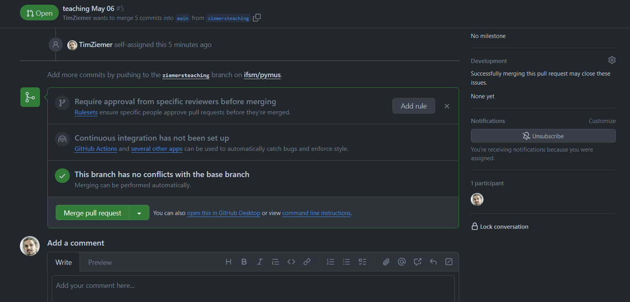

Slide 52
Updates from your branch are merged into the Main branch

Slide 53
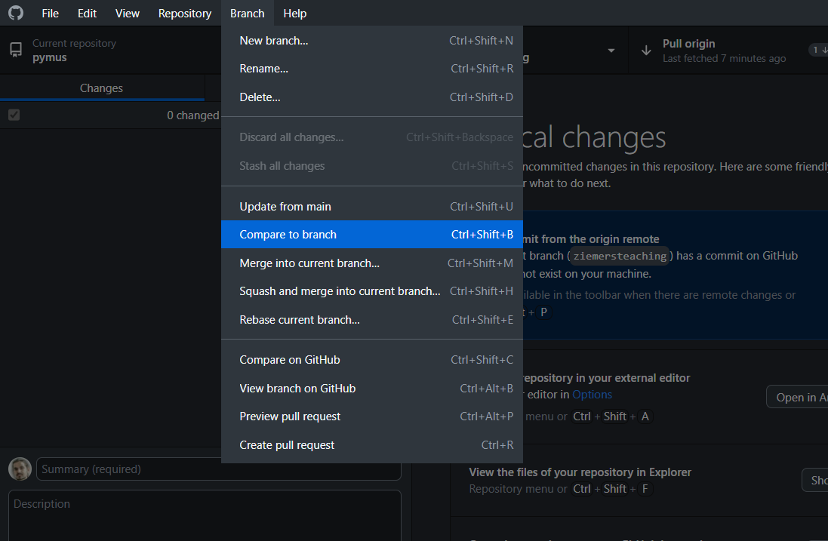
While you work on your own branch
Include the latest changes of the main branch to avoid conflicts

Slide 54
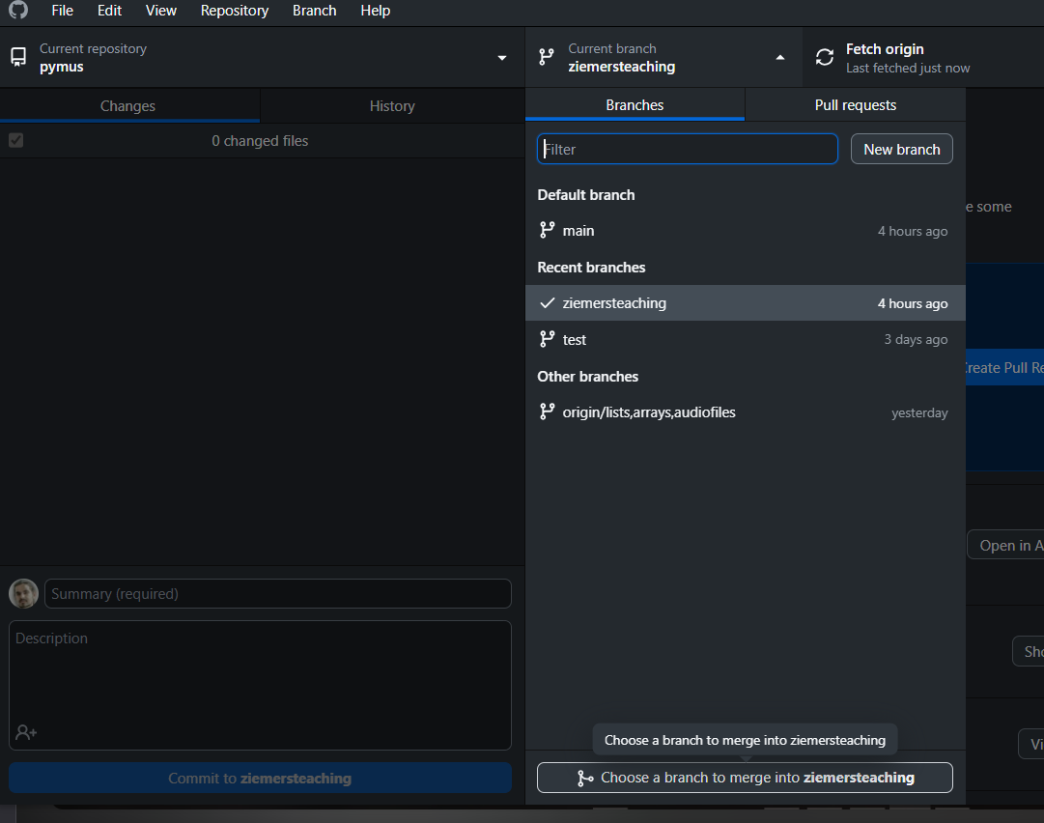
While you work on your own branch
and merge the main branch into your branch every now and then

Slide 56
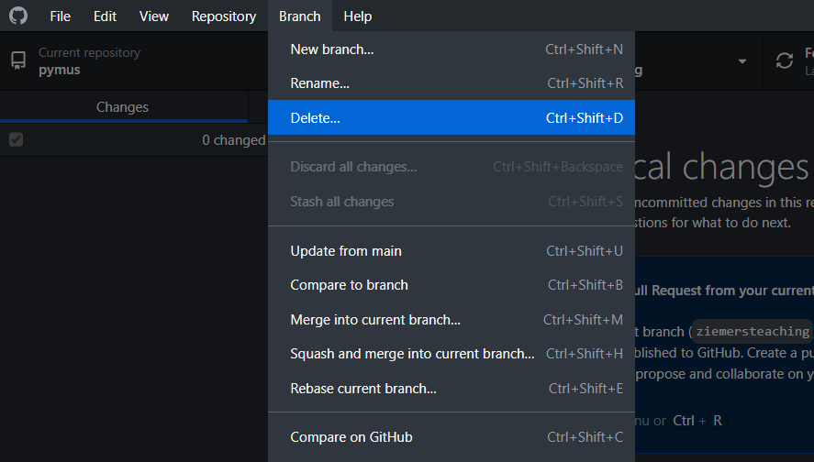
When you’ve finished
Delete your branch

