Slide 1

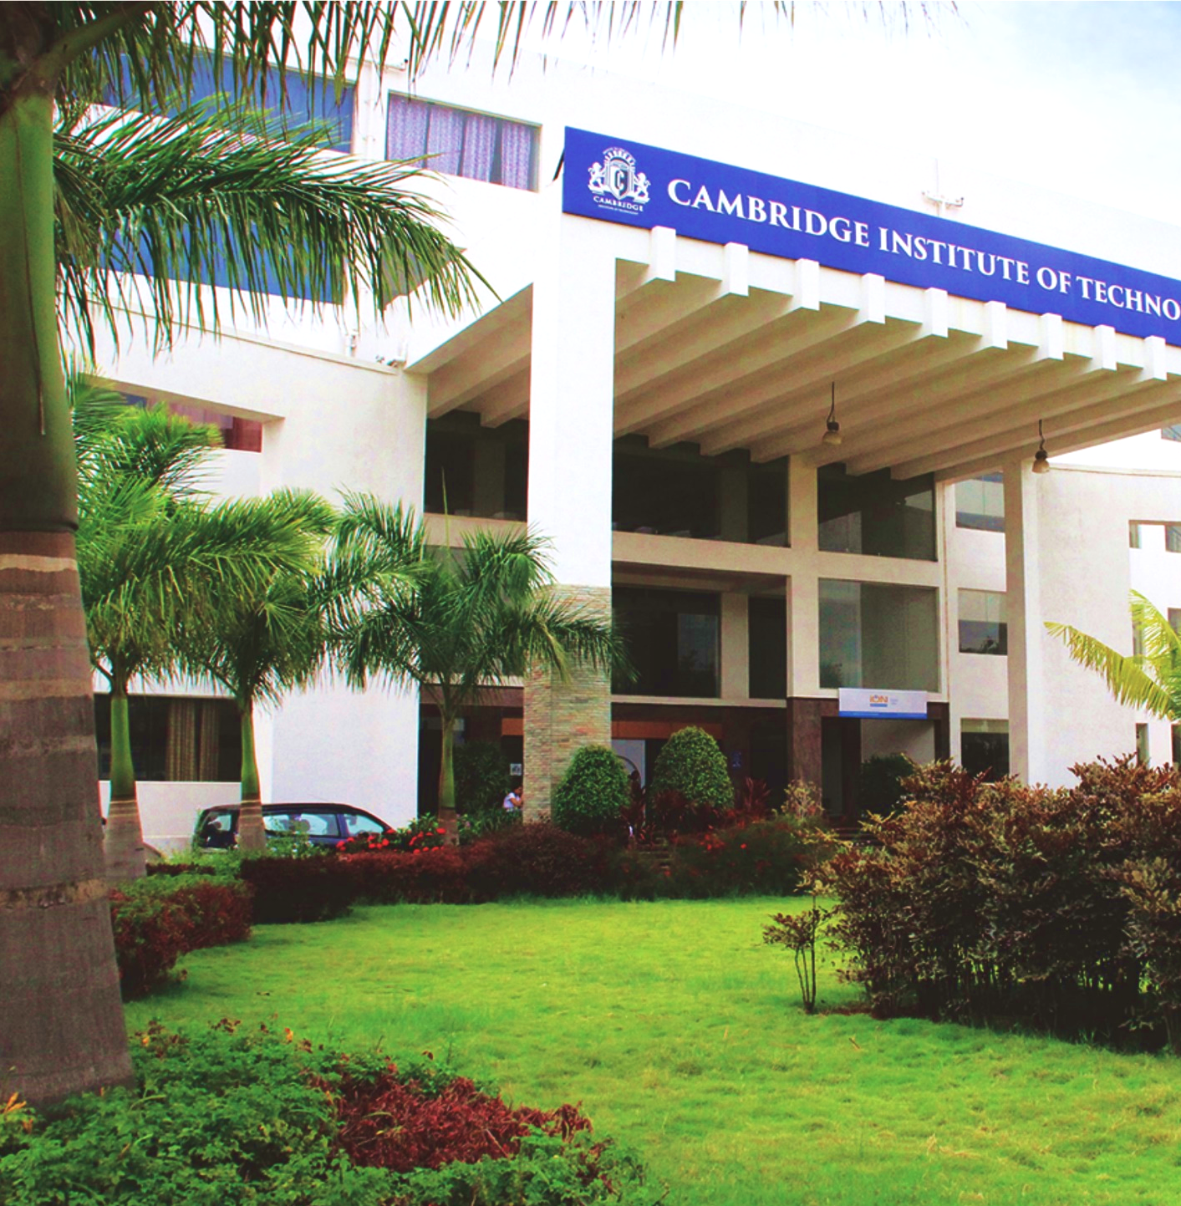
Department of Computer Science & Engineering
Project Presentation
On
“title”
By
Student Name1 (1CD18CS001)
Student Name2 (1CD18CS002)
Under the Guidance of
Prof. XYZ
www.cambridge.edu.in

Slide 2
Contents
Introduction
Objectives
Literature Survey
Proposed Method
Hardware/Software Requirements
Architecture
Algorithms/Methdology
Implementation Modules Identified
Works completed
Works to be completed.
References

Slide 3
Introduction

Slide 4
Introduction

Slide 5
Introduction(Cont…)

Slide 6
Objectives

Slide 7
Objectives (Cont…)

Slide 8
Literature Review

Slide 9
Literature Review (Cont…)

Slide 10
Proposed method

Slide 11
Proposed method (Cont…)

Slide 12
Hardware/Software requirements

Slide 13
Architecture

Slide 14
Architecture (Cont…)

Slide 15
Algorithms

Slide 16
Implementation : Modules

Slide 17
Implementation- Modules(Cont…)

Slide 18
Works Completed

Slide 19
Works to be completed

Slide 20
References

Slide 21
Thank you

