Slide 1
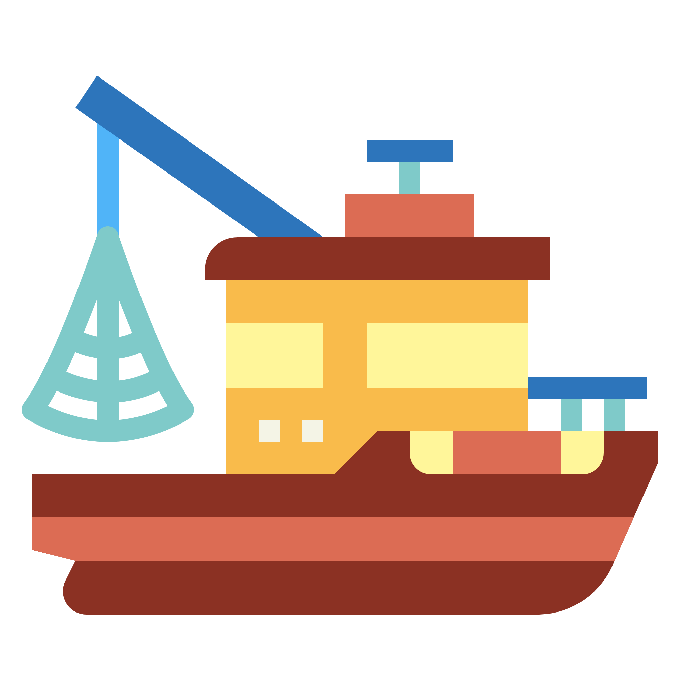
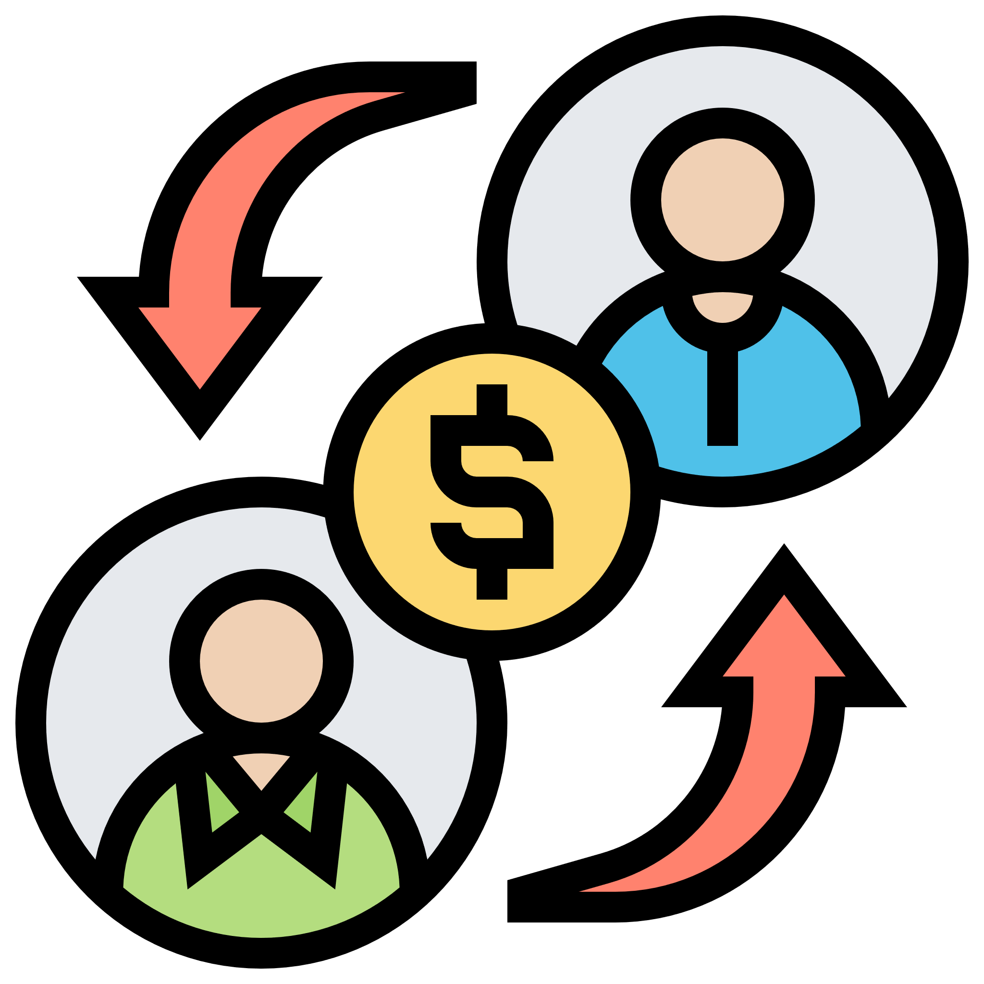
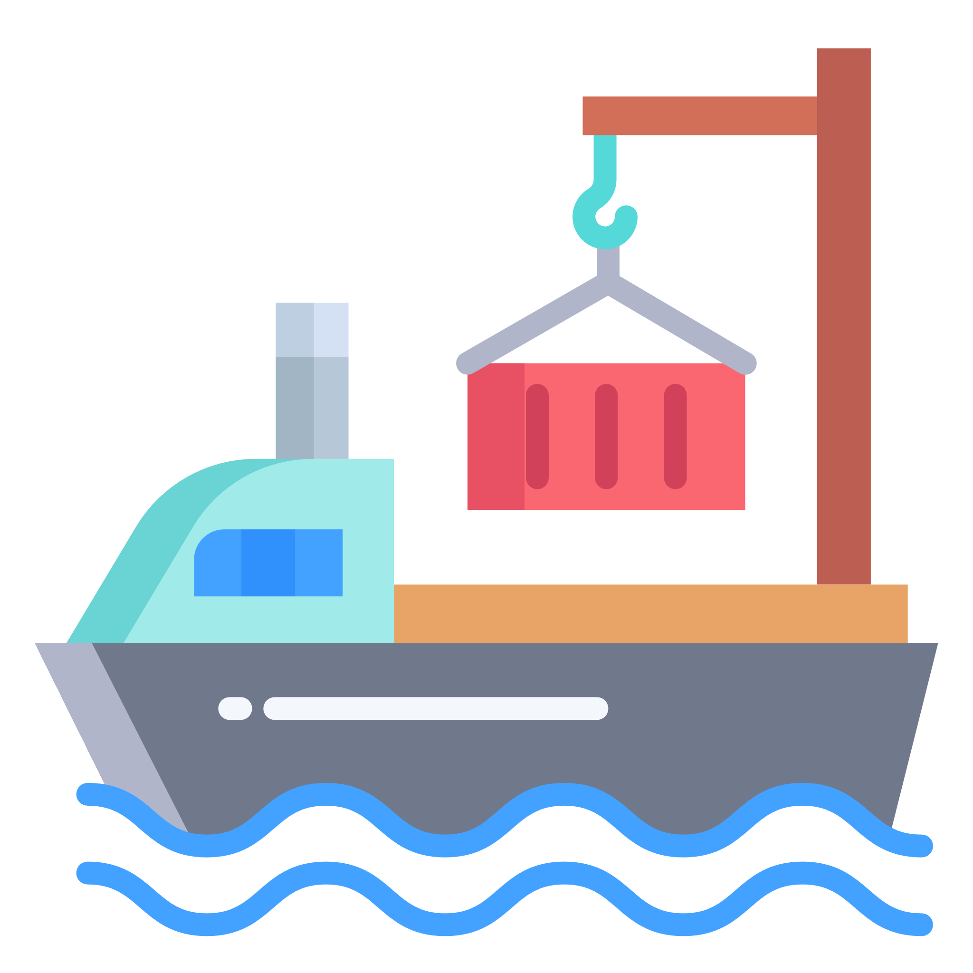
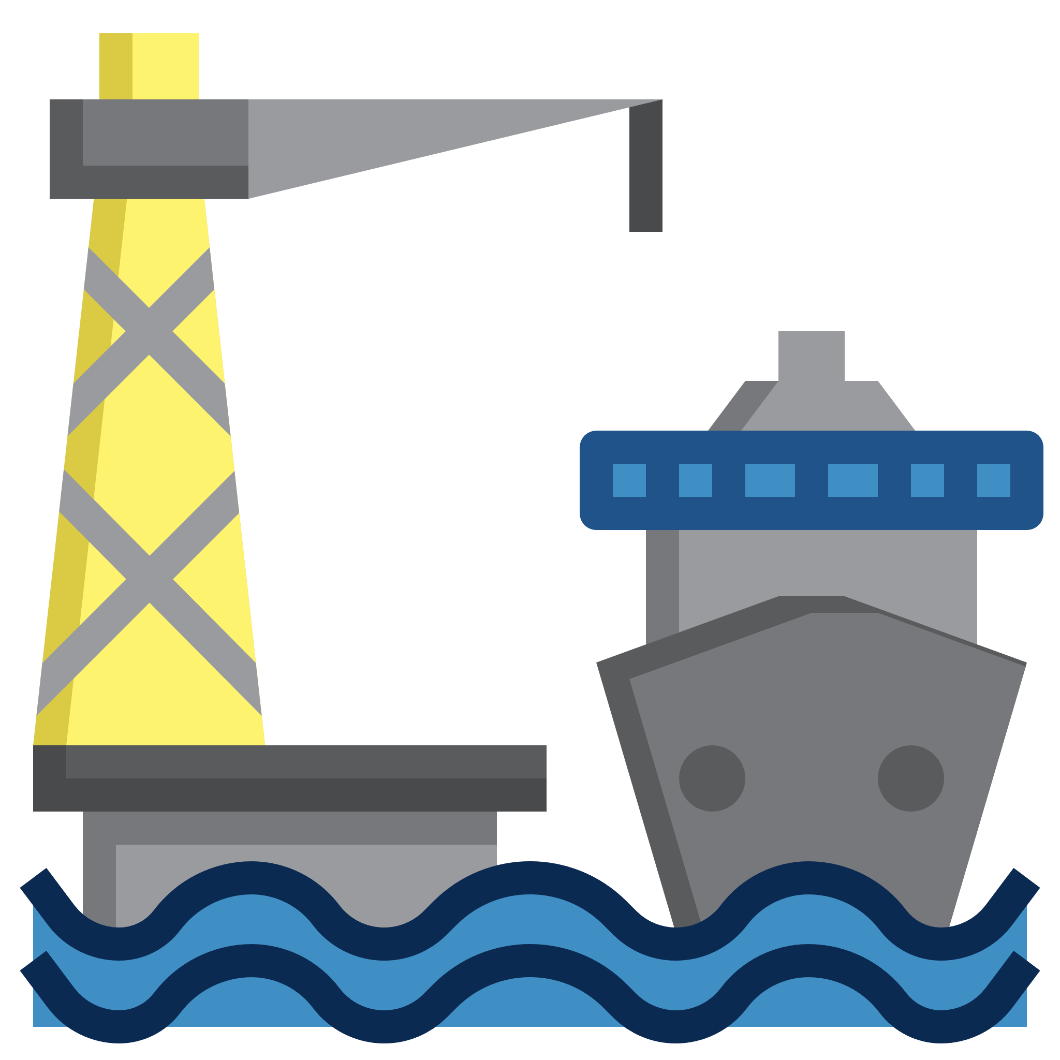
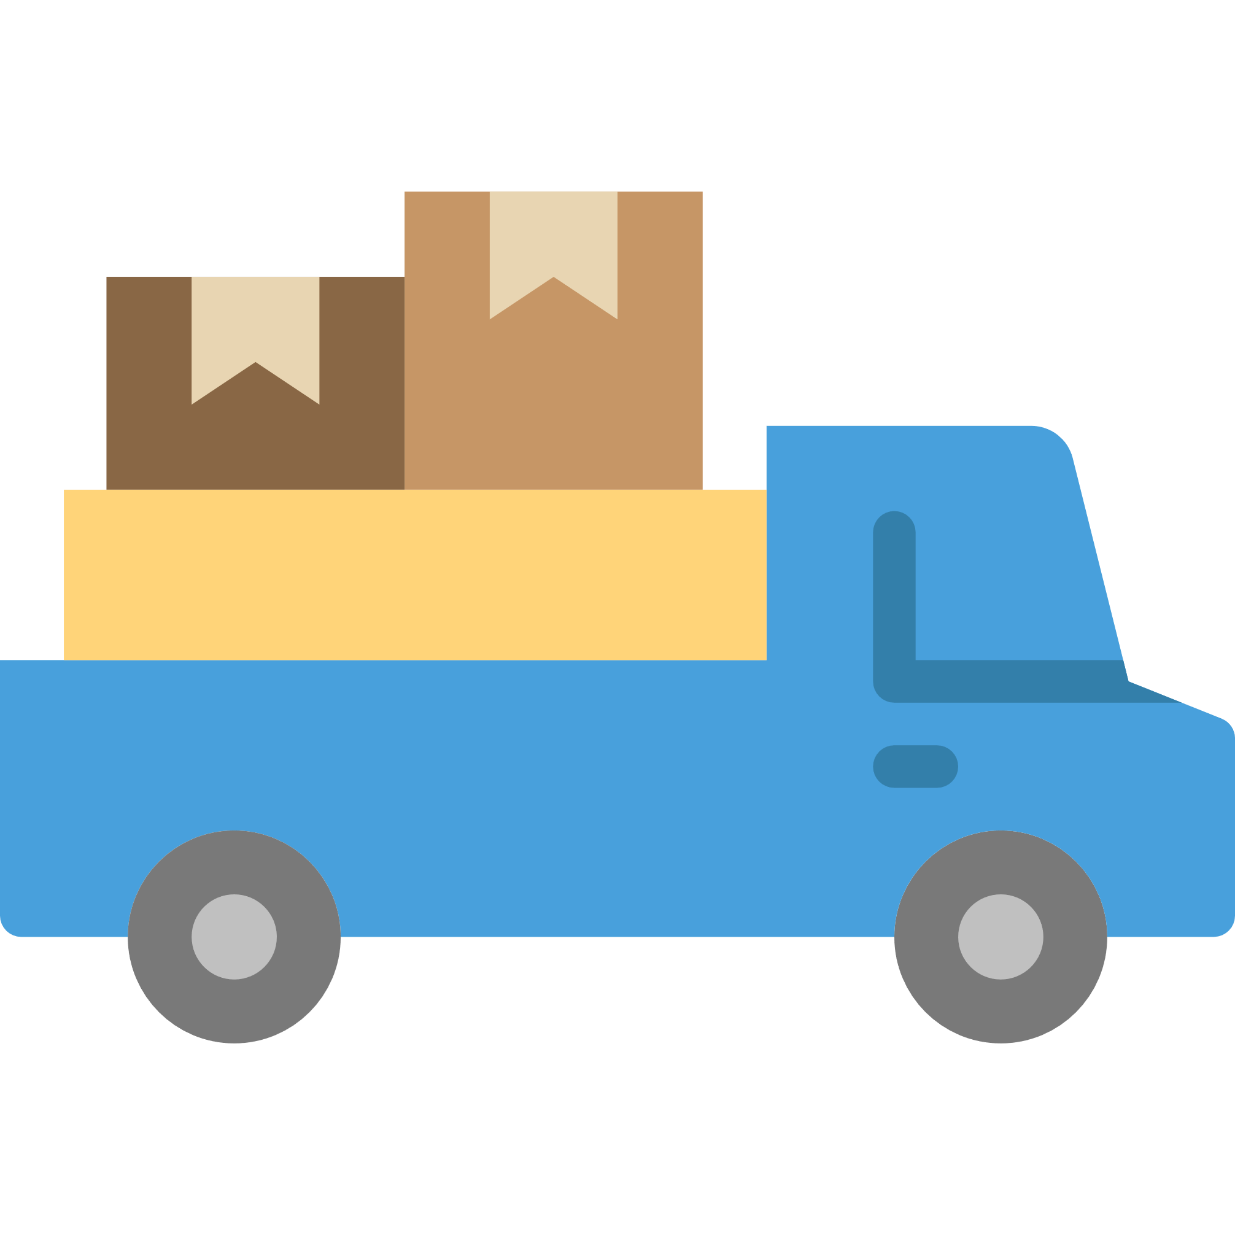
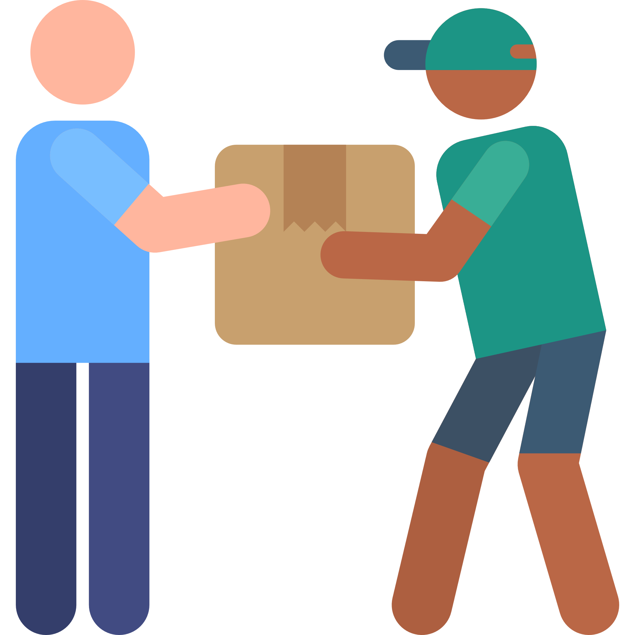
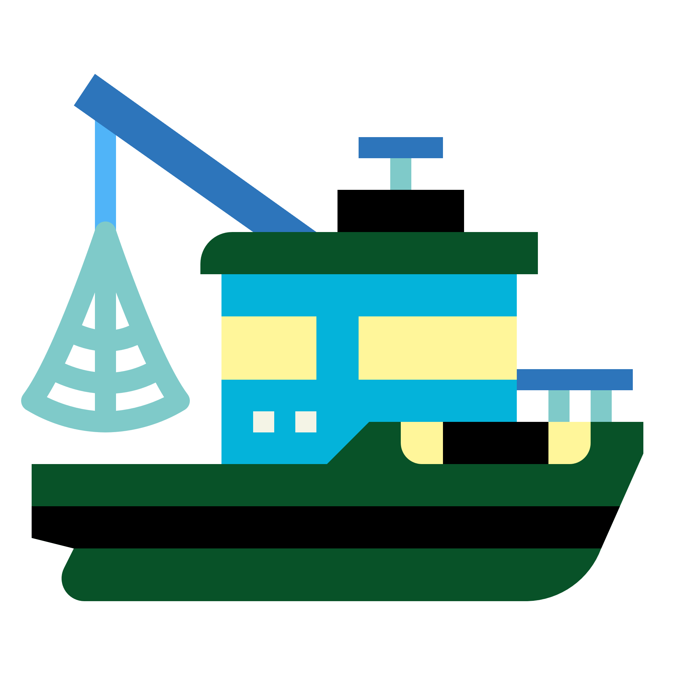
Fishing
Transshipment
Landing
Shipping
Receiving
Fishing
= Change of Ownership

Slide 2




Stocking
Feed
Treatment
Hatching
Shipping
Receiving
Stocking
Feed
Treatment
Harvest
Broodstock → Fingerling
Fingerling → Salmon
**Long Running Transformation
**Long Running Transformation
= Change of Ownership

Slide 3
Hatchery
Salmon Farm
Stocking
Hatching
Shipping
Receiving
Stocking
Harvest
Broodstock → Fingerling
Fingerling → Salmon
**Long Running Transformation
**Long Running Transformation
= Change of Ownership

