Slide 1
FISHTEGRATE
HACKATON ENTRY

Slide 2




This is so us yesterday
We can VERIFY and CERTIFY data. HOW CAN WE INTEGRATE?
HOW CAN WE INTEGRATE?
Hey guys I have traceability data from our transponders and nfc cards.. I can send it directly to the buyer but according to MDPI and others someone needs to certify and validate. HOW CAN WE INTEGRATE?
Hey guys, we can store your verified and certified data and provide it to your customers. We can even monetize it. HOW CAN WE INTEGRATE?

Slide 3

What we agreed
FISHTEGRATE
You Create, We Fishtegrate
A hardware and software solution to connect all types of fishing applications and integrate data for regulatory and commercial use.

Slide 4
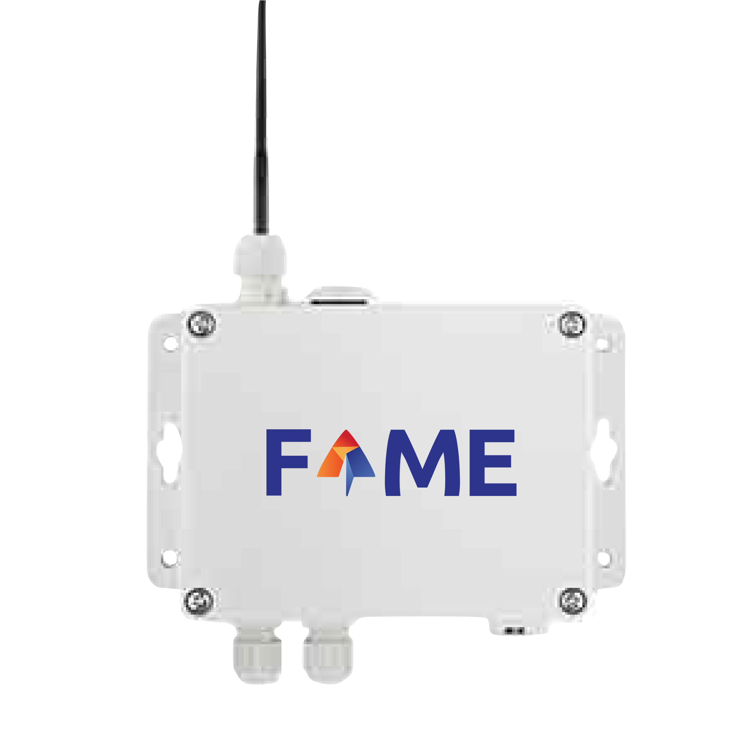
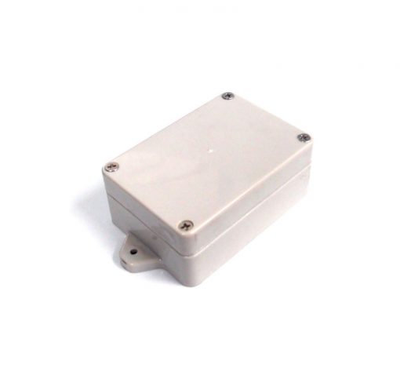


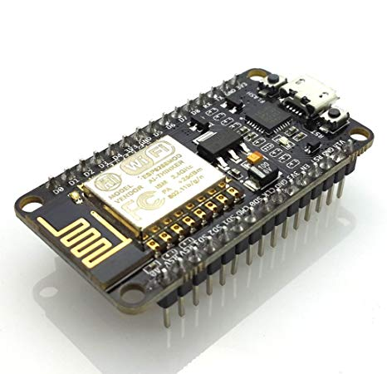
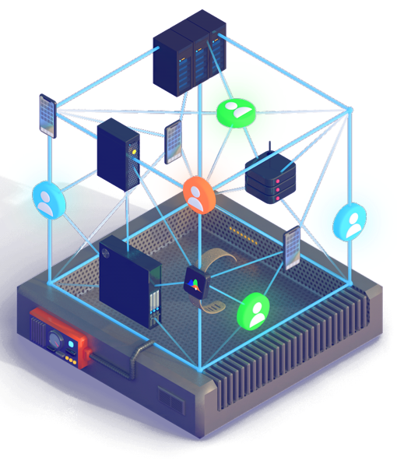
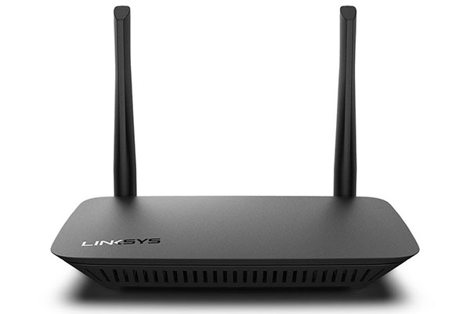
How it works
Other data sources
Regulatory verification and certification
Connect via
LoRaWAN network
Other Networks
Buyers
Accredited apps
Can connect
Streamr Network
Connect via INTERNET
Organizations
Processors

Slide 5
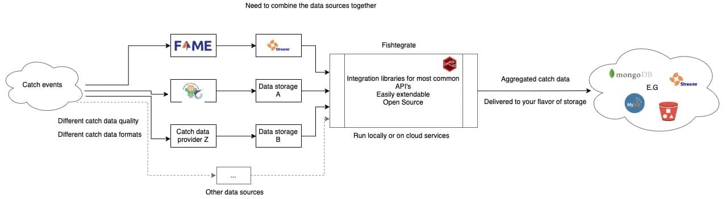
Data Transfer

Slide 6
EXAMPLE
Connect your wifi to Fishtegrate SSID
Go to http://192.168.4.2
Fill up the example form. We can accept data from various connectivity (Ex. HTTP)

