Slide 1
Coin Flipping with Constant Bias Implies One-Way Functions
Iftach Haitner and Eran Omri
TexPoint fonts used in EMF.
Read the TexPoint manual before you delete this box.: AAAA

Slide 2
Cryptography Implies One-Way Functions
Almost all “computational” cryptography is known to imply one-way functions [Impagliazzo-Luby ‘89]
One-way functions (OWFs): efficiently computable functions that no efficient algorithm can invert (with more than negligible probability)
The characterization of coin-flipping protocols is not (fully) known

Slide 3




Coin-Flipping Protocols
$$c←\{0,1\}$$
$$c$$

Slide 4



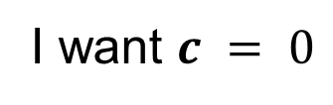

Coin-Flipping Protocols
I want $c = 0$
$$c =0$$
c = 0 w.p one
Bias is ½
Notes:
The big problem how to react to abort??
Even the simple strategy of abort is a problem

Slide 5


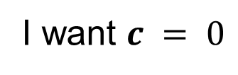






Blum’s Coin-Flipping Protocol
I want $c = 0$
$$a←\{0,1\}$$
$$z ← commit(a)$$
$$b←\{0,1\}$$
$$b$$
$$a ← decommit(z)$$
$$c=a⊕b$$
$$c=a ⊕ b$$
Negligible bias
Commitment obtained using OWF

Slide 6
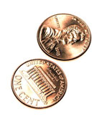
Coin-Flipping Protocols
An efficient two-party protocol (A,B) is ±-bias CF if:
Pr[(A,B)(1^{n})= (1,1)] = Pr[(A,B)(1^{n}) = (0,0)] = ½
For any PPT A and b2{0,1}, Pr[(A,B)(1^{n}) =(·,b)] · ½ + ± (same for B)
Numerous applications (Zero-knowledge Proofs, Secure Function Evaluation…)
Implied by OWFs [Blum’83, Naor‘89, Håstad et. al ‘90]
Does coin flipping imply OWFs?

Slide 7
Known Results
Almost-optimal (i.e., negl(n)-bias) CF implies OWFs [IL ‘89]
Non-trivial (i.e., (½ -1/poly(n))-bias) constant-round CF implies OWFs [Maji, Prabhakaran, Sahai ‘10]
Constant-bias (¼ -1/poly(n)) CF implies P ≠ NP [Maji, Prabhakaran, Sahai ‘10]
Non-trivial CF implies P ≠ PSPACE
For !(1)-round, non-negl-bias CF, the results are far from being tight

Slide 8
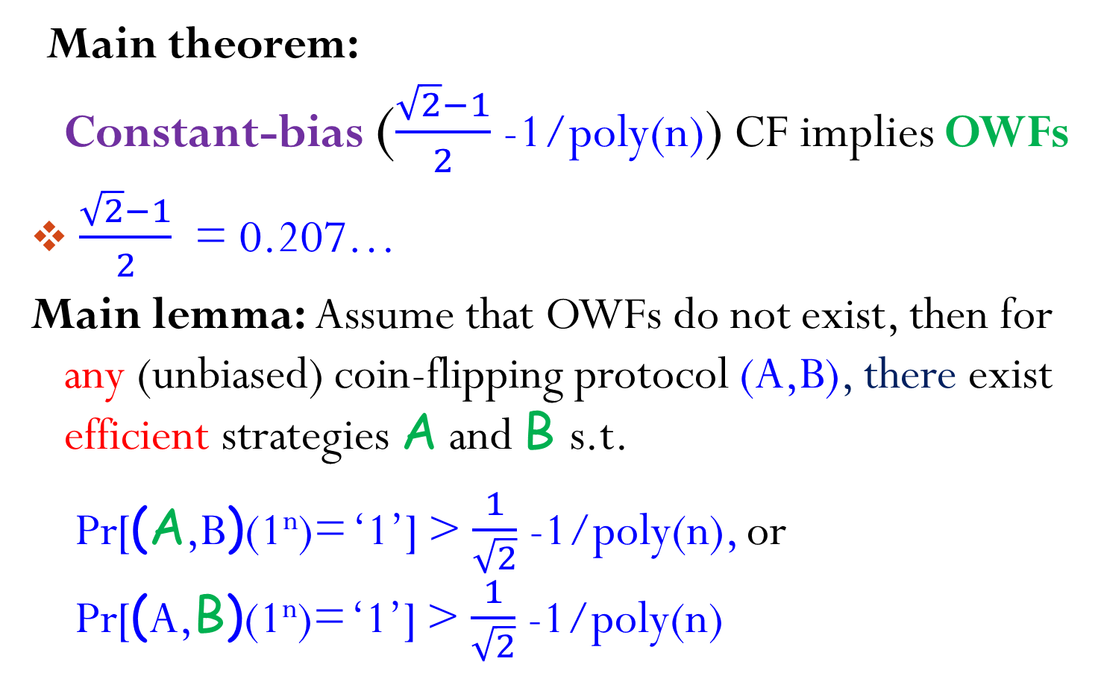
Our Result
Main theorem: Constant-bias ($\frac{\sqrt{2}−1}{2}$-1/poly(n)) CF implies OWFs
$\frac{\sqrt{2}−1}{2}$ = 0.207…
Main lemma: Assume that OWFs do not exist, then for any (unbiased) coin-flipping protocol (A,B), there exist efficient strategies A and B s.t.
Pr[(A,B)(1^{n})= ‘1’] > $\frac{1}{\sqrt{2}}$-1/poly(n), or Pr[(A,B)(1^{n})= ‘1’] > $\frac{1}{\sqrt{2}}$ -1/poly(n)

Slide 9
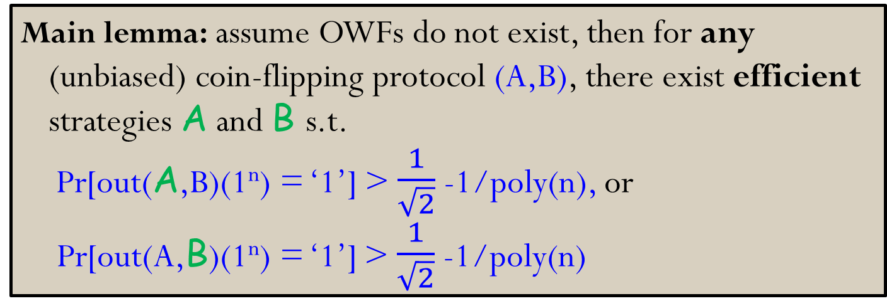
Proving the Main Lemma
Main lemma: assume OWFs do not exist, then for any (unbiased) coin-flipping protocol (A,B), there exist efficient strategies A and B s.t. Pr[out(A,B)(1^{n}) = ‘1’] > $\frac{1}{\sqrt{2}}$ -1/poly(n), or Pr[out(A,B)(1^{n}) = ‘1’] > $\frac{1}{\sqrt{2}}$ -1/poly(n)
Proof outline:
Define unbounded strategies for A and B
Careful analysis
Approximate the strategies efficiently using OWF inverter

Slide 10
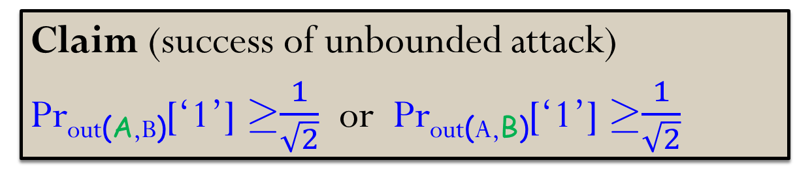
The “Random Continuation” Attack
Define A as follows (B is defined analogously)
A aborts if no valid (r_{A},r_{B}) exists
On transcript ®, A samples uniform (r_{A},r_{B}) s.t.
(A(r_{A}),B(r_{B})) is consistent with ®
out(A(r_{A}),B(r_{B})) = ‘1’
Sends A(r_{A})’s reply on ®
Claim (success of unbounded attack)
Pr_{out(A,B)}[‘1’] ¸$\frac{1}{\sqrt{2}}$ or Pr_{out(A,B)}[‘1’] ¸$\frac{1}{\sqrt{2}}$

Slide 11
The Protocol (A,B) – All Honest
Execution tree T of (A,B)
Nodes are all possible (partial) transcripts
Node ® is labeled by v[®] / w[®]
v[®] = Pr_{out(A,B)}[‘1’|®]
w[®] = Pr_{(A,B)}[®]
Leaves determine the parties’ inputs
½ / 1
0
1
?/ ½
?/ ½
0
1
…
0/?
…
1/?
0/?
0-leaf
1-leaf

Slide 12
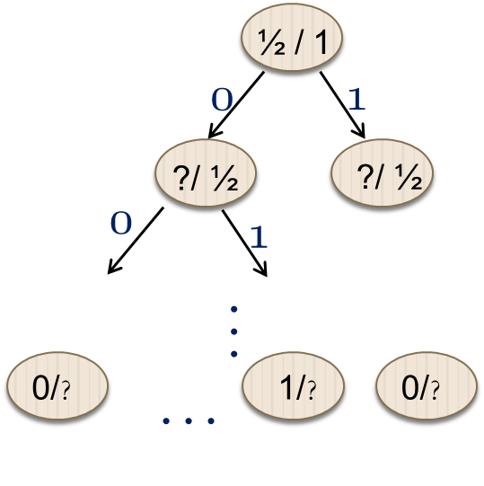
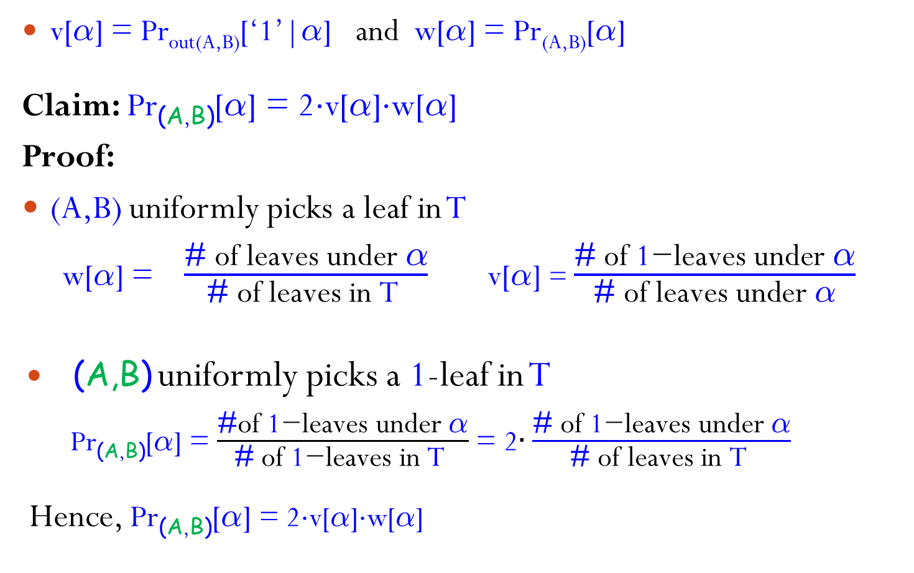
The Protocol (A,B) – All Cheating
v[®] = Pr_{out(A,B)}[‘1’|®] and w[®] = Pr_{(A,B)}[®]
Claim: Pr_{(A,B)}[®] = 2¢v[®]¢w[®]
Proof:
(A,B) uniformly picks a leaf in T
w[®] = $\frac{\text{\#} \text{of} \text{leaves} \text{under} \text{®}}{\text{\#} \text{of} \text{leaves} \text{in} \text{T} }$ v[$\text{®}$] = $\frac{\text{\#} \text{of} \text{1}\text{−}\text{leaves} \text{under} \text{®}}{\text{\#} \text{of} \text{leaves} \text{under} \text{®}}$
(A,B) uniformly picks a 1-leaf in T
Pr_{(A,B)}[®] = $\frac{\text{\#}\text{of} \text{1}\text{−}\text{leaves} \text{under} \text{®}}{\text{\#} \text{of} \text{1}\text{−}\text{leaves} \text{in} \text{T} }$ = 2$∙\frac{\text{\#} \text{of} \text{1}\text{−}\text{leaves} \text{under} \text{®}}{\text{\#} \text{of} \text{leaves} \text{in} \text{T} }$
Hence, Pr_{(A,B)}[®] = 2¢v[®]¢w[®]

Slide 13
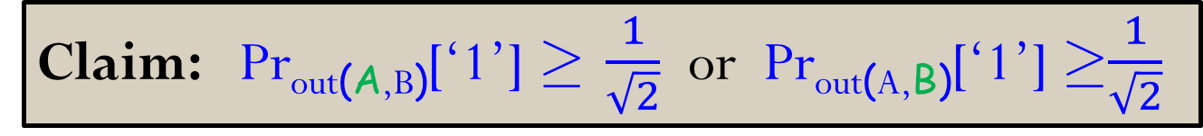
The Protocols (A,B) and (A,B)
Compensation Lemma (slightly simplified):
For any frontier* L in T Pr_{(A,B)}[L] ¢ Pr_{(A,B)} [L] = Pr_{(A,B)}[L] ¢Pr_{(A,B)}[L]
No node in L has an ancestor in L (wrt. T)
Proof:
Let L ={®2 T: ® is a 1-leaf}
Pr_{(A,B)} [L] = ½ and Pr_{(A,B)}[L] = 1
) Pr_{(A,B)}[L] ¢ Pr_{(A,B)}[L] = ½
Claim: Pr_{out(A,B)}[‘1’] ¸ $\frac{1}{\sqrt{2}}$ or Pr_{out(A,B)}[‘1’] ¸$\frac{1}{\sqrt{2}}$
Pr_{(A,B)}[®] = 2¢v[®]¢w[®]

Slide 14
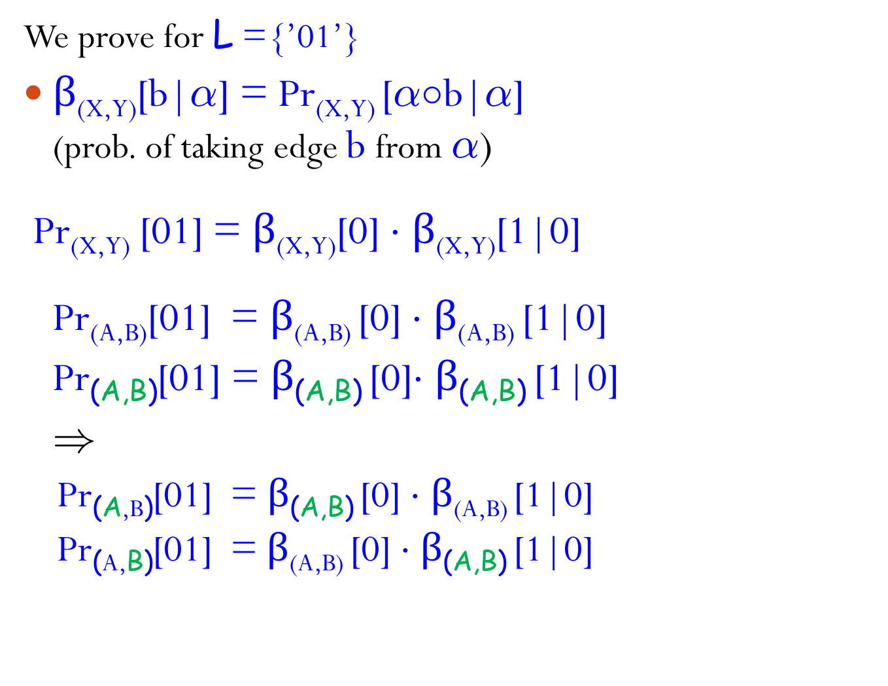
Pr_{(A,B)}[L]¢Pr_{(A,B)}[L] = Pr_{(A,B)}[L]¢Pr_{(A,B)}[L]
We prove for L ={’01’}
$β$_{(X,Y)}[b|®] = Pr_{(X,Y)} [®±b|®] (prob. of taking edge b from ®)
Pr_{(X,Y)} [01] = $β$_{(X,Y)}[0] ¢ $β$_{(X,Y)}[1|0]
Pr_{(A,B)}[01] = $β$_{(A,B)} [0] ¢ $β$_{(A,B)} [1|0]
Pr_{(A,B)}[01] = $β$_{(A,B)} [0]¢ $β$_{(A,B)} [1|0]
)
Pr_{(A,B)}[01] = $β$_{(A,B)} [0] ¢ $β$_{(A,B)} [1|0]
Pr_{(A,B)}[01] = $β$_{(A,B)} [0] ¢ $β$_{(A,B)} [1|0]
A
½ / 1
0
1
B
?/ ½
?/ ½
0
1
?/ ?
…

Slide 15
Efficient Strategies
using OWFs inverter
On trans. ®, A samples uniform (r_{A},r_{B}) s.t.
(A(r_{A}),B(r_{B})) is consistent with ®
out(A(r_{A}),B(r_{B})) = ‘1’
Sends A(r_{A})’s reply on ®
“ ”
f(r_{A},r_{B},i) = l(r_{A},r_{B})_{1,,i},v[l(r_{A},r_{B})]
l(r_{A},r_{B}) is the full transcript (leaf) generated by (A(r_{A}),B(r_{B}))
To sample (r_{A},r_{B}), A invokes “f-inverter” to get uniform preimage of (®,1)
“ ”

Slide 16
Inverting f(r_{A},r_{B},i)= l(r_{A},r_{B})_{1,,i},v[l(r_{A},r_{B})]
Assuming OWFs do not exist, 9 efficient f-inverter that on a unifrom output of f, returns almost uniform preimage [IL ‘89]
Problem: the query distribution induced by unbounded (A,B), might be far from uniform – A repeatedly deviates from the prescribed protocol
Does the success of unbounded A‘s (or of B), depend on “non-typical” queries?
Main observation:
A or B do “well enough”, even if f-inverter fails on non-typical queries

Slide 17
Two Types of Non-Typical Queries
f(r_{A},r_{B},i) = l(r_{A},r_{B})_{1,,i},v[l(r_{A},r_{B})]
A‘s queries are of the form (®,1)
UnBalanced queries
UnBal_{A} = {®2 T: Pr_{(A,B)} [®] > c ¢ Pr_{(A,B)} [®]}
where c is large (e.g., 1000)
Pr_{f}[(UnBal_{A},¢)] = Pr_{(A,B)} [UnBal_{A}] < 1/c
Low-Value queries
LowVal = {®2 T: v[®] < ±}, where ± is small (e.g., 0.001)
Pr_{f}[(LowVal,1)] < ±
Distribution of other queries is dominated by the output distribution of f

Slide 18
Low-Value Queries
Pr_{(A,B)}[®] = 2¢v[®]¢w[®]
LowVal ={®2 T: v[®]< ±²and ® is top-most such node}
Pr_{(A,B)} [LowVal] = ∑_{®2LowVal} 2¢v[®]¢ Pr_{(A,B)} [®]
< 2±² ¢ ∑_{®2LowVal} Pr_{(A,B)} [®] < 2±²
Compensation Lemma yields Pr_{(A,B)} [LowVal] ¢ Pr_{(A,B)} [LowVal] < 2±²
Yet, Pr_{(A,B)} [LowVal] might be large
) A’s success might depend on inverting f on LowVal
We prove: A or B do “well enough”, even if both fail on LowVal (but succeed elsewhere)

Slide 19
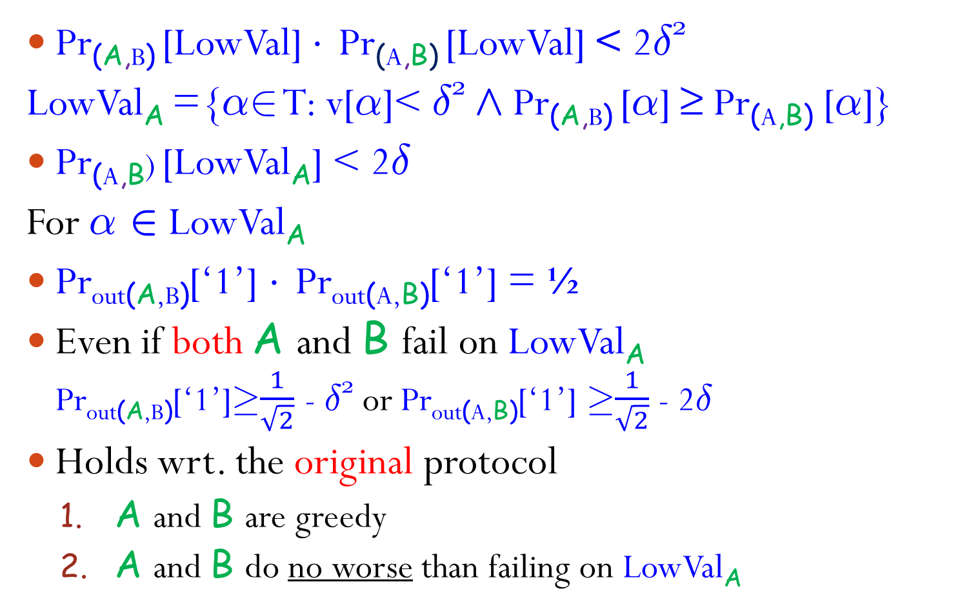



Low-Value Queries cont.
Pr_{(A,B)} [LowVal] ¢ Pr_{(A,B)} [LowVal] < 2±²
LowVal_{A} ={®2 T: v[®]< ±² Æ Pr_{(A,B)} [®] ≥ Pr_{(A,B)} [®]}
Pr_{(A,B}) [LowVal_{A}] < 2±
For ® 2 LowVal_{A}
Pr_{out(A,B)}[‘1’] ¢ Pr_{out(A,B)}[‘1’] = ½
Even if both A and B fail on LowVal_{A}
Pr_{out(A,B)}[‘1’]¸$\frac{1}{\sqrt{2}}$ - ±² or Pr_{out(A,B)}[‘1’] ¸$\frac{1}{\sqrt{2}}$ - 2±
Holds wrt. the original protocol
A and B are greedy
A and B do no worse than failing on LowVal_{A}
®
B
$$δ^{2}$$
$$δ^{2}$$
$${1−δ}^{2}$$
1
0
1
0
…

Slide 20
UnBalanced Queries
UnBal_{A} = {®2 T: Pr_{(A,B)} [®] > c¢Pr_{(A,B)} [®] and ® is top-most such node}
Pr_{(A,B)} [UnBal_{A}] < 1/c
Pr_{(A,B)}[UnBal_{A}] = 2¢∑_{®2UnBalA} v[®]¢ Pr_{(A,B)}[®]
· 2¢Pr_{(A,B)}[UnBal_{A}] < 2/c
Compensation Lemma yields Pr_{(A,B)}[UnBal_{A}] < 2/c²

Slide 21

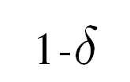
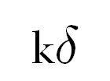
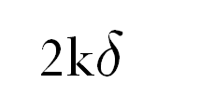

UnBalanced Queries cont.
UnBal_{A}= {®: Pr_{(A,B)} [®] > c¢Pr_{(A,B)} [®]}
Pr_{(A,B)} [UnBal_{A}] < 2/c²
For ®2 UnBal_{A} with v[®]=±
Solution: 1. Use larger outcomes
2. Instruct A to take red edges w.p. 1/±k
Ex[out(A,B)] ¢ Ex[out(A,B)] ¸ ½
Even if both A and B fail on UnBal_{A} Ex[out(A,B)] ¸ $\frac{1}{\sqrt{2}}$ – $\frac{2}{k}$ or Ex[out(A,B)] ¸ $\frac{1}{\sqrt{2}}$ –$\frac{2kδ}{c^{2}}$
Pr_{out (A,B)}[‘1’]¸$\frac{1}{\sqrt{2}}$ – $\frac{2}{c}$ or Pr_{out (A,B)}[‘1’]¸$\frac{1}{\sqrt{2}}$ – $\frac{2δ}{c}$ (taking k=c)
Holds wrt. the original protocol
®
B
1/k
1-1/k
A
1
1
0
0
1
0
1
0
0
½
½
0
…
Unless ± is small, A might (still) gain a lot from visiting Biased_{A}

Slide 22


The Constant $\frac{\sqrt{2}−1}{2}$ = 0.207…
The right bound for ``two-side” attackers (even unbounded ones)
²-bias weak coin-flipping implies ($\frac{\sqrt{2}−1}{2}$+ ²)-bias coin-flipping [Chaillou and Kerenidis ‘09]
Quantum ($\frac{\sqrt{2}−1}{2}$)-bias coin-flipping exists, and is optimal [Kitaev ’03, Chaillou and Kerenidis ’09]
²-bias weak coin-flipping:
Pr[(A,B)(1^{n}) = ‘0’] · ½ + ²
Pr[(A,B)(1^{n}) = ‘1’] · ½ + ²
Weaker security guarantee, yet has many applications
Previous work holds wrt weak coin-flipping

Slide 23
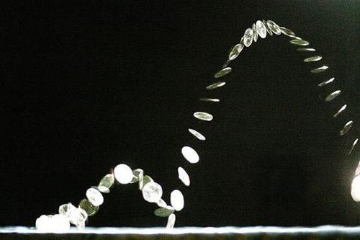
Summary
Constant-bias coin flipping implies OWFs
Challenge: prove that any non-trivial coin flipping implies OWFs

