Slide 1
Coin Flipping with Constant Bias Implies One-Way Functions
Iftach Haitner and Eran Omri
TexPoint fonts used in EMF.
Read the TexPoint manual before you delete this box.: AAAA

Slide 2
Cryptography Implies One-Way Functions
Most cryptographic primitives are based on hardness assumptions
(Almost all) are known to imply one-way functions [Impagliazzo-Luby ‘89]
One-way functions (OWFs): efficiently computable functions that no efficient algorithm can invert with more than negligible probability
The characterization of coin-flipping protocols is not (fully) known
known

Slide 3




(Naïve) Coin-Flipping Protocol
$$c ← a$$
$$c ← a$$
$$a$$

Slide 4


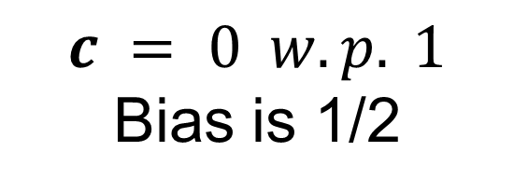
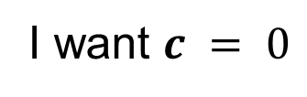



(Naïve) Coin-Flipping Protocol
I want $c = 0$
$$c ← a = 0$$
$$a =0$$
$$c = 0 w.p. 1$$
Bias is 1/2
Notes:
The big problem how to react to abort??
Even the simple strategy of abort is a problem

Slide 5





Blum’s Coin-Flipping Protocol
$$c ← a ⊕ b$$
$$c ← a ⊕ b$$
$$z ← commit(a)$$
$$b$$
$$a ← decommit(z)$$

Slide 6



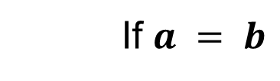
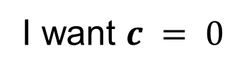

Blum’s Coin-Flipping Protocol
I want $c = 0$
$$z ← commit(a)$$
$$b$$
$$a ← decommit(z)$$
$$c ← a ⊕ b = 0$$
If $a = b$
$$c ← ⊥$$
Otherwise abort
Negligible bias
OWF are used for the commitment
Notes:
The big problem how to react to abort??
Even the simple strategy of abort is a problem
A bias of ¼ is not good although better than trivial
Connect to fair exchange

Slide 7
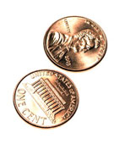
Coin Flipping Protocols
An efficient 2-party protocol (A,B) is ±-bias CF if:
Pr[(A,B)(1^{n})= (1,1)] = Pr[(A,B)(1^{n}) = (0,0)] = ½
For any PPT A and b2{0,1}, Pr[(A,B)(1^{n}) =(·,b)] · ½ + ± (same for B)
* A protocol is CF if ± = negl(n).
Numerous applications (Zero-knowledge Proofs, Secure Function Evaluation…)
Implied by OWFs [Blum’83, Naor‘89, Håstad et. al ‘90]
Does coin flipping imply OWFs?
Comparison with Fair coin-flipping
|Pr[(A,B)(1^{n}) =(·,b)] - ½| ≤ ±

Slide 8
Known Results
Almost-optimal (i.e., negl(n)-bias) CF implies OWFs [IL ‘89]
Non-trivial (i.e., (½ -1/poly(n))-bias) constant-round CF implies OWFs [Maji, Prabhakaran, Sahai ‘10]
Constant-bias (¼ -1/poly(n)) CF implies P ≠ NP [Maji, Prabhakaran, Sahai ‘10]
Non-trivial CF implies P ≠ PSPACE

Slide 9
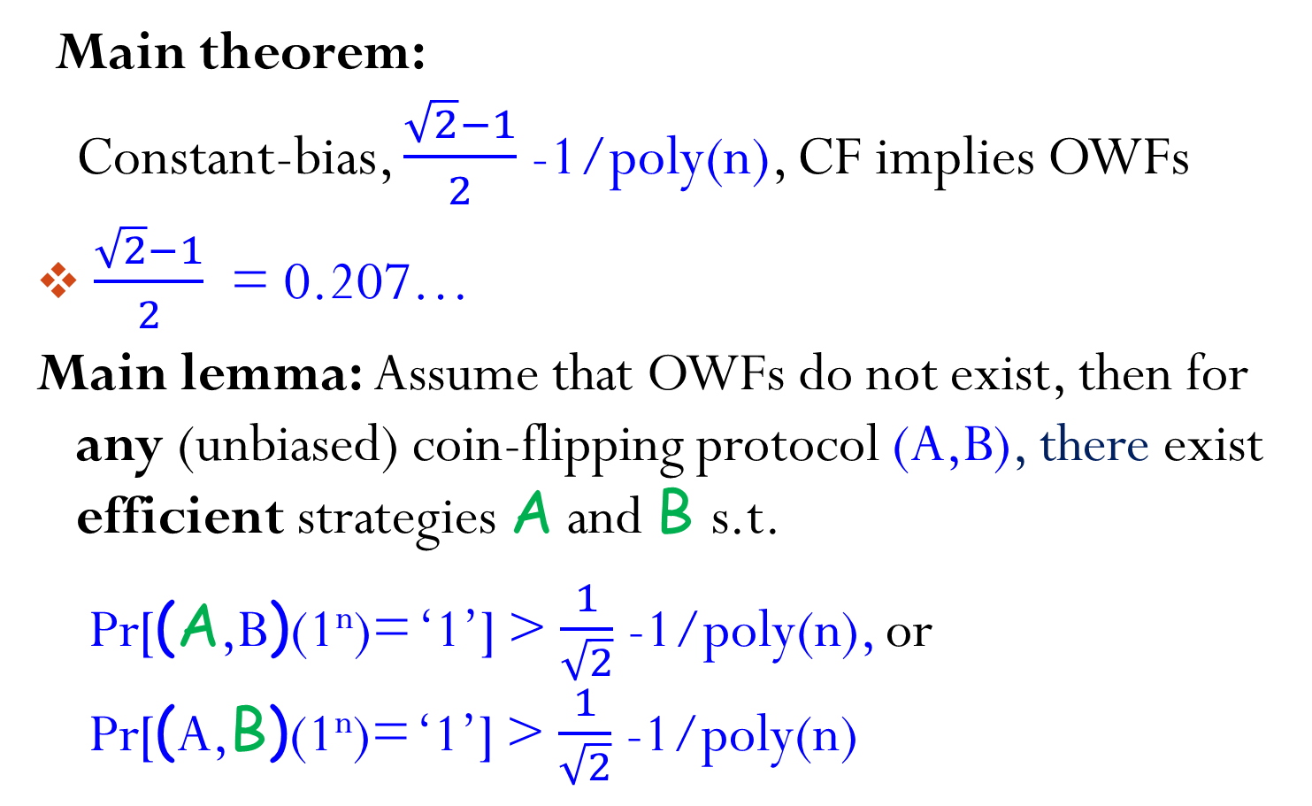
Our Result
Main theorem: Constant-bias, $\frac{\sqrt{2}−1}{2}$-1/poly(n), CF implies OWFs
$\frac{\sqrt{2}−1}{2}$ = 0.207…
Main lemma: Assume that OWFs do not exist, then for any (unbiased) coin-flipping protocol (A,B), there exist efficient strategies A and B s.t.
Pr[(A,B)(1^{n})= ‘1’] > $\frac{1}{\sqrt{2}}$-1/poly(n), or Pr[(A,B)(1^{n})= ‘1’] > $\frac{1}{\sqrt{2}}$ -1/poly(n)

Slide 10

Proving the Main Lemma
Main lemma: Assume that OWFs do not exist, then for any (unbiased) coin-flipping protocol (A,B) and, there exist efficient strategies A and B s.t. Pr[out(A,B)(1^{n}) = ‘1’] > $\frac{1}{\sqrt{2}}$ -1/poly(n), or Pr[out(A,B)(1^{n}) = ‘1’] > $\frac{1}{\sqrt{2}}$ -1/poly(n)
Proof outline:
Define unbounded strategies for A and B
Careful analysis
Approximate the strategies efficiently using OWF inverter

Slide 11
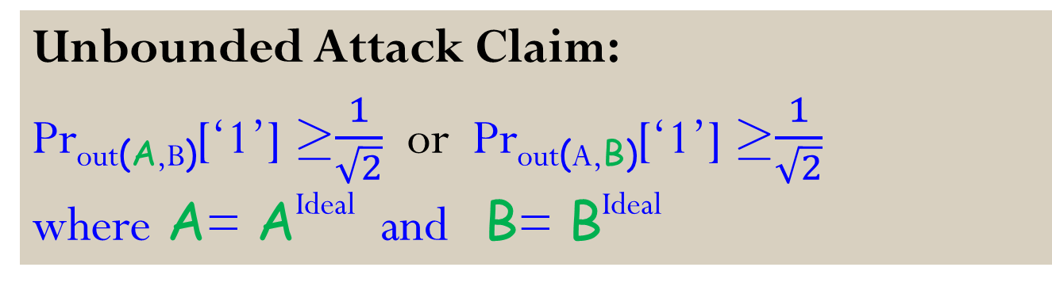
The Random Continuation Attack
Ideal
Real
Define A as follows
B is defined analogously
Ideal Sampler
OWF Inverter
Given a trans. ®, A invokes to get uniform (r_{A},r_{B}) s.t.
(A(r_{A}),B(r_{B})) is consistent with ®
out(A(r_{A}),B(r_{B})) = ‘1’
Sends A(r_{A})’s reply on ®
Unbounded Attack Claim:
Pr_{out(A,B)}[‘1’] ¸$\frac{1}{\sqrt{2}}$ or Pr_{out(A,B)}[‘1’] ¸$\frac{1}{\sqrt{2}}$
where A= A^{Ideal} and B= B^{Ideal}

Slide 12
The Protocol (A,B) – All Honest
Transcript tree T of (A,B) – trans. implied by path to node ® (messages are bits, and full transcripts determine the parties’ output coin)
® is labeled by v[®]/ w[®]
w[®] = Pr_{(A,B)}[®] = P_{A}(®) ¢ P_{B}(®)
The correlation between A and B is in ®
v[®] = Pr_{out(A,B)}[‘1’|®]
½ / 1
0
1
?/ ½
?/ ½
0
1
…
0/?
…
1/?
0/?

Slide 13
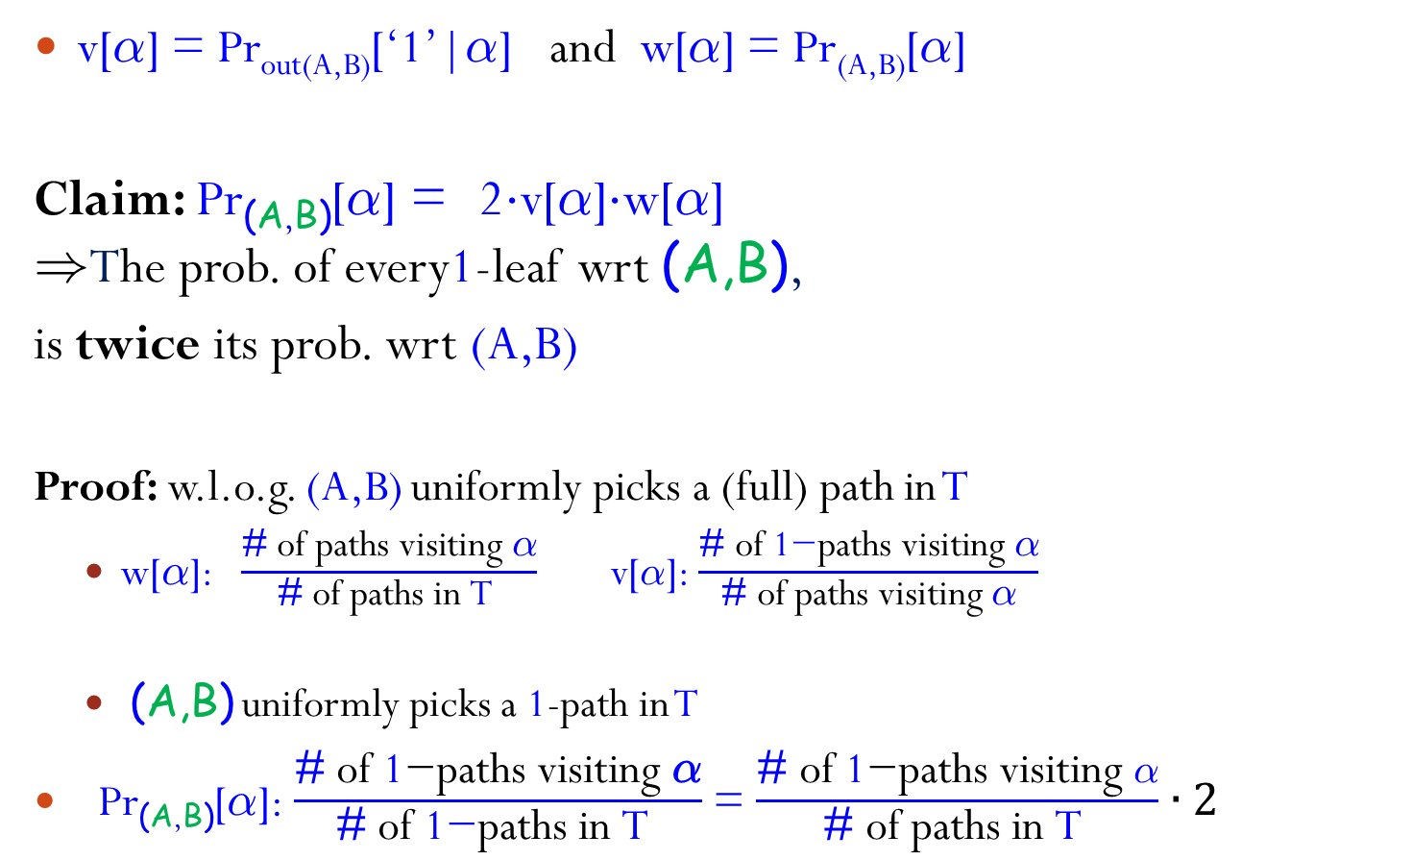
The Protocol (A,B) – All Cheating
v[®] = Pr_{out(A,B)}[‘1’|®] and w[®] = Pr_{(A,B)}[®]
Claim: Pr_{(A,B)}[®] = 2¢v[®]¢w[®] )The prob. of every1-leaf wrt (A,B),
is twice its prob. wrt (A,B)
Proof: w.l.o.g. (A,B) uniformly picks a (full) path in T
w[®]: $\frac{\text{\#} \text{of} \text{paths} \text{visiting} \text{®}}{\text{\#} \text{of} \text{paths} \text{in} \text{T} }$ v[$\text{®}$]: $\frac{\text{\#} \text{of} \text{1}\text{−}\text{paths} \text{visiting} \text{®}}{\text{\#} \text{of} \text{paths} \text{visiting} \text{®}}$
(A,B) uniformly picks a 1-path in T
Pr_{(A,B)}[®]: $\frac{\text{\#} \text{of} \text{1}\text{−}\text{paths} \text{visiting} \text{®}}{\text{\#} \text{of} \text{1}\text{−}\text{paths} \text{in} \text{T} }$ = $\frac{\text{\#} \text{of} \text{1}\text{−}\text{paths} \text{visiting} \text{®}}{\text{\#} \text{of} \text{paths} \text{in} \text{T} }∙2$
½ / 1
0
1
?/ ½
?/ ½
0
1
…
0/?
…
1/?
0/?

Slide 14

The Protocols (A,B) and (A,B)
Pr_{(A,B)}[®] = P_{A}(®) ¢ P_{B}(®), and Pr_{(A,B)}[®] = P_{A}(®) ¢ P_{B}(®)
Compensation Lemma (slightly simplified):
For any frontier* L of transcripts Pr_{(A,B)}[L] ¢ Pr_{(A,B)} [L] = Pr_{(A,B)}[L] ¢Pr_{(A,B)}[L]
* No transcript in L has prefix in L
Proof of Unbounded Attack Claim:
Define frontier 1-leaves = {®2 T: ® is a full transcript and v[®] =1}
Pr_{(A,B)}[1-Leaves] =1 and Pr_{(A,B)} [1-leaves] = ½
) Pr_{(A,B)}[1-leaves] ¢ Pr_{(A,B)}[1-leaves] = ½
Pr_{out(A,B)}[‘1’] ¸$\frac{1}{\sqrt{2}}$ or Pr_{out(A,B)}[‘1’] ¸$\frac{1}{\sqrt{2}}$

Slide 15
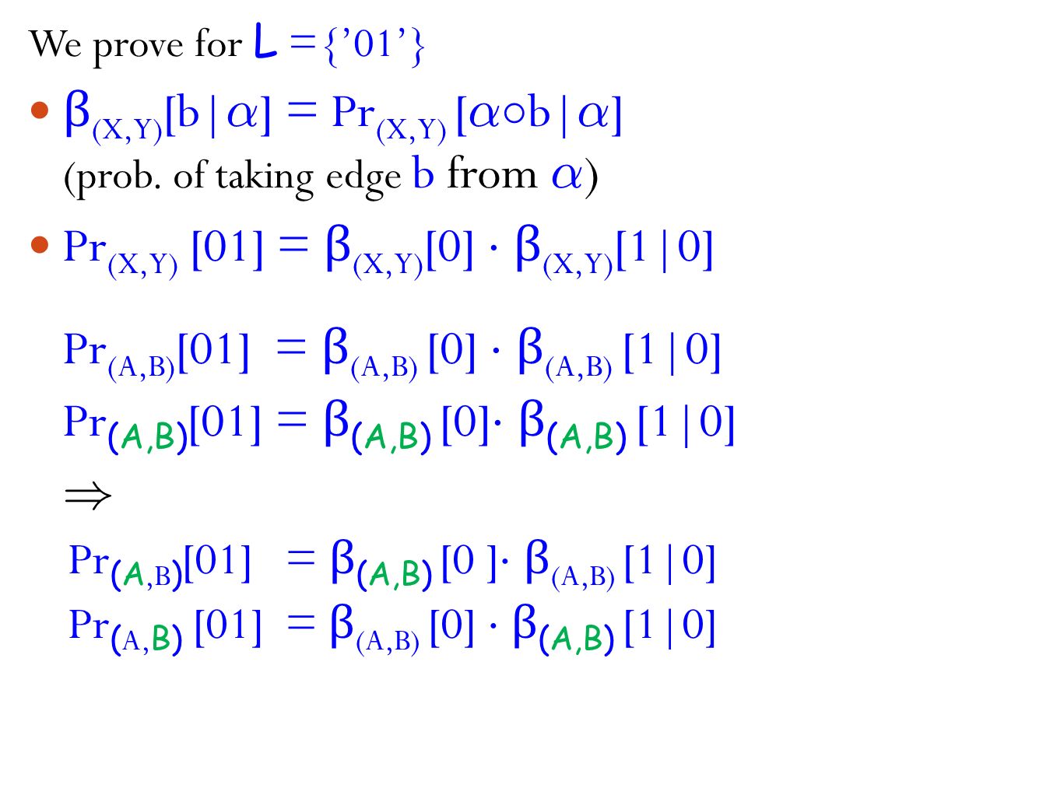
Pr_{(A,B)}[L]¢Pr_{(A,B)}[L] = Pr_{(A,B)}[L]¢Pr_{(A,B)}[L]
We prove for L ={’01’}
$β$_{(X,Y)}[b|®] = Pr_{(X,Y)} [®±b|®] (prob. of taking edge b from ®)
Pr_{(X,Y)} [01] = $β$_{(X,Y)}[0] ¢ $β$_{(X,Y)}[1|0]
Pr_{(A,B)}[01] = $β$_{(A,B)} [0] ¢ $β$_{(A,B)} [1|0]
Pr_{(A,B)}[01] = $β$_{(A,B)} [0]¢ $β$_{(A,B)} [1|0]
)
Pr_{(A,B)}[01] = $β$_{(A,B)} [0 ]¢ $β$_{(A,B)} [1|0]
Pr_{(A,B)} [01] = $β$_{(A,B)} [0] ¢ $β$_{(A,B)} [1|0]
A
½ / 1
0
1
B
?/ ½
?/ ½
0
1
?/ ?
…

Slide 16
Efficient Strategies
Ideal Sampler
OWF Inverter
Given a trans. ®, A invokes to get uniform (r_{A},r_{B}) s.t.
(A(r_{A}),B(r_{B})) is consistent with ®
out(A(r_{A}),B(r_{B})) = ‘1’
Sends A(r_{A})’s reply on ®
A needs to sample (r_{A},r_{B}) efficiently (given a OWFs inverter)
Define f(r_{A},r_{B},i) = (l(r_{A},r_{B})_{1,,i},v[l(r_{A},r_{B})]) l(r_{A},r_{B}) is the (full) transcript generated
by (A(r_{A}),B(r_{B}))
To sample (r_{A},r_{B}) given ®, A invokes the inverter
to get a random preimage of (®,1)
½ / 1
0
1
?/ ½
?/ ½
0
1
l(r_{A},r_{B})_{1,,i}
?/ ½
…
l(r_{A},r_{B})
0/?
…
1/?
0/?

Slide 17
Inverting f(r_{A},r_{B},i)=(l(r_{A},r_{B})_{1,,i},v[l(r_{A},r_{B})])
Assuming OWFs do not exist, we can efficiently obtain an (almost) uniform pre-image for a uniformly chosen output of f [IL ‘89]
Problem: the distribution induced by (A,B) might be far from uniform - A repeatedly deviates from the prescribed protocol
A^{Real} may only successfully attack on “typical” nodes
Does A‘s success depend on inverting non-typical nodes?
Main observation: A and B do “well enough” even if completely failing on non-typical nodes

Slide 18

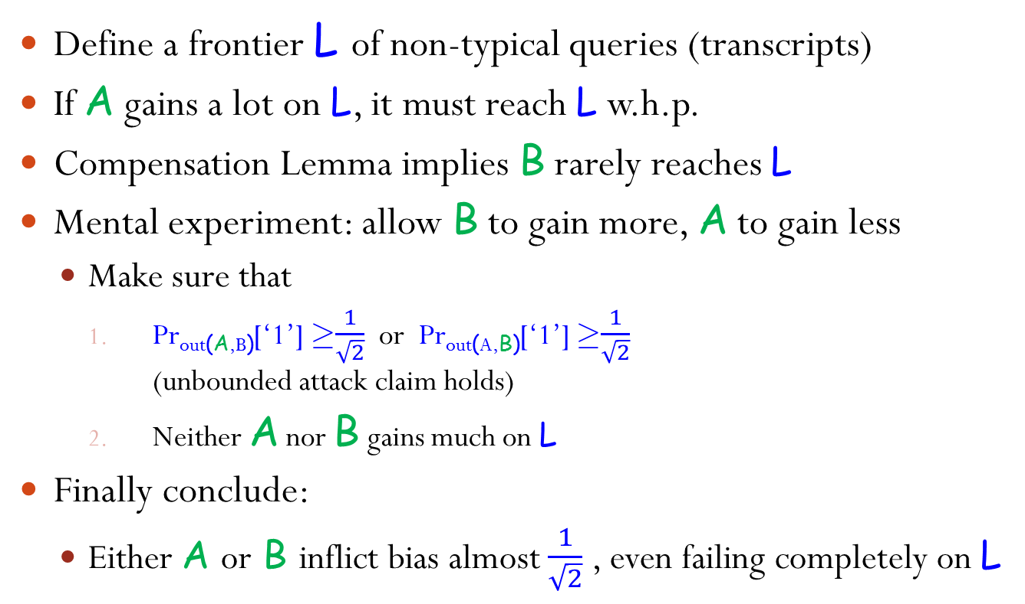



Handling Non-Typical Queries
Define a frontier L of non-typical queries (transcripts)
If A gains a lot on L, it must reach L w.h.p.
Compensation Lemma implies B rarely reaches L
Mental experiment: allow B to gain more, A to gain less
Make sure that
Pr_{out(A,B)}[‘1’] ¸$\frac{1}{\sqrt{2}}$ or Pr_{out(A,B)}[‘1’] ¸$\frac{1}{\sqrt{2}}$ (unbounded attack claim holds)
Neither A nor B gains much on L
Finally conclude:
Either A or B inflict bias almost $\frac{1}{\sqrt{2}}$ , even failing completely on L
B
$$δ^{2}$$
$$δ^{2}$$
$${1−δ}^{2}$$
1
0
1
0
…

Slide 19
Two Types of Non-Typical Queries
f(r_{A},r_{B},i) = (l(r_{A},r_{B})_{1,,i},v[l(r_{A},r_{B})])
Un-Balanced Transcripts
UnBal_{A} = {®2 T: Pr_{(A,B)} [®] > c ¢ Pr_{(A,B)} [®]}
where c is large (e.g., 1000)
Pr[f(U) = (®, 1) Æ ® 2 UnBal_{A}] ≤ Pr_{(A,B)} [UnBal_{A}] < 1/c
Low-Value Transcripts
LowVal = {®2 T: v[®] < ±²}, where ± is small (e.g., 0.001)
Pr[f(U) = (®,1) Æ ® 2 LowVal] < ±²
Distribution on other transcripts is close to uniform

Slide 20
Low-Value Transcripts
LowVal ={®2 T: v[®]< ±² and ® is top-most such node}
Pr_{(A,B)} [LowVal] = ∑_{®2LowVal} 2¢ v[®]¢ Pr_{(A,B)} [®] < 2±² ¢ ∑_{®2LowVal} Pr_{(A,B)} [®] · 2±²
Yet, Pr_{(A,B)} [LowVal] might be large
) much of A’s success depends on inverting f on LowVal
We prove that A does “well enough”, even if it always fails on LowVal

Slide 21
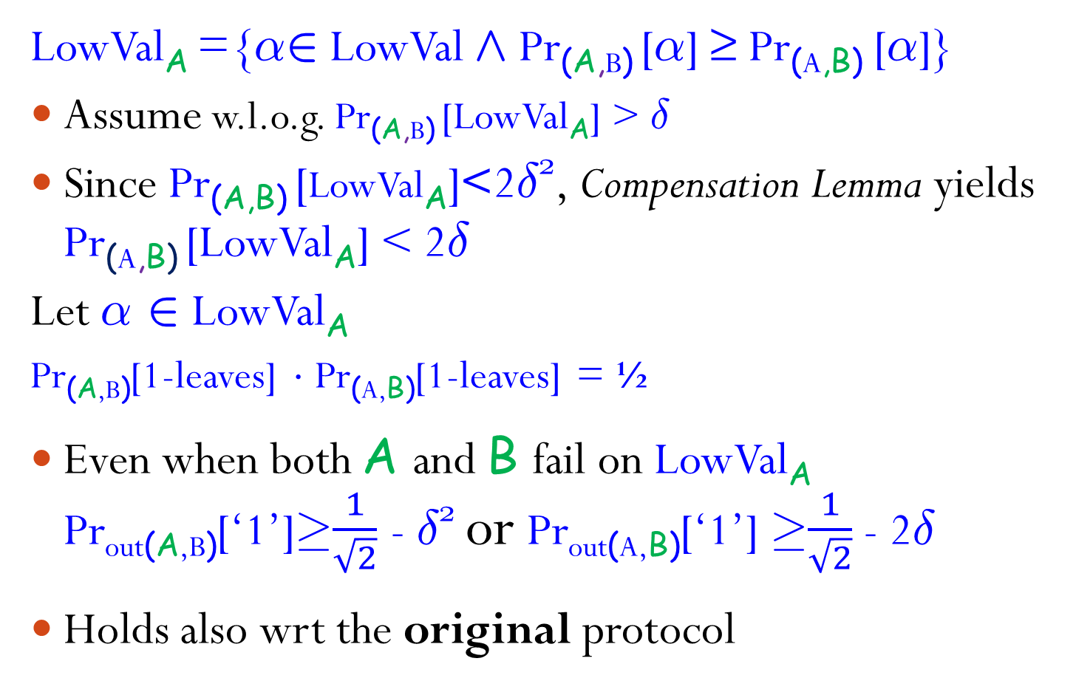
Low-Value Transcripts cont.
LowVal_{A} ={®2 LowVal Æ Pr_{(A,B)} [®] ≥ Pr_{(A,B)} [®]}
Assume w.l.o.g. Pr_{(A,B)} [LowVal_{A}] > ±
Since Pr_{(A,B)} [LowVal_{A}]<2±², Compensation Lemma yields Pr_{(A,B)} [LowVal_{A}] < 2±
Let ® 2 LowVal_{A}
Pr_{(A,B)}[1-leaves] ¢ Pr_{(A,B)}[1-leaves] = ½
Even when both A and B fail on LowVal_{A}
Pr_{out(A,B)}[‘1’]¸$\frac{1}{\sqrt{2}}$ - ±² or Pr_{out(A,B)}[‘1’] ¸$\frac{1}{\sqrt{2}}$ - 2±
Holds also wrt the original protocol
B
$$δ^{2}$$
$$δ^{2}$$
$${1−δ}^{2}$$
1
0
1
0
…

Slide 22
Un-Balanced Transcripts
UnBal_{A} = {®2 T : Pr_{(A,B)} [®] > c ¢ Pr_{(A,B)} [®] and ® is top-most such node}
Pr_{(A,B)} [UnBal_{A}] < 1/c
Pr_{(A,B)}[UnBal_{A}] = 2¢∑_{®2UnBalA} v[®]¢ Pr_{(A,B)}[®] · 2¢Pr_{(A,B)}[UnBal_{A}] < 2/c
the Compensation Lemma yields that
Pr_{(A,B)}[UnBal_{A}] < 2/c²

Slide 23

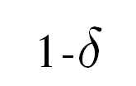
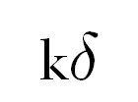
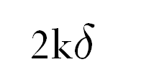
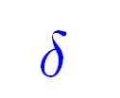
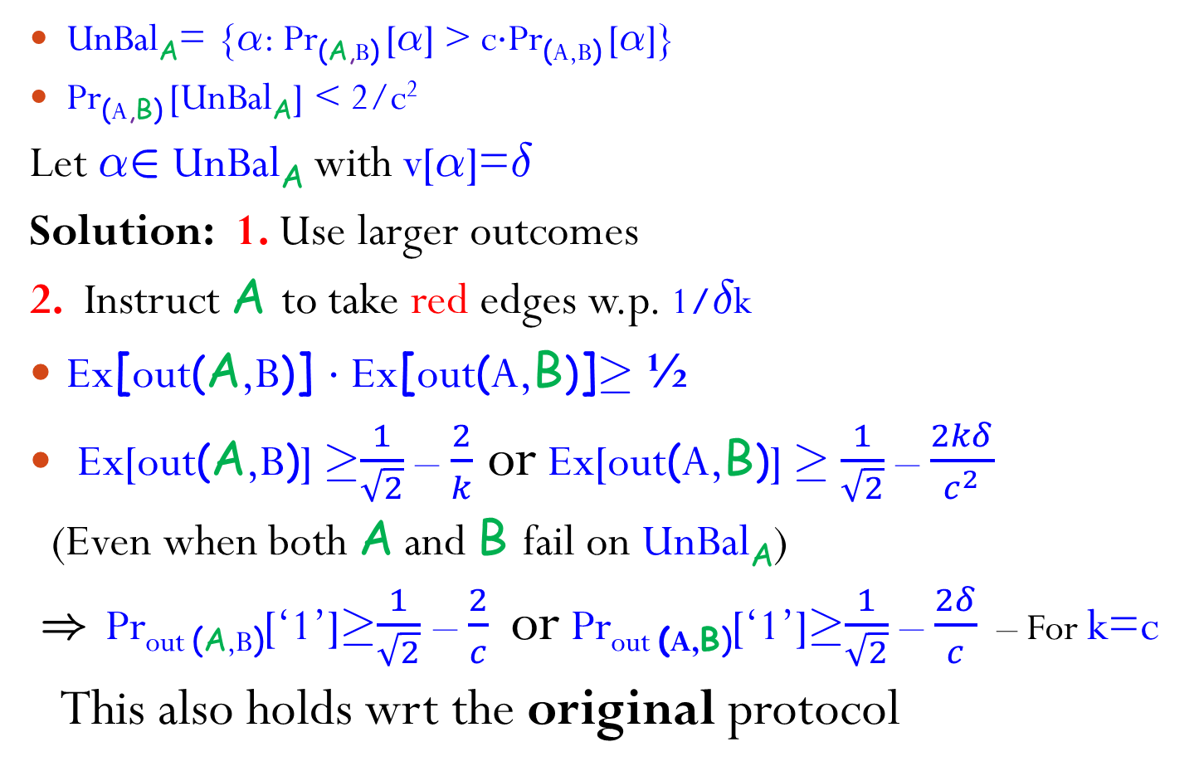
Un-Balanced Transcripts cont.
UnBal_{A}= {®: Pr_{(A,B)} [®] > c¢Pr_{(A,B)} [®]}
Pr_{(A,B)} [UnBal_{A}] < 2/c²
Let ®2 UnBal_{A} with v[®]=±
Solution: 1. Use larger outcomes
2. Instruct A to take red edges w.p. 1/±k
Ex[out(A,B)] ¢ Ex[out(A,B)]¸ ½
Ex[out(A,B)] ¸$\frac{1}{\sqrt{2}}$ – $\frac{2}{k}$ or Ex[out(A,B)] ¸ $\frac{1}{\sqrt{2}}$ –$\frac{2kδ}{c^{2}}$
(Even when both A and B fail on UnBal_{A})
) Pr_{out (A,B)}[‘1’]¸$\frac{1}{\sqrt{2}}$ – $\frac{2}{c}$ or Pr_{out (A,B)}[‘1’]¸$\frac{1}{\sqrt{2}}$ – $\frac{2δ}{c}$ – For k=c
This also holds wrt the original protocol
B
1/k
1-1/k
A
1
1
0
0
1
0
1
0
0
½
½
0
…
Unless is small, A might still gain substantially from visiting Biased_{A}

Slide 24


The Constant $\frac{\sqrt{2}−1}{2}$ = 0.207…
The right bound for fixed-outcome attackers (even unbounded ones)
²-bias weak coin-flipping implies ($\frac{\sqrt{2}−1}{2}$+ ²)-bias coin-flipping [Chaillou and Kerenidis ‘09]
Quantum ($\frac{\sqrt{2}−1}{2}$)-bias coin-flipping exists, and is optimal [Kitaev ’03, Chaillou and Kerenidis ’09]
²-bias weak coin-flipping:
Pr[(A,B)(1^{n}) = ‘0’] · ½ + ²
Pr[(A,B)(1^{n}) = ‘1’] · ½ + ²
Weaker security guarantee, yet has many applications
Previously known results hold

Slide 25
Summary
Constant-bias coin flipping implies OWFs
Fixed-bit attackers – novel even for unbounded one
Our constant 0.207…
A slightly better constant, would yield a similar result for weak coin flipping
Interesting connection between Quantum and our current knowledge of plain model CF
Challenge: prove that any non-trivial coin flipping implies OWFs

Slide 26
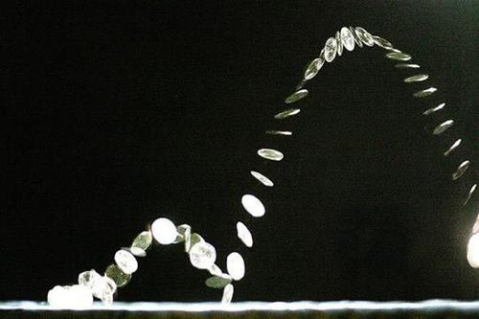
Thank You!!!
Omrier@gmail.com

