Slide 1

Going Down HILL: Efficiency Improvements in Constructing Pseudorandom Generators from One-way Functions
Iftach Haitner
Omer Reingold
Salil Vadhan

Slide 2


Cryptography
Rich array of applications and powerful implementations.
In some cases (e.g Zero-Knowledge), more than we would have dared to ask for.
Notes:
Amazing concepts, implications and constructions.
Many things that you want, and in many cases things that you didn’t even know that you want before were found to be possible

Slide 3
Cryptography
Proofs of security very important
BUT, almost entirely based on computational hardness assumptions (factoring is hard, cannot find collisions in SHA-1, …)
I ♥
Crypto
Notes:
When your system is broken it might be too late to try and fix it
Sometimes you won’t even know that your system is broken
Unfortunately, we cannot prove security unconditionally
Crypto is based on hardness assumptions
A line of work mainly took place in the 80’s, base crypto on the weakest assumption possible
The weakes such assumption is OWF

Slide 4
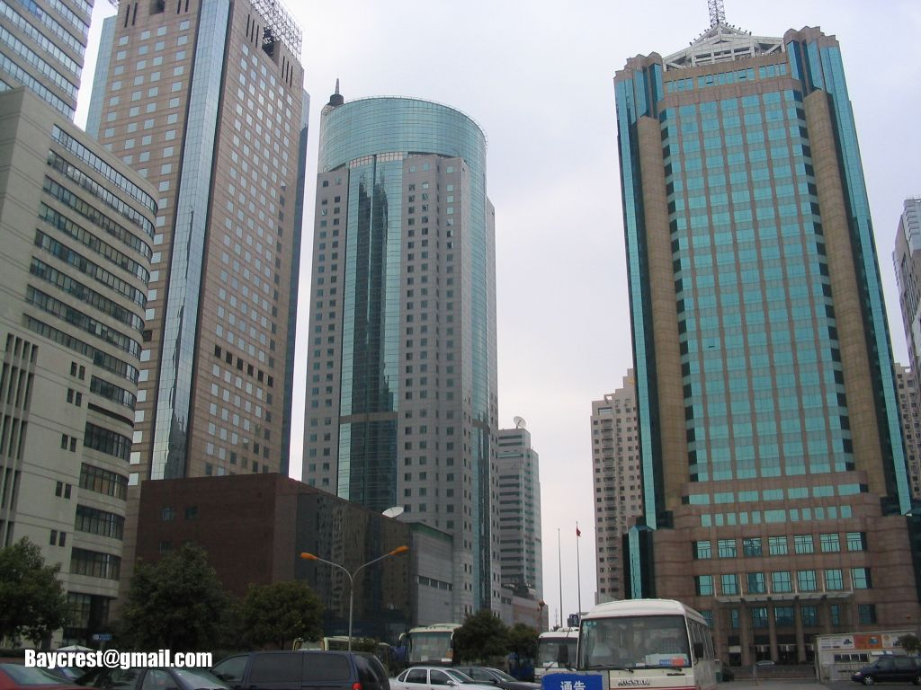
One Way Functions (OWF)
Easy to compute
Hard to invert (even on the average)
The most basic, unstructured form of cryptographic hardness [Impagliazzo-Luby ‘95]
Major endeavor: base as much of Crypto on existence of OWFs – Great success (even if incomplete)
f
x
f(x)
Intermediate primitives

Slide 5
Pseudorandom Generators [BM,Yao]
Efficiently computable function G:{0,1}^{s} → {0,1}^{m}
Stretching (m > s)
Output is computationally indistinguishable from uniform
x
G(x)
Notes:
Originally introduced in order to convert a small amount
of randomness into a much larger number of effectively random bits, pseudorandom generators have
since proved to be valuable components for various cryptographic applications

Slide 6




(Private-key) Encryption
m
m
©
k
k
k
G
G
k’
k’

Slide 7

Håstad, Imagliazzo, Levin and Luby ‘90
Theorem Existence of OWFs ) Existence of PRGs
Centerpiece in basing Cryptography on OWFs
Introduced key concepts and techniques (Pseudoentropy, Leftover Hash Lemma, …)
Inefficient and quite complex
Notes:
The reason being that while using what seems as the right abstractions, their actuall construction still uses some ad-hoc solutions, resulting in an inefficient and complicate construction

Slide 8
Simplicity
With years, [HILL] became simpler
But mainly because we got used to it (tools and techniques became “standard”).
[HILL99,Holens06] additional abstractions and more modularity (+ Holenstein's Uniform Hard-Core Lemma)

Slide 9
Our Result
New construction of PRG from OWF
Simpler
Improve efficiency/security
Non-adaptive, OWFs in NC¹ ⇒ PRGs in NC¹
Derive (via [AIK 06]) OWFs in NC¹ ⇒ PRGs in NC⁰

Slide 10
Efficiency
f:{0,1}^{n}  {0,1}^{n} ) G:{0,1}^{s(n)}  {0,1}^{m(n)}
For this talk efficiency (and security) of construction is measured by PRG’s seed length s(n)
[HILL90, Hol06] O(n⁸), [HHR06a] O(n⁷) Here O(n⁴)
Assume that f is secure on 100 bits input, the PRG of [HHR06a] is secure on O(10¹⁴) bits input Here on O(10⁸)
From exponentially hard OWFs:
[Hol06] Õ(n⁴), [HHR06b] Õ(n) Here Õ(n)

Slide 11

The HILL Construction

Slide 12
Pseudoentropy Generator
The basic object in HILL: G_{pe}(x,h) = f(x), h, h(x)_{1..d(x)+1}
f:{0,1}^{n} → {0,1}^{n} is a OWF, h is random n£n matrix and d(x) = log|f⁻¹(f(x))|
The entropy of G_{pe}(x,h) (over a random (x,h)):
The (Shannon) entropy of X is H(X) = E_{xÃX}[log(1/Pr[X=x)]
X has pseudoentropy ≥ k if 9 Y
X ≈_{C} Y
H(Y) = k
G_{pe} (x,h) =
f(x)
h
h(x)_{1…d(x)+1}
Looks uniform
H(f(x)) +|h| bits of entropy
d(x) bits of entropy
n+|h| bits of entropy
n+|h| + 1 bits of pseudoentropy
Leftover Hash Lemma*
Δ = output pseudoentropy – output (real) entropy = 1
Goldreich-Levin hardcore bit

Slide 13
Proof
G_{pe}(x,h)=f(x),h,h(x)_{1..d(x)+ 1}
d(x)= log|f⁻¹(f(x))|
Claim: g’(x,h) = f(x), h, h(x)_{1..d(x)} is almost-injective OWF
Proof: (f(x),h,U_{1..d(x)}) “dominates” (f(x), h, h(x)_{1..d(x)} )
Corollary: G_{pe} (x,h) ≈_{C} (f(x),h,h(x)_{1..d(x)},U) and thus has pseudoentropy n+|h| + 1
Proof: Goldreich-Levin
Remark: Any pairwise ind. hash function (or strong extractor) for the first part of h will do, achieving |h| 2 O(n)

Slide 14
Pseudoentropy Generator ! PRG
G_{pe} (x₁,h₁)=
f(x₁)
h₁
h₁(x₁)_{1…d(x1)+1}
pseudoentropy
pseudo min-entropy
G_{pe} (x₂,h₂)=
f(x₂)
n+|h|+ 1 bits of pseudoentropy
h₂
h₂(x₂)_{1…i(x2)+1}
…
G_{pe} (x_{t},h_{t}) =
f(x_{t})
h_{t}
h_{t}(x_{t})_{1…d(xt) + 1}
Problem: G_{pe} might not be efficiently computable
(since d(x) = |f⁻¹(f(x))| might not be)
Extractor
G(x₁,h₁…,h_{t},x_{t})

Slide 15
Pseudoentropy Generator – Actual Construction
G_{pe}(x,h) = f(x), h, h(x)_{1..d(x)+ 1}
G_{pe}(x,h,i) = f(x), h, h(x)_{1..i}
Δ = output pseudoentropy – output (real) entropy = 1/n
“Proof”:
Disadvantages:
Δ rather small
Output pseudoentropy < entropy of input
Value of output pseudoentropy is unknown
) Less efficient and more complicate overall construction
i
i
i
G_{pe} (x,h) =
f(x)
h
h(x)_{1…d(x) + 1}
< n+|h| bits of entropy
n+|h| + 1bits of pseudoentropy
n+|h| bits of entropy

Slide 16

Our Construction

Slide 17
Our Building Block
Simply do not truncate:
G_{nb}(x,h) = f(x), h, h(x)
Nonsense: G_{nb}(x,h) is invertible and therefore has no pseudoentropy!
Well yes, but: G_{nb}(x,h) does have psudoentropy from the point of view of an online (eff.) predictor (getting one bit at a time).
G_{nb} (x,h) =
f(x)
h
h(x)
pseudoentropy = entropy
n +|h| + 1 bits of next-bit pseudoentropy

Slide 18
Next-Bit Pseudoentropy
X=(X₁…X_{n}) has next-bit pseudoentropy ≥ k if ∃ {Y₁,…,Y_{n}} (jointly distributed with X) with
8i (X₁…X_{i-1},X_{i}) ≈_{C} (X₁…X_{i-1},Y_{i})
Σ_{i} H(Y_{i}|X₁…X_{i-1}) ≥ k
Hence, Pr[P(X₁…X_{i-1})=X_{i})] is “small” for any eff. P
Remarks:
Quantitative generalization of unpredictability
For k=n, same as pseudorandmness [BM, Yao, GGM]
Generalizes to blocks and to min entropy
Pr[P(X₁…X_{i-1})=X_{i})]
≈ Pr[P(X₁…X_{i-1})=Y_{i})]
= “small”
?
X₁
?
X₂
?
X₃
?
.
?
.
?
.
?
X_{n}

Slide 19
Our Next-Block Pseudoentropy Generator
Claim: G_{nb} has next-block pseudoentropy n +|h|+ 1
Proof:
X = G_{nb}(x,h) =
Y obtained from X by replacing h(x)_{d(x)+1} with a uniform bit
Advantages:
Δ = output next-block pseudoentropy – output (real) entropy = 1
Output next-block pseudoentropy > input entropy
Pseudoentropy bound is known
d(x)=log|f⁻¹(f(x))|
f(x)
h
h(x)
n+|h| bits of entropy
looks uniform to online observer

Slide 20
Shorter h
Cannot simply split h into pairs-wise ind. hash + hard core bit
Hence, naïve implementation requires |h|2O(n²)
Does not effect the overall complexity
Better codes achieve |h|2O(n)

Slide 21
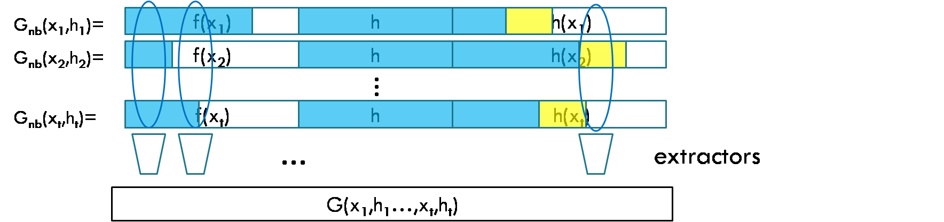
Next-Block Pseudoentropy ! PRG
G_{nb}(x₁,h₁)=
f(x₁)
h
h(x₁)
G_{nb}(x₂,h₂)=
f(x₂)
h
h(x₂)
n+|h|+ 1 bits of next-block pseudoentropy
…
G_{nb}(x_{t},h_{t})=
f(x_{t})
h
h(x_{t})
[BM, Yao, GGM]: Distinguisher for G
) next-bit predictor for G
) (hybrid) next-bit predictor for G_{nb}
) G_{nb} does not have high next-bit pseudoentropy
Seed length O(n³), but construction is (highly) non-uniform
“Entropy equalization” ) uniform construction with seed length O(n⁴)
…
extractors
G(x₁,h₁…,x_{t},h_{t})

Slide 22
Entropy Equalization
Task: Given X=(X₁…X_{n}) with next-block-entropy k, construct X’ =(X’₁…X’_{n’}) for which ∃ Y’=(Y’₁…Y’_{n’}) with
8i (X’₁…X’_{i-1},X’_{i}) ≈_{C} (X’₁…X’_{i-1},Y’_{i})
8i H(Y’_{i}|X’₁…X’_{i-1}) = k/n - ±
Y’ = (X⁽¹⁾_{j},X⁽¹⁾_{j+1}…X⁽¹⁾_{n},X⁽²⁾₁, …X^{(t)}_{j-n}) where jÃ[n]
8i H(Y’_{i}|X’₁…X’_{i-1}) = k/n - k/(t-1)n
A Very similar Idea used in the work of [HRVW 09] on Accessible Entropy
X⁽¹⁾₁
X⁽¹⁾₂
…
X⁽¹⁾_{n}
X⁽¹⁾₁
X⁽²⁾₂
…
X⁽²⁾_{n}
…
X^{(t)}₁
X^{(t)}_{n}
…
X^{(t)}_{n}
j
n-j

Slide 23
Conclusion: Simple form of PRGs in OWFs
For OWF f:{0,1}^{n} → {0,1}^{n} & (appropriate) pair-wise independent hash function h:{0,1}^{n}→{0,1}^{n}
Has pseudoentropy in the eyes of an online distinguisher (i.e., next-bit pseudoentropy)
Question: do we need h at all?
x
f(x), h, h(x)
Notes:
Originally introduced in order to convert a small amount
of randomness into a much larger number of effectively random bits, pseudorandom generators have
since proved to be valuable components for various cryptographic applications

Slide 24
Open Questions
Have we reached optimal seed length?
Length-doubling PRG with low adaptivity

Slide 25

More Details
Notes:
In the rest of this talk I will describe our construction and say a few words about it proof

Slide 26
The Uniform Case
X = G_{nb}(x,h)= (f(x),h,h(x)), Y = (f(x), h, h*(x))
h*(x)_{i} =
Σ_{i} H(Y_{i}|X₁…X_{i-1}) = n+|h|+1
8i (X₁…X_{i-1},X_{i}) ≈_{C} (X₁…X_{i-1},Y_{i})
But Y might be distinguishable from X given oracle access to (X,Y)
Use Holenstein’s uniform hardcore lemma: For every distinguisher D, there exists a good Y_{D}
U i = d(x)+1, where d(x) = log|f⁻¹(f(x))|
h(x)_{i} o/w

Slide 27
The Uniform Case cont.
Lemma [Holenstein 05’]: Let g and b be eff. function and predicate over {0,1}^{t} (1) Assume Pr[M(g(U_{t})) = b(U)] · 1-±/2 for every eff. M Then, for every eff. M exists S½{0,1}^{t} of density ± s.t (2) Pr_{xÃS}[M^{1S}(g(x)) = b(x)] · ½ + neg(t)
Let g(x,h,i) = f(x),h,h(x)_{1…,i} and b(x,h,i)= h(x)_{i+1,} then (1) holds w.r.t. ± = (n-H(f(U_{n}))+1)/n
For S½{0,1}^{n}£{h} £[n] of density ±, let Y^{S}=(f(x),h,h*(x)) where h*(x)_{i}=
Σ_{i} H(Y^{S}_{i}|X₁…X_{i-1}) ≥ n+|h|+ 1
9 eff. M s.t |Pr[A^{X,YS}(X₁…X_{i-1},X_{i})] =1]-Pr[A^{X,YS}(X₁…X_{i-1},Y^{S}_{i})] =1] < neg ) Pr_{xÃS}[M^{A,1S}(g(x)) = b(x)] >½ + neg
U (x,h,i)2S
h(x)_{i} o/w

Slide 28
More Efficient Codes
We use C: {0,1}^{n}  {0,1}^{poly(n)}, s.t
H = {h_{i} : h_{i}(x) = C(x)_{i}} is (almost) pairwise independent
Efficient list decoding for distance (½ – 1/n)
Question: find a pairwise code with (small) list decoding for distance (½ – 1/poly(n))

