Slide 1
Next-Block Pseudoentropy ! PRG
g(x₁,h₁)=
f(x₁)
h
h(x₁)
g(x₂,h₂)=
f(x₂)
h
h(x₂)
n+|h|+ 1 bits of next-block pseudoentropy
…
g(x_{t},h_{t})=
f(x_{t})
h
h(x_{t})
…
extractors
G(x₁,h₁…,x_{t},h_{t})

Slide 2
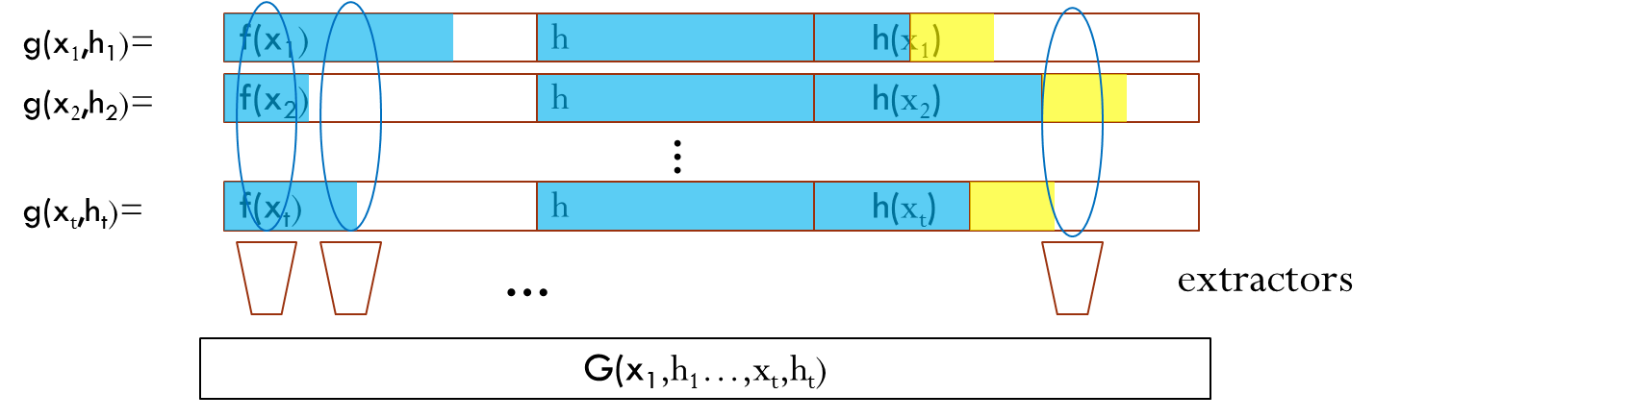
Next-Block Pseudoentropy ! PRG
Distinguisher for G
) next-bit predictor for G
) (hybrid) next-bit predictor for g
) g does not have high next-bit pseudoentropy
Seed length O(n³), but construction is (highly) non-uniform
  “Entropy equalization” ) uniform construction with seed length O(n⁴)

Slide 3
Entropy Equalization
Task: Given X=(X₁…X_{n}) with next-block-entropy k, construct
X’ =(X’₁…X’_{n’}) for which ∃ Y’=(Y’₁…Y’_{n’}) with
8i (X’₁…X’_{i-1},X’_{i}) ≈_{C} (X’₁…X’_{i-1},Y’_{i})
8i H(Y’_{i}|X’₁…X’_{i-1}) = k/n - ±
X’ = (X⁽¹⁾_{I},X⁽¹⁾_{I+1}…X⁽¹⁾_{n},X⁽²⁾₁, …X^{(t)}_{I-n}) and Y’ = (Y⁽¹⁾_{I},Y⁽¹⁾_{j+1}…Y⁽¹⁾_{n},Y⁽²⁾₁, …Y^{(t)}_{I-n})
8i H(Y’_{i}|X’₁…X’_{i-1}) = k/n - k/(t-1)n
X⁽¹⁾₁
X⁽¹⁾₂
…
X⁽¹⁾_{n}
X⁽¹⁾₁
X⁽²⁾₂
…
X⁽²⁾_{n}
…
X^{(t)}₁
X^{(t)}_{n}
…
X^{(t)}_{n}
j
n-j

