Slide 1
A Parallel Repetition Theorem for Any Interactive Argument Or On the Benefits of Cutting Your Argument Short
Iftach Haitner
Microsoft Research New England
TexPoint fonts used in EMF.
Read the TexPoint manual before you delete this box.: AAAAAAAAA

Slide 2
outline
Motivating examples for the question: Does parallel repetition improve security?
Our result
Proof’s sketch

Slide 3




Example #1 – CAPTCHAS
CAPTCHAS – Aim to distinguish human beings from a machines. Used to fight spamming, denial of service,…
Basic task –
Not hard enough (easy to guess with probability 1/36)
– – Amplification via “Parallel repetition”
By how much (if at all) does parallel repetition improve security?
?
=
?
=
?
Amplification via “sequential repetition”
Improves security (to any degree)
Problem: impractical, too much time
=
?
=
?
=
Notes:
What are captchas

Slide 4

Example #2 – Commitment Schemes
Commit stage
Reveal stage
S
R
m
m
m
Notes:
We saw two examples
4

Slide 5
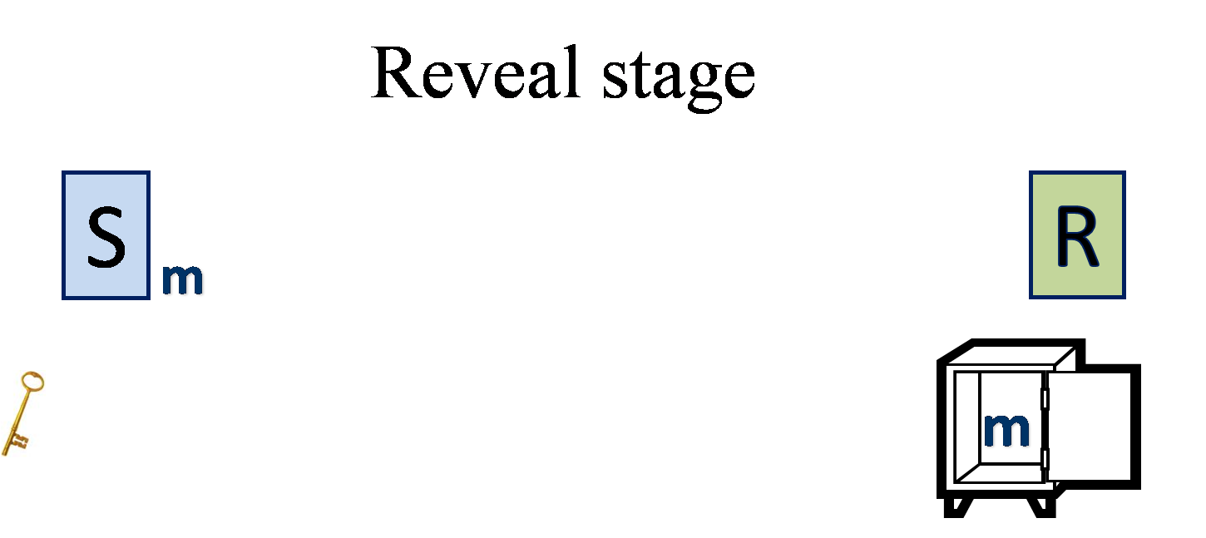
Example #2 - Commitment Schemes
Security properties:
Hiding: R learns nothing about m during commit stage
Binding: S cannot decommit to two different values
More “powerful” than encryption
Can have statistical hiding
Extremely useful
Weakly binding: S cannot decommit into two different values with ”too high” probability
Amplification idea: S commits to the same value many times (in parallel)
By how much (if at all) binding is improved?
Notes:
Commitment schemes, and in particular SH-com, are fundamental primitives in cryptography. They serve an important role in constructions of ZK proof/ argument , protocol for secure computation and more.
We demonstrate the notion of SHC using the following animation
5

Slide 6





Goal – Hardness Amplification
Starting point – A protocol/algorithm with “weak security” – security holds with some probability
Goal – Amplify to fully secure protocol/algorithm
Examples: one-way functions, PCP’s, CAPTCHAS, identification schemes, interactive arguments, …
Real challenge – preserve other properties, in particular efficiency
Most natural approach is via parallel repetition
Does parallel repetition improve security?
Answer: (in general) No
Our result: Effectively, Yes
?
≠
=
=

Slide 7
Interactive Arguments
P
V
The soundness of (P,V) equals the binding of (S,R)
P tries to make V accept an invalid statement
…
Accepts / Rejects
V accepts if the keys open the safe into two different values
Soundness: For any efficient P* Pr[V accepts in (P*,V)] is negligible
Typically, (P,V) has additional functionality and other useful properties
Realizes the security of significant types of systems
Weak soundness: For any efficient P* Pr[V accepts in (P*,V)] < ε (e.g., ½)
Soundness error
Notes:
I write * to mention that P can arbitrary deviate from the protocol

Slide 8
Amplification of Interactive Arguments
P
V
P’
V’
…
…
For any efficient P*
Pr[V accepts in (P*,V)] < ε
For any efficient P*
Pr[V’ accepts in (P*,V’)] is negligible
Goal – a generic transformation that preserves other properties of (P,V) (in particular efficiency), and can be applied to any protocol.

Slide 9
Sequential Repetition
P
V
…
Accept / Reject
No overlap between executions
Verifier accepts if all sub-verifiers do
Known to reduce the soundness error (to any degree, i.e., ε^{k})
Since repetitions are independent
Preserves most properties of the original protocol
Blows up round complexity (# of communication rounds)
P
V
…
K
Accept / Reject
…
P
V
…
Accept / Reject

Slide 10
Parallel Repetition
P
V
P
V
P
V
…
…
…
…
Accept / Reject
Accept / Reject
Accept / Reject
K
Interactions are done in parallel
Verifier accepts if all sub-verifiers do
Preserves round complexity.
Does it improve security?
Does not work in general!

Slide 11

The Counterexample of [Bellare et al. ’97]
P
V
b Ã{0,1}
b
b
b’
b’
b’
V accepts if b’ = b, and the safes are different
Safes are realized as commitment schemes
Soundness error ½

Slide 12
Two Repetitions Do Not Improve Soundness
Both verifiers accept if b₁ = b₂ ) soundness error ½
Can be extended to any (# of repetitions) k
[Pietrzak-Wikstrom ‘07] There exists a single protocol whose soundness error remains ½ for any (poly) k
V₁
b₁ Ã{0,1}
b₁
P*
b₁_
1
V₂
b₂ Ã{0,1}
b₂
b₂_
2
Notes:
Explain the single protocol better

Slide 13
Can we improve security efficiently?
Parallel repetition does improve soundness in few special cases:
3-message protocols [Bellare-Impagliazzo-Naor ‘97]
Public-coin protocols (i.e., verifier sends random coins as its messages) [Håstad-Pass-Pietrzak-Wikström ‘08] and [Chung-Liu ‘09]
Also in Interactive proofs [Goldreich ‘97] and two-prover Interactive proofs [Raz ‘95]
The above does not apply to many interesting cases
Can we efficiently improve the security of general interactive arguments?

Slide 14
Our Result [H ’09]
A simple modification of the verifier of any interactive argument, yields a protocol whose security is improved (to any degree) by parallel repetition
In fact, we are going to “cripple” the original protocol, in a way that, paradoxically, enables repetition to improve security

Slide 15

The Random Terminating Verifier
P
Ṽ
V
halts & accepts w.p. 1/4m
m rounds
halts & accepts w.p. 1/4m
…
halts & accepts w.p. 1/4m
accept if V does

Slide 16
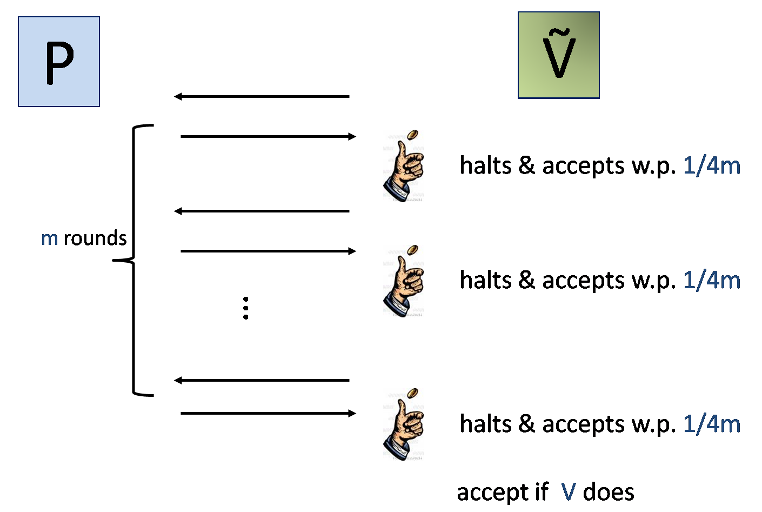
The Random Terminating Verifier
(P,Ṽ) has, essentially, the same soundness guarantee
Most properties of original protocol are preserved
Applicable to many settings
Notes:
Why 1/4m

Slide 17

Why Does Random-Termination Help?
The transformation makes the verifier less predictable
Prevents cheating prover from using one verifier against the other
Notes:
In the rest of this talk I will describe our construction and say a few words about it proof

Slide 18
Beats the Counterexample
Pr[Ṽ accepts in (P*,Ṽ)] = 9/32 < ½
Ṽ₁
Halts
b₁ Ã{0,1}
b₁
P*
?
b₁_
1
Ṽ₂
b₂ Ã{0,1}
b₂
b₂_
2
Notes:
Weaker but less predictable

Slide 19
Proof’s Overview
Skip
Assume for any efficient P*
(1) Pr[V accepts in (P*,V)] < ε
Prove for any efficient P^{(k)*}
(2) Pr[V accepts in (P*,V)] < ε^{(k)} w ε^{k}
Proof by reduction –
Assuming P^{(k)*} contradicts (2)
build P* that contradicts (1)
ε is much larger than ε^{k}, thus an averaging argument would not be enough
The proof “almost” works for any interactive argument
V accepts in (P*,V) $ P* “wins”

Slide 20
Defining P*
V₁
P*
V₂
…
V-i
V
…
P^{(k)*}
…
V_{i}
…
i chosen at random
…
V_{k}

Slide 21
Defining P*
If succeeded, do the same for the second round
Does such q_{-i} always exist?
W.h.p, over q_{i}, a noticeable fraction of the q_{-i} are “good”
How to find q_{-i}?
Sample (at random) many candidates, and for each estimate ® = Pr[P^{(k)*} wins| q_{i},q_{-i}]
Proposition (follows [Raz ‘95] or [Talagrand ’96]): Let W be an event over X = (X₁,…,X_{k}), then (for large enough k) Pr[W |X_{i} = x] w Pr[W], w.h.p. over iÃ[k] and xÃ X_{i}
emulated verifiers’ first messages
P*
V-i
V
q_{-i}
a_{-i}
P^{(k)*}
V_{i}
q_{i}
a_{i}
q_{i}
Given q_{i} , find q_{-i} such that
Pr[P^{(k)*}wins]¸(1- 1/2m)¢ε^{(k)}
a_{i}

Slide 22

Estimating ®
P*
V-i
q_{-i}
V
a_{-i}
q²_{-i}
…
V_{i}
P^{(k)*}
q^{m}_{-i}
a^{m}_{-i}
q_{i}
a_{i}
q²_{i}
…
q^{m}_{i}
a^{m}_{i}
Estimate ® ( = Pr[P^{(k)*}wins| q_{i},q_{-i}]) as the fraction of successful, random, continuations (i.e., P^{(k)*}wins – all sub-verifiers accept)
If V is public coin, sampling random continuations is easy
Sampling might be infeasible for arbitrary V – As hard as finding a random preimage of an arbitrary (efficient) function.
This is why parallel repetition fails

Slide 23
The Random Terminating Case
P*
V-i
q_{-i}
V
a_{-i}
q²_{-i}
…
V_{i}
P^{(k)*}
q^{m}_{-i}
a^{m}_{-i}
q_{i}
a_{i}
q²_{i}
Still hard to sample
…
halts and accepts
q^{m}_{i}
a^{m}_{i}
We sample random continuations, conditioned that Ṽ_{i} halts after first round.
I.e., we estimate the value of ®’ = Pr[P^{(k)*}wins| (q_{i},q_{-i}) & Ṽ_{i} halts after first round]
Notes:
Explain What happens in the next round

Slide 24
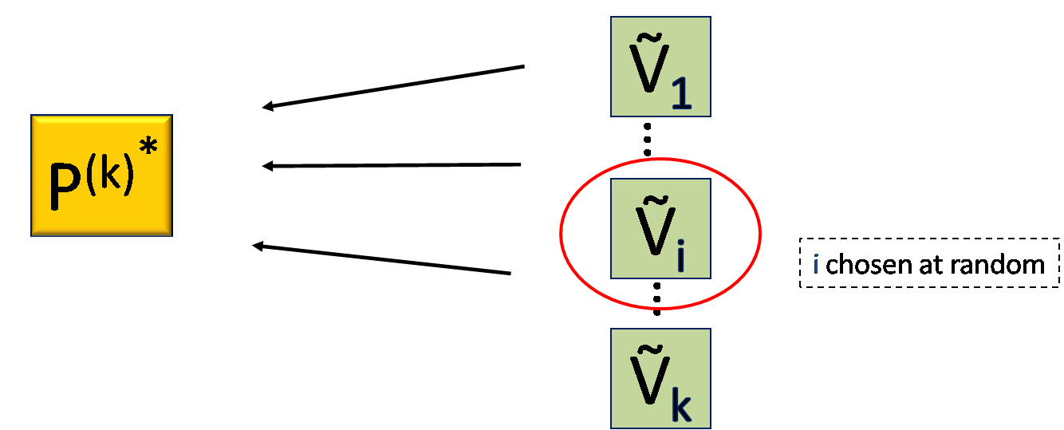
®’ Approximates ® Well
®’ = Pr[P^{(k)*}wins| (q_{i},q_{-i}) & Ṽ_{i} halts after first round]
Since many of the Ṽ_{j}’s are expected to halt after the first round ) ®’ w ® for a random i
Proposition: Let W be an event over X= (X₁,…,X_{k}), then Pr[W |X_{i} = x] w Pr[W] w.h.p. over iÃ[k] and xÃX_{i}

Slide 25

Skip
More Details
Notes:
In the rest of this talk I will describe our construction and say a few words about it proof

Slide 26
Defining P*(revisited)
Estimate ® = Pr[P^{(k)*}wins |q_{i},q_{-i}] - sample random continuations of all verifiers
Easy for the real random-terminating verifier
For the emulated verifiers, as hard as finding a random second pre-image of a function!
Estimate ® = Pr[P^{(k)*}wins |r_{i},r_{-i}] - sample random continuations of all verifiers
r_{j} - random coins of the j’th verifier drawn at first round
Sample random continuations is:
feasible for (arbitrary) emulated verifiers
impossible for (arbitrary) real verifier (even for unbounded sampler)
feasible for the real random termination verifier
P*
V-i
V
q_{-i}
a_{-i}
P^{(k)*}
V_{i}
q_{i}
a_{i}
q_{i}
Find q_{-i} such that
Pr[P^{(k)*}wins|q_{i},q_{-i}]¸(1 -1/2m)ε^{(k)}
Find r_{-i} such that
Pr[P^{(k)*}wins|r_{i},r_{-i}]¸(1 -1/2m)ε^{(k)}
a_{i}

Slide 27
Defining P*(revisited #2)
P* picks the first r_{-i} s.t.
®’ (r_{-i}) = Pr[P^{(k)*} wins| (r_{i},r_{-i} ) & V_{i} halts after first round] > (1- 1/2m)²^{(k)},
where ®’(r_{-i}) is estimation for ®(r_{-i}) = Pr[P^{(k)*} wins| r_{i},r_{-i} ]
Problem: threshold sensitivity
Solution: follows “Smooth sampling” approach of Håstad et al.:
P* Samples many (r_{-i},r²,…,r^{m}) (all protocol’s random coins), and chooses r_{-i} as the prefix of first successful execution (P* wins).
Proof w.r.t. ® still goes through
The probability that r_{-i} is picked, is proportional to ®(r_{-i})
Hence, proof still go through w.r.t. ®’
The original proof can be fixed, using soft thresholds

Slide 28

Summary
Parallel repetition may not improve security
Does improve security of a slight variant of any protocol
Main reason, the modified verifier is unpredictable
Useful for many settings
Main open question:
Can this proof technique be applied to other settings

