Slide 1

The random terminating verifier
P
Ṽ
V
halts & accepts w.p. 1/4m
m rounds
halts & accepts w.p. 1/4m
…
halts & accepts w.p. 1/4m
accept if V does

Slide 2
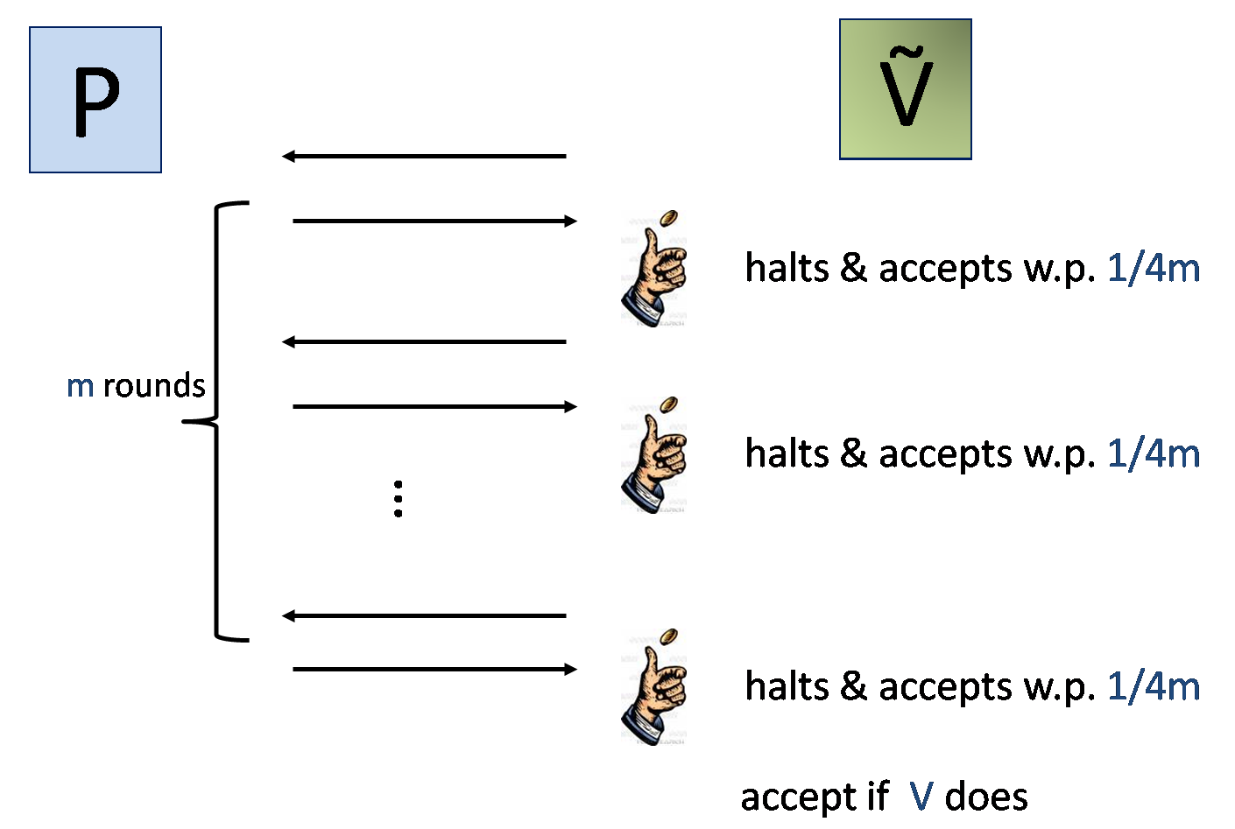
The random terminating verifier
(P,Ṽ) has, essentially, the same soundness guarantee
Most properties of original protocol are preserved
Applicable to many settings
Notes:
Why 1/4m

Slide 3

Why does random-termination help?
The transformation makes the verifier less predictable
Prevents cheating prover from using one verifier against the other
Notes:
In the rest of this talk I will describe our construction and say a few words about it proof

Slide 4


Beats the counterexample
Pr[Ṽ accepts in (P*,Ṽ²)] = 9/32 < ½
Ṽ₁
Halts
b₁ Ã{0,1}
b₁
P*
?
b₁_
1
Ṽ₂
b₂ Ã{0,1}
b₂
b₂_
2
Notes:
Weaker but less predictable

