Slide 1
Parallel Repetition of Interactive Arguments
TexPoint fonts used in EMF.
Read the TexPoint manual before you delete this box.: AAAAAAAAA

Slide 2

Commitment Schemes
Commit stage
Reveal stage
S
R
m
m
m
Security properties:
Hiding: R learns nothing about m during commit stage
Binding: S cannot decommit to two different values
Notes:
We saw two examples
2

Slide 3

Parallel repetition might not reduce soundness error
P
V
b Ã{0,1}
b
b
b’
b’
b’
V accepts if b’ = b,
and the safes are different
Safes are realized as commitment schemes
Soundness error ½

Slide 4

The Random Terminating Verifier
P
Ṽ
V
halts & accepts w.p. 1/4m
m rounds
halts & accepts w.p. 1/4m
…
halts & accepts w.p. 1/4m
accept if V does

Slide 5
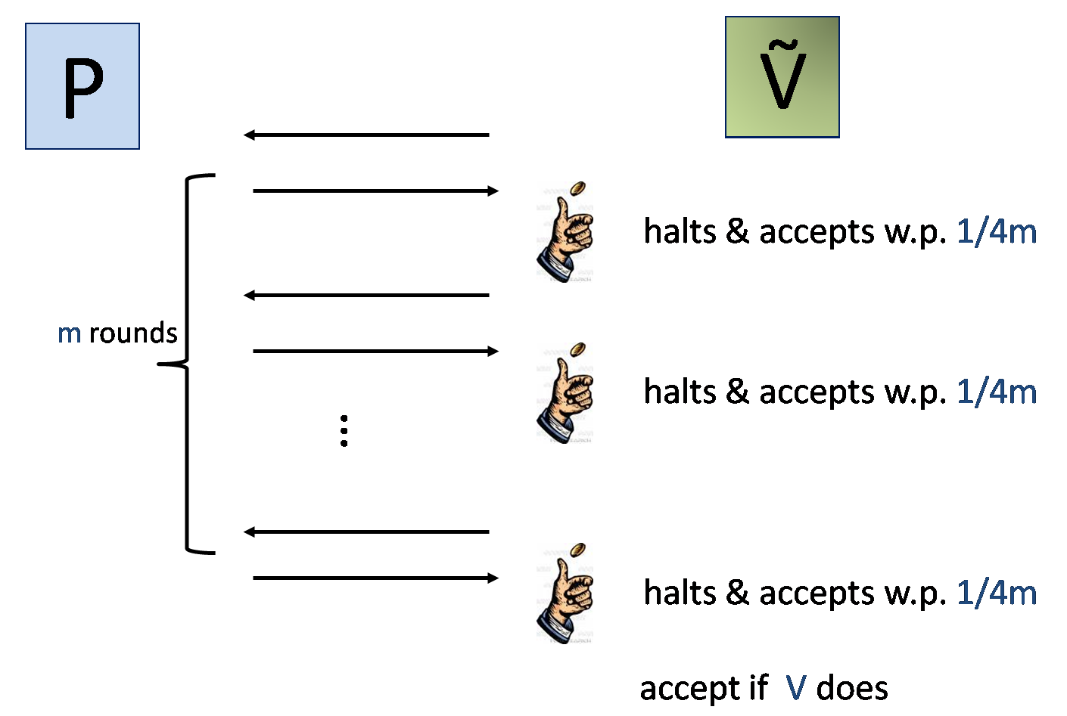
The Random Terminating Verifier
(P,Ṽ) has, essentially, the same soundness guarantee
Most properties of original protocol are preserved
Applicable to many settings
Notes:
Why 1/4m

Slide 6

Why Does Random-Termination Help?
The transformation makes the verifier less predictable
Prevents cheating prover from using one verifier against the other
Notes:
In the rest of this talk I will describe our construction and say a few words about it proof

Slide 7
Beats the Counterexample
Pr[Ṽ accepts in (P*,Ṽ²)] = 9/32 < ½
Ṽ₁
Halts
b₁ Ã{0,1}
b₁
P*
?
b₁_
1
Ṽ₂
b₂ Ã{0,1}
b₂
b₂_
2
Notes:
Weaker but less predictable

