Slide 1
CSE-299
Dietary: a Cloud-based
Nutriment & Fitness Assistant(fact-based)
Android App for Bangladeshi Youths.
Presentation on Progress
Week: 03
Presenting by – Group 1
Date: 06.08.2020

Slide 2

Outline
Recapture
Task Distribution
Weekly Goal
Weekly Progress
Next Week Plan
Conclusion
Reference
Q/A Segment

Slide 3
Recapture
New Addition
Background Study
Tools
Markel value of Android
Similar Apps in Play Store
Scholarly Articles on Food recommendation
Language : Java, Python.
Framework : Android Studio, TensorFlow Lite, DilogFlow.
Machine Learning with KNN Classifier for “Nutrition Assistant”

Slide 4
Task Distribution
Name | On Progress | Done
Polin | User Interface, Dataset Collection, Nutrition Assistant, User Assistant | -
Rifat | Authentication, Database Connection, Fitness Assistant | -
Iftehad | Fitness Assistant, Database Connection, User Assistant | -

Slide 5
This Week Goal
Authentication
- Registration
- Sign in
- Sign out
- Firebase Connection

Slide 6
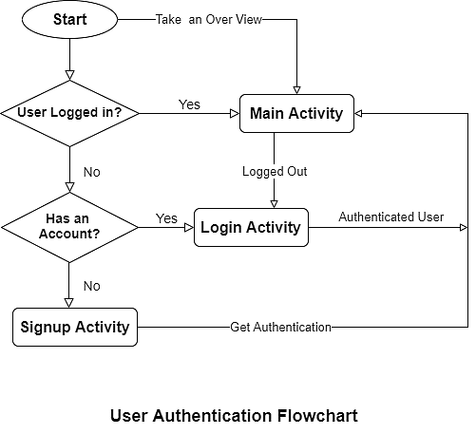
Weekly Progress
User can take an Over View of this Application
Only Authenticated User get Cloud Services

Slide 7
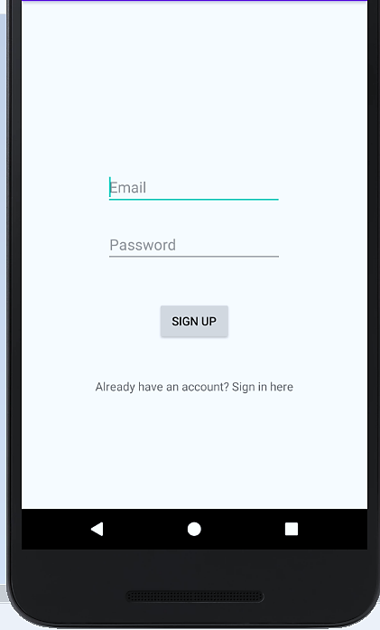
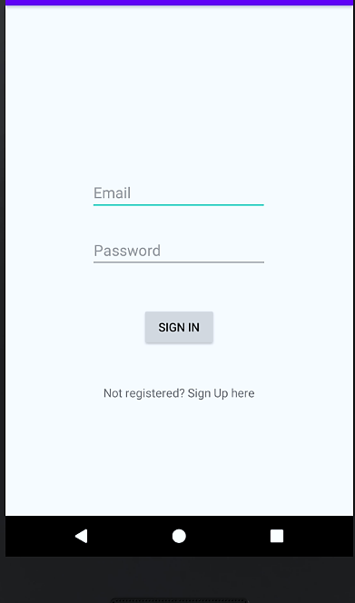
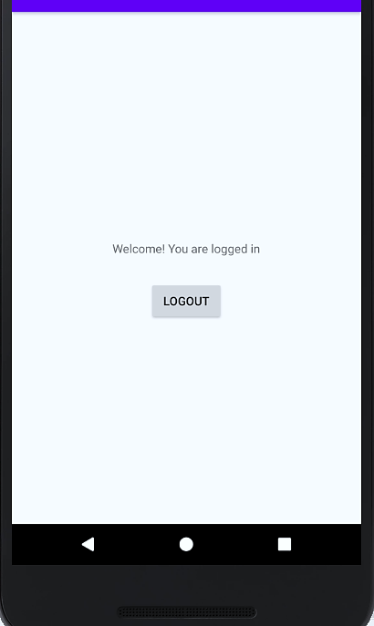
This Week Progress (Continued)
Currently our Main
Activity, UI on progress

Slide 8
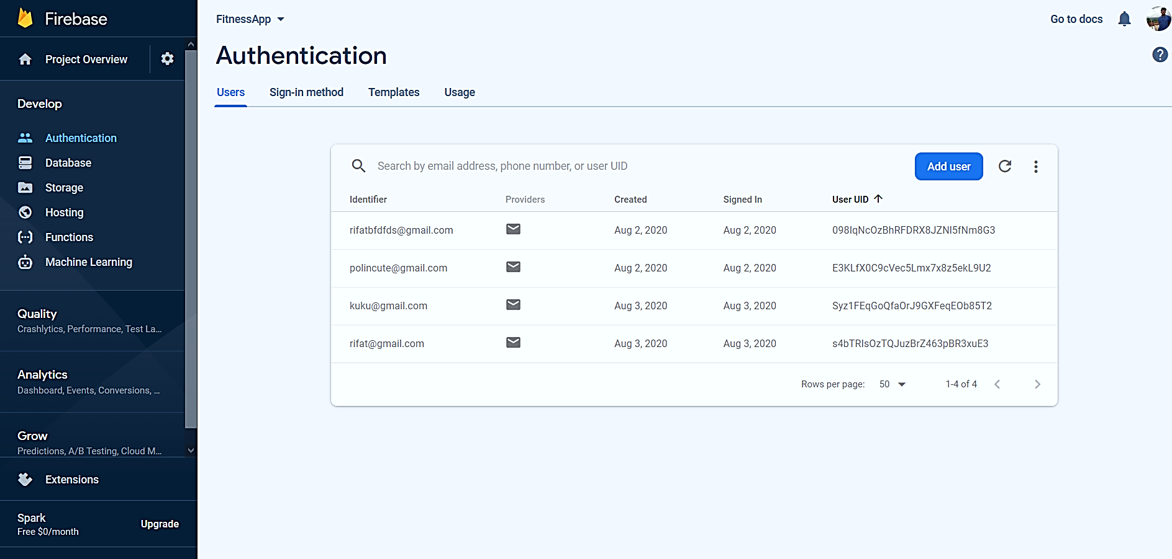
This Week Progress (Continued)

Slide 9
This Week Progress (Continued)
Add dependencies
Authentication perform
build.gradle(Module:app)
Create class
Firebase- auth 19.3.2*
.get instance();
Apply plugin
Firebase console
Create project
Add package name
Add json file

Slide 10
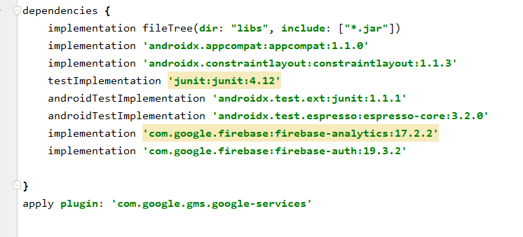
This Week Progress (Continued)
Dependencies needed
implementation 'com.google.firebase:firebase-analytics:17.2.2'
implementation 'com.google.firebase:firebase-auth:19.3.2'
apply plugin: 'com.google.gms.google-services'

Slide 11
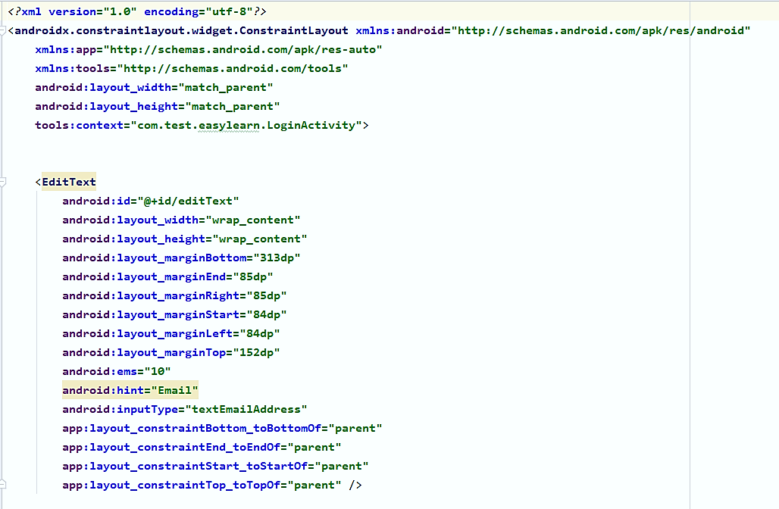
This Week Progress (Continued)
Sign in

Slide 12
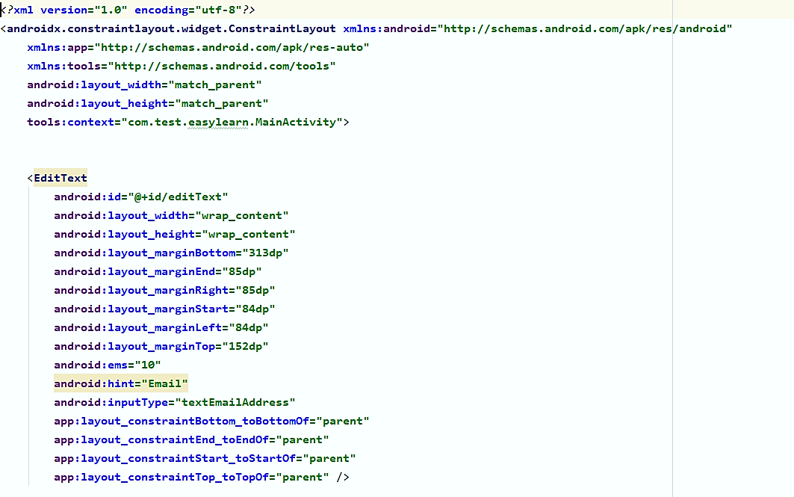
This Week Progress (Continued)
Sign Up

Slide 13
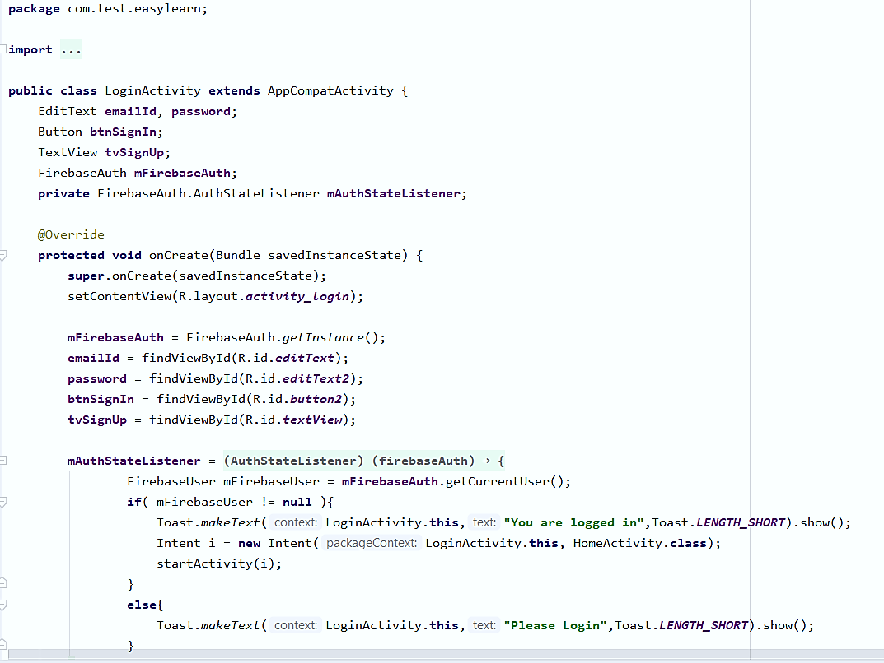
This Week Progress (Continued)
Sign in

Slide 14
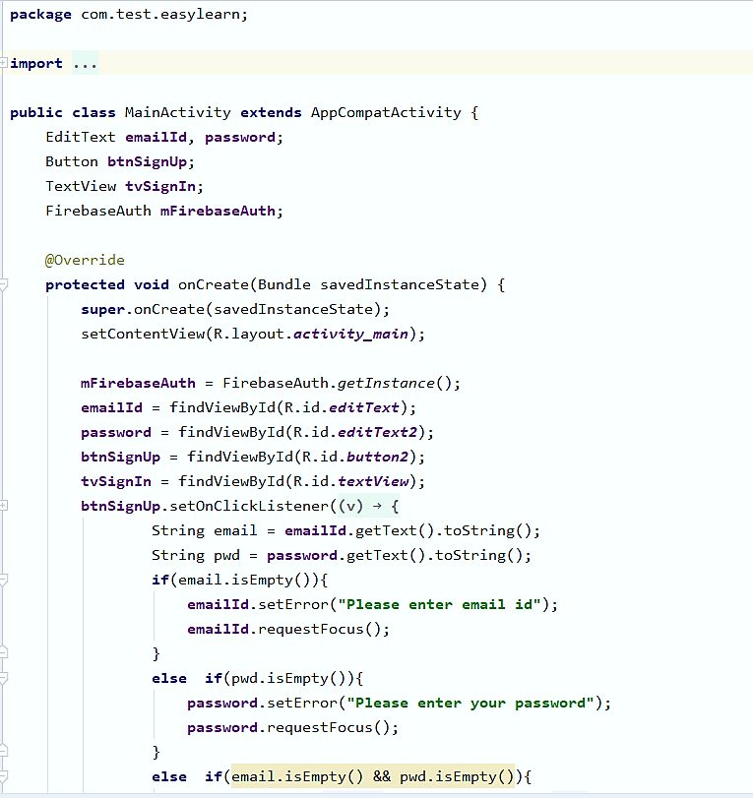
This Week Progress (Continued)
Sign Up

Slide 15
Next Week Plan
Fitness Assistant
Regular Life
Guided Yoga
with Time counter
Fitness
Assistant
Busy Life

Slide 16
Conclusion
Authentication is the practice of validating the identity of a registered user attempting to gain access to an application. It also ensures user data security.
Currently, our App is in a Test mode with Basic Authentication. We will upgrade App’s Authentication rules for ensuring better security.

Slide 18
Reference
"Remember And Authenticate Users | Android Developers". Android Developers, 2020, https://developer.android.com/training/id-auth

Slide 19


Any
Questions
or
Suggestions

