Slide 1

Store Sales EDA
By Iftikar Patel

Slide 2
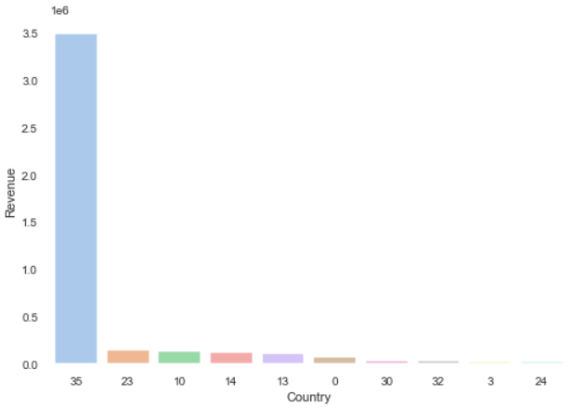
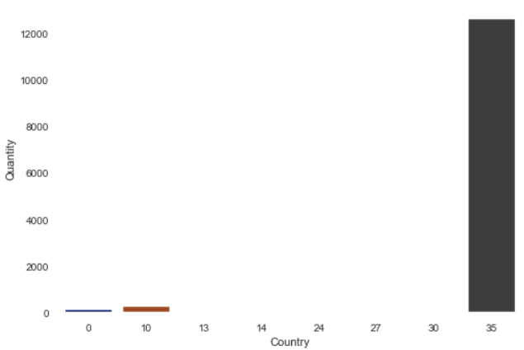
EDA
Top 10 country revenue
Top 10 country giving freebies
Inferences :
Country code 35 generates the best revenues and also gives Freebies to the customers.

Slide 3
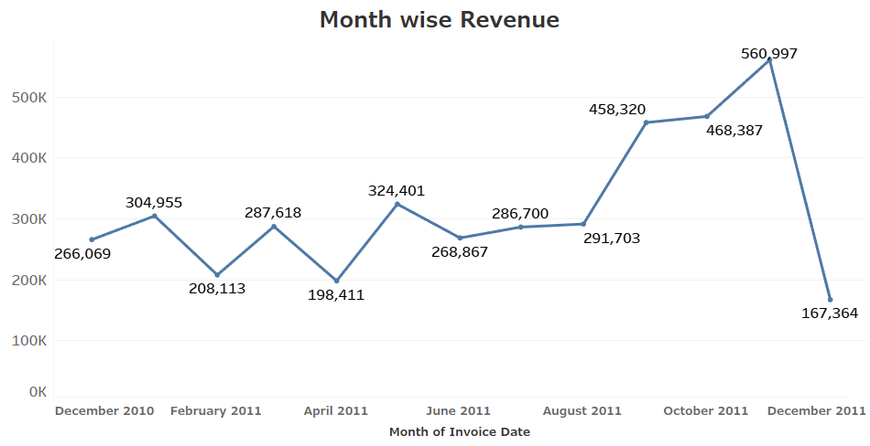
Inferences :
A sharp deep is observed in the December month revenue,Reason could be the presences of negative value in Quantity column.

Slide 4
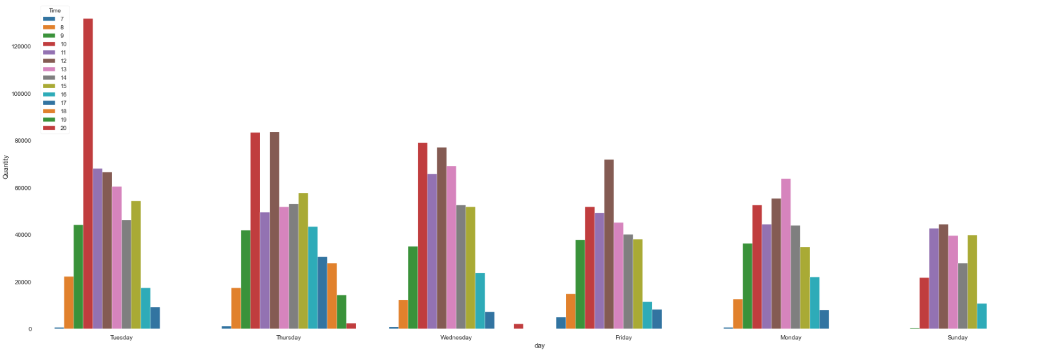
Inferences :
Best Sales is observed on Tuesday and best time is observed around 8pm.
Recommendation :
Most of the sales representative should made available on Tuesday evening for better sales result.

Slide 5
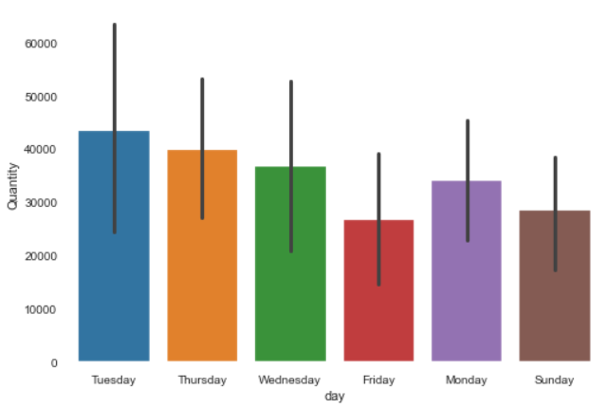
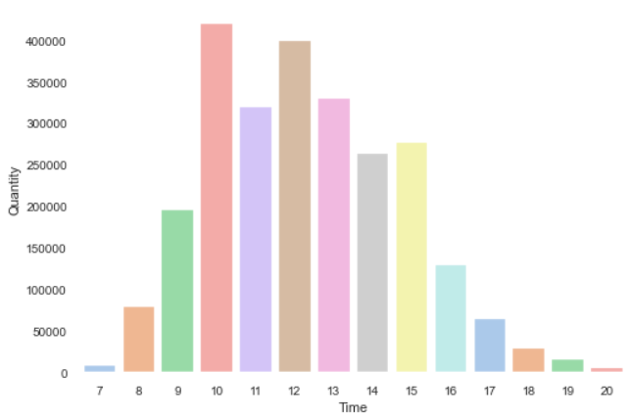

Slide 6
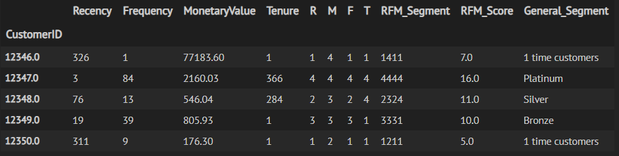
Custmer segmentation is done as platinum,silver,bronze and 1 time customer.
Based on the type we can provide added advantage to customer for example by giving offer to privilege customer.

Slide 7
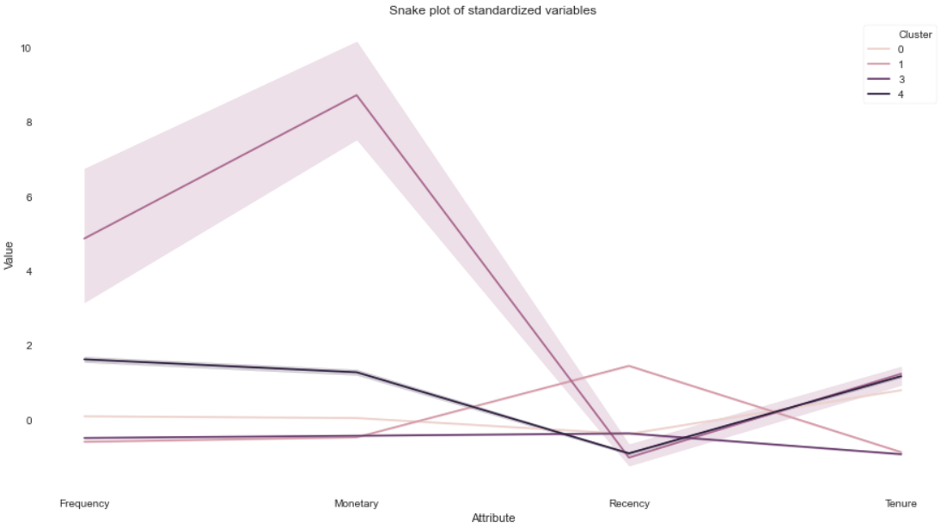

Slide 8
