Slide 1
3d BRAIN MRI IMAGE RECONSTRUCTION USING GAN
Partha Sutradhar(17-34254-1), Khondaker Iftekhar Amin(18-36524-1), Zihan, Ismail Hossain(18-38808-3)

Slide 2
Research Paper
3D MRI Reconstruction Based on 2D Generative Adversarial Network Super-Resolution. Authors : Hongtao Zhang 1, Yuki Shinomiya 2 and Shinichi Yoshida 2
Abstract: The diagnosis of brain pathologies usually involves imaging to analyze the condition of the brain. Magnetic resonance imaging (MRI) technology is widely used in brain disorder diagnosis. The image quality of MRI depends on the magnetostatic field strength and scanning time. Scanners with lower field strengths have the disadvantages of a low resolution and high imaging cost, and scanning takes a long time. The traditional super-resolution reconstruction method based on MRI generally states an optimization problem in terms of prior information. It solves the problem using an iterative approach with a large time cost. Many methods based on deep learning have emerged to replace traditional methods. MRI super-resolution technology based on deep learning can effectively improve MRI resolution through a three-dimensional convolutional neural network; however, the training costs are relatively high. In this paper, we propose the use of two-dimensional super-resolution technology for the super-resolution reconstruction of MRI images. In the first reconstruction, we choose a scale factor of 2 and simulate half the volume of MRI slices as input. We utilize a receiving field block enhanced super-resolution generative adversarial network (RFB-ESRGAN), which is superior to other super-resolution technologies in terms of texture and frequency information. We then rebuild the super-resolution reconstructed slices in the MRI. In the second reconstruction, the image after the first reconstruction is composed of only half of the slices, and there are still missing values. In our previous work, we adopted the traditional interpolation method, and there was still a gap in the visual effect of the reconstructed images. Therefore, we propose a noise-based super resolution network (nESRGAN). The noise addition to the network can provide additional texture restoration possibilities. We use nESRGAN to further restore MRI resolution and high-frequency information. Finally, we achieve the 3D reconstruction of brain MRI images through two super resolution reconstructions. Our proposed method is superior to 3D super-resolution technology based on deep learning in terms of perception range and image quality evaluation standards.

Slide 3
Introduction
Diagnosis of the brain lesions is an active field of research. Magnetic resonance imaging is one of the most important diagnostic imaging methods and has been widely used in diagnosis.
They have used 2D CNNS to replace 3D CNNS in order to reduce memory and time costs.
They have proposed the second super-resolution reconstructions, they have realizes three dimensional MRI reconstruction in the two-dimensional super super-resolution convolutional neural network.
A new noise-based enhanced super-resolution generative adversarial network with the addition of noise and interpolated sampling is proposed. The noise part of the network can provide specific high-frequency information and details without affecting the overall feature recovery. Simultaneously, interpolation sampling solves artifacts and color changes caused by the checkerboard effect.

Slide 4
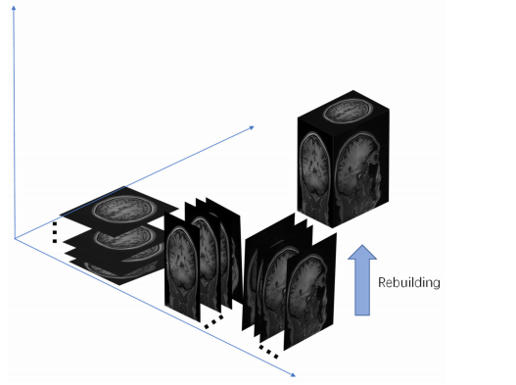
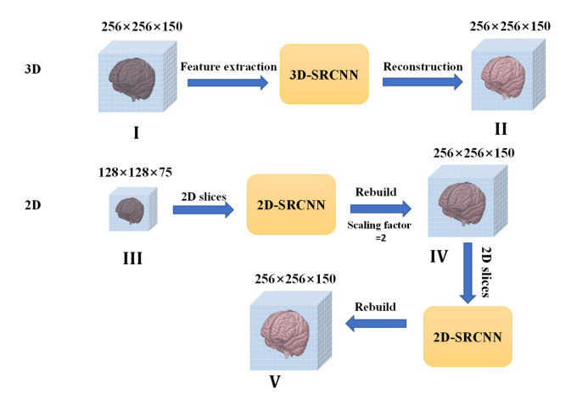
Their Proposed method
They have made it possible from 3d MRI reconstruction from 2d MRI slices.
Through two-dimensional super-resolution CNN (2D-SRCNN), MRI can be recovered with more detail and rebuilding can be finished.

Slide 5
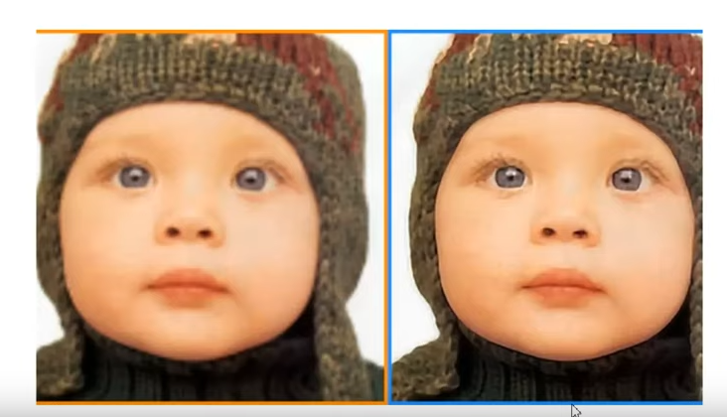
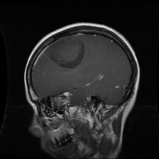
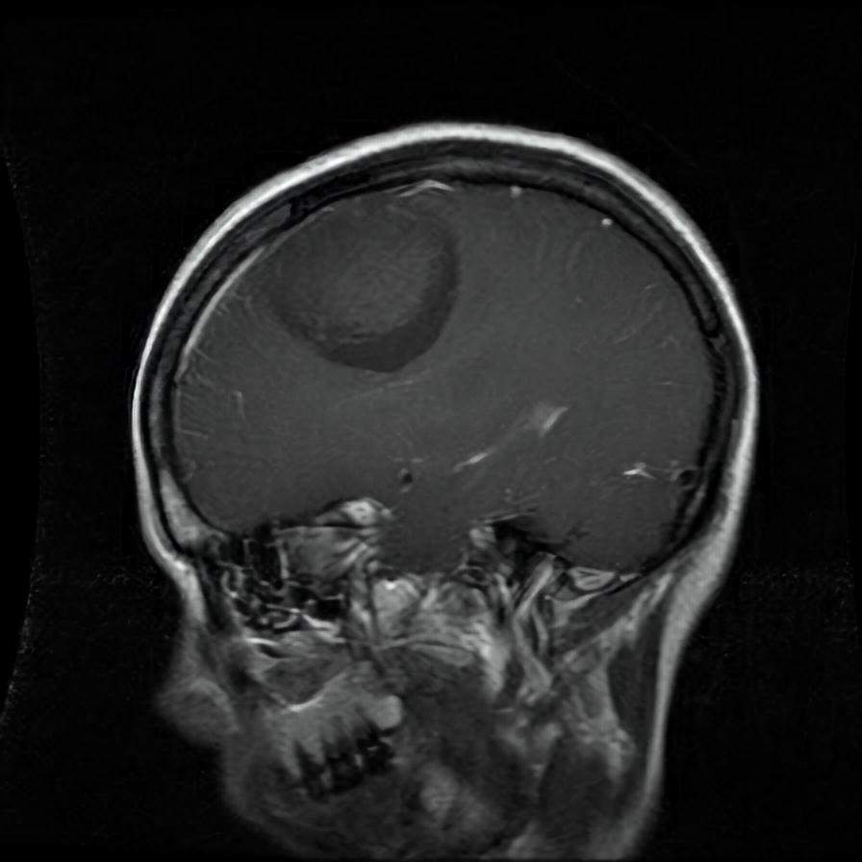
Main Idea of Reconstruction
In most super-resolution studies of MRI, researchers often use three-dimensional convolutional neural networks for image reconstruction. However, the three dimensional convolutional neural networks has excessive parameters and large weight, which results in a considerable memory cost. An MRI image is usually saved in the form of a voxel matrix. According to the matrix’s particularity, MRI rebuilding can be completed with half the number of slices in three directions, but there are many missing values. In 3D-SRCNN, MRI structure information is generally read to perform reconstruction. Using a two-dimensional CNN to replace a three-dimensional CNN can reduce computational costs. Instead of using 3D-SRCNN they have used 2D-SRCNN, which is computationally efficient.
Converting low resolution image to high resolution
ORIGINAL
ESR-GAN

Slide 6
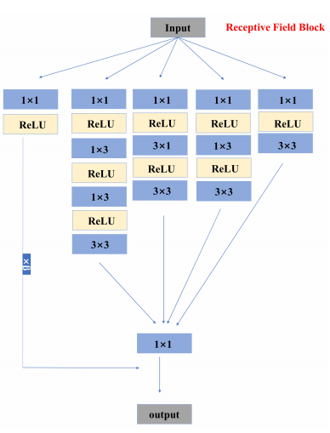
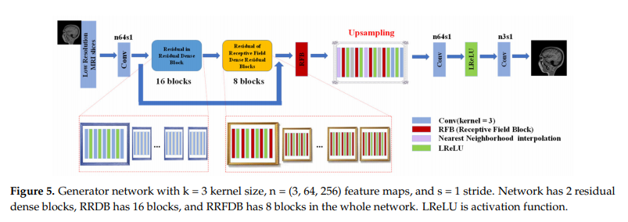
RBF-ESRGAN
RFB-ESRGAN alternately uses the up sampling operations of nearest neighborhood interpolation (NNI) and sub-pixel convolution (SPC) to achieve a good blend of spatial and depth information that will not lose detail performance due to over-resolution. Alternating different up sampling methods reduces the computational complexity. To a certain extent, the super-resolution of multi-scale MRI images can be achieved.
Receptive Field Block
Their RBF-ESRGAN Model

Slide 7
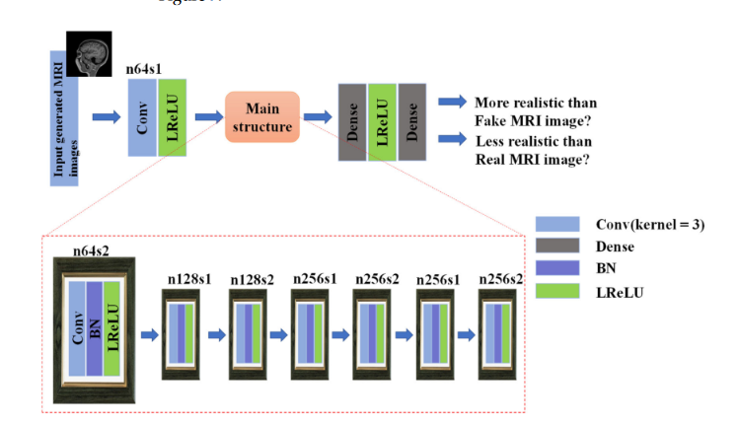
Discriminator Network
Discriminator network with k = 3 kernel size, n = (64, 128, 256, 512) feature maps, and s = (1,2) stride. In this network, dense is fully connected layer, BN is Batch Normalization and LReLU is activation function.

Slide 8
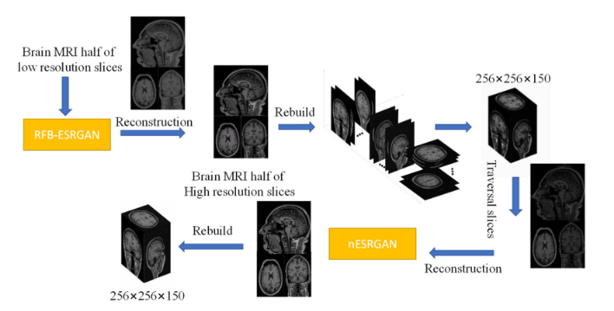
Working Process of RFB-ESRGAN
Notes:
Main processes of experiment. Prepare slices on three planes (with an interval of 1 slice) for super-resolution reconstruction. Obtain high-resolution MRI slices through receiving field block enhanced super-resolution generative adversarial network (RFB-ESRGAN). Since there is half the number of slices, they can still be rebuilt into the MRI. Rebuilt MRI image has many missing values because half the slices are missing; then, super-resolution reconstruction is used to repair the image. Finally, super-resolution reconstruction is completed.

Slide 9
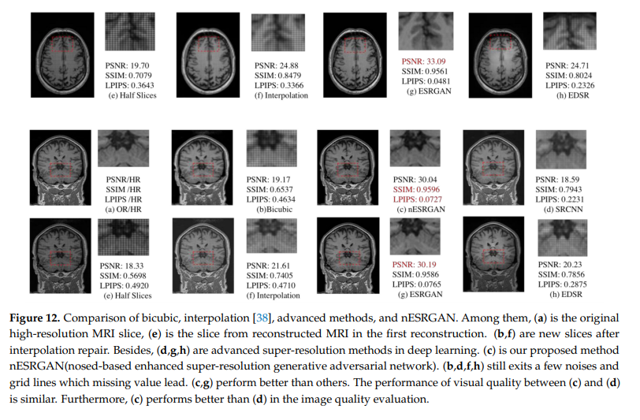
Results and Comparison
They have compared bicubic, interpolation. The performance of visual quality between and is similar. Furthermore, performs better than in the image quality evaluation.
They have used these imaging method for
Quality measurement.
Learned Perceptual Image Patch Similarity.(LPIPS)
Structural Similarity Index Measure.(SSIM)
Peak Signal to noise ratio.(PSNR)

Slide 10
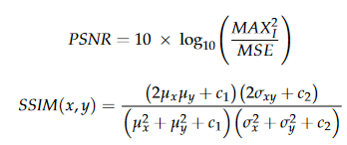
Image Quality Evaluation
Here, They have used this equation to evaluate the image quality Peak Signal to noise ratio.(PSNR)
where μx and μy represent the mean values of images X and Y, σx and σy represent the variances of images X and Y, and σxy represents the covariances of images X and Y.
Here, They found that the higher the values of PSNR and SSIM, the lower the distortion of the picture. LPIPS is used to evaluate the distance between image patches; the lower the value of LPIPS, the more similar the images.

Slide 11
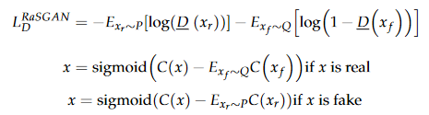
Loss Function
P is the distribution of real data. Q is the distribution of fake data. xF is the image generated by the generator, and xR is the original image. C(x) and D(x) are, respectively, defined as the output of the non-transform discriminator and the standard discriminator.

Slide 12
Thank You

