Slide 1
Welcome to my presentation

Slide 2
project Title : hospital management system
Presented by: Md. Iftekharul Islam
ID . 201930068
Department : CSE
Date: 11.06.2024

Slide 3
INTRODUCTION
Objective:
To provide an overview of the Hospital Management System.
To demonstrate how the system manages patients, doctors, and appointments efficiently.
Agenda:
Overview of the System
Key Features
Code Walkthrough
Live Demo

Slide 4
System Overview
Purpose:
Streamline patient and doctor management.
Simplify appointment scheduling and tracking.
Key Components:
Patient Management
Doctor Management
Appointment Scheduling
Information Display

Slide 5
Key Features
Patient Management:
Add and update patient information.
View detailed patient medical history.
Doctor Management:
Add and update doctor details.
View doctor specialties.
Appointment Management:
Schedule and cancel appointments.
View all upcoming appointments.
View appointments for a specific patient.
Information Display:
Display detailed information for patients and doctors.
List all patients and doctors in the database.

Slide 6
System architecture
Classes and Their Responsibilities:
Person:
Base class for Patient and Doctor.
Stores common attributes like name, age, and gender.
Patient (inherits Person):
Adds medical history.
Methods to update and display patient information.
Doctor (inherits Person):
Adds specialty information.
Methods to display doctor information.
Appointment:
Manages appointment details (patient, doctor, date, time).
Method to display appointment details.
Hospital:
Central hub for managing patients, doctors, and appointments.
Methods for adding, updating, and displaying data.

Slide 7
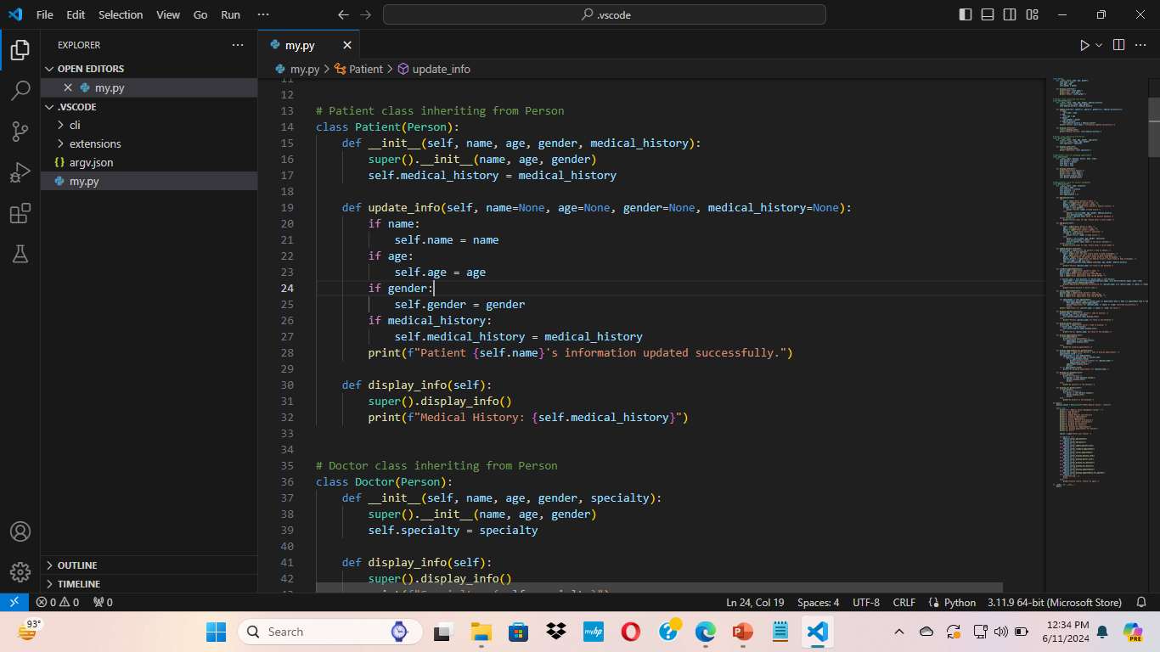
Code Walkthrough - Patient Class
Key Methods:
__in it__: Initializes a new patient.
Update_ info: Updates patient details.
Display_info: Displays patient information, including medical history.

Slide 8
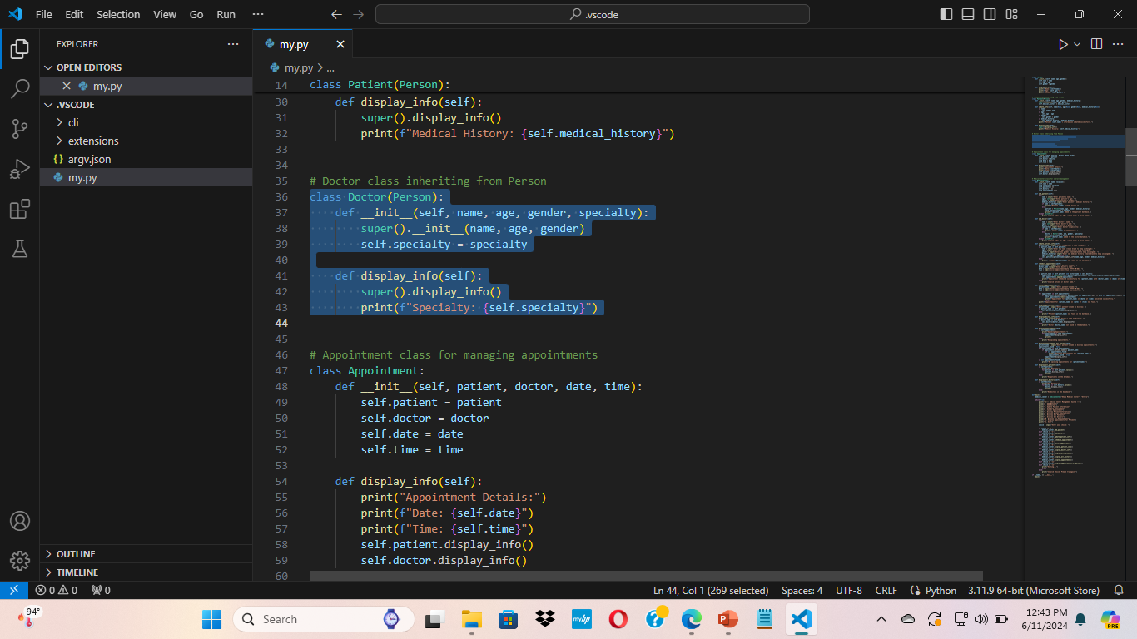
Code Walkthrough - Doctor Class
Key Methods:
__init__: Initializes a new doctor.
display _info: Displays doctor information, including specialty.

Slide 9
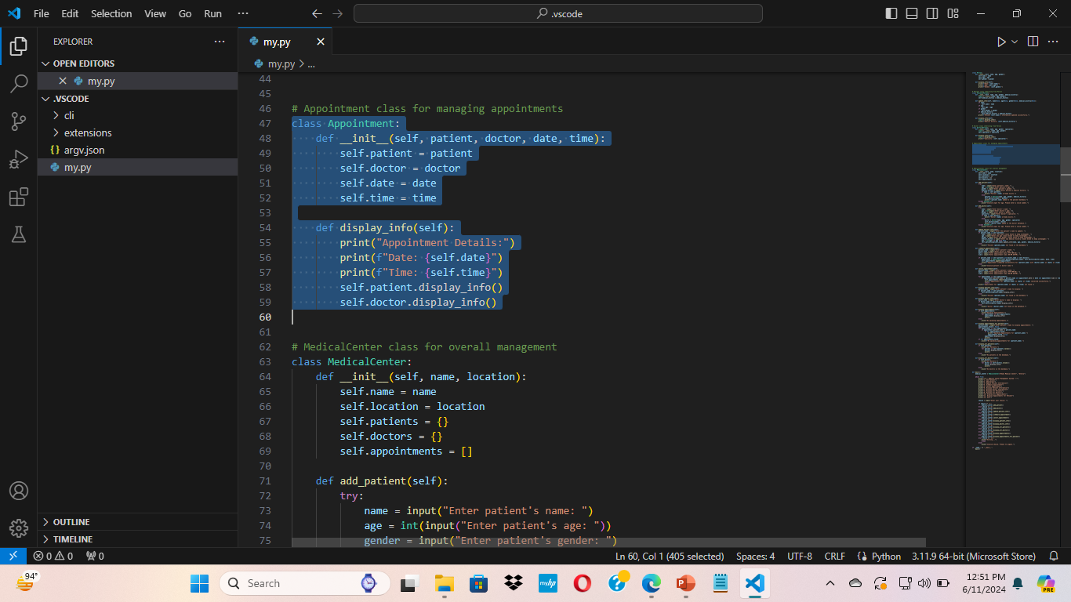
Code Walkthrough - Appointment Class
Key Methods:
__init__: Initializes a new appointment.
Display_info: Displays appointment details along with patient and doctor info.

Slide 10
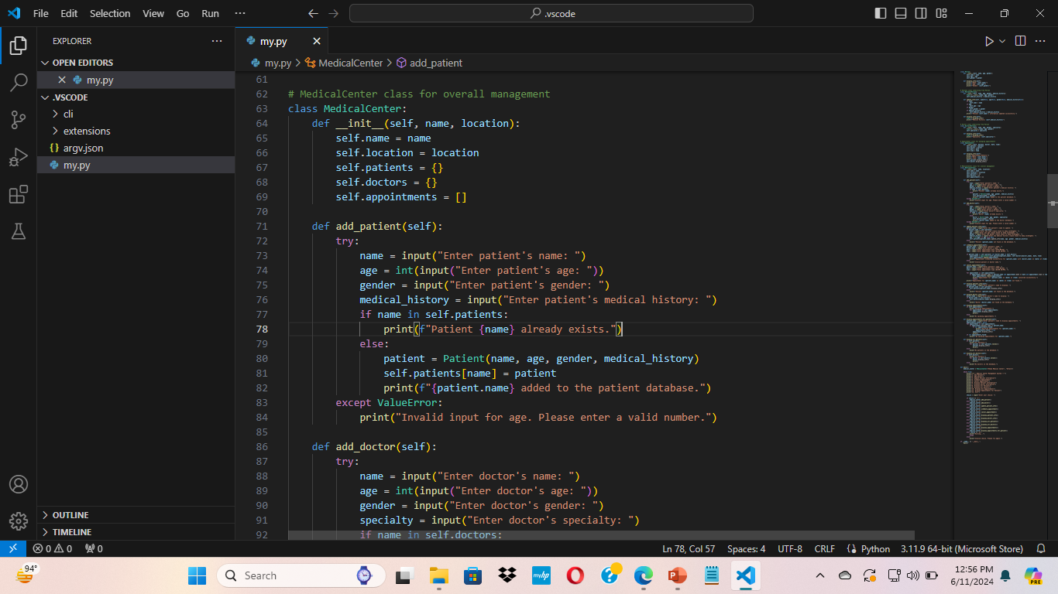
Code Walkthrough - Hospital Class
Key Methods:
add_patient: Adds a new patient to the database.
add_doctor: Adds a new doctor to the database.
update_patient_info: Updates existing patient information.
schedule_appointment: Schedules a new appointment.
cancel_appointment: Cancels an existing appointment.
display_patient_info: Displays information of a specific patient.
display_doctor_info: Displays information of a specific doctor.
display_appointments: Displays all upcoming appointments.
display_appointments_for_patient: Displays appointments for a specific patient.
display_all_patients: Displays all patients.
display_all_doctors: Displays all doctors.

Slide 11
Conclusion
Summary:
The Hospital Management System simplifies the management of patients, doctors, and appointments.
The system ensures efficiency, reliability, and ease of use.

Slide 12
ARIGATOU GOZAIMASU
Md. Iftekharul Islam

