Slide 1
Working Software (Testing)
Today’s Topic
  Why testing?
  Some basic definitions
  Kinds of testing
  Test-driven development
  Code reviews (not testing)
Today is a look ahead to CS 362

Slide 2

Why Testing?
Ideally: we’d prove code
correct, using formal
mathematical techniques
(with a computer, not chalk)
  Extremely difficult: for some trivial programs (100 lines) and many small (5K lines) programs
  Simply not practical to prove correctness in most cases – often not even for safety or mission critical code

Slide 3

Why Testing?
Nearly ideally: use symbolic or abstract
model checking to prove that a model is correct
  Automatically extract a mathematical abstraction from code
  Prove properties with model over all possible executions
      In practice, can work well for very simple properties (“this program never crashes in this particular way”), of some programs, but can’t handle complex properties (“this is a working file system”)
      Doesn’t work well for programs with complex data structures (like a file system)

Slide 4

As a last resort…
… we can actually run the program, to see if it works
This is software testing
  Always necessary, even when you can prove correctness – because the proof is seldom directly tied to the actual code that runs
“Beware of bugs in the above code; I have only proved it correct, not tried it” – Knuth

Slide 5
NOT a last resort…
Testing is a critical part of every software development effort
Can too easily be left as an afterthought, after it is expensive to correct faults and when deadlines are pressing
  The more code that has been written when a fault is detected, the more code that may need to be changed to fix the fault
    Consider a key design flaw: better to detect with a small prototype, or after implementation is “finished”?
  May “have to ship” the code even though it has fatal flaws

Slide 6
Testing and Reviews in Processes
Waterfall
Requirements analysis
Prototyping
Design
Implementation
Testing
Operation

Slide 7
Testing and Reviews in Processes
Spiral
Draft a menu of
program designs
Analyze risk &
prototype
Draft a menu of
architecture designs
Analyze risk &
prototype
Draft a menu of
requirements
Analyze risk &
prototype
Establish
requirements
Plan
Establish
architecture
Plan
Operation
Testing
Implementation
Establish
program design

Slide 8
Testing and Reviews in Processes
Agile
Do “spike” to evaluate & control risk
Customer provides “stories”
(short requirement snippets)
Prioritize
stories and plan
Write/run/modify
unit tests
Operation
Implement
System and acceptance tests

Slide 9

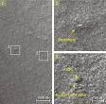
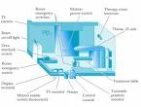
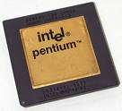
Testing saves lives and money
NIST report, “The Economic Impacts of Inadequate Infrastructure for Software Testing” (2002)
  Inadequate software testing costs the US alone between $22 and $59 billion annually
  Better approaches could cut this amount in half
Major failures: Ariane 5 explosion, Mars Polar Lander, Intel’s Pentium FDIV bug
Insufficient testing of safety-critical software can cost lives: THERAC-25 radiation machine: 3 dead
We want our programs to be reliable
  Testing is how, in most cases, we find out if they are
Ariane 5:
exception-handling
bug : forced self
destruct on maiden
flight (64-bit to 16-bit
conversion: about
370 million $ lost)
Mars Polar
Lander crash
site?
THERAC-25 design

Slide 10
Today’s Topic
  Why testing?
  Some basic definitions
  Kinds of testing
  Test-driven development
  Code reviews (not testing)

Slide 11
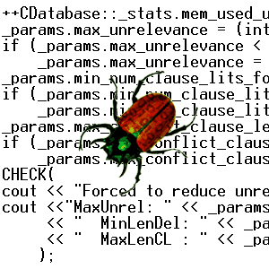
Basic Definitions: Testing
What is software testing?
  Running a program
  Generally, in order to find faults (bugs)
    Could be in the code
    Or in the spec
    Or in the documentation
    Or in the test…

Slide 12
Terms: Test (Case) vs. Test Suite
Test (case): one execution of the program, that may expose a bug
Test suite: a set of executions of a program, grouped together
  A test suite is made of test cases
Tester: a program that generates tests

Slide 13
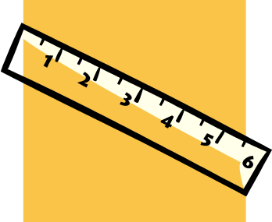
Terms: Coverage
Coverage measures or metrics
  Abstraction of “what a test suite tests” in a structural sense
  Common measures:
    Statement coverage
      A.k.a line coverage or basic block coverage
      Which statements execute in a test suite
    Decision coverage
      Which boolean expressions in control structures evaluated to both true and false during suite execution
    Path coverage
      Which paths through a program’s control flow graph are taken in the test suite
    Mutation coverage
      Ability to detect random variations to the code

Slide 14
Today’s Topic
  Why testing?
  Some basic definitions
  Kinds of testing
  Test-driven development
  Code reviews (not testing)

Slide 15
Kinds of testing
Whitebox
Blackbox
Unit
Integration
System
Acceptance
Regression

Slide 16
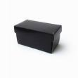
Terms: Black Box Testing
Black box testing
  Treats a program or system as a
  That is, testing that does not look at source code or internal structure of the system
  Send a program a stream of inputs, observe the outputs, decide if the system passed or failed the test
  Abstracts away the internals – a useful perspective for integration and system testing
  Sometimes you don’t have access to source code, and can make little use of object code
    True black box? Access only over a network

Slide 17
Terms: White Box Testing
White box testing
  Opens up the box!
    (also known as glass box, clear box, or structural testing)
  Use source code (or other structure beyond the input/output spec.) to design test cases

Slide 18
Stages of Testing
Unit testing is the first phase, done by developers of modules
Integration testing combines unit-tested modules and tests how they interact
System testing tests a whole program to make sure it meets requirements
Acceptance testing by users to see if system meets actual use requirements

Slide 19
Stages of Testing: Unit Testing
Unit testing is the first phase, mostly done by developers of modules
  Typically the earliest type of testing done
  Unit could be as small as a single function or method
  Often relies on stubs to represent other modules and incomplete code
  Tools to support unit tests available for most popular languages,
    Junit (http://junit.org)
    Simpletest for PHP (http://simpletest.org)

Slide 20
Stages of Testing: Integration Testing
Integration testing combines unit-tested modules and tests how they interact
  Relies on having completed units
  After unit testing, before system testing
  Test cases focus on interfaces between components, and assemblies of multiple components
  Often more formal (test plan presentations) than unit testing

Slide 21
Stages of Testing: System Testing
System testing tests a whole program to make sure it meets requirements
  After integration testing
  Focuses on “breaking the system”
  Defects in the completed product, not just in how components interact
  Checks quality of requirements as well as the system
  Often includes stress testing, goes beyond bounds of well-defined behavior

Slide 22
An aspect of System Testing: Functional Testing
Functional testing is when a developer tests a program from a “user’s” perspective – does it do what it should?
  It’s a different mindset than unit testing, which often proceeds from the perspective of other parts of the program
    Module spec/interface, not user interaction
    Sort of a fuzzy line – consider a file system – how different is the use by a program and use of UNIX commands at a prompt by a user?
  Building inspector does “unit testing”; you (or user), walking through the house to see if its livable, perform “functional testing”
  Kick the tires vs. take it for a spin?

Slide 23
Stages of Testing: Acceptance Testing
Acceptance testing by users to see if system meets actual use requirements
  Black box testing
  By end-users to determine if the system produced really meets their needs
  May revise requirements/goals as much as find bugs in the code/system

Slide 24

Appropriate at all times: Regression Testing
Regression testing
  Changes can break code, reintroduce old bugs
    Things that used to work may stop working (e.g., because of another “fix”) – software regresses
  Usually a set of cases that have failed (& then succeeded) in the past
  Finding small regressions is an ongoing research area – analyze dependencies
“. . . as a consequence of the introduction of new bugs, program maintenance requires far more system testing. . . . Theoretically, after each fix one must run the entire batch of test cases previously run against the system, to ensure that it has not been damaged in an obscure way. In practice, such regression testing must indeed approximate this theoretical idea, and it is very costly."
- Brooks, The Mythical Man-Month

Slide 25
Today’s Topic
  Why testing?
  Some basic definitions
  Kinds of testing
  Test-driven development
  Code reviews (not testing)

Slide 26
Test-Driven Development
One way to make sure code is tested as early as possible is to write test cases before the code
  Idea arising from Extreme Programming and often used in agile development
    Write (automated) test cases first
    Then write the code to satisfy tests

Slide 27
Test-Driven Development
How to add a feature to a program, in test-driven development
  Add a test case that fails, but would succeed with the new feature implemented
  Run all tests, make sure only the new test fails
  Write code to implement the new feature
  Rerun all tests, making sure the new test succeeds (and no others break)

Slide 28
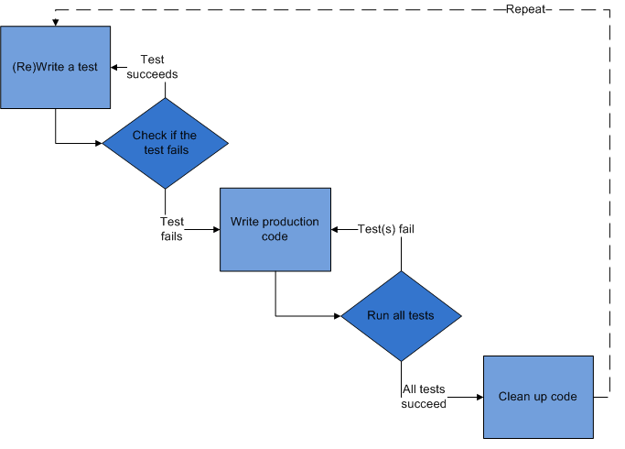
Test-Driven Development Cycle

Slide 29
Test-Driven Development Benefits
Results in lots of useful test cases
  A very large regression set
Forces attention to actual behavior of software: observable & controllable behavior
Only write code as needed to pass tests
  And may get good coverage of paths through the program, since they are written in order to pass the tests
  Reduces temptation to tailor tests to idiosyncratic behaviors of implementation
Testing is a first-class activity in this kind of development

Slide 30

Test-Driven Development Problems
Need institutional support
  Difficult to integrate with a waterfall development
  Management may wonder why so much
  time is spent writing tests, not code
Lots of test cases may create false confidence
  If developers have written all tests, may be blind spots due to false assumptions made in coding and in testing, which are tightly coupled

Slide 31
Exhaustive vs. Representative Testing
Can we test everything?
File system is a library, called by other components of some flight software
Operation Result
mkdir (“/eng”, …) SUCCESS
mkdir (“/data”, …) SUCCESS
creat (“/data/image01”, …) SUCCESS
creat (“/eng/fsw/code”, …) ENOENT
mkdir (“/data/telemetry”, …) SUCCESS
unlink (“/data/image01”) SUCCESS
File system
/
/eng
/data
image01
/telemetry

Slide 32
Example: File System Testing
How hard would it be to just try “all” the possibilities?
Consider only core 7 operations (mkdir, rmdir, creat, open, close, read, write)
  Most of these take either a file name or a
  numeric argument, or both
  Even for a “reasonable” (but not provably safe)
  limitation of the parameters, there are 266¹⁰
  executions of length 10 to try
  Not a realistic possibility (unless we have 10¹²
  years to test)

Slide 33
Today’s Topic
  Why testing?
  Some basic definitions
  Kinds of testing
  Test-driven development
  Code reviews (not testing)

Slide 34

Not Testing: Code Reviews
Not testing, exactly, but an important method for finding bugs and determining the quality of code
  Code walkthrough: developer leads a review team through code
    Informal, focus on code
  Code inspection: review team checks
  against a list of concerns
    Team members prepare offline
    in many cases
    Team moderator usually leads

Slide 35

Not Testing: Code Reviews
Code inspections have been found to be one of the most effective practices for finding faults
  Some experiments show removal of 67-85% of defects via inspections
  Some consider XP’s pair programming as a kind of “code review” process, but it’s not quite the same
    Why?
  Can review/walkthrough requirements
  and design documents, not just code!

Slide 36
What’s next for you?
HW 6 is up, due on Saturday.
  Make sure you have your plan for this week of development ready
  Make sure you have your environment ready and accessible to others

