Slide 1
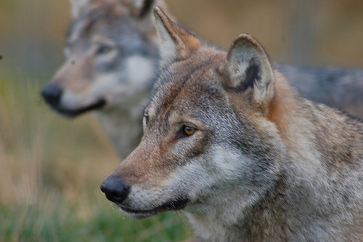
Individuals and interactions
http://www.flickr.com/photos/pss/1536583146/

Slide 2

The prey, the pack, and the hunt
Your goal is to meet your customer’s needs.
That goal, and nothing else, is the prey.
  Not throwaway prototypes
  Not documentation
  Not models
You will work as a team to obtain your goal.
http://www.flickr.com/photos/orinrobertjohn/3598881393/sizes/s/

Slide 3
Today’s lecture
Acceptance tests
Review of unit tests
Pair programming
Models and communication

Slide 4
Identifying your prey
Extreme Programming offers three ways to identify your goal.
  User stories
  Acceptance tests
  Unit tests

Slide 5
Pop quiz on user stories
How big should a story be?
  3x5” card
How many user stories is the customer allowed to generate?
  As many as desired
When can the engineer prioritize the stories?
  Never. The customer does the prioritization

Slide 6
Acceptance tests and user stories
Each user story may have multiple acceptance tests.
A single acceptance test validates an aspect of a user story by exercising the system the way that a user would.
Acceptance tests tell what the customer will use to judge success.
Main benefit of acceptance tests: you know when you can stop developing!

Slide 7
Example tests
User Story: Generate a Receipt
“As items are entered by the clerk, their name and price are added to a receipt, and the price is added to the subtotal.”
items
items
receipt
PriceLookup
PrintReceipt
printer
prices

Slide 8
Example tests
User Story: Generate a Receipt
“As items are entered by the clerk, their name and price are added to a receipt, and the price is added to the subtotal.”
Unit tests for PriceLookup component
Input: 6-pack of beer; Verify: $6.47
Input: milk; Verify: $2.00

Slide 9
Example tests
User Story: Generate a Receipt
“As items are entered by the clerk, their name and price are added to a receipt, and the price is added to the subtotal.”
Unit tests for PrintReceipt component
Input: Beer $6.47, Milk $2.00, Beer $6.47
Verify: Receipt lists items and total is $14.94

Slide 10
Example tests
User Story: Generate a Receipt
“As items are entered by the clerk, their name and price are added to a receipt, and the price is added to the subtotal.”
Acceptance test (combines several unit tests)
Test: Scan 1 6-pack, 1 milk, 1 6-pack
Verify: Receipt lists items and total is $14.94

Slide 11
About creating acceptance tests
Ideally, the customer writes the acceptance tests
Acceptance tests are blackbox tests
  The test writer doesn’t get to read the tested code
Tests should be unambiguous

Slide 12
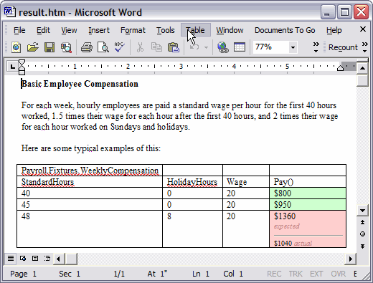
FIT framework
http://fit.c2.com/

Slide 13
Junit Fixture
package junitfaq;
import org.junit.*;
import static org.junit.Assert.*;
import java.util.*;
public class SimpleTest {
private Collection<Object> collection;
@Before
public void setUp() {
collection = new ArrayList<Object>();
}
@Test
public void testEmptyCollection() {
assertTrue(collection.isEmpty());
}
@Test
public void testOneItemCollection() {
collection.add("itemA");
assertEquals(1, collection.size());
}
}

Slide 14
About running acceptance tests
Run acceptance tests at least once a week, preferably more often.
Often useful to have an integration machine where you run acceptance tests.
  Representative of what the customer would have.

Slide 15
Pop quiz on unit tests
Who writes the unit tests?
  Programmer
When do the unit tests get written?
  Before writing the application code

Slide 16
Benefits of unit tests
Clarifies the task at hand
Frees you from writing perfect code (temporarily)
Makes reliable refactoring possible

Slide 17
About creating unit tests
Unit tests start out as blackbox tests and become whitebox tests
  They are first created for non-existent code.
  At any time, you can read your (new) application code and revise the test code
Exhaustive testing is usually infeasible
So use representative testing instead
  Typical inputs
  Boundary cases

Slide 18
Writing the first test is the hardest.
But keep in mind…
  “Your test suite is more valuable than your code”
  “If you want a good suite of tests next year you must start collecting them today.”

Slide 19
Time to program
You only code when the test suite is broken or you are refactoring
Your twin goals
  Pass the unit tests for today’s user stories
  Refactor to keep the bad smells under control

Slide 20
The hunt is not yours alone
It’s not your code. It’s the team’s code.
  “Egoless programming doesn't work; expand your ego to include everyone's code.”
ANYBODY can edit ANY code that has been checked in.

Slide 21
Pair programming - benefits
Real-time code reviews
Copilot can help to catch implicit assumptions
Pair programming takes 15% longer but leads to 15% fewer bugs… a “win” for many projects
Ideas and techniques spread throughout the group

Slide 22
Pair programming – the driver
The driver…
  controls keyboard and mouse
  is actively talking to the copilot
  explains intent of code and where s/he is going

Slide 23
Pair programming – the co-pilot
Copilot is not a passenger! Copilots pay attention, watch for mistakes, offer ideas
  Talk about and agree upon best course of action
  If you can’t agree, then take turns yielding to one another’s preferences
At any moment, copilot can request to switch places and become the driver.
  Driver can say, “hold on a second” but should switch as soon as possible
  You are working as a pair, a team.

Slide 24
Pair programming - principles
If someone asks you to pair with him or her and you can, then you must say yes.
Code formatting: pick a standard as a team, enforce it, and move on
Font size and eyesight: choose a font large enough for the copilot to see, too
Take turns pairing with lots of different people
If you write code alone, then it must be rewritten.
  If you have a brilliant idea when you’re alone, then write it down.

Slide 25
Interacting with the team
Periodically communicate your progress
  An end-of-day email is usually perfect
  Perhaps track progress with wiki, emails or Google Docs?
Use models judiciously
  Draw diagrams to help you reason
  Draw diagrams to communicate
  But only draw diagrams if it helps your team to get the prey

Slide 26
In agile processes, models…
Must provide value
Must fulfill a purpose
Must be understandable
Must be as simple as possible
Must be sufficiently
  accurate
  concise
  detailed
Notes:
Dynamic Systems Development Method (DSDM)
Scrum
Crystal
eXtreme Programming (XP)
Agile manifesto
Individuals and interactions over processes and tools
Working software over comprehensive documentation
Customer collaboration over contract negotiation
Responding to change over following a plan
Principles of XP
Communication – it is good to talk with customer and between developers
Simplicity – keep it simple and grow the system and models when required
Feedback – let users provide feedback early and often
Courage – speak the truth, with respect

Slide 27
Not true about models in agile
Models equal documentation.
Modeling implies a heavyweight process.
Modeling freezes the requirements.
Models never change.
Models are complete.
Models must be created with a tool.
All developers know how to model properly.
Modeling is a waste of time.
The data model is the only one that matters.

Slide 28
Tips for agile modeling
Don’t let the models distract from the hunt
Model iteratively and incrementally
Model with other people
  Involve stakeholders
  Own models collectively
  Display models publicly
    (share on Google Docs or Office on the Web?)
Create simple content
Use the simplest tools

Slide 29
More tips for agile modeling
Don't spend time getting every line straight.
Follow standards
Reuse existing resources
Discard temporary models

Slide 30
What’s next for you?
Revise your plan from last week, if necessary.
Get going on implementation!!!!
http://www.flickr.com/photos/orinrobertjohn/3598881393/sizes/s/

