Slide 1
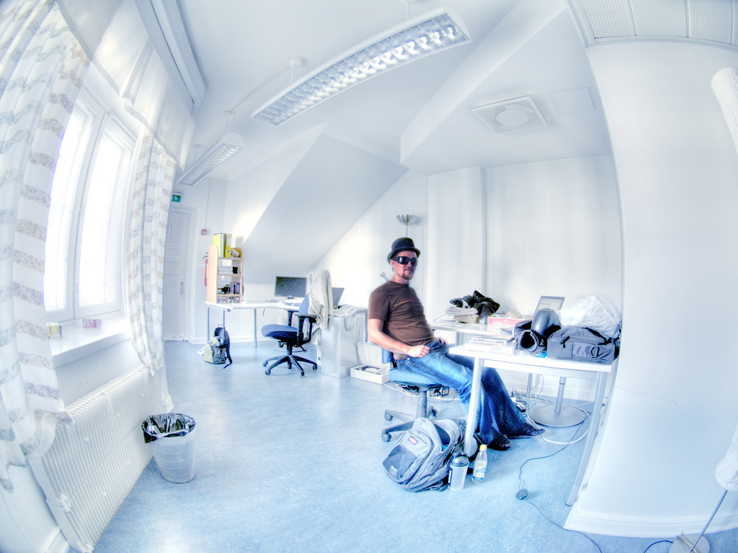
Professionalism
http://www.flickr.com/photos/wili/242259195/

Slide 2
Professionalism takes more than knowledge
“Professionalism is a way of thinking and living rather than an accumulation of learning.”
A profession isnt just what you do, it’s who you are
Think: What does it take to be a doctor?
  Hint: it’s not just by going to medical school
Likewise, we don’t just “engineer” (verb)
We also are engineers (noun).

Slide 3
A profession is who you are, not a contract.
“Shame on the engineer who regards his professional function as a business transaction to be judged by the question: ‘Just what do I get out of it?’”

Slide 4
Life as a professional: activities
You perform “professional activity of a type carrying high individual responsibility, requiring application of special skills to activities that are predominantly intellectual and varied rather than routine and normal.”
What are the specific pieces of “special skills” that you have learned in this course?
How are an engineer’s activities “varied”?

Slide 5
Life as a professional: motivation
“Motivation for service takes first place over consideration of reward.”
Think about your two projects. Why did we focus on large problems focused on helping others during this term?

Slide 6
Life as a professional: joy and pride
“Motivation … implies joy and pride in the work to be done, and self-imposed standards.”
If you don’t take joy and pride in engineering, then you should look for another line of work.
  Burn-out sucks
Companies and customers are also entitled to impose (secondary) standards of excellence.

Slide 7
Life as a professional: social duty
You have a “social duty, fulfilled through guarding the ideals and standards of the profession, by advancing it …, by sharing advances …, by rendering gratuitous public service, all as a return to society.”
“Giving back” to society
  What does “guarding the ideals” mean?
  When are patents and copyrights acceptable?

Slide 8
Four traits of a professional
Varied activities requiring special skills
Society-centric motivation
Personal standards of excellence
Giving back to society

Slide 9
When you put many professionals together, what do you have?
A profession isn’t just defined by who you are
A profession is also something you are part of
“Most professional engineers adopt an institutional view of the organisations of the profession: they perceive them as bodies representing the profession and therefore deserving, even requiring, the loyalty of each engineer as an expression of his identity as a professional engineer.”
IEEE and ACM

Slide 10
Trait #1 of a profession
“A body of knowledge and art, held as a common possession and to be extended through united effort.”
What “united effort” is required to extend this knowledge and art?

Slide 11
Trait #2 of a profession
“An educational process, based on the body of knowledge and art, and in the ordering of which the professional group has a recognised responsibility.”
How does the current course fit into your planned course of study at Oregon State?
What do you plan to do after this course in order to continue learning?

Slide 12
Trait #3 of a profession
“A standard of personal qualification for admission, based on character, education and proved competence.”
Without naming names, in what ways have your teammates “proved” or failed to prove their competence?

Slide 13
Trait #4 of a profession
“A standard of conduct, based upon an ethical code to guide the practitioner in his relationships with his employer or client, his colleagues and the community.”
What is a reasonable “standard of conduct” to expect from your teammates?
How would this standard differ at a company?

Slide 14
Trait #5 of a profession
“A formally recognised status, either by members of the profession or by the State.”

Slide 15
Trait #6 of a profession
“Organisations of the profession, devoted to common advancement, social duty and economic well-being.”
What are the key organizations for software engineers?
What are the benefits and responsibilities associated with membership in these organizations?

Slide 16
Six traits of a profession
Body of knowledge and art
Educational process
Standard of qualifications
Standard of conduct
Formally recognized status
Organizations of the profession

Slide 17
Part of being a professional is behaving ethically
“Ethics means something more than ‘law’ and ‘morals’; it carries an additional connotation of ‘rightness’.”
Breaking the law: can earn a fine or jail time
Breaking a moral: can ruin your reputation
Breaking an ethic: can ruin your conscience
It’s possible to break all three, simultaneously, but there’s no bonus for doing so.

Slide 18
Legal, Moral, Ethical
Legal: Right or Wrong according to laws of the state an individual resides in.
Moral: Right or Wrong according to that which defines a person’s character. Can be philosophy, religion, culture, etc
Ethical: Right or Wrong according to standards of behavior expected by a group the individual belongs to.

Slide 19
Laws vs morals vs ethics
Speeding in Los Angeles (driving 65 in a 55)
  Illegal, moral (“everyone” does it), maybe ethical
Speeding in Corvallis (driving 55 in a 25)
  Illegal, immoral, unethical
What might a software engineer do that is…
  Illegal, immoral, unethical ?
  Legal, immoral, unethical ?
  Legal, moral, unethical ?

Slide 20
IEEE Code of Ethics: Actions
1. PUBLIC - Software engineers shall act consistently with the public interest.
2. CLIENT AND EMPLOYER - Software engineers shall act in a manner that is in the best interests of their client and employer consistent with the public interest.

Slide 21
IEEE Code of Ethics: Products
3. PRODUCT - Software engineers shall ensure that their products and related modifications meet the highest professional standards possible.

Slide 22
IEEE Code of Ethics: Hierarchy
4. JUDGMENT - Software engineers shall maintain integrity and independence in their professional judgment.
5. MANAGEMENT - Software engineering managers and leaders shall subscribe to and promote an ethical approach to the management of software development and maintenance.

Slide 23
IEEE Code of Ethics: Peers
6. PROFESSION - Software engineers shall advance the integrity and reputation of the profession consistent with the public interest.
7. COLLEAGUES - Software engineers shall be fair to and supportive of their colleagues.

Slide 24
IEEE Code of Ethics: Self
8. SELF - Software engineers shall participate in lifelong learning regarding the practice of their profession and shall promote an ethical approach to the practice of the profession.

Slide 25
8 Principles of IEEE Code of Ethics
Act in public interest
Act in interest of clients and employers
Produce quality products
Maintain independent judgment
Manage ethically
Protect integrity of profession
Support colleagues
Pursue lifelong learning

Slide 26
Scenario #1
You are the owner of a software engineering company. Your employees (engineers) want you to pay for them to attend training.
How would you respond in a way that is
legal, moral, and ethical?

Slide 27
Scenario #2
You are the owner of a software engineering company. Your employees (engineers) want you to let them do pro bono work for a local non-profit organization on company time.
How would you respond in a way that is
legal, moral, and ethical?

Slide 28
Scenario #3
You are the head of a computer science department at a university. Your boss
(a “dean”) wants you to find a way to tweak your curriculum so undergrads are more likely to choose your department for their major.
How would you respond in a way that is
legal, moral, and ethical?

Slide 29
Scenario #4
You are a software engineer working at a large publicly-traded corporation, where a colleague invents a new kind of compiler. Your managers see it as a huge potential cash cow.
How would you respond in a way that is
legal, moral, and ethical?

Slide 30
Scenario #5
You are a software engineer at a company where management routinely encourages you and your colleagues to use pirated software.
How would you respond in a way that is
legal, moral, and ethical?

Slide 31
True or false?
“The young of today rise to idealism and altruistic motivation perhaps more readily than any previous generation. It must be the responsibility of this generation of our profession, and of the next generation, to see that our profession never will lose sight of its prime objective - the use of our professional talents in the service of the community.”

Slide 32
What’s next for you?
Tuesday , Wednesday PowerPoint presentation (15-20 minutes) on Homework 6 and whatever finished.
HW 7 due August 15th Thursday
In class final exam on August 15th Thursday.
Demo on August 16th Friday

