Slide 1
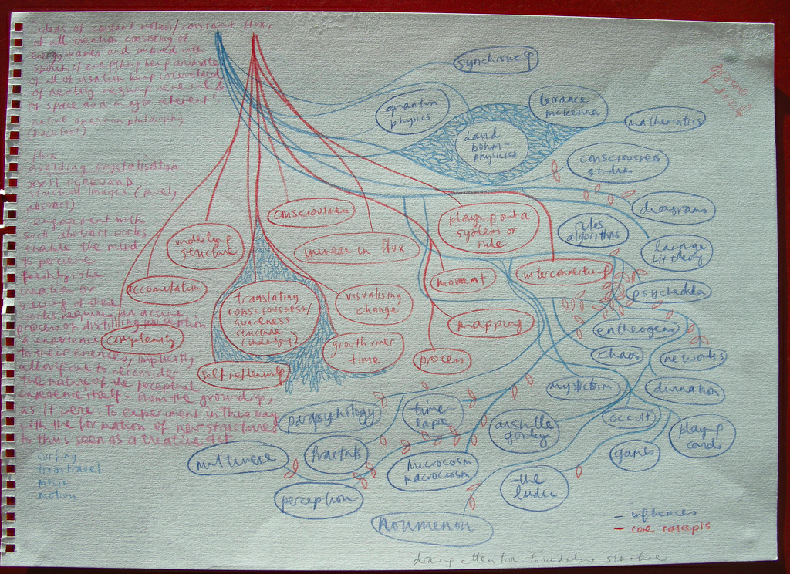
More on Class Diagrams

Slide 2
Visibility
Both attributes’ and methods’ visibility can be defined in the class diagram:
+ public / derived
- private underlined static
# protected
Ex:
All three of these
attributes are public
Repression tweet
+ user
+ when (datetime)
+ text (string)

Slide 3
Associations
A solid line represents an association and contains:
A unary or binary link
Cardinality
A name defining the association
Can be also adorned with role names, ownership, visibility and other properties
Associations exist when one class is an attribute of another
User
+ username: String
+ tweets: Tweet[]
1
tweets
*
Repression tweet
+ user: id
+ when: datetime
+ text: String

Slide 4
Specific Associations
Aggregations – “has a” relationships
Occurs when a class is a container of other classes
However, this is not imply ownership, (ie. when the “parent” gets destroyed, the aggregates do not)
Ex: A class has professors, but if the class is cancelled, the professors do not disappear
1
*
Professor
+ name: String
teaches
Class
+ courseNumber: String

Slide 5
Specific Associations
Composition – combining simple objects into a more complex whole
Can have multiple objects compose into one
Implies an “owns a” relationship
If the parent is destroyed, all its composites typically are also destroyed
Ex: Demolishing a building destroys its floors
1
Building
+ address: String
contains
1..*
Floor
+ floorNumber: int

Slide 6
Difference between Composition and Aggregation
Composition:
Composed of multiple parts
Parts have no independent existence
The structured whole makes the object
Aggregation:
Does not imply ownership
Parts have independent existence
May be called a composition if the distinction is not important

Slide 7
Generalization/Specialization
Generalization:
“is a parent”
Repression view is a generalization of RSS View
Specialization
“is a child”
Google map view is a specialization of Repression view
Repression view
+ reports
Google map view
+ JavaScript
RSS View
+ XML text

Slide 8
Realization (Implementation)
Relationship where one class (the client) implements another (the supplier)
Represented with a dashed line from the implemented class to the implementation
Blueprint
+ address: String
Building
+ address: String

Slide 9
Dependencies
Occur when
a client class depends on another because it uses it (supplier) at some point in time
Common when the client class:
Uses a supplier class that has global scope
Uses a supplier class as a parameter
Uses a supplier class as a local variable
Sends a message to the supplier
Note the difference between this and associations
Supplier
Client

Slide 10
A more complete Class/Object
Class/Object Name
Attributes
Methods/Operations
Bank Account
- owner: String
- balance: Dollars
+ getBalance() : Dollars
A class name should be descriptive (Italic if abstract)
The attributes of a class defines its properties, what data the class stores
The methods/operations of a class specify what the class does

Slide 11
UML Examples
Note we will not be getting into this level of detail until HW 4
I’m presenting it now as part of the diagram section
For HW1, I only expected you to use what we did in previous lectures
For HW 2, I want you to think about adding some of the new relationships we discussed, but remember that we are still not designing the program’s structure

Slide 12
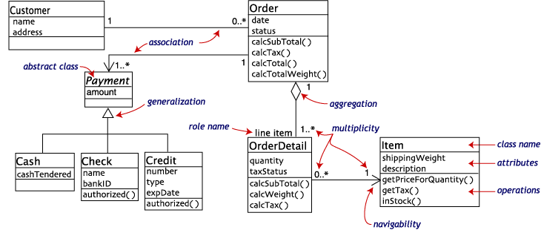
Source: bigelow.ch

Slide 13
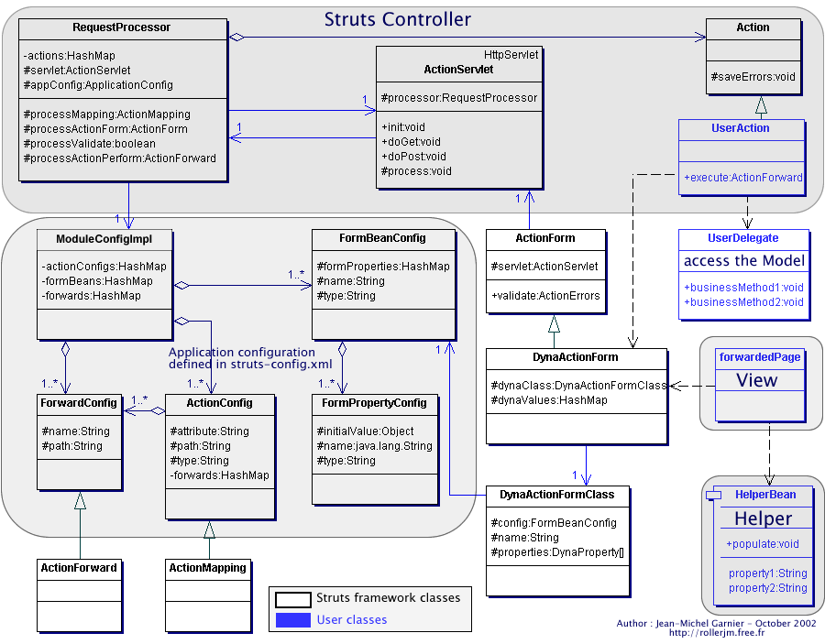

Slide 14
More on Use-Cases
We’ll go into more detail about
How to create a more formal use-case
Guidelines for creating use-cases
This section has been adapted from Dr. Scott Fleming of U. Memphis

Slide 15

What are “fully dressed” use cases?
All steps and variations written in detail
Structured template
Tend toward the formal
However, rough sketching can be useful
http://flic.kr/p/a6qunq

Slide 16
“Fully dressed” UC template
UC name
Scope
Level
Primary actor
Stakeholders and interests
Preconditions
Success guarantees
Main success scenario
Extensions (or alternative flows)
Special requirements
Technology and data variations list
Frequency of occurrence
Miscellaneous
Notes:
13

Slide 17
UC name
Start with a verb
Examples:
Process Sale
Handle Returns

Slide 18
Scope
Will always be the software system under development for us
Example:
NextGen POS application
There also business use cases, but we don’t care about them in this class

Slide 19
Level
Two levels that we care about:
User-goal level: describes scenarios that fulfill the goals of the primary actor
Most common
Subfunction level: describes substeps to support a user goal
Used to factor out common text from other UCs

Slide 20
Primary actor
Principal actor that calls upon system services to fulfill a goal
Usually human, but not always

Slide 21
Stakeholders and interests list
“The [system] operates a contract between stakeholders, with the use cases detailing the behavioral parts of that contract… The use case, as the contract of behavior, captures all and only the behaviors related to satisfying the stakeholders’ interests” –Cockburn (2001)
Example stakeholders and interests:
Cashier: Wants accurate, fast entry and no payment errors, as cash drawer shortages are deducted from his/her salary.
Salesperson: Wants sales commission updated.

Slide 22
Stakeholders and interests list
“The [system] operates a contract between stakeholders, with the use cases detailing the behavioral parts of that contract… The use case, as the contract of behavior, captures all and only the behaviors related to satisfying the stakeholders’ interests” –Cockburn (2001)
Example stakeholders and interests:
Cashier: Wants accurate, fast entry and no payment errors, as cash drawer shortages are deducted from his/her salary.
Salesperson: Wants sales commission updated.
Note: Explains why

Slide 23
Preconditions
Things that must always be true be the scenario begins
May imply completion of another UC’s scenario
Examples:
User has logged in
Cashier is identified and authenticated
Skip uninteresting or obvious preconditions
Anti-example: User is alive
Anti-example: Computer is plugged in

Slide 24
Success guarantees (postconditions)
Things that must be true after the success scenario or some alternative path
Should meet the needs of all stakeholders
Example:
Sale is saved. Tax is correctly calculated. Accounting and Inventory are updated. Commissions recorded. Receipt is generated.

Slide 25
Main success scenario
Sequence of steps in a scenario of a successful typical use of the system
Three types of steps:
Interaction between actors
Validation (usually by system)
State change of system (e.g., recording or modifying something)
(Additionally, step 1 may indicate a trigger event)
Defer conditionals to Extensions section
Idiom: capitalize actors names

Slide 26
Extensions (or alternative flows)
All other scenarios and branches
May end in success or failure
Example:
3a. Invalid item ID (not found in system):
1. System signals error and rejects entry.
2. Cashier responds to error…
3b. Multiple of same item…
Guideline: write conditions as something that can be detected by system or actor

Slide 27
Extensions (cont’d)
Alt. condition resulting from main success step 3
All other scenarios and branches
May end in success or failure
Example:
3a. Invalid item ID (not found in system):
1. System signals error and rejects entry.
2. Cashier responds to error…
3b. Multiple of same item…
Guideline: write conditions as something that can be detected by system or actor
Resulting steps
Another alt. condition resulting from main success step 3

Slide 28
Extensions (cont’d)
At end, the extension merges back with the main success scenario unless the extension indicates otherwise
Complex extensions might be better expressed as a separate UC
Example: a condition that is possible during any step of the main scenario:
*a. System crashes…
Example: branching to another use case:
2c. Cashier performs Find Product Help to obtain…

Slide 29
Special requirements
Non-functional requirements relevant to the UC
I.e., URPS+ requirements
Examples:
Touch screen UI on a large flat panel monitor. Text must be visible from 1 meter.
Credit authorization response within 30 seconds 90% of the time
Language internationalization on the text displayed.
Pluggable business rules to be insertable at steps 2 and 6.

Slide 30
Technology and data variations list
Constraints on how to build the system
Typically imposed by the customer
Examples (reference relevant steps):
3a. Item identifier entered by laser scanner or keyboard
3b. Item identifier may be any UPC, EAN, JAN, or SKU coding scheme
7a. Credit account information entered by card reader or keyboard
7b. Credit payment signature captured on paper receipt. But within two years, we predict many customers will want digital signature capture

Slide 31
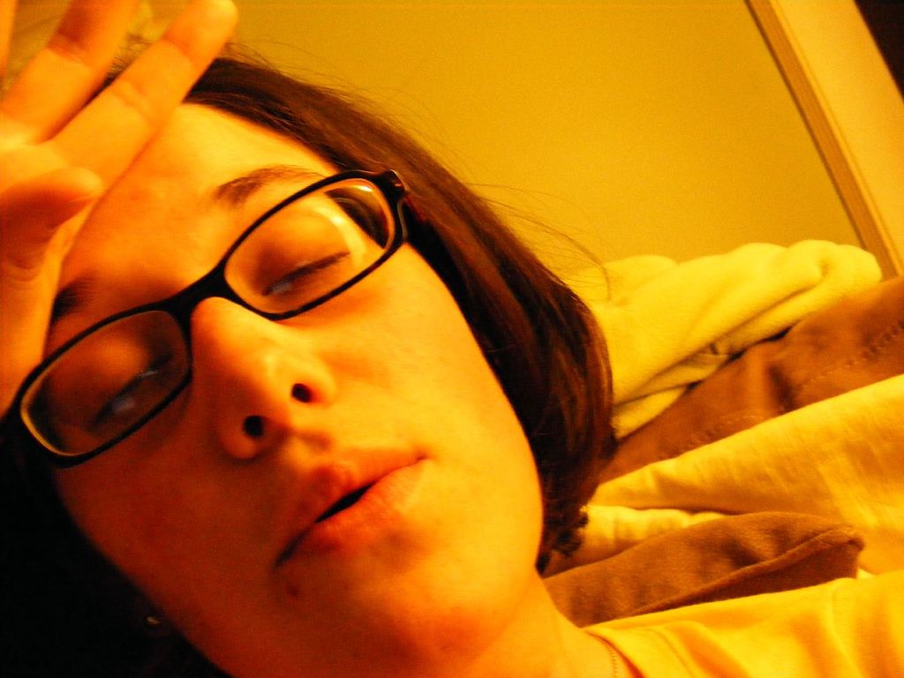
Whew! That’s a lot to remember
http://flic.kr/p/3rZuWu

Slide 32
How could creating “fully dressed” use cases be useful? (Why write them?)

Slide 33
How could creating “fully dressed” use cases be useful?
Aid for thinking through what to build
Help with detailed planning
Reveal other use cases
? Documenting requirements ?
? Communicating with customer ?
Project-specific costs/benefits very important to consider!

Slide 34
When do you think you should write “fully dressed” use cases?

Slide 35
When do you think you should write “fully dressed” use cases?
After many brief/casual UCs have been identified
Larman says “10% of the critical use cases would be written this way during the first requirements workshop”
Not long before you implement
Possibly never depending on the type of project
If you write them all at the beginning, you’re doing waterfall!

Slide 36
Now let’s discuss some guidelines to help you write better, more useful UCs

Slide 37
Consider this motivating example
At requirements workshop, a cashier says he needs to “log in to the system”
Is he making assumptions about the solution?
How might that limit you, as the designer?
How can you prevent customers from accidentally imposing unnecessary requirements?

Slide 38
Guideline: Write in essential style
Express narrative at level of
user’s intentions and
system’s responsibilities
Avoid UI details!!

Slide 39
What is wrong with this example?
Administrator enters ID and password in dialog box.
System authenticates Administrator
System displays the “edit users” window

Slide 40
What is wrong with this example?
Administrator enters ID and password in dialog box.
System authenticates Administrator
System displays the “edit users” window
Limits possible designs by specifying UI

Slide 41
Here’s an essential-style example
Administrator identifies self.
System authenticates identity.
This version leaves open novel solutions such as biometric readers that the other version precluded

Slide 42
Here’s another motivating example
Consider a UC step that says
“The system generates a SQL INSERT statement for the sale…”
What assumptions does the UC make?
How might those assumptions limit you?
How can you prevent customers from accidentally imposing these sorts of unnecessary requirements?

Slide 43
Guideline: Use black-box style
Do not describe internal workings of system
Say what the system does, not how it does it
Think of system in terms of its responsibilities

Slide 44
How might you word this step using black box?
The system generates a SQL INSERT statement for the sale…

Slide 45
How might you word this step using black box?
The system generates a SQL INSERT statement for the sale…
Like this: The system records the sale.

Slide 46
Consider this motivating quote
“the software industry is littered with failed projects that did not deliver what people really needed” — Larman
How can we make sure we deliver what our customers really need?

Slide 47
Guideline: Actor and actor-goal perspective
Write requirements focusing on the users (actors) of a system, asking about their goals and typical situations
Look for different types of users
Focus on understanding what the actor considers a valuable result

Slide 48
We know that the customers have difficulty effectively communicating requirements
How can we discover requirements that the customer might not think to tell us about?

Slide 49
Guideline for finding requirements
Ask probing questions that focus on:
The system boundary
The primary actors and their goals

Slide 50
Such probing might produce a helpful diagram like this
Bicycle stations
The System
Mobile/web customer
Phone customer
Phone system
Service tech
Phone support

Slide 51
What’s Next For You?
HW 2 is available online
Get together and get started on it early
Due to some students dropping, we may need to modify some teams

