Slide 1

Software Architecture
http://www.flickr.com/photos/brunkfordbraun/270401961/

Slide 2
Architecture
Architecture = shows pieces of a system & their relationships
Component = self-contained piece of a system, with clearly-defined interfaces
Connector = a linkage between components via an interface

Slide 3
Drawing architectures
All the usual diagramming notations apply
  Dataflow diagrams
  UML class & entity-relationship diagrams
  Sequence & state diagrams
… but with strong emphasis on the internals of the system, rather than relationship to users

Slide 4
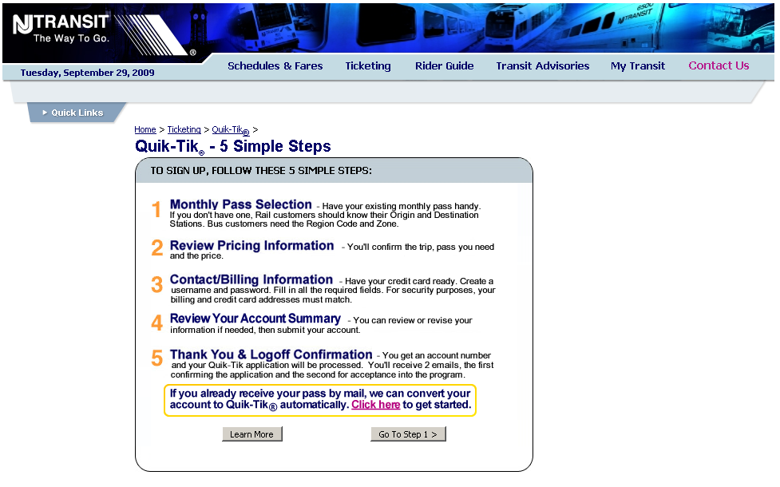
Example: A real system used by millions of customers every month

Slide 5
UC#1: Sign-up
Actor: user on internet
Preconditions: user has credit card and browser
Postconditions: login & purchase info stored
Flow of events: User visits web site
User fills out login info
User fills out purchase info
Website stores to mainframe

Slide 6
Sequence diagram: showing flow of control…. UC#1
User
Servlet
Edit Login
Info JSP
Edit Purchase
Info JSP
User DB
Mainframe
Visit site
[username and password are valid]
Login info (starts empty)
Username & password
[purchase information is valid]
Purchase info (starts empty)
Purchase
info
Login info
Purchase info

Slide 7
UC#2: Edit purchase
Actor: user on internet
Preconditions: user has existing account
Postconditions: updated purchase info stored
Flow of events: User logs into web site
User updates purchase info
Website stores to mainframe

Slide 8
High-level data flow diagram
User
Login Info
Website
Purchase Info
Mainframe
Purchase Info
Login Info
User DB
Notice that the “function” ovals are usually omitted in data flow diagrams for architectures.
Note: all of the diagrams for this system represent a simplified version of the architecture.

Slide 9
Decomposition: providing a detailed view of a component
Decomposition of the “website” component
Typical J2EE system: Servlet passes data to JSP, which displays it; browser posts back to servlet
Login JSP
Login Info
Java Servlet
Login Info
Purchase Info
Edit Purchase Info JSP
Edit Login Info JSP

Slide 10
Approaches for decomposing an architecture
Functional decomposition
Data-oriented decomposition
Object-oriented decomposition
Process-oriented decomposition
Feature-oriented decomposition
Event-oriented decomposition

Slide 11
Functional decomposition
Break each requirement into functions, then break functions recursively into sub-functions
  One component per function or sub-function
Each function computationally combines the output of sub-functions
  E.g.: ticket_price = fee(station₁) + fee(station₂)
  + distance_fee(station₁ , station₂)
  + fuel_surcharge(station₁ , station₂)

Slide 12
Functional decomposition
Requirement
Requirement
Requirement
Function 1
Function 2
Sub-function A
Sub-function B
Sub-function C
Sub-function x
Sub-function y
Sub-function z
System Boundary

Slide 13
Data-oriented decomposition
Identify data structures in requirements, break data structures down recursively
  One component per data structure
Each data structure contains part of the data
  E.g.: Purchase info = Ticket info and billing info; ticket info = two stations and a ticket type;
  billing info = contact info and credit card info;
  contact info = name, address, phone, …;
  credit card info = type, number, expiration date

Slide 14
Data-oriented decomposition
Requirement
Requirement
Requirement
Data Struct A
Data Struct B
Data Struct C
Data Struct D
Data Struct E
Data Struct F
Data Struct G
Data Struct H
System Boundary

Slide 15
Object-oriented decomposition
Identify data structures aligned with functions in requirements, break down recursively
  One class component per data+function package
Each component contains part of the data+fns
  OO decomposition essentially is the same as functional decomposition aligned with data decomposition

Slide 16
Object-oriented decomposition
Requirement
Requirement
Requirement
Class A
Class B
Class C
Class D
Class E
Class F
Class G
Class H
System Boundary

Slide 17
Process-oriented decomposition
Break requirements into steps, break steps into sub-steps recursively
  One component per sub-step
Each sub-step completes one part of a task
  E.g.: one component to authenticate the user, another to display purchase info for editing, another to store the results away

Slide 18
Process-oriented decomposition
Requirement
Process step A1
Process step A2
Process step A3
Requirement
Process step B1
Process step B2
Process step B3
Requirement
Process step X4
Process step C1
Process step C2
Process step C3
System Boundary

Slide 19
Feature-oriented decomposition
Break each requirement into services, then break services into features
  One component per service or feature
Each feature makes the service “a little better”
  E.g.: service does basic authentication, but one feature gives it a user interface, another feature gives it an OpenID programmatic interface, another feature gives it input validation, and another feature does logging

Slide 20
Feature-oriented decomposition
Requirement
Requirement
Requirement
Service 1
Service 2
Feature 1a
Feature 2a
Feature 1b
Feature 2b
Feature 1c
Feature 2c
Feature 2d
System Boundary

Slide 21
Event-oriented decomposition
Break requirements into systems of events, recursively break events into sub-events and state changes
  Each component receives and sends certain events, and manages certain state changes
Each component is like a stateful agent
  E.g.: in the larger ticketing system, the mainframe signals the ticket printing system and the credit card company; the ticket printer notifies mainframe when it mails ticket to user

Slide 22
Event-oriented decomposition
Requirement
Requirement
Component B
Component A
Component C
Component D
Component F
Component E
System Boundary

Slide 23
Architectural style = a common kind of architecture
Certain kinds of decomposition often occur
  Certain kinds of components & connectors
  Certain typical arrangements
Example: which web app is shown below?
User
Website
DB 1
DB 2
Could be just about any web app… they all look pretty similar at this level of abstraction.

Slide 24
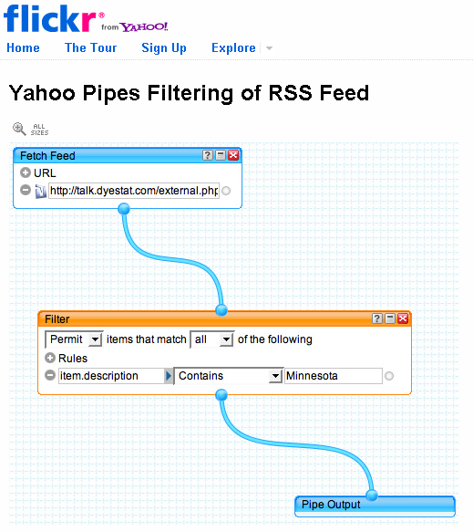
Pipe and filter
Generally a kind of process-oriented design
Filter = component that transforms data
Pipe = connector that passes data between filters
http://www.flickr.com/photos/edkohler/1187471998/

Slide 25
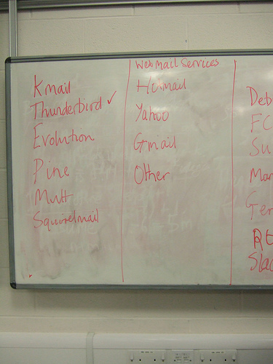
Client-server
Generally a kind of feature- or object-oriented design
Server = component that provides services
Client = component that interacts with user and calls server
http://www.flickr.com/photos/60572130@N00/324440918/

Slide 26
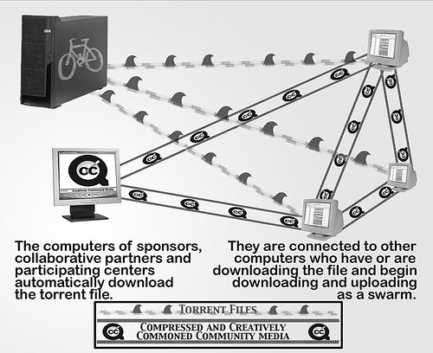
Peer-to-peer
Generally a kind of feature- or event-oriented design
Peer = component that provides services and may signal other peers
http://www.flickr.com/photos/nstw/580552/

Slide 27
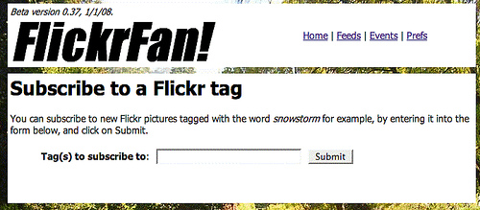
Publish-subscribe
Generally a kind of event-oriented design
Publish = when a component advertises that it can send certain events
Subscribe = when a component registers to receive certain events
http://www.flickr.com/photos/scriptingnews/2158743575/

Slide 28
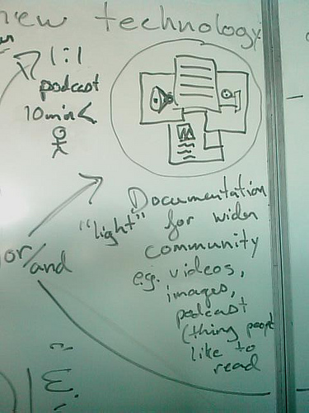
Repositories
Classic repository is just a client-server design providing services for storing/accessing data
Blackboard repository is a publish-subscribe design: components wait for data to arrive on repository, then they compute and store more data
http://www.flickr.com/photos/wocrig/2634599860/

Slide 29
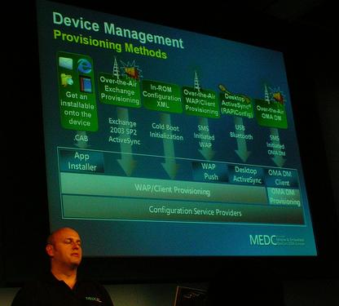
Layering
Generally a kind of feature-oriented design
Layer = component
that provides services
to the next layer
Separation of concerns
http://www.flickr.com/photos/benoitdarcy/161980766/

Slide 30
Mixing and matching is sometimes necessary
Simple client-server architecture
Server 1
Client
Server 2

Slide 31
Mixing and matching is sometimes necessary
Decomposing one server may reveal a process-oriented design.
Server 1
Client
Service 2
Service 2’
Service 2’’

Slide 32
Mixing and matching is sometimes necessary
Decomposing the servers further may reveal a feature-oriented design.
Service 1
Client
Feature 1a
Feature 1b
Feature 1c
Service 2
Service 2’
Service 2’’
Feature 2a
Feature 2a’
Feature 2a’’
Feature 2b
Feature 2b’
Feature 2b’’

Slide 33
Mixing and matching is sometimes necessary
Decomposing the client might reveal an object-oriented design.
Class A
Service 1
Class B
Feature 1a
Feature 1b
Class C
Class D
Feature 1c
Class E
Class F
Service 2
Service 2’
Service 2’’
Feature 2a
Feature 2a’
Feature 2a’’
Feature 2b
Feature 2b’
Feature 2b’’

Slide 34
Mixing and matching is sometimes necessary
Class A
Service 1
Class B
Feature 1a
Feature 1b
Class C
Class D
Feature 1c
Class E
Class F
Service 2
Service 2’
Service 2’’
Feature 2a
Feature 2a’
Feature 2a’’
Feature 2b
Feature 2b’
Feature 2b’’

Slide 35
What’s next for you
More work than in previous two weeks
Design two candidate architectures
  Evaluate them using techniques covered tomorrow
Start your designs
TODAY or TOMORROW
Today’s and tomorrow’s
readings will be very
useful to HW 3

