Slide 1
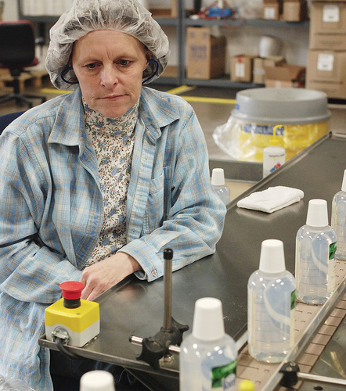
Evaluating Architectures
Quality control: rarely fun, but always necessary
http://www.flickr.com/photos/pierrelaphoto/2314190563/

Slide 2
Four basic ways to evaluate architectural designs
Compare against desired quality attributes
Check for problematic failure modes
Walk through use cases
Verify conformance to checklist of principles
The goal is NOT to “prove” that the architecture is perfect, but rather to identify opportunities for improvement.

Slide 3
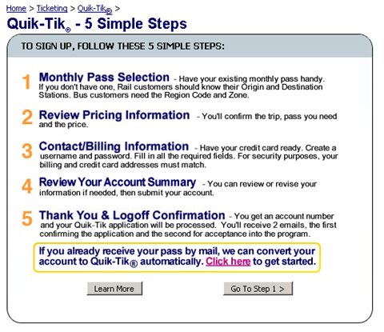
Example system from last lecture
User
Java Servlet
Mainframe
User DB
Login JSP
Edit Login Info JSP
Edit Purchase Info JSP

Slide 4
Four basic ways to evaluate architectural designs
Compare against desired quality attributes
Check for problematic failure modes
Walk through use cases
Verify conformance to checklist of principles
The goal is NOT to “prove” that the architecture is perfect, but rather to identify opportunities for improvement.

Slide 5
Quality attributes of great software
Reliability
Efficiency
Integrity
Usability
Maintainability
Testability
Flexibility
Portability
Reusability
Interoperability

Slide 6
Checking against quality attributes
Maintainability (includes modifiability)
  How hard will it be to make anticipated changes?
Efficiency (includes performance)
  Can the system respond quickly, do a lot of work per unit time, and scale to high loads?
Reliability
  Will it perform properly under assumed conditions?
Integrity (includes security)
  Is it possible put the system into a bad state?
Usability
  Can real users complete their goals with the system?

Slide 7
Checking against quality attributes
Testability
  Can you (semi-)automatically test if the system is right?
Flexibility (includes robustness)
  How easily can the system adapt to unusual conditions?
Portability
  Could you get the system to run on a new platform?
Reusability
  What parts of the system could you use in a new system?
Interoperability
  Can the system talk to other relevant systems?

Slide 8
Checking example system against key quality attributes
Integrity: security
Integrity: another consideration
Efficiency
Integrity: security
  Are all communications and databases encrypted?
  Is credit card info stored in any risky location?
Integrity: another consideration
  What happens when a credit card expires?
Efficiency
  What platform is used to run the servlet & JSPs? What throughput and response time is likely?

Slide 9
Four basic ways to evaluate architectural designs
Compare against desired quality attributes
Check for problematic failure modes
Walk through use cases
Verify conformance to checklist of principles
The goal is NOT to “prove” that the architecture is perfect, but rather to identify opportunities for improvement.

Slide 10
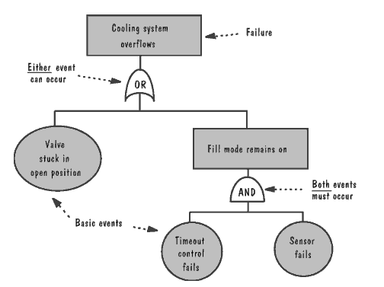
Checking against failure modes
What does it take to cause a “very bad thing”?
Software Engineering, Pfleeger, 3rd Edition

Slide 11
Identifying failures
List main failures that you expect from your system
Work backwards identifying what can cause that failure
Use fault trees and cut-set trees to help you identify where failures arise

Slide 12
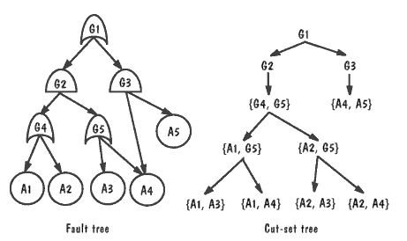
Checking against failure modes
Trace the basic events through the “AND” and “OR” gates of the fault tree.
Software Engineering, Pfleeger, 3rd Edition
Notes:
In cut set tree:
Same root
Working from top:
Expand OR into two children, one for each child
Expand AND into a composition containing both children
Expand a composition node by propagating the node to its children, but expanding one of the gates listed in the node
Continue until there are only leaf nodes and composition nodes

Slide 13



Checking against failure modes
G1: Credit card theft
Note: This tree isn’t exhaustive;
it’s just what fits one 1 slide for
illustrative purposes.
Use this to find
faults and failures
G2: Steal credentials
G3: Man-in-middle
G4: Steal from data store
A1: Unencrypted connection
A3: Compromised servlet
A4: Unencrypted data from store
A2: Sniffer

Slide 14
Errors, faults, and failures
Error: discrepancy between intended behavior and actual behavior, usually caused by faults
  Prevent errors by establishing requirements up-front, by doing design up-front, by pair programming, …
Fault: defect in the system, may or may not lead to failure
  Prevent errors from causing faults by using
  unit testing, system testing, & similar techniques
Failure: undesirable event caused by fault
  Prevent faults from causing failures through redundancy, transactions, graceful degradation, etc

Slide 15
Strengths and weaknesses of alternate architectures
Would the risk of a security breach failure mode have been higher in a peer-to-peer architecture that extended beyond our intranet? Maybe.
  But for a file-sharing system, total system blackout might be the failure mode of concern, in which case peer-to-peer might reduce the risk of failure
Quality attributes: Would performance have been improved by a system fully implemented in EJBs?
  But would interoperability have been reduced?
Notes:
EJB: Enterprise Java Beans, server side components and APIs used to implement business logic (information exchange between a database and the interface)

Slide 16
Four basic ways to evaluate architectural designs
Compare against desired quality attributes
Check for problematic failure modes
Walk through use cases
Verify conformance to checklist of principles
The goal is NOT to “prove” that the architecture is perfect, but rather to identify opportunities for improvement.

Slide 17
Walk through use cases
Methodically step through each use case
  Are all the necessary components in the system?
  Are they connected correctly?
  Are all your arrows pointing the right direction?
  Does the system enact the right state changes?
  Does performing a use case prevent subsequently performing any other use cases?

Slide 18
Having a sequence diagram really helps to prevent surprises
User
Servlet
Edit Login
Info JSP
Edit Purchase
Info JSP
User DB
Mainframe
Visit site
[username and password are valid]
Login info (starts empty)
Username & password
[purchase information is valid]
Purchase info (starts empty)
Purchase
info
Login info
Purchase info
Notes:
It shows both dataflow and sequence unlike the other charts

Slide 19
Other ways to walk through use cases
Use your requirements document and specification to your advantage
Compare your architecture documentation to what you’ve already created to identify any gaps you may not have seen

Slide 20
Four basic ways to evaluate architectural designs
Compare against desired quality attributes
Check for problematic failure modes
Walk through use cases
Verify conformance to checklist of principles
The goal is NOT to “prove” that the architecture is perfect, but rather to identify opportunities for improvement.

Slide 21
Verify conformance to checklist
(Has a lot in common w/ quality attrs!)
Is the architecture modular, well structured, and easy to understand?
Can we improve the structure and understandability of the architecture?
Is the architecture portable to other platforms?
Are aspects of the architecture reusable?
Does the architecture support ease of testing?
Does the architecture maximize performance, where appropriate?
Does the architecture incorporate appropriate techniques for handling faults and preventing failures?
Can the architecture accommodate all of the expected design changes and extensions that have been documented?

Slide 22
Example system from last lecture
User
Java Servlet
Mainframe
User DB
Login JSP
Edit Login Info JSP
Edit Purchase Info JSP

Slide 23
Checking example system vs checklist
Modular?
  .
Understandable?
  .
Testable?
Performance?
Modular?
  “User DB” is a big black box. May need data-oriented decomposition.
  “Mainframe” may need decomposition, too.
Understandable?
  Interaction among servlet and JSP is probably unclear to some programmers. May need some textual specification.
Testable?
  It depends on how fancy the JSP’s HTML is. (DHTML?)
  Mainframe is fully testable.
Performance?
  See earlier discussion regarding quality attributes.

Slide 24
Checking example system vs checklist
Portable?
Reusable?
Portable?
  Not at all. Do we care? It depends.
Reusable?
  Probably only the data. Do we care? It depends.
  Further decomposition might identify more reusable parts.

Slide 25
Checking example system vs checklist
Fault handling & failure prevention?
  Need to keep people from entering invalid data.
  May need server redundancy.
  All data should be backed up.
  Encrypt communications + data in databases.
    Security audit of system?
  More consideration will be needed after the implementation is designed.

Slide 26
Checking example system vs checklist
Maintainable?
  Separating user interface code into JSPs generally improves maintainability.
  But adding new fields requires changes in many places (e.g.: adding another field to purchase info, requires updating the servlet, JSP, and mainframe)
    Object-oriented decomposition could have avoided this particular problem in this situation.

Slide 27
Take note of opportunities for improvement
Encrypt database and connections
Improve use case & sequence diagram to cover situations where credit card expires
Decompose the database and mainframe
Decompose servlet, looking for reusable parts

Slide 28
Consider tradeoffs
Use DHTML or AJAX in HTML from JSP?
  Might improve usability
  Might hinder testability
Specify server redundancy?
  Might improve fault tolerance and performance
  Might hinder integrity (keeping servers in sync)
Move to object-oriented decomposition?
  Might improve maintainability
  Might hinder interoperability (legacy mainframe)

Slide 29
Takeaways
Choices made at this stage have identifiable trade-offs
  It is up to the stakeholders and developers to determine which benefits outweigh the drawbacks
If I were to ask your team why you selected one architecture over another, I want to hear reasons that pertain both to the customer and the developers

Slide 30
What’s next for you?
High-level dataflow diagram for one architecture
High-level dataflow diagram for an alternate architecture
Assess how well the architectures support 2 quality attrs.
Assess how the architectures are prone to 2 failure modes
Select one architecture
  Decompose 2 key components.
  Describe how the architecture supports use cases from HW2
  Assess the architecture with the checklist (Section 5.9)
How would you revise your selected architecture; how would revisions improve quality & reduce risk of failure?
You have all the information you need to finish HW 3

