Slide 1
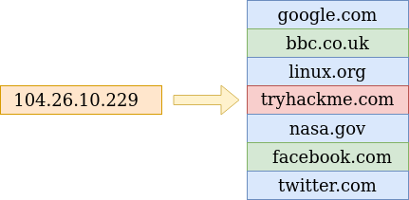
What is DNS?
DNS (Domain Name System) provides a simple way for us to communicate with devices on the internet without remembering complex numbers. Much like every house has a unique address for sending mail directly to it, every computer on the internet has its own unique address to communicate with it called an IP address. An IP address looks like the following 104.26.10.229, 4 sets of digits ranging from 0 - 255 separated by a period. When you want to visit a website, it's not exactly convenient to remember this complicated set of numbers, and that's where DNS can help. So instead of remembering 104.26.10.229, you can remember tryhackme.com instead.

Slide 2
Domain Hierarchy

Slide 3
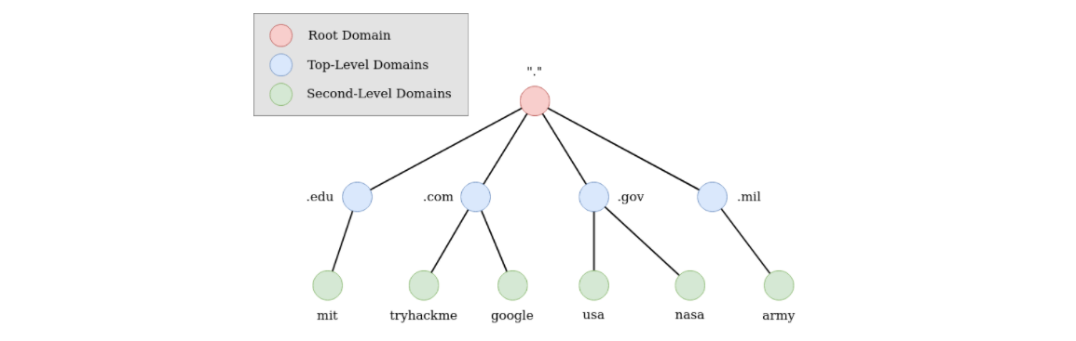

Slide 4
TLD (Top-Level Domain)
A TLD is the most righthand part of a domain name. So, for example, the tryhackme.com TLD is .com. There are two types of TLD: gTLD (Generic Top Level) and ccTLD (Country Code Top Level Domain). Historically a gTLD was meant to tell the user the domain name's purpose; for example, a .com would be for commercial purposes, .org for an organisation, .edu for education and .gov for government. And a ccTLD was used for geographical purposes, for example, .ca for sites based in Canada, .co.uk for sites based in the United Kingdom and so on. Due to such demand, there is an influx of new gTLDs ranging from .online , .club , .website , .biz and so many more. For a full list of over 2000 TLDs .
[2000 TLD]https://data.iana.org/TLD/tlds-alpha-by-domain.txt

Slide 5
Second-Level Domain
Taking tryhackme.com as an example, the .com part is the TLD, and tryhackme is the Second Level Domain. When registering a domain name, the second-level domain is limited to 63 characters + the TLD and can only use a-z 0-9 and hyphens (cannot start or end with hyphens or have consecutive hyphens).
Subdomain
A subdomain sits on the left-hand side of the Second-Level Domain using a period to separate it; for example, in the name admin.tryhackme.com the admin part is the subdomain. A subdomain name has the same creation restrictions as a Second-Level Domain, being limited to 63 characters and can only use a-z 0-9 and hyphens (cannot start or end with hyphens or have consecutive hyphens). You can use multiple subdomains split with periods to create longer names, such as jupiter.servers.tryhackme.com. But the length must be kept to 253 characters or less. There is no limit to the number of subdomains you can create for your domain name.

Slide 6
DNS Record Types We'll go over some of the most common ones that you're likely to come across. A Record: These records resolve to IPv4 addresses, for example 104.26.10.229 AAA Record: These records resolve to IPv6 addresses, for example 2606:4700:20::681a:be5

Slide 7
DNS Record Types
DNS isn't just for websites though, and multiple types of DNS record exist. We'll go over some of the most common ones that you're likely to come across.
A Record
These records resolve to IPv4 addresses, for example 104.26.10.229
AAAA Record
These records resolve to IPv6 addresses, for example 2606:4700:20::681a:be5
CNAME Record
These records resolve to another domain name, for example, TryHackMe's online shop has the subdomain name store.tryhackme.com which returns a CNAME record shops.shopify.com. Another DNS request would then be made to shops.shopify.com to work out the IP address.

Slide 8
MX Record
These records resolve to the address of the servers that handle the email for the domain you are querying, for example an MX record response for tryhackme.com would look something like alt1.aspmx.l.google.com. These records also come with a priority flag. This tells the client in which order to try the servers, this is perfect for if the main server goes down and email needs to be sent to a backup server.
TXT Record
TXT records are free text fields where any text-based data can be stored. TXT records have multiple uses, but some common ones can be to list servers that have the authority to send an email on behalf of the domain (this can help in the battle against spam and spoofed email). They can also be used to verify ownership of the domain name when signing up for third party services.

Slide 9
What happens when you make a DNS request
When you request a domain name, your computer first checks its local cache to see if you've previously looked up the address recently; if not, a request to your Recursive DNS Server will be made.
A Recursive DNS Server is usually provided by your ISP, but you can also choose your own. This server also has a local cache of recently looked up domain names. If a result is found locally, this is sent back to your computer, and your request ends here (this is common for popular and heavily requested services such as Google, Facebook, Twitter). If the request cannot be found locally, a journey begins to find the correct answer, starting with the internet's root DNS servers.
The root servers act as the DNS backbone of the internet; their job is to redirect you to the correct Top Level Domain Server, depending on your request. If, for example, you request www.tryhackme.com, the root server will recognise the Top Level Domain of .com and refer you to the correct TLD server that deals with .com addresses.
The TLD server holds records for where to find the authoritative server to answer the DNS request. The authoritative server is often also known as the nameserver for the domain. For example, the name server for tryhackme.com is kip.ns.cloudflare.com and uma.ns.cloudflare.com. You'll often find multiple nameservers for a domain name to act as a backup in case one goes down.
An authoritative DNS server is the server that is responsible for storing the DNS records for a particular domain name and where any updates to your domain name DNS records would be made. Depending on the record type, the DNS record is then sent back to the Recursive DNS Server, where a local copy will be cached for future requests and then relayed back to the original client that made the request. DNS records all come with a TTL (Time To Live) value. This value is a number represented in seconds that the response should be saved for locally until you have to look it up again. Caching saves on having to make a DNS request every time you communicate with a server.

Slide 10
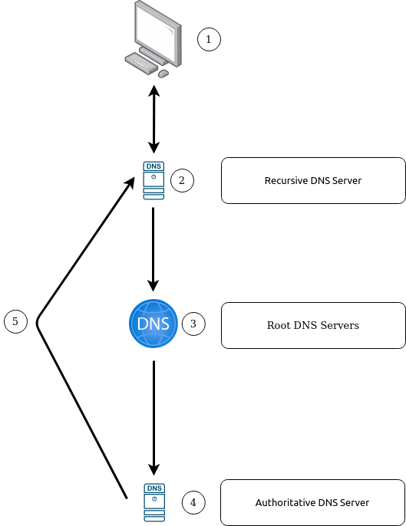

Slide 11
HTTP in detail

Slide 12
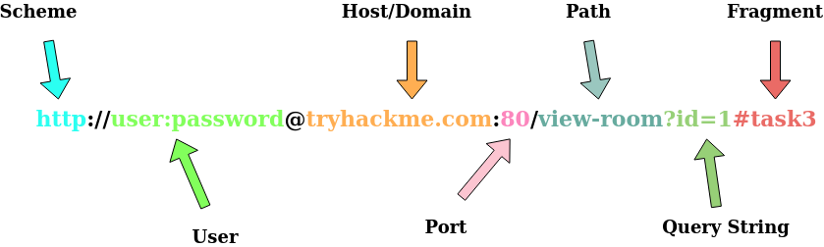
What is HTTP? (HyperText Transfer Protocol)
HTTP is what's used whenever you view a website, developed by Tim Berners-Lee and his team between 1989-1991. HTTP is the set of rules used for communicating with web servers for the transmitting of webpage data, whether that is HTML, Images, Videos, etc.
What is HTTPS? (HyperText Transfer Protocol Secure)
HTTPS is the secure version of HTTP. HTTPS data is encrypted so it not only stops people from seeing the data you are receiving and sending, but it also gives you assurances that you're talking to the correct web server and not something impersonating it.
What is a URL? (Uniform Resource Locator)
If you’ve used the internet, you’ve used a URL before. A URL is predominantly an instruction on how to access a resource on the internet. The below image shows what a URL looks like with all of its features (it does not use all features in every request).

Slide 13
Scheme: This instructs on what protocol to use for accessing the resource such as HTTP, HTTPS, FTP (File Transfer Protocol).
User: Some services require authentication to log in, you can put a username and password into the URL to log in.
Host: The domain name or IP address of the server you wish to access.
Port: The Port that you are going to connect to, usually 80 for HTTP and 443 for HTTPS, but this can be hosted on any port between 1 - 65535.
Path: The file name or location of the resource you are trying to access.
Query String: Extra bits of information that can be sent to the requested path. For example, /blog?id=1 would tell the blog path that you wish to receive the blog article with the id of 1.
Fragment: This is a reference to a location on the actual page requested. This is commonly used for pages with long content and can have a certain part of the page directly linked to it, so it is viewable to the user as soon as they access the page

Slide 14
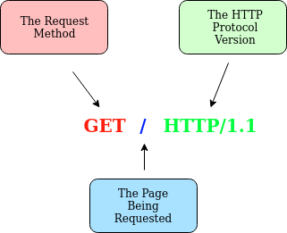
Making a Request
It's possible to make a request to a web server with just one line "GET / HTTP/1.1"

Slide 15
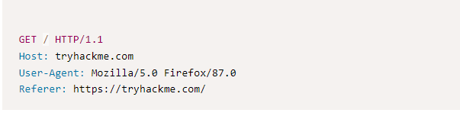
Example Request:
Line 1: This request is sending the GET method , request the home page with / and telling the web server we are using HTTP protocol version 1.1.
Line 2: We tell the web server we want the website tryhackme.com
Line 3: We tell the web server we are using the Firefox version 87 Browser
Line 4: We are telling the web server that the web page that referred us to this one is https://tryhackme.com
Line 5: HTTP requests always end with a blank line to inform the web server that the request has finished.

Slide 16
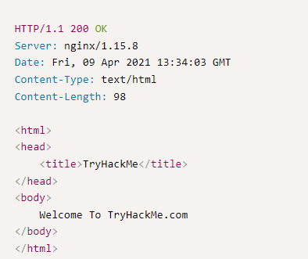
Example Response:
Line 1: HTTP 1.1 is the version of the HTTP protocol the server is using and then followed by the HTTP Status Code in this case "200 Ok" which tells us the request has completed successfully.
Line 2: This tells us the web server software and version number.
Line 3: The current date, time and timezone of the web server.
Line 4: The Content-Type header tells the client what sort of information is going to be sent, such as HTML, images, videos, pdf, XML.
Line 5: Content-Length tells the client how long the response is, this way we can confirm no data is missing.
Line 6: HTTP response contains a blank line to confirm the end of the HTTP response.
Lines 7-14: The information that has been requested, in this instance the homepage.

Slide 17
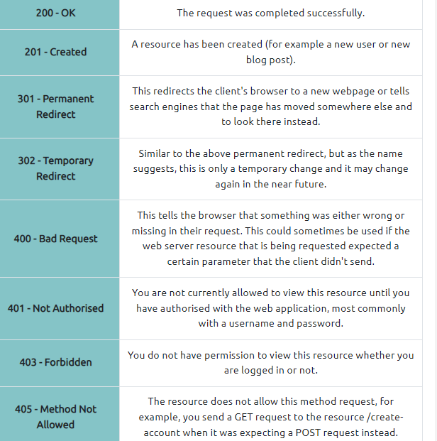
HTTP methods: HTTP methods are a way for the client to show their intended action when making an HTTP request.
GET Request: This is used for getting information from a web server.
POST Request: This is used for submitting data to the web server and potentially creating new records
PUT Request: This is used for submitting data to a web server to update information
DELETE Request: This is used for deleting information/records from a web server.
HTTP Status Codes:

Slide 18
Common Request Headers: Headers are additional bits of data you can send to the web server when making requests.
Host: Some web servers host multiple websites so by providing the host headers you can tell it which one you require, otherwise you'll just receive the default website for the server.
User-Agent: This is your browser software and version number, telling the web server your browser software helps it format the website properly for your browser and also some elements of HTML, JavaScript and CSS are only available in certain browsers.
Content-Length: When sending data to a web server such as in a form, the content length tells the web server how much data to expect in the web request. This way the server can ensure it isn't missing any data.
Accept-Encoding: Tells the web server what types of compression methods the browser supports so the data can be made smaller for transmitting over the internet.
Cookie: Data sent to the server to help remember your information (see cookies task for more information).

Slide 19
Common Response Headers
These are the headers that are returned to the client from the server after a request.
Set-Cookie: Information to store which gets sent back to the web server on each request (see cookies task for more information).
Cache-Control: How long to store the content of the response in the browser's cache before it requests it again.
Content-Type: This tells the client what type of data is being returned, i.e., HTML, CSS, JavaScript, Images, PDF, Video, etc. Using the content-type header the browser then knows how to process the data.
Content-Encoding: What method has been used to compress the data to make it smaller when sending it over the internet

Slide 20
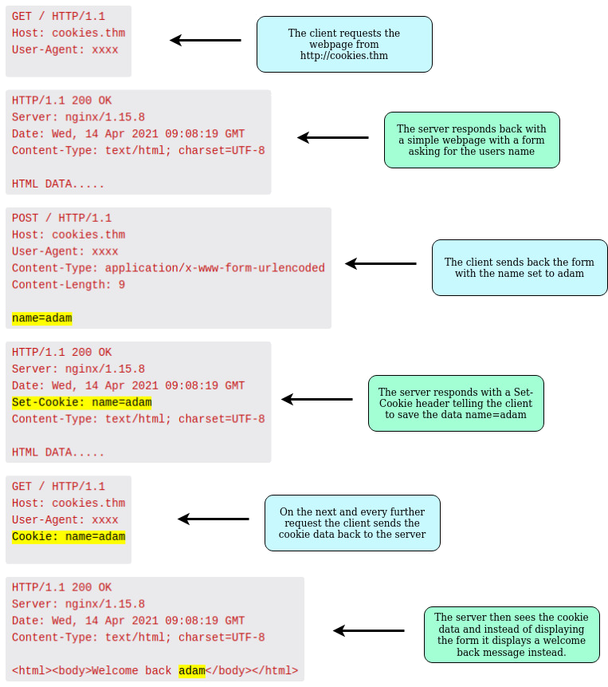
Cookies:
They're just a small piece of data that is stored on your computer. Cookies are saved when you receive a "Set-Cookie" header from a web server. Then every further request you make, you'll send the cookie data back to the web server. Because HTTP is stateless (doesn't keep track of your previous requests), cookies can be used to remind the web server who you are, some personal settings for the website or whether you've been to the website before. Let's take a look at this as an example HTTP request:

Slide 21
How websites work

Slide 22
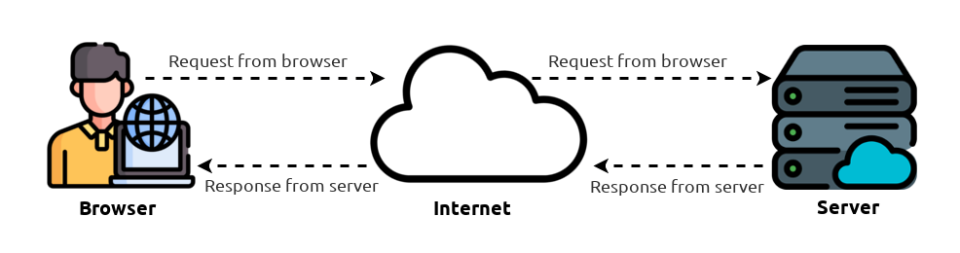
How websites work:
When you visit a website, your browser (like Safari or Google Chrome) makes a request to a web server asking for information about the page you're visiting. It will respond with data that your browser uses to show you the page; a web server is just a dedicated computer somewhere else in the world that handles your requests.
There are two major components that make up a website:
Front End (Client-Side) - the way your browser renders a website.
Back End (Server-Side) - a server that processes your request and returns a response.

Slide 23
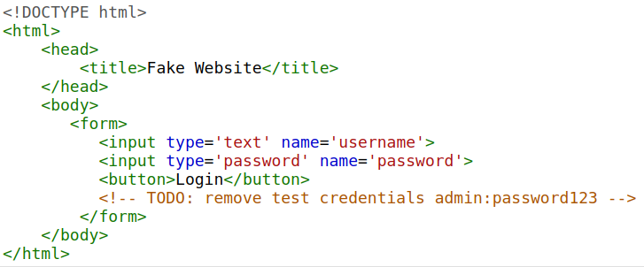
HTML:
Websites are primarily created using:
HTML,-- to build websites and define their structure
CSS,-- to make websites look pretty by adding styling options
JavaScript,-- implement complex features on pages using interactivity
JavaScript:
HTML is used to create the website structure and content, while JavaScript is used to control the functionality of web pages
Sensitive Data Exposure:
Sensitive Data Exposure occurs when a website doesn't properly protect (or remove) sensitive clear-text information to the end-user; usually found in a site's frontend source code.

Slide 24
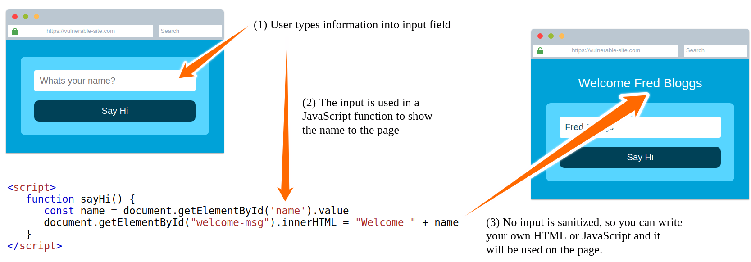
Html Injection:
HTML Injection is a vulnerability that occurs when unfiltered user input is displayed on the page. If a website fails to sanitise user input (filter any "malicious" text that a user inputs into a website), and that input is used on the page, an attacker can inject HTML code into a vulnerable website.
When a user has control of how their input is displayed, they can submit HTML (or JavaScript) code, and the browser will use it on the page, allowing the user to control the page's appearance and functionality.

Slide 25
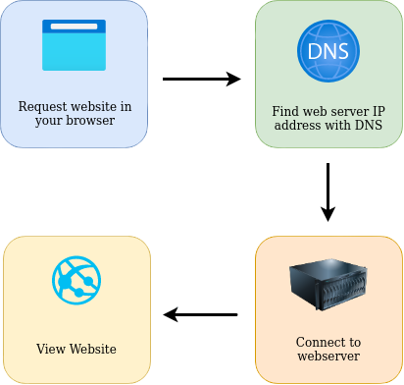
Putting It All Together
To summarise, when you request a website, your computer needs to know the server's IP address it needs to talk to; for this, it uses DNS. Your computer then talks to the web server using a special set of commands called the HTTP protocol; the webserver then returns HTML, JavaScript, CSS, Images, etc., which your browser then uses to correctly format and display the website to you

Slide 26
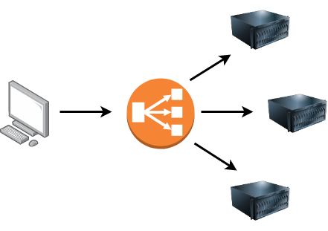
Load Balancers: When a website's traffic starts getting quite large or is running an application that needs to have high availability, one web server might no longer do the job. Load balancers provide two main features, ensuring high traffic websites can handle the load and providing a failover if a server becomes unresponsive.When you request a website with a load balancer, the load balancer will receive your request first and then forward it to one of the multiple servers behind it. The load balancer uses different algorithms to help it decide which server is best to deal with the request. A couple of examples of these algorithms are round-robin, which sends it to each server in turn, or weighted, which checks how many requests a server is currently dealing with and sends it to the least busy server.
Load balancers also perform periodic checks with each server to ensure they are running correctly; this is called a health check. If a server doesn't respond appropriately or doesn't respond, the load balancer will stop sending traffic until it responds appropriately again.

Slide 27

CDN (Content Delivery Networks)
A CDN can be an excellent resource for cutting down traffic to a busy website. It allows you to host static files from your website, such a JavaScript, CSS, Images, Videos, and host them across thousands of servers all over the world. When a user requests one of the hosted files, the CDN works out where the nearest server is physically located and sends the request there instead of potentially the other side of the world.
WAF (Web Application Firewall):
A WAF sits between your web request and the web server; its primary purpose is to protect the webserver from hacking or denial of service attacks. It analyses the web requests for common attack techniques, whether the request is from a real browser rather than a bot. It also checks if an excessive amount of web requests are being sent by utilising something called rate limiting, which will only allow a certain amount of requests from an IP per second. If a request is deemed a potential attack, it will be dropped and never sent to the webserver.

Slide 28
How Web servers work.
What is a Web Server?
A web server is a software that listens for incoming connections and then utilises the HTTP protocol to deliver web content to its clients. The most common web server software you'll come across is Apache, Nginx, IIS and NodeJS. A Web server delivers files from what's called its root directory, which is defined in the software settings. For example, Nginx and Apache share the same default location of /var/www/html in Linux operating systems, and IIS uses C:\inetpub\wwwroot for the Windows operating systems. So, for example, if you requested the file http://www.example.com/picture.jpg, it would send the file /var/www/html/picture.jpg from its local hard drive.
Virtual Hosts
Web servers can host multiple websites with different domain names; to achieve this, they use virtual hosts. The web server software checks the hostname being requested from the HTTP headers and matches that against its virtual hosts (virtual hosts are just text-based configuration files). If it finds a match, the correct website will be provided. If no match is found, the default website will be provided instead.

Slide 29
Static Vs Dynamic Content
Static content, as the name suggests, is content that never changes. Common examples of this are pictures, javascript, CSS, etc., but can also include HTML that never changes. Furthermore, these are files that are directly served from the webserver with no changes made to them.
Dynamic content, on the other hand, is content that could change with different requests. Take, for example, a blog. On the homepage of the blog, it will show you the latest entries. If a new entry is created, the home page is then updated with the latest entry, or a second example might be a search page on a blog. Depending on what word you search, different results will be displayed.
These changes to what you end up seeing are done in what is called the Backend with the use of programming and scripting languages. It's called the Backend because what is being done is all done behind the scenes. You can't view the websites' HTML source and see what's happening in the Backend, while the HTML is the result of the processing from the Backend. Everything you see in your browser is called the Frontend.

