Slide 1
Opencv hand gesture recognition in python

Slide 2

What is opencv?
Open source computer vision library

Slide 3

Python?
*Highh level programing language
*Code readability

Slide 4

Hand gestures.....

Slide 5
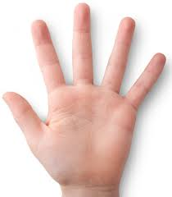
Capturing frames and displaying them
import cv2 #importing libraries
cap = cv2.VideoCapture(0) #creating camera object
while( cap.isOpened() ) :
ret,img = cap.read() #reading the frames
cv2.imshow('input',img) #displaying the frames
k = cv2.waitKey(10)
if k == 27:
break

Slide 6
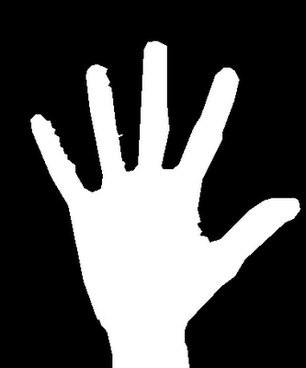
Extracting (ROI): or background subtraction
1)BGR to gray
gray = cv2.cvtColor(img,cv2.COLOR_BGR2GRAY)
2)Blurring
blur = cv2.GaussianBlur(gray,(5,5),0)
3)Thresholding
ret,thresh1 = cv2.threshold(blur,70,255,
cv2.THRESH_BINARY_INV+cv2.THRESH_OTSU)

Slide 7
Find out contours and draw convex hull
Contours:Contours can be explained simply as all the continuous points (along the boundary)
Convex hull:curve joining contour points

Slide 8
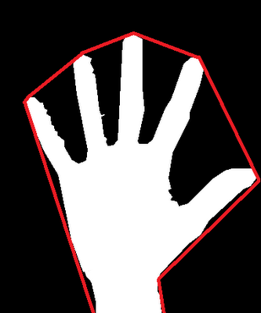
contours, hierarchy =
cv2.findContours(thresh1,
cv2.RETR_TREE,cv2.CHAIN_APPROX_SIMPLE)
#extracting contour point
hull = cv2.convexHull(cnt)
#points for convex hull
drawing = np.zeros(img.shape,np.uint8)
cv2.drawContours(drawing,[cnt],0,(0,255,0),2)
cv2.drawContours(drawing,[hull],0,(0,0,255),2)
#displaying convex hull

Slide 9
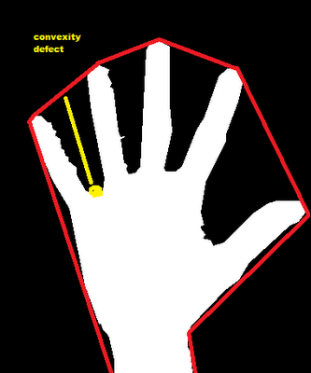
Convexity defects

Slide 10
>finding out convexity defects
hull = cv2.convexHull(cnt,returnPoints = False
defects = cv2.convexityDefects(cnt,hull)
>ploting and displaying number of defects
mind=0
maxd=0
i=0
for i in range(defects.shape[0]):
s,e,f,d = defects[i,0]
start = tuple(cnt[s][0])
end = tuple(cnt[e][0])
far = tuple(cnt[f][0])
dist = cv2.pointPolygonTest(cnt,centr,True)
cv2.line(img,start,end,[0,255,0],2)
cv2.circle(img,far,5,[0,0,255],-1)
print(i)
Dependingon number of defects perform the required function

