Slide 1

Plain-English Explainer for Dense Paragraphs
Milestone 4
Date: 11/18/2025
Course: DSC670-T301 Fall 2025
Author: Iftikhar Qureshi

Slide 2
Problem & Motivation
Dense policy, legal, and technical paragraphs are hard to understand.
Many readers struggle to quickly extract key points.
Need a simple tool that rewrites complex text into a clear, structured explanation.

Slide 3

Original Concept
Simple workflow: Paste → Click → Get structured explanation.
Fixed output format:
3 summary sentences
5 key bullet points
3 vocabulary terms
Goals: clarity, consistency, and faithfulness to the source text.

Slide 4
Fine-Tuned Model
Custom fine-tuned GPT-4.1-mini model.
Trained on structured examples using the 3/5/3 format.
Produces reliable JSON output.
Prevents format drift and improves clarity.

Slide 5

JSON Schema Enforcement
App validates model output using a strict JSON Schema.
Ensures correct structure:
  Summary: 3-sentences
  Key Points: 5-bullets
  Vocabulary: 3-terms
Improves reliability and maintains consistent formatting.

Slide 6
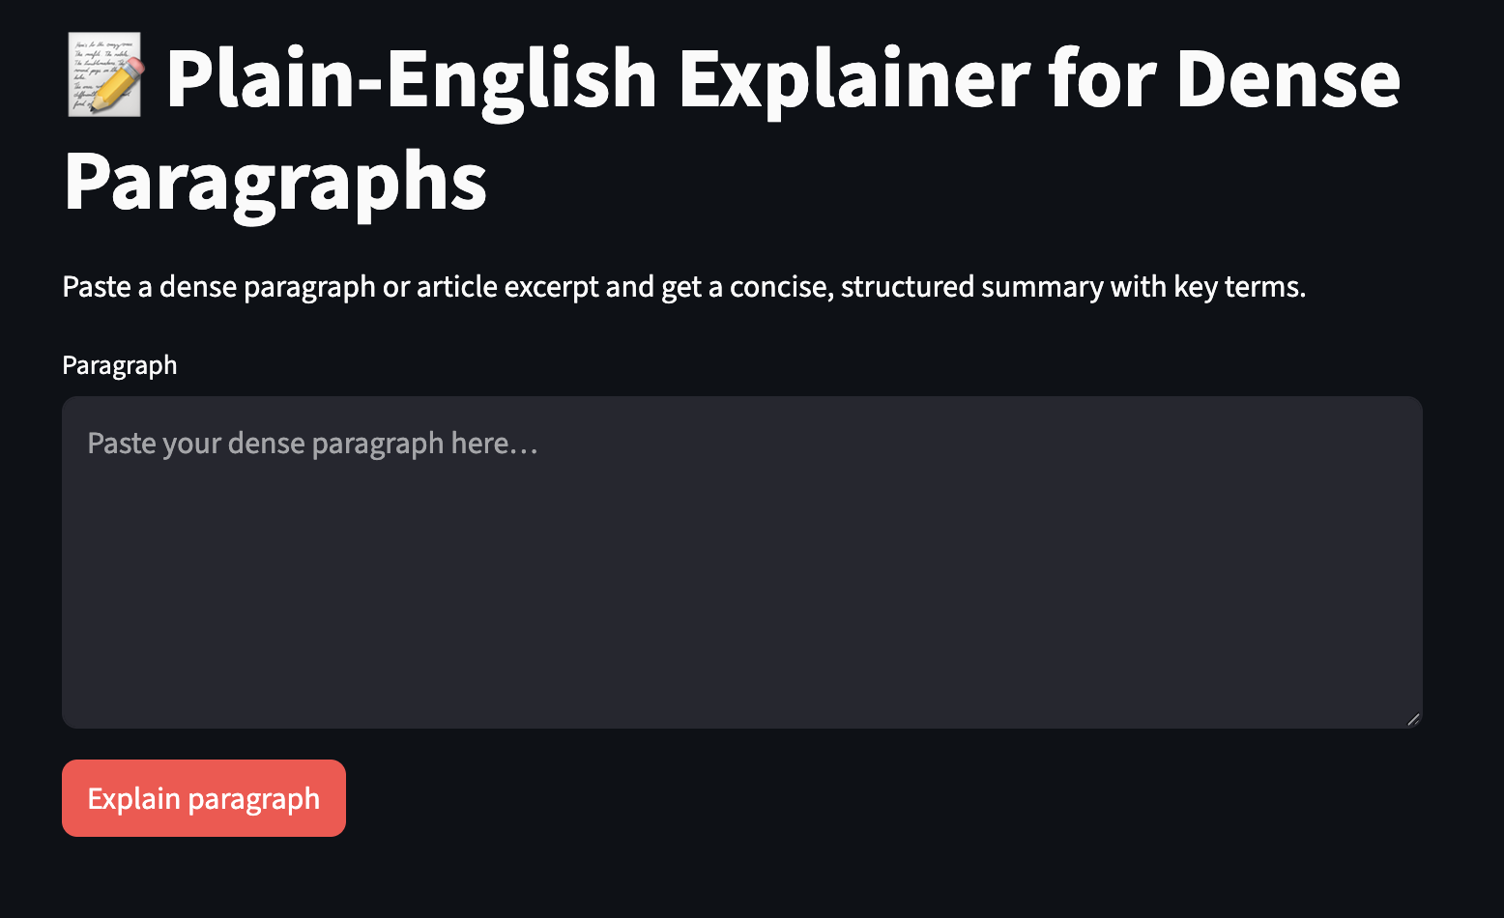
App Interface – Home Screen

Slide 7
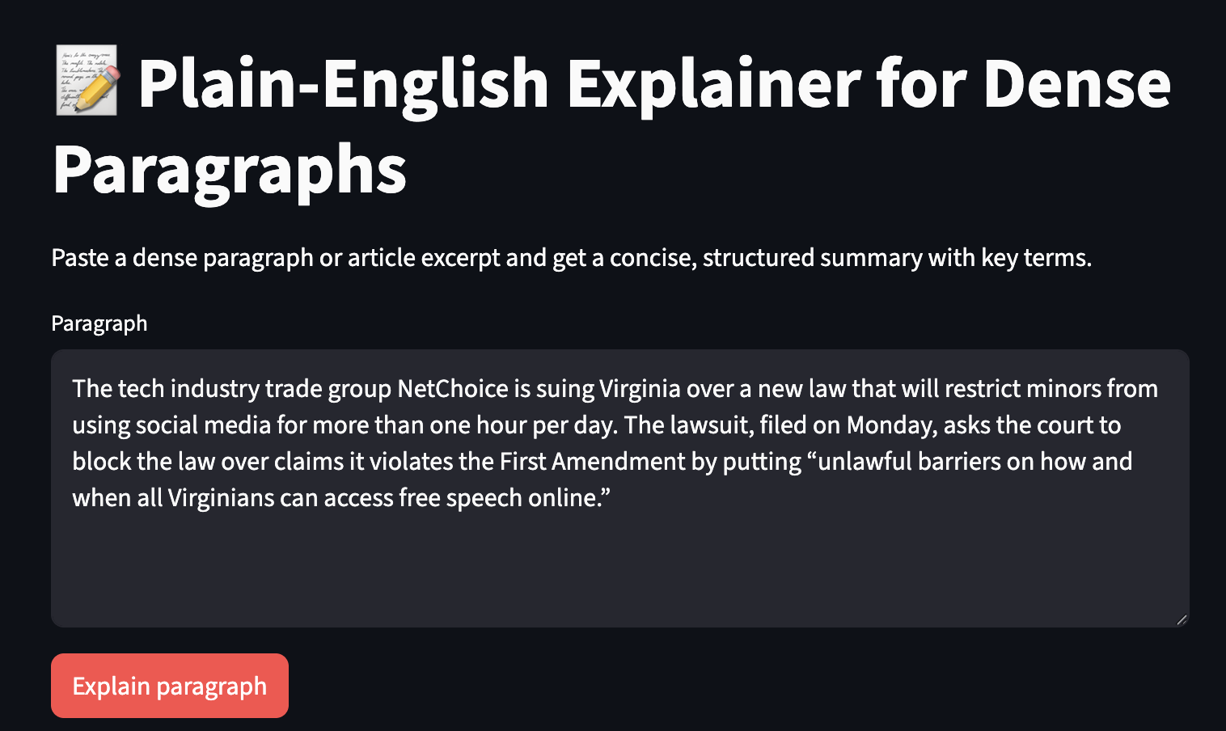
User Input Example

Slide 8
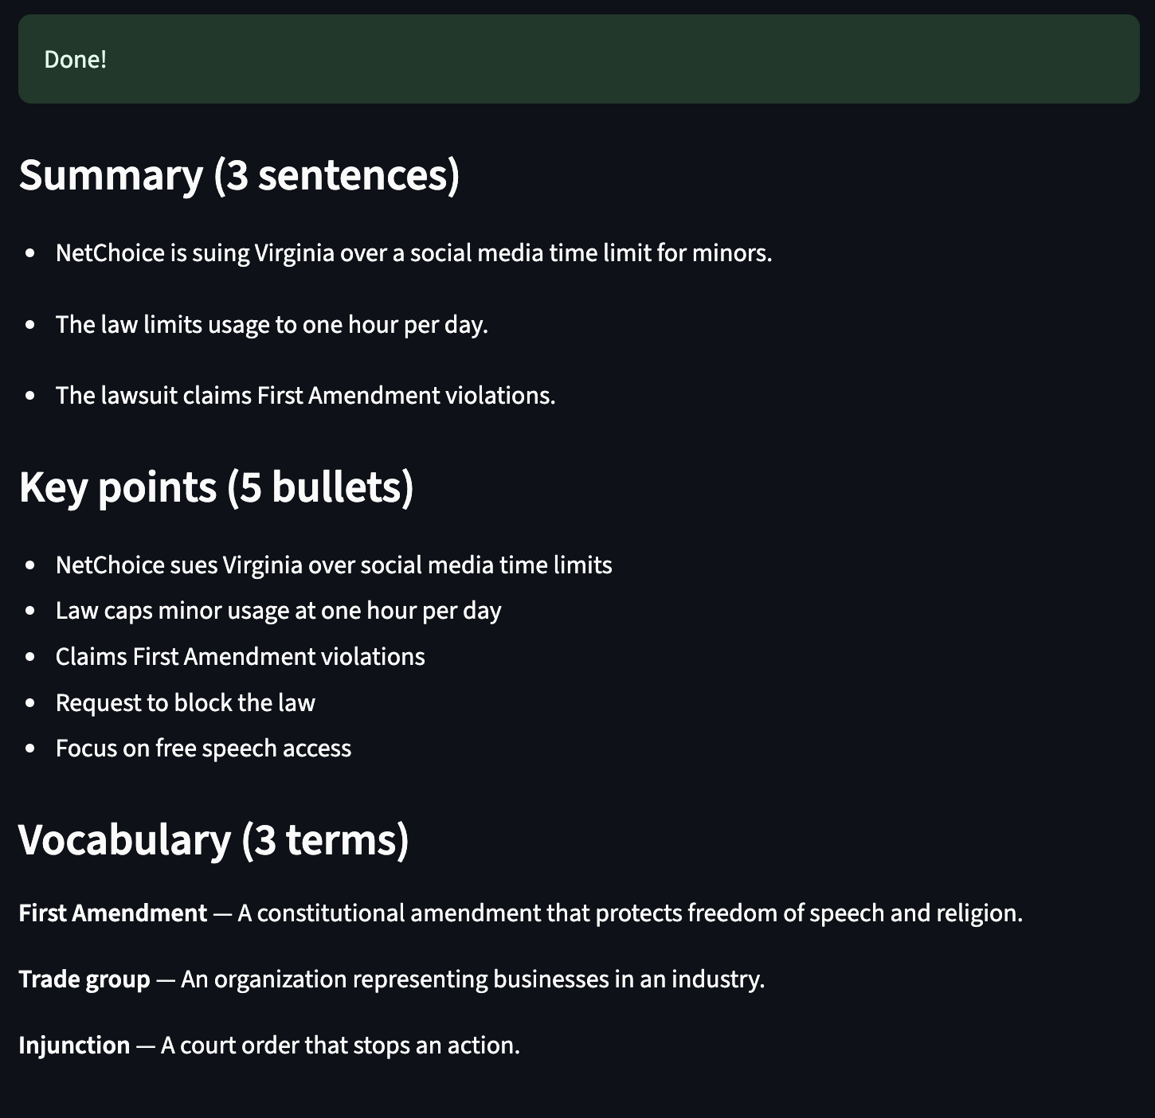
Structured Output
(3/5/3 Format)

Slide 9
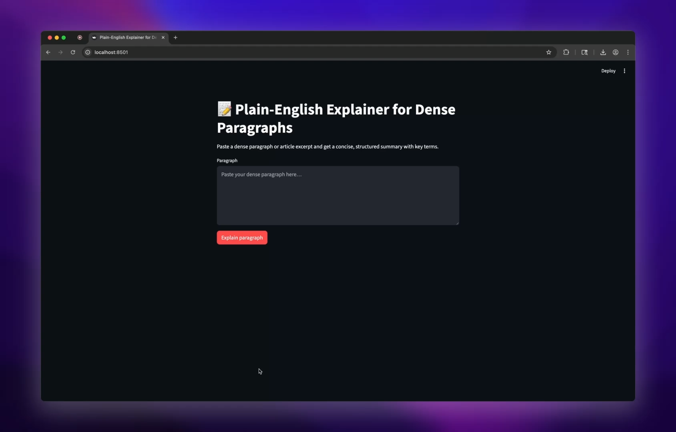
Demo
Video
Notes:
This video demonstrates the full workflow: entering text, generating the structured summary, and viewing the app’s output.

Slide 10
Results & Evaluation
Outputs are consistently structured and easy to read.
Model stays close to the source text (no added facts).
Improvement over baseline prompts due to fine-tuning + schema.
Strong match with original project goals.

Slide 11

Portfolio & Wrap-Up
Project demonstrates skills in:
  Prompt engineering
  Dataset creation
  Fine‑tuning
  Streamlit development
JSON schema enforcement

