Slide 1
Ghost Blog on AWS
Iftikhar Hossain
https://www.linkedin.com/in/engiftikhar

Slide 2
Terraform
Terraform is an open-source infrastructure as code software tool created by HashiCorp. Users define and provide data center infrastructure using a declarative configuration language known as HashiCorp Configuration Language, or optionally JSON.
Write declarative config files
Installable modules
Plan and predicts changes
State Management
Provision Infrastructure in familiar languages
Manage infrastructure across clouds

Slide 3
Terraspace
Terraspace is a Terraform Framework that optimizes for Infrastructure-as-code (IaC) happiness.
An organized project structure.
Keeping your code DRY by building Terraform projects from your app and config/terraform files and easily manageable multiple environments.
The automated creation of backend buckets.
CLI hooks: Call custom commands before and after terraform commands.
You can deploy all or some infrastructure in a single command: terraspace all up.
Built-in Test Framework.
Terraform Cloud and Terraform Enterprise are also supported.

Slide 4
AWS Services
Create VPC [Public & Private Subnet, Nat Gateway, Internet Gateway]
Use Multi-AZ MySQL RDS / AWS Aurora [Private Subnet]
Create EKS Cluster with Fargate [Private Subnet]
AWS Secret Manager to Manage Sensitive data [like Terraform DB credentials]
ALB can be Configured to save access logs to S3
Static images can be serve via AWS S3 via AWS Cloudfront
AWS Lambda will be responsible for processing access logs
AWS WAF is responsible for traffic control [Skip AWS Shield Advanced for pricing]

Slide 5
Helm and ArgoCD
Create Kubernetes manifest files to deploy ghost applications
Install Ingress Controller to serve the frontend applications using Helm Charts
Install Kubernetes external secret using Helm Charts to manage sensitive data like credentials.
Install ArgoCD tool using Helm Charts.
Install metrics server on EKS and use horizontal pod autoscaler to scale the traffic.

Slide 6
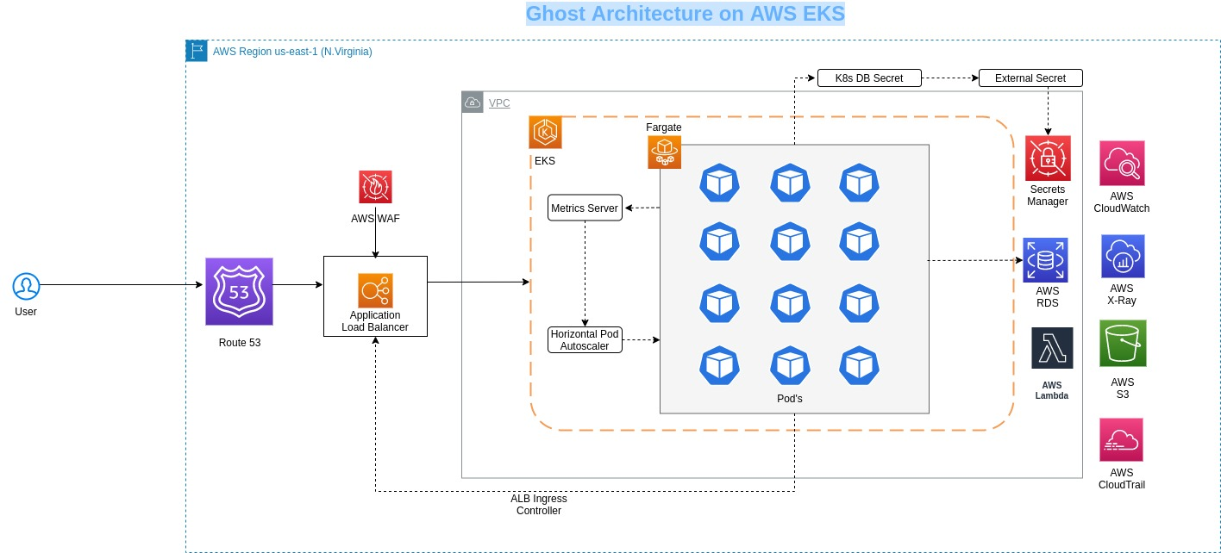
Ghost Blog Architecture on AWS EKS
Ghost is an open source, professional publishing platform built on a modern Node.js technology stack designed for teams who need power, flexibility and performance.

Slide 7
CI/CD implementation for Ghost blog
Using Gitlab CI, integrated with Git repo
Build and test the code
Push the docker images with tag in Dockerhub/ AWS ECR
Create another job with update manifest files in deploy stage.
This clones and commits news changes to Helm manifest repository.
Argo CD automatically detects this change and triggers the sync to change the state of resources as per the Git repo
Sync action is triggered through a webhook action from Jenkins CI after commit or after a regular polling interval.pository.
Argo CD runs as a controller on the Kubernetes cluster, which continuously monitors running applications and compares the current state with the desired target state (as specified in the GitOps repository).
The controller detects an out-of-sync application state, which is done by diff-in Helm manifest template outputs and optionally takes corrective action.

Slide 8
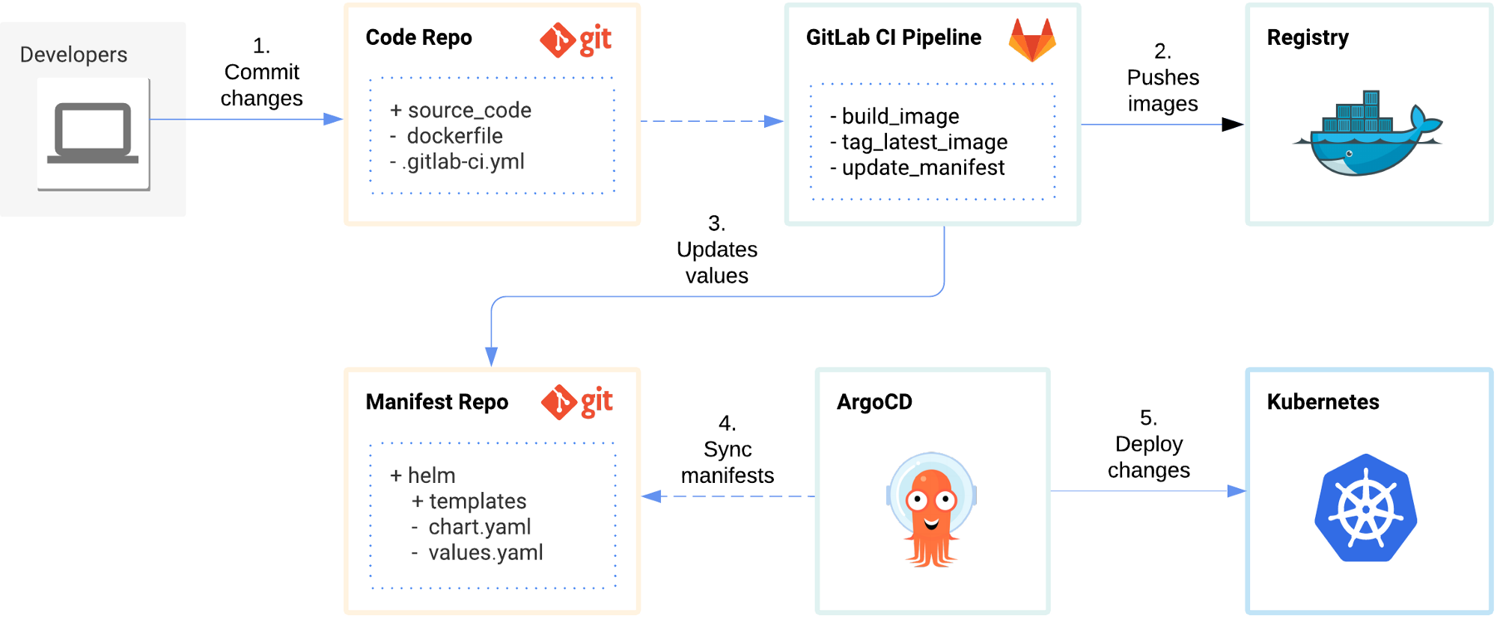
CI/CD implementation for Ghost blog

Slide 9
Security and Monitoring
ECR Scan allowed to check the docker images
Implement WAF to protect the frontend applications
Allowed Office IP/VPN IP with specific ports only Security Groups
Implement AWS Lambda functions to delete the posts
Implement Monitoring solution like AWS Prometheus, AWS Grafana, AWS X-Ray, Cloudwatch
Implement logging solution with Cloudwatch logs, AWS Elasticsearch
For Security, use Cloudtrail and AWS Guard Duty and AWS Inspector.

Slide 10
Disaster Recovery
Create Nat Gateway per AZ to protect Availability zone failure
Deploy the same architecture on another region.
Implement AWS Global Accelerator provides static IP addresses that act as a fixed entry point to both ALB's and change GA point to AWS Route53.
EKS cluster are running on different region and create VPC peering between them.
Use AWS RDS (MYSQL/Aurora) Multi-AZ for replication, automatic failover and backups.

Slide 11
Questions
Stateful set/ headless Service (https://kubernetes.io/docs/tutorials/stateful-application/basic-stateful-set)
Storage class (https://kubernetes.io/docs/concepts/storage/storage-classes/)
Manage Terraform state files
Terraform testing (https://terratest.gruntwork.io/)
Kube practise

