Slide 1
Practice 1
Normalize this table
No Order | OrderDate | Item1 | Item2 | Item3 | Total
TR001 | 10/09/2021 | P1 | P2 | P3 | 500.000
TR002 | 11/09/2021 | P3 | P5 |  | 300.000
TR003 | 12/09/2021 | P1 | P2 |  | 200.000
This table does not meet the 1NF condition because there are cells that are not filled in, which could be considered wasteful. Additionally, for the 'item' column, it is not effective because what if the order has more than three items? That would require adding more columns like 'item4,' 'item5,' and so on.

Slide 2
Solution
Form a table containing the items and the second table contains the date of order and the total of price.
No Order | Item
TR001 | P1
TR001 | P2
TR001 | P3
TR002 | P3
TR002 | P5
TR003 | P1
TR003 | P2
No Order | OrderDate | Total
TR001 | 10/09/2021 | 500.000
TR002 | 11/09/2021 | 300.000
TR003 | 12/09/2021 | 200.000

Slide 3
Practice 2
Is this table normal? If yes, which normal form? Can we normalize it to a higher level normalization?
ProjectID | EmployeeName | Department
P001 | Adi | EDP
P002 | Bima | HRD
P002 | Adi | EDP
P003 | Bima | HRD
P003 | Candra | Production
This table meets 1NF because there are no repeating groups, but we can normalize it to a 2NF, because there are no identified candidate or primary key on the table, and there are partial dependencies, for examples, EmployeeName depends on both ProjectID and Department, and Department only depends on ProjectID. So it can be passed the 2NF if we assume that the ProjectID is the primary key

Slide 4
Solution
We can normalize the table by separate the table into two parts.
ProjectID | EmployeeName
P001 | Adi
P002 | Bima
P002 | Adi
P003 | Bima
P003 | Candra
ProjectID | Department
P001 | EDP
P002 | HRD
P002 | EDP
P003 | HRD
P003 | Production

Slide 5
Practice 3
Is it normal form? If not, how to normalize it?
NRP | Name | Subject | NIP | Lecturer
5103100101 | Ali | SBD | 32151250 | Bapak X
5103100102 | Sita | SBD | 32151250 | Bapak X
5103100102 | Sita | Alin | 23000712 | Ibu Y
5103100103 | Adi | Komnum | 43101253 | Bapak Z
This table does meet the 1NF, but doesn’t meet the 2NF because there are attributes which dependent partially.
{NRP, NIP} is the primary key but:
{NRP,NIP} → Name
{NRP,NIP} → Subject
{NRP,NIP} → Lecturer

Slide 6
Solution
We can normalize the table by separate the table into two parts.
Functional dependency:
fd1 (NRP, Name) → Table Student
fd2 (NIP, Lecturer, Subject) → Table Lecturer
NRP | Name
5103100101 | Ali
5103100102 | Sita
5103100103 | Adi
NIP | Lecturer | Subject
32151250 | Bapak X | SBD
23000712 | Ibu Y | Alin
43101253 | Bapak Z | Komnum

Slide 7
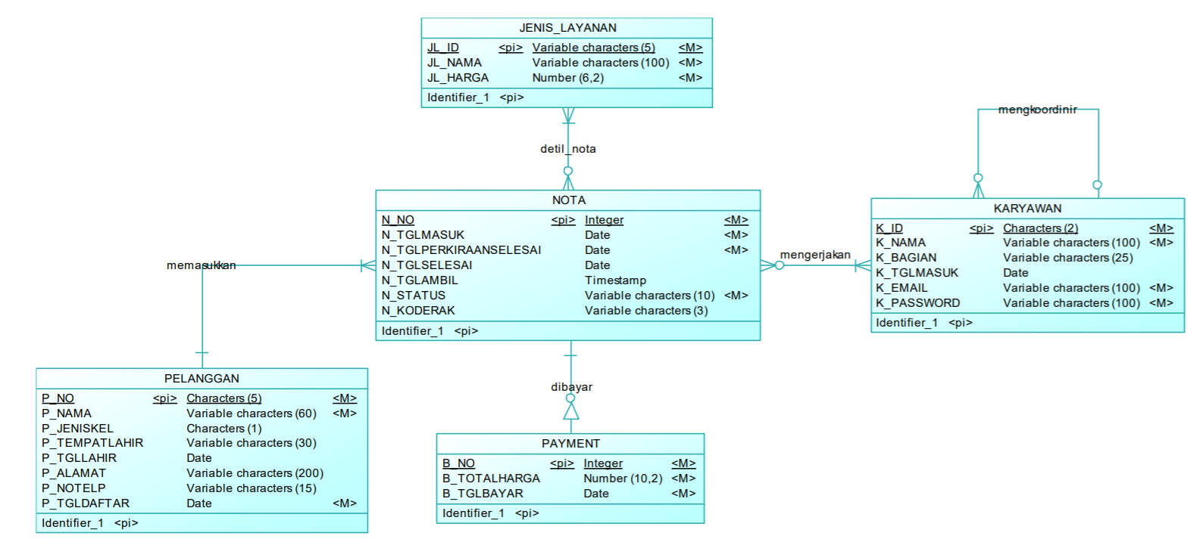
Practice 4
Create PDM from the CDM and write down the proof of every level of normal form

Slide 8
