Slide 1
Java Lab
Version Control Systems

Slide 2
Java Lab
And Command Line basics

Slide 3
contents
Why do we need command line?
Bash
Version Control Systems
Git

Slide 4
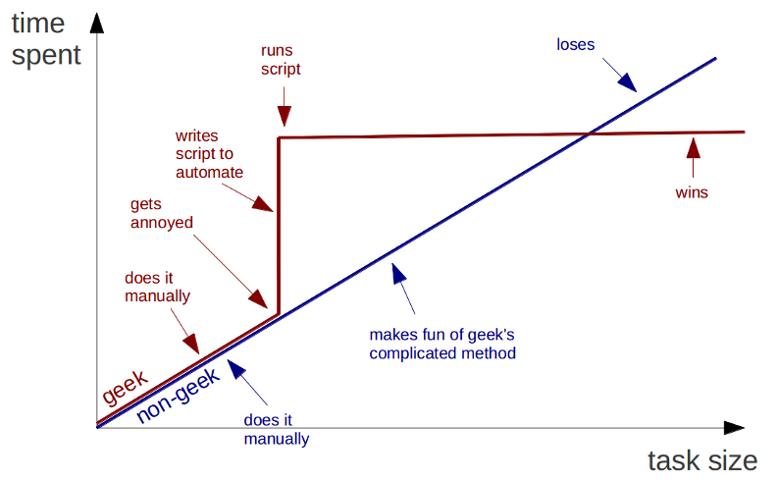
Geeks And repetitive Tasks

Slide 5
Command LIne
Concise and reliable actions
Speed (several clicks can be replaced with a single command)
Automation
Necessity (ssh access, other programs without UI)
Wide variety of shells (command prompt, sh, bash, powershell)
Wide variety of commands and arguments
Low level language

Slide 6
BASH
Bash is a Unix shell and command language released in 1989

Slide 7




Navigation
pwd (print working directory)
ls (list directory content)
cd (change the working directory)

Slide 8
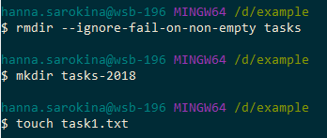
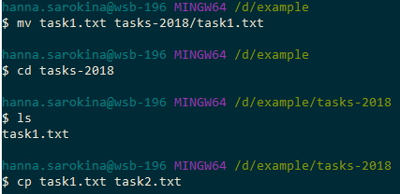
Manipulate
mkdir (create directory)
rmdir (remove directory)
touch (create a file)
cp (copy)
rm (remove)
mv (move)

Slide 9
VIEW and Edit
cat (reads files sequentially, writing them to standard output)
head (display the beginning of a text file)
tail (display the tail end of a text file)
less (terminal pager program)
nano (small and friendly text editor)
vi / vim (visual editor)

Slide 10

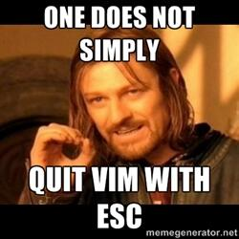
VIM

Slide 11
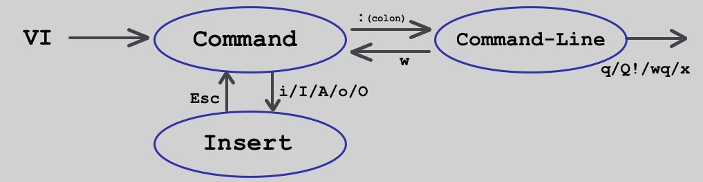
VIM
i – switch to insert mode
: (colon) - switch to command mode
q – if you don’t have unsaved changes
q! – ignore any unsaved changes and quit
w – save and return to command line
wq or x – save and quit

Slide 12
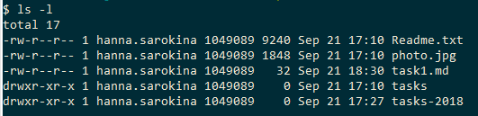
Permissions
sudo (super user do)
chmod (change the file modes/attributes/permissions)

Slide 13
Permissions
Symbolic Notation
-rwxr-xr-x r: readable w: writable x: executable
first triad what the owner can do
second triad what the group members can do
third triad what other users can do
Numeric Notation
---------- 0000 ---x--x--x 0111
--wx-wx-wx 0333 -rwxrwxrwx 0777

Slide 14
Process management
command1; command2 (execute in sequence)
command1 & (execute in background)
command1 && command2 (conditional execution)
ctrl+C (stop any command in terminal safely)
ctrl+Z (force stop)

Slide 15

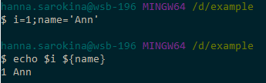
OTHER
man and --help (display system documentation)
echo (write to standard output)
tab (fill up in terminal)
brace expansion
variables

Slide 16
Version control Systems
CVS, Subversion (SVN), Git, Team Foundation Server (TFS), …

Slide 17
Why do we need VCS
Rollback of incorrect changes
Clarifying the reasons for the change
Support for multiple product versions
Data recovery in case of equipment damage
Teamwork
Ability to see changes for a specific task
Code review

Slide 18
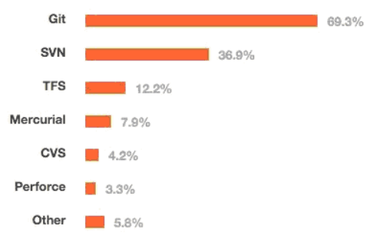
Types
Local (RCS)
Centralized (CVS, Subversion (SVN), Perforce)
Distributed (Git, Mercurial, Bazaar, Darcs)

Slide 19
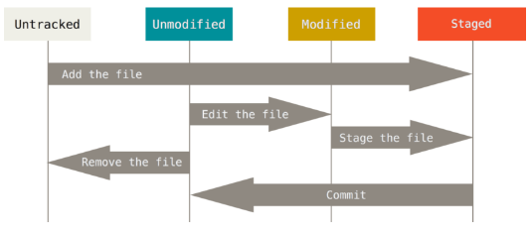
simple file workflow
git init git status
git add git log
git commit git <command> --help

Slide 20
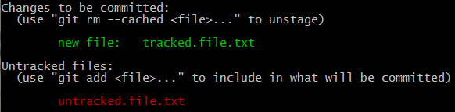
simple file workflow

Slide 21
Cancel changes
git checkout <hash or branch>
git reset <hash>
--soft
--mixed
--hard (danger!!!)
git revert <hash>

Slide 22
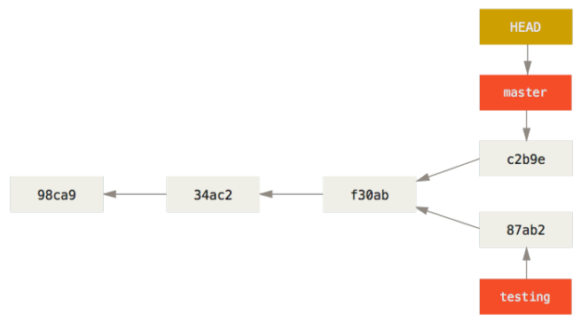
Branches
git branch <name>
git checkout <branch>
git merge <feature_branch>
git rebase <base_branch>

Slide 23
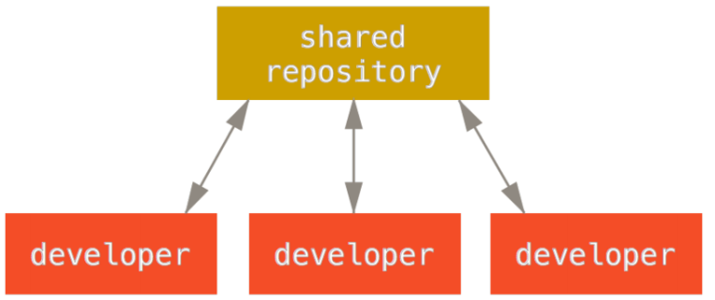
Remote Repository
git clone git push
git fetch git pull (fetch + merge)
git remote add origin <url>

Slide 24
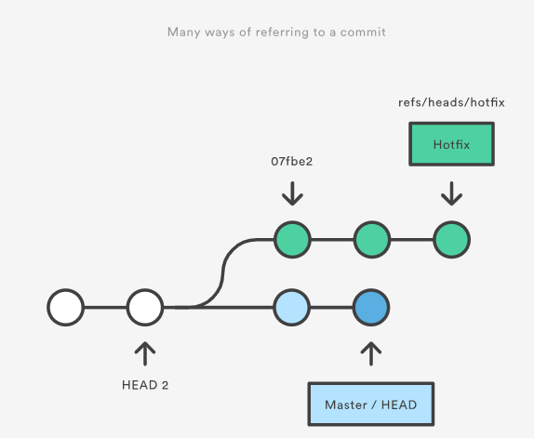
Refs
Hash
Branch
Tag
Remote
etc.
HEAD
HEAD^2
ORIG_HEAD
etc.

Slide 25
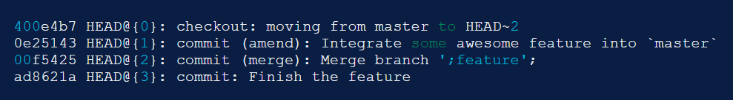
Reflog
The reflog is Git’s safety net.
Chronological history of everything you’ve done in your local repo.
git reflog

Slide 26
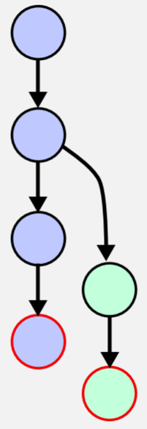
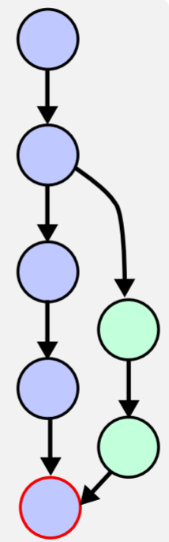
Merging

Slide 27
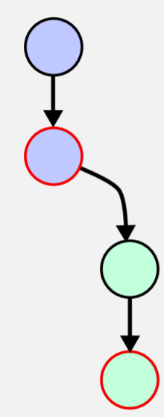
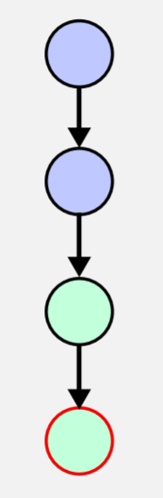
Fast Forward

Slide 28
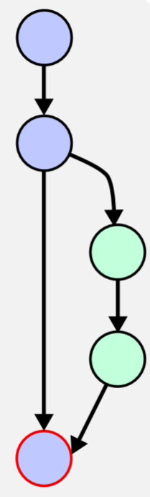
No Fast Forward (--no-ff)

Slide 29
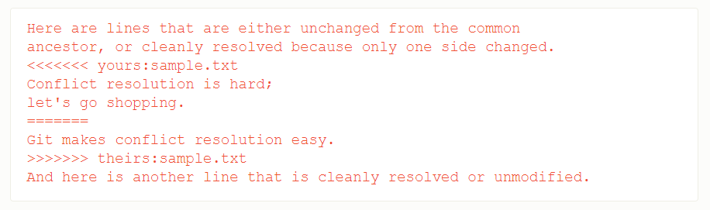
Merge Conflict
Edit files with conflicts
Add conflicted files to the index git add
Commit git commit
git merge --continue

Slide 30
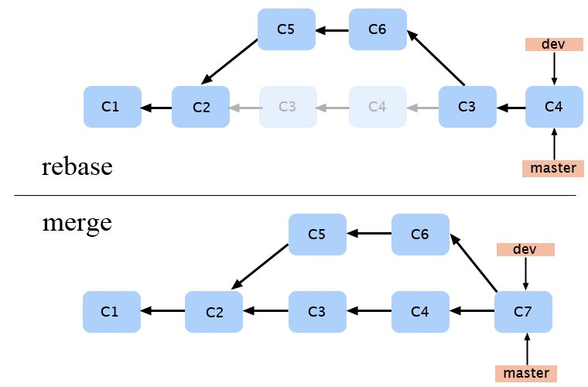
Rebase

Slide 31
Rebase
git rebase
git rebase --onto <newbase>
git rebase --continue
git rebase --skip
git rebase --abort
git rebase --quit
git push --force

Slide 32
Rewriting History
git stash
git stash list / apply / drop / pop
git commit --amend
git rebase --interactive HEAD~3
Notes:
https://git-scm.com/book/en/v2/Git-Tools-Rewriting-History

Slide 33
.Gitignore
Rules
Blank lines or lines starting with # are ignored.
Standard glob patterns work.
You can start patterns with a forward slash (/) to avoid recursivity.
You can end patterns with a forward slash (/) to specify a directory.
You can negate a pattern by starting it with an exclamation point (!).

Slide 34
.Gitignore
Glob patterns
An asterisk (*) - zero or more characters.
A question mark (?) - a single character
[abc] - any character inside the brackets
[0-9] - any character from range
Two asterisks (**) - nested directories

Slide 35
Git Config Levels
1. --system (C:/ProgramData/Git/.config)
2. --global (C:/Users/$USER/.gitconfig)
3. config file in the Git directory (.git/config)
e.g.
git config --global user.name "John Doe"
git config --global user.email johndoe@example.com

Slide 36
Git Config
core.autocrlf
true checkout Windows-style, commit Unix-style
input checkout as-is, commit Unix-style
false checkout as-is, commit as-is
credential.helper
feature to avoid inputting git credentials repeatedly

Slide 37
Git Hooks
client side (pre-commit, post-commit, pre-push, etc.)
server side (pre-receive, update, post-receive)

Slide 38
Git Workflow
a recipe or recommendation for how to use Git to accomplish work in a consistent and productive manner
Notes:
https://www.atlassian.com/git/tutorials/comparing-workflows

Slide 39
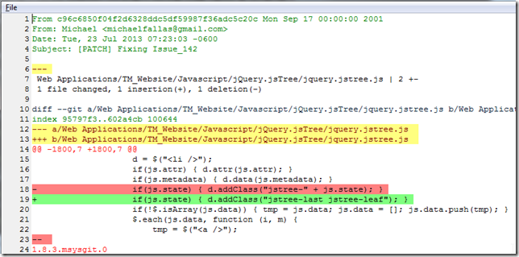
PATCH

Slide 40
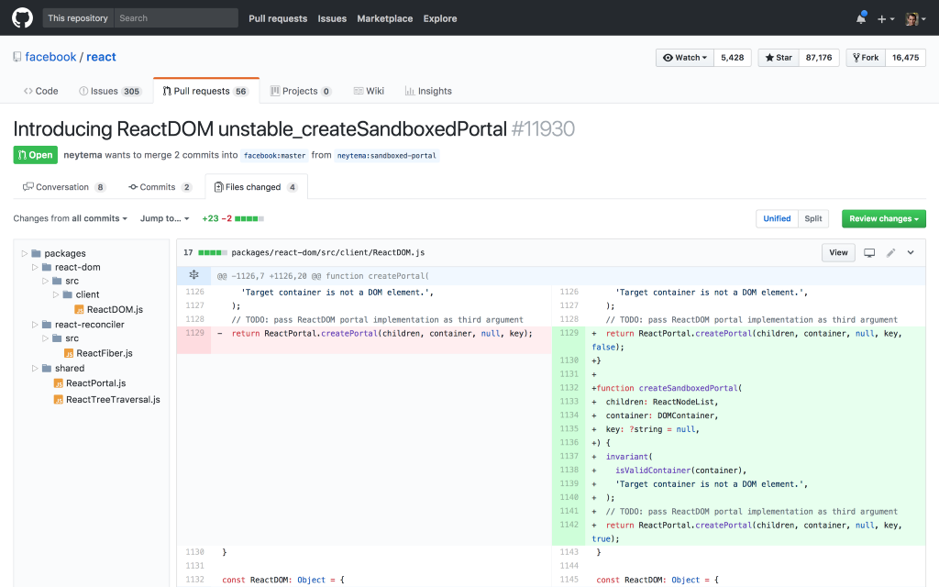
PULL Request

Slide 41
Pull Request
Pull requests are a feature that makes it easier for developers to collaborate.
Notify team members that feature is completed.
Discuss the proposed feature.
Post feedback if there are any problems.
Notes:
https://www.atlassian.com/git/tutorials/making-a-pull-request

Slide 42
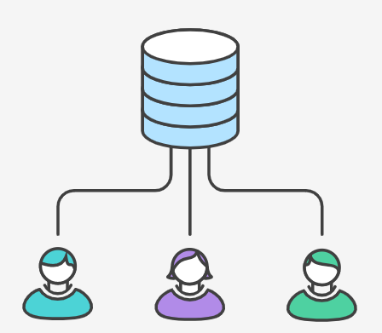
Centralized Workflow
Central repository is a single point-of-entry for all changes to the project.
Each developer work independently of all other changes to a project, but all changes are pushed into the single branch master.

Slide 43
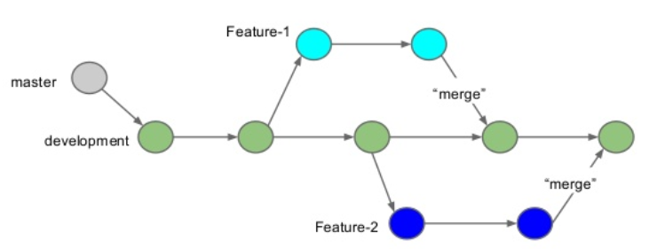
Feature Branch Workflow
All feature development should take place in a dedicated branch.
Encapsulation of every feature.
Master branch will never contain broken code.
Possibility for PRs.

Slide 44

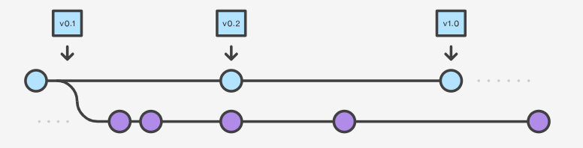
Gitflow Workflow
Gitflow is ideally suited for projects that have a scheduled release cycle.
In addition to feature branches, it uses individual branches for preparing, maintaining, and recording releases.

Slide 45
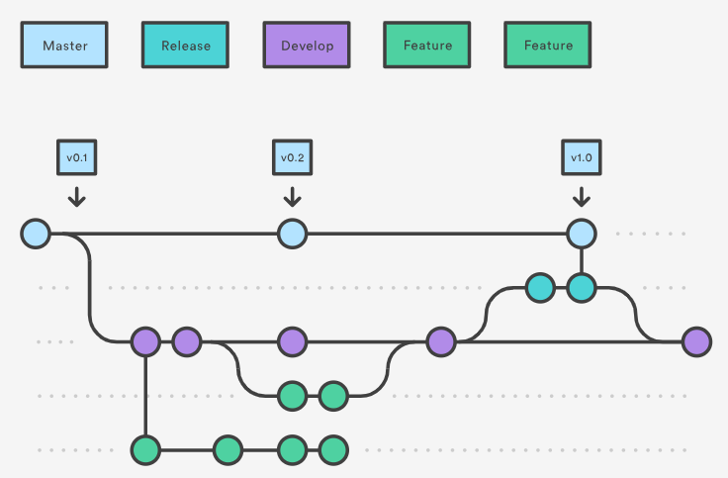
Release Branches
Notes:
Once develop has acquired enough features for a release (or a predetermined release date is approaching), you fork a releasebranch off of develop. Creating this branch starts the next release cycle, so no new features can be added after this point—only bug fixes, documentation generation, and other release-oriented tasks should go in this branch. Once it's ready to ship, the releasebranch gets merged into master and tagged with a version number. In addition, it should be merged back into develop, which may have progressed since the release was initiated.

Slide 46
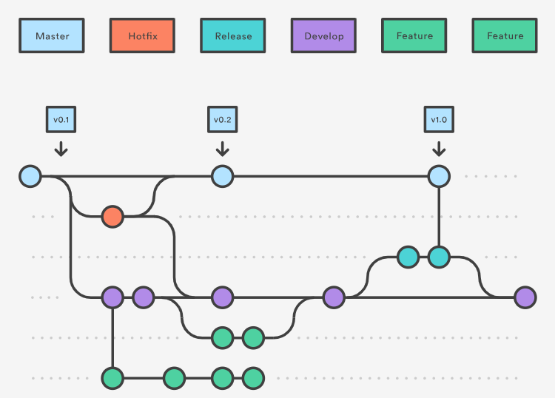
Hotfix Branches
Notes:
Maintenance or “hotfix” branches are used to quickly patch production releases. Hotfix branches are a lot like releasebranches and feature branches except they're based on masterinstead of develop. This is the only branch that should fork directly off of master. As soon as the fix is complete, it should be merged into both master and develop (or the current releasebranch), and master should be tagged with an updated version number.

Slide 47
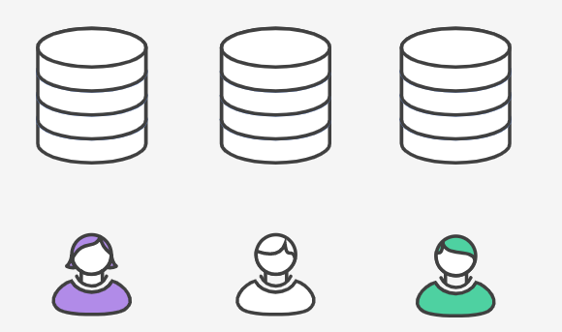
Forking Workflow
It gives every developer their own server-side repository.
Forked repositories are created using git clone.
It is most often seen in public open source projects.

Slide 48
Questions?
It's better to ask a question and be a fool once, than never ask and be a fool forever.

Slide 49
Thank you for your attention!

