Slide 1
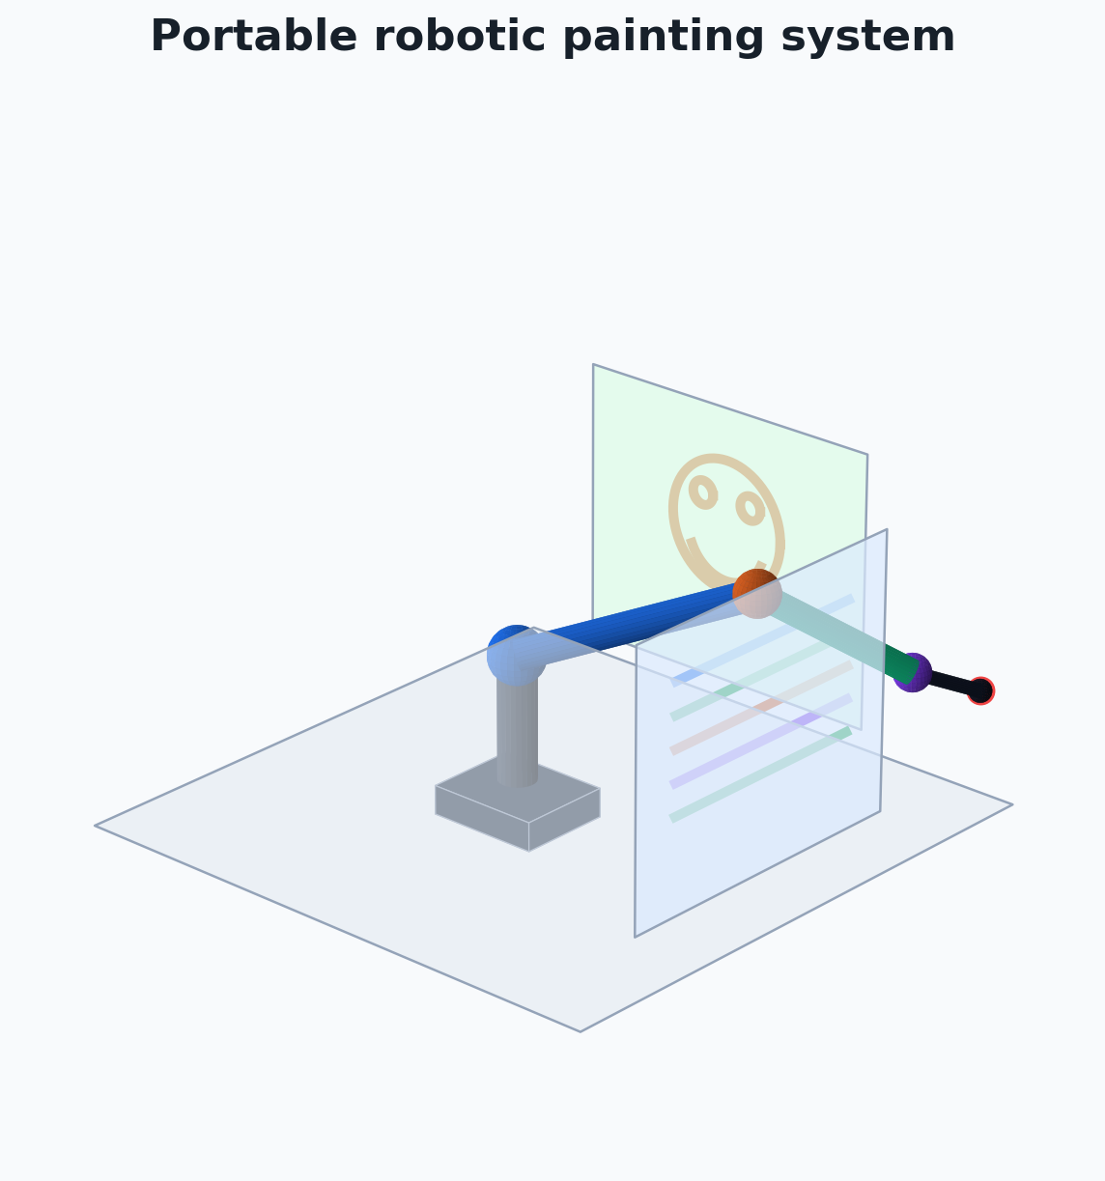
STARTUP PITCH
RoboRoll Coatings
Robotic wall painting for faster, safer, more repeatable interior finishing.

Slide 2
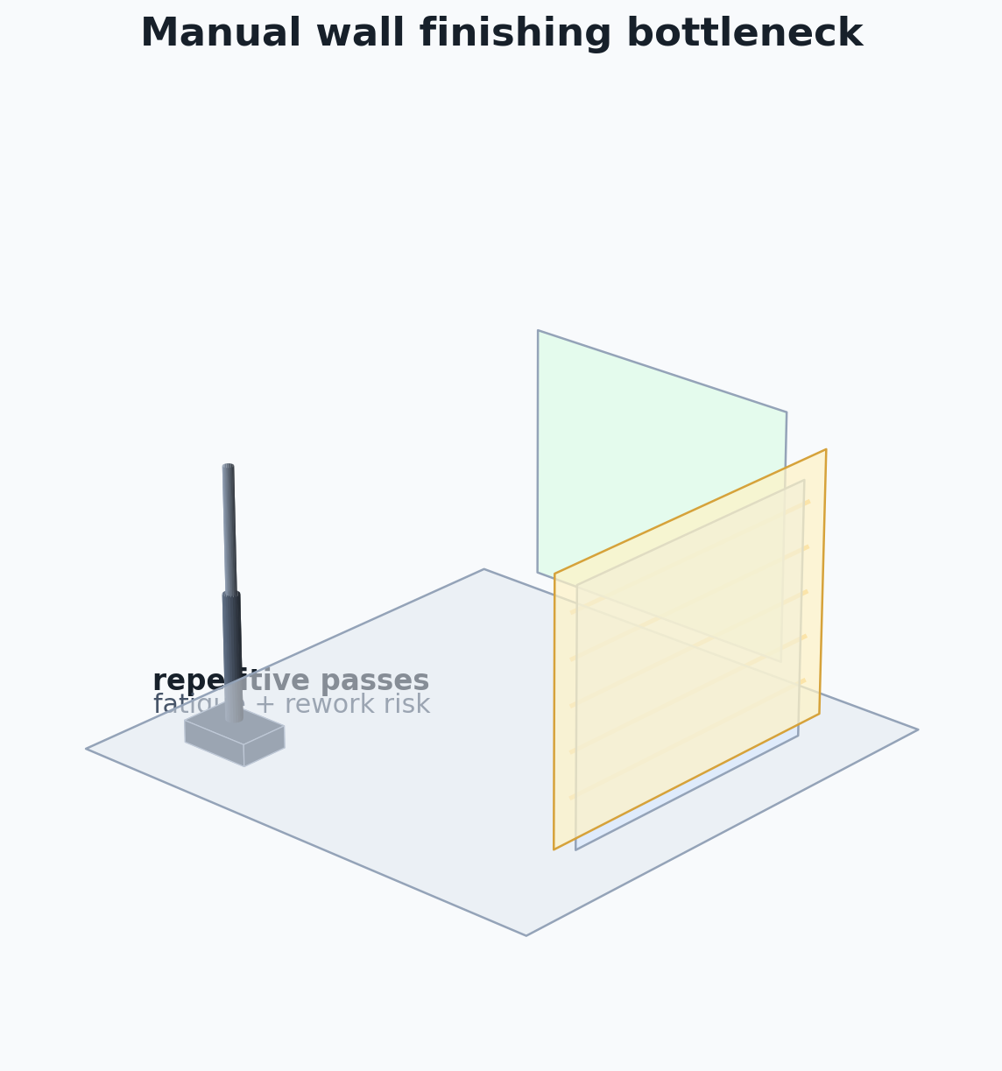
1. THE PROBLEM
Interior painting is still a manual bottleneck.
• Repetitive wall coverage consumes crew hours.
• Quality changes with fatigue, reach, lighting, and setup consistency.
• Labor bottlenecks delay final construction turnover.

Slide 3
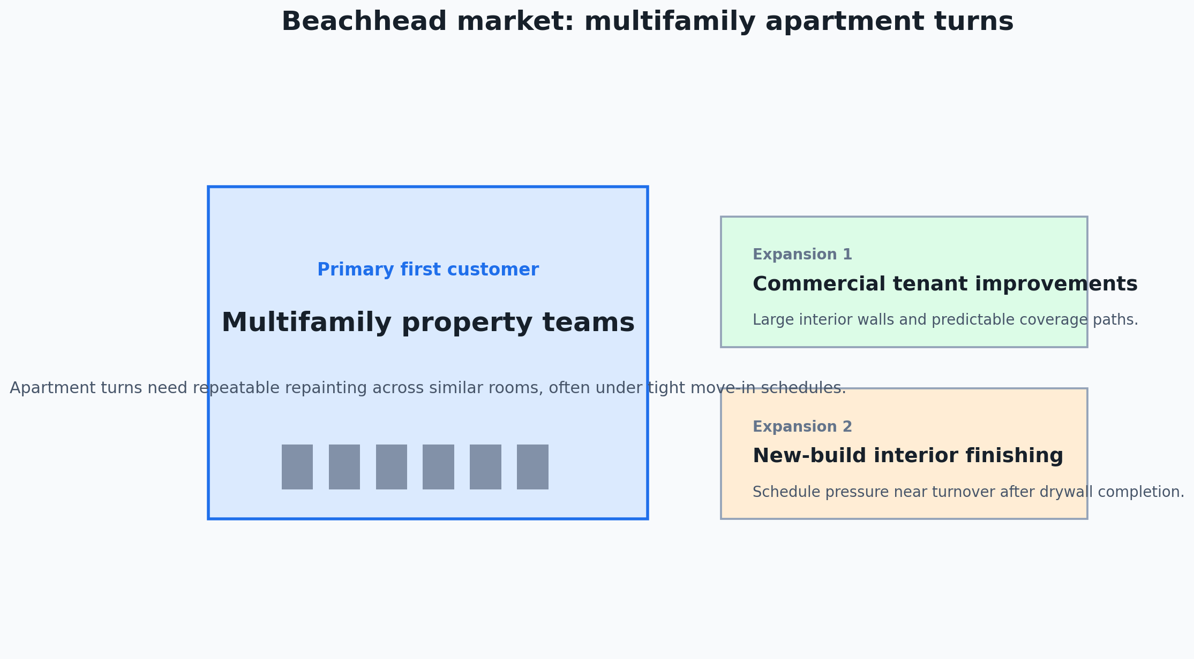
2. WHY IT MATTERS
Construction needs focused automation that helps crews now.
Common task
Painting shows up across apartments, commercial spaces, and new builds.
Repeatable work
Large wall areas create predictable paths that a robot can execute.
Schedule value
Fewer rework passes mean more predictable finishing timelines.

Slide 4
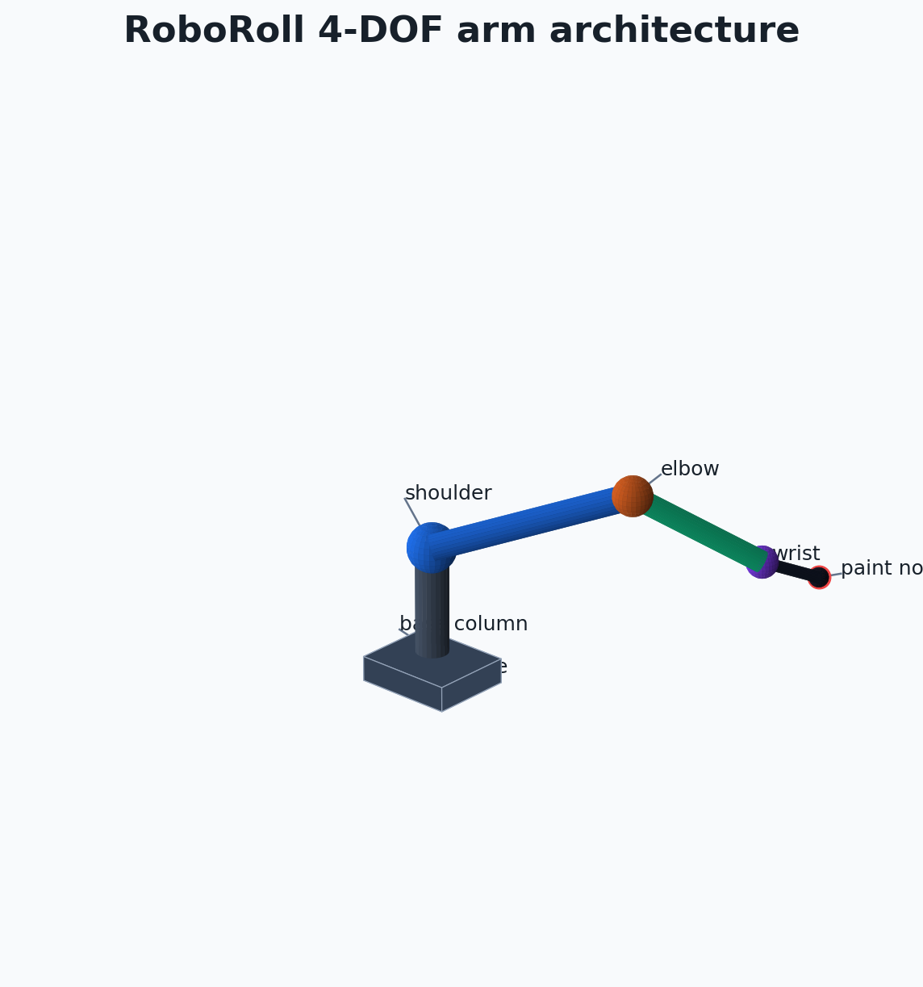
3. THE SOLUTION
A portable 4-DOF robot that follows planned wall paths.
• Base yaw aims the arm around the room.
• Shoulder, elbow, and wrist place the nozzle on target.
• Inverse kinematics converts wall points into smooth joint motion.

Slide 5
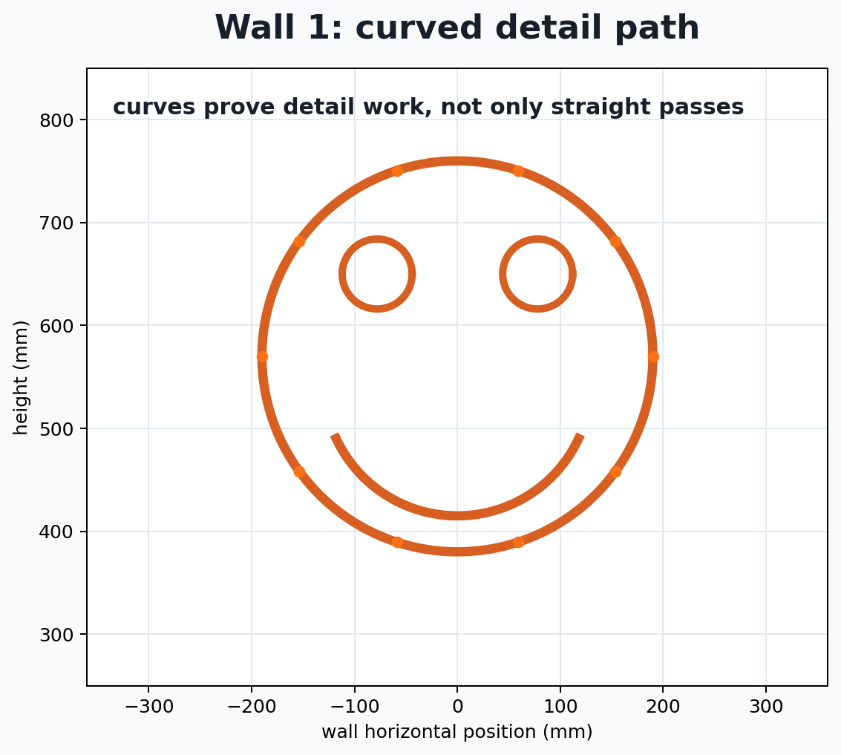
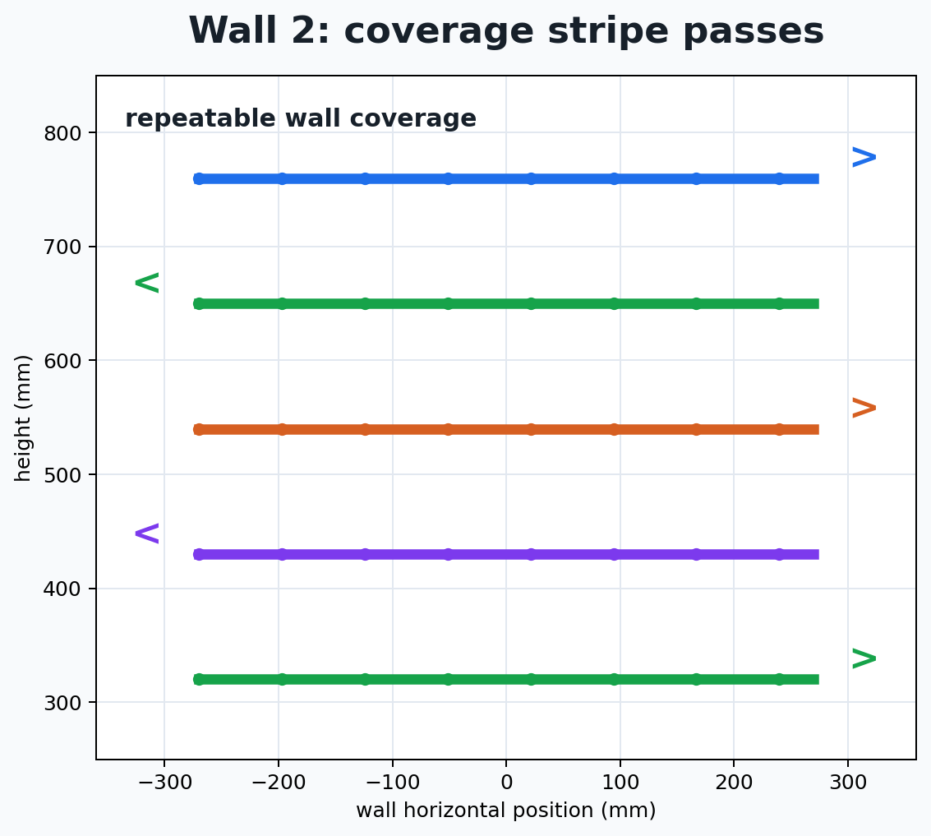
4. PRODUCT DEMO
The simulated robot already paints across two walls.
• Wall 1: smiley face — outline, eyes, and smile arc.
• Wall 2: five horizontal color stripes.
• Curved paths prove more than straight-line coverage.

Slide 6
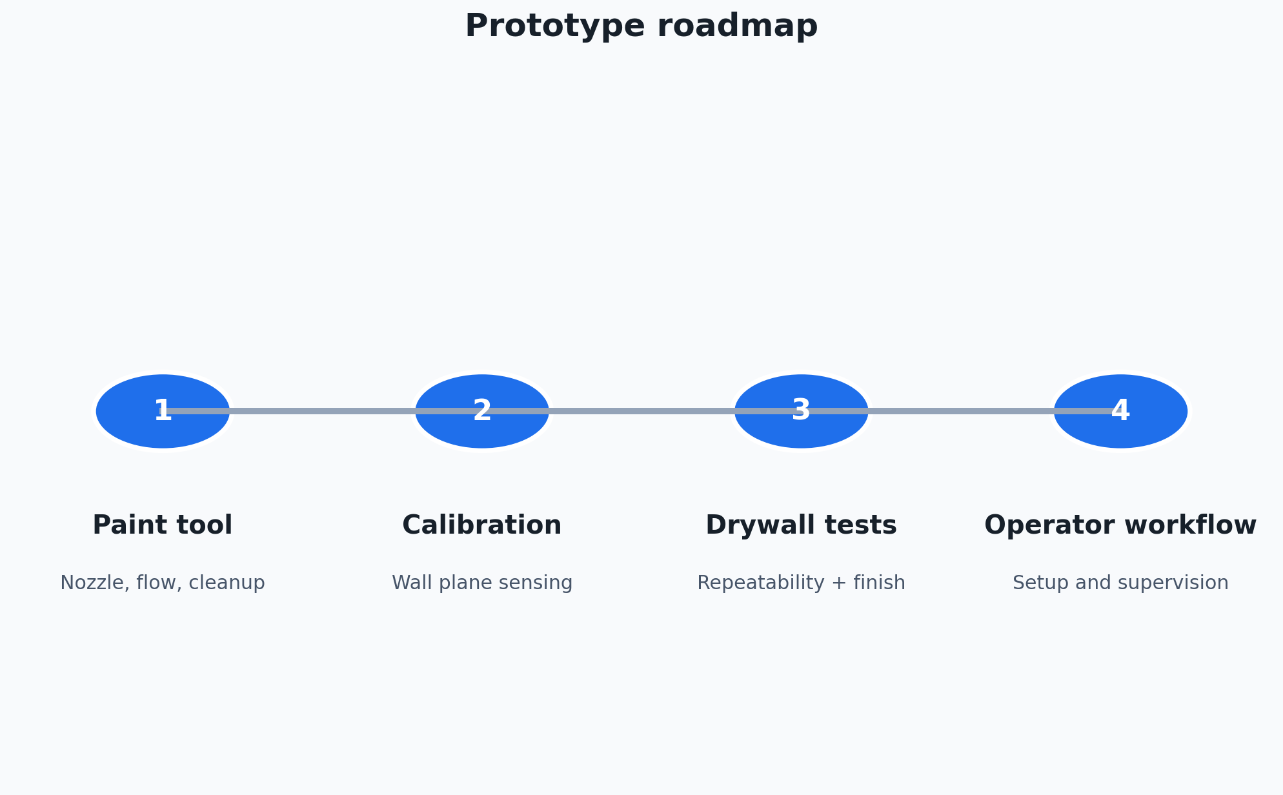
5. WHY WE WIN
RoboRoll starts with one focused construction task.
Focused wedge
Interior wall finishing is narrow enough for a first product.
Technical proof
FK, IK, trajectory generation, and dynamics are already simulated.
The ask
Seed funding turns the validated simulation into a portable prototype.

Slide 7
Thank You
RoboRoll Coatings — robotic painting for the next generation of construction crews.

Slide 8
ADDITIONAL MATERIALS
Leave-Behind Slides
The following slides provide the fuller technical, market, and roadmap story.

Slide 9
A1. BEACHHEAD MARKET
Start with multifamily apartment turns.
Why first
Similar room layouts create repeatable painting paths.
Buyer pain
Turnover schedules are tight; labor availability affects move-in dates.
Next markets
Commercial interiors and new-build finishing once setup is proven.

Slide 10
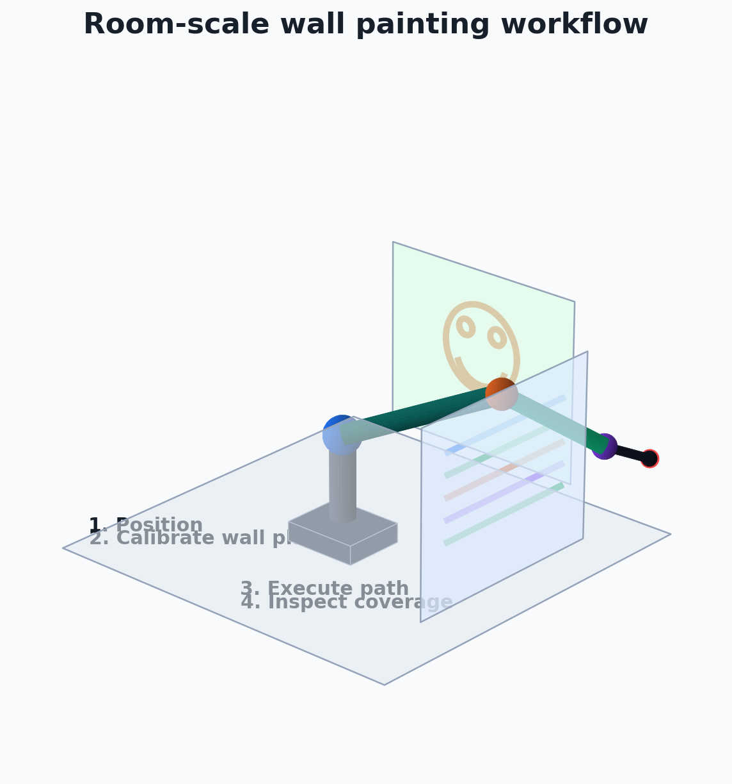
A2. CUSTOMER WORKFLOW
RoboRoll helps one operator supervise repeatable wall coverage.
1 Position
Roll the robot into the room near the target wall.
2 Calibrate
Register the wall plane and reachable painting area.
3 Paint
Execute planned coverage paths with human supervision.
4 Verify
Inspect coverage, refill, and move to the next room.

Slide 11
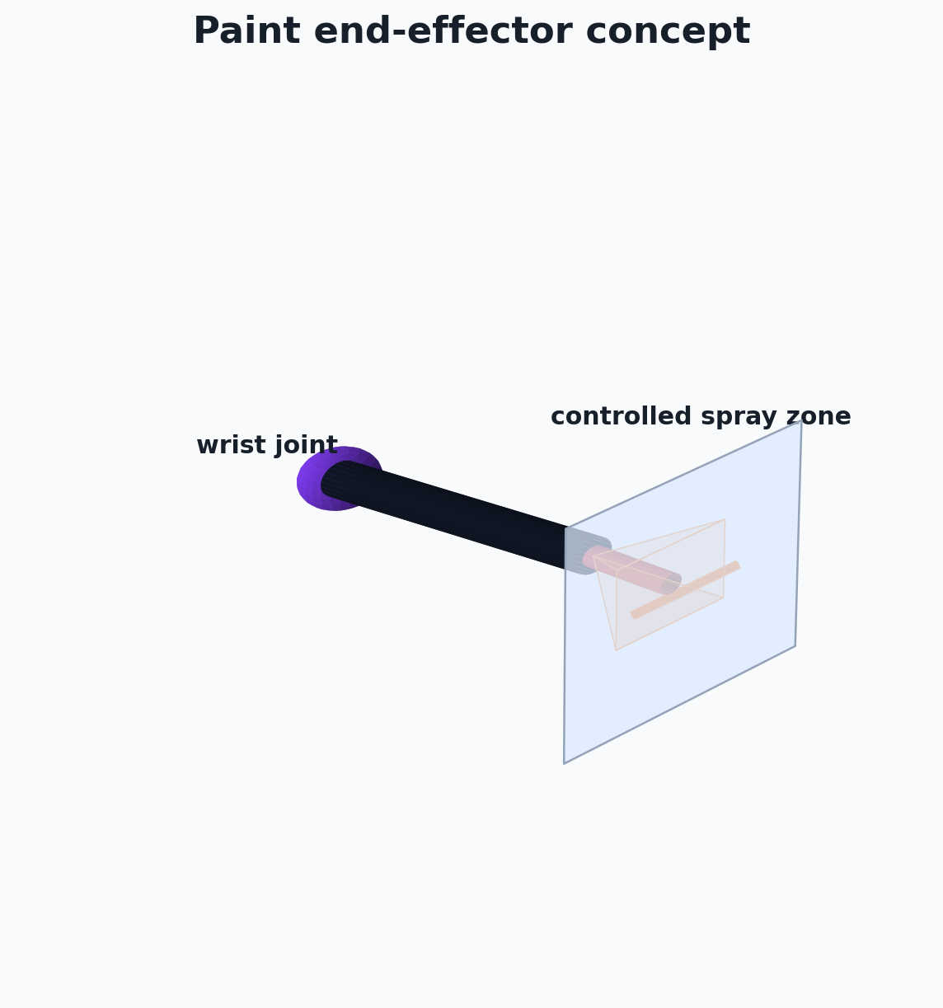
A3. ROBOT ARCHITECTURE
The first design is intentionally simple.
• 4 revolute joints: base yaw, shoulder pitch, elbow pitch, wrist pitch.
• 500 mm base height with 700 mm and 500 mm arm links.
• 200 mm nozzle offset for reaching the wall surface.

Slide 12
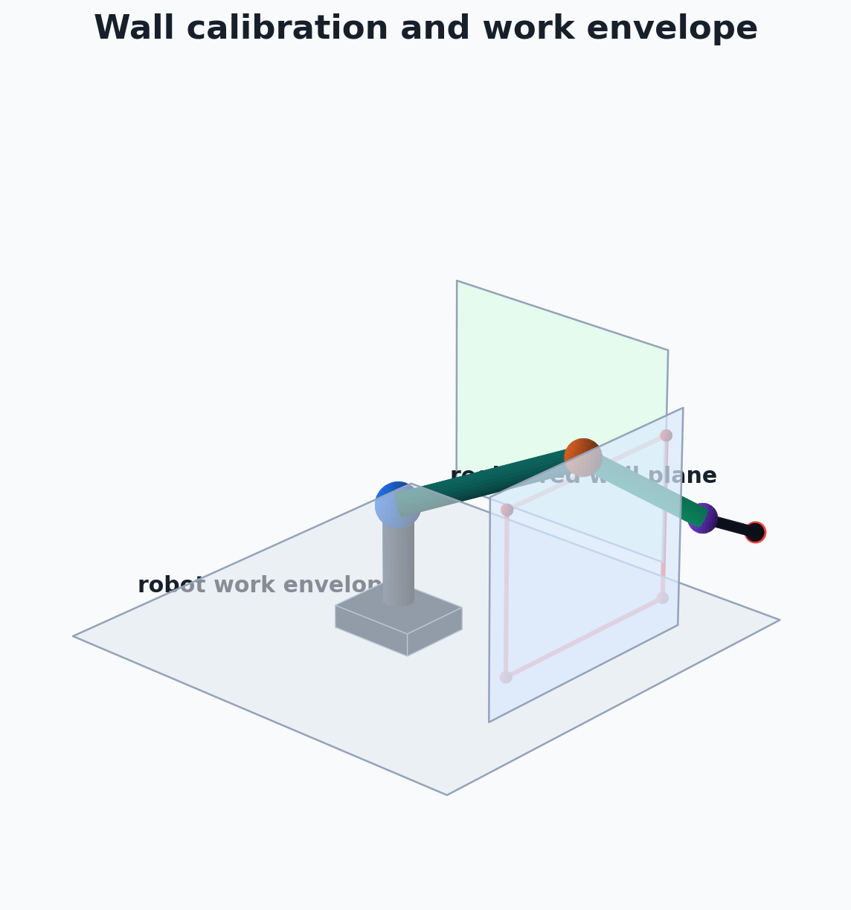
A4. KINEMATICS PROOF
The robot can turn wall targets into joint commands.
• Forward kinematics verifies the end-effector pose.
• Inverse kinematics solves reachable wall targets.
• Joint limits prevent unrealistic poses during planning.

Slide 13
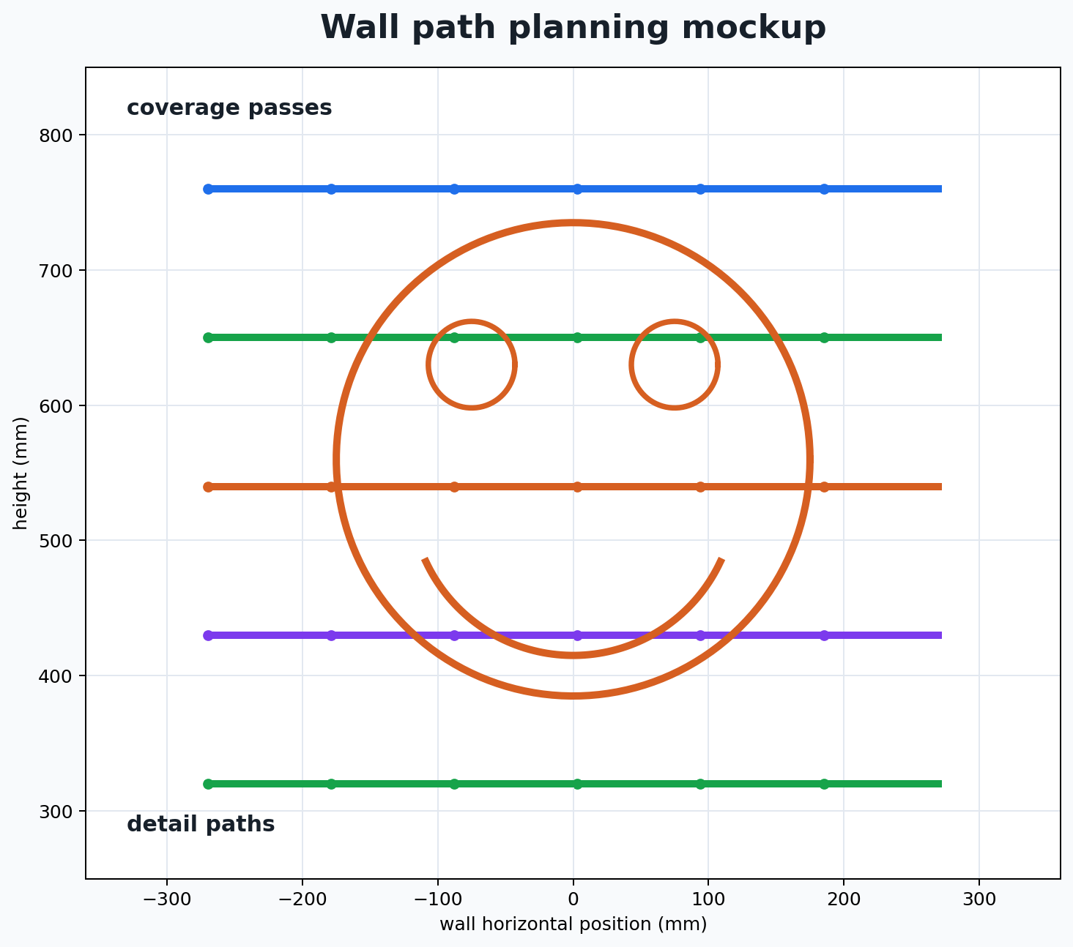
A5. DEMO PATH DETAILS
The demo combines coverage and detail work.
• Hundreds of rendered frames across both walls.
• Smoothstep interpolation between IK waypoints.
• Lift motions prevent unwanted diagonal paint marks.

Slide 14
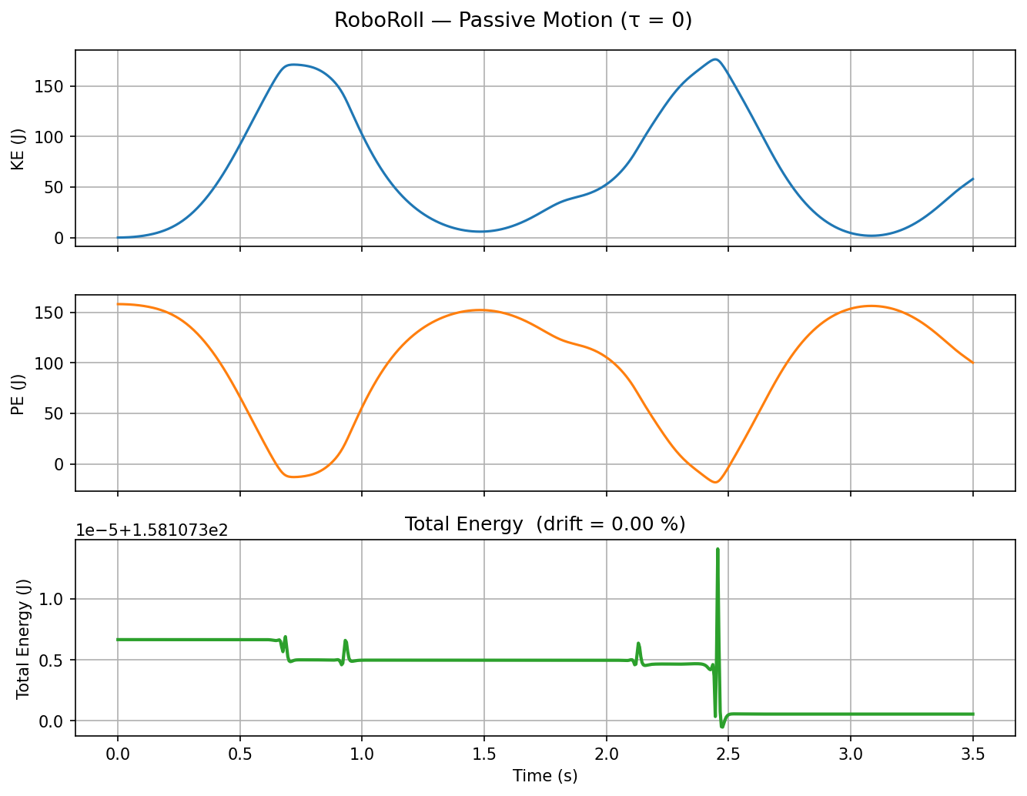
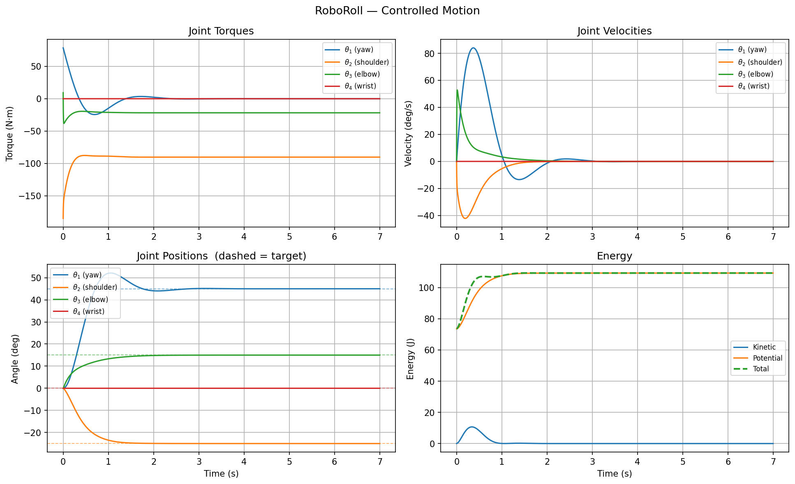
A6. DYNAMICS PROOF
The simulation includes physical reasoning.
• Passive motion checks kinetic, potential, and total energy behavior.
• PD plus gravity feedforward controls motion to a painting target.
• Torque and velocity plots support physically reasonable motion.

Slide 15
A7. DEVELOPMENT ROADMAP
The next milestones move from simulation to hardware.
End effector
Prototype paint delivery and nozzle control.
Calibration
Add wall sensing and room registration.
Testing
Measure repeatability on drywall panels.
Workflow
Build the operator setup process.

Slide 16
A8. RISKS AND MITIGATIONS
The key risks are practical and testable.
Surface quality
Test nozzle spacing, flow rate, and overlap on drywall panels.
Wall localization
Add sensing and calibration before each room run.
Setup time
Design a simple operator workflow with repeatable presets.
Safety
Limit speed, add supervised operation, and define a work envelope.

Slide 17
A9. FUNDING USE
Funding turns the validated simulation into a prototype.
Arm
Build a first portable mechanism.
Paint tool
Integrate nozzle, flow, and cleanup hardware.
Sensing
Add wall plane detection and calibration.
Testing
Run repeatability and finish-quality trials.

Slide 18
A focused wedge into construction automation.
RoboRoll begins with repeatable interior painting, proves value in controlled room-scale tasks, and expands toward broader finishing automation.

