Slide 1
That Group
Nestor Almanza
Irving Arredondo
Daniel Childs
Luis Santos
Herald Chris Villarreal

Slide 2
Daniel Childs
XML schema
XML instance
Import
GAE models

Slide 3
XML Schema/Instance
Our phase 1 schema vs. chosen schema:
Flexibility with required fields
Flexibility with multiple occurrences of data types
Conclusion
Flexibility is good, but uniformity might be better
Changing our instance was TEDIOUS!

Slide 4

Import (Replacement)
Simple – clears GAE datastore and executes merge import
Seemed inefficient, but effects on performance/quota were negligible

Slide 5
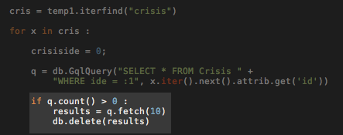
Import (Merge)
Used the id to determine uniqueness
Pros:
Simple
Fast
Low risk of overwriting unrelated content
Cons:
Duplicates possible

Slide 6
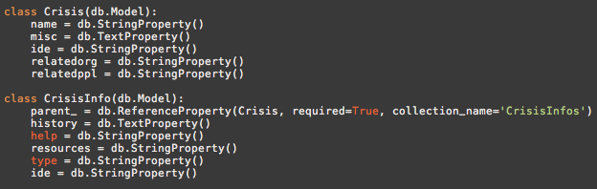
GAE Models
Used GAE’s ‘reference property’ to construct a hierarchal model for the data
Useful for referencing custom types (i.e. ‘crisisType’ type contains certain other types)

Slide 7
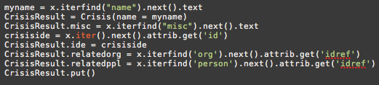
GAE Models (cont.)
Populated models using Element Tree’s iterFind() capability for elements and attrib.get() for attributes
Surprisingly effective – no need to find a “more efficient” approach

Slide 8
Herald Chris Villarreal
Helped with some backend (models, import, etc)
HTML template
Django templates
Dynamic pages

Slide 9
Site Design
Simple and easy to navigate
Familiar (IMDb clone)
Made from scratch
JS used: Nivo slider & Top Up
Templates: Home, lists, pages
Django populates pages/lists
Different page aspects

Slide 10
Nestor Almanza
XML validation
Static HTML
GAE Models

Slide 11
Luis Santos
UML Diagrams
Import
Dynamic Pages

Slide 12
Irving Arredondo
Technical Report
Export
Static HTML
GAEUNIT tests

Slide 13
Export
Phase 1: saved uploaded xml in a global variable
Easy
No need for models
Hint helped:
self.response.content_type = "text/xml"

Slide 14
Export
Phase 2: needed to export from models
All info was in models
Query models for info
Turned into a long mess
Everything in get method

Slide 15
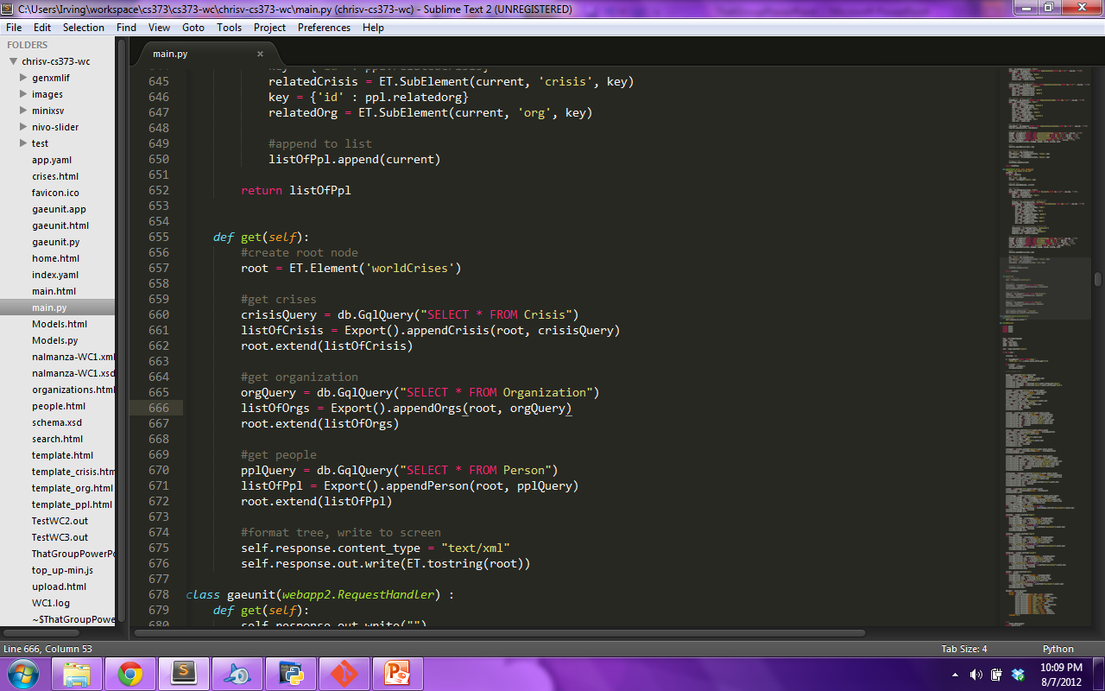
Export
Phase 3: needed to refactor
Get method became only a few lines

Slide 16
Export – Phase 3
Looked for common structures in data models
Made these to methods
Sent the queries to them

Slide 17
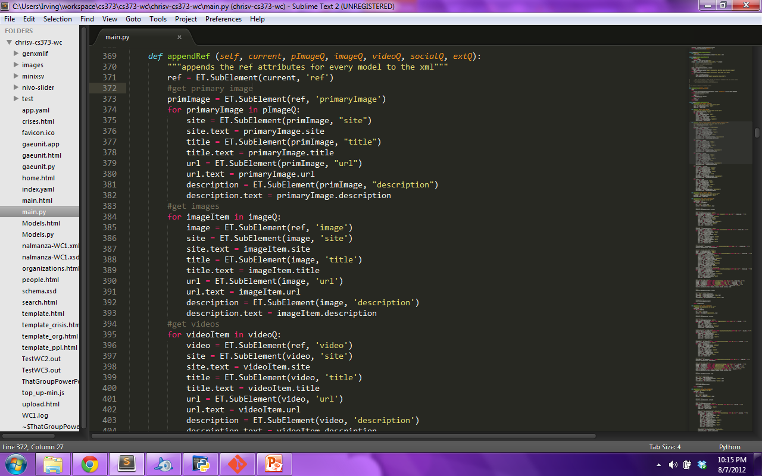

Slide 18
Export
Slow
Uses a lot of quota
Could create a cache?
Liked this idea from another group

Slide 19
GAE unit tests
Total of 28 tests
Tried having 3 for every function
Trouble at first

Slide 20
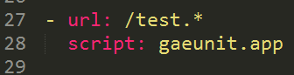
Wrong instructions
Instructions said to set it as gaeunit.py
We had to set it as gaeunit.app

Slide 21
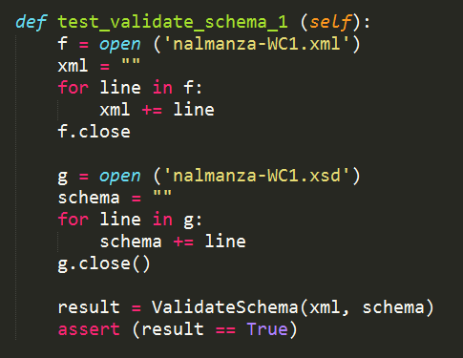
Format of Tests
Simply passed arguments to functions in main.py
Example -->

Slide 22
“All the Single Ladies’” Critique – What did they do well?
Easy navigation
Simple design

Slide 23
“All the Single Ladies’” Critique – What did we learn?
Straight to the point
Import
Think of all possibilities
Make 108 unit tests
Necessary to extensively test website

Slide 24
“All the Single Ladies’” Critique – What can they do better?
Export is slow
Improve design?
Home page lacking
More attention grabbers
Layout changes with resolution

Slide 25
“All the Single Ladies’” Critique – What puzzles us about their app?
Note saying status in import
Good idea
Although we like their import
Simplification
Too much responsibility for user

Slide 26
What Did We Do Well?
Created easily navigated website
Literal representation of IMDB
Chose interesting topics

Slide 27
What Did We Learn?
Teamwork
Communication
New Set of Tools
Learn from Documentation

Slide 28
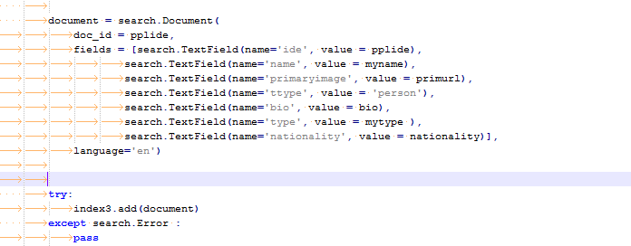
Search
Google App Search
Searchable Documents
Created on import while parsing XML
No need for models

Slide 29
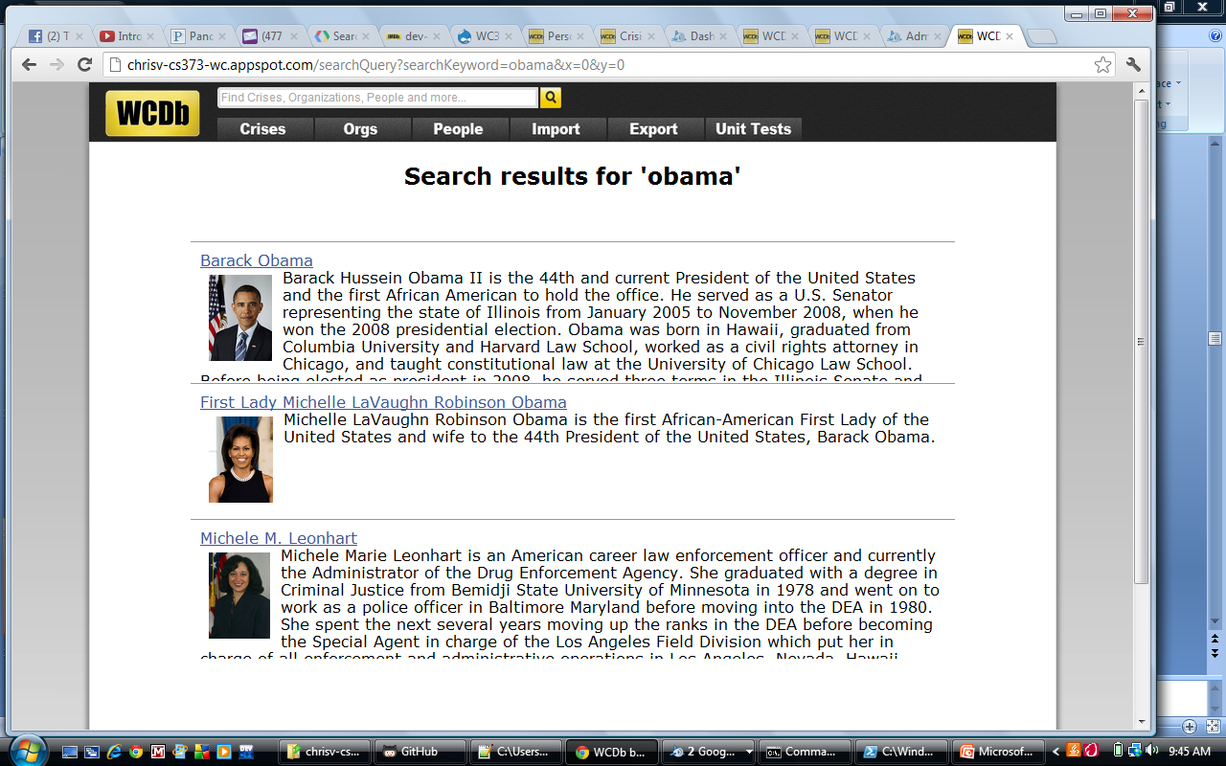
Search
Google App Search
Snippets
Weren’t working
AND / OR results

Slide 30
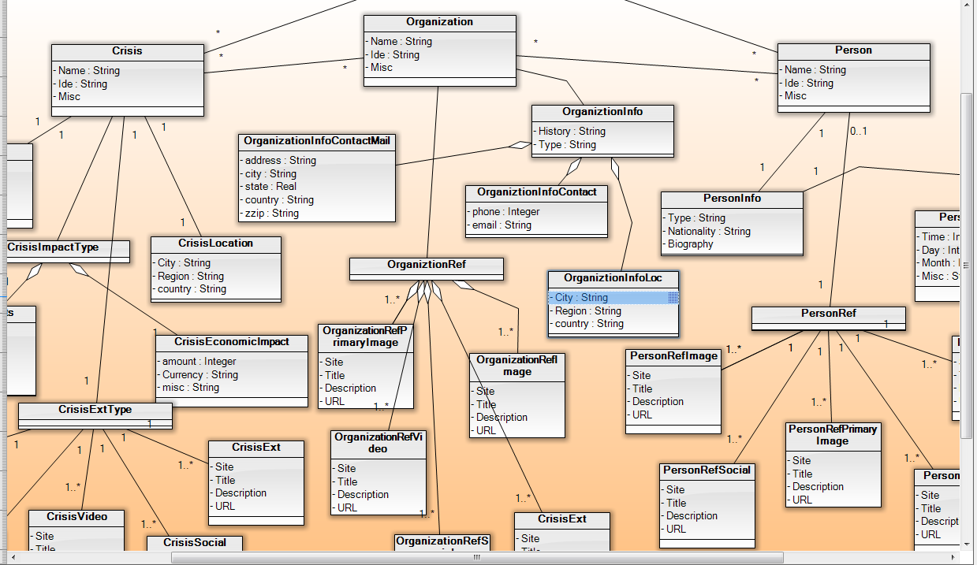
UML Diagrams
Software Ideas modeler
Models

Slide 31
What Can We Do Better?
Make dynamic pages more efficient
Make export more efficient
Document our functions more clearly

Slide 32
What Puzzles Us?
Making a form input
Liked this idea from another group
Highlight keywords in search
Password protect certain privileges
Liked this idea from another group

