Slide 1
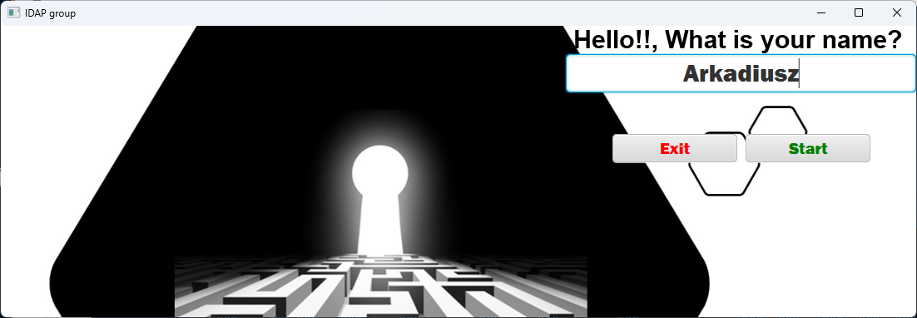
CodeCool
WAW.2022.04
BRAIN RESET part 2 – time to spice JAVA

Slide 2





intelliJ IDEA
GITHUB
JAVA
JAVAFX
TOOLS
JAVAFX

Slide 3
Participants
Arkadiusz Bojara
WARSAW
Join Codecool April 24th 2022.

Slide 4
General INTRO
Simple like 2+2 = 4
You have to find THE key allowing you enter next level
You can increase your power by collecting sword
You can increase your protection by collecting shield
You can refresh your live by collection other item
Please note - do not drink everything.

Slide 5
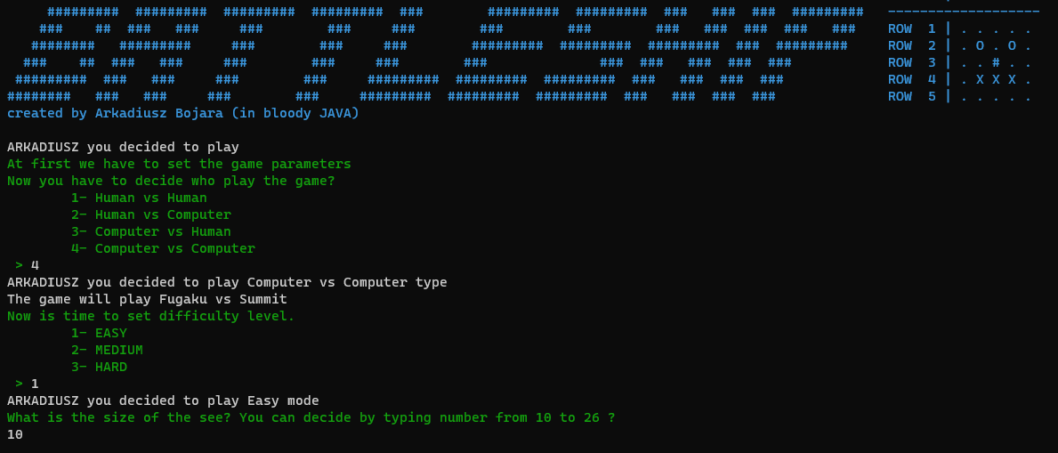
START - PARAMETERS

Slide 6
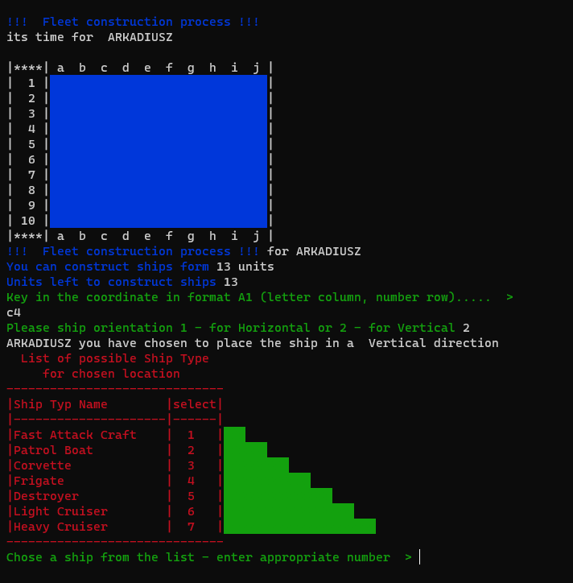
START – SHIP PLACEMENT
The system helps to set the board.
User point the starting coordinates and system show availlable options. EXAMPLE = C4
The system helps to set the play board. User points the starting coordinates and direction of the ship and system show available option.

Slide 7
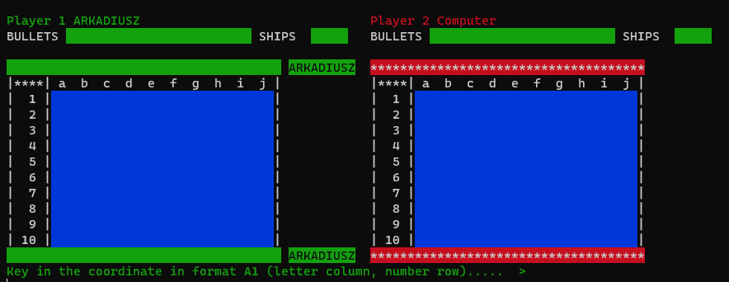
GAME PROCESS - Shooting phase
GREEN bar and name between boards indicates whose turn is now
RED bar indicates next player

Slide 8

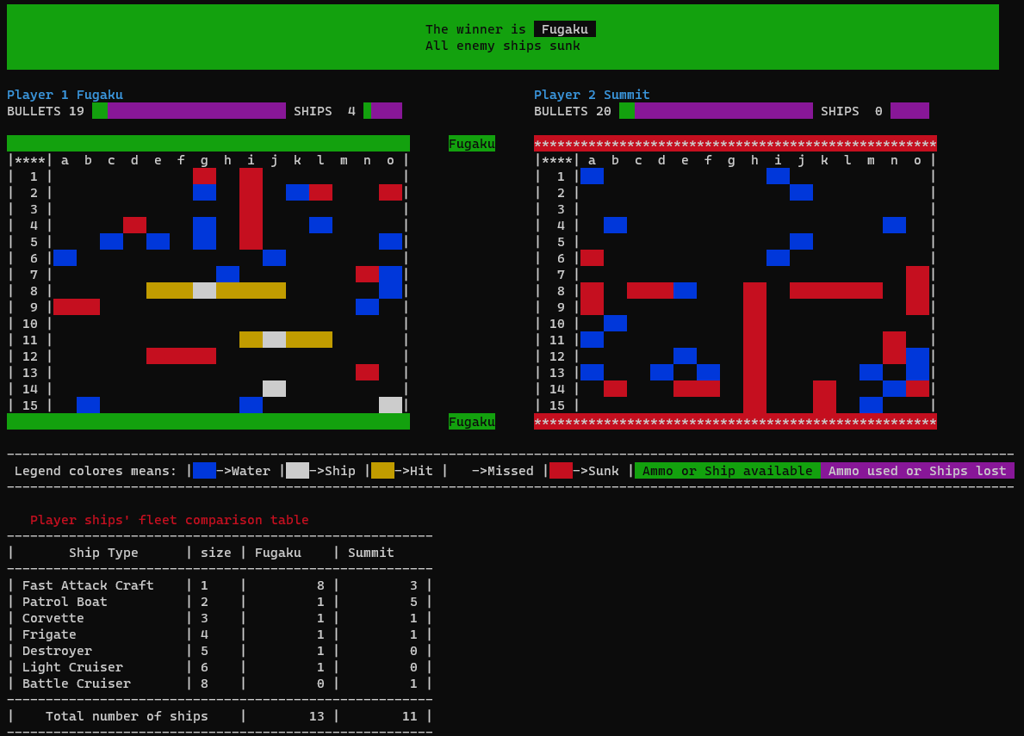
WINNING
Final information who won the game and why
Green bar
highlights the winner board
Legend colores used
Fleet comparison table

Slide 9
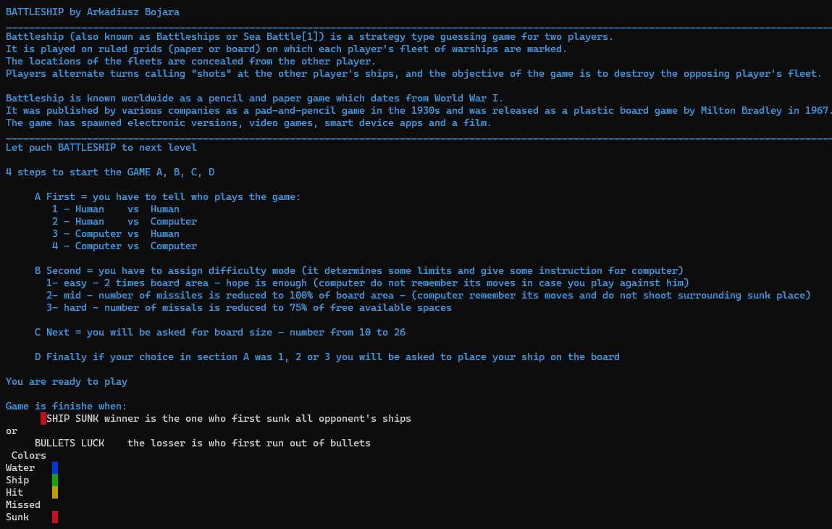
HELP

Slide 10

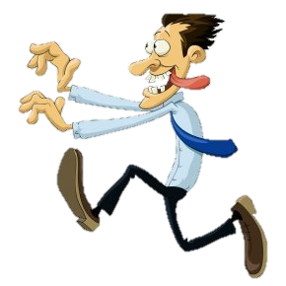

JAVASCRIPT
TEAM APRIL 2022
Our Filip

Slide 11


JAVA is not that BAD AS JAVASCRIPT

Slide 12
SPECIAL THANKS
Filip Nożkiewicz for his efforts during 6 months of teaching and consulting.
Bartosz Rzemek for his vital help during consultations enabling the reduction of the justified level of criticism of our Filip in the assessment of the solutions presented.

