Slide 1
input4 | input3 | input2 | input1 | output
0 | 0 | 0 | 0 | 0 | 0
0 | 0 | 0 | 1 | 1 | 1
0 | 0 | 1 | 0 | 0 | 2
0 | 0 | 1 | 1 | 1 | 3
0 | 1 | 0 | 0 | 0 | 4
0 | 1 | 0 | 1 | 1 | 5
0 | 1 | 1 | 0 | 1 | 6
0 | 1 | 1 | 1 | 1 | 7
1 | 0 | 0 | 0 | 0 | 8
1 | 0 | 0 | 1 | 1 | 9
1 | 0 | 1 | 0 | 1 | 10
1 | 0 | 1 | 1 | 1 | 11
1 | 1 | 0 | 0 | 0 | 12
1 | 1 | 0 | 1 | 1 | 13
1 | 1 | 1 | 0 | 1 | 14
1 | 1 | 1 | 1 | 1 | 15

Slide 2
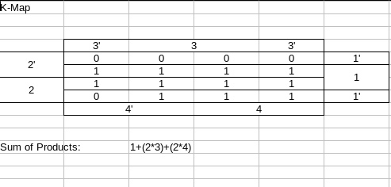

Slide 3
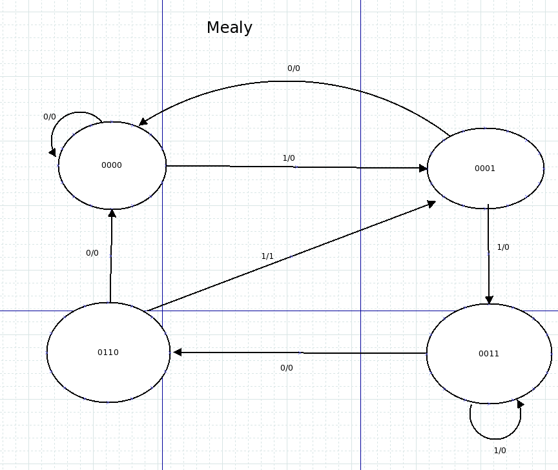
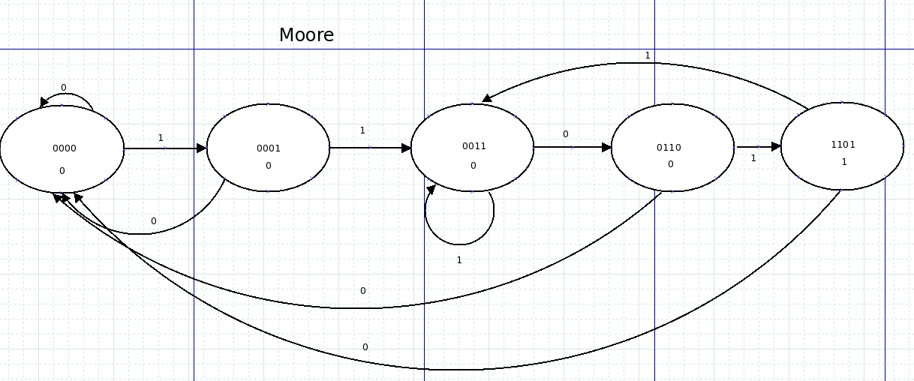

Slide 4
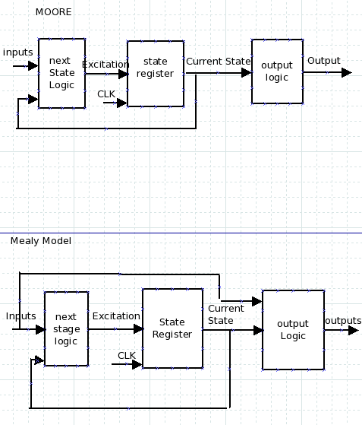
synchronizer
signal
reg
d1
reg
d2
D
Q
D
Q
Clk
Clk
nRst
nRst

Slide 5
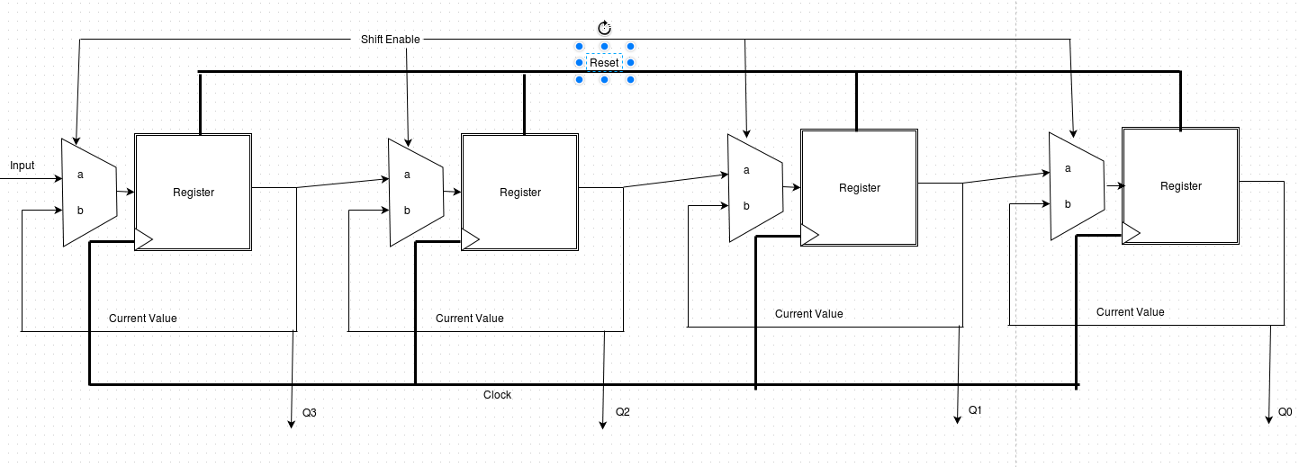
RTL for Serial to Parallel

Slide 6
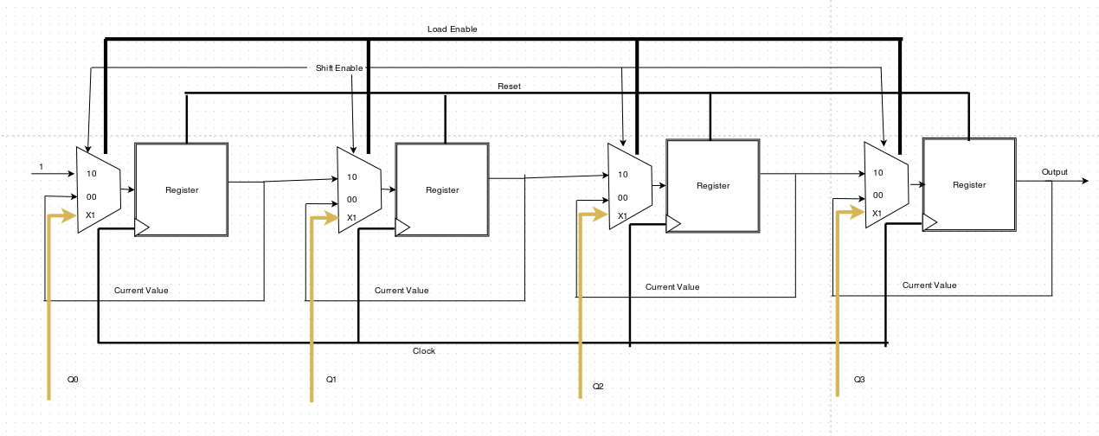
RTL for Parallel to Serial

Slide 7
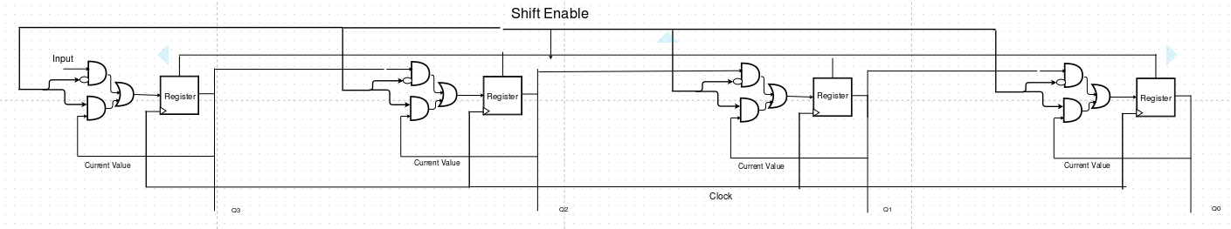
Schematic for Serial to Parallel

Slide 8
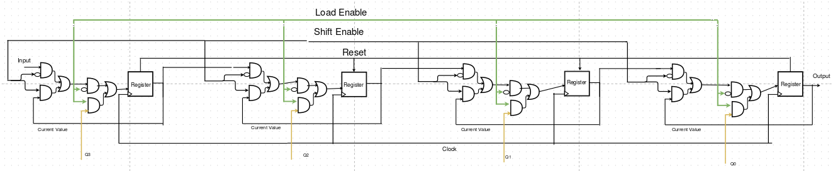
Schematic for Parallel to Serial

