Slide 1
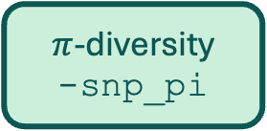
Alignment
Pangenome Synteny
-synteny
Gene annotation
-annogroup <path>
Genes
Alignment Summary
Consensus Sequences
-consensus
Compare SVs with other Sequences
-sv_sim <file>
SNPs
-snp
SVs
-sv
SNP-related
SV-related
$π$-diversity
-snp_pi
SV Families
-sv_family
ORFs in SVs
-sv_orf

Slide 2
Alignment
Pangenome Synteny
-synteny
Gene annotation
-annogroup <path>
IV
I
Consensus Sequences
-consensus
Compare SVs with other Sequences
-sv_sim <file>
SNPs
-snp
SVs
-sv
II
III
$π$-diversity
-snp_pi
SV Families
-sv_family
ORFs in SVs
-sv_orf

