Slide 1


Atypical handedness in bipolar disorder: a genetic and clinical study
Inés García-Ortiz
19th May 2026
Neurogenetics lab

Slide 2
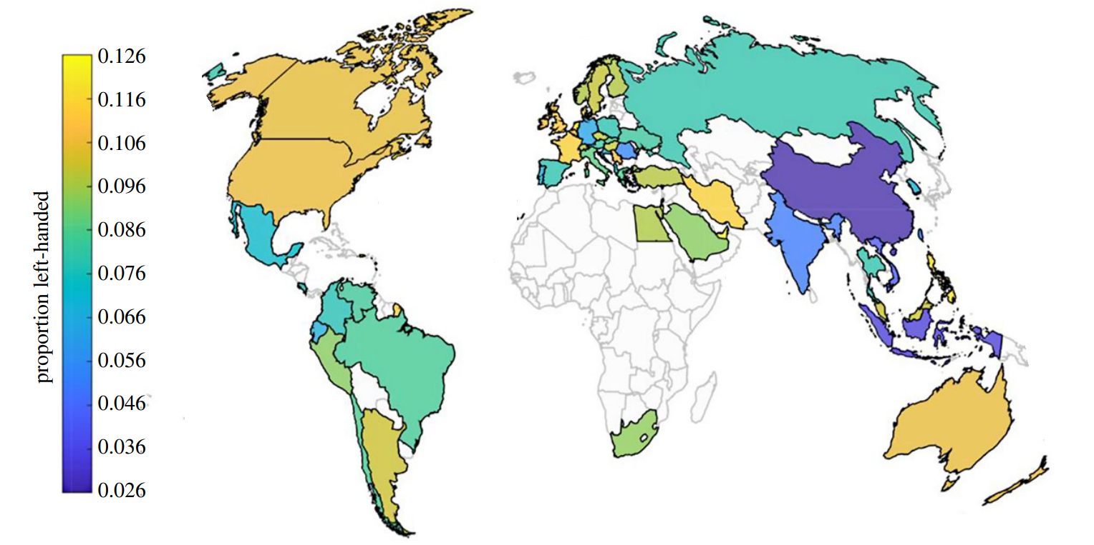
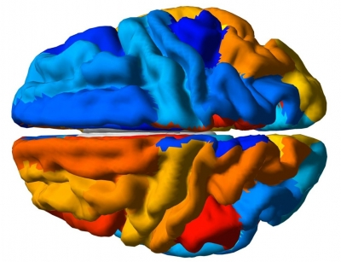
Handedness in general population
Introduction
Left-handed: around 10%
Sex differences: 12% men, 8% women
Non-right-handedness (NRH): ~18%
Different brain asymmetry patterns

Slide 3
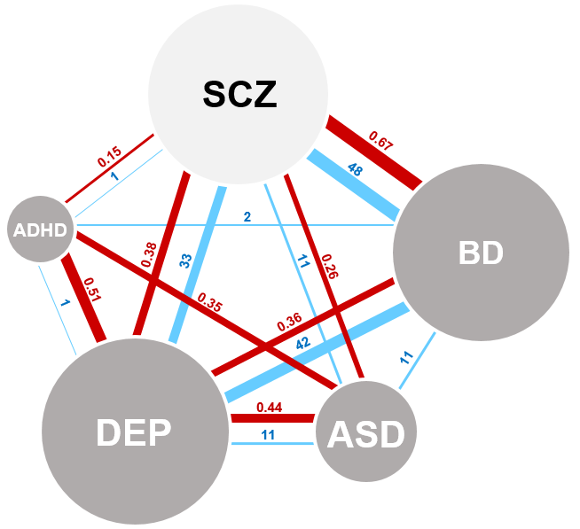
Handedness in neurodevelopmental and psychiatric disorders
Introduction
High genetic + clinical overlap between mental disorders
Schizophrenia (SCZ)
Left-handed: ~20%
NRH: ~35%**
Depression (DEP)
NRH: 18%
Bipolar disorder (BD)
???
Autism (ASD)
NRH: ~35%**
No concordant pattern:
Small sample sizes
Lack of clinical data
Diverse measurements
0.67 genetic correlation SCZ v BD
48 shared symptoms
ADHD
NRH: ~25%*

Slide 4
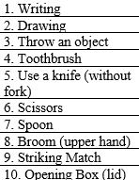
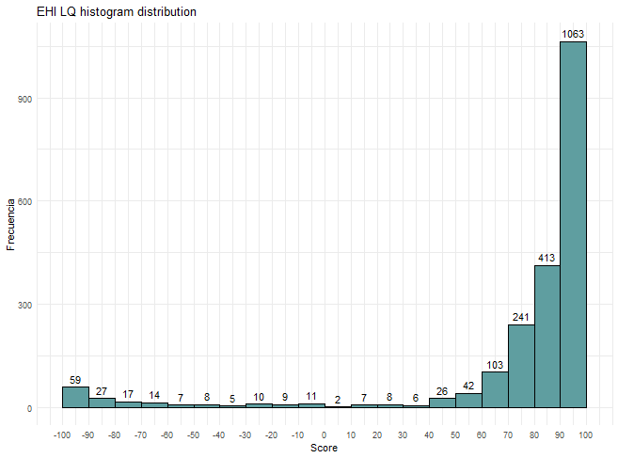
Edinburgh Handedness Inventory
Introduction
EHI: What hand do you use for…
Writing
Drawing
Throw an object
Use a toothbrush
Use a knife (without fork)
Use scissors
Use spoon
Upper hand to broom
Strike a match
Open the lid of a box
-100
0
+100
LQ
Left
Right
NRH
Left
Mixed
Right
Non-lateralized
Right Score -Left Score
Right Score +Left Score
Lateralization Quotient (LQ)
=
Lateralized

Slide 5
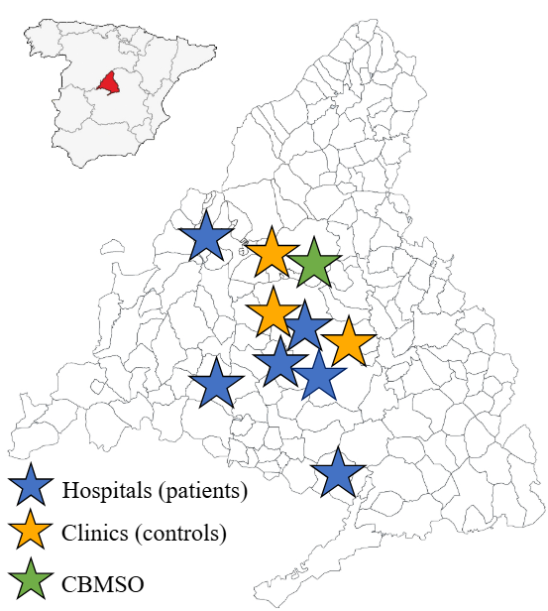
MadManic cohort
M&M
> 400 BD patients, > 1,800 controls
Deep phenotyping
BD subtype + clinical features (e.g. psychosis, rapid cycling…)
Behaviour -> EHI
Severity scales: WHODAS, CGI, Index of Number of Events and Severity (INES), GAF
Genotyping, RNAseq, epigenomic profile
MadManic cohort map
Do BD patients present atypical handedness patterns?
Notes:
Recruitment ongoing
Mention that there are also behavioural scales for controls

Slide 6


Exploratory prevalence analysis
Results
Case-control (433 BD, 433 controls*)
Subtle increased mixed-handedness in BD (8.31%) compared with controls (4.62%)
Greater preference for left eye and foot
Within BD
No sex differences in hand-use patterns
Trend between BD subtypes
Atypical handedness associated to severity
Control group (N=1,707)
Similar left ratios as other studies
Sex differences
Age differences
Mixed-handedness [-60, 60]
Notes:
The age differences point to the need of age-match data to study comparisons with other groups (BD)

Slide 7
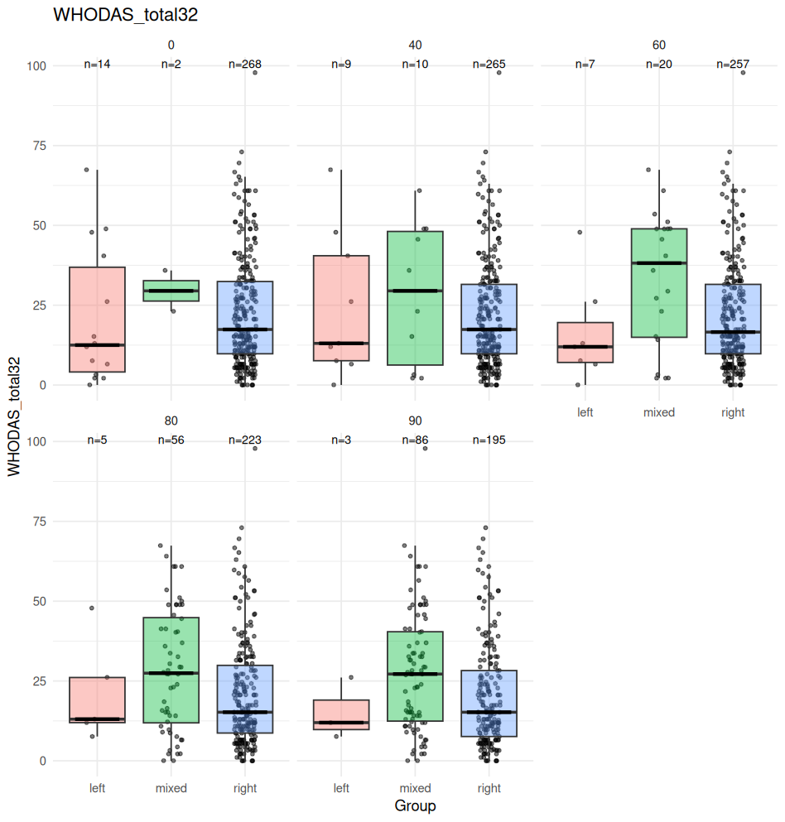
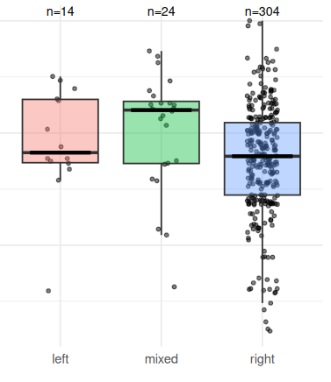
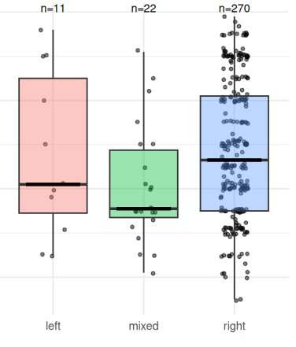
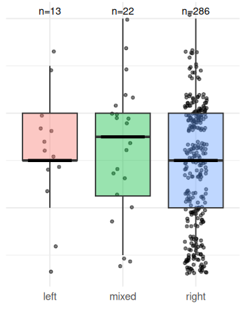
Severity scales by hand groups
Results
WHODAS
WHO Disability Assessment Schedule
P=0.01*
INES
Index of Number of Events and Severity
P=0.007**
N= 284-342
Test of proportions:
Mixed-handed vs lateralized (left + right)
GAF
Global Assessment of Functioning
P=0.01*
CGI
Clinical Global Impression
P=0.1
Mixed-handedness [-60, 60]
Notes:
GAF is inverse-scored

Slide 8
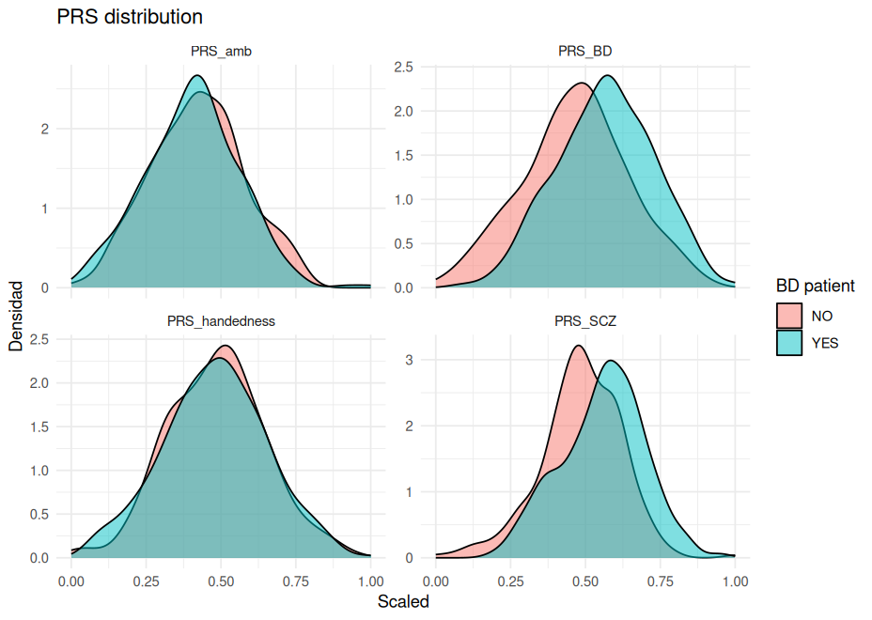
Discussion
BD subgroups present different handedness patterns
Lack of sex differences in handedness in BD
Next step: integrate PGS
Control
BD

Slide 9
Thank you for your attention! Any questions?

