Slide 1
Laterality Project
May 2026

Slide 2
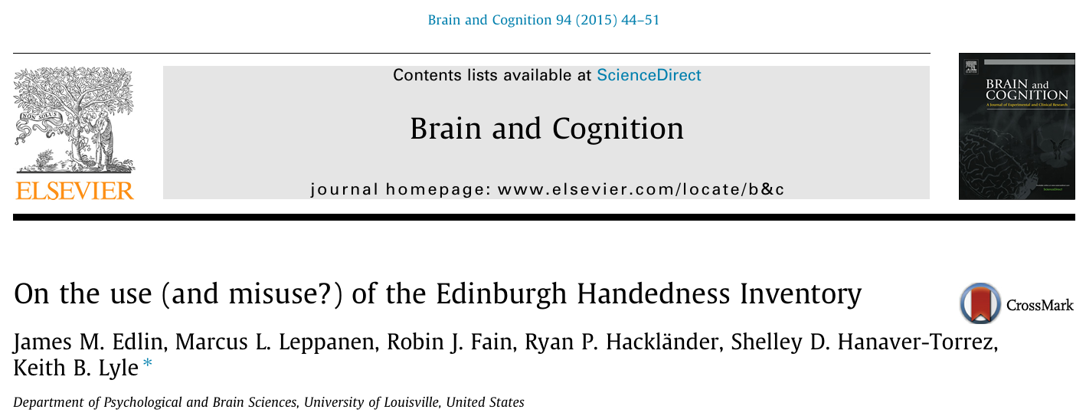
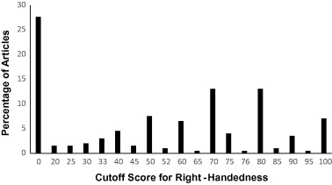
Where to set the threshold?
https://doi.org/10.1016/j.bandc.2015.01.003

Slide 3
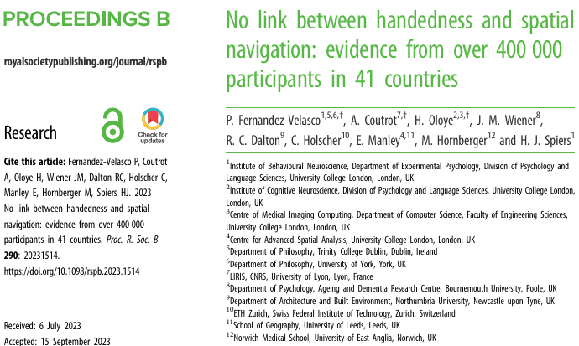
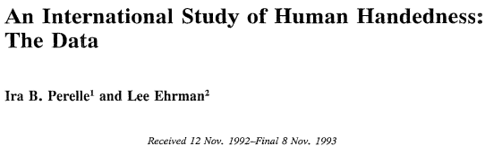
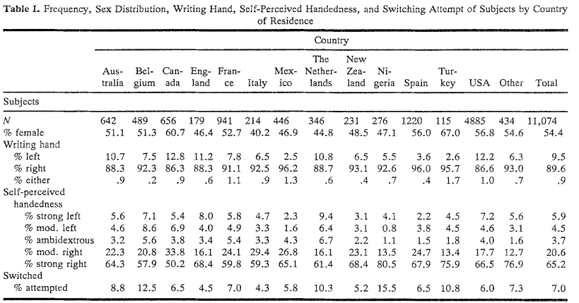
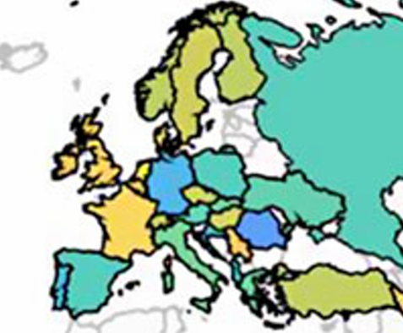
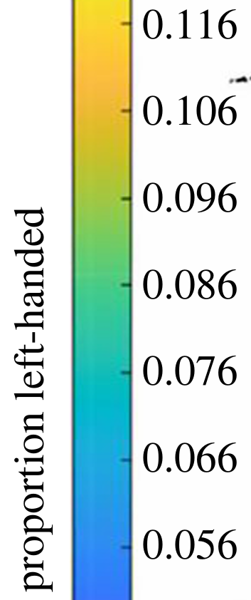
Left-handers prop in Spain
https://doi.org/10.1098/rspb.2023.1514
https://doi.org/10.1007/BF01067189

Slide 4
GWAS handedness
Page 9: Sex and age were included as covariates in all models. We performed four analyses: (1) right- versus lefthanded; (2) right versus ambidextrous; (3) right- versus left-handed (male only); and (4) right- versus left-handed (female only)

Slide 5
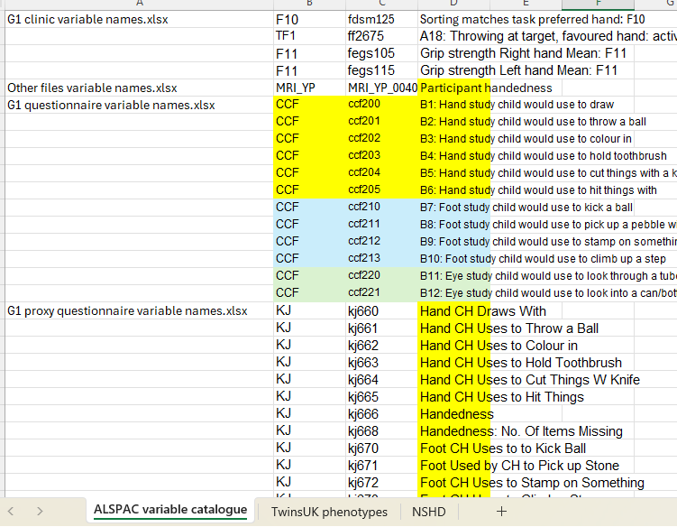
Cohorts: ALSPAC
84 ítems to consider regarding hand or other lat markers
UPDATE: Matched with available info in Silvias Excel workbook

Slide 6
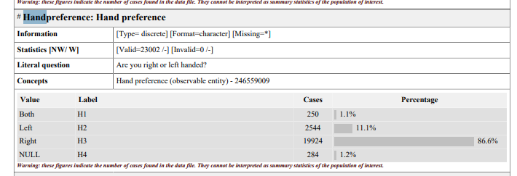
Cohorts: NIHR Bioresource
https://www.bioresource.nihr.ac.uk/media/4url1uzq/hlq_generic-health-and-lifestyle-questionnaire_20210902_1-6.pdf

Slide 7
Cohorts: Twins UK

Slide 8
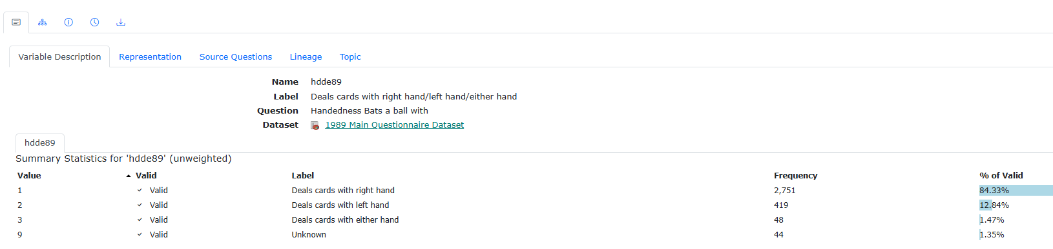
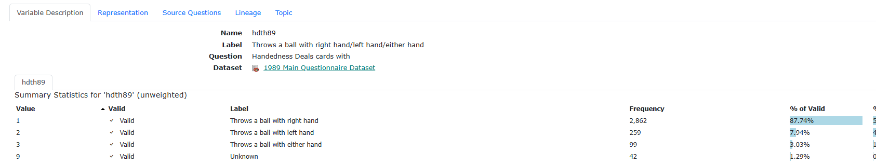
Cohorts: NHSD -> Main questionnaire 1989
Question associated doesn’t always match to label. Label matches with posible answers.

Slide 9

Cohorts NHSD: Handedness
Grip strength assessed later on life
Details on hand use were assessed on 1989 (age 43).
Name | question | either hand | left hand | right hand | Total for this question | % either hand | % left hand | Average either hand | Average left hand
hdwr89 | handedness writes with | 19 | 293 | 2,921 | 3233 | 0.5876 | 9.062 | 1.948 | 9.03
hdmt89 | strikes a match with | 61 | 273 | 2,886 | 3220 | 1.894 | 8.478
hdth89 | throws a ball with | 99 | 259 | 2,862 | 3220 | 3.074 | 8.043
hdbt89 | bats a ball with | 80 | 274 | 2,861 | 3215 | 2.48 | 8.522
hdte89 | handedness brushes teeth with | 60 | 264 | 2,894 | 3218 | 1.86 | 8.203
hdha89 | handedness hammers a nail with | 72 | 254 | 2,891 | 3217 | 2.23 | 7.895
hdde89 | handedness deals cards with | 48 | 419 | 2,751 | 3218 | 1.49 | 13.020

Slide 10
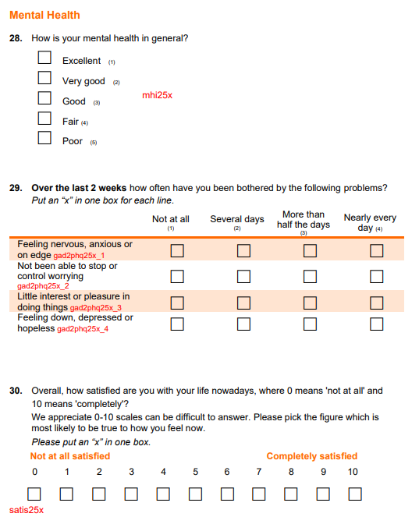
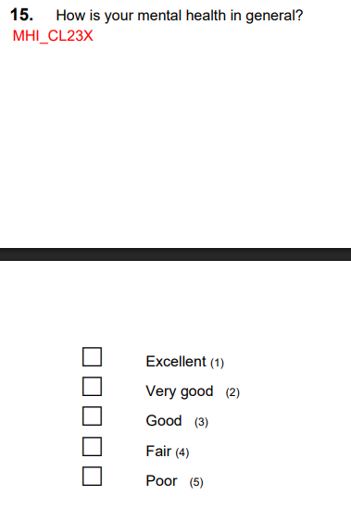
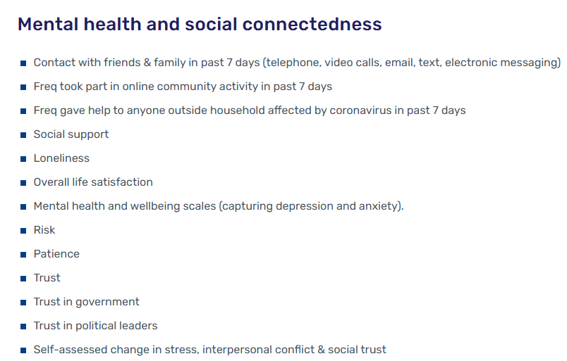
Cohorts NHSD: Mental health
2025: 2 pages about mental health, but no diagnostics
2023 Cost of living questionnaire
2020 Covid year

Slide 11
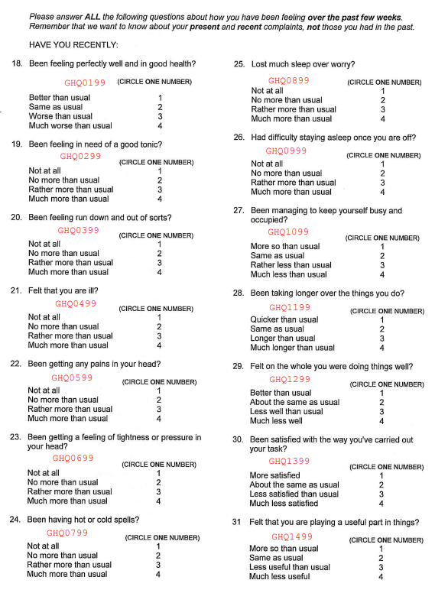
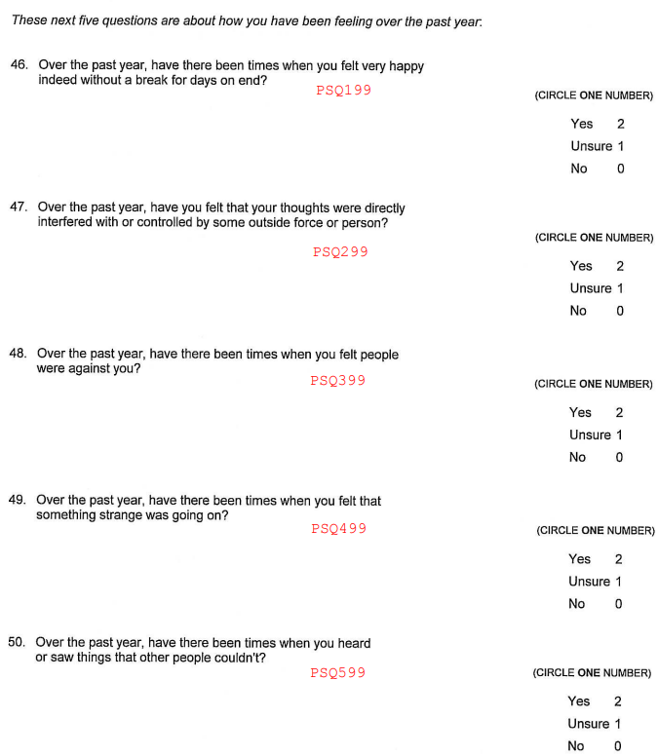
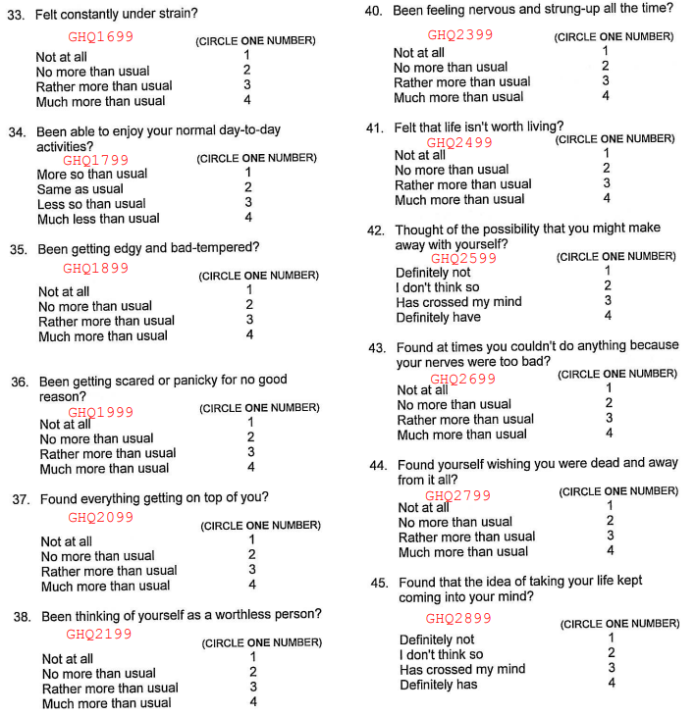
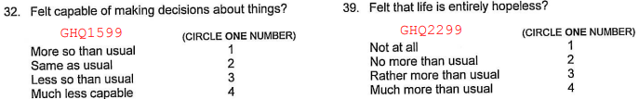
Cohorts NHSD: Mental health
1999 Self completion questionnaire: general health questionnaire (mental wellbeing) and Psychosis screening questions

Slide 12
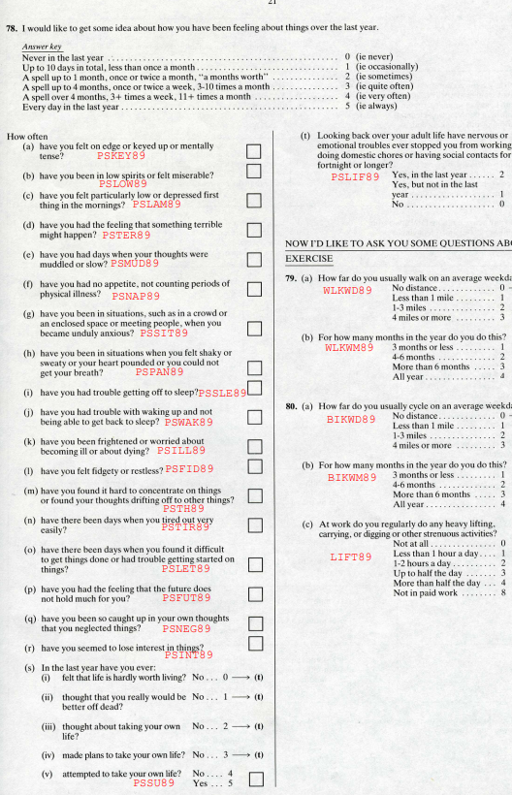
Cohorts NHSD: Mental health
1989 Main questionnaire: Psychiatric Symptom Frequncy Inventory

Slide 13
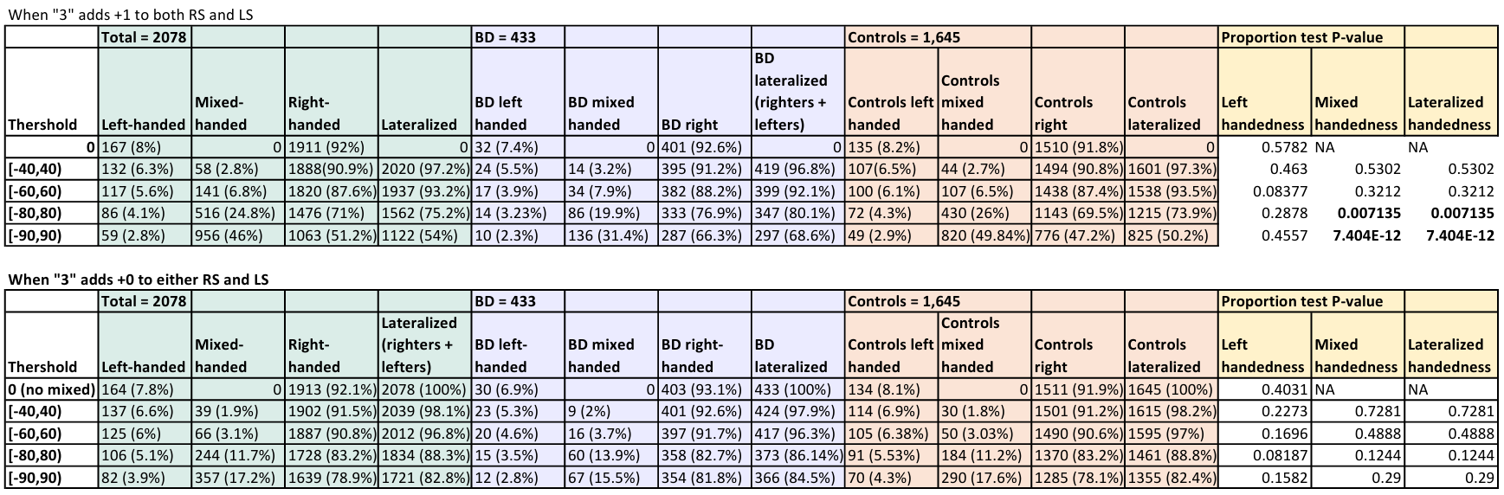
Prevalence comparison (preliminar, week 1)
RS -> Right Score
LS -> Left Score
RS - LS
RS + LS
= LQ
We decide to go for this and think about how to distinguished between inconsistent hand users and ambidextrous by thinking another approach.

Slide 14
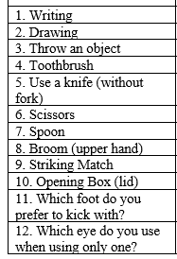
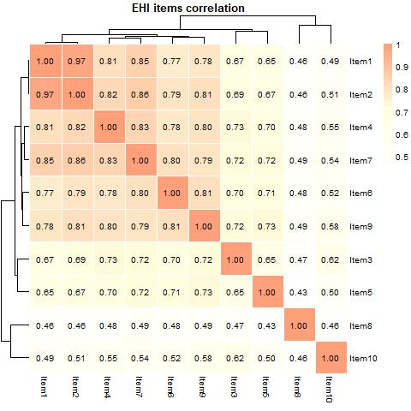
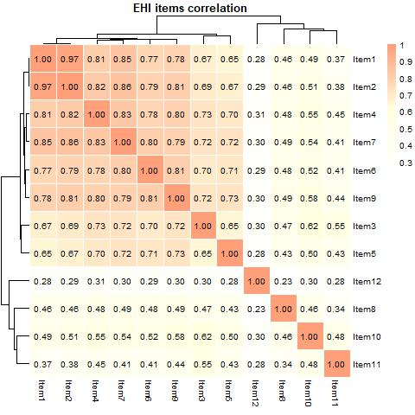
Correlation EHI items
Item1 -> writing; Item2 -> drawing.
Less correlated -> Item8, upper hand using broom.
Open box lid presents more correlation to preferred foot than to other hand ítems.
Preferred eye has the least correlation to the rest of the items

Slide 15
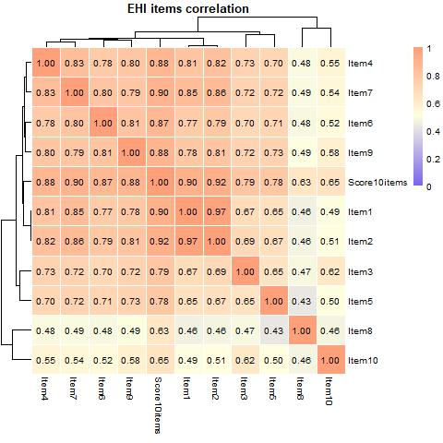
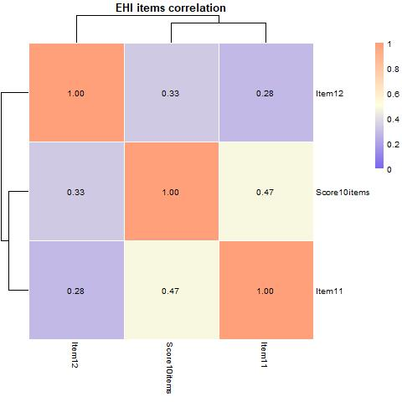
Correlation with LQ

Slide 16
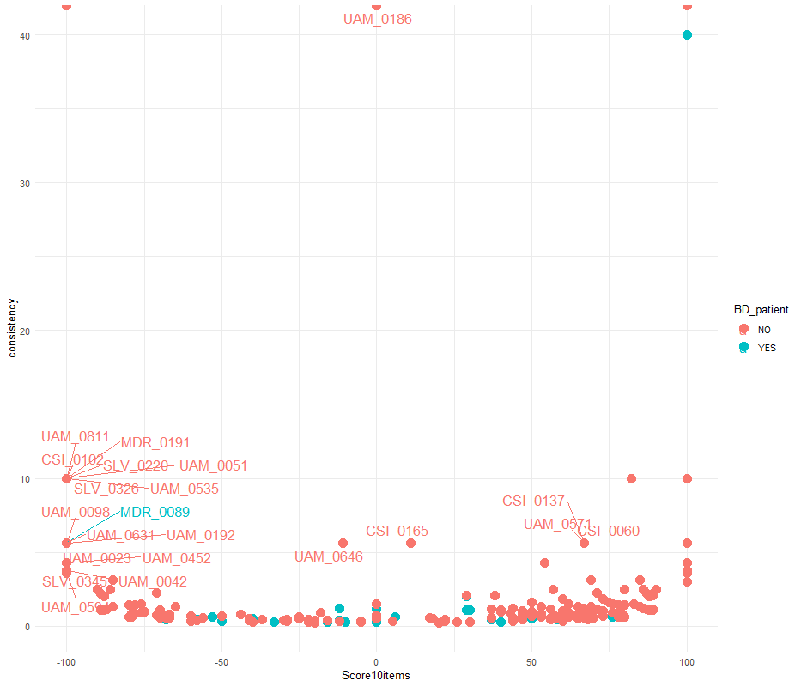
Ambidextrous or mixed hand users?
1
Standard deviation (EHI ítems)^2 + 1
15 People Of Interest: 50% or more of EHI ítems marked as “3”

Slide 17
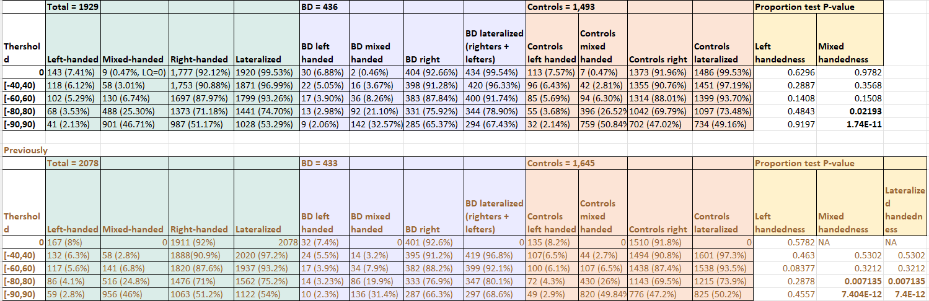
Prevalence comparison (after 1st lab meeting )
Data has been cleaned and light psychiatric diagnoses discarded. Very, very similar

Slide 18
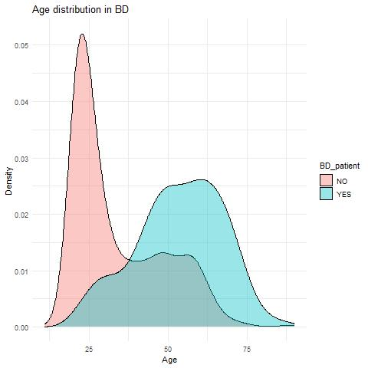
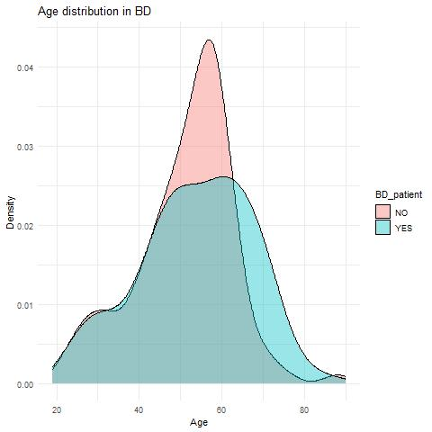


Integrating age
Wild difference in age distribution between cases and controls.
436 BD, 1,493 controls
433 BD, 433 controls

Slide 19
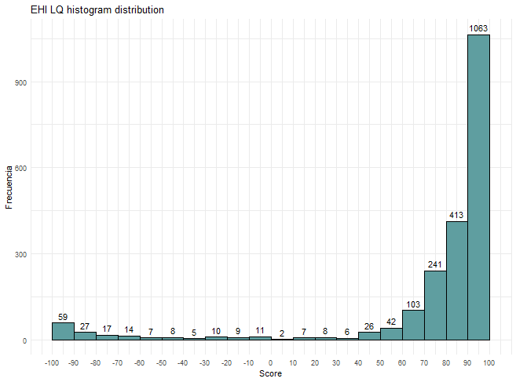
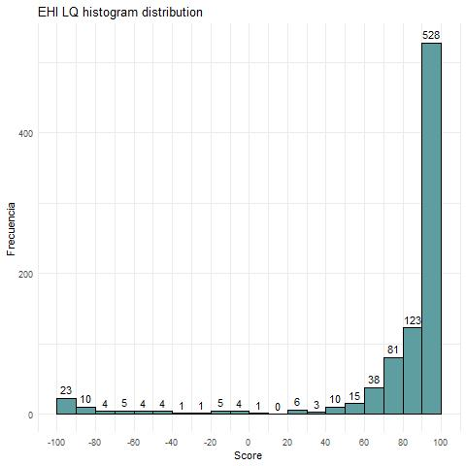
LQ dist in all
Unbalanced
Balanced

Slide 20
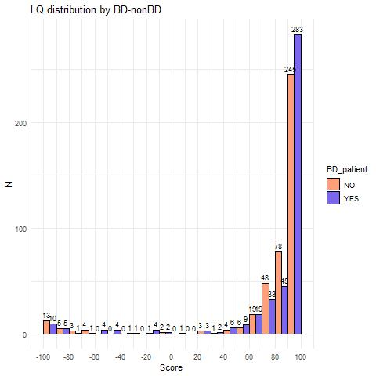
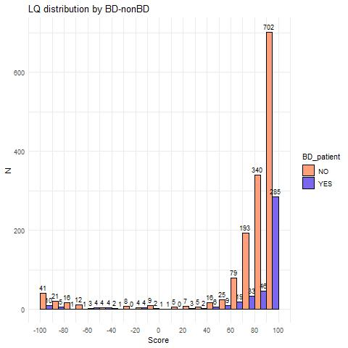
LQ dist by BD
Original Whole dataset
Age-matched dataset

Slide 21
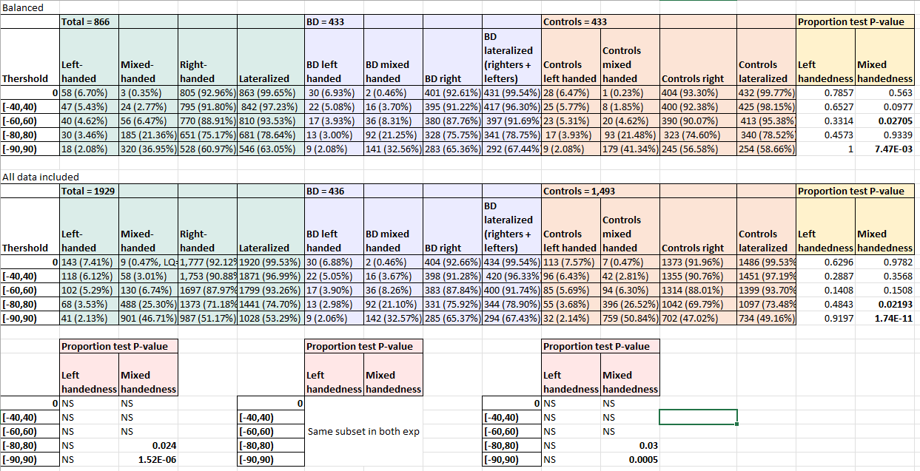
Comparison with previous data
There is more mixed handedness among younger people.
Proper effect should be calculated over oldies vs youngies. In this cases, the comparison is oldies vs all sample, which is not correct for sharing

Slide 22
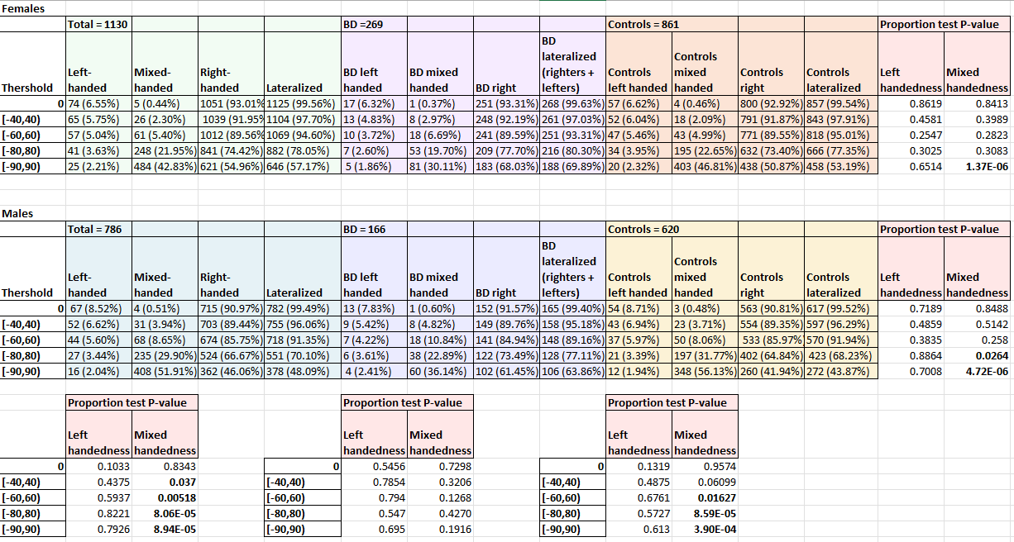
What happens with sex
WHOLE DATASET (NOT AGE MATCH)
Expected diff between males and females. If considering non-right-handedness (left+mixed) would still be there

Slide 23
What happens with sex
WHOLE DATASET (NOT AGE MATCH)
No differences between males and females in BD

Slide 24
What happens with sex
WHOLE DATASET (NOT AGE MATCH)
More differences in mixed handedness in males when comparing BD and controls, but still some in females

Slide 25
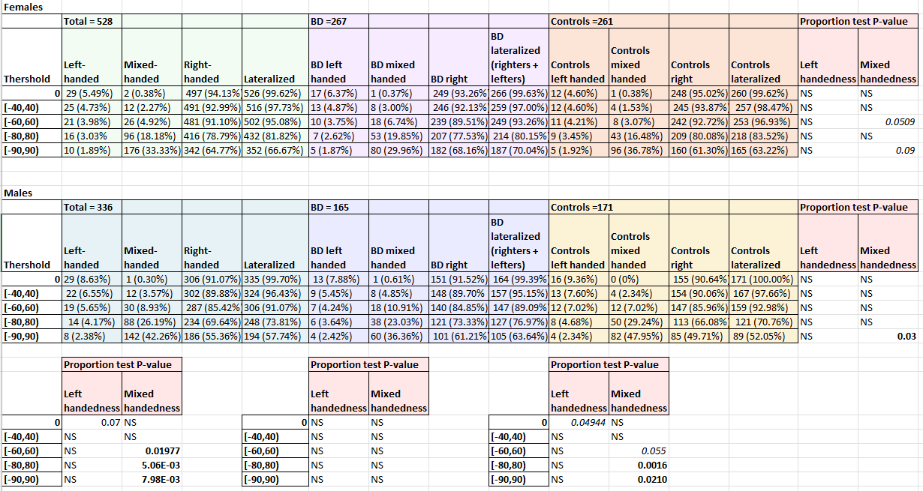
Stratification by sex
AGE MATCH
Similar patterns as with unbalanced data, but subtler.
Interesting how, in left handers when thr = 0, % of females is 5.49% and males is 8.63%. When BD are removed, males reach 9.36% of left handedness

Slide 26
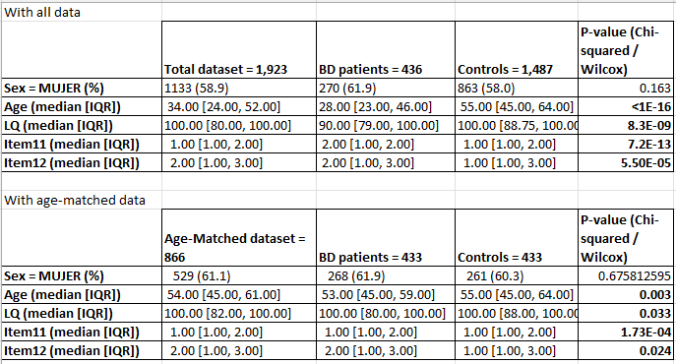
Overall
Different distribution of LQ, prefered eye, prefered foot, but age still very different even after matching.

Slide 27
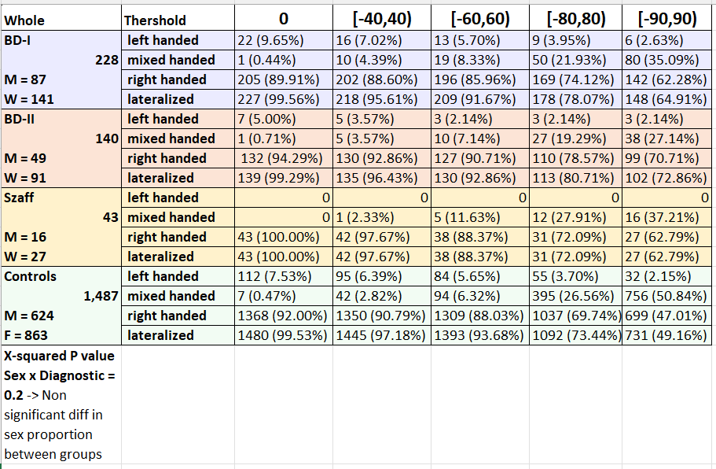
By subtype

Slide 28
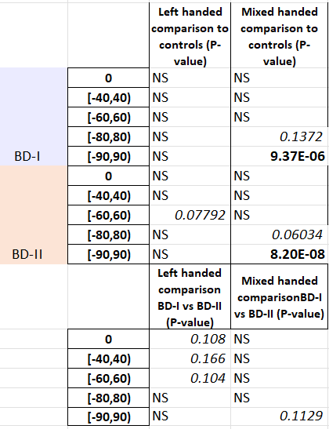
By subtype

Slide 29
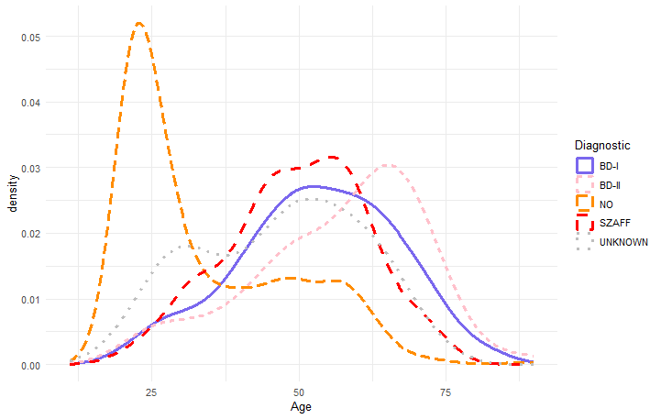
Age distribution differs by subtype

Slide 30
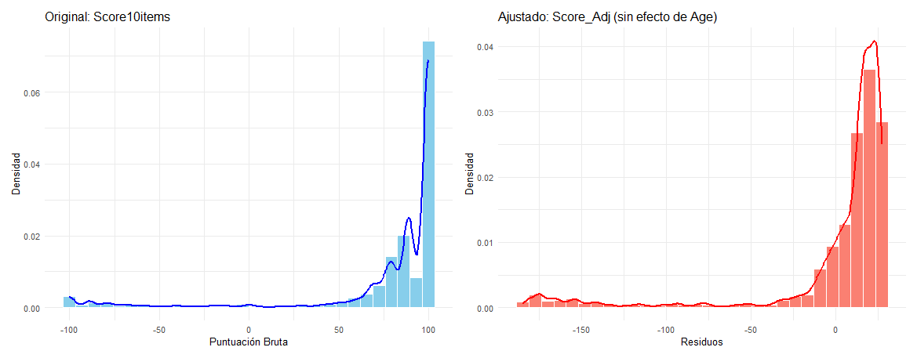
Residualizing LQ
LQ can be residualized to take away Age effect, though the residuals scale changes. A new definition of thresholds should be set in order to define what is lef-handed and mixed-handed in this case.

