Slide 1


Atypical handedness as a marker of altered brain lateralization: genetic and clinical study in bipolar disorder
Inés García-Ortiz
10th North Sea Meeting on Laterality
19th – 22nd August 2026, Brighton

Slide 2
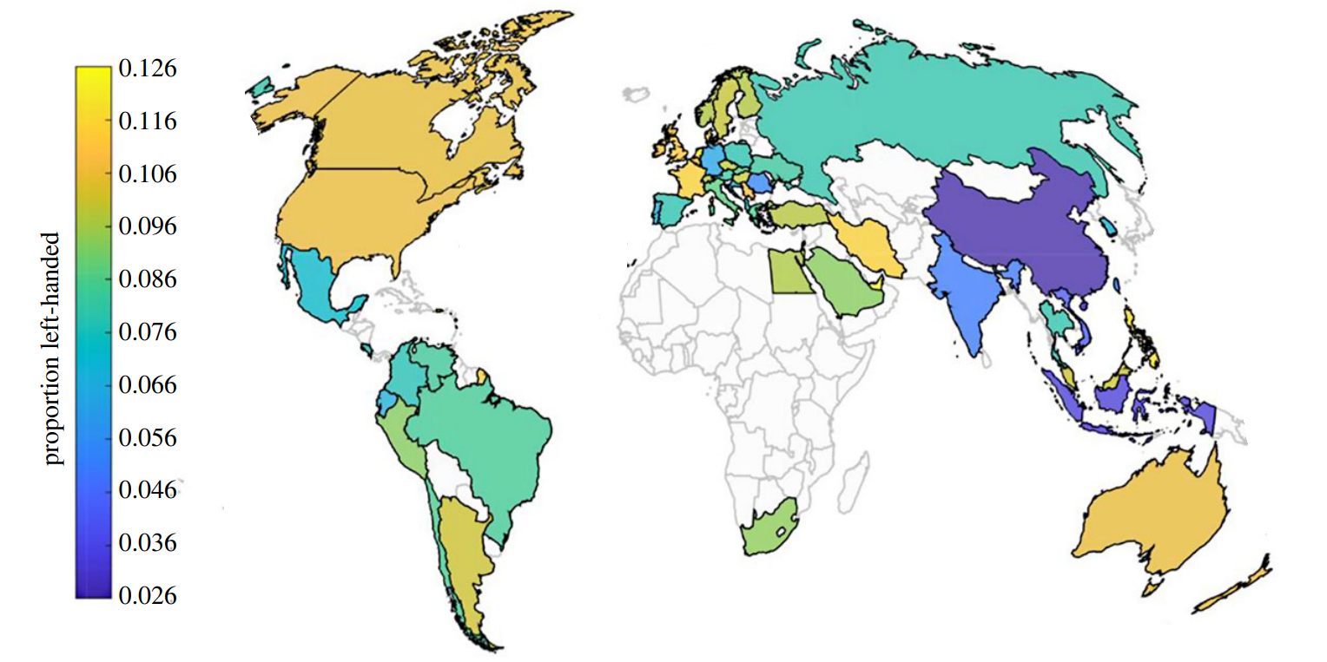
Handedness in general population
Introduction
Left-handed (LH): ~ 10%
Sex differences: 12% men, 8% women
Non-right-handedness (NRH): ~18%
Twin-based H² = 25%
Fernandez-Velasco et al. 2023
Different brain assymetry patterns in NRH individuals

Slide 3
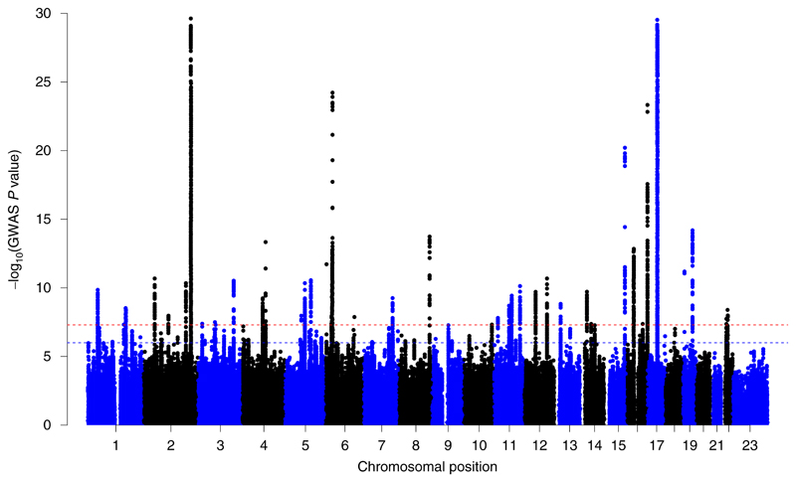
GWAS of handedness: 194K left-handers, 1.5 M controls
Introduction
48 loci
3.45% SNP-based heritability
Cuellar-Partida et al. 2020

Slide 4
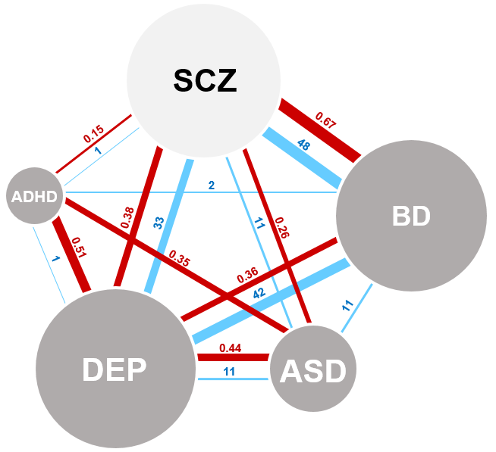
Handedness in neurodevelopmental/psychiatric disorders
Introduction
Controls
ADHD
Autism (ASD)
Depression (DEP)
Schizophrenia (SCZ)
BD
NRH
18%
25%*
35% **
18%
35%**
???
No clear pattern:
Small sample sizes
Lack of clinical data
Diverse measurements
High genetic + clinical overlap in mental disorders

Slide 5
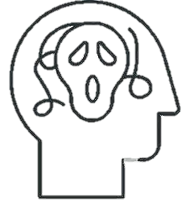
Bipolar disorder
Introduction
Mania
Psychosis
Mood
Prevalence ~1%
50% suicidal behaviour Heritability: 80%
Suicide behaviour
Depression

Slide 6
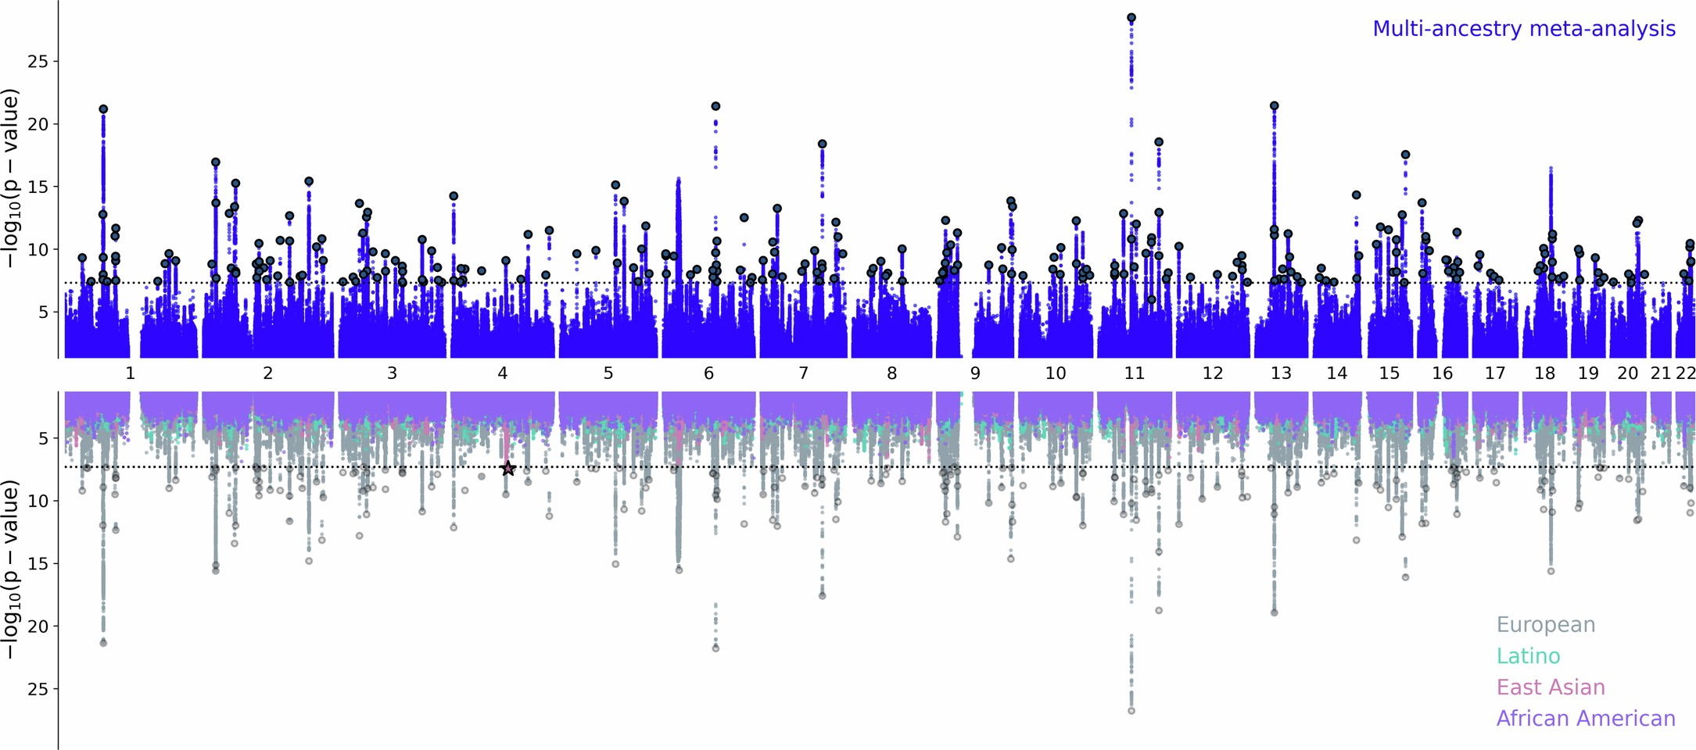
GWAS in BD (PGC-4): 158,000 cases and 2.8 M controls
Introduction
298 loci
O’Connell et al. 2025

Slide 7
Objectives
Prevalence of atypical handedness patterns in BD
Potential common genetic factor between BD and handedness

Slide 8
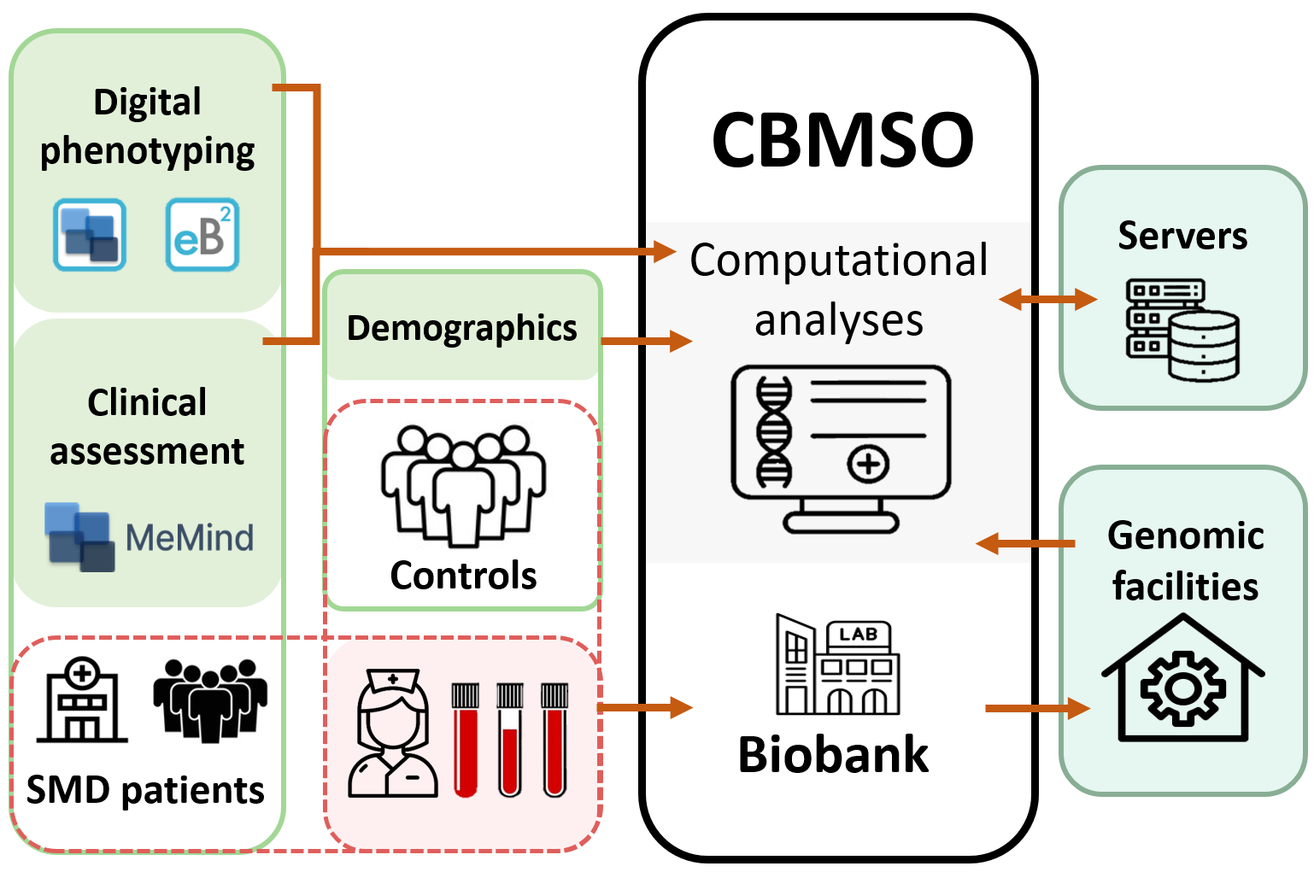


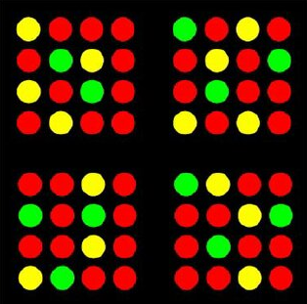
MadManic cohort
M&M
1,480 controls
436 BD
EHI
Preferred foot/eye
SNP data
BD subtype
Clinical history
Severity scales
García-Ortiz et al. 2026

Slide 9
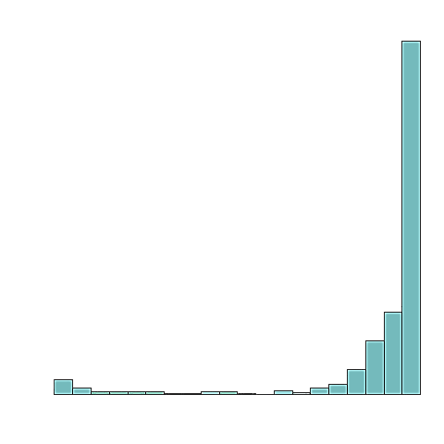
Edinburgh Handedness Inventory
M&M
Which hand do you use for…
Writing
Drawing
Throw an object
Use a toothbrush
Use a knife (without fork)
Use scissors
Use spoon
Upper hand to broom
Strike a match
Open the lid of a box
-100
LQ
+100
Left
0
Right
NRH
60
Left
-60
Mixed
Right
NRH
-90
Non-lateralized
90
Right Score - Left Score
Right Score + Left Score
Lateralization Quotient (LQ)
=
Lateralized
Notes:
****For this presentation im going to use this terminology

Slide 10
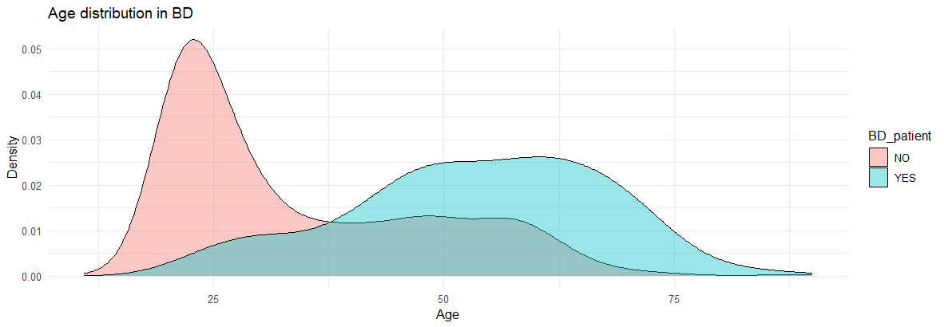
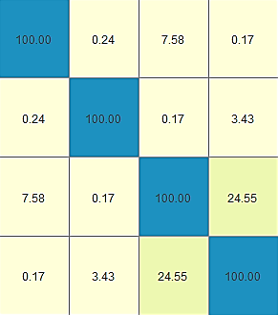

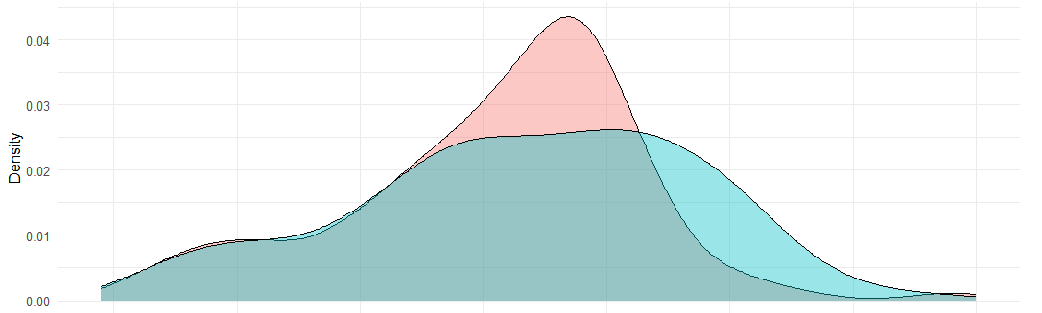
Sample characteristics
Results
Age
P <1E-16
Controls = 1,480
1,480 controls
436 BD
BD= 436
Correlation between traits
LQ
25
50
75
Age matching
Sex
Controls =436
BD = 436
Age
BD/control
20
40
60
80
Controls for age-dependent changes in handedness and generational effects.
LQ
Sex
Age
BD/control

Slide 11
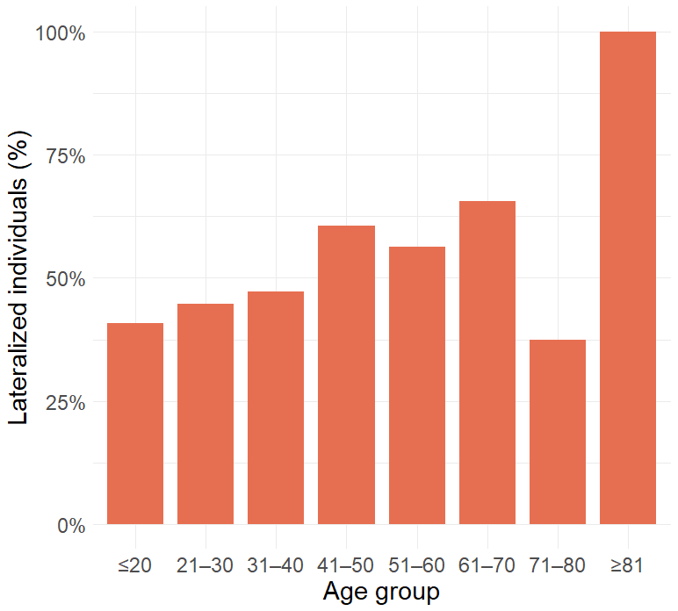
NRH in Spanish population
Results
LQ
1,480 controls
Cut-off
0
<+60
>|90|
Left
8.04 %
12.03 %
49.19%
NRH
LAT
EUR population
10.6%
18%
Cut-off
0
<+60
Left
NRH
Lateralization increases with age
P = 1.8E-08
Notes:
Reference EUR estimates: Papadatou-Pastou M, Ntolka E, Schmitz J, et al. Human handedness: A meta-analysis. Psychological Bulletin. 2020;146(6):481–524. doi:10.1037/bul0000229.

Slide 12
Case-control handedness study
Results
436 controls
436 BD
157 SCZ
Cut-off
LQ
0
<+60
>|90|
6.65 %
10.09 %
58.26%
7.34 %
12.16 %
67.43%
10.19 %
26.11 %
25.48%
Left
NRH
P = 0.012
LAT
NS
***
***

Slide 13
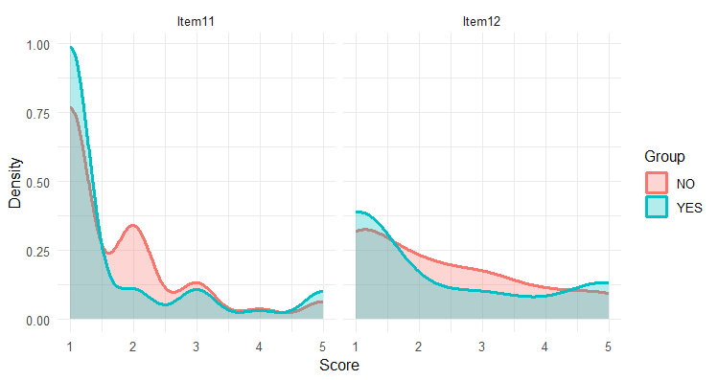
Stronger lateralization of foot and eye in BD patients
Results
Which foot do you prefer to kick with?
Which eye do you use when using only one?
Preferred foot
Preferred eye
436 controls
436 BD
Left
Right
Left
Right
Wilcox P = 6.57E-05
Wilcox P = 0.015

Slide 14



Sex-stratified analyses
Results
Controls
Higher prevalence of atypical handedness (AH) in males
262 females
174 males
Cut-off
0
<+60
>|90|
Left
4.96 %
7.25 %
63.22 %
9.20 %
14.37 %
51.15%
NRH
Higher AH in males, but NS
LAT
BD females slightly higher AH, but NS
BD
Cut-off
270 females
166 males
0
<+60
>|90|
Left
6.67 %
10.37 %
69.63 %
8.43 %
15.06 %
63.83%
BD males slighly higher NRH + LAT, but NS
NRH
LAT

Slide 15
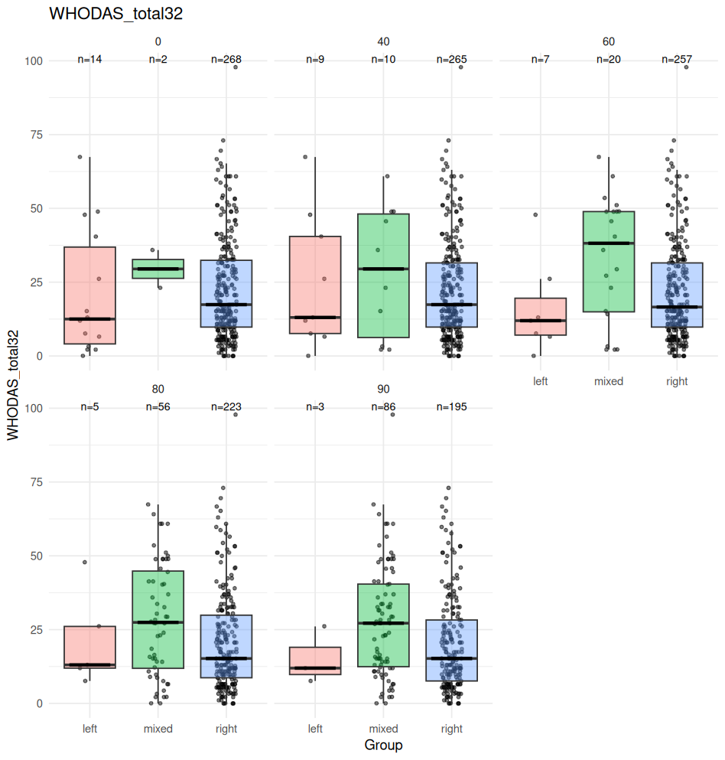
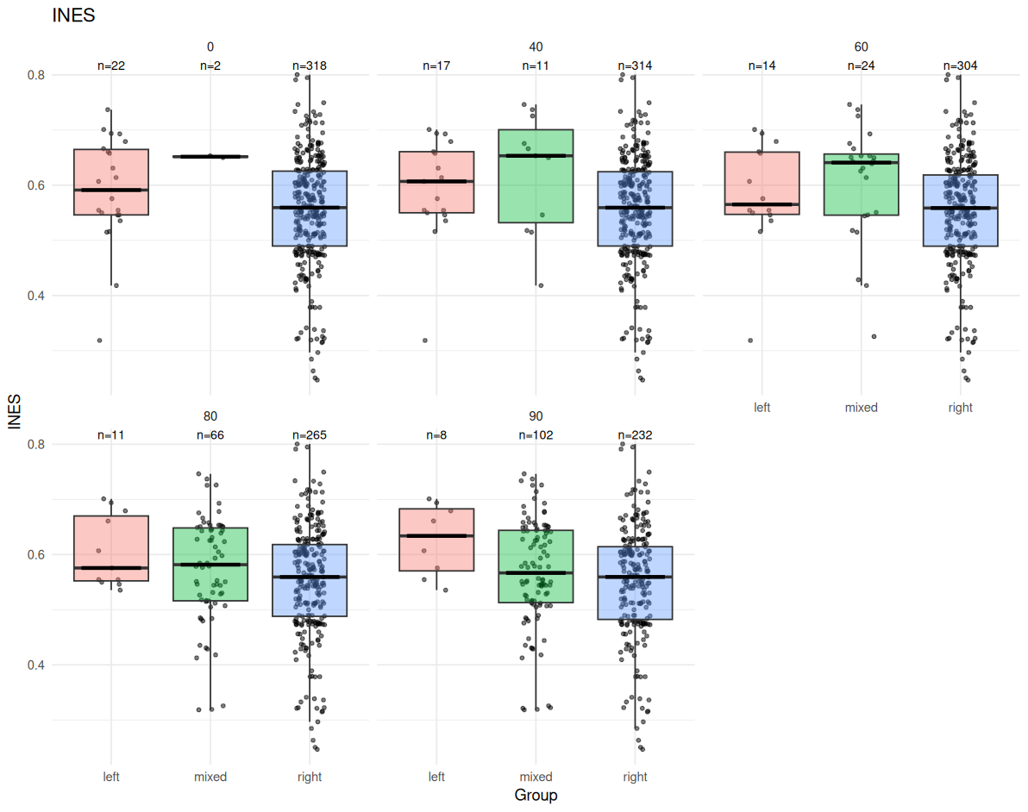
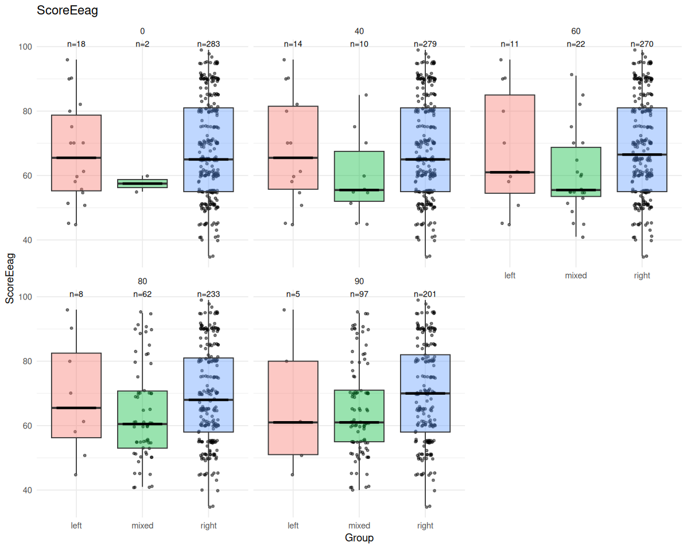
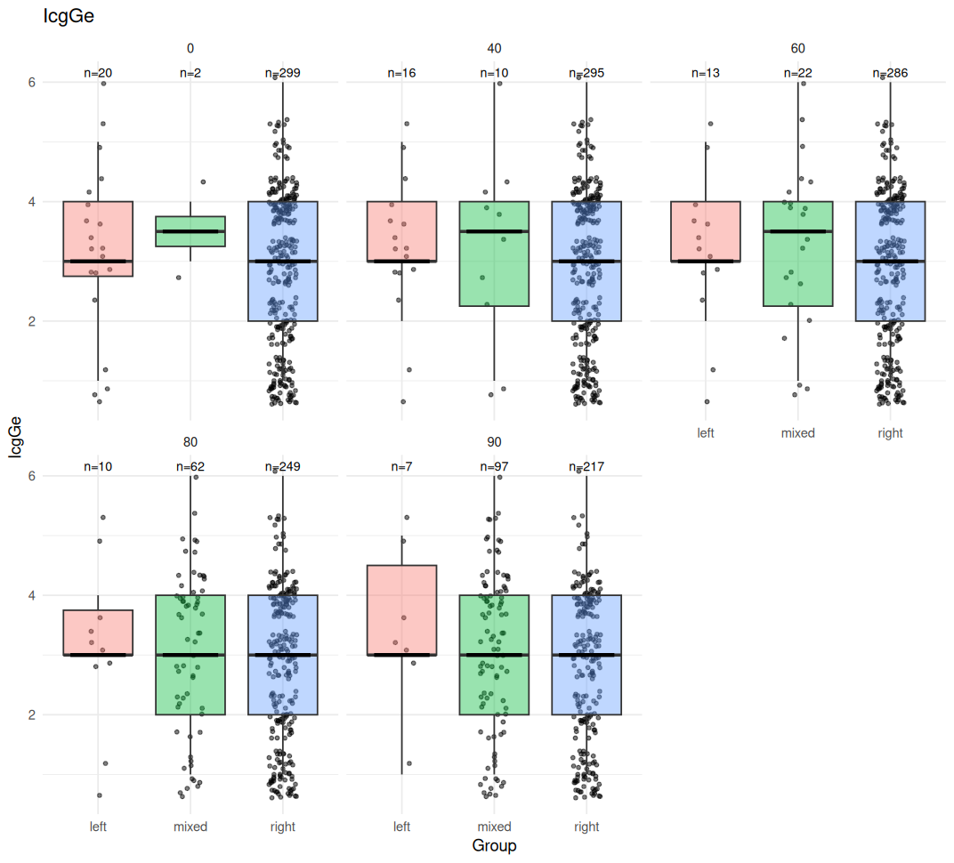
Mixed-handed people present higher severity
Results
WHODAS
WHO Disability Assessment Schedule
P=0.03*
INES
Index of Number of Events and Severity
P=0.016**
Left (N=7-14)
Mixed (N=20-24)
Right (N=257-304)
436 BD
-60 +60
NRH, and specifically mixed individuals presented higher severity scores
Mix
GAF
Global Assessment of Functioning
P=0.03*
CGI
Clinical Global Impression
P=0.04*
Left
Right

Slide 16
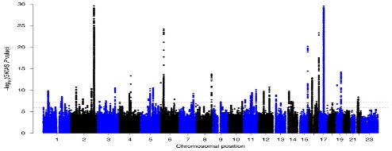
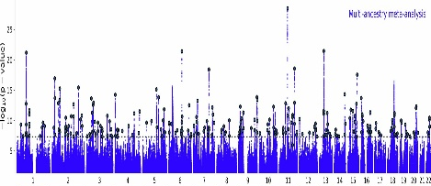
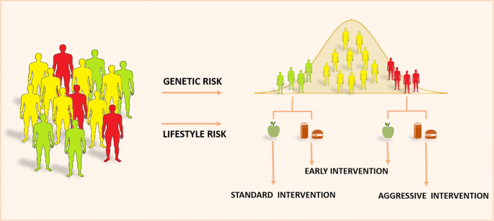
Polygenic Score (PS): individual genetic liability to a trait
M&M
+
Is handedness influenced by genetic liability to BD?
GWAS data
SNP data
Is BD influenced by genetic liability to handedness?

Slide 17
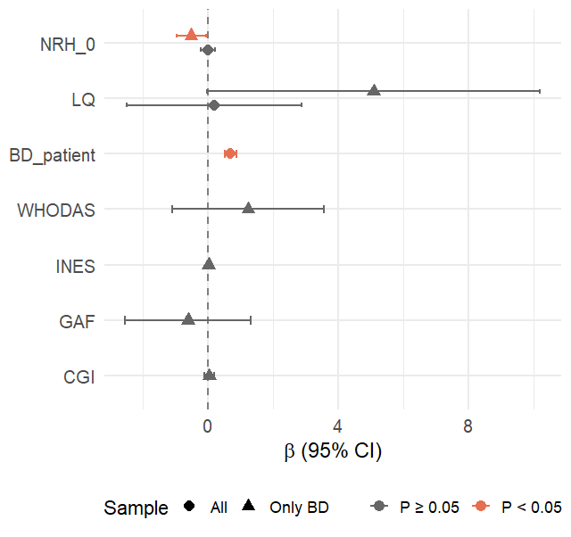
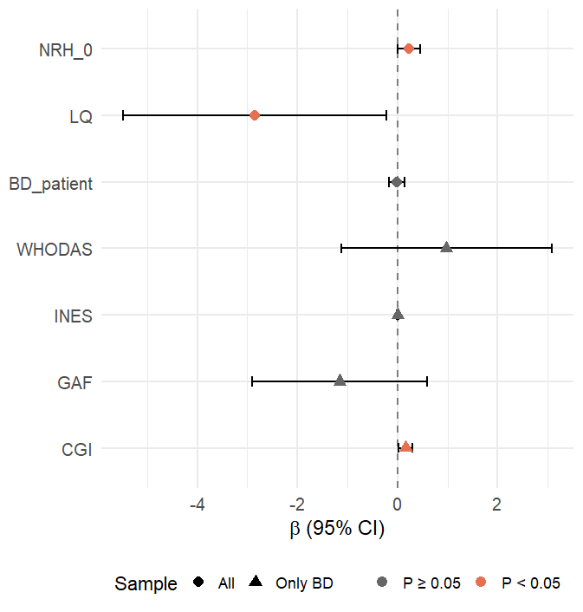
Polygenic Score
Results
PS handedness
PS BD
Left handedness
PS to BD contributes marginally in left-handedness when considering BD patients, but no controls

Slide 18

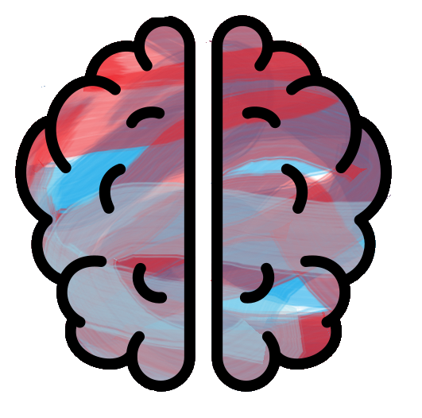
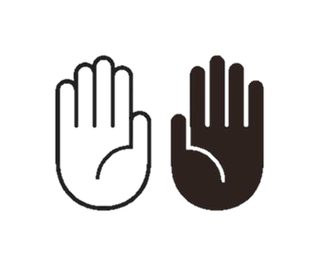
Discussion
Hand lateralization as marker for brain assymetry
“Typical” functional + structural assymetry
“Atypical” brain assymetry
Mixed-hand use
Strong hand lateralization
Cognitive flexibility
Worse mental health

Slide 19
BD subgroups in hand use
Discussion
BD
Despite clinical + genetic similarities, opposite hand use patterns
SCZ
Overall, higher LAT than controls
When mixed-handed, greater severity
Increase sample size
Prevalence by subtype

Slide 20
Conclusions
Handedness differences between BD and controls are subtle
Mixed-hand BD patients present higher severity
Left-handed BD patients present lower polygenic liability for BD

Slide 21
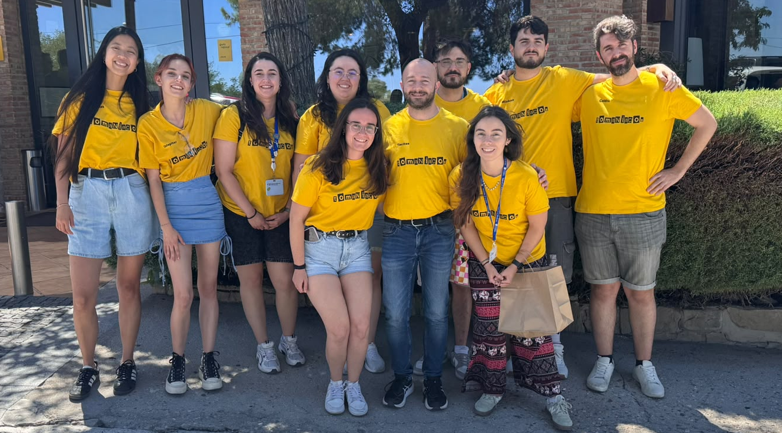
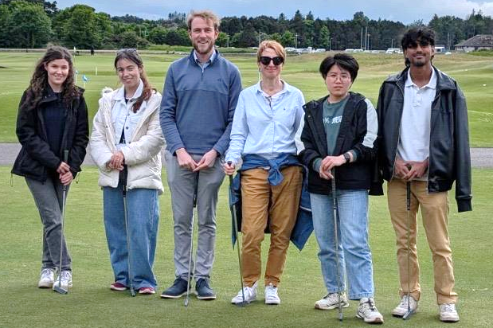








Acknowledgements
Claudio Toma’s lab
Silvia Paracchini’s lab

